Slide 1
Globalization
Final Thoughts

Slide 2
Dichotomy:
Contrasting views of identity, community, and humanity, with geographical imaginations
Nationalism
Cosmopolitanism

Slide 3
Rising Tide of Populism
Human Rights
Human Values

Slide 4
One World (?)
Global Consciousness
Global Citizenship

Slide 5
To understand the world/To live in the world
To be educated
To have lived your life
What does it all mean?

Slide 6
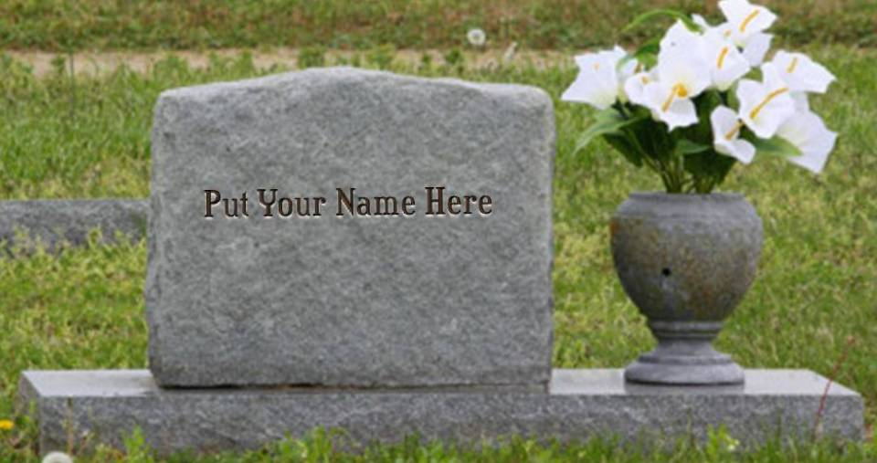
60 years from now

Slide 7
Life is education; degrees, awards, money lose their importance when you have them and they leave you when you die. The fact that you lived a principled life lives on in your actions and the ways you affect those around you and who come after – those who benefit from your engagement, learn from your example, and develop further your ideas for what it means to be a passionate, principled, thoughtful, reflexive, engaged, loving individual who recognizes the intellectual, material, and cultural power they possess and puts it to use for the benefit OF ALL in the communities within which they live. And in turn, benefits oneself-- culturally, intellectually, and yes, materially.

Slide 8
You
History
Economics
Politics
Culture
Ecology
Ideology
Media
What is your role?

Slide 9
A Parable for Life
A man walked along the ocean on a beach littered by thousands and thousands of starfish which had washed ashore.
Further on, he encountered a young child walking slowly and stooping often, picking up one starfish after another and tossing each one gently into the ocean.
"Why are you throwing starfish into the ocean?" he asked.
"Because the sun is up and the tide is going out and if I don't throw them further in they will die."
"Ha”, he scoffed incredulously, bowing and shaking his head.
“There are miles and miles of beach and starfish all along it! You can't possibly save them all.”
“You can't even save one-tenth of them.”
The young child carried on in silence.
In exasperation, the man called out to the child with arms outstretched, pointing to the beach’s expanse, “Even if you work all day, it won't make any difference at all!"
Calmly and without hesitation, the child bent down, picked up another starfish and threw it into the sea, whispering to no one in particular: "It made a difference to that one."

Slide 10
As I walk through
This wicked world
Searchin' for light in the darkness of insanity
I ask myself
Is all hope lost?
Is there only pain and hatred and misery?
And each time I feel like this inside,
There's one thing I wanna know:
What's so funny 'bout peace love & understanding?
Imagine
Act

