Slide 1
Qualitative content analysis/discourse analysis
Radicalization of Politics in CEE

Slide 2
Outline
Part I
Overview of the approach
Logic of the qualitative content analysis
Discourse analysis
Part II
Examples of analyses of populist content in a qualitative way

Slide 3
Qualitative content analysis – the logic
the characteristics of language as communication with attention to the content or contextual meaning of the text
Focus rather on the meaning than on numbers (frequencies)
Far less theory driven, but rather theory developing
Usually based on open-ended research question (how does an actor talk about welfare-state related policies?)
Text as data: manifestoes, interviews, focus groups, … (RQ determined)
„qualitative content analysis is a research method for the subjective interpretation of the content of text data through the systematic classification process of coding and identifying themes or patterns“ (Hsiu-Fang, Shannon 2005)

Slide 4
Variants of qualitative content analysis
Conventional
Directed
Summative

Slide 5
Conventional content analysis
Usually descriptive aims when an appropriate theory is missing
categories and names for categories flowing from the data
Inductive category development
Reading a text as a whole (general impression), assignment of first codes, creating categories based on the relationships between the codes – meaning of the text (development of codes, their description)
Theories discussed after the analysis
Perhaps more suitable for analysing specific populist policies (without prior conceptual direction)

Slide 6
Directed content analysis
Validate or extend conceptually a theoretical framework or theory
Existing concepts can be used for analysis specification (e.g. initial coding scheme)
What is the meaning of the „people“, „the elites“, and „the restoration of people`s sovereignty“ in the communication of an populist actor? – not looking for specific words but rather concepts/categories
Used for support or extension of an existing theory

Slide 7
Summative content analysis
Starts with a concept and categories
Finding words representing them – reminds of the quantitative dictionary approach BUT
The aim is to explore the meaning not to count the words
Sometimes called as latent content analysis – interpretation of the content

Slide 9
Technocratic populism of ANO (Havlík 2019)
Havlík, V. (2019). Technocratic Populism and Political Illiberalism in Central Europe. Problems of Post-Communism, 66(6), s. 369-384. https://dx.doi.org/10.1080/10758216.2019.1580590

Slide 10
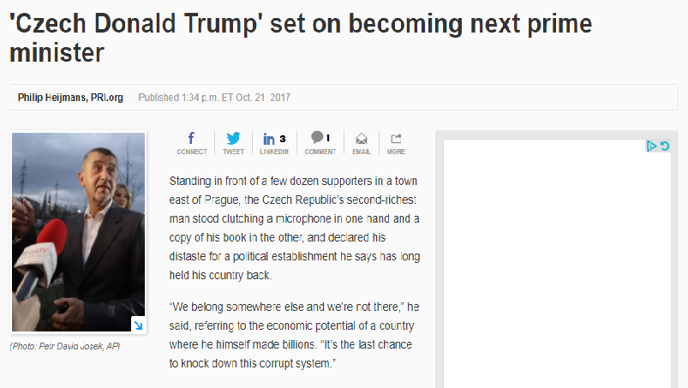
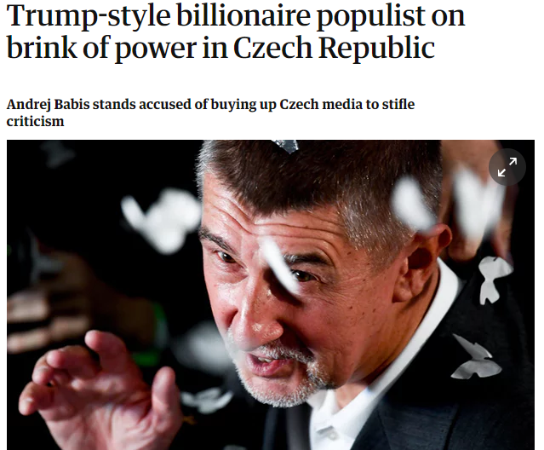
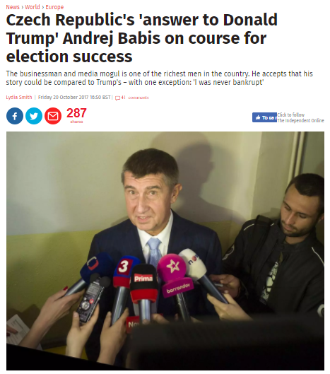
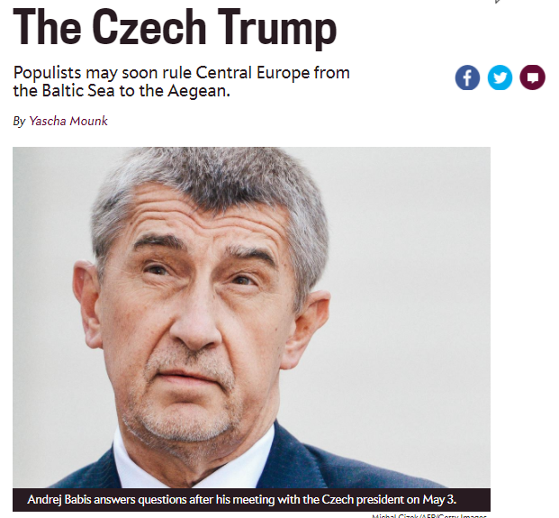

Slide 11
RQ1: What kind of (populist) political party is it?
RQ2: How does its illiberal narrative look like?

Slide 12
Anti-elitisim
Restoration of people`s sovereignty
People-centrism
“populism as an ideology that considers society to be ultimately separated into two homogeneous and antagonistic groups, ‘the pure people’ versus ‘the corrupt elite’, and which argues that politics should be an expression of the volonté générale (general will) of the people” (Mudde 2004, see also Stanley 2008, Albertazzi, McDonnell 2008)

Slide 13
Populism and democracy
Based on Pappas 2014, Mair 2012, Caramani 2017
Liberal democracy | Populist democracy
Plurality of interests | Universal good
Overlapping consensus | Adversarial politics
Constitutionalism | Majoritarianism

Slide 14
Data and analysis
Qualitative data:
Purposive sampling (interviews in the media, Babiš´s book and blog, election manifestoes)
Combination of directed and summative content analysis
Quantitative data:
Description of positions in political space
  CHES 2014 – Bakker et al. 2015
  Populist proxies – antielite_salience + anti_corruption salience
  Major policy dimensions – lrecon + galtan
Policy vs valence
  Comparative Campaign Dynamics Project (Baumann, Gross 2016)
  Manual coding of parties` statements in newspapers before the 2013 election
  Policy x issue valence x valence

Slide 15
Technocratic populism of ANO
People centrism:
“populist heartland” (Taggart 2000) – the mythical picture of Czechs as skillful craftsmen, engineers and businessmen (“Czech golden hands”):
“We are a talented nation but we are governed by cack-handed”
Anti-elitism:
“The main problems of the Czech Republic are incompetent and unprofessional politicians“
Incompetent and lacking real-life experience (“have not built a dog house”)
There is no such thing as right and left. In the Czech Republic we have a completely different division. On one side are the current parties and current politicians, and on the other side are the voters […] – anti-political, anti-party democracy narrative
Restoration of people`s sovereignty:
Anti-party and anti-political discourse of technocratic effectivity guaranteed by Babiš who listens to the people (the project We want a better Czechia)
Dichotomy of the two worlds: politics (represented by the established parties) and business (Babis)
“run the state like a business”, „we are not like politicians, we work hard“
Incompetency and ideology vs expertise and effectivity

Slide 16
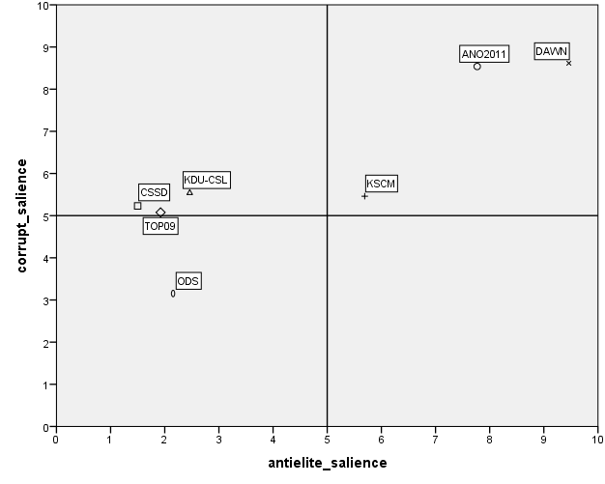
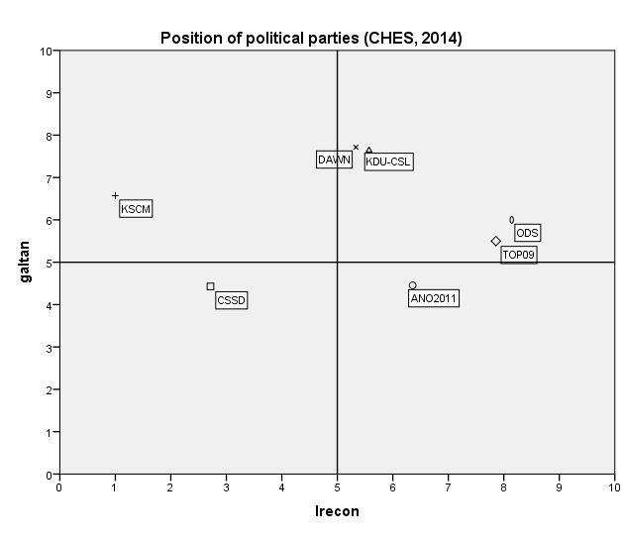
Technocratic populism of ANO
Data: CHES 2014, CCDP 2016

Slide 17
Technocratic populism and illiberalism
Universal good:
Anti-political/ideological narrative of policy divisions in society - managerial competency
Adversarial politics:
Other parties like enemies ( “so-called democratic parties”, “corrupt” etc.)
Little respect for politics of compromises, deliberation and checks and balances since “first of all, coalition quarrels complicate everything ” and the parliament is “blatherhouse“ (žvanírna)
Majoritarianism
Approach to politics and proposal of a highly centralized strongly majoritarian version of a democratic polity driven by the narrative of effectivity and simplicity
Babiš like[s] majoritarian system in the USA. When Trump came to power, he went into the office right away and made decisions.”
“There is a lot of things we can learn in Slovakia, […] because there was a Fico´s single party government. It made a decision, called to the parliament, they made the law, that was a drive”

Slide 18
Conclusion
Legitimation of illiberalism based on technocratic/managerial populism
Division constructed around the notion of competency and honesty (talented nation vs incompetent and corrupt elites)
Solution based on the contrast between (partisan) politics and the world of business
The key role of valence (in contrast to ideology) and effectivity
A majoritarian and centralized version of a supposedly more effective democratic polity
Populist illiberalism not necessarily combined with radical ideologies
“rhetorical/ideational illiberalism”, illiberal mentality so far
Many subtle but complex changes possible through ordinary laws or government legislation (e.g. media) – the Polish way

Slide 19
Discourse analysis
Related to works by Laclau or Mouffé
The central notion is a meaning, socially constructed articulation
“Each of these discourses is a [specific] social and political construction that establishes a system of [meaningful] relations between different objects and practices, while providing (subject) positions with which social agents can identify” (Howarth, Stavrakakis 2000)
Populism one of many discourses (hegemonic bids) to construct a novel arrangement of meaning
the process of articulation can radically change the meaning of whatever is being articulated (nodal points + other signifyiers)
Which signifyiers (nodal points) + how they relate to each other = meaning
Often dialectic logic (ingroups + outgroups)

Slide 20
De Cleen, Stavrakakis
Comparing nationalist and populist discourses
Nationalism – nodal point is nation (inc.people)
Spatial definition – various exclusive nations
Specific discoursive construction of the ingroup – „imagined community“ constructed in contrast to other nations
Organic community – belonging together
Populism
Antagonistic relationship between the people and the elites
Chain of equivalence – continuous and actively stimulate and reinforce dissatisfaction with the elites (negative mobilization of various groups)
Vertical special orientation concentrated around political power

Slide 22
Conclusion
Text as data source for meaning interpretation not for numbers
Various ways how to approach it
Looking for a deeper meaning of a studied object
Dependent on the researcher (to some extent – often quotes)
Theory building rather than testing
Producing new data (unlike the work with the existing data)

