Slide 1
Ecosystems are sustained systems; they flourish within their limits
Learning objectives
  What is an ecosystem?
  Understanding energy and its role in ecosystems
  Food webs and trophic levels
  How they change over time

Slide 2
Definitions
Biota – all living things within a given area
Biosphere – the region of earth where life exists
Ecosystems – community of organisms and its nonliving environment in which energy flows and matter cycles.
What is needed to sustain life?
  Sustained life on Earth is a characteristic of ecosystems. Earth as a system – no organism, population, or species can produce it own food and completely recycle it metabolic waste.

Slide 3
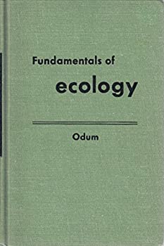
Ecology
Science of relations between living organisms and their environment (Ernst Haeckel – 1866, in German oekologie)
Ecosystem is the basic system of ecology, “not only the organism-complex, but the also the whole complex of physical factors forming what we call the environment” (Tansley - 1935)
Fundamentals of Ecology – EP Odum (1953)

Slide 4
Atmosphere, lithosphere, and hydrosphere all have functional links involving transfers of energy and matter with the living material of the biosphere

Slide 5
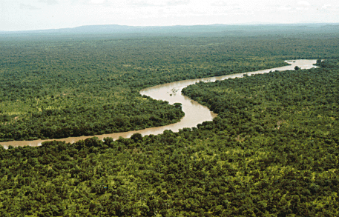
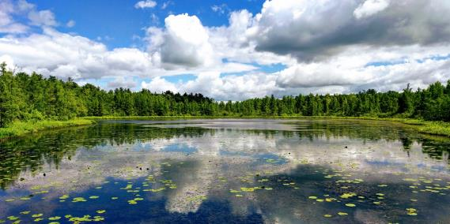
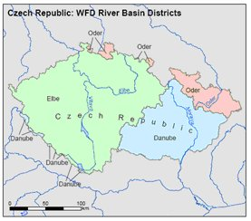
When do you have an ecosystem?
Different size, different scale, different species
Borders can be vague
Natural (forest, field, wetland, stream, lake, etc.) or artificial (wastewater treatment ponds, agriculture, lawn)
Watersheds –Political and natural boundaries not typically the same
Common processes

Slide 6
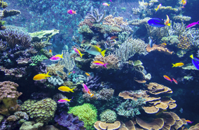
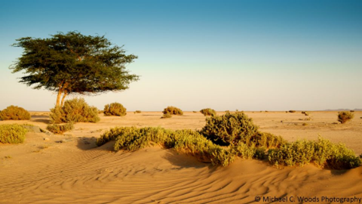
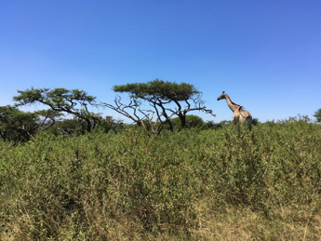
Ecosystem has
structure (parts) and
function (processes) and is
dynamic (orderly change called succession)
Two main functions are
  Transfer/Exchange of energy
  Cycling of material (particularly nutrients)

Slide 7
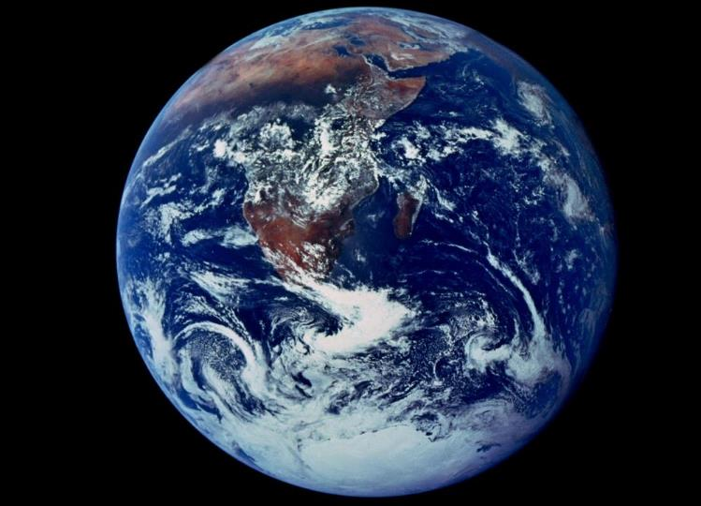

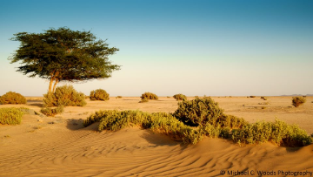
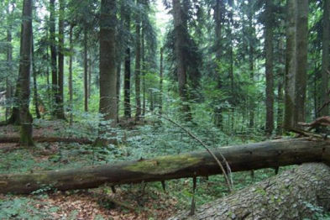

We live in a world full of life.
Nothing on Earth is entirely abiotic
Rather it is
With Life – conbiotic

Slide 8
Earth energy balance (1st law) as a closed system
Energy flow in ecosystems

Slide 9
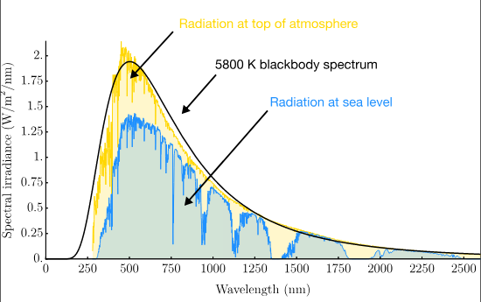
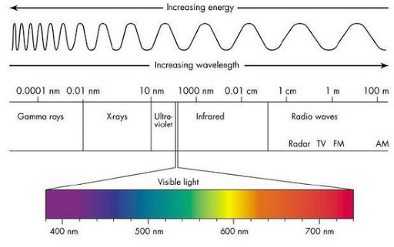
Energy input: solar radiation
Electromagnetic radiation – travels at constant velocity – speed of light

Slide 10
Energy output and the planetary radiation balance
In absence of atmosphere, long term-balance:
net radiation = incoming radiation (mainly shortwave visible light) minus
outgoing radiation (mainly longwave heat)
= 0
The increasing concentration of greenhouse gases retains Earth’s energy from escaping to space, thus, warming the planet

Slide 11
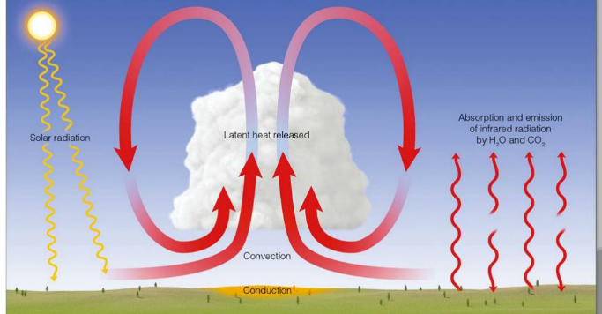
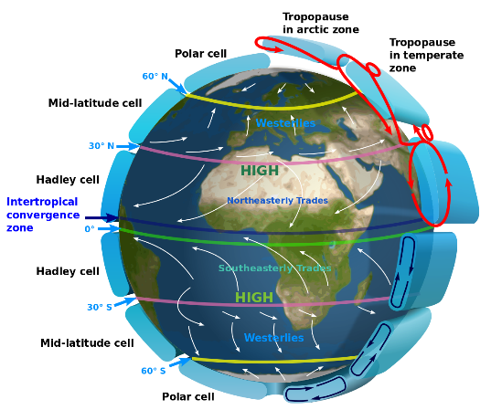
Sun’s energy drives global circulation

Slide 12
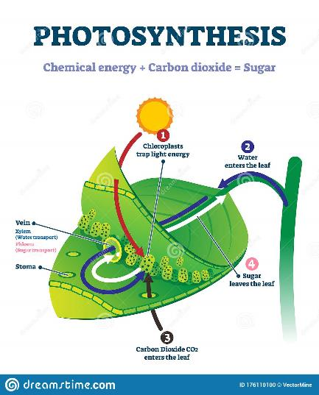
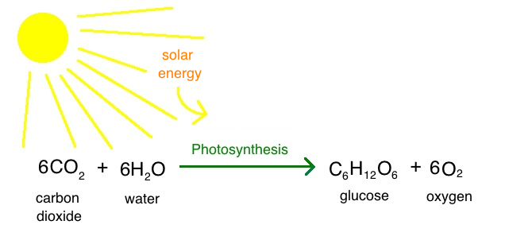
And, some used for photosynthesis to create organic, biological matter (biomass)

Slide 13
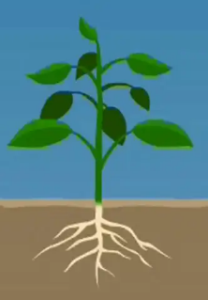
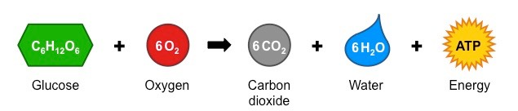
glucose
Used as basic building block of living matter
Energy stored in the chemical bond can be utilized later (in respiration) to do work

Slide 14
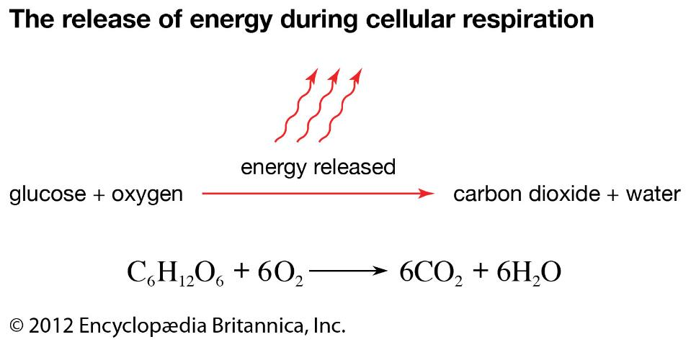
Respiration – complimentary process to photosynthesis

Slide 15
Energy flow in ecosystems – trophic levels
Solar radiation
Primary Producers/
Plants
Herbivores
(animals that eat plants)
Carnivores
(animals that eat animals)
Input
heat
heat
heat
Omnivores
(animals that eat plants and animals)
Autotrophs
heat
Decomposers
Heterotrophs
heat

Slide 16
Functional activity of the ecosystem: transfer of energy and matter
Fundamental functional activity – assimilation and utilization of energy and respiration

Slide 17
Inside the ecosystem boundary is a complex, flourishing system

Slide 18
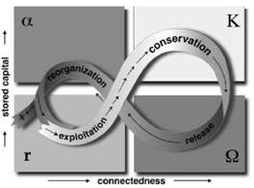
Succession - Ecological dynamics
Adaptive Cycle

Slide 19
Growth → Quantitative increase
Development → Qualitative increase
"We must realize that growth and development are two very different things. You can develop without growing and vice versa.“
Tibor Vasko, 2009, www.solon-line.de/interview-with-tibor-vasko.html

Slide 20

Ecosystems are dynamic
Biological systems are characterized by a capacity for directional change – the cumulative manifestation of positive feedback.
Succession – ordered pattern of growth and development
Increase in complexity and order as the result of controlled growth – decrease internal entropy

Slide 21
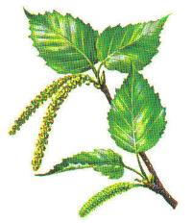
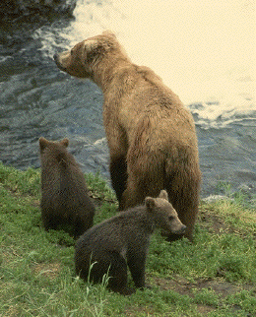
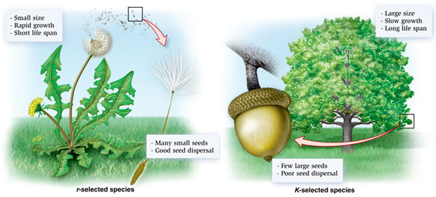
Community and Ecosystem Dynamics
r species (ability to reproduce rapidly), fast growing, effective dispersal mechanisms, wind borne seeds, short lived, vegetative or asexual reproduction, do not compete well with other species, numbers fluctuating widely, strong influence of density-independent factors
K species (ability to maintain populations at their carrying capacity) species, slow growing, low reproductive rates, low dispersal rates, time lag to sexual maturity, diverting production or energy to defense.

Slide 22
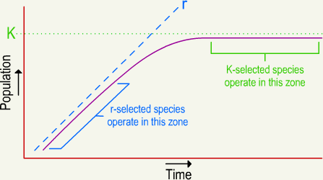
Succession
Early stage Late stage

Slide 23
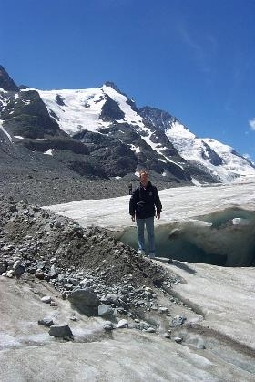
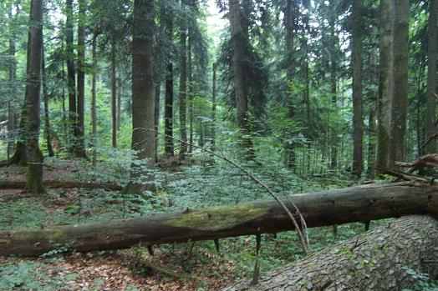
These are paralleled by two distinct environments:
r-selecting environments – ephemeral, extreme, unpredictable
K-selecting environments – equable, predictable, stable.

Slide 24
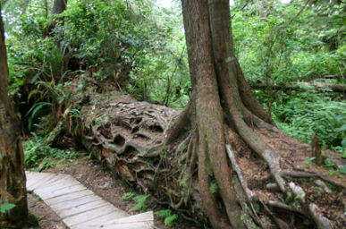
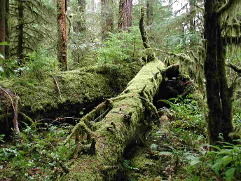
Succession
Mature communities with the highly developed interdependence of their constituent species and their complex network of interaction with the environment are the result of inherent processes of change – directional change akin to the growth and development of the organism.
Organisms modify their environment, but in such a way as to allow other species to enter the community. This is the facilitation model of succession, a positive feedback process reinforcing change.

Slide 25
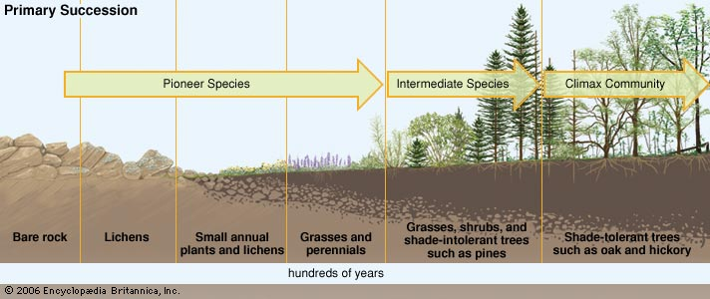
Primary succession – initial establishment and development of an ecosystem in an area devoid of an ecological community

Slide 26
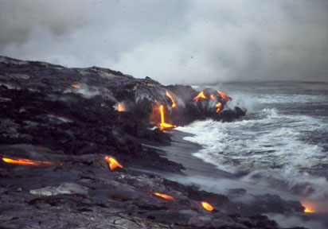
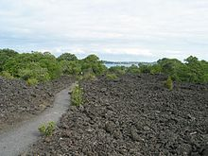
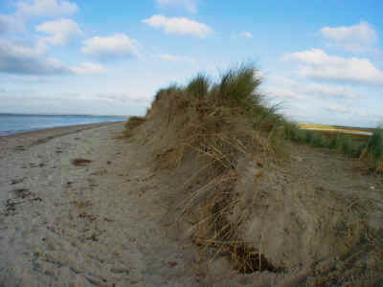
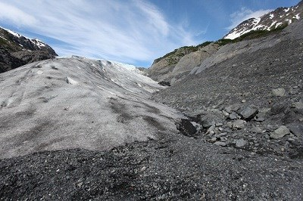
Primary succession

Slide 27
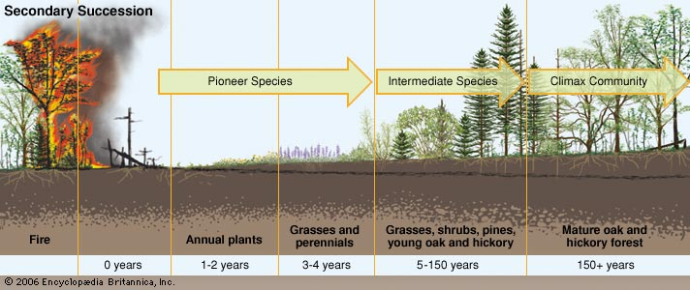
Secondary succession – reestablishment of an ecosystem from the remnants of a previous biological community following disturbance

Slide 28
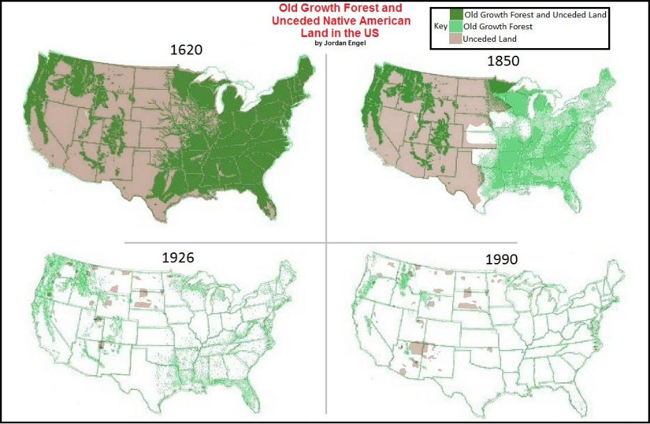
Almost all old growth forests have been cleared in the US

Slide 29
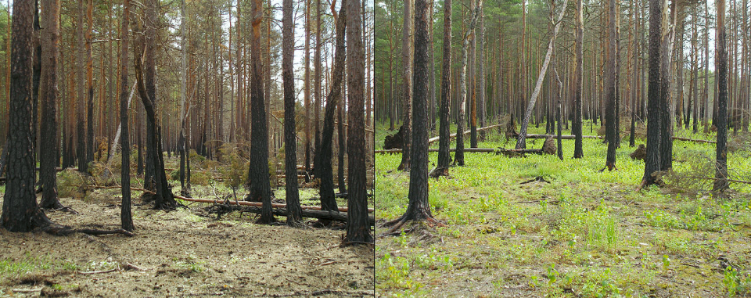
Boreal forest one year and two years after a wildfire
By Hannu - Own work, Public Domain, https://commons.wikimedia.org/w/index.php?curid=5190488

Slide 30
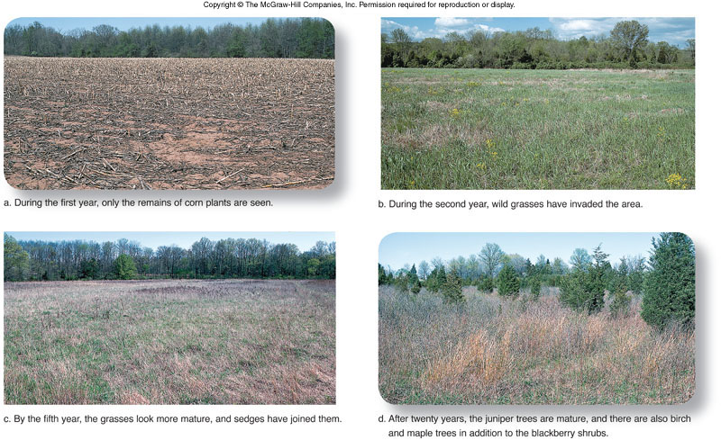
Secondary succession

Slide 31
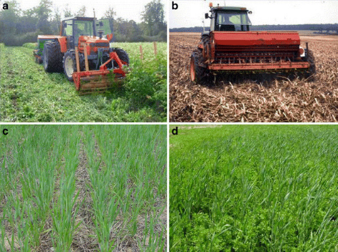
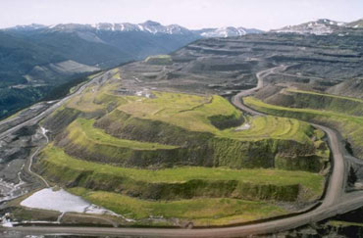
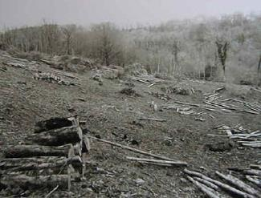
Secondary succession
Human induced succession – agriculture, forestry, plowing, mining, fisheries, damming rivers, war, etc.

Slide 32
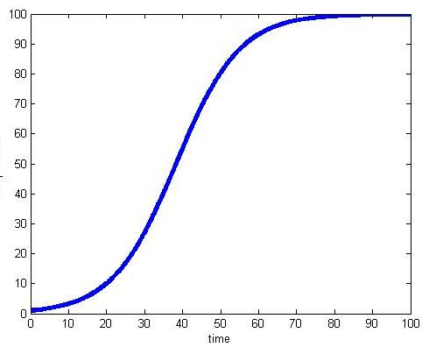
Logistic growth from early to late successional stages
Late stage
Early stage

Slide 33
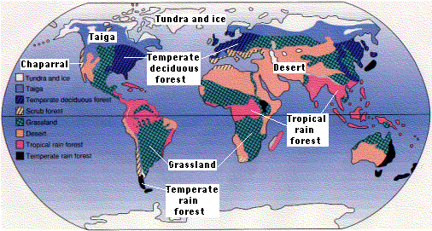
Biomes of the world – nature flourishing within the climatic (temperature and precipitation) constraints

Slide 34
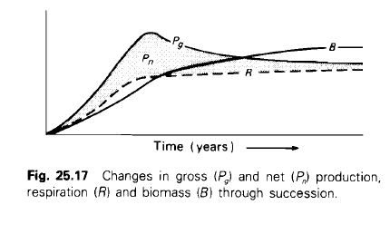
Bioenergetic model of succession
In early stages of succession, Pg>R and excess is channeled into growth and accumulation of biomass. Pn>0
Increase capacity and complexity of the energy storage compartments (total biomass of all species and trophic levels) as well as the complexity of energy transfer pathways.

Slide 35
Bioenergetic model of succession
In late stages of succession, Pg=R as maintenance costs increase respiration. Pn≈0
Negative feedback maintains steady state, with little or no change in biomass (network, feedback, cycling).

Slide 36
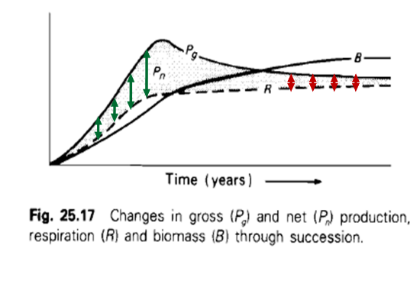
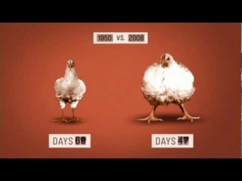
Ecosystem services are extracted to exploit growth phase
Human induced succession –deforestation, agriculture– moves the system back to earlier stage.

Slide 37
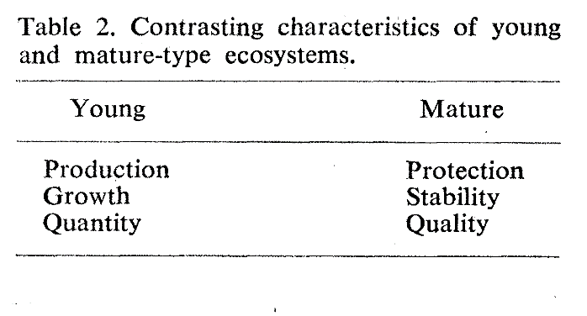
Odum, EP 1969
Strategy of Ecosystem Development

Slide 38
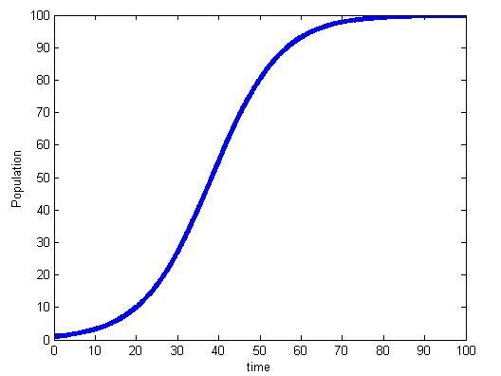
Logistic growth from early to late successional stages
Protection
Stability
Quality
Production
Growth
Quantity

Slide 39
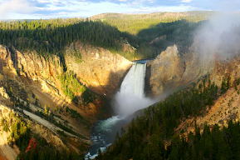
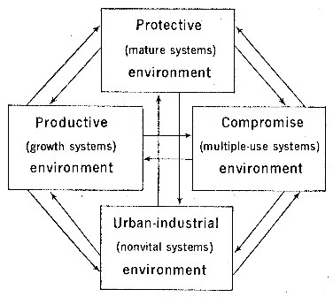
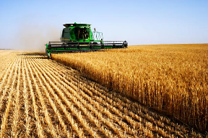


Compartment model of the basic kinds of environment required by humans
partitioned according to ecosystem development

Slide 40




Complex Systems Cycle: Holling’s 4-stage model of ecosystem dynamics
Logistic growth only captures part of the cycle
complexity
May 2010

Slide 41


Slide 42





All systems show signs of complex growth and DECAY dynamics

Slide 43


Benefits of collapse
Schumpeter labeled the collapse, “creative destruction”, since it allowed for new configurations and innovation opportunities

Slide 44


Collapse of Complex Societies (Tainter 1988)
Complexification is limited as a problem solving strategy.
“More complex societies are more costly to maintain than simpler ones… as societies increase in complexity, more networks are created among individuals, more hierarchical controls are created to regulate these networks, more information is processed … increasing
need to support specialists not directly involved in resource production, and the like” (Tainter 1988).
Benefit from Complexity
Complexity

Slide 45

Adaptive Cycle - reoriented
K
α
Ω
r
Burkhard et al. 2011

Slide 46
Develop-
mental
potential
Connectedness
Developmental opportunities result from the collapse

Slide 47


Slide 48
ecosystem indicator
number of connections
Long-term succession of ecosystems: small-scale disturbances may support the development of the overall system.

Slide 49

The Okay/Not Okay Principle of Human Induced Succession
Multiple stable states – once it goes to one of the “not okay” basins it is hard or impossible to return

Slide 50



Slide 51
Summary
Ecosystems and urban systems are dynamic, undergoing patterned growth and development
Different stages emphasize different “priorities”
  growth v. development
  positive feedback v. negative feedback
  change v. stasis
Disturbance is a natural part of the complex systems cycle
Disturbance may move system to “Not Okay” domain

