Slide 1
Millennium Ecosystem Assessment Findings

Slide 2
Largest assessment of the health of Earth’s ecosystems
Experts and Review Process
  Prepared by 1360 experts from 95 countries
  80-person independent board of review editors
  Review comments from 850 experts and governments
Governance
  Called for by UN Secretary General in 2000
  Authorized by governments through 4 conventions
  Partnership of UN agencies, conventions, business, non-governmental organizations with a multi-stakeholder board of directors

Slide 3
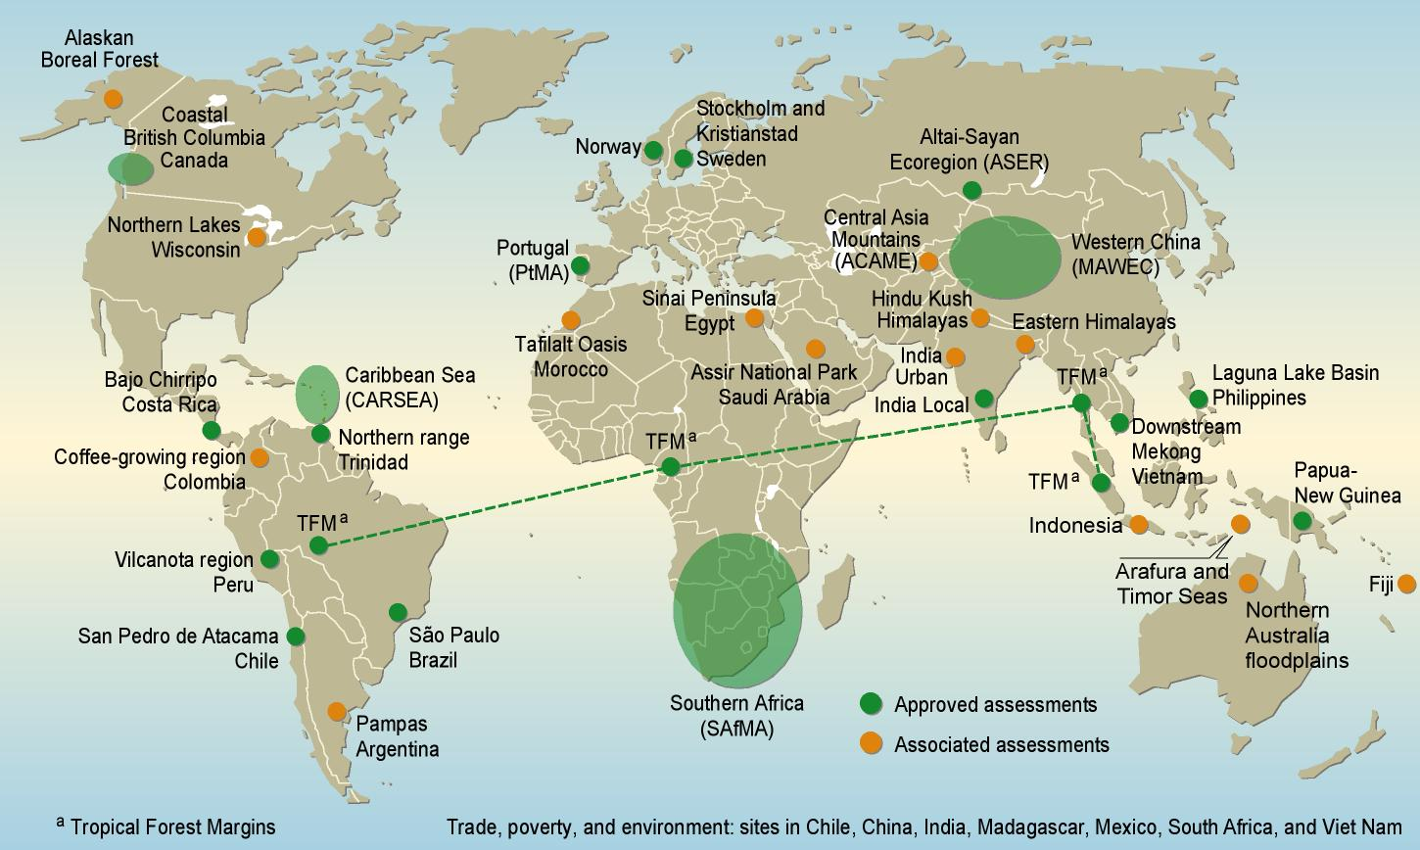
Defining Features
Multi-scale assessment
  Includes information from 33 sub-global assessments

Slide 4
Focus: Ecosystem Services
The benefits people obtain from ecosystems

Slide 5
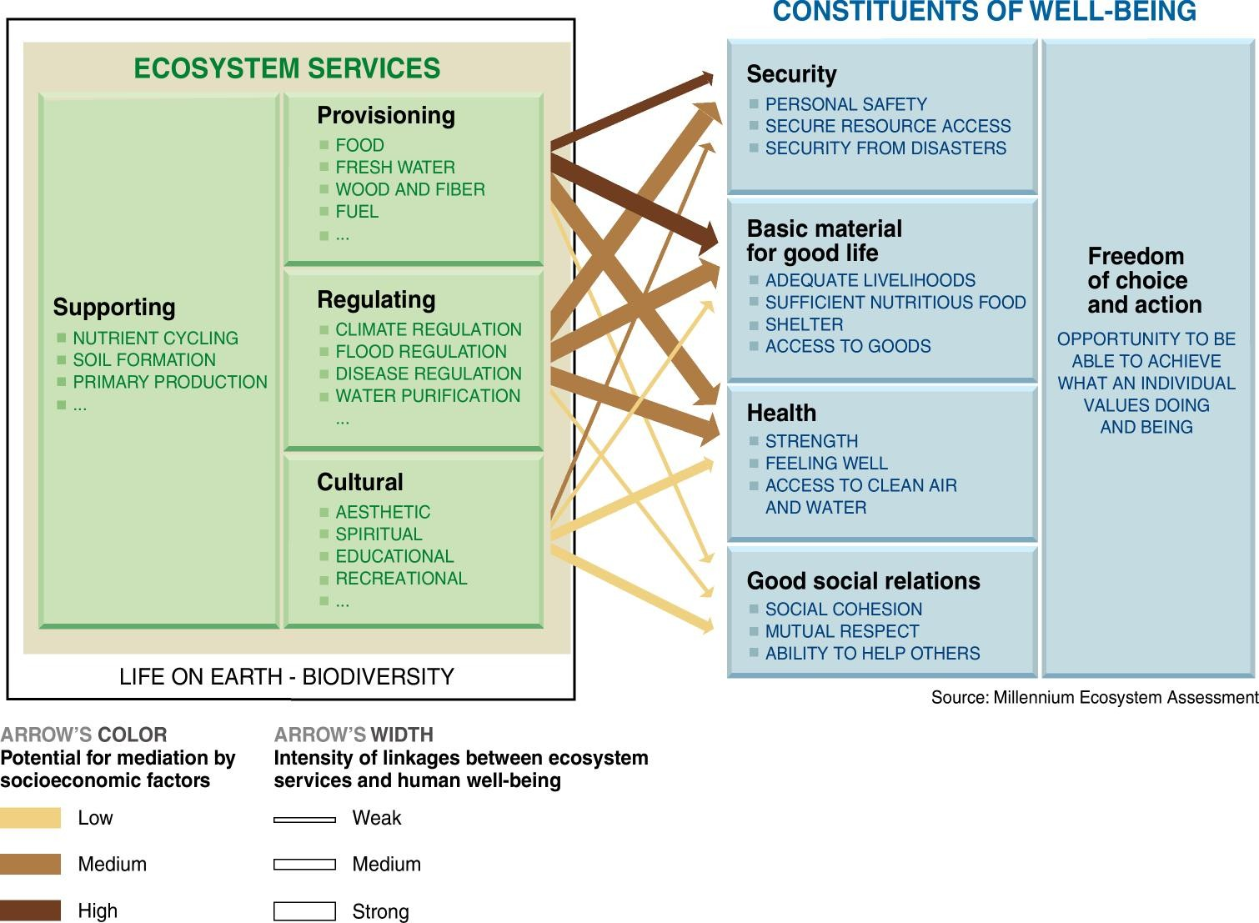
Focus: Consequences of Ecosystem Change for Human Well-being

Slide 6
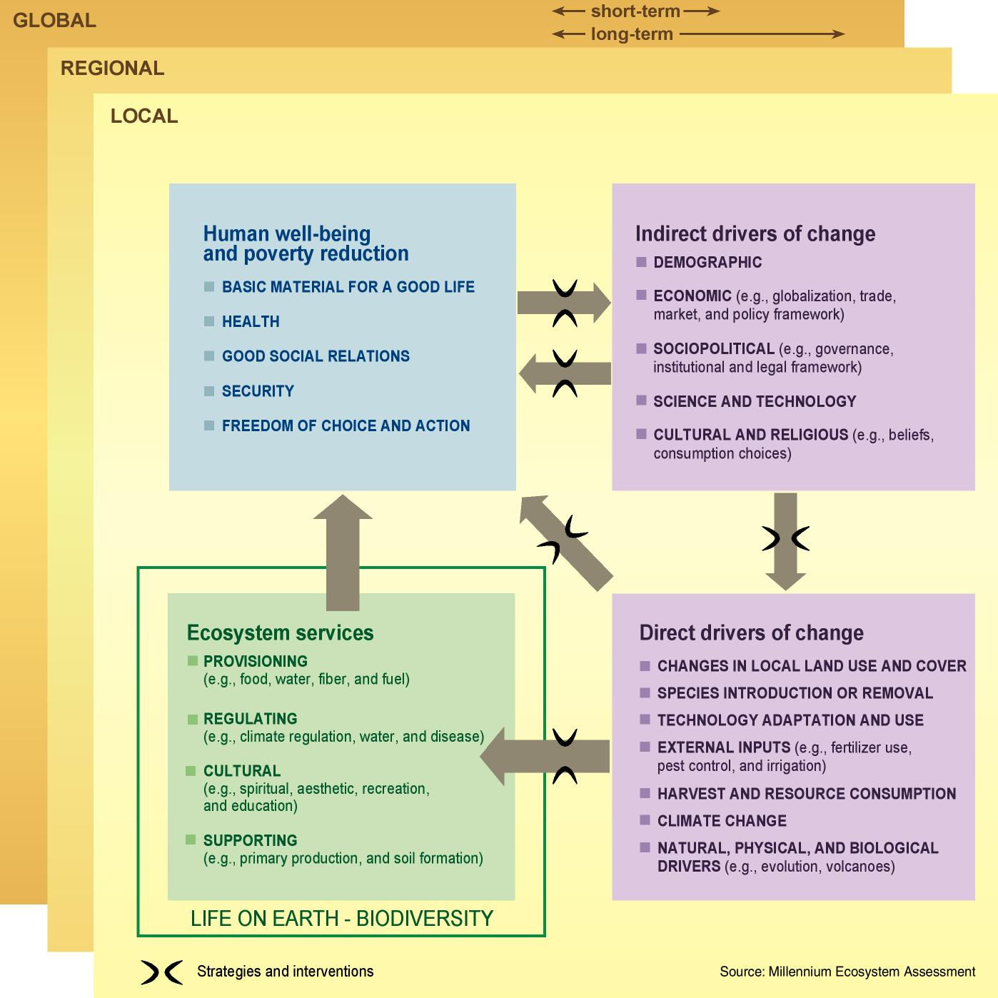
MA Framework
Human Well-being and
Poverty Reduction
Basic material for a good life
Health
Good Social Relations
Security
Freedom of choice and action
Indirect Drivers of Change
Demographic
Economic (globalization, trade, market and policy framework)
Sociopolitical (governance and institutional framework)
Science and Technology
Cultural and Religious
Human
Well-being
Indirect
Drivers
Ecosystem
Services
Direct Drivers of Change
Changes in land use
Species introduction or removal
Technology adaptation and use
External inputs (e.g., irrigation)
Resource consumption
Climate change
Natural physical and biological drivers (e.g., volcanoes)
Direct
Drivers

Slide 7
MA Findings - Outline
1. Ecosystem Changes in Last 50 Years
2. Gains and Losses from Ecosystem Change
  Three major problems may decrease long-term benefits
  Degradation of Ecosystem Services
  Increased Likelihood of Nonlinear Changes
  Exacerbation of Poverty for Some People
3. Ecosystem Prospects for Next 50 Years
4. Reversing Ecosystem Degradation

Slide 8
Finding #1
  Over the past 50 years, humans have changed ecosystems more rapidly and extensively than in any comparable period of time in human history
  This has resulted in a substantial and largely irreversible loss in the diversity of life on Earth

Slide 9
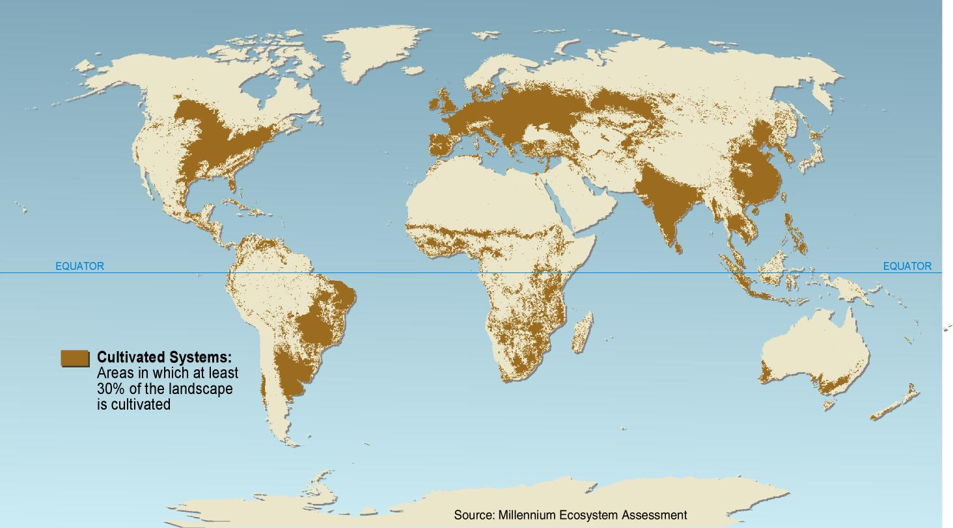
Unprecedented change in structure and function of ecosystems
More land was converted to cropland in the 30 years after 1950 than in the 150 years between 1700 and 1850.
Cultivated Systems in 2000 cover 25% of Earth’s terrestrial surface
(Defined as areas where at least 30% of the landscape is in croplands, shifting cultivation, confined livestock production, or freshwater aquaculture)

Slide 10
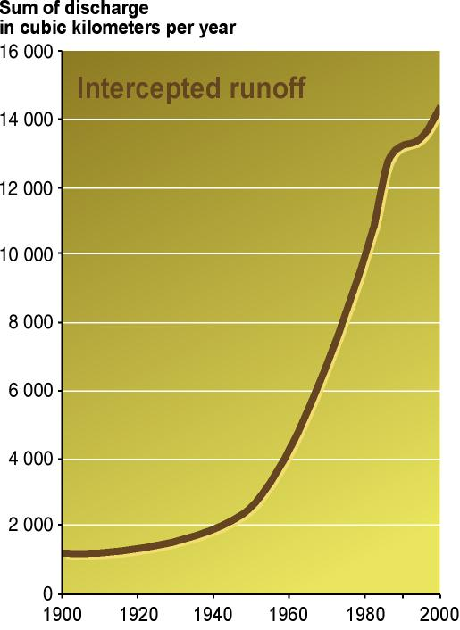
Unprecedented change: Ecosystems
  20% of the world’s coral reefs were lost and 20% degraded in the last several decades
  35% of mangrove area has been lost in the last several decades
  Amount of water in reservoirs quadrupled since 1960
  Withdrawals from rivers and lakes doubled since 1960
Intercepted Continental Runoff:
3-6 times as much water in reservoirs as in natural rivers
(Data from a subset of large reservoirs totaling ~65% of the global total storage)
Notes:
most water use (70% worldwide) is for agriculture.

Slide 11
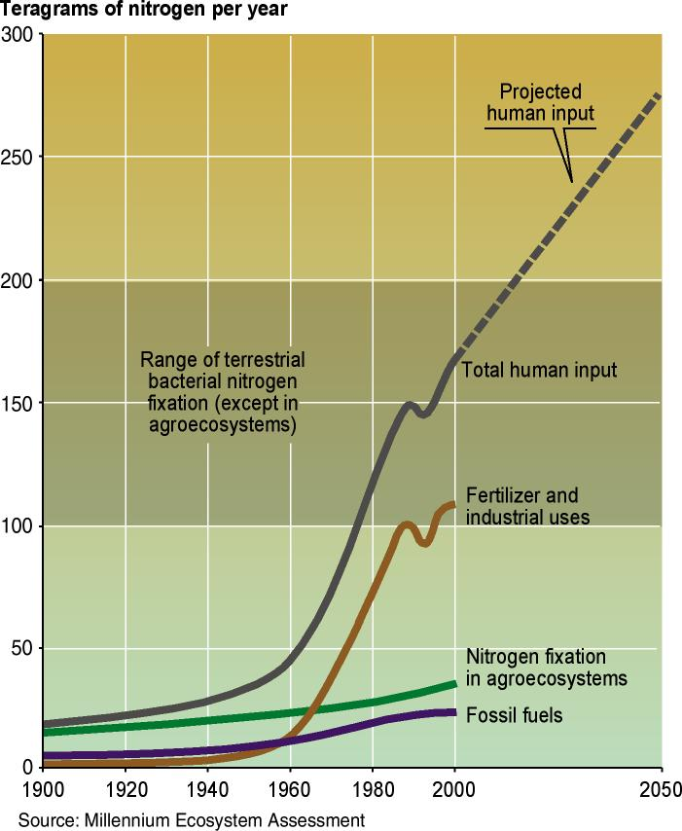
Unprecedented change: Biogeochemical Cycles
Since 1960:
  Flows of biologically available nitrogen in terrestrial ecosystems doubled
  Flows of phosphorus tripled
> 50% of all the synthetic nitrogen fertilizer ever used has been used since 1985
60% of the increase in the atmospheric concentration of CO₂ since 1750 has taken place since 1959
Human-produced Reactive Nitrogen
Humans produce as much biologically available N as all natural pathways and this may grow a further 65% by 2050
Notes:
Synthetic N was first manufactured in 1913.
Since 1750, the atmospheric concentration of carbon dioxide has increased by about 32% (from about 280 to 376 parts per million in 2003), primarily due to the combustion of fossil fuels and land use changes.

Slide 12
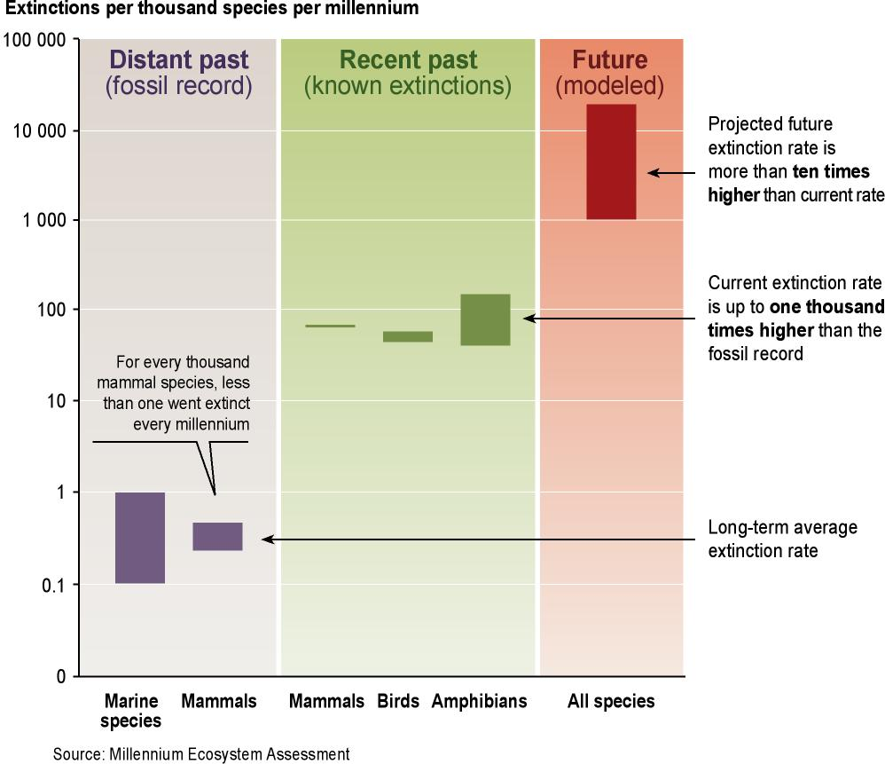
Significant and largely irreversible changes to species diversity
  Humans have increased the species extinction rate by as much as 1,000 times over background rates typical over the planet’s history (medium certainty)
  10–30% of mammal, bird, and amphibian species are currently threatened with extinction (medium to high certainty)

Slide 13
MA Findings - Outline
1. Ecosystem Changes in Last 50 Years
2. Gains and Losses from Ecosystem Change
  Three major problems may decrease long-term benefits
  Degradation of Ecosystem Services
  Increased Likelihood of Nonlinear Changes
  Exacerbation of Poverty for Some People
3. Ecosystem Prospects for Next 50 Years
4. Reversing Ecosystem Degradation

Slide 14
Finding #2
  The changes that have been made to ecosystems have contributed to substantial net gains in human well-being and economic development, but these gains have been achieved at growing costs
  These problems, unless addressed, will substantially diminish the benefits that future generations obtain from ecosystems

Slide 15
Changes to ecosystems have provided substantial benefits
Rapid growth in demand for ecosystem services between 1960 and 2000:
  world population doubled from 3 to 6 billion people
  global economy increased more than sixfold
To meet this demand:
  food production increased 2 ½ times
  water use doubled
  wood harvests for pulp and paper production tripled
  timber production increased by more than half
  installed hydropower capacity doubled

Slide 16
MA Findings - Outline
1. Ecosystem Changes in Last 50 Years
2. Gains and Losses from Ecosystem Change
  Three major problems may decrease long-term benefits
  Degradation of Ecosystem Services
  Increased Likelihood of Nonlinear Changes
  Exacerbation of Poverty for Some People
3. Ecosystem Prospects for Next 50 Years
4. Reversing Ecosystem Degradation

Slide 17
Degradation and unsustainable use of ecosystem services
  Approximately 60% (15 out of 24) of the ecosystem services evaluated in this assessment are being degraded or used unsustainably
  The degradation of ecosystem services often causes significant harm to human well-being and represents a loss of a natural asset or wealth of a country

Slide 18
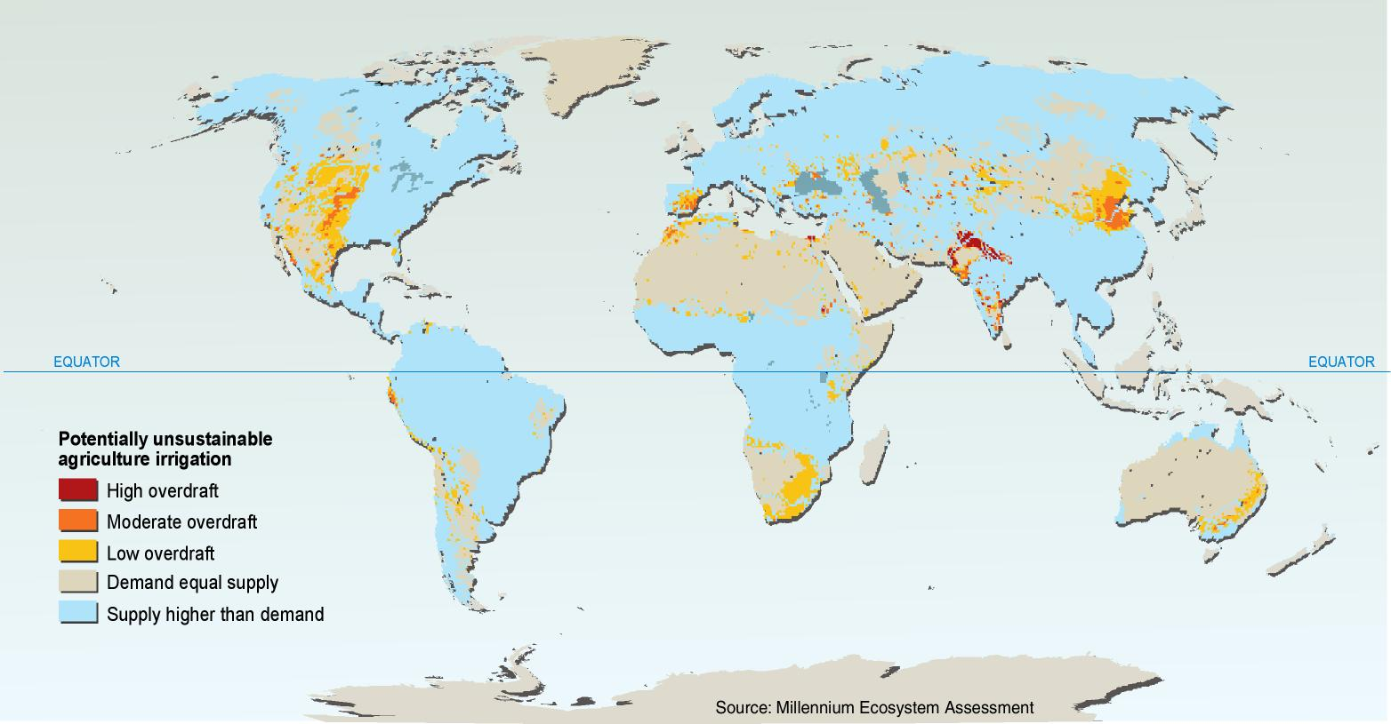
Water
  5 to possibly 25% of global freshwater use exceeds long-term accessible supplies (low to medium certainty)
  15 - 35% of irrigation withdrawals exceed supply rates and are therefore unsustainable (low to medium certainty)

Slide 19
Regulating Services
Air quality regulation
  Ability of the atmosphere to cleanse itself of pollutants has declined since pre-industrial times but not by more than 10%
Regional and local climate regulation
  Changes in land cover have affected regional and local climates both positively and negatively, but there is a preponderance of negative impacts ; for example, tropical deforestation and desertification have tended to reduce local rainfall
Water purification and waste treatment
  Globally, water quality is declining, although in most industrial countries pathogen and organic pollution of surface waters has decreased over the last 20 years
  Nitrate concentration has grown rapidly in the last 30 years

Slide 20
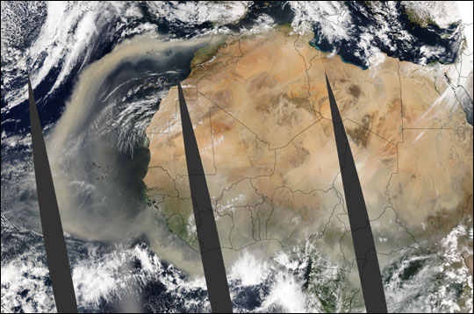
Wealthy populations cannot be insulated from ecosystem degradation
  The physical, economic, or social impacts of ecosystem service degradation may cross boundaries
  Many sectors of industrial countries still depend directly on ecosystem services.
  Wealth cannot buffer people from changes in all ecosystem services (e.g., cultural services, air quality)
  Changes in ecosystems that contribute to climate change affect all people
Source: NASA Earth Observatory
Dust Cloud Off the Northwest Coast of Africa extending to South America

Slide 21
MA Findings - Outline
1. Ecosystem Changes in Last 50 Years
2. Gains and Losses from Ecosystem Change
  Three major problems may decrease long-term benefits
  Degradation of Ecosystem Services
  Increased Likelihood of Nonlinear Changes
  Exacerbation of Poverty for Some People
3. Ecosystem Prospects for Next 50 Years
4. Reversing Ecosystem Degradation

Slide 22
Finding #4:
  The challenge of reversing the degradation of ecosystems while meeting increasing demands for their services can be partially met under some scenarios that the MA considered but these involve significant changes in policies, institutions and practices, that are not currently under way
  Many options exist to conserve or enhance specific ecosystem services in ways that reduce negative trade-offs or that provide positive synergies with other ecosystem services

Slide 23
Responses – Importance of Indirect Drivers
Ecosystem degradation can rarely be reversed without actions that address one or more indirect drivers of change:
  population change (including growth and migration)
  change in economic activity (including economic growth, disparities in wealth, and trade patterns)
  sociopolitical factors (including factors ranging from the presence of conflict to public participation in decision-making)
  cultural factors
  technological change
Collectively these factors influence the level of production and consumption of ecosystem services and the sustainability of the production.

Slide 24
Responses – Key Barriers
  Inappropriate institutional and governance arrangements, including the presence of corruption and weak systems of regulation and accountability.
  Market failures and the misalignment of economic incentives.
  Social and behavioral factors, including the lack of political and economic power of some groups that are particularly dependent on ecosystem services or harmed by their degradation.
  Underinvestment in the development and diffusion of technologies
  Insufficient knowledge (as well as the poor use of existing knowledge) concerning ecosystem services and responses that could enhance benefits from these services while conserving resources.
  Weak human and institutional capacity related to the assessment and management of ecosystem services.

Slide 25
Responses: Institutions
Changes in institutional and environmental governance frameworks are sometimes required to create the enabling conditions for effective management of ecosystems, while in other cases existing institutions could meet these needs but face significant barriers.
Promising Responses
  Integration of ecosystem management goals within other sectors and within broader development planning frameworks
  Increased coordination among multilateral environmental agreements and between environmental agreements and other international economic and social institutions
  Increased transparency and accountability of government and private-sector performance on decisions that have an impact on ecosystems, including through greater involvement of concerned stakeholders in decision-making

Slide 26
Responses: Economics
Economic and financial interventions provide powerful instruments to regulate the use of ecosystem goods and services
Promising Responses
  Elimination of subsidies that promote excessive use of ecosystem services (and, where possible, transfer these subsidies to payments for non-marketed ecosystem services)
    Subsidies paid to the agricultural sectors of OECD countries between 2001 and 2003 averaged over $324 billion annually, or one third the global value of agricultural products in 2000
    Compensatory mechanisms may be needed for poor people who are adversely affected by the removal of subsidies
    removal of agricultural production subsidies within the OECD would need to be accompanied by actions to minimize adverse impacts on ecosystem services in developing countries

Slide 27
Responses: Economics
Promising Responses
  Greater use of economic instruments and market-based approaches in the management of ecosystem services (where enabling conditions exist):
    Taxes or user fees for activities with “external” costs (e.g. include taxes on excessive application of nutrients)
    Payment for ecosystem services
      For example, in 1996 Costa Rica established a nationwide system of conservation payments under which Costa Rica brokers contracts between international and domestic “buyers” and local “sellers” of sequestered carbon, biodiversity, watershed services, and scenic beauty
    Mechanisms to enable consumer preferences to be expressed through markets such as existing certification schemes for sustainable fisheries and forest practices

Slide 28
Responses: Social & Behavioral
These are generally interventions that stakeholders initiate and execute through exercising their procedural or democratic rights in efforts to improve ecosystems and human well-being
Promising Responses
  Measures to reduce aggregate consumption of unsustainably managed ecosystem services
    Behavioral changes that could reduce demand for threatened ecosystem services can be encouraged through actions such as education and public awareness programs, promotion of demand-side management, commitments by industry to use raw materials that are from sources certified as being sustainable, and improved product labeling
  Communication and education
  Empowerment of groups particularly dependent on ecosystem services or affected by their degradation, including women, indigenous peoples, and young people

Slide 29
Responses: Technological
Development and diffusion of technologies designed to increase the efficiency of resource use or reduce the impacts of drivers such as climate change and nutrient loading are essential
Promising Responses
  Promotion of technologies that enable increased crop yields without harmful impacts related to water, nutrient, and pesticide use
  Restoration of ecosystem services
  Promotion of technologies to increase energy efficiency and reduce greenhouse gas emissions

Slide 30
Responses: Knowledge
Effective management of ecosystems is constrained both by the lack of knowledge and information about ecosystems and by the failure to use adequately the information that does exist
Promising Responses
  Incorporation of nonmarket values of ecosystems in resource management decisions
  Use of all relevant forms of knowledge and information in assessments and decision-making, including traditional and practitioners' knowledge
  Enhancement of human and institutional capacity for assessing the consequences of ecosystem change for human well-being and acting on such assessments

Slide 31
Summary
  Over the past 50 years, humans have changed ecosystems more rapidly and extensively than in any comparable period of time in human history, largely to meet rapidly growing demands for food, fresh water, timber, fiber and fuel
  The changes that have been made to ecosystems have contributed to substantial net gains in human well-being and economic development, but these gains have been achieved at growing costs in the form of the degradation of many ecosystem services, increased risks of nonlinear changes, and the exacerbation of poverty for some groups of people
  The degradation of ecosystem services could grow significantly worse during the first half of this century and is a barrier to achieving the Millennium Development Goals
  The challenge of reversing the degradation of ecosystems while meeting increasing demands for their services can be partially met under some scenarios that the MA has considered but these involve significant changes in policies, institutions and practices, that are not currently under way

Slide 32
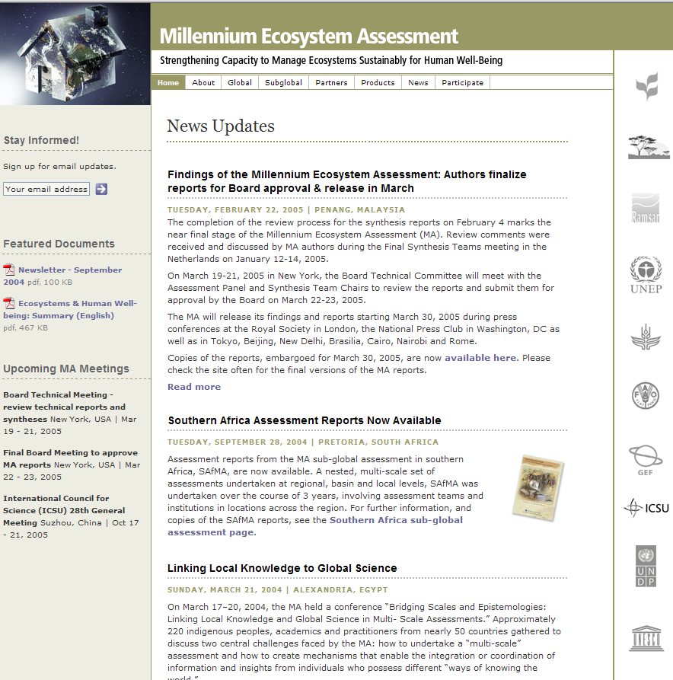
Visit the MA Website
www.millenniumassessment.org
All MA reports available to download
Access to core data
MA ‘outreach’ kit
  Slides
  Communication tools

