Slide 1
Biophysical Limits to Growth
Brian D. Fath
Professor, Biology Dept, Towson University, USA
Senior Research Scholar, IIASA, Austria
Co-Editor-in-Chief, Current Research in Environmental Sustainability

Slide 2
Biophysical Limits to Growth
Brian D. Fath
Professor, Biology Dept, Towson University, USA
Senior Research Scholar, IIASA, Austria
Co-Editor-in-Chief, Current Research in Environmental Sustainability

Slide 3
We witness unsustainable human-ecosystem interactions
How could people make such serious mistakes in the past and why does society continue to repeat such mistakes today?
Is it inevitable that the environment must be degraded to satisfy human needs?

Slide 4
Why environmental resources have been poorly conserved in the past?
Nature’s rate of return of ecosystem services leads us to over exploitation
  Living off the flow is too slow, for how we want to grow
  Poor understanding of growth, exponential growth
Externalities
  Indirect cost not paid for by producer and consumer as part of a transaction
  When a decision (for example, to pollute the atmosphere) causes costs or benefits to individuals or groups other than the person making the decision
Pressure for resource consumption
  Economic and institutional growth paradigm
  Victor Lebow (1955): our enormously productive economy demands that we make consumption our way of life, that we convert the buying and use of goods into rituals, that we seek our spiritual satisfactions, our ego satisfactions, in consumption
  Marketing

Slide 5
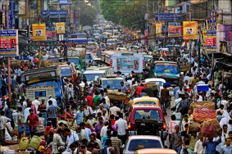
Drivers of Unsustainability
HUMAN POPULATION INCREASE
  Agriculture
  Shelter
  Mobility
  Stuff
Use Energy and
Material Resources
causes
Land use change
Habitat loss
Deforestation
Alter biogeochemical cycles
Climate Change
Eutrophication
Acid precipitation
Ozone Depletion
Smog
…
Leads to

Slide 6

Economics
Economics is one the main organizing forces in society
Many decisions are made based on cost-benefit analysis but true costs (direct + indirect) to individual, society, or environment are often not known

Slide 7
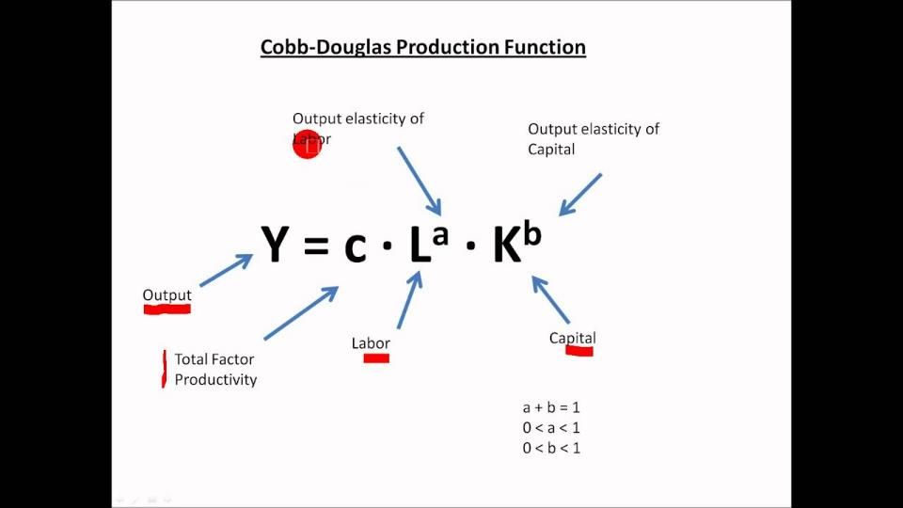
Economic Growth Models
WHERE IS ENVIRONMENT?

Slide 8
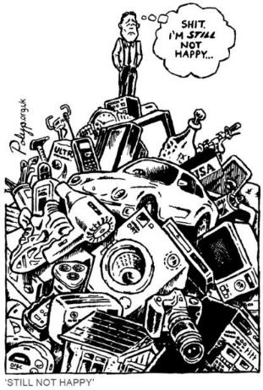
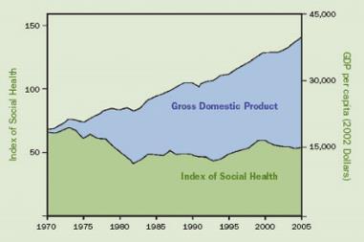
What is the purpose of growth?
Does bigger always mean better?
Alternative well-being indicators tell a different story

Slide 9
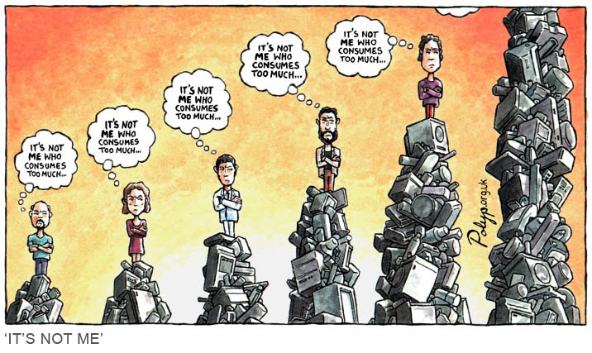
Humans are social animals, measuring in terms of others, not absolutes

Slide 10
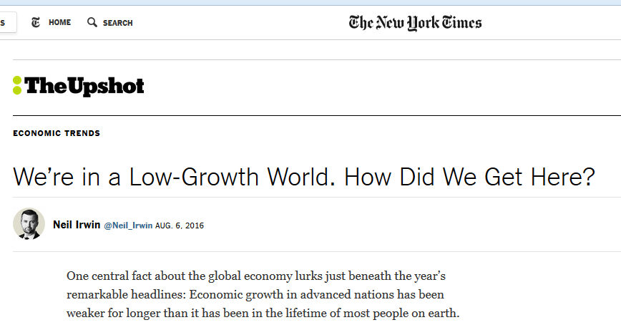
No mention of natural resources or environment
It increasingly looks as if something fundamental is broken in the global growth machine — and that the usual menu of policies, like interest rate cuts and modest fiscal stimulus, aren’t up to the task of fixing it (though some well-devised policies could help).
www.nytimes.com/2016/08/07/upshot/were-in-a-low-growth-world-how-did-we-get-here.html?hp&action=click&pgtype=Homepage&clickSource=story-heading&module=first-column-region&region=top-news&WT.nav=top-news&_r=0

Slide 11
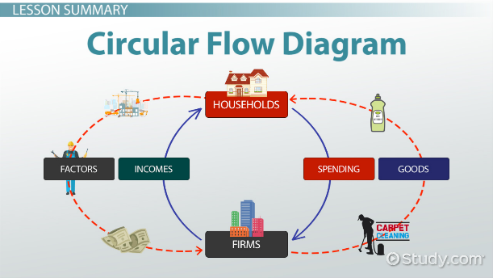
Assumption error:
Economy as an isolated system

Slide 12
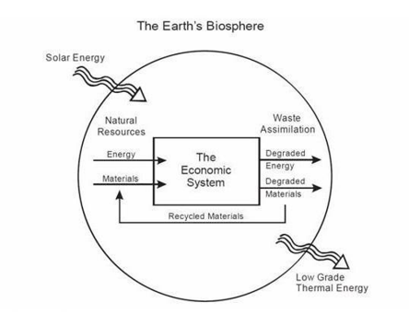
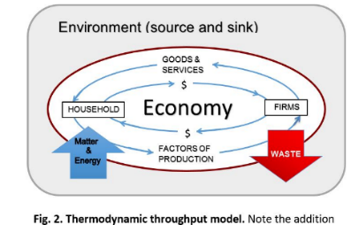

A better model:
Economy as an open system

Slide 13
A look back at the history recognizing limits

Slide 14
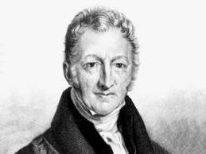
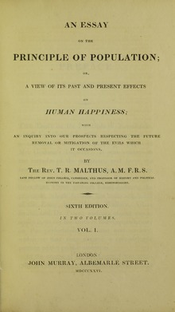
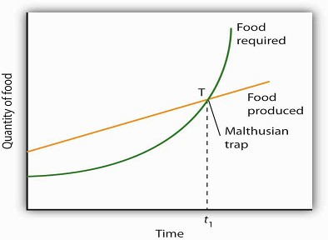
Thomas Malthus
Predicts eventually food and resources will run out as populations explode
1798

Slide 15
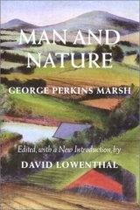
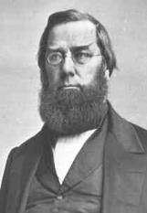
George Perkins Marsh
1864
“A certain measure of transformation of terrestrial surface, of suppression of natural, and stimulation of artificially modified productivity becomes necessary. This measure man has unfortunately exceeded.”
“The ravages committed by man subvert the relations and destroy the balance which nature has established…; and she avenges herself upon the intruder by letting loose her destructive energies…”

Slide 16
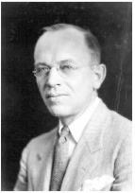
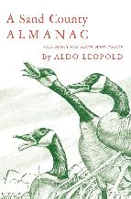
Aldo Leopold
A Sand County Almanac – regarded as the most influential book on conservation ever written.
The land ethic:
"A thing is right when it tends to preserve the integrity, stability, and beauty of the biotic community. It is wrong when it tends otherwise."
Enlarges the boundaries of the community to include soils, waters, plants, and animals, or collectively: the land.
1949

Slide 17
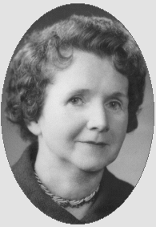
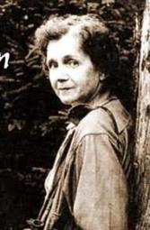
Rachel Carson
1960s – The modern environmental movement is born
1962 Silent Spring
Carson, writer and marine biologist, told how chemical use on farms, forests, and gardens, poison the environment. Insects were dying (not just the pest species) which meant no food for the birds. No birds, no bird song – a silent spring
Public awareness that humans are damaging environment

Slide 18
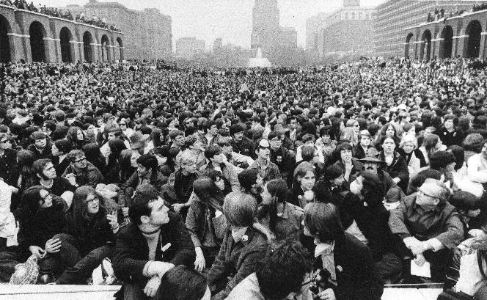
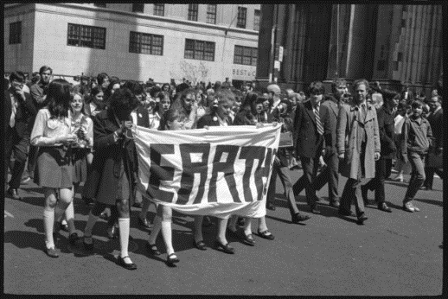
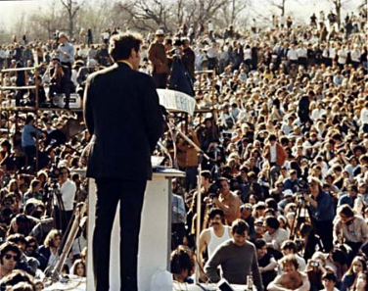
1st Earth Day 1970

Slide 19
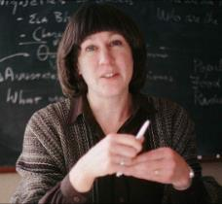
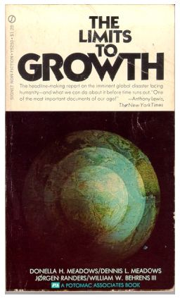
Donella Meadows and Club of Rome
1972

Slide 20
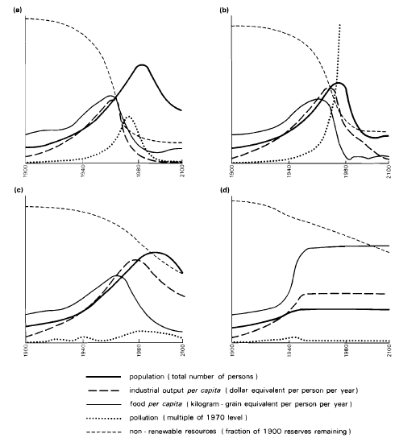
Forrester-Meadows world model
(a) A standard computer simulation based on 1970 values.
(b) Pollution-induced collapse even when known natural resource reserves are 2x.
(c) Collapse due to population growth even though resources are set as unlimited and pollution controls are assumed.
(d) Stabilized model producing a sustainable future. Assumptions: birth rate= death rate, capital investment= capital depreciation, and technological policies are implemented, e.g., resource recycling, pollution control, and restoration of eroded and infertile soils.
(After Meadows, 1971)

Slide 21
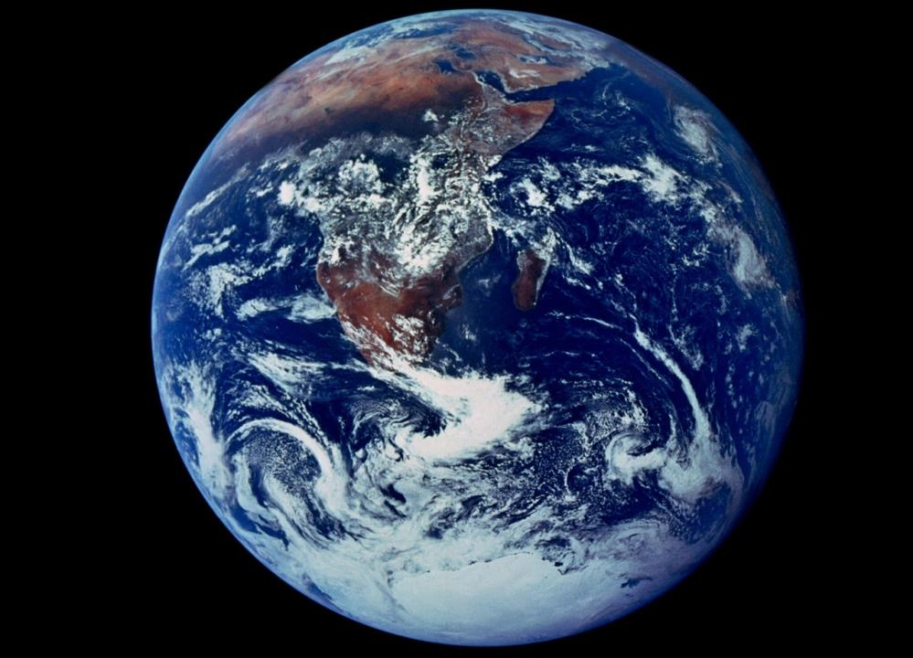

Slide 22

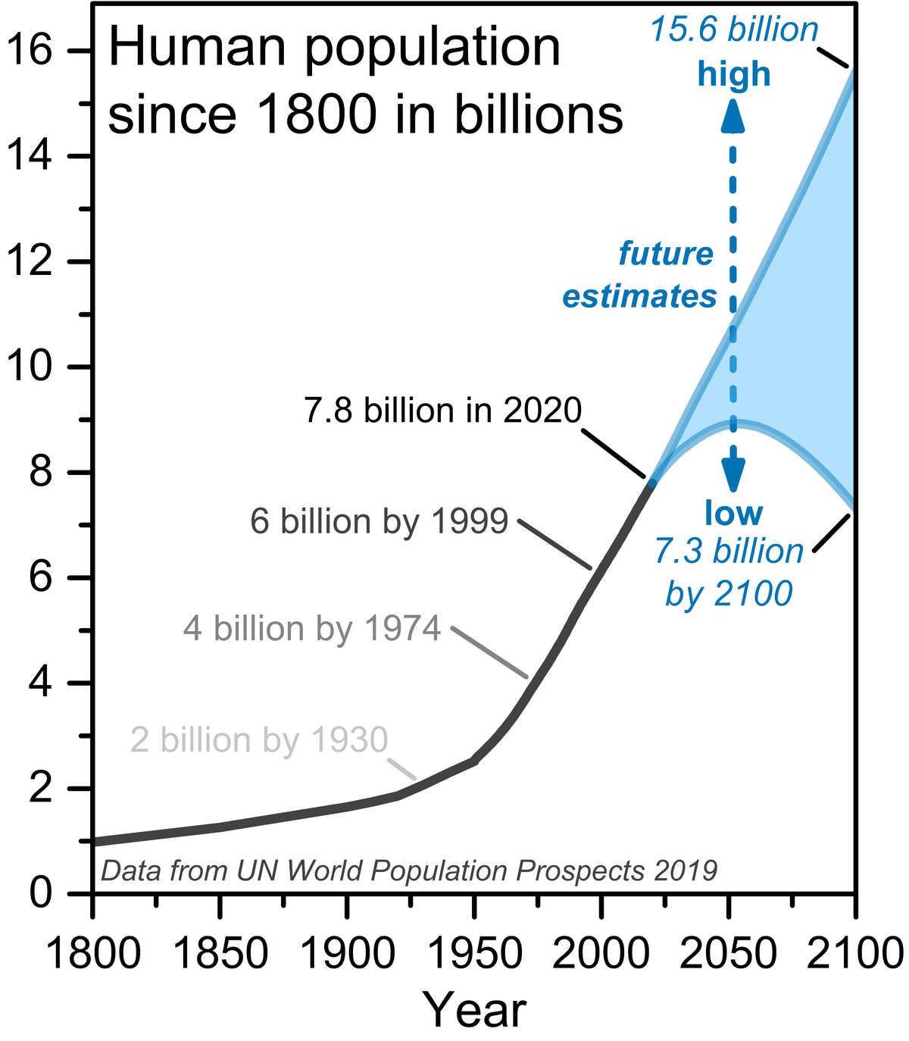
Importance of scale

Slide 23
Importance of scale

Slide 24
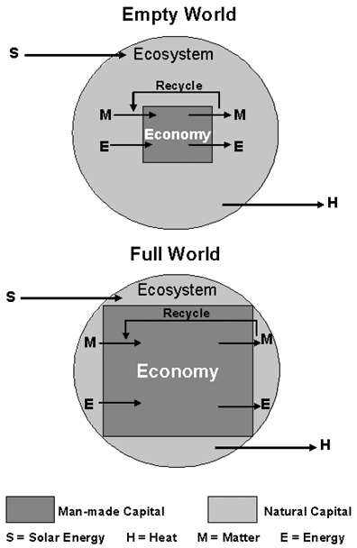
Emergence of humans, from a minor component of natural system to predominant occupant
Scale of humanity has increased greatly putting pressure on all natural resources
The changes have come so fast our customs, ethics, and religious patterns may not have adapted to them.

Slide 25
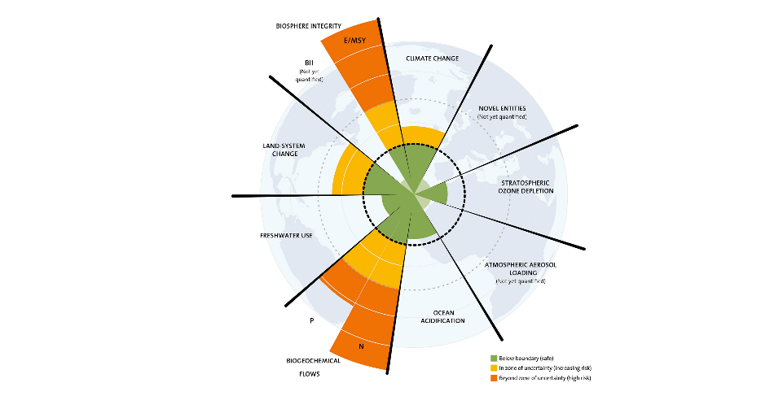
Planetary Boundaries – Stockholm Resilience Centre
2009

Slide 26
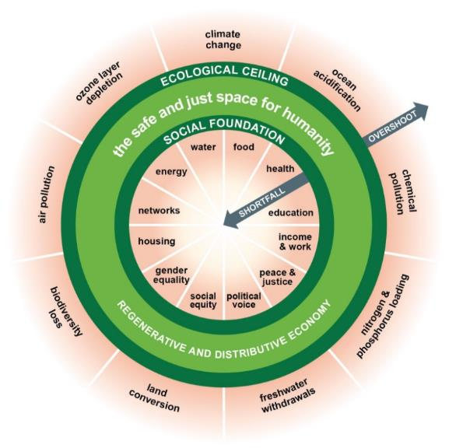
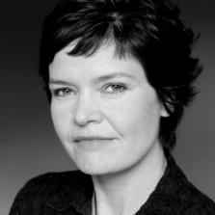
Donut Economics – Kate Raworth
2012

Slide 27
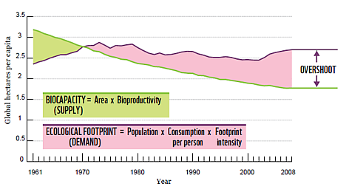
Overshooting the limits

Slide 28
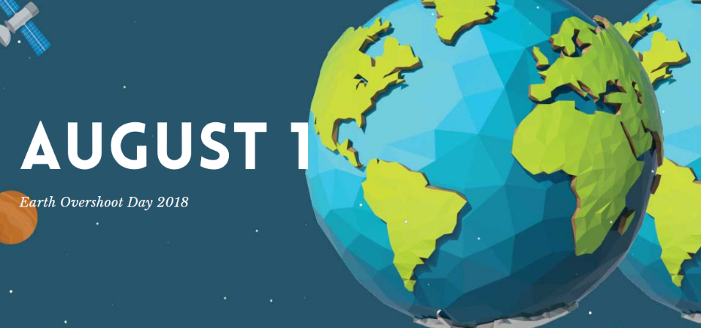
Overshooting the limits

Slide 29
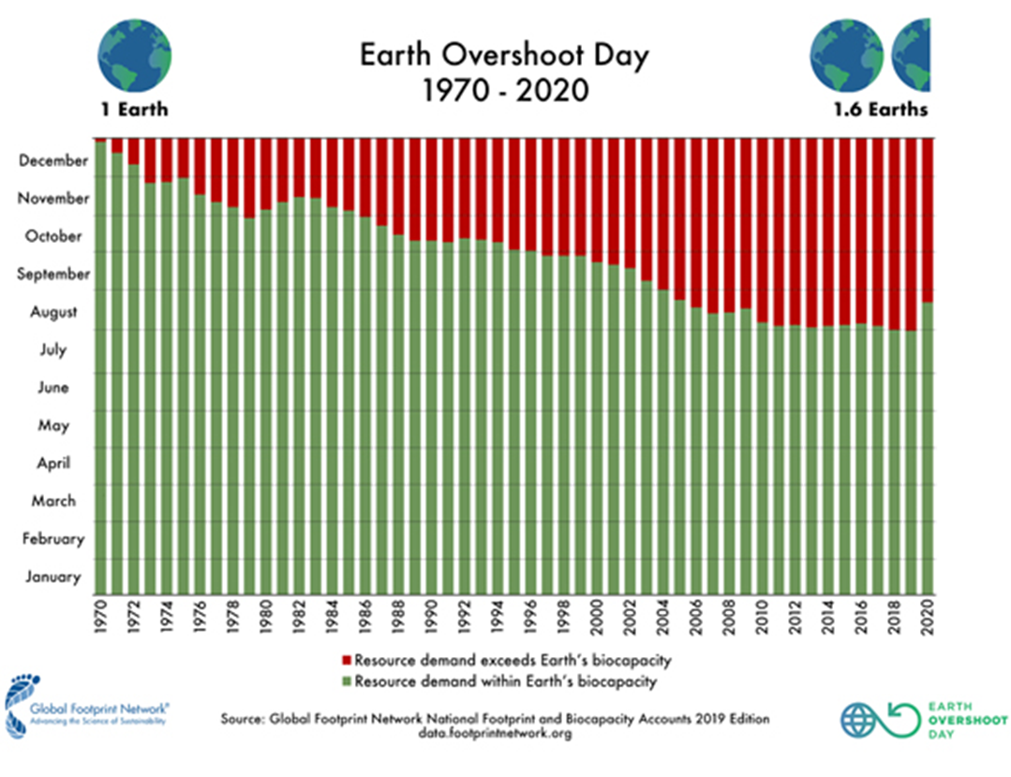

Slide 30
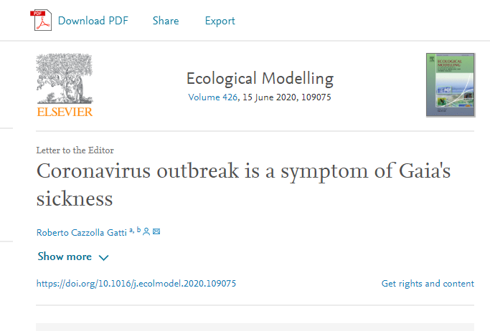

Slide 31
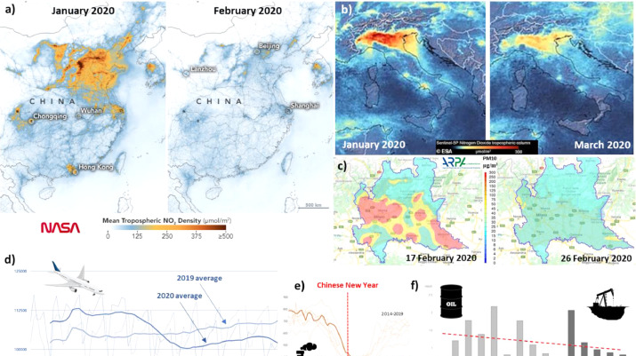
www.flightradar24.com/blog/then-and-now-visualizing-covid-19s-impact-on-air-traffic/

Slide 32
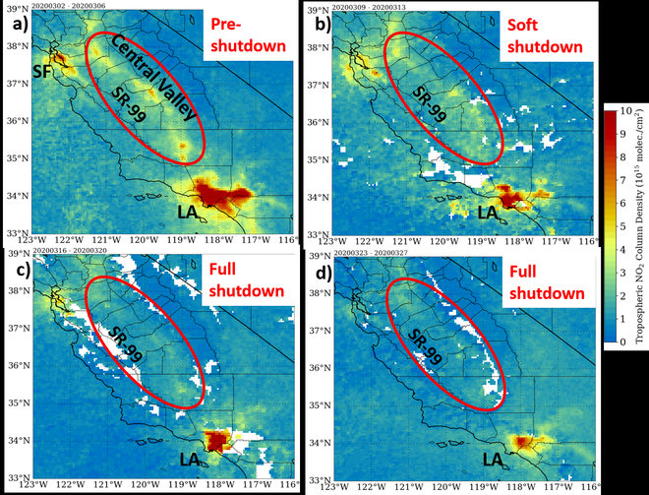
nasasport.wordpress.com/2020/04/04/new-generation-satellite-observations-monitor-air-pollution-during-covid-19-lockdown-measures-in-california/

Slide 33
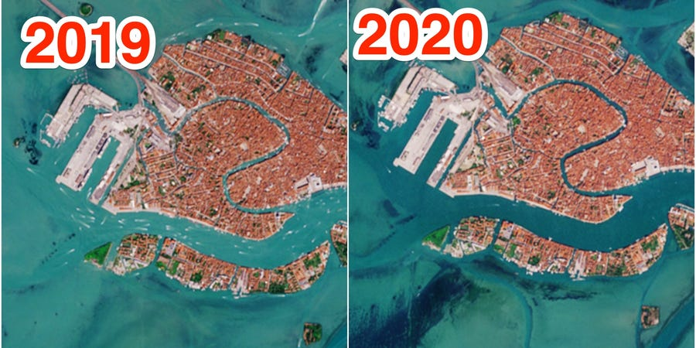
Venice, Italy

Slide 34
Alternative Economic Systems…
One mistake of the 2007 financial crisis was the rush to put the system back as it was, flaws and all
Use Covid to Build back better

Slide 35
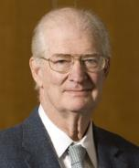
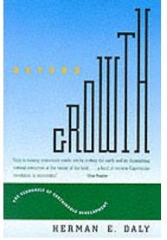
Herman Daly
Beyond Growth: the economics of sustainable development
  The first and second laws of thermodynamics must be the starting point of economics
  Neither the sources of useful inputs nor the sinks for polluting waste outputs are infinite.
1996

Slide 36
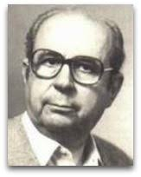
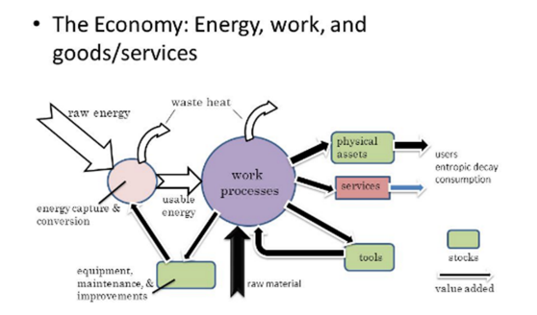
Nicolas Georgescu-Roegen
The Entropy Laws and the Economic Process (1971)
  Wealth is an open system, a structure maintained in the midst of throughput
  It begins with the depletion of useful matter/energy and ends with the return of an equal quantity of spent matter/energy back to the environment.

Slide 37
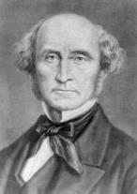
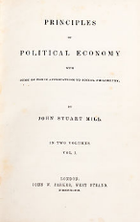
John Stuart Mill
British philosopher, political economist and civil servant (1806-1873)
Considered “the most influential English-speaking philosopher of the nineteenth century"
“Perpetual growth in material well-being is not possible or desirable.”
Mill argued that the logical conclusion of unlimited growth was destruction of the environment and a reduced quality of life. He concluded that a stationary state could be preferable to unending economic growth
1848
WHY HAVE WE NOT LEARNED THIS LESSON?

Slide 38
Steps forward
Identify a shared common vision that respects planetary boundaries
Enhance built environment by mimicking natural processes
Systems thinking at all levels of decision-making
Define sustainability and measure/monitor if current trends are heading toward or away from these trajectories
Next generation initiates transformative change

Slide 39
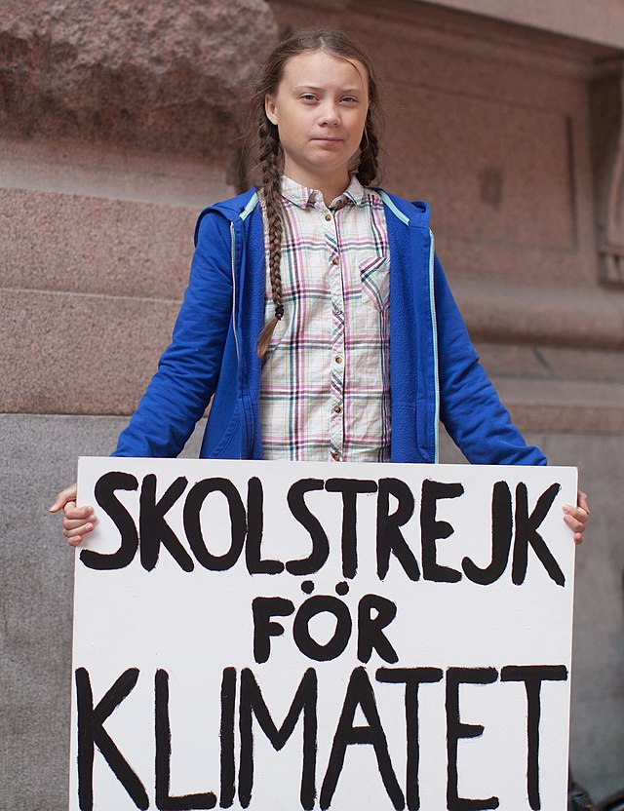
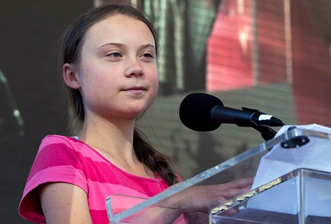

Greta Thunberg
2018 – School Strike for climate – Friday’s for Future
2019 Spoke before UN Climate conference
We will remember…
Sunrise Movement - 2017

Slide 40
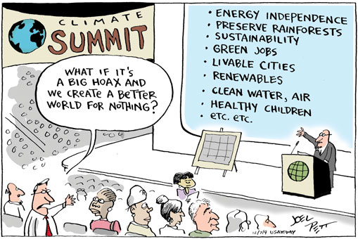

Slide 41
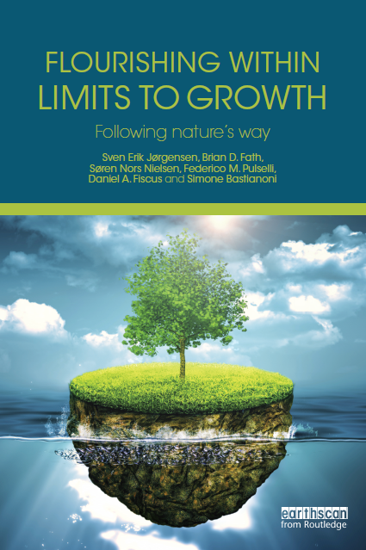
Ecosystems do quite well under constraints, let’s learn from them
2015
clubofsiena.eco-soft.dk

Slide 42

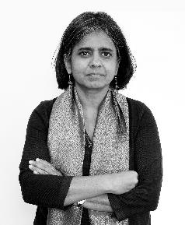

“There are limits. Let’s celebrate the limits, because we can reinvent a different future.”
Sunita Narain
This Changes Everything 2015

