Slide 1
Ecosystems as complex adaptive systems

Slide 2
Complex adaptive systems
Many parts
Many interactions
Adaptive because feedback allows them to survive in fluctuating environment

Slide 3
Systems
Holistic view includes the relation between parts and the whole

Slide 4
Hierarchical Representation of Systems
Hierarchical levels can be identified by a stronger set of interactions within a hierarchical level than between levels.
A critical feature of such hierarchies is the asymmetry of interactions among hierarchical levels.
Level n+1
Level n
objects possess both self-assertive and integrative tendencies
Level n−1

Slide 5
Systems
It’s not just a random relation: “the whole exists for and by means of the parts and the parts exists for and by means of the whole.”
– Stuart Kauffman
(www.npr.org/sections/13.7/2011/08/08/139006531/the-end-of-a-physics-worldview-heraclitus-and-the-watershed-of-life)

Slide 6
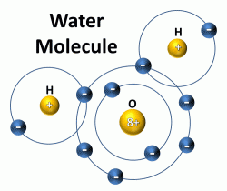
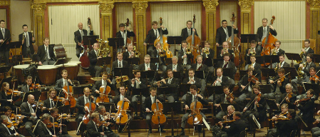
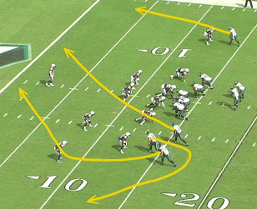
Emergent Properties
Function at higher order of organization that arises from behavior at a lower level
Whole is more than the sum of the parts

Slide 7
Emergent Properties
Self organization – increase complexity without being guided by outside force
  Macroscopic structure from microscopic disorder

Slide 8

Within species organization

Slide 9
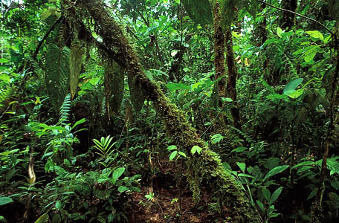
Among species organization

Slide 10
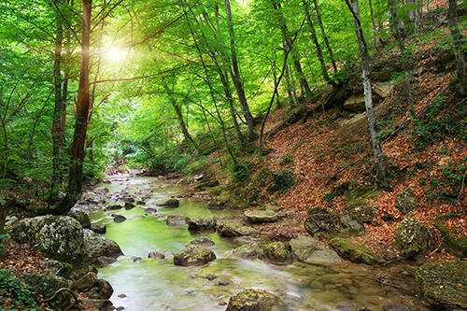
Among species with their environment

Slide 11
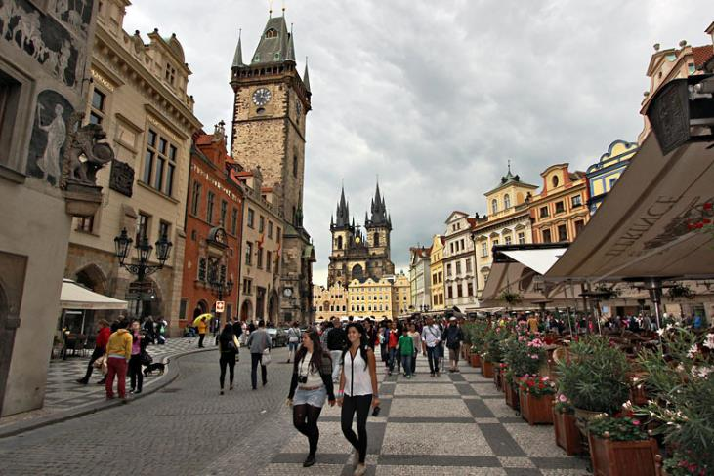
Among humans

Slide 12
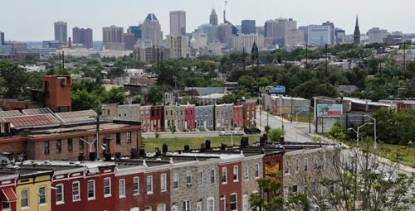
Among humans and nature

Slide 13
Ecosystem Organization
Self-organizing processes in ecosystems make them awesomely complex

Slide 14
Some properties of sustainable systems
How they organize
How they are organized/designed – patterns that emerge
How they stay functioning – homeostasis
How they interact with adjacent systems - open with input-output flows
  Natural Ecosystems
  Agricultural Ecosystems
  Urban Ecosystems
Coadaptation
  Fitting together
Coevolution
  Changing together

Slide 15
Ecosystem Design
Redundancy – duplication
Leads to Reliability and Resilience
“The ecosystem ensures its survival be feedback mechanisms that regulate the biological populations within it.” p. 63

Slide 16
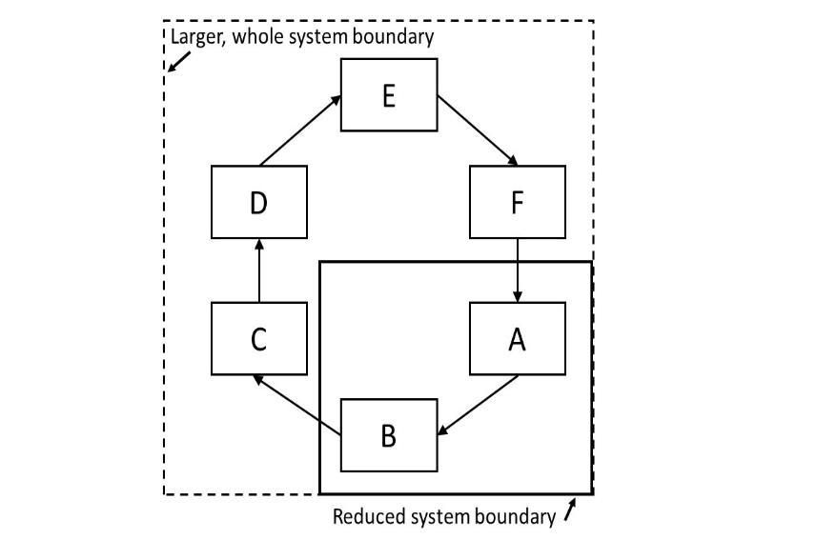

Slide 17
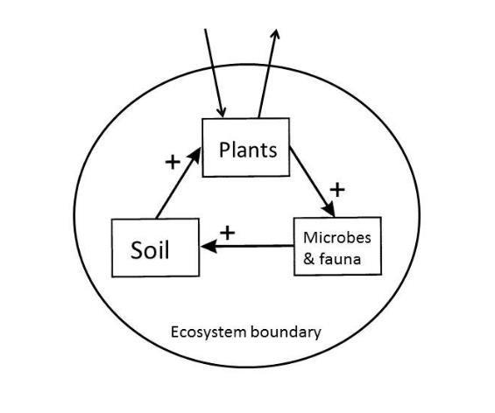
Key design feature
Positive feedback in an autocatalytic Life—Environment system

Slide 18
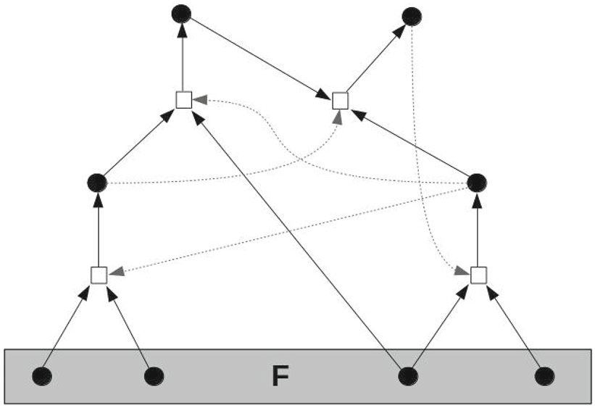
Autocatalysis – self catalyzing

Slide 19
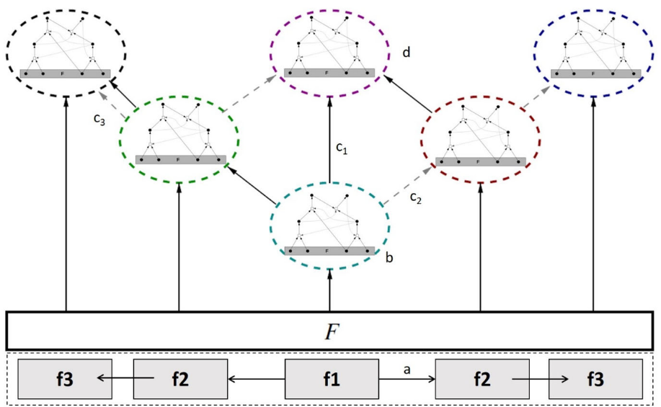
Interacting autocatalytic systems – expands the possibilities

Slide 20
Combinations of things give rise to new things

Slide 21
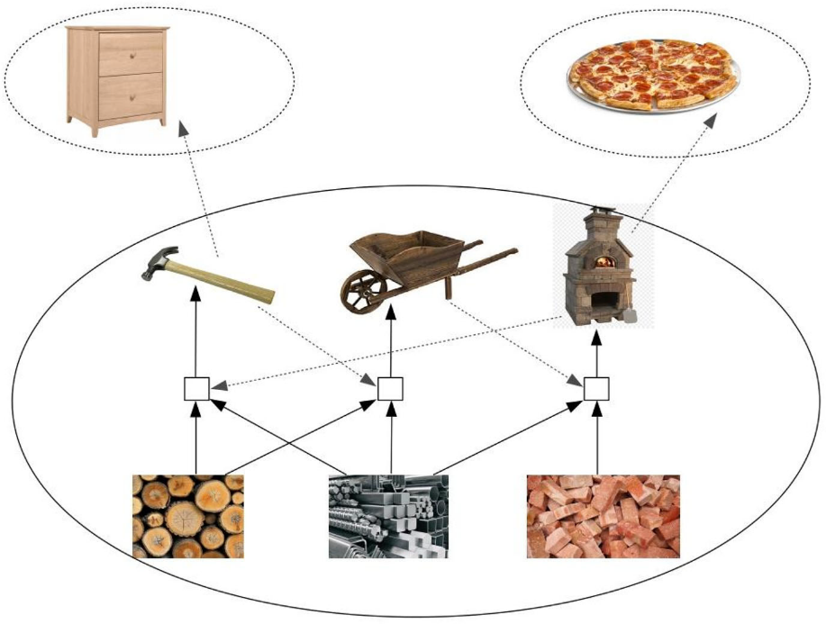

Slide 22
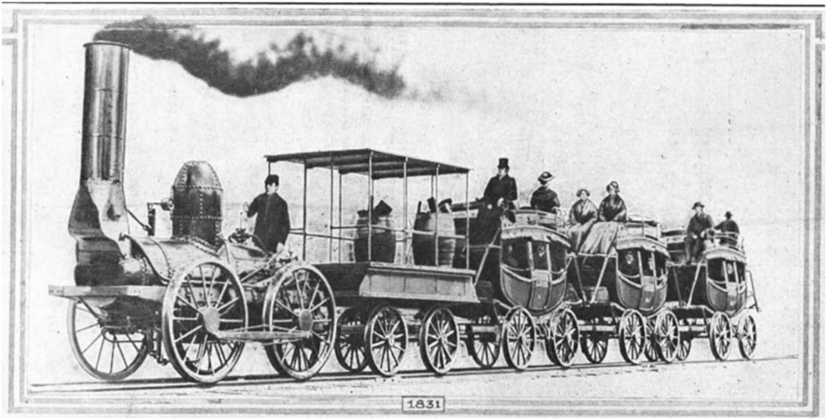
DeWitt Clinton Locomotive pulling coaches on the Mohawk-Hudson railroad

Slide 23

Everything operates as a web of interdependent co-developments
The fittest panther in the jungle is a goner if its habitat goes. And what is habitat? It’s an intricate, complicated web of interdependencies
The ensemble itself made the environment rich by expanding.

Slide 24
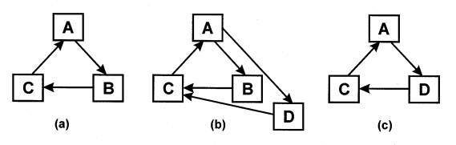
As the community assembly process forms a food web, it selects only species that fit into the existing web
Competition is occurring within a cooperative network

Slide 25
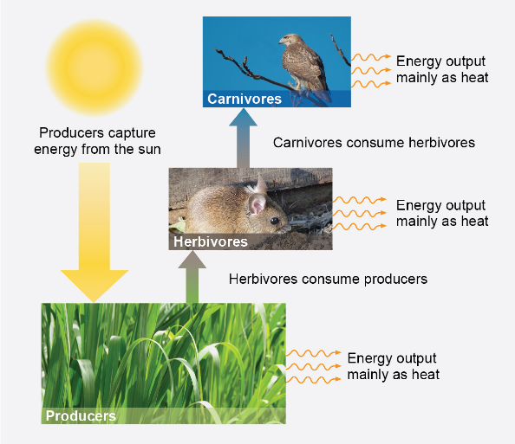
Open systems to energy flow
A self-sustaining system needs infusions of energy from outside itself.
The second half is energy discharge
So an ecosystem can be thought of as a conduit through which energy passes, with many or few transformations of energy/matter during its trip through the conduit. The interesting question is what happens in the conduit.

Slide 26


Organization matters
Desert – energy passage is swift and simple leaving little traces of its passage
In the forest, energy flow is anything but swift and simple, because of the diverse and roundabout way that the system’s web of teeming, interdependent organisms uses energy.

Slide 27
Thermal radiation from different biomes – the forest captures and utilizes more of the energy, with it creating complex and diverse structures.
Debeljak, 2004

Slide 28

One major barrier is the dominant idea in mainstream science now – to treat the fundamental working unit of Nature as a “mechanism” – we have turned the world into the machine we have pictured it to be.
The suite of systemic problems listed above – showing a world and natural life support ecosystems literally “running out of gas” and “breaking down” in myriad ways – is not typical behavior of natural living systems.

Slide 29
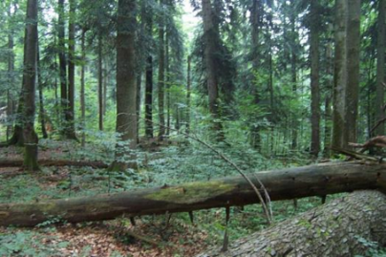
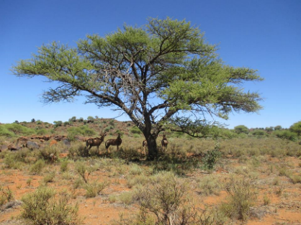
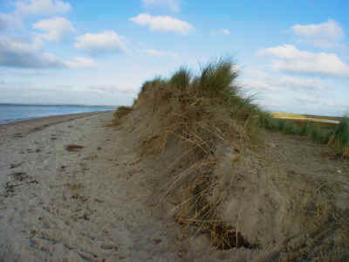
On the contrary, natural living systems normally self–organize continually and self–repair after disturbance. They grow, develop and improve in environmental quality over time (O₂ atmosphere, O₃ layer, soils, water purification, etc.)
These demonstrate the normal behavior of healthy Life systems is a win–win where life and environment both improve over time.

Slide 30
Life-environment interactions are self-organizing, self-regulating, and self-enhancing:
They make the overall conditions better for life as evidence in the greater complexity, diversity, and total energy utilization

Slide 31

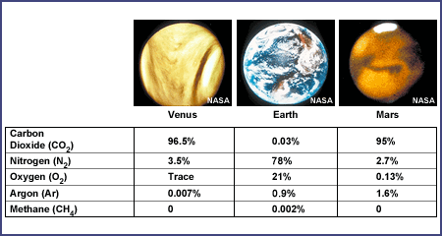
Ecosystem Homeostasis:
Evidence that led James Lovelock to Gaia Hypothesis

Slide 32
Comparison of systems: Natural, Agriculture, Urban
How big are the input-output flows?
Are the inputs renewable?
Are the outputs renewable (able to be used by others)?

Slide 33
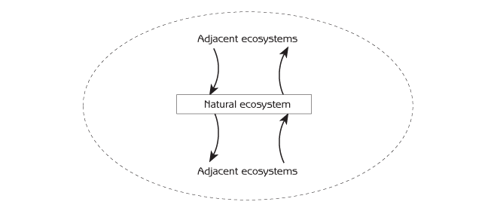
Natural ecosystems are self-organizing, self-sufficient, and self-sustaining
Inputs are renewable
Inputs are small since the evolved mechanisms for holding onto materials
Outputs have use by others in the ecosystem

Slide 34
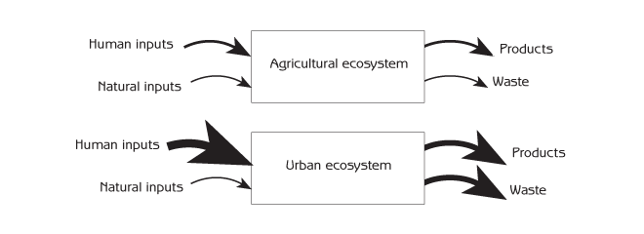
Agricultural and Urban are managed for specific purposes
Inputs are often largely nonrenewable
Inputs are large to meet the specific end
Outputs are large in terms of products and waste

Slide 35
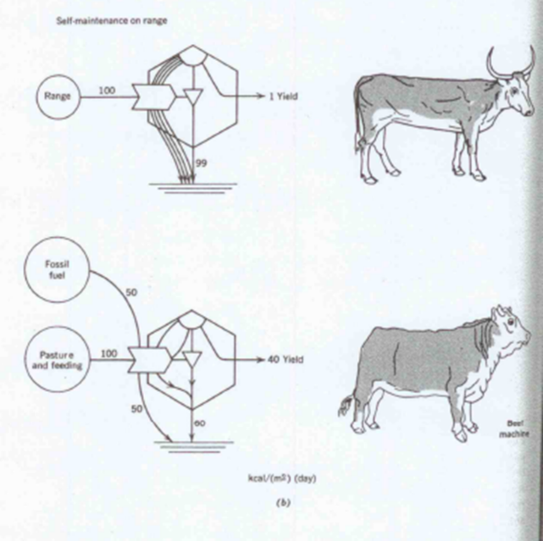
Environment, Power, and Society (1971)
HT Odum
Role of thermodynamics and energetics in human society

Slide 36
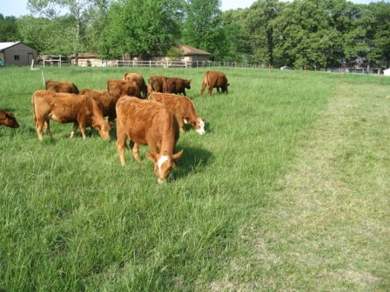
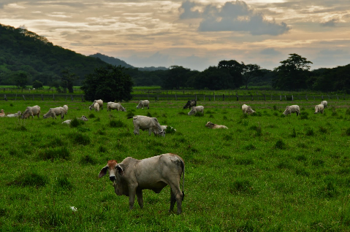
Ways of farming meat
Pastureland

Slide 37
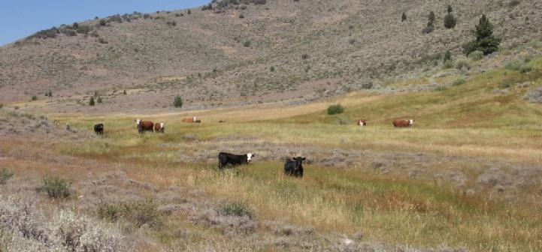
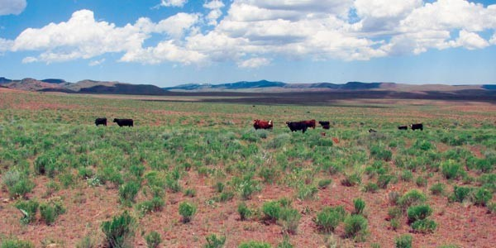
Ways of farming meat
Rangeland

Slide 38
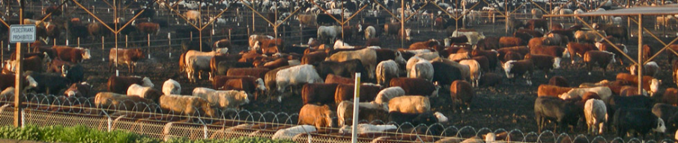
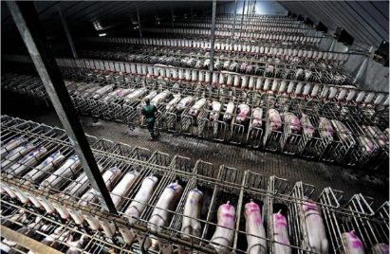
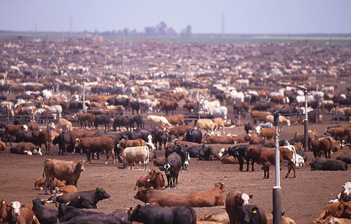
Ways of farming meat
Factory farming
Google maps/satellite
Dalhart, Texas

Slide 39
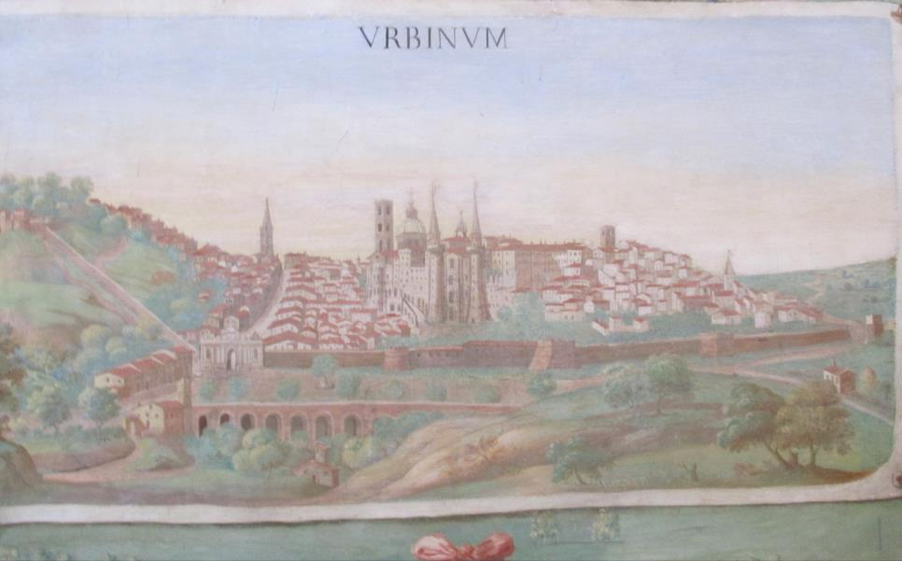
URBAN SYSTEM BOUNDARIES
Open system with connections and dependencies on the countryside

Slide 40
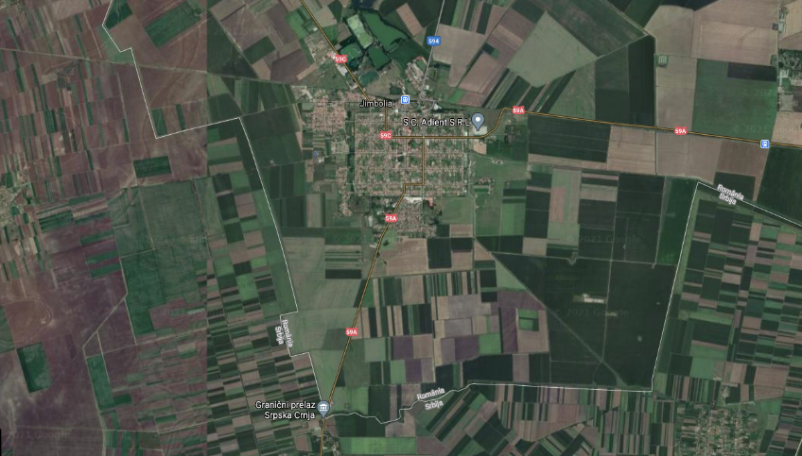

Slide 41

A. City as system
Inputs: air, water, food, fuels, raw materials, people
Outputs: waste heat, finished goods, ideas, wastewater, solid wastes, air pollutants
“Systems theory is, strictly speaking, not a theory of systems, but of system-environment distinctions.”

Slide 42
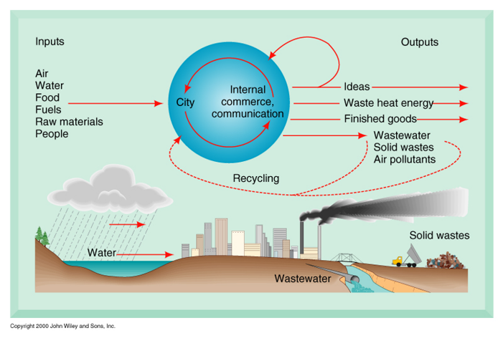
Urban System

Slide 43
Metabolic Network tracking of carbon flows in Vienna, Austria is used to analyze that the major emission sectors (Agriculture, Domestic, and Industry) are most impacted by indirect transfer through the Energy and Construction sectors. This indirect flow analysis allows one to make more effective reduction strategies.
Chen S, Chen B, & Fath BD. 2014. Environmental Pollution 190, 139-149
ITS – industry Dom – domestic Ene – energy production W&S – water and soil
Con – construction Agr – agriculture Loc – local environment Dis – distal environment

Slide 44
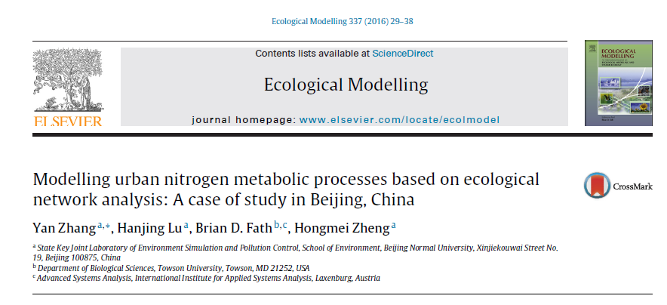

Quantitative analysis of urban metabolism: nutrients and water

Slide 45
Urban Metabolic Nitrogen model of Beijing
Trace direct, indirect, and integral flows
Network model of the nitrogen metabolic processes in Beijing’s urban ecosystem

Slide 46
Direct Nitrogen Flows

Slide 47
Indirect Nitrogen Flows

Slide 48
Importance of indirect flows
Metabolic Network tracking of nitrogen flows in Beijing is used to analyze that the major emission sectors were dominated by indirect flows (Animal Husbandry, Crop Cultivation, Sewage Treatment, Surface Water, Atmosphere, and Forest).

Slide 49
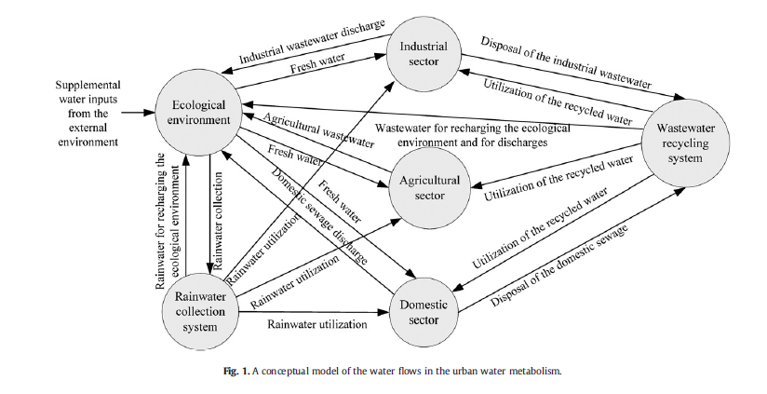
Water network model of Beijing
Zhang et al. 2011. Science of Tot. Env.

Slide 50
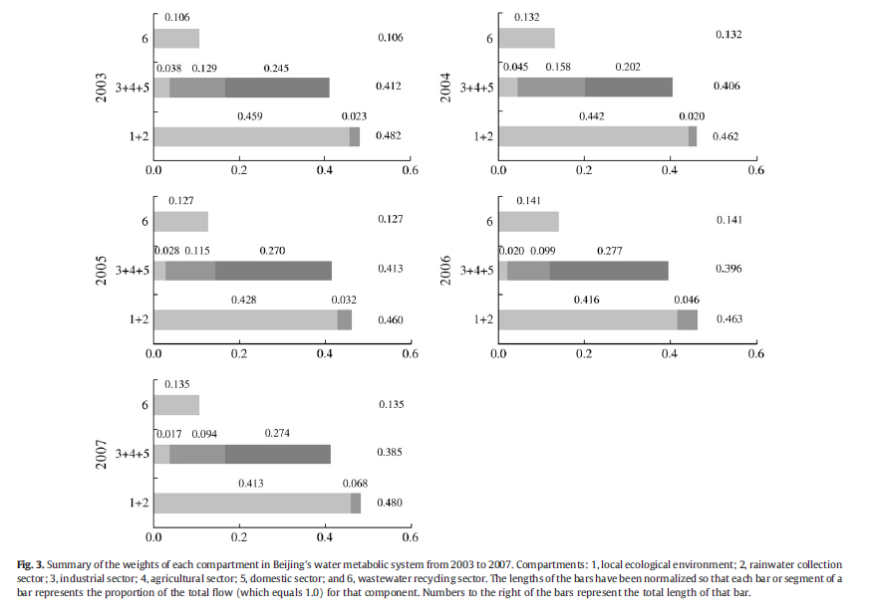
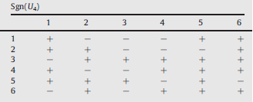
“Trophic” water structure of Beijing
Holistic interactions between sectors

Slide 51
Conclusions from urban metabolism
Cities, obviously, depend on exogenous energy resources
Urban energetic trophic structure mostly inverted
Additional energy recovery systems needed
Households and industry always in competition for final demand energy
Energy efficiency improvements can help but more importantly are how the energy networks are formed and maintained.

Slide 52
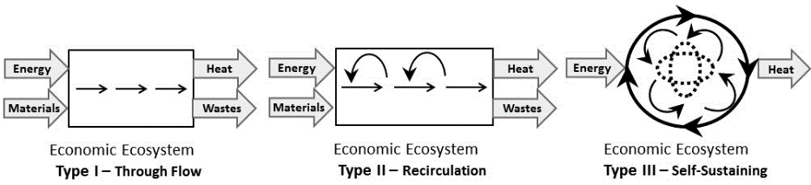
Key feature is forming and maintaining self-sustaining cycles

