Slide 1
International monetary regime
Vladan Hodulák
This powerpoint serves as a learning material for the students of the course International law and regimes (IREn4004) at FSS MU in Spring 2021. Using this presentation for other purposes without the consent of the author is prohibited.

Slide 2
Introduction
Definition – a set of international monetary and financial rules (both formal and informal) that govern interactions between actors and that create their expectations
Fundamental attributes of the regime
What are the rules for balance of payments adjustment?
Who and how provides liquidity in the system?
How is confidence in the system maintained? (legitimacy)
Who and how exercises governance in the system?
How are the rules adjusted?
What is the normative purpose of the regime?

Slide 3
Balance of payments adjustment
Sustainability of balance of payments deficits
Borrowing or reduction on savings/assets
Mechanisms for BoP adjustment
Change in relative prices (external devaluation × internal devaluation)
Administrative controls
Other
Transitional costs of adjustment
The cost of the change itself – economic crisis, inflationary pressures, redistribution, political instability
Continuing costs of adjustment
Costs prevailing after all change has occurred – lower absorption (relative × absolute)

Slide 4
International monetary power
Monetary autonomy × monetary statecraft
Power to deflect
Derives from fundamental economic variables – mainly the degree of openness and the degree of adaptability of the economy (ability to quickly and easily realocate factors of production, availability of resources etc.)
Power to delay
Derives from financial variables that determine each country’s international liquidity position – total amount of reserves, availability of credit, international standing of domestic currency
Surplus × deficit countries
Active and passive mode of monetary power

Slide 5
Development stages of international regimes
Inspired by Kuhn’s life cycle of paradigms
Period of perceived stability
The regime is considered legitimate, the rules reflect the prevailing balance of power, economic reality meets the normative expectations, distributional consequences are not challenged
Period of stresses and transformations
Increasing political contestation of the rules and distributional consequences, distribution of power changes, there are more frequent and serious anomalies, these are explained away and addressed by ad hoc solutions, entrenchment of ideological positions
Crisis stage
The consensus around prevailing policies and interests falls apart, various actors search for viable alternatives, there is an ideological and power related struggle regarding the new rules of the game

Slide 6
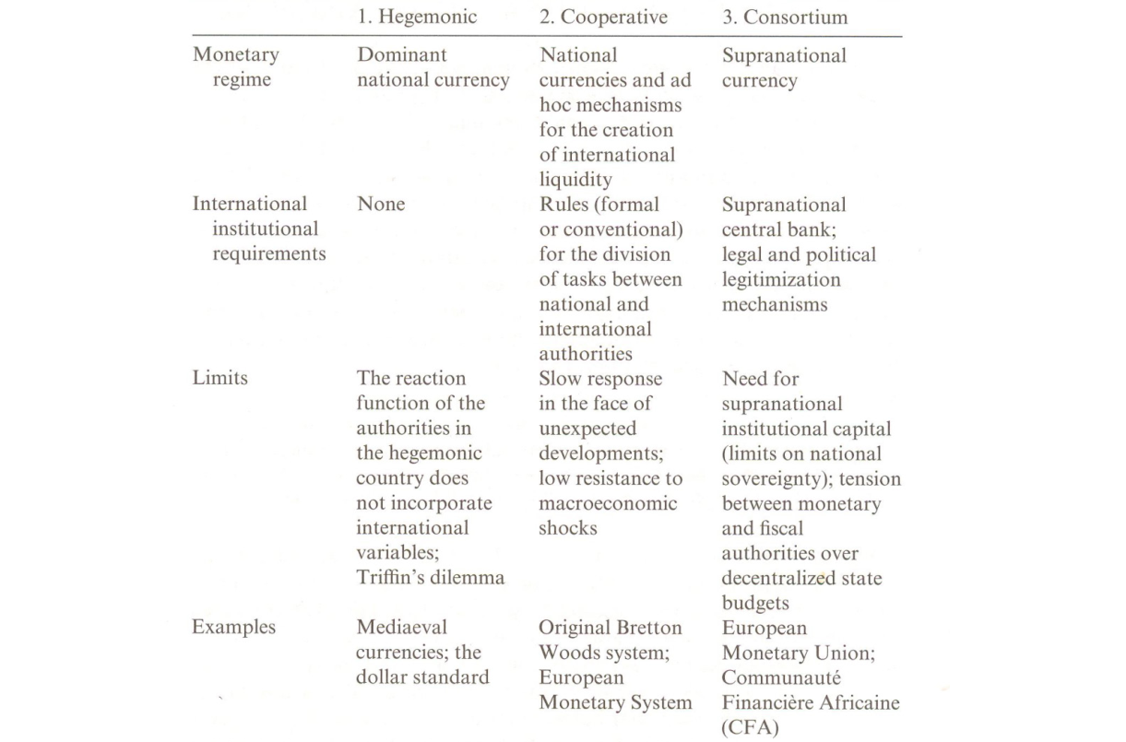
Typology

Slide 7
Gold standard
Inception and development of the regime
1821/1873-1914/1931
The fundamental attributes of the regime
Adjustment – the price-specie flow mechanism (theory), interest rate adjustment, domestic economic policies
Liquidity – limited by the available gold, de facto provided by the Bank of England
Confidence – idea of gold being real money, power of the British Empire
Management – informal cooperation among central banks
Rule change – no rule adjustment mechanism/unilateral decisions of nation states
Normative purpose– laissez-faire, economic liberalism, free trade
Collapse of the regime

Slide 8
The Bretton Woods regime
Inception and development of the regime
1945/1959-1971/1976
The fundamental attributes of the regime
Adjustment – fixed but adjustable exchange rates, short term relief by the IMF, capital controls
Liquidity – gold, IMF credit, de facto USD
Confidence – gold as real money, US hegemony, multilateral cooperation (IMF WB)
Management – multilateral via IMF, Articles of agreement, but mostly US dominance
Rule change – multilateral conference coordinated by the IMF, US unilateralism
Normative purpose – domestic economic autonomy, full employment, stable system to promote international trade
Collapse of the regime

Slide 9
The post Bretton Woods system
Inception and development of the regime
1974/1979-2008/?
The fundamental attributes of the regime
Adjustment – deficit countries adjust by external or internal devaluation, debts have to be paid in full, de facto partial debt relief
Liquidity – IMF credit, in systemic crises FED
Confidence – US hegemony, network dependence on USD, no viable alternative
Management – IMF (Articles of agreement), G7, G20, BIS, eurozone, US unilateralism
Rule change – G7/20 meetings, BIS rules – Basel I-III, EU summits, US unilateralism
Normative purpose – price stability, protection of creditors interests (investment)
Collapse of the regime?

Slide 10
The current regime and future prospects
Great financial crisis
Rising Chinese economic powe
The fundamental attributes of the regime
Adjustment – mounting pressure on surplus countries?
Liquidity – enhance the role of SDR, regional hegemony of USD and RNB?
Confidence – multilateral agreement or regional hegemony?
Management – multilateralism, od regional spheres of influence?
Rule change - ?
Normative purpose - ?

