Slide 1
International Security Regimes
Mgr. Zinaida Bechná, Ph.D.
IREn4004 International Law and Regimes
30.3.2021

Slide 2
Structure
Definition
Examples of international security regimes
International nuclear non-proliferation regime
International regime banning chemical weapons
Conventional Armed Forces Control Regime in Europe
Conclusion
List of literature

Slide 3
International Regimes: definition
The study of International Regimes has been formed since the 1970s:
connected with the theory of interdependence, state-centric framework, the importance of international institutions.
Classical definition (Stephen Krasner): “implicit or explicit principles, norms, rules and decision-making procedures around which actor expectations converge in a given issue-area.”
Koehane and Nye: “network of rules, norms and procedures that regularize behaviour and control its effects.”
Haas and Bull refer to “general imperative principles which require or authorize prescribed classes of persons or groups to behave in prescribed ways”.

Slide 4
International regime: definition
Regimes are more than temporary “one-shot” arrangements. Regimes facilitate agreements.
The principles of the IR are based on facts, causes and justice. Norms are considered to be rights and obligations that define the standard behaviour of members. The rules are orders and prohibitions in negotiations. The decision-making process is based on authoritative measures.
Neoliberals: multilateral institutions are important for security, especially nuclear security. International system and peace are not dependent on balance of power, but on international law and institutions.
Beyond this state-centred and transnational framework we can trace the “third wave” of analytical framework: radical constructivist/post structuralist theorization of regimes. Move from neorealism and hegemonic stability theory to neoliberal institutionalism regime theory and than to cognitivism pressing the role of ideas and norms.
In the 90s, cognitivist and knowledge based theories of regimes: the shift from state-centrism to neo-functional, neo-institutional and knowledge oriented research.
It is capable to grasp regime complexes (including actors, networks, artifacts: material and ideational).

Slide 5
International regime: definition
The existence of the regime is often linked to the existence of a multilateral agreement as e.g. General Agreement on Tariffs and Trade (GATT), Treaty on the Non-Proliferation of Nuclear Weapons
However, other international institutions may be part of the regime, as for example international organizations.
At the same time, the regime can operate on an informal basis.
Examples:
security regimes - arms control regimes
economic regimes - GATT, free trade zones
environmental regimes - protection of the ozone layer.

Slide 6
Examples of internation security regimes
Collective security
Security community
Zones without nuclear weapons
Regime eliminating landmines
Biological weapons ban regime
Missile Technology Control Regime (MTCR) - 1987
Non-proliferation regime
Regime banning chemical weapons
Regime on regulation of conventional armed forces in Europe

Slide 7
Arms control
Arms control - an important topic of security policy in Western European countries. During the Cold War - along with the concept of containment and deterrence, one of the tools used to ensure the security of the West.
During the Cold War, research into arms control was developing. In practice, emphasis was placed on ensuring control and reduction of WMD.
Less attention has been paid to the issue of conventional weapons.
The goal of arms control was to ensure security and strategic stability at the lowest possible level of arms potential.
Last but not least, arms control strengthens arms transparency and trust between states.
Reduction of arms:
1. Saves funds and allows them to be reallocated elsewhere; and
2. Can reduce the horrors of war by eliminating overly injuring weapons systems.
In general, there is more failure than success stories in arms control regulations. Do not overestimate the importance of arms control.
Raymond Aron: "Weapons pose a permanent risk, not a permanent war. It's people, not weapons, who start wars. "

Slide 8
International non-proliferation regime
The main goal is to prevent the proliferation of nuclear weapons:
So that those states that do not have nuclear weapons do not acquire it.
Nowadays, fears of states such as Iran and the DPRK - instability in the region, fears of a spiralling armament.
So that nuclear technology and weapons do not fall into the hands of terrorist groups.
The regime consists of several interrelated international agreements.
It also includes an international organization (IAEA).
And various informal commitments of states.

Slide 9
The nature of the regime
The fundamental basis is the Treaty on the Non-Proliferation of Nuclear Weapons 1968 (in force 1970).
It also consists of other contracts:
1963 Treaty on the partial prohibition of nuclear tests (space, atmosphere, underwater, but allows underground testing);
1971 Treaty banning the deployment of nuclear weapons and other WMD on the seabed;
Agreements that established nuclear-free zones (Latin America, Antarctica, Africa, Southeast Asia, Central Asia, Mongolia, southern Pacific);
Nuclear exporters and suppliers control conventions (eg Zangger Committee or Nuclear Suppliers Group).

Slide 10
The origins of the regime
International situation after World War II:
The USA acquired an atomic weapon in 1945, in 1949 it was acquired by the USSR and in the early 1950s by Great Britain.
In 1953, US President Eisenhower proposed the establishment of the International Atomic Energy Agency at the United Nations.
Support the development of civilian nuclear programs, prevent the misuse of nuclear energy for war purposes.
The IAEA was founded in 1957 and began operating in 1958.

Slide 11
Attitudes of the USA and the USSR
Negotiations between the US and the USSR on nuclear disarmament in order to stop arms races.
The result was the creation of the first nuclear-free zone in Antarctica in 1959.
Another result was Agreement on the Prohibition of Testing of Nuclear Weapons in the Atmosphere, Outer Space and Underwater (= Comprehensive Nuclear-Test-Ban Treaty, PTBT) in 1963.
Failure to reach an agreement on a general ban on nuclear tests.

Slide 12
NPT Treaty
Negotiations on the Treaty on the Non-Proliferation of Nuclear Weapons took place in 1965-1968 under the auspices of the United Nations.
Impulses: France conducted nuclear tests in 1960, China in 1964.
The aim was to prevent an increase in the number of countries that own a nuclear weapon. Furthermore, it aimed to address the issues of testing, production and deployment of weapons by nuclear states on the territory of other states. Provide guarantees to non-nuclear-weapon states.
The treaty was concluded in 1968 (NPT) and entered into force in 1970.
It was signed and ratified by the former Czechoslovakia.
Signed and ratified by 189 states, all permanent members of the Security Council.
The agreement was not signed by India, Pakistan and Israel. At the same time, all these states acquired a nuclear weapon.
In 2003, North Korea withdrew from the treaty.

Slide 13
NPT Treaty
The major goal of the treaty is to prevent the proliferation of nuclear weapons:
Nuclear states may not transfer nuclear weapons or other nuclear explosive devices to other states;
Non-nuclear states have committed not to produce or otherwise acquire nuclear weapons;
Fissile materials must not be exported to non-nuclear states - any transfers must take place under IAEA supervision;
It is possible to develop nuclear programs for peaceful purposes.
Criticism:
Preservation of the power status quo. The world is divided into states that own a nuclear weapon and those that do not. Nuclear powers are not forced to disarmament.

Slide 14
IAEA function
The International Atomic Energy Agency is an independent organization within the UN system, intergovernmental forum promoting a peaceful uses of nuclear energy and non-proliferation of nuclear weapons.
IAEA has a critical role in the global nuclear governance system. Main goals include:
1. nuclear safety: safeguarding and control of facilities, reaction to emergency situations;
2. nuclear security: physical protection of nuclear materials and activities;
3. nuclear safeguard and verification: controls, internationalization of the fuel cycle;
4. promotion of peaceful use of nuclear energy: technical and scientific cooperation.
Nuclear power dual use: for production of medical isotopes, electricity and fissile materials for nuclear weapons (enriched uranium and plutonium).
Limits:
India, Pakistan, Israel, North Korea and South Sudan are not its part.
Ineffectiveness in detecting illegal activities of the treaty Parties, inconsistent policy of the NSG states and the risk of militarization of nuclear installations.
IAEA ineffective to detect two decades Iran’s illegal activities and illegal installations in Iraq.

Slide 15
IAEA function
Countries strongly defend their nuclear autonomy- therefore IAEA’s authority has always been difficult.
Deep reforms needed in order to overcome the risks of dissemination of civilian nuclear technology:
- expand verification activities by implementing “unplanned” inspection and strengthening non-proliferation verification system;
- modification of strategic planning, inconsistent quality control across departments, better personal policies and modern management tools;
- multinationalisation of nuclear fuel cycle through establishment of “nuclear fuel bank” (world’s first bank of low-enriched uranium in Oskemen, Kazakhstan).

Slide 16
Other agreements
Comprehensive Test-Ban Treaty (CTBT)
Signed in 1996 by 182 states, ratified by 157, although the treaty did not enter into force.
A need of ratification by states listed in Annex 2 to Article 14 of the Treaty.
These countries are: India, North Korea, Pakistan (not signed) and China, Egypt, Iran, Israel and the USA (not ratified).
Absolute ban on nuclear weapons testing.
Upon entry into force, it will replace the Comprehensive Nuclear-Test-Ban Treaty (PT63).

Slide 17
Chemical weapons and their regulation
1675 - Strasbourg Agreement (Franco-German agreement prohibiting any use of poisons);
1868 - St. Petersburg (non-use of weapons causing unnecessary suffering);
1874 - Brussels Convention (the use of poisonous and annoying weapons and the use of weapons, projectiles and substances that would cause unnecessary suffering is prohibited);
1899/1907 - Hague Peace Conference (on the laws and customs of war, ban on suffocating gases);
The use of chemical weapons initially had devastating effects in World War I, when there was no protection against this completely new way of fighting.
1925 - Geneva Protocol (condemned the use of suffocating, annoying or similar gases and bacteriological materials in war);
1972 - Biological and Toxin Weapons Convention;
In the 1980s, there were several cases of the use of chemical weapons against civilians in densely populated areas and cities. Iraq - Iran - 80s.

Slide 18
IR banning chemical weapons
Progress after the end of the Cold War - the foundations laid earlier - the emergence of an international security regime banning chemical weapons.
In 1979, the United Nations established the Disarmament Conference, which operated in Geneva as the only global negotiating forum of the international community dealing with disarmament agreements in the field of chemical weapons.
In 1992, the Conference established a Convention on the Prohibition of the development, production, stockpiling and use of Chemical Weapons and on their destruction (Chemical Weapons Convention, CWC), which was opened for signature in Paris on 13 January 1993 and entered into force on 29. April 1997.
1997 - The International Organization for the Prohibition of Chemical Weapons (OPCW), based in the Hague, the Netherlands, was established.
The aim of the organization is to ensure compliance with the convention. The convention has been adopted by the vast majority of countries in the world, which gives hope that humanity wants and will most likely be able to get rid of this category of weapons of mass destruction.

Slide 19
OPCW
The Organization for the Prohibition of Chemical Weapons (OPCW) is an international organization based in the Hague, the Netherlands.
https://www.opcw.org
Established 1997 to ensure compliance with the Convention on the Prohibition of the Development, Production, Stockpiling and Use of Chemical Weapons and on their Destruction (CWC).
https://www.sujb.cz/fileadmin/sujb/docs/zakaz-zbrani/Umluva_CW.pdf
The Convention is the first comprehensive mechanism aimed to destruct a whole category of weapons of mass destruction, while setting out measures to monitor compliance with this obligation.
Objective: to completely eliminate the possibility of using chemical weapons.
The OPCW is an independent international organization, but works closely with the United Nations, cooperation agreement in 2001. Budget about 80 million euros, about 500 employees, 192 member states.
The convention was not signed by: Angola, Egypt, and Somalia. Signed and not ratified: Israel and Burma. Syria has been a member since 2013 following pressure and threats from the West.

Slide 20
OPCW
Tasks of the OPCW:
1. chemical disarmament - liquidation of existing stockpiles of chemical weapons,
2. control of the non-proliferation of chemical weapons through the submission of declarations and notifications by individual states and the subsequent verification of declared data by international inspection teams,
3. assistance to states and protection against the possible use of chemical weapons,
4. international cooperation of the contracting states in the field of peaceful uses of the chemical sector.
The Czech Republic is one of the founding members of the OPCW. It signed the Convention at the conference of states parties in Paris, held on 13 January 1993 and ratified it on 6 March 1996. The Czech Republic has been actively participating in the activities of the OPCW from the very beginning.
The Czech Republic has long been involved, among other things, in improving the capacity of the OPCW technical secretariat and contracting states in the field of protection and assistance against chemical weapons and in strengthening regional cooperation between national authorities responsible for implementation of the Convention.
The national authority responsible for the implementation of the Convention in the Czech Republic is the State Office for Nuclear Safety.
In 2003, for the first time, the Czech Republic provided a financial contribution of 2 million CZK for the destruction of chemical weapons in the Russian Federation (through cooperation with the United Kingdom) and thus joined other donor countries assisting the Russian Federation in the destruction of its chemical weapons.

Slide 21
Results of the Convention
At the time of signing the agreement, over 72,000 tons of chemical weapons had been declared. According to the OPWC,98,5% of the declared amount of these weapons was destroyed by now.
From the entry into force of the Convention, from April 1997 until 28 February 2018, the OPCW carried out 4,884 inspections on the territory of 81 Contracting States, including 2,226 inspections of chemical weapons sites.
2016 - 305 inspections - each year the organization provides a detailed report on activities.
Of the 227 declared sites, the inspectorate visited 195 sites.
100% of the declared chemical stockpiles of weapons were inventoried and verified and 100% of the declared chemical production facilities for chemical weapons were inactivated.
All facilities are in a mode of strict unprecedented verification, with 62 of the 70 such facilities being either destroyed by the OPCW (43) or transferred for peaceful purposes (19).
A total of 13 member states have notified such facilities - Bosnia and Herzegovina, China, France, India, Iran, Japan, Libya, Russia, Serbia, the United Kingdom, Northern Ireland, the United States.

Slide 22
Russia and USA
At the time of signing the treaty, the US owned 31,500 tons of chemical weapons - they destroyed over 90%. The US began liquidation in the 80s on its own initiative, binding since 1993 - completed in 2023.
After acceding to the international convention, Russia began liquidating its chemical arsenal in 1996, allowing it to become a member of the Organization for the Prohibition of Chemical Weapons (OPWC) a year later. Russia in OPWC since 1997.
Russia - 44,000 tons - destroyed about 60% - still 2015 lags behind the plan - according to the OPWC.
According to Russia, between 2002 and 2015, 92 percent of the planned amount for the stage was liquidated.
2017 - Russia reports completion of liquidation.
Initially, the program was financially supported by the United States and Canada, and later by the Russian government. Moscow stated that a total of 316 billion rubles (120 billion crowns) was spent.

Slide 23
Conventional arms control regime in Europe
Components:
The Treaty on Conventional Armed Forces in Europe (CFE) is considered a key element of European security.
It entered into force on 9 November 1992. It currently has 30 contracting parties. Russia left it in 2015.
The Open Skies Agreement, through its verification and inspection mechanism, and the Vienna Confidence-Building Document. The Open Skies Agreement was signed in 1992 and entered into force on 1 January 2002.
Vienna Document 2011 (VD-11) - serves to build confidence and transparency among OSCE participating States.
VD-11 contains politically binding measures aimed to ensure greater openness and transparency of military activities in the OSCE region. These include, in particular, the exchange of information, inspections, verification visits (including measures to dispel concerns in connection with unusual military activities), demonstrations of military equipment and facilities, and other military contacts in accordance with the provisions of VD-11.
Code of Conduct on Politico-Military Aspects of Security – 1994.
A set of principles and standards to be applied by OSCE participating states to ensure democratic control of the armed and security forces, the protection of the human rights of members of the armed forces and respect for international humanitarian law.

Slide 24
Conventional armaments and disarmament – Gorbachev
1985 - Gorbachev's came to power to the USSR - gradual change in Soviet foreign policy. Withdrawal from hard principles of the USSR was also accelerated by the Helsinki process.
The key follow-up meeting of the “Conference on Security and Co-operation in Europe", held in Vienna between 1986 and 1989.
Agreement on further negotiations on the reduction of conventional forces in Europe.
Progress in the negotiations on conventional forces in Europe has been made since the beginning of reforms in the socialist states in both domestic and foreign policy.
Gorbachev needed an understanding of the West in order to obtain the means to reform socialism - reducing the militarization of the country.
Mikhail Gorbachev's proposal in April 1986 for a substantial reduction of conventional forces from the Atlantic to the Urals, including the adoption of verification and control procedures.
The USSR has admitted the possibility of conducting bilateral inspections - a revolutionary turn around!

Slide 25
Soviet initiatives
In the past, the Soviets have consistently rejected functional principles of verification.
1986 WP (USSR) proposals for the reduction of both blocs from the Atlantic to the Urals. NATO proposal to create a new platform instead of the MBFR (Mutually Balanced Force Reductions).
In December 1988 - an unprecedented step by the USSR, which testified economic problems - caused, among other things, by the excessive militarization of Soviet society - rather than by the peaceful intentions of the Soviet Union.
Unilateral reduction of the Soviet army by 500,000 troops and withdrawal of 50,000 troops, 10,000 tanks, 8,500 artillery systems and 800 aircraft from the territory of the Czechoslovak Socialist Republic, the GDR and Hungary.
It had to foster mutual trust, even in the absence of verification mechanisms.
Western public opinion was suddenly on the Soviet side, and the USSR was very often disguised as a model of a peaceful state, although it continued to maintain quantitative conventional military superiority.
But the West believes (rightly) that the USSR is now taking its disarmament initiatives seriously.

Slide 26
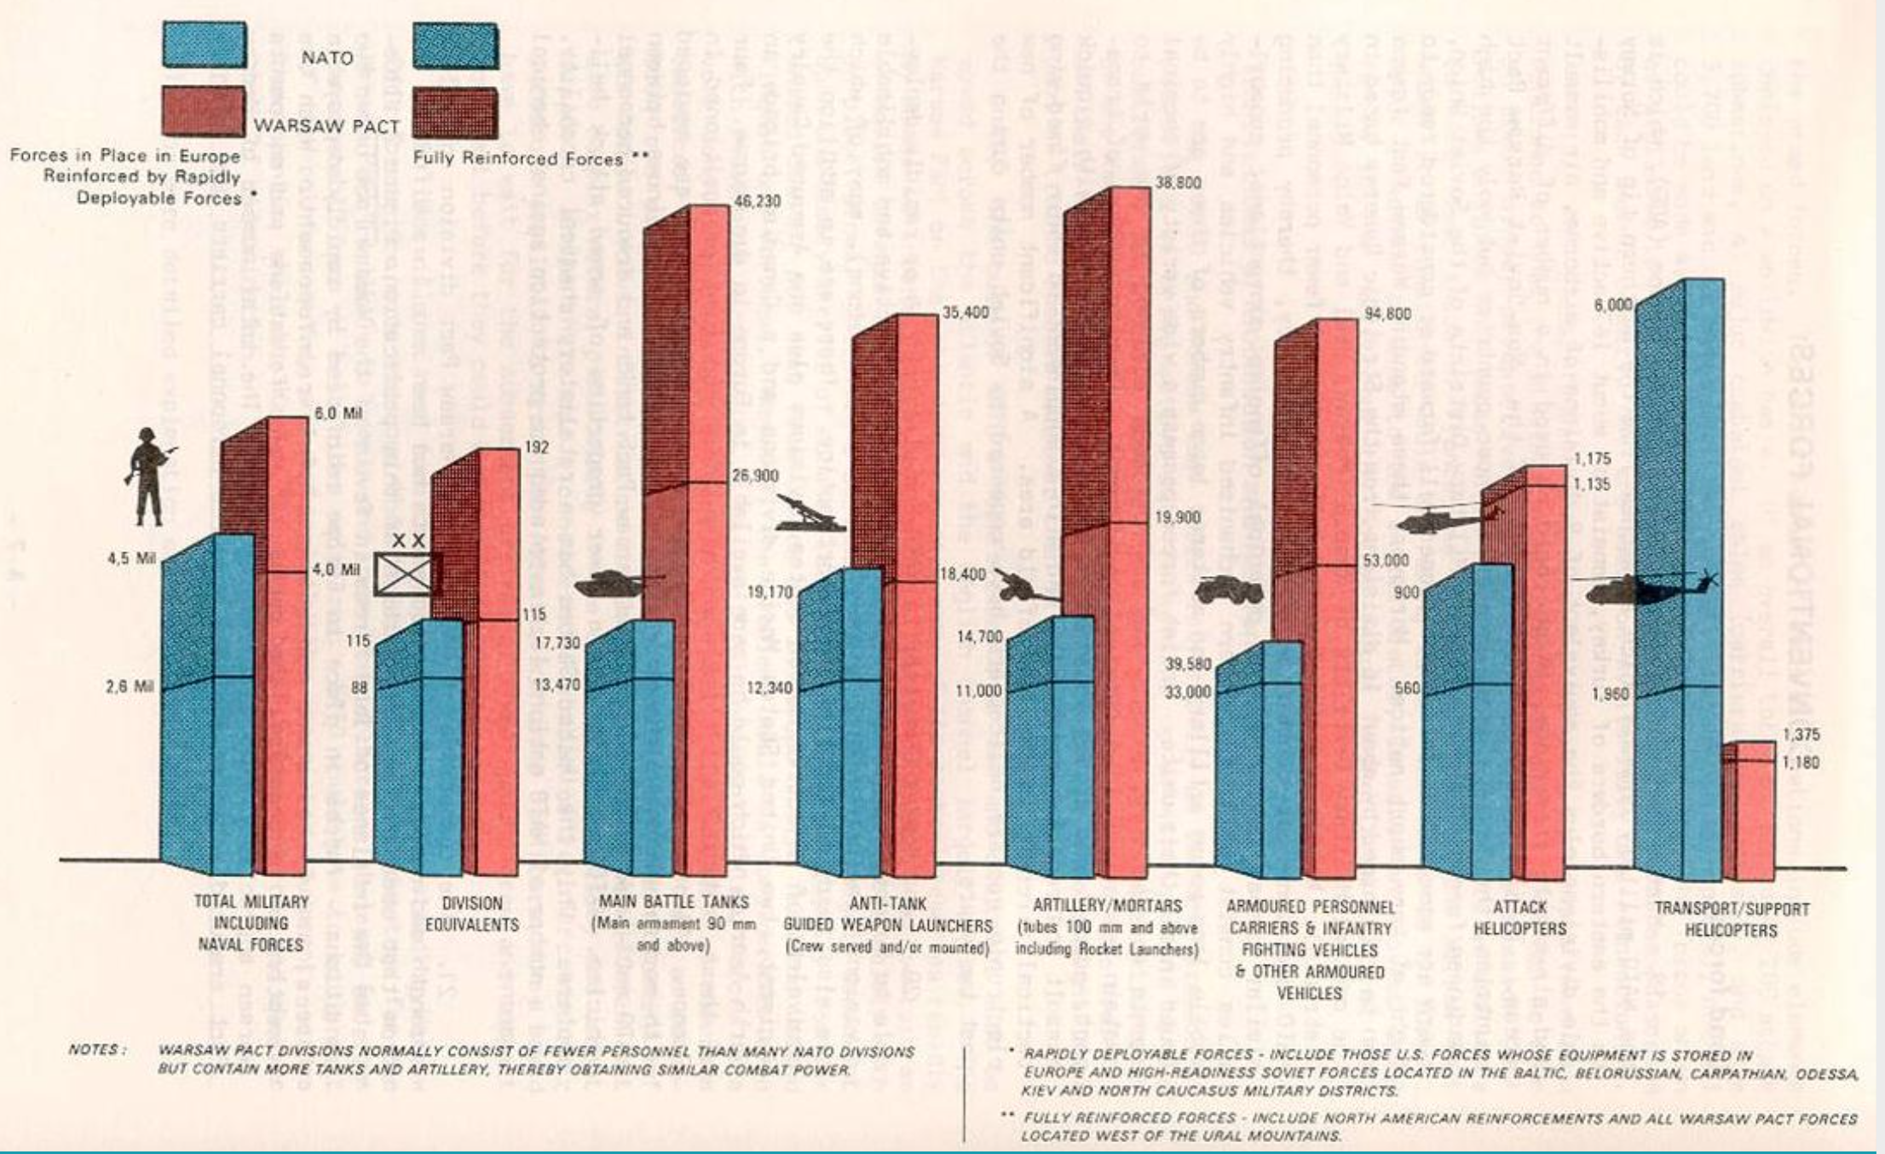
NATO-Warsaw pact force comparison

Slide 27
Principles of the CFE
Negotiations on the reduction of conventional forces in Europe, held in Vienna since March 1989, were based on the recognition of the bloc principle - France's proposal to negotiate within groups of states - the principle of blocs.
Few expected such a rapid internal collapse of the socialist states and the subsequent collapse of the Warsaw Pact.
The purpose of regulating weapons arsenals was to reduce the potential of conventional weapons to a level that would make it impossible to strike a sudden first strike and conduct active offensive operations by one side or another.
Revolutionary change of thinking of the USSR - the principle of parity between blocks adopted!
For the purposes of the treaty, conventional combat techniques were considered, located in the area from the Atlantic to the Urals, divided into five categories:
Tanks, armored combat vehicles (infantry fighting vehicles and armored personnel carriers), artillery systems over 100 mm, combat aircraft and attack helicopters.
The Warsaw Pact accepted the proposals of the North Atlantic Alliance, which enforced limits of 20,000 tanks, 28,000 armoured combat vehicles (infantry fighting vehicles - BVP and armored personnel carriers), 16,500 artillery systems for each unit.
Setting a maximum, about 30% limit for one country in each category of conventional weapons and setting limits for the deployment of forces outside the national territory.

Slide 28
Principles of the CFE II
Last but not least, ways of effective information exchange and verification have been agreed.
The text of the Treaty on Conventional Armed Forces in Europe was signed on 19 November 1990 in Paris.
Signatories from the North Atlantic Alliance (United States, United Kingdom, Canada, Iceland, Norway, Denmark, Germany, France, Belgium, the Netherlands, Luxembourg, Portugal, Spain, Italy, Turkey and Greece) and the Warsaw Pact (Soviet Union, Poland, Czechoslovakia, Hungary, Romania and Bulgaria). Due to the unification of Germany, the GDR could no longer sign the treaty.
For each group of states, the treaty set the maximum numbers of the five types of heavy combat equipment mentioned above, with one state not being able to own more than one third of the total quota allocated to all signatories.
The agreement also set maximum numbers of the above categories of contract-limited armaments, with the exception of combat aircraft and attack helicopters in three regions from the Atlantic to the Ural Mountains, including the so-called "wing regime".
The wing regime applies to Bulgaria, Greece, Iceland, Norway, Romania, Turkey and the northern and southern military districts of the former Soviet Union (Russia and the successor states at present). Within its framework, the contracting parties set maximum limits for individual groups of states in this territory deployed appropriate conventional combat equipment (4,700 tanks, 5,900 combat armored vehicles and 6,000 artillery systems).

Slide 29
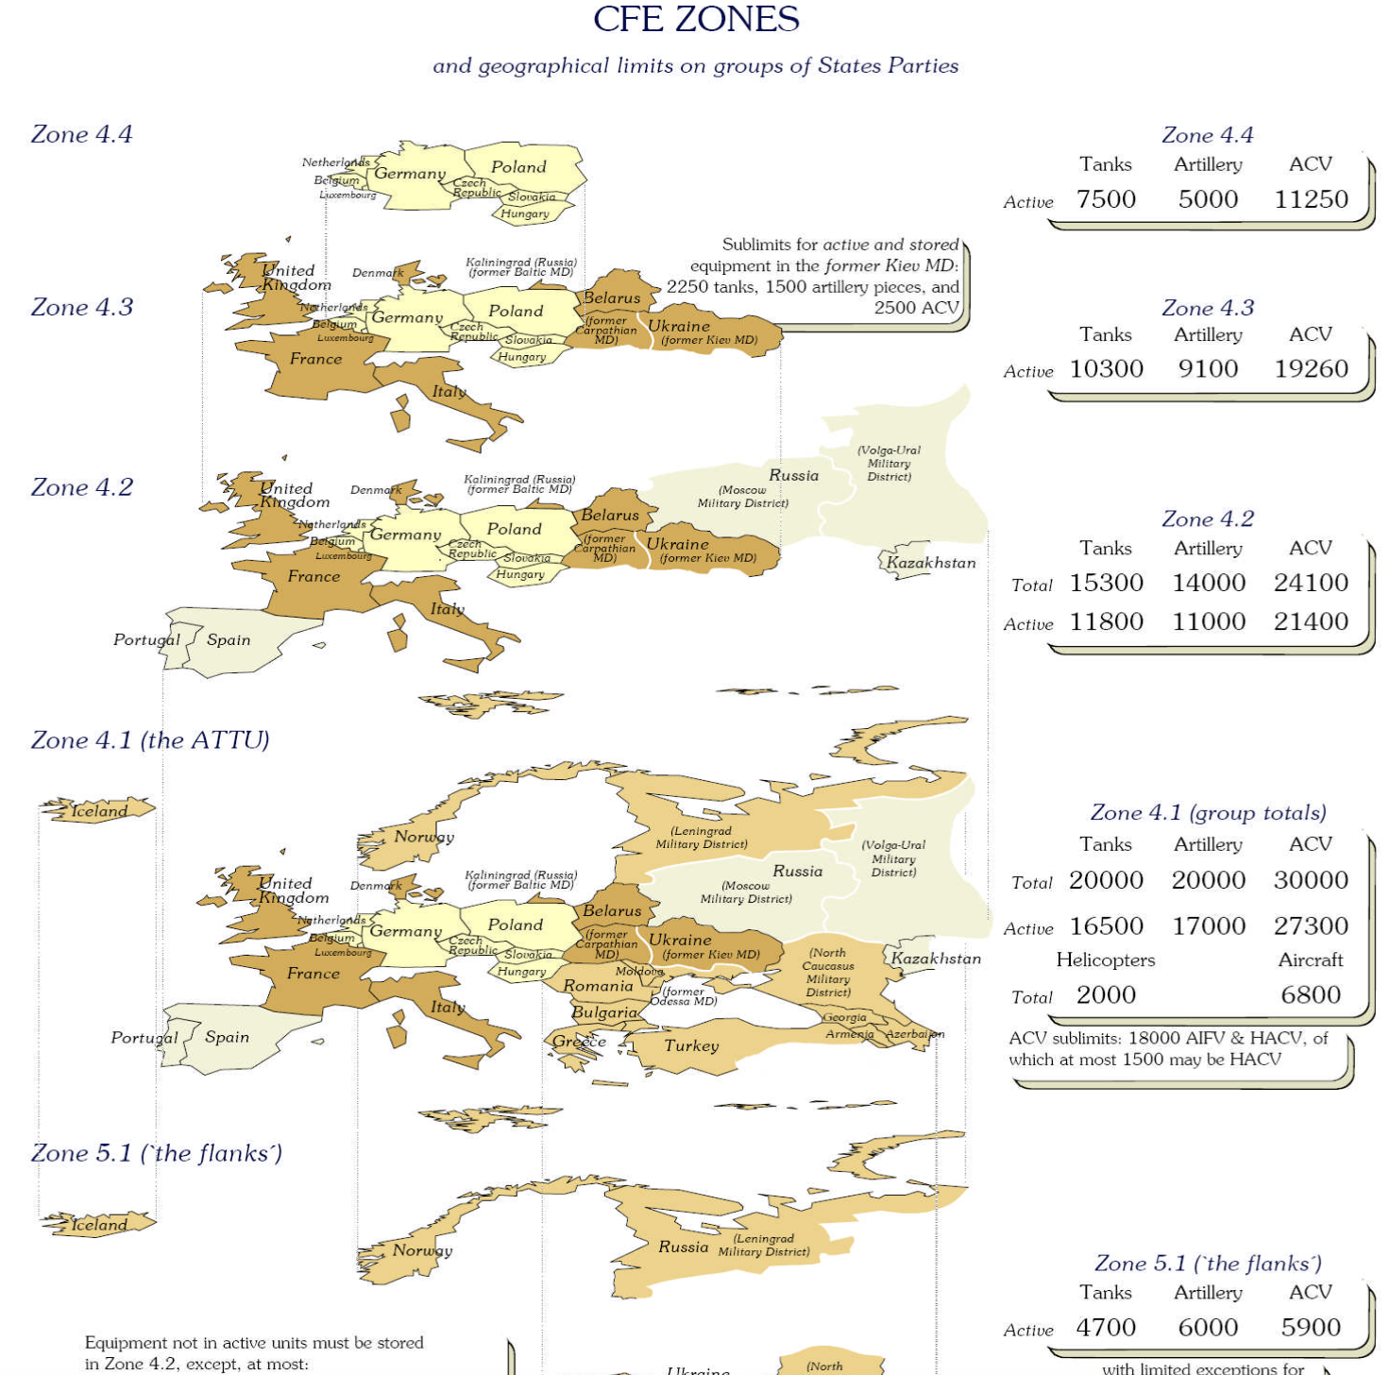

Slide 30
Limits of the treaty
However, the above mentioned maximum limits did not include all contract-limited combat equipment - room for violation.
1. The limits didn’t apply on equipments located in units used to ensure the internal security of the state. In particular, the Soviet Union had (and today's Russian Federation still has) powerful and heavy equipment armed units to ensure internal security.
2. Furthermore, equipment in a production testing process, equipment used for development and research, equipment belonging to historical collections, equipment which is ready for decommissioning and equipment temporarily located in the application zone which is prepared for export were not included into the treaty.
These provisions provided ample room for manoeuvrer.

Slide 31
Limits of the treaty
Between 1990 and 1991, the Soviet Union moved 57,300 pieces of contract-limited conventional armaments, which where originally deployed within the scope of the treaty further east, outside the territory of the treaty.
It removed three motorized rifle divisions from the land forces and included it into the navy structures, which were not affected by the negotiations on the reduction of the conventional armed forces.
The original treaty did not cover the numbers of manpower of the signatory states.
Following the July CSCE meeting in Helsinki in 1992, the agreement was supplemented by the "Final Act on Negotiations on Personnel Strength of Conventional Armed forces in Europe” CFE-1A = reduction in the manpower levels within the CFE area of application.
Following the ratification procedures, the Treaty entered into force on 19 November 1992, with a certain delay compared to the originally intended schedule.

Slide 32
Verification
Detailed regime for information exchange, inspections and verification.
Each signatory state is obliged to inform other signatories about the numbers and deployment of its own army in details.
The other signatories are informed - by means of "exchange information" process - by 15 December of the calendar year with effect from the beginning of the following year.
It includes the current organizational structure of the ground and air forces, the total number of heavy combat equipment regulated by the treaty, information on its deployment, etc.
The system of notifications and inspections allows for effective on-site inspection activities and effective verification of contract performance.
Because of the fact, that the treaty was based on the bloc principle, the negotiation of national limits was left to the North Atlantic Alliance and the Warsaw Pact.
Shifts between limits are only possible within "groups of states".

Slide 33
Treaty on Open Skies
May 1986 - Mr. Bush reopens Eisenhower's Open Skies Plan. The East is open to negotiations this time. February 1990 - beginning of negotiations on this proposal between NATO and the US.
Objectives of the regime:
maximum possible openness and minimum restrictions on inspection flights.
introduction of the possibility to carry out and the obligation of inspection flights.
The treaty was adopted in 1992. The United States ratified 1993 and Russia 2001.
Valid from 2002.
Its aim is to strengthen trust between the 34 contracting states. The main tool is observation flights monitoring the territory of other contracting parties by aircraft with certified sensors.
The Treaty allows each Contracting State to conduct an unarmed observation flight over the entire territory of the other contracting states for the purpose of collecting data on the armed forces and possible military activities.
During the existence of the S-ON regime, more than 1000 observation flights have been carried out, which have contributed to greater transparency and confidence-building.
An important element in European arms control. It makes it possible to prevent a surprise attack and increases mutual trust.

Slide 34
The Vienna document
The beginnings of the Vienna Document dates back to the Conference on Security and Co-operation in Europe, held in Helsinki in 1975. In 1990, negotiations resulted in the adoption of the so called Vienna Document, which was amended and extended in 1992 and 1994.
Another revision in 1999 extended the Vienna Document to the area of ​​regional security.
The 2011 revision includes a commitment to discuss the progress made, with the possibility of a subsequent revision at least once every five years.
Vienna Document (1990) - signatory states pledged to notify military activities over 13,000 troops and 300 tanks and to participation of observers in exercises with more than 17,000 troops (following Stockholm).
Other restrictions:
1. A two-year reporting obligation to exercises with more than 40,000 soldiers or 900 tanks.
2. The signatories do not participate in more than six exercises with more than 13,000 soldiers or 300 tanks for one year.
Agreement on the extension of the CFE application zone to the post-Soviet republics in Central Asia.
The latest version from 2011. The new was supposed to be adopted in 2016 (revised every 5 years), but it has not been done yet.

Slide 35
Implementation of the CFE
The period after signing the treaty can be divided into four key parts:
1. Reduction of armaments of the signatory states during 1992–1995;
2. achievements in armament limitations in individual geographical areas by February 1995.
3. exchange of information and notification of the structure of forces and armaments of signatory states according to the "Protocol on Notification and Exchange of Information"
4 the process of mutual inspections examining the limits of achievements of the treaty.
During the implementation of the contract, a total of 58,000 pieces of limited equipment were destroyed by the treaty. The number of armies was reduced by 1.2 million soldiers. Such a large-scale reduction in heavy conventional weapon systems has financial cost of $ 1-2 billion.
As about 90% of the destroyed military equipment were located on the territory of the Warsaw Pact member states, these states (and their successors) carried most of the disarmament costs.
The Russian Federation, Ukraine and Belarus had to destroy the largest number of weaponry systems.
Some parts of the treaty were not fulfilled at all.
Disputes were also over Russia's commitments to dispose 16,000 pieces of armaments from the territories outside the area of ​​interest. Belarus, Armenia and Azerbaijan also had problems meeting deadlines for a number of reasons.

Slide 36
Adaptation of the CFE
The relatively very fast and, despite the above-mentioned problems, basically successful implementation of the treaty was possible by the changed parameters of the international security environment (disintegration of the bipolar world order due to the internal collapse of socialist states).
The new international political situation caused a rapid obsolescence of the treaty. The bloc principle, which has lost its meaning after the collapse of the Warsaw Pact and the ongoing enlargement of the North Atlantic Alliance has challenged its legitimacy.
Russia used the treaty as a mean of delaying and slowing down the enlargement of the North Atlantic Alliance.
In 1996, some progress was made in adaptation of the treaty: revision of the “flank zones”, which was of particular interest to Russia. Russia demanded the complete abolition of the flank zones (Wars in Chechnya).
Opposition from Norway and Turkey.
Modified contract signed in 1999 in Istanbul:
Block principles were abolished. The principle of national and territorial limits was implemented.
It has never entered into force but is being respected. All European armies are well below the limits envisaged in this modification.

Slide 37
Russia and CFE
Russia withdrew from the implementation of the treaty in 2007.
2011 - Some NATO countries, including the USA and the Czech Republic, stopped providing information to Russia under the CFE Treaty as Russia did not fulfil its obligations.
In connection with this requirement, the outdated ideas of the local (often post-Soviet) military elites about the importance of quantitative, not qualitative superiority, also play a very important role. On the other hand, it is clear that modern weaponry systems cannot be afforded by these countries for economic reasons, while older and obsolete combat techniques of not only Soviet origin can now be bought on the world market.
2015 - Russia withdraws from the treaty = the end of the conventional arms control regime in Europe.
The numbers of contract-limited armaments are in fractions from the Cold War era. Also applies to Russia.
The Vienna Document and the Open Skies Treaty continue to apply - without CFE they are of little importance.

Slide 38
List of literature
ABBASI, R. 2014. Emerging Security Trends and Legitimacy of the Nuclear Non-Proliferation Regime. Strategic Studies , Vol. 34, No. 2/3 (Summer and Autumn 2014), pp. 67-93
HAYASHI, M. 2007. Suspension of Certain Obligations of the CFE Treaty by NATO Allies: Examination of the Response to the 2007 Unilateral Treaty Suspension by Russia. Journal of Conflict & Security Law, Vol. 18, No. 1 (2013), pp. 131-150.
MLYNARSKI, T. 2017. The Role of International Atomic Energy Agency in Maintaining Peace. Politeja , No. 50/5, 149-166.
SAUER, T. 2011. The Emerging Powers and the Nuclear Non-Proliferation and Disarmament Regime. Egmont Institute.
SUCHÝ, P. – KUCHYŃKOVÁ, P. (eds.) Vývoj a výsledky procesu kontroly zbrojení a odzbrojování. Marnost nad marnost? MPU MU Brno 2005.

