Slide 1
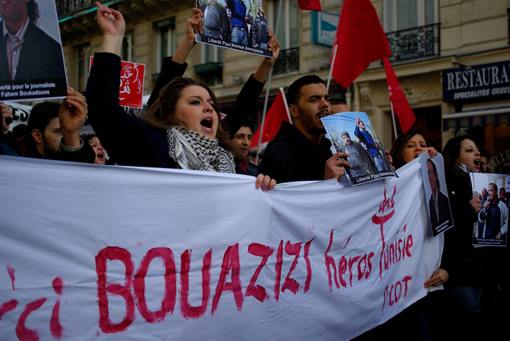
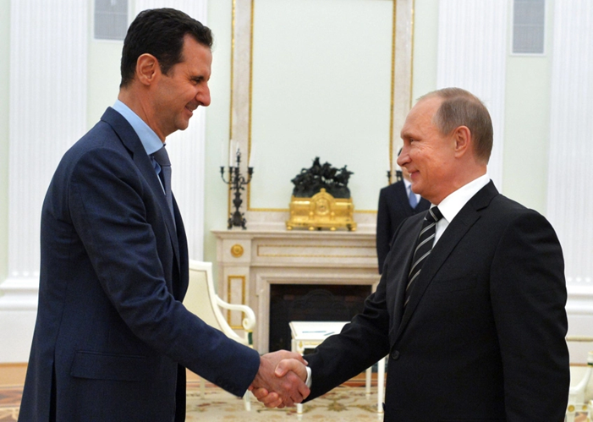
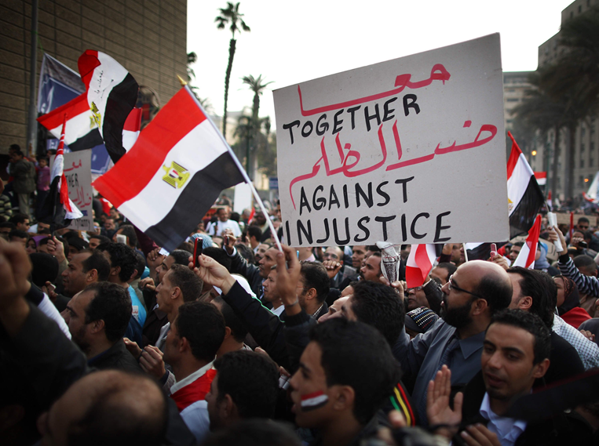
Interpreting the Arab Spring:
Can democracy work in the Middle East?
Mgr. Eva Taterova, M.A., Ph.D.
Middle East Crossroads

Slide 2
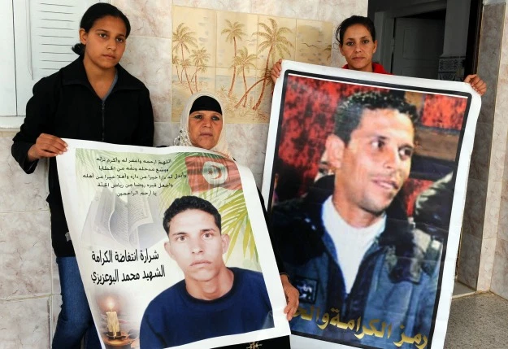

ARAB SPRING
December 2010: Mohamed Bouazizi‘s self-immolation in Tunisia → protest against president Bin Ali‘s government → spread to almost all other Arab countries
(a significant surprise for the whole world).
Various reasons for the protests: economic troubles, difficult social situation, corruption, limited human and political right.
Role of the new media and social networks such as Facebook and Twitter.

Slide 3
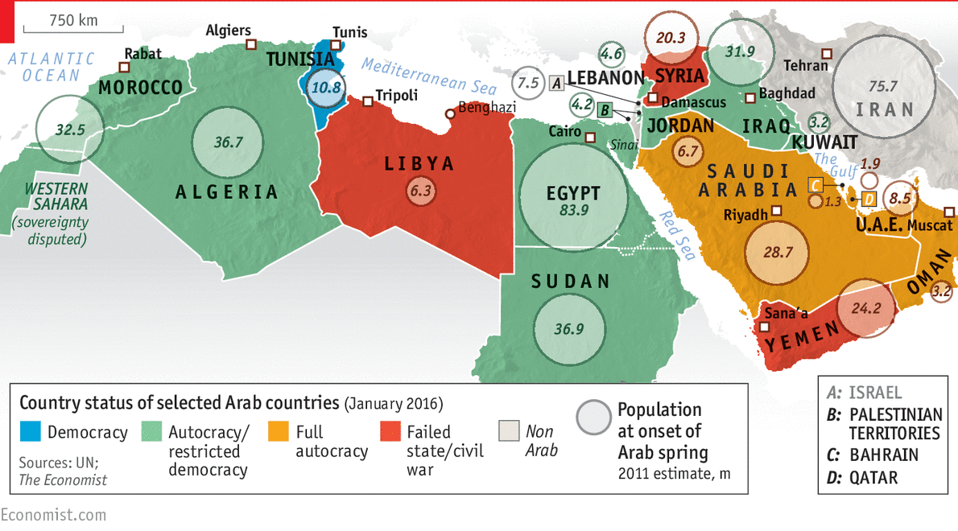
SITUATION AFTER ARAB SPRING

Slide 4
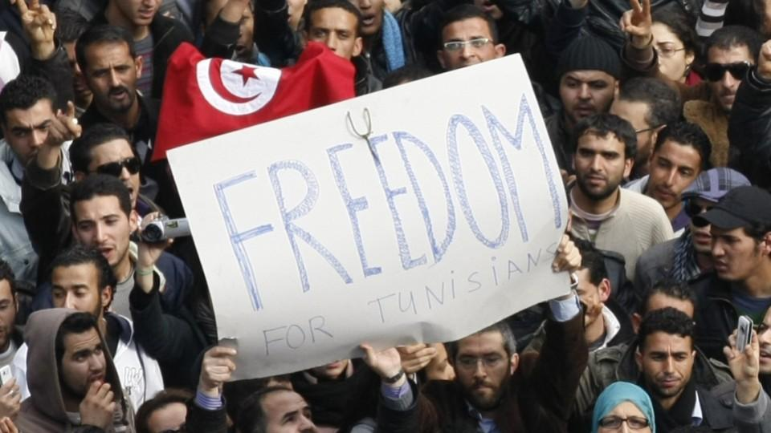
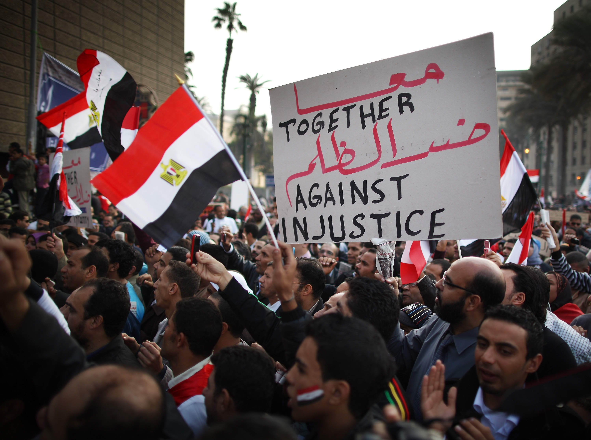
ARAB SPRING AND ITS CONSEQUENCES
Initial strengthening of civil society and democracy, which in most cases did not last (the most successful transition to democracy in Tunisia).
Stable but often very brutal autocracies plunged into chaos (Syria, Yemen, Libya), or the exchange of one dictatorial regime for another (Egypt).
In the ensuing chaos, radicals have been strengthening.
The power of the USA is weakening, it slightly strengthens the influence of Russia (Syria), China, the regional power Turkey is trying to become a local hegemon.
Refugee waves, humanitarian disasters, devastation or stagnation of economies, rising inequality and poverty.

Slide 5
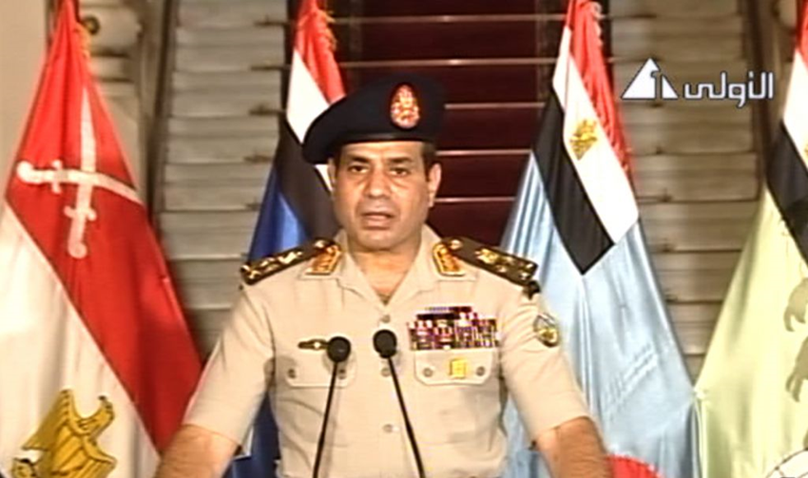
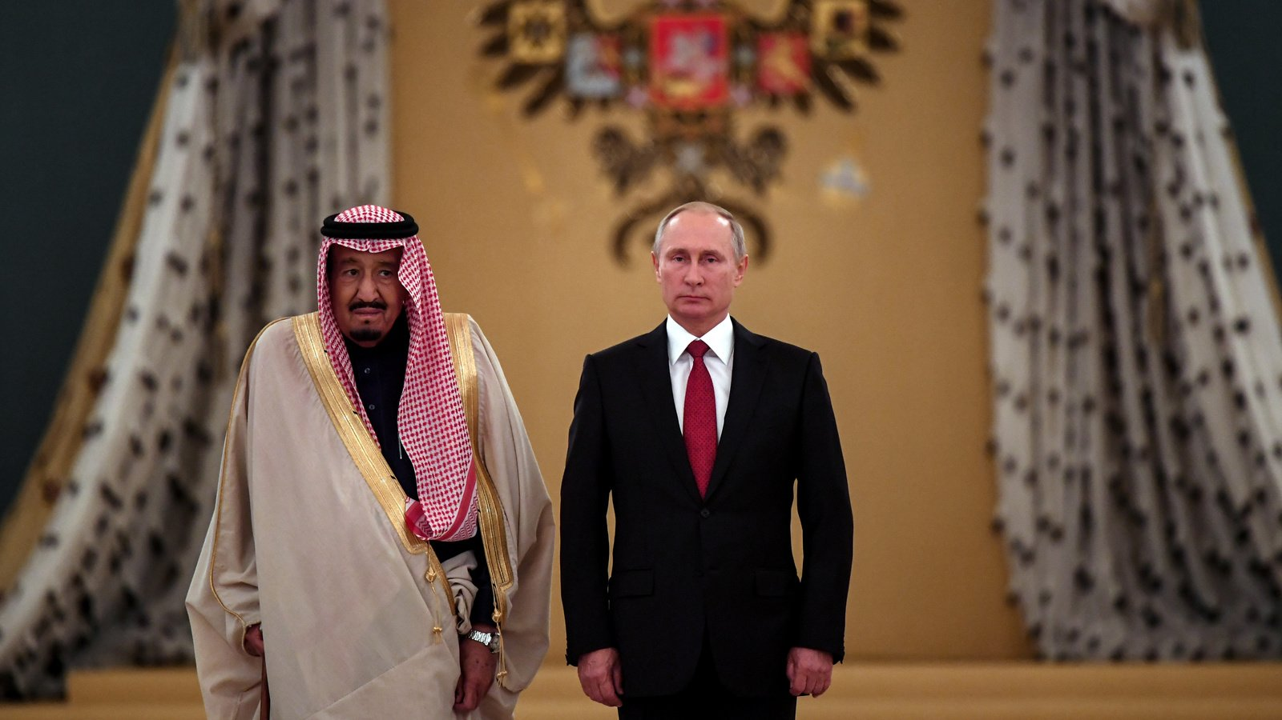
SITUATION AFTER ARAB SPRING
A stable but often very brutal autocracy sinks into chaos (Syria, Yemen, Libya) or the resurgence of autocracy (Egypt).
In the ongoing chaos, radicals of all kinds are strengthening - from secularists (clan warlords in Syria or Kurdish militias) to religious extremists (ISIS, An-Nusra).
Weakening US power, slightly strengthening influence of Russia (Syria), China, regional power Turkey is trying to become a local hegemon.
Response of Europe?

Slide 6
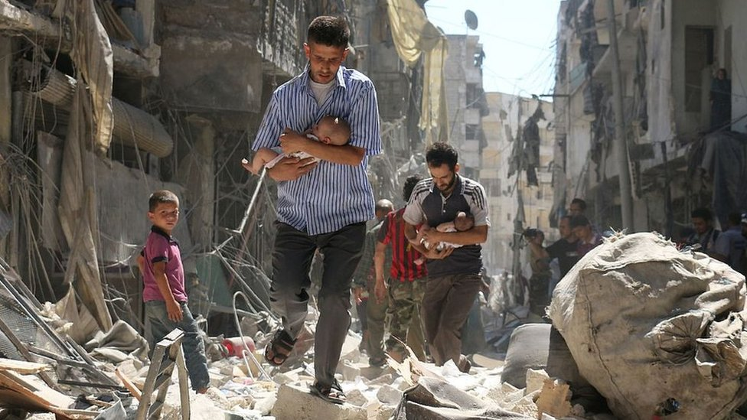
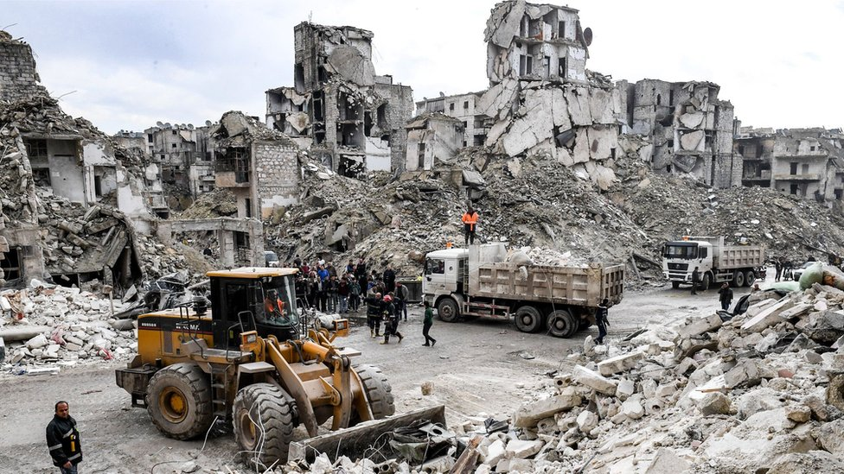
WAR IN SYRIA (since 2011)
March 2011 demonstrations against Bashar Assad‘s regime.
Bashar Assad decide to suppress the uprisings with the help of the army → the conflict escalated in regular civil war.
Massive damages: more than 470,000 death, more 3 millions of refugees – huge violation of the human rights (torture, political prisoners, weapons of massive destruction).
Syria has become the battlefield of the great powers such as Iran, Saudi Arabia, Russia, Turkey and others.

Slide 7

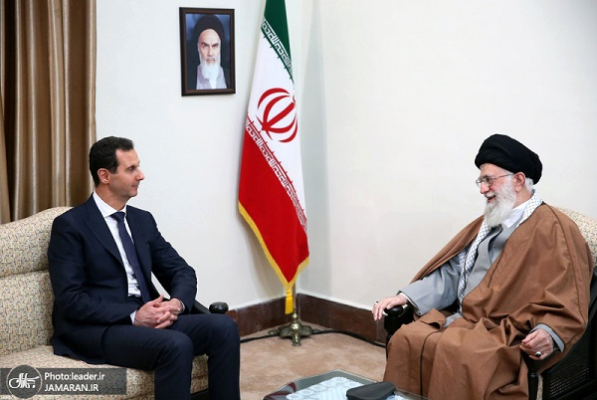
WAR IN SYRIA (since 2011)
Assad‘s supporters:
  Syrian government forces.
  Hizballah.
  Russia, Iraq, Iran.
Opposition:
  National Coalition for Syrian Revolutionary and Opposition Forces
  Islamic state.
  An-Nusra Fronte (close connections to al-Kaida).
  Turkey, Qatar, Saudi Arabia.

Slide 8
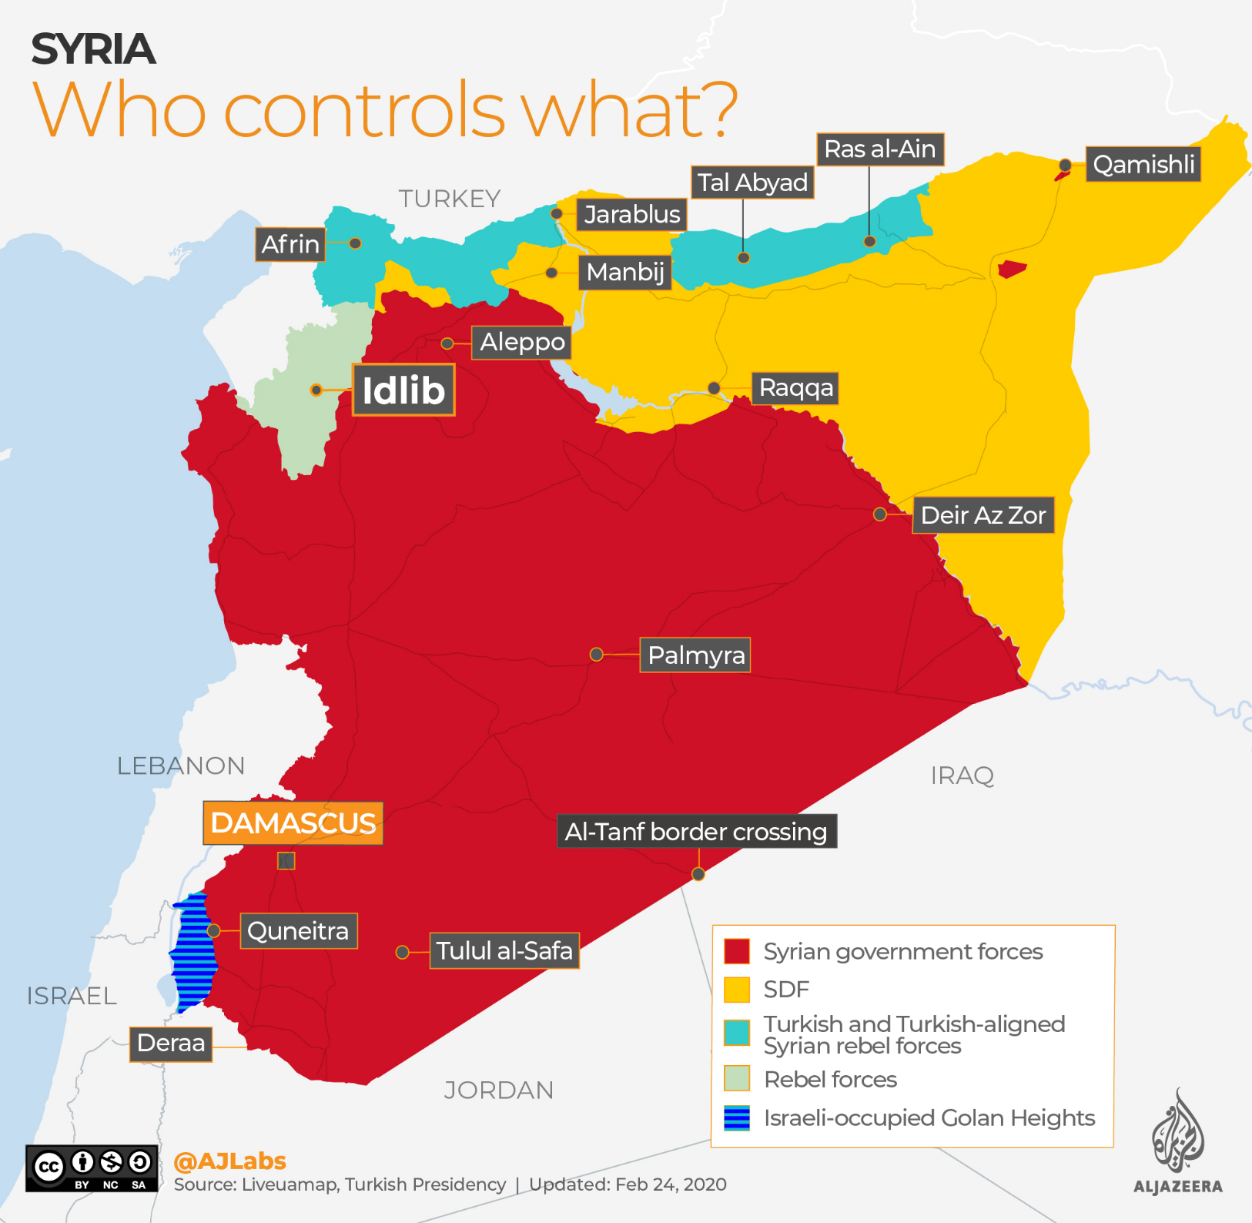

Slide 9
Can democracy work in the Middle East?

Slide 10
THANK YOU FOR YOUR ATTENTION

