Slide 1
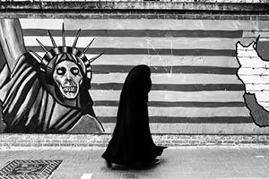
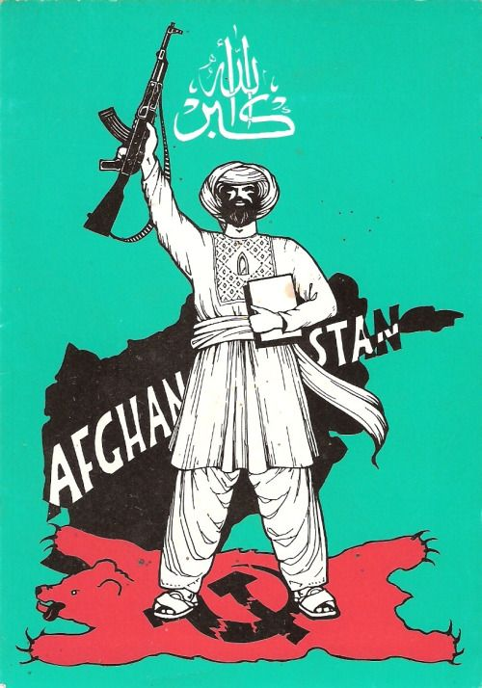
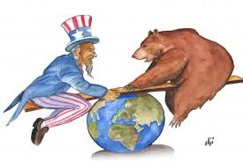
The Pragmatic Superpowers
Winning the Cold War in the Middle East
Mgr. Eva Taterova, M.A., Ph.D.
Middle East Crossroads

Slide 2
WW2 AND THE MIDDLE EAST
Middle East had a great geo-strategic importance in WW2 (oil resources, Suez Canal, Aden).
Most of the local states officially declared neutrality in WW2 but this status was not always respected by the great powers (occupation of Iran by the Allies, cooperation of Grand Mufti with Nazi Germany).
WW2 military operations in northern Africa (Egypt, Libya, Tunisia, Morroco) – Afrikakorbs led by Erwin Rommel – the fightings ended by the victory of the allies in 1943.
Weakening of the traditional European great powers during WW2 + rise of nationalism in the region → expectations of the crucial political changes in the Middle East after WW2 (1941 independent Syria, 1943 independent Lebanon).

Slide 3
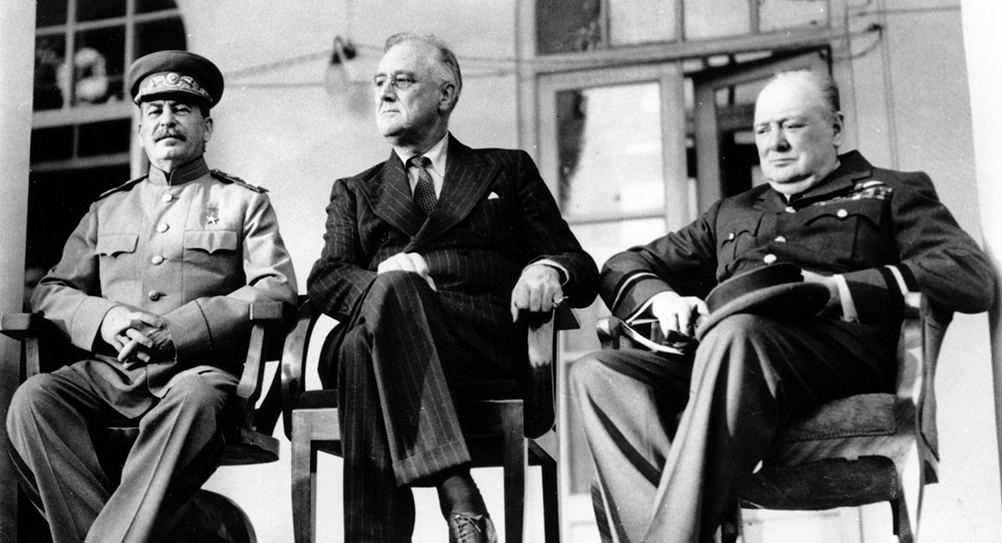
BIG THREE IN TEHRAN CONFERENCE 1943

Slide 4
OCCUPATION OF IRAN AND THE CONSEQUENCES
Occupation of Iran during the war very unpopular among the local population → January 1942 Great Britain and USSR declared that they would withdraw from Iran at latest 6 months since the end of the war + would provide the financial compensation.
Tehran conference 1943 (Churchill, Roosevelt, Stalin) – discussion of the current events of WW2, confirmation of the territorial integrity of Iran.
Fears that USSR shall attempt to include Iran among its satellites:
  Significant support of USSR to the Communist Party of Iran (Tudeh).
  Reluctance to withdraw from northern Iran.
  November 1945 the declaration of independent Kurdish People‘s Republic (unsuccessful).
Pressure from USA and Great Britain on USSR in UN → January 1946 Soviet troops forced to leave Iran.

Slide 5
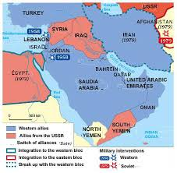
BEGINNINGS OF THE COLD WAR
Increasing competition between the members of anti-Hitler coalition – beginnings of the Cold War (1945-1948).
USA and USSR, the two superpowers that compeated in all areas (ideology, economy, culture, science, technology etc.) in almost all regions all over the world including Middle East.
Growing influence of USA and USSR in the Middle East in late 1940s – Truman‘s doctrine (1947), Soviet support for local leftist actors.

Slide 6
PRAGMATIC PARTNERSHIPS IN THE MIDDLE EAST
US allies:
Iran under shah Mohammad Reza Pahlavi (1941-1979).
Israel (since 1960s „special relationship“).
Turkey (since 1952 member state of NATO).
Saudi Arabia (partnership since 1930s).
Mujahideen in Afghanistan.
Soviet allies:
Local Communist Parties.
Iraq, Syria (due to the rise of Baath Party).
Yemen (civil war since 1962, communist vs. non-communist actors).
Palestinian movements (since Six Days War 1967).
Kurdish nationalists (PKK)

Slide 7
CONFLICT OVER PALESTINE IN LATE 1940s
International pressure on GB to find a solution for Palestine: Zionists emphasized the need of having their own state as the guarantee of their security due to the tragedy of Holocaust.
Increase of violence between Arab and Jews, at the same time the attacks of radional Zionist groups on British targets – unofficial civil war.
GB decided to cease her rule over Palestine → role of UN (November 1947 UN Partition Plan).

Slide 8
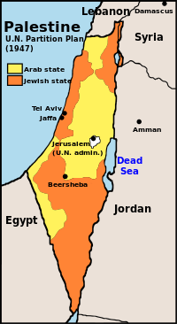
UN PARTITION PLAN (1947)
In favour (33 countries, 72% of total votes): Bolivia, Brazil, Costa Rica, Dominican Republic, Ecuador, Guatemala, Haiti, Nicaragua, Panama, Paraguay, Peru, Uruguay, Venezuela, Belgium, Denmark, France, Iceland, Luxembourg, Netherlands, Norway, Sweden, Poland, Czechoslovakia, USSR, Ukrainian SSR, Byelorussian SSR, Liberia, South Africa, Australia, New Zealand, Philippines, Canada, USA.
Against (13 countries, 28% of total votes): Afghanistan, India, Iran, Iraq, Lebanon, Pakistan, Saudia Arabia, Syrian, Yemen, Greece, Turkey, Egypt, Cuba.
Abstentions (10 countries): Argentina, Chile, Colombia, El Salvador, Honduras, Mexico, China, Ethiopia, Great Britain, Yugoslavia.

Slide 9
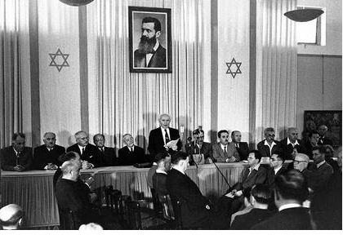
ISRAEL DECLARES INDEPENDENCE (1948)
Independent war vs. disaster
(al nakba).
Israel immediatelly recognized by both USSR (de iure) and USA (de facto).
Israel vs. all surrounding states (supported by other Arab states such as Saudi Arabia, Iraq etc.) → Arab coalition was more numerous however many organizational problems + conflicts among Arab leaders.
The overwhelming victory of Israel.
The beginnings of Palestinian diaspora (UNWRA).

Slide 10
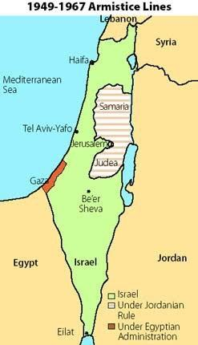
UN PARTITION PLAN (1947) vs. POST-WAR SITUATION (1948)

Slide 11
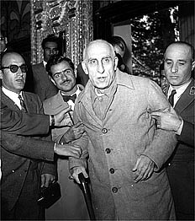
DECOLONIZATION AND THE ROLE OF SUPERPOWERS
1951 Iranian nationalist Mohammad Mosaddeq appointed as prime minister of Iran – the attempts to nationalize local oil industry from GB → coup against Mosaddeq organized by CIA → disillusion of Iranian people, growth of anti-Americanism in Iran.
1956: Suez Crisis – diplomatic fiasco for GB and France, ultimate confirmation of the decline of European power in the Middle East.
1958: United Arab Republic – panarabism in the Middle East,
the project failed already in 1961.
1963: coup d‘état in Syria by Baath Party (Arab socialism).
1970s: last countries of the Middle East declared independence.

Slide 12
AFGHANISTAN AS SOVIET VIETNAM (1979-1989)
Soviet intervention to Afghanistan started in December 1979 – surprise attack, the Red Army was quickly able to get control over Kabul and the other important geostrategic places (death of president Hafizullah Amin).
Resistance movement (mujahideen) – guerilla war.
Political fiasco of the Soviet Union that contributed to the failure of the superpower.

Slide 13
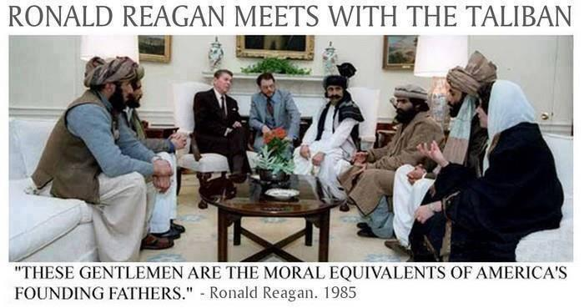

Slide 14
WAS THERE A WINNER OF THE COLD WAR
IN THE MIDDLE EASt?

Slide 15
THANK YOU FOR YOUR ATTENTION

