Slide 1
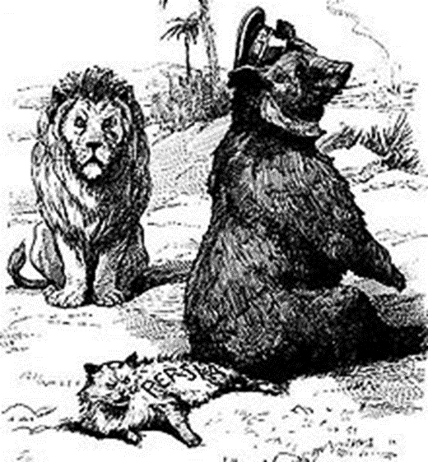
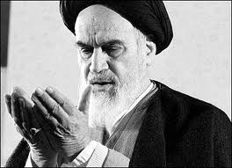
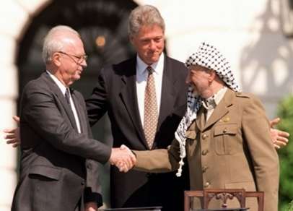
MIDDLE EAST CROSSROADS
Mgr. Eva Taterova, M.A., Ph.D.
Faculty of Social Studies
Masaryk University

Slide 2
COURSE OVERVIEW
Online MS Teams: https://teams.microsoft.com/l/channel/19%3a72a3caf32d2d473da3a4c9173aa29238%40thread.tacv2/Obecn%25C3%25A9?groupId=2ec1f2ff-ba5b-404b-8a06-00de9f4a6667&tenantId=11904f23-f0db-4cdc-96f7-390bd55fcee8
Credits: 4 ECTS
Lecturer: Mgr. Eva Taterova, M.A., Ph.D. (evataterova@gmail.com)

Slide 3
COURSE SCHEDULE
March 4: Introduction: scope of the course, organization
of the course, and course requirements
March 11: Looking Back: Middle East in last 100 years.
March 18: Carving up the Middle East in and after WWI: Was Europe lucky, evil, or smart?
March 25: The Pragmatic Superpowers: Winning the Cold War
in the Middle East.
April 1: The Suez Crisis: New Saladin of the Arab World
and a final confirmation of European decline.

Slide 4
COURSE SCHEDULE
April 1: The Suez Crisis: New Saladin of the Arab World and a final confirmation of European decline.
April 8: Iranian Revolution 1978: Great Satan, Little Satan demonizing epithets and the spread of anti-western propaganda
in the Middle East.
April 15: Kurdish Issue and Palestinian Issue: Do all nations deserve their own state?
April 22: 1990s as the Decade of Hope: Does peace even have
a chance in the Middle East?
April 29: Online essay

Slide 5
COURSE SCHEDULE
May 6: Global Jihadism: Clash of civilization confirmed?
May 13: Interpreting the Arab Spring: Can democracy work in the Middle East?
May 20: Current events in the Middle East
May 27: Final exam

Slide 6
COURSE ACTIVITIES
Presentation: The topics will be chosen by the students from the list available in IS. (30 points)
Online essay: April 29, 2021 (20 points)
Final Exam: May-June, 5 open questions (60 points)

Slide 7
PRESENTATION
Each presentation is about 20 minutes long.
Consists of a short summary/background to the given topic, critical analysis of the problem, questions for in-class discussion, and literature and sources.

Slide 8
PRESENTATION TOPICS
April 1 Anwar Saddat
April 8 ayatollah Ali Khamenei
April 15 Yasser Arafat
April 22 Binyamin Netanyahu
May 6 Abu Bakr al-Baghdadi
May 13 Bashar Assad
May 20 Mohammed bin Salman

Slide 9
ONLINE ESSAY
The students shall provide critical assessment of the perspectives to the given topic based on classes and readings. The students are expected to integrate the readings in a thoughtful way, not just summarize them.
Sample question: Discuss the consequences of Arab Spring
for the Middle East.

Slide 10
GRADES
A 92 - 100
B 84 - 91
C 76 - 83
D 68 - 75
E 60 - 67
F less than 60 points

Slide 11
THANK YOU FOR YOUR ATTENTION

