Slide 1
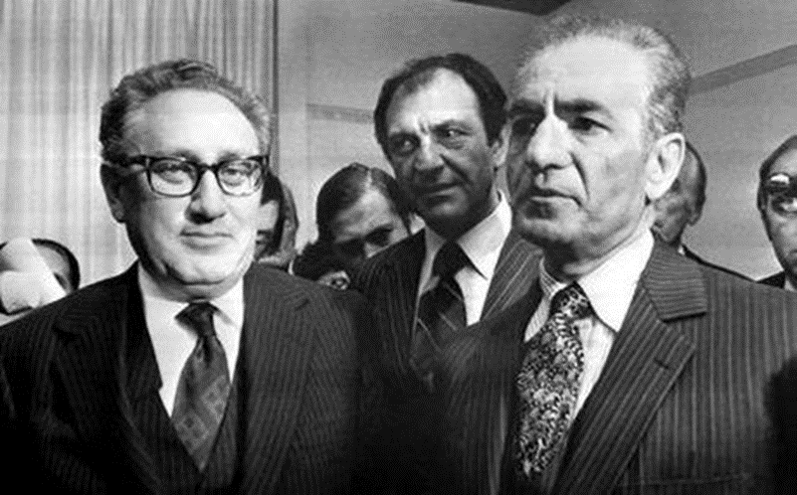
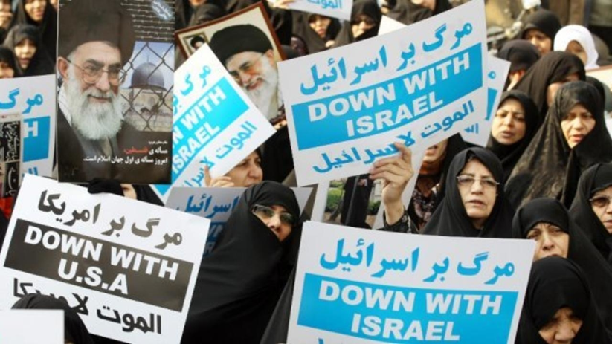
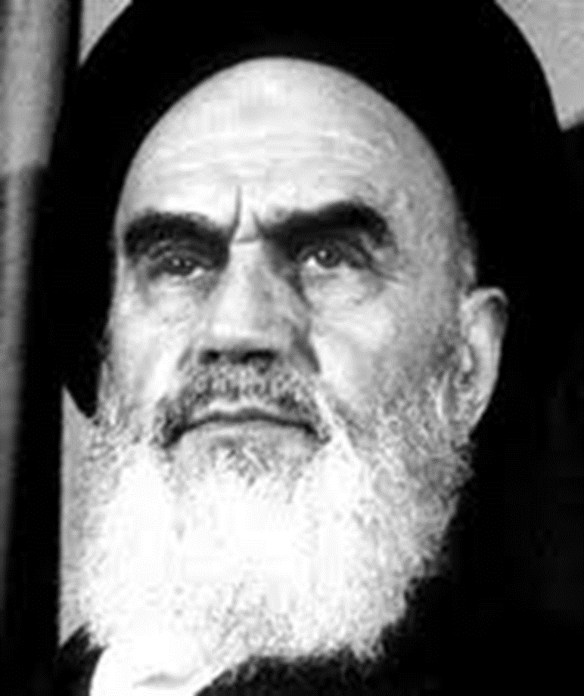
Iranian Revolution 1978:
Great Satan, Little Satan demonizing epithets and the spread of anti-western propaganda
Mgr. Eva Taterova, M.A., Ph.D.
Middle East Crossroads

Slide 2
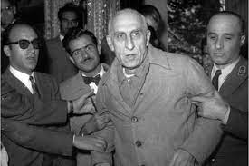
IRAN IN 1950s: MOSADDEQ‘S CASE
USA became the guarantor of political sovereignty of Iran (1947 Truman‘s doctrine) – close relations to shah Mohammad Reza.
Mohammad Mosaddeq became famous as the leader od Iranian nationalists → 1951 prime minister of Iran – the attempts to nationalize Iranian oil industry that time under control of GB.
GB and USA saw Mosaddeq as anti-western politician who might cooperate with USSR → CIA organized the coup against Mosaddeq → damage of USA image in Iranian society - Mosaddeq became a symbol of US oppression of the country.

Slide 3
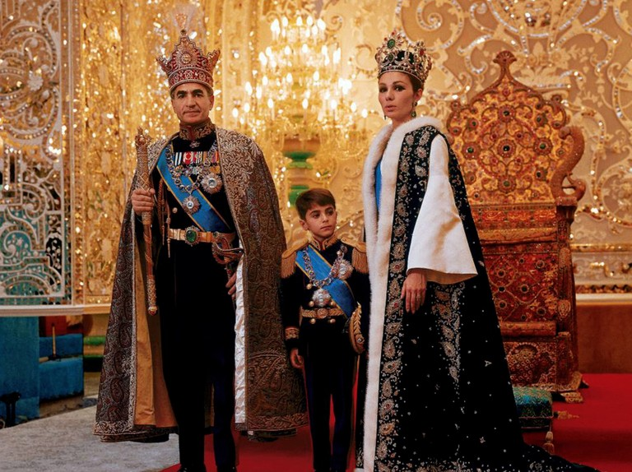
SHAH‘S REGIME
Rapid modernization of the country by western standards, system of capitalism, huge investments to the army.
Authoritarian government, corruption, poverty of the country despite the modernization efforts.
Huge celebrations of 2,500 years of Persepolis in 1971.
According Amnesty International Report shah imprisoned more that 2,200 people in 1978.

Slide 4
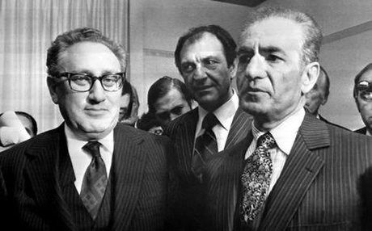
IRAN-USA MUTUAL RELATIONS
USA fully supported the regime of Mohammad Reza even though shah was criticized for his autocratic government, violation of human rights etc.
Iran under shah understood as a close US ally in the Cold War and the guarantee of stability in the Middle East.
USA provided a significant economic aid to Iran as well as supplies of weapons and military equipment.
Close collaboration of secret services CIA and SAVAK.

Slide 5

GROWTH OF OPPOSITION
1963 Ruhollah Khomeini had a famous speech in Qom where he criticized the shah for his alleged atheism, corruption, and friendly ties to Israel and USA → arrested and later forced to leave to exile.
Khomeini‘s popularity had increased in Iran especially in the conservative part of the society but he also had support of those who disapproved the shah‘s regime (corruption, secret police, limited civil rights etc.)
Opposition against shah was rather heterogeneous: Communist Party (Tudeh), republicans, Islamic nationalists, anarchist, etc.

Slide 6
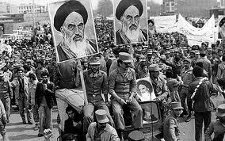
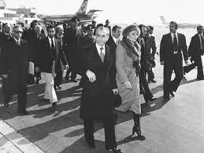
IRANIAN REVOLUTION 1978
Sometimes titled as Islamic revolution but this is not precise – the revolution was made by many fractions of the opposition, the Islamists took power only after few months (“revolution eats her own children“).
During the whole year 1978 massive demonstrations and strikes all over the country → January 1979 escalation of the situation – shah lead the country while ayatollah Khomeini came back to Iran as the hero of the revolution.
March 1979: referendum → declaration of Iranian Islamic Republic – Khomeini became the supreme leader with the support of the Revolutionary Guards.

Slide 7
WHAT ARE THE STRATEGIES TO KEEP
THE RADICAL POST-REVOLUTIONARY REGIME IN POWER?

Slide 8
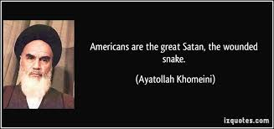
KHOMEINI‘S SPEECH ON NOVEMBER 5, 1979

Slide 9
HOSTAGE CRISIS IN TEHRAN
http://www.youtube.com/watch?v=gGUI7kDLsQo

Slide 10

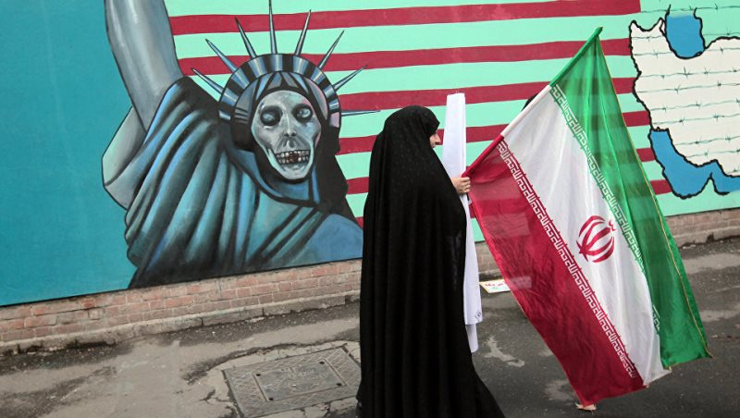
IMPACTS OF IRANIAN REVOLUTION
Big shock in the western countries but also
for the Soviet Union („lesser Satan“).
Breaking of the mutual relations with USA (hostage crisis in USA embassy in Tehran).
Disruption of regional stability – increase
of radicalism in the Middle East due to the effort of Iran to export the revolution (support of the radical groups in Middle East: Hizballah, Hamas).
Hostility in relations with Israel but also with Saudi Arabia and other sunni Islam leaders.

Slide 11
HAVE USA DESERVED SUCH A HOSTILITY
BY IRAN?

Slide 12

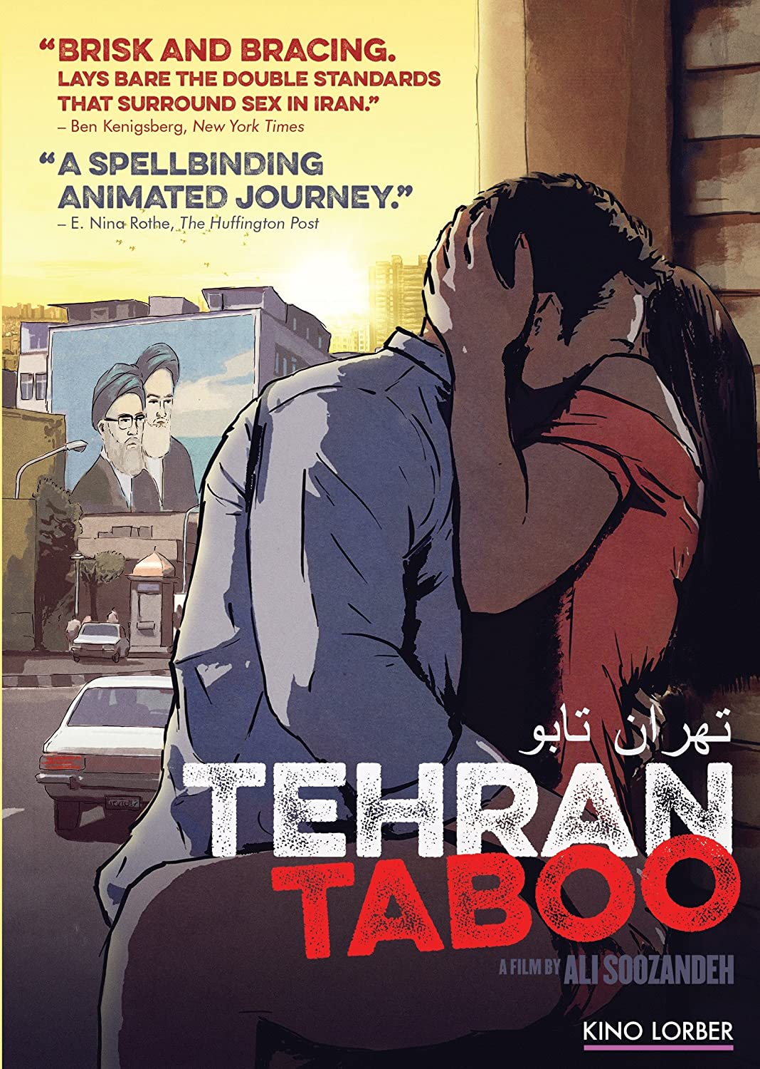

RECOMMENDED MOVIES

Slide 13
THANK YOU FOR YOUR ATTENTION

