Slide 1
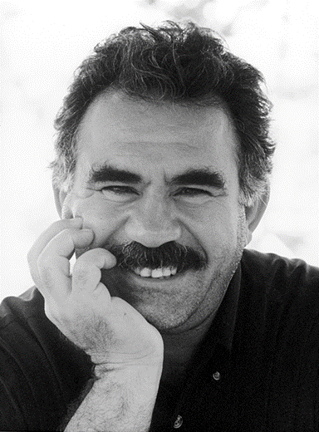

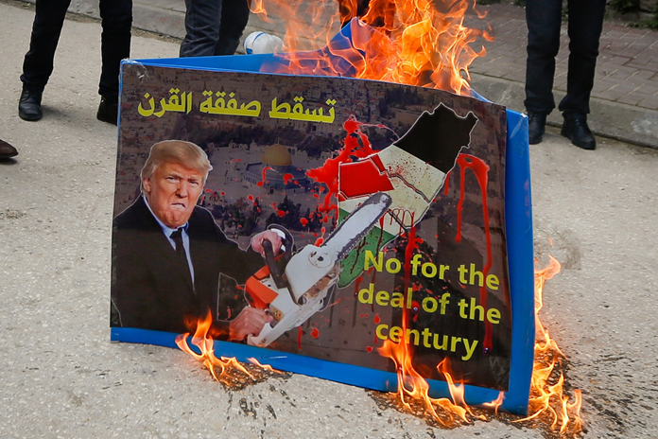
Kurdish Issue and Palestinian Issue:
Do all nations deserve their own state?
Mgr. Eva Taterova, M.A., Ph.D.
Middle East Crossroads

Slide 2
NATIONS AND NATIONALISM
A nation is a group of people that has got a common language, culture, historical experience and often also the territory where they live.
The borders of the states often do not respect the territories inhabited by individual nations.
Today, there are more than 190 states in the world and more than 5,000 ethnic groups.
There are about 82% of the states where more than 2 ethnic groups live together on one territory.
The nationality becomes significant when the members of a concrete ethnic group distinguish themselves from the other ethnic groups in the state and call for the guarantees of their national rights.

Slide 3
NATIONS AND NATIONALISM
Modern nationalism dates back to the times of French revolution (1789) – awaking of nations in Europe, later also transferred to the other regions including the Middle East.
Right to self-determination for the nations – the assumption that the individual nations differs due to their internal characteristics and identity → national state.
Extreme nationalism (chauvinism) claims that some nations are better than the others.
UN Charter (article 1,2): “To develop friendly relations among nations based on respect for the principle of equal rights and self-determination of peoples, and to take other appropriate measures to strengthen universal peace.“

Slide 4
Do all nations deserve their own state?

Slide 5
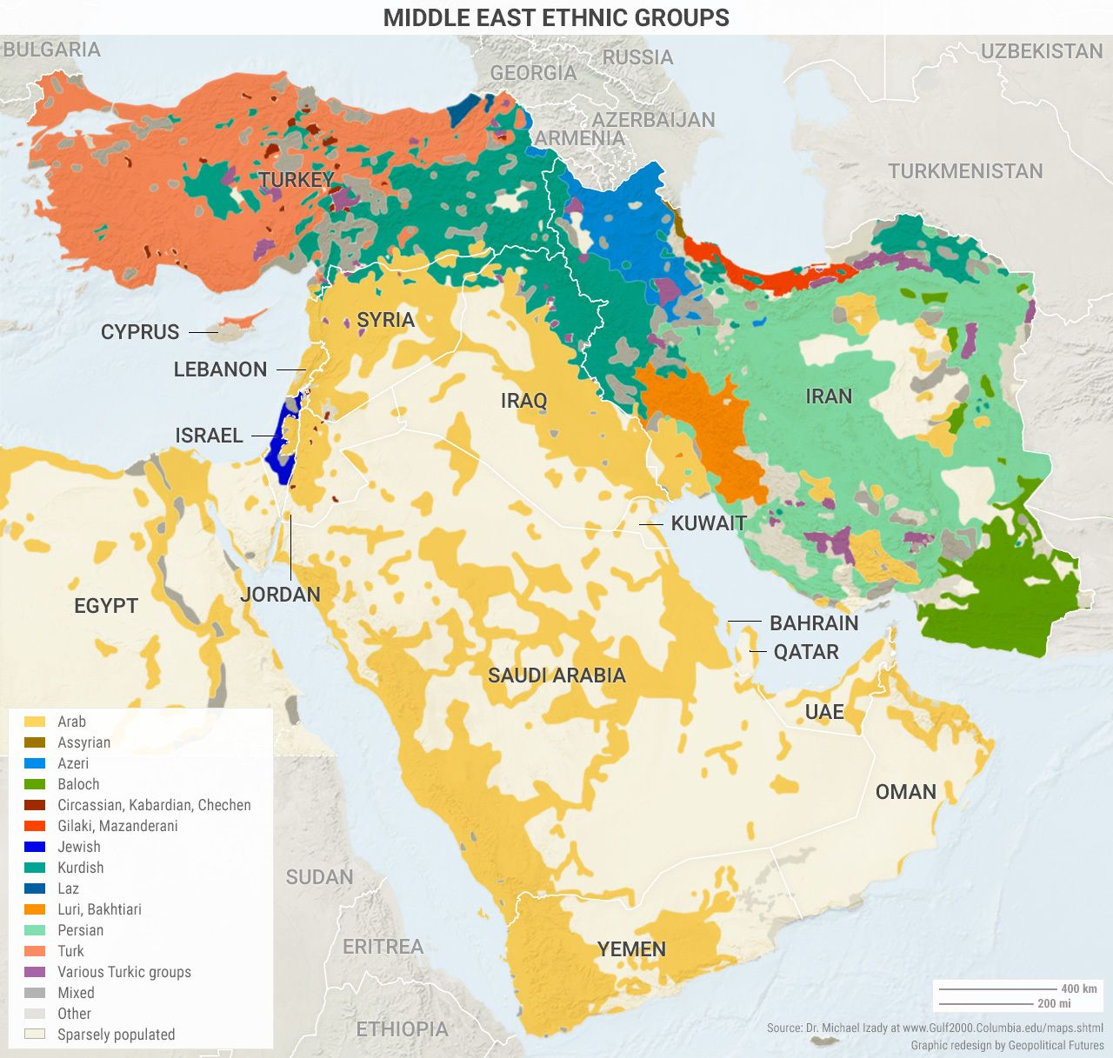
MIDDLE EAST ETHNIC GROUPS
The Middle East has a population of about 246 million.
Three most numerous ethnic groups: Arabs, Turks, and Persians.
Variety of many others – not all of them aim to have their own state.

Slide 6

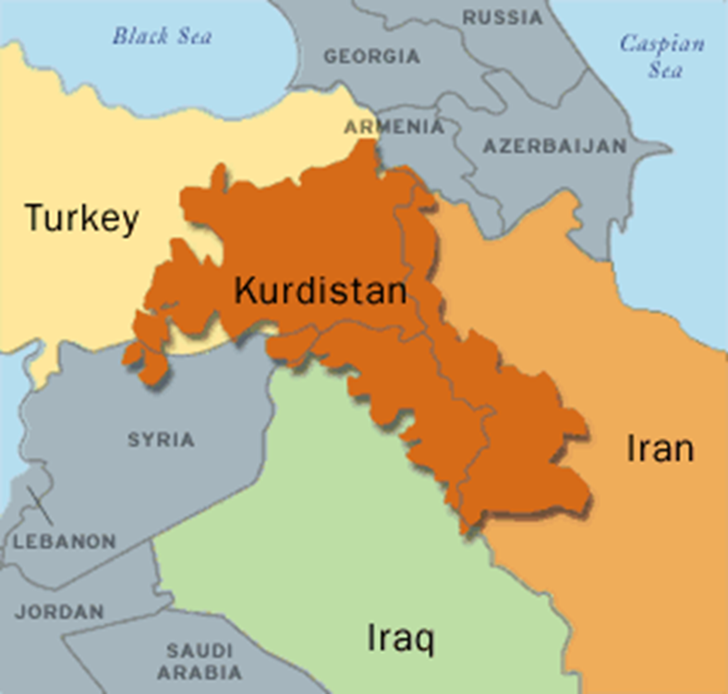
KURDISH NATION
Indo-European origin – various languages (Kurmanji, Sorani).
Estimated population: 30 millions (Turkey, Iraq, Iran, Syria, diaspora).
Most of the Kurds share the nationalist dream of independent state.
Attempts of turkification of the Kurds in 20th century in Turkey.
Kurdistan Workers' Party (PKK) established in 1970s by Abdullah Ocalan – originally Marxist ideology, the use of violence.
In Iran, the Kurds are generally seen as one of the Iranian nations.
Complicated status in Iraq – in 1980s genocide of the Kurds by Saddam Hussein‘s regime.

Slide 7
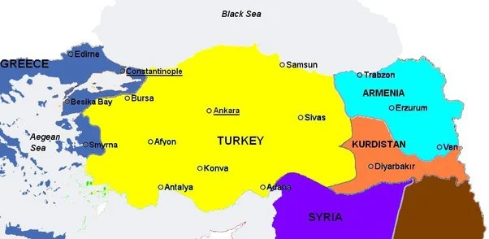
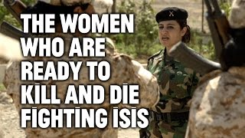
KURDISH DREAM OF INDEPENDENCE
Treaty of Sévres (1920) proposed the idea of Kurdish autonomy – never realized.
Vision of a smaller state that would cover at least a part of a territory inhabited by the Kurds (?northern Iraq?).
Hopes that Kurds shall be rewarded for their fights with ISIS.
Resistance of the regional powers – especially Turkey.
Lack of unity among the Kurds.

Slide 8

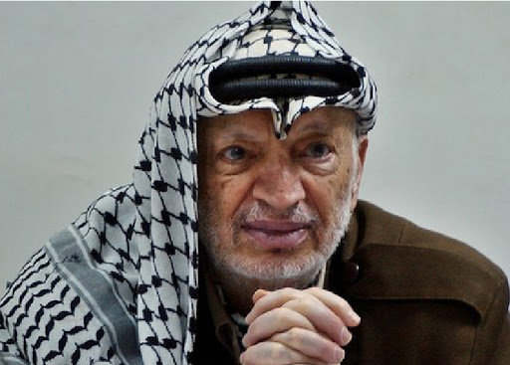
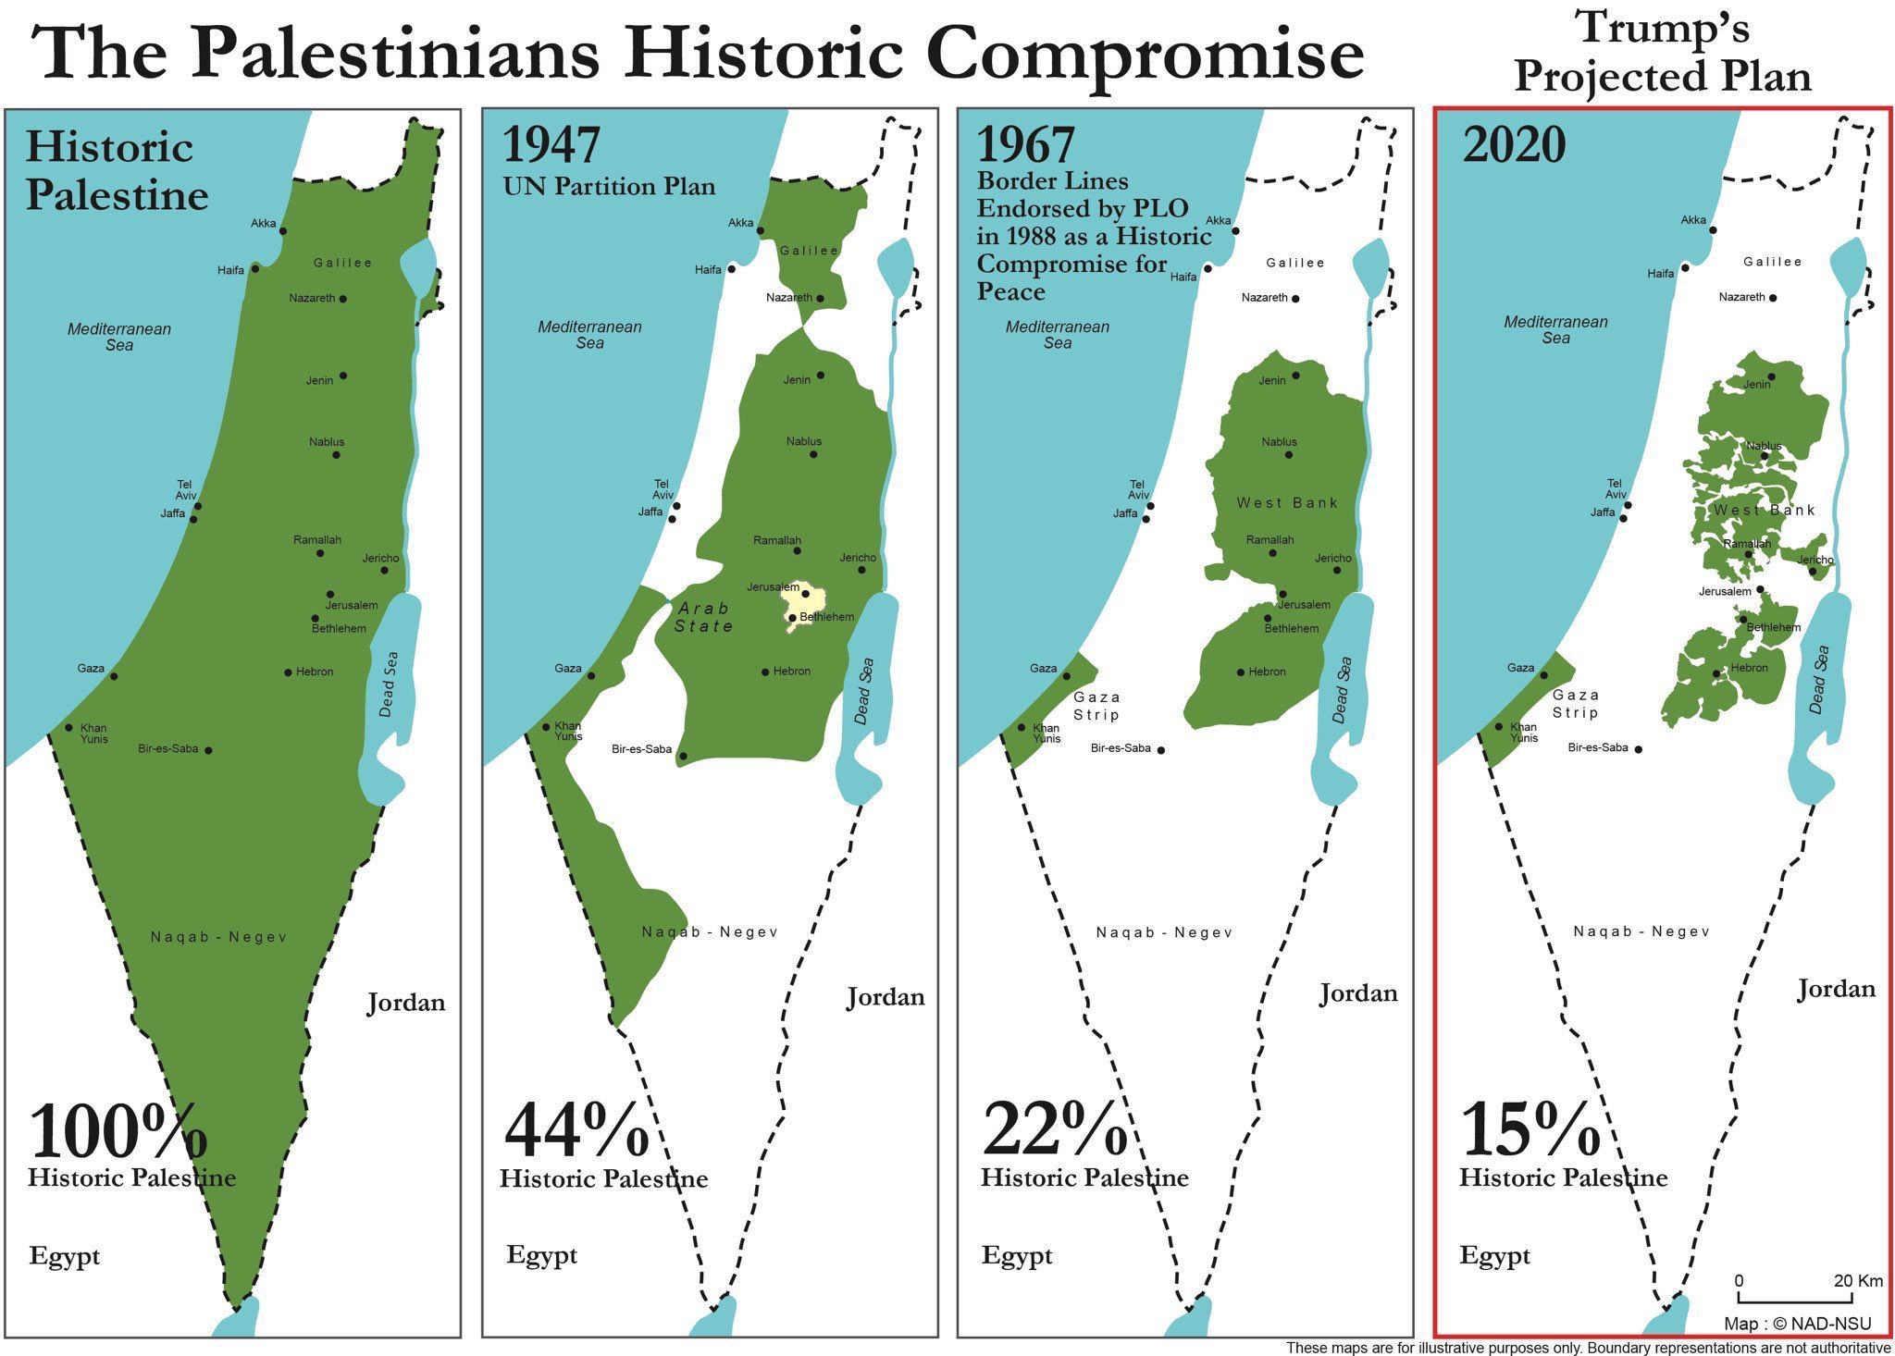
PALESTINIANS
Arab origin, estimated population about 11 millions of people (Jordan, West Bank, Gaza Strip, Israel, Lebanon, other countries).
Palestinian identity developed during the conflict with Israel.
Originally, the Palestinians were represented by the king of Jordan.
Rise of Palestinian nationalism since 1960s.

Slide 9

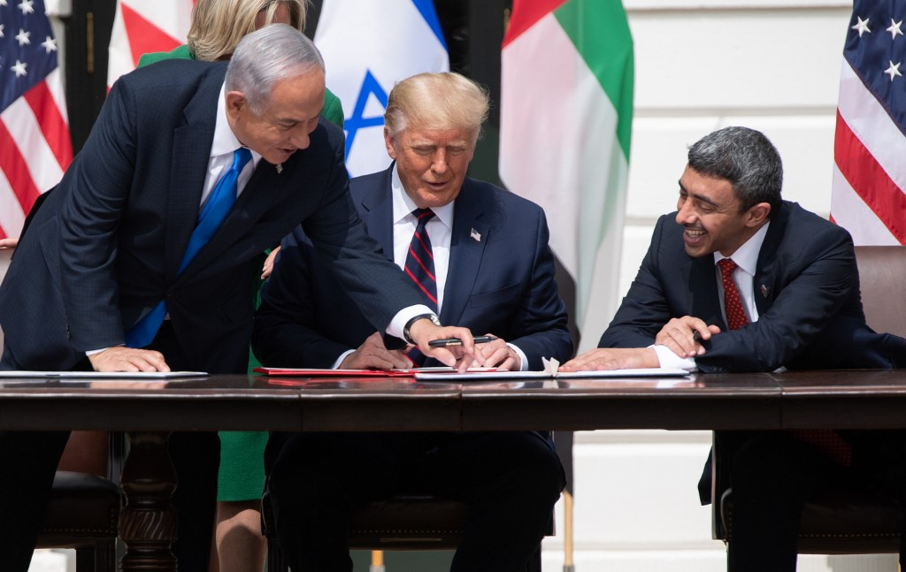
PALESTINIAN DREAM OF INDEPENDENCE
One state solution vs. two state solution.
Lack of unity in Palestinian leadership especially after the death of Yasser Arafat (Fatah vs. Hamas).
Frozen peace process with Israel
in last two decades – lack of international support for the Palestinian issue.
Are the Palestinians still the priority
for the Arab world?

Slide 10
What makes a nation to succeed
in creating their own state?

Slide 11
POSSIBLE SOLUTIONS OF ETHNIC CONFLICTS
Federalism and shared power
- Switzerland, Lebanon
Separation
- Czechoslovakia, ?Israel/Palestine?
Outside intervention
- Cyprus
Exhaustion of all sides of the conflict
- Lebanon

Slide 12
THANK YOU FOR YOUR ATTENTION

