Slide 1
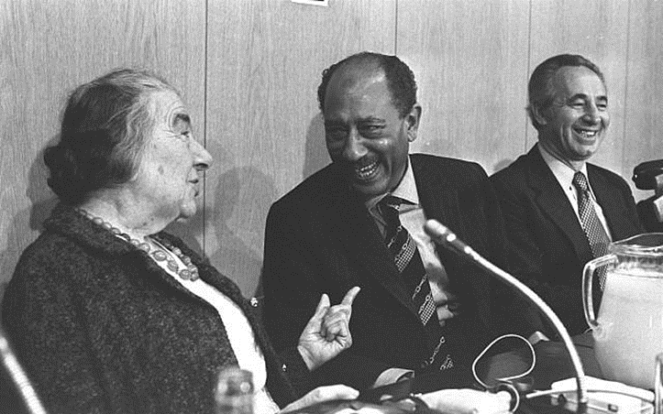
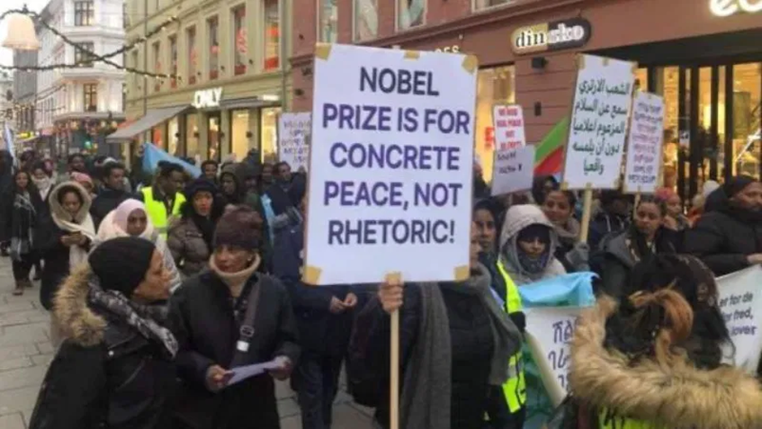
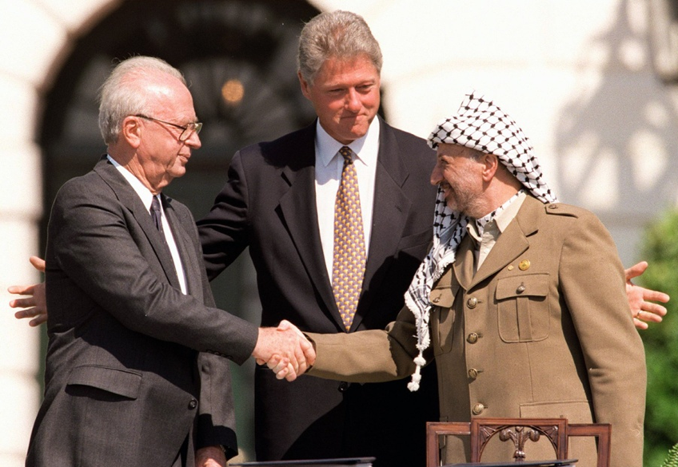
1990s as the Decade of Hope: Does peace even have a chance in the Middle East?
Mgr. Eva Taterova, M.A., Ph.D.
Middle East Crossroads

Slide 2
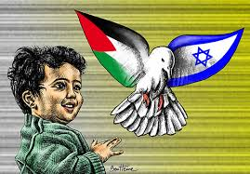
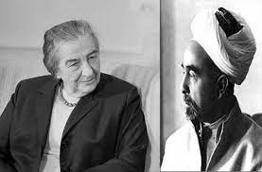
ARAB-ISRAELI PEACE PROCESS
Arab-Israeli conflict has been one of the longest conflicts of modern history.
The need to make a historical compromise.
The peace negotiations since the birth of Israel in 1948 – both bilateral and multilateral.
International support and sometimes interventions in order to achieve peace (USA, EU, non-state actors).
Separate vs. complex peace solution.

Slide 3

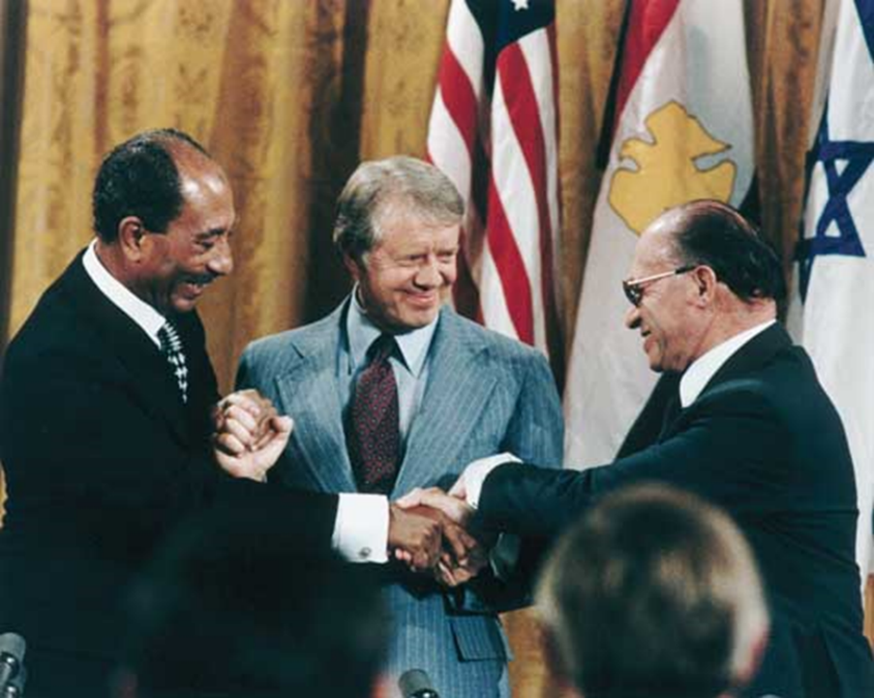
CAMP DAVID PEACE AGREEMENT 1978
Secret peace negotiations took place since 1948.
Saddat‘s visit to Jerusalem in 1977 – a big surprise
for the Arab world.
Milestone: 1978 peace agreement between Israel and Egypt (Camp David summit supported by Jimmy Carter) – “a cold peace“?
Return of Sinai peninsula to Egypt – security guarantees of Israeli western border.
Egypt punished by the other Arab countries.

Slide 4
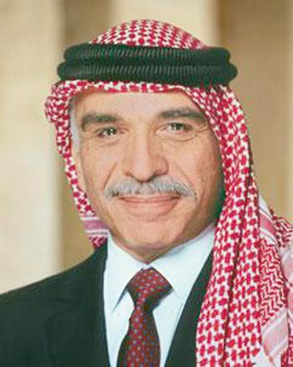

PEACE AGREEMENT ISRAEL-JORDAN
In the first decades of Arab-Israel conflict, the king of Jordan represented the Palestinians – later he was replaced by the leaders of Palestinian Liberation Organization (PLO).
In fact, no serious bilateral problems between Israel and Jordan aside the Palestinian issue.
Peace agreement signed in 1994.
Hope that a complex peace settlement shall follow up soon.

Slide 5
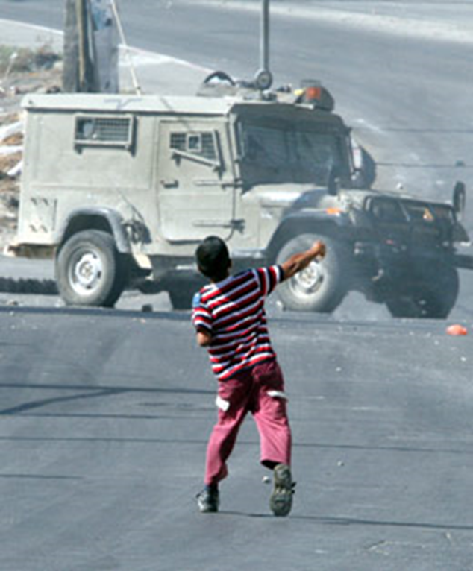
PEACE PROCESS WITH THE PALESTINIANS
Crucial part of Arab-Israeli peace process and concurrently the most complicated one.
1st intifada (Palestinian uprising) in 1987-1993: intensively discussed by whole international community.
End of the Cold War – active role of USA in the peace process.
Breakthrough came in 1990s (decade of hope) – in previous decades both parties refused to negotiate together)
1991 conference in Madrid – first official meeting of the delegations however without the highest political representatives.

Slide 6
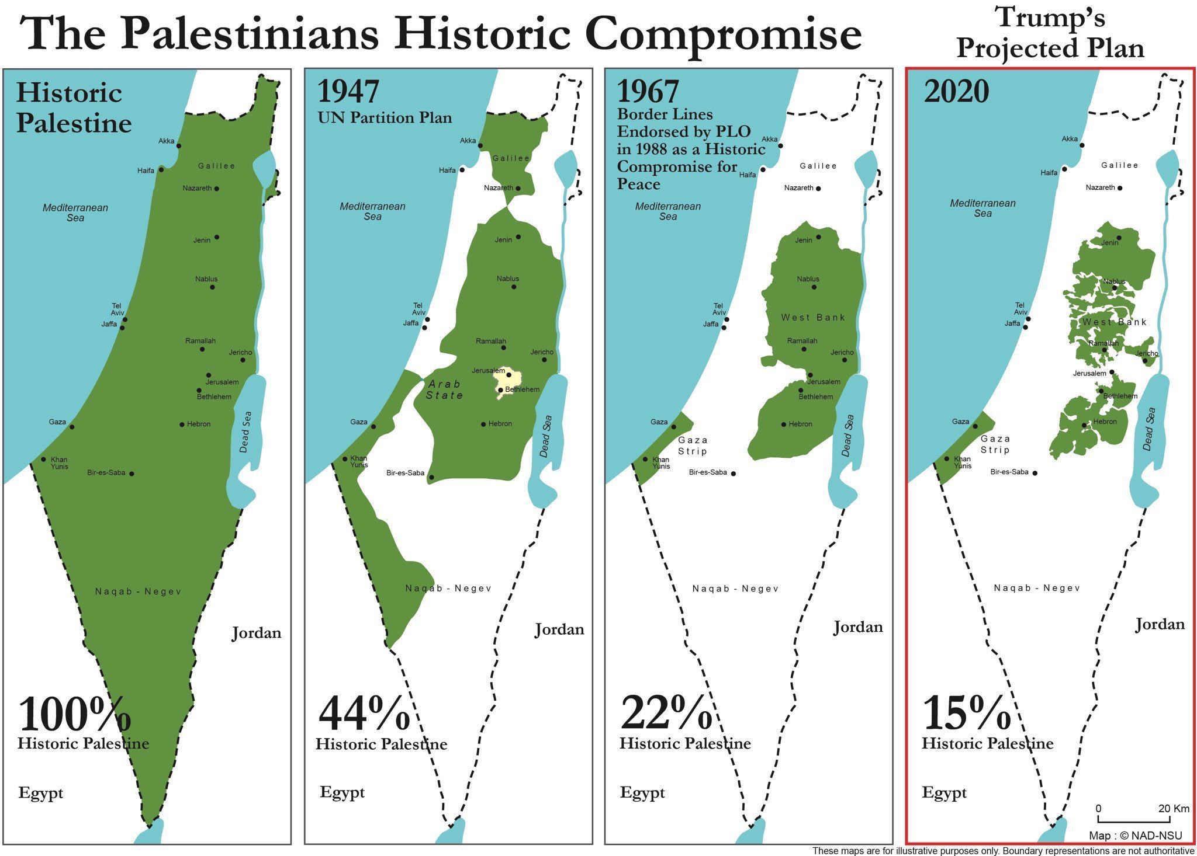
MAIN OBSTACLES OF THE PEACE PROCESS
Restoring of the peace process.
Split of the Palestinians.
Status of Jerusalem and other religious sites.
Jewish settlement in Western Bank.
Palestinian refugees and their claims.
Radicalism and terrorism.
Contemporary conflicts in the Middle East.

Slide 7


OSLO PEACE PROCESS
A series of peace negotiations supported by Norway and USA in 1990s – a principle “land for peace“.
Mutual recognition, obligation to continue with the peace talks in the future.
Key person Israeli prime minister Yitzhak Rabin who personally promoted the peace process despite of the intense criticism – in 1995 assassinated by radical student Yigal Amir.
Protests against the Oslo Accords on both sides (Hebron massacre, Hamas‘s attacks, demonstrations etc.).

Slide 8
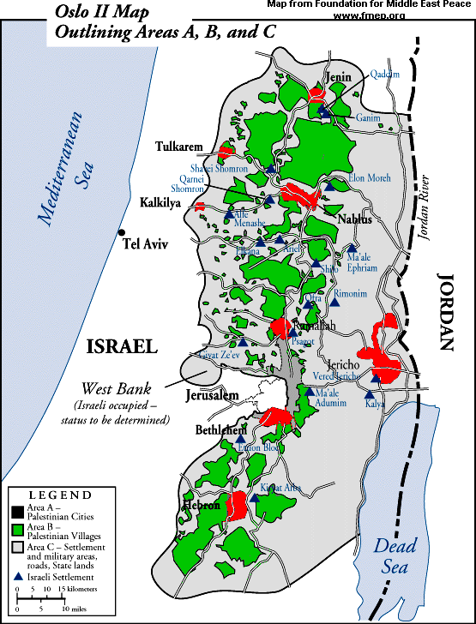
RESULTS OF THE PEACE PROCESS IN EARLY 1990s
Palestinian autonomous territories, first democratic elections – victory of PLO and Yasser Arafat.
The most difficult issues such as the status of Palestinian refugees, Jewish settlements, status of Jerusalem left for later round of negotiations.
After Rabin‘s assassination a slow-down of the peace process → early elections – new government made by Binyamin Netanyahu from Likud party.
Netanyahu was known as a critic of peace process – reluctance to any kind of compromise (security to be the unconditional priority).

Slide 9
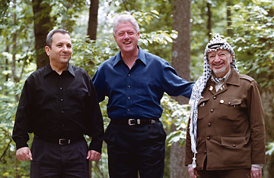
CAMP DAVID SUMMIT 2000
In 1999, another early election in Israel → Ehud Barak from Labor Party became the new prime minister.
Barak had a very ambitious vision to solve out Arab-Israeli conflict: peace negotiations with the Palestinians, and Syria.
Summit in Camp David has been the last big political meeting → failure of the peace process.
Prevailing interpretation: Barak made the most generous offer in history but Arafat refused it.

Slide 10
BARAK‘S OFFER TO ARAFAT (UNOFFICIAL)
Israel would withdraw from 95 % of occupied territory in West Bank, and from 100 % of occupied territory in Gaza Strip.
Israel would remove the isolated Jewish settlements and this territory shall be returned back to the Palestinians.
The highly populated Jewish settlements shall remain under Israeli control – the Palestinians shall receive a compensation in form of other territories.
The Palestinians shall obtain a control over East Jerusalem (Muslim and Christian parts of the Old City).
Religious sovereignty over Temple Mount.
Palestinians shall declare the official end of the conflict, to accept this situation as final and give up all potential future claims.
WHAT DO YOU THINK ABOUT SUCH AN OFFER?

Slide 11
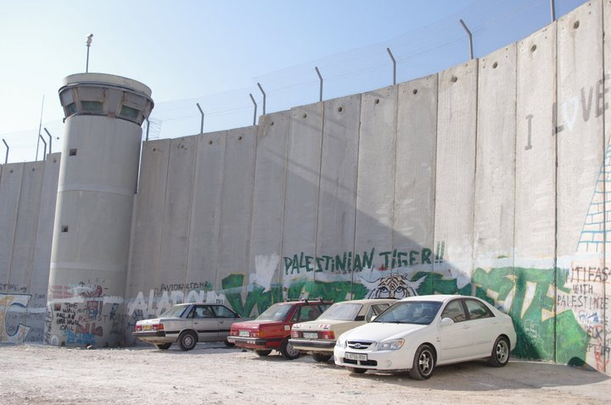
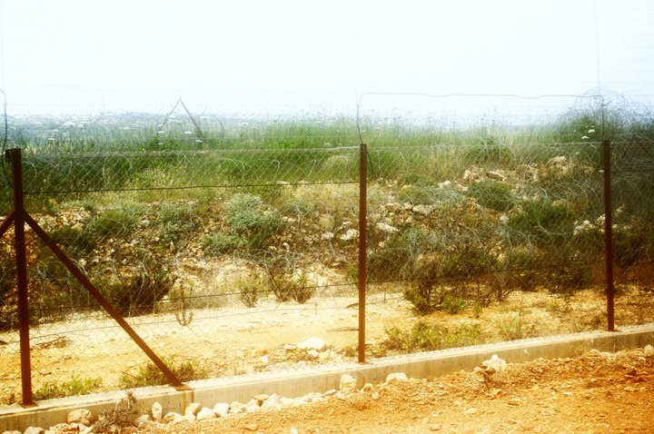
2nd PALESTINIAN INTIFADA
After the failure of peace process, the deep disillusion in both Israel and Palestine → escalation of tension, freezing of peace process.
Typical for suicide attacks in public places (bus stations, cafés, markets).
Unilateral withdrawal of Jewish settlements from Gaza in 2004.
Security Wall built with the intention to separate Israel from Western Bank – heavily criticized (apartheid wall vs. security guarantees).

Slide 12
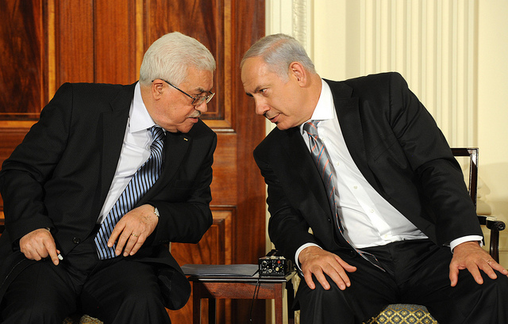
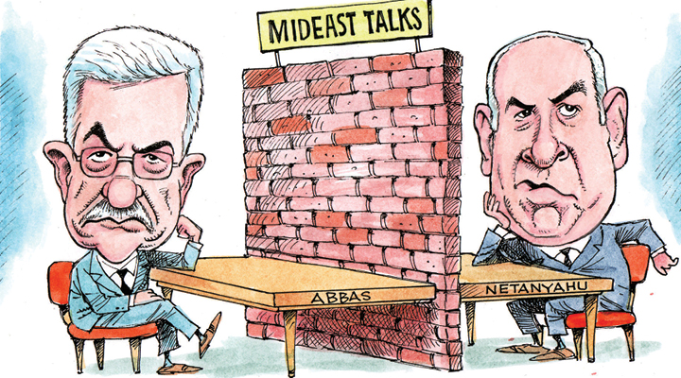
POLITICAL DEVELOPMENT SINCE 2000
Changes in international community since 9/11/2001 – shift in attitudes towards Palestinian nationalist groups.
Changes in Israeli politics – Ehud Barak lost the elections → 2000 victory of Likud Party led by Ariel Sharon (Israeli right-wings hawks).
In general, a negative perception of 2nd intifada by the international community.
More focus on the other Middle Eastern issues: war against terrorism, wars in Afghanistan, Iraq, Syria, and Yemen.

Slide 13
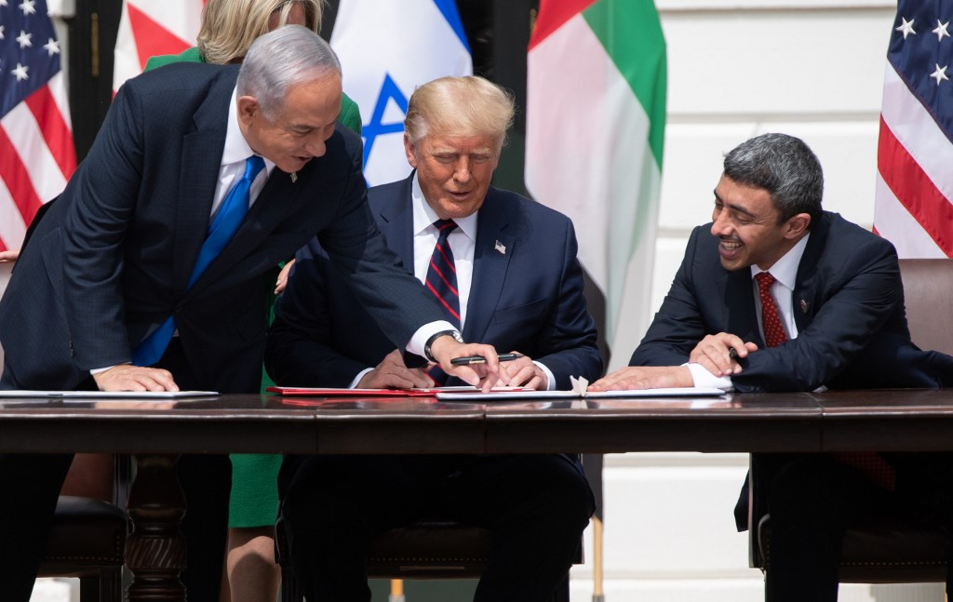
RECENT PEACE AGREEMENTS
Normalization of the diplomatic relations with selected Muslim countries in 2020:
  United Arab Emirates.
  Bahrain.
  Sudan.
  Morocco.
Israeli prime minister Benjamin Netanyahu, US President Donald Trump, and UAE Foreign Minister Abdullah bin Zayed Al-Nahyan

Slide 14
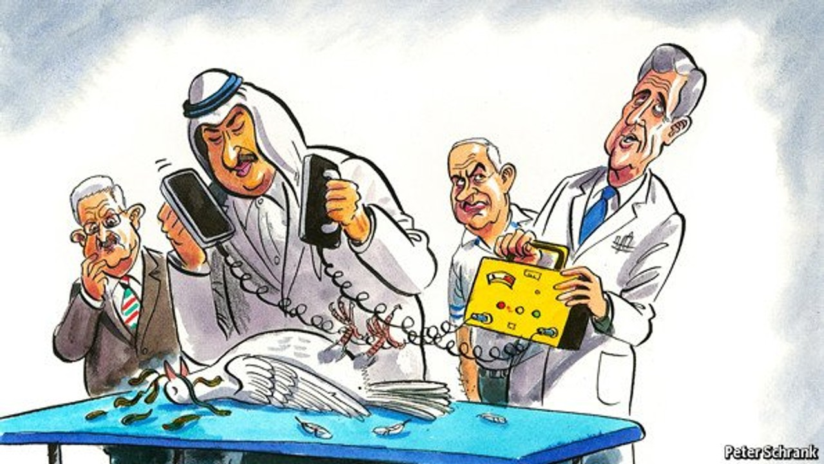
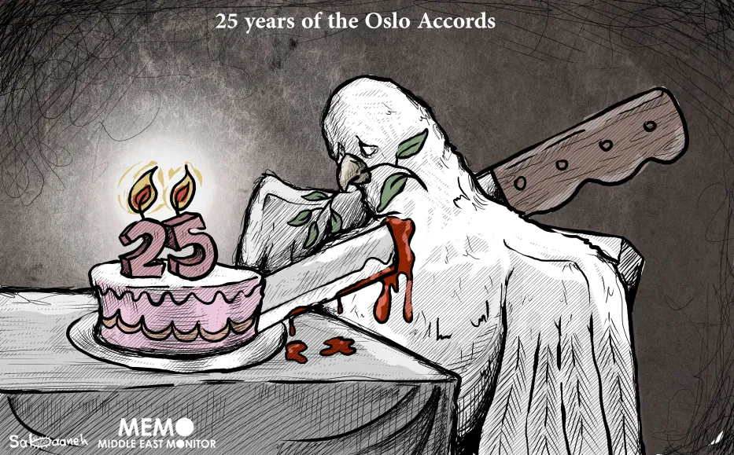
DOES PEACE ACTUALLY HAVE A CHANCE IN THE MIDDLE EAST?
(OR IN OTHER WORDS: COULD THE PEACE DOVE FLY AGAIN?)

Slide 15
THANK YOU FOR YOUR ATTENTION

