Slide 1
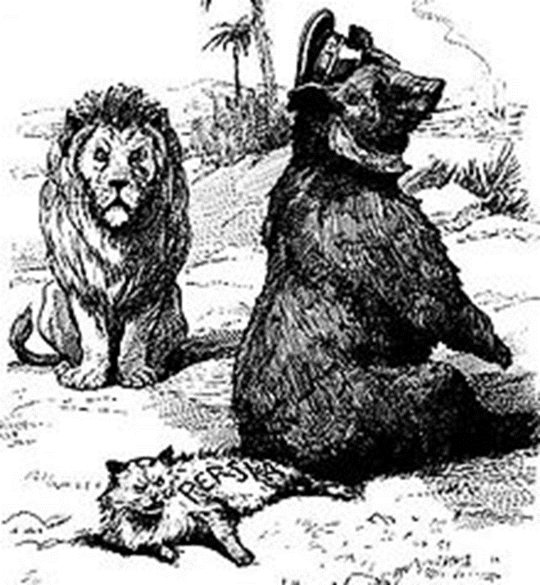
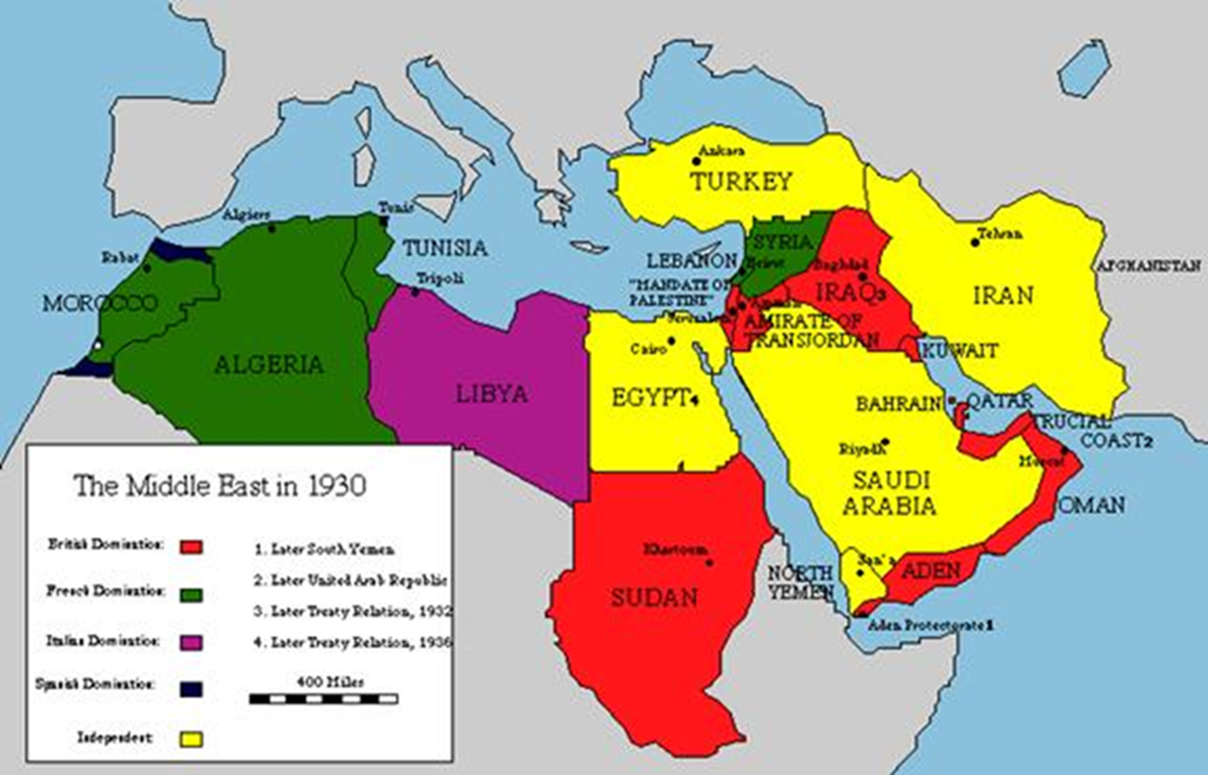
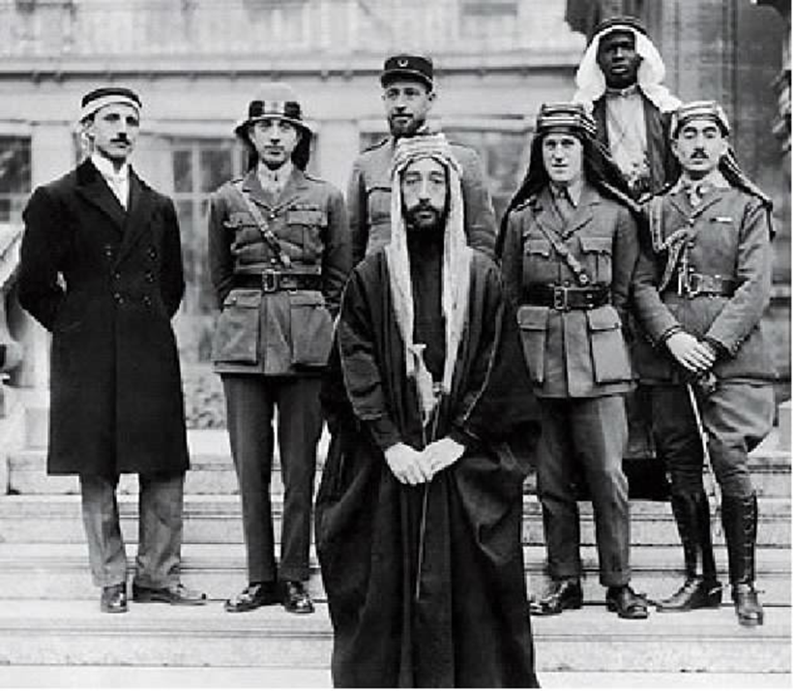
Carving up the Middle East in and after WWI: Was Europe lucky, evil, or smart?
Mgr. Eva Taterova, M.A., Ph.D.
Middle East Crossroads

Slide 2
DECLINE OF THE OTTOMAN EMPIRE
During the time the power status of Ottoman Empire had been weakening (economically: inability to follow the trends of industrial revolution; corruption; political instability: frequent palace coups; lack of military reforms) → "sick man of the Bosporus" (1853-56 Crimean War: confirmation of growing weakness of the Ottoman Empire).
1798: Napoleon's invasion to Egypt – sometimes interpreted as a milestone regarding the growth of Arab nationalism (Egypt: pasha Muhamad Ali; turmoils in Syria and Palestine in 19th century).
19th century: „Race for Africa“ – European powers attempted to get control over territories in Africa, since 1830s growing influence of France in northern Africa (Algeria, Tunisia, Morocco), since 1870s consolidation of British power in Egypt.

Slide 3
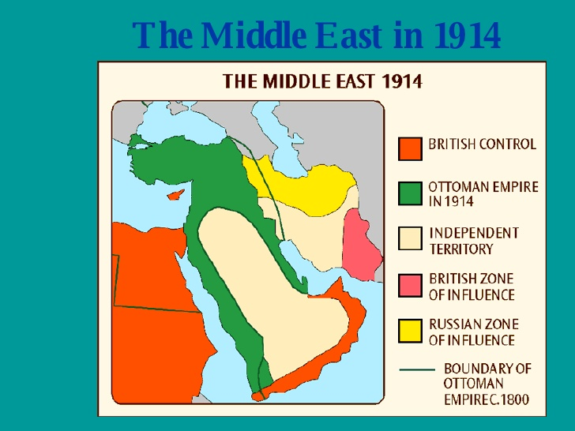

Slide 4
KIPLING: THE WHITE MAN'S BURDEN
Take up the White Man's burden—
Send forth the best ye breed—
Go bind your sons to exile
To serve your captives' need;
To wait in heavy harness
On fluttered folk and wild—
Your new-caught, sullen peoples,
Half devil and half child.
WHAT WERE THE CONSEQUENCES OF EUROPEAN COLONIALISM FOR MIDDLE EAST?

Slide 5
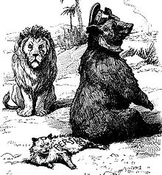
POLITICAL DEVELOPMENT OF THE REGION TO WW1
19the century: the birth of Zionism = Jewish nationalism (Theodor Herzl: Der Judenstaat), 1897 founding of Zionist organization in Basel → more and more European Jews emigrate to Palestine – first clashes and disputes with local people.
Deepening crisis of the Ottoman Empire – in WW1 Ottoman Empire joined the coalition of the Central Powers.
The region had become the center of interests of European colonial powers (Great Britain claimed Egypt as her protectorate in 1914, competition of Russia and Great Britain in Persia).

Slide 6
WW1 AND THE MIDDLE EAST
Both Jews and Arabs (Lawrence of Arabia) supported the Triple Entente with a hope that after the collapse of Ottoman Empire that would be granted independence or at least autonomy.
Military operations in the region: Palestinian Front, Mesopotamian Front, Caucasian front → armistice October 30, 1918
The goals and ambitions of both groups were obviously contradictory: European great powers had the negotiations with both of them (Balfour Declaration 1917, correspondence of Henry McMahon and Sharif Hussein 1915-16).
Concurrently secret negotiations between Great Britain and France in order to divide the Middle East: Sykes-Picot Agreement (1916) – violation of all pledges given to Arabs and Jews.

Slide 7
BALFOUR DECLARATION (1917)
November 2nd, 1917
Dear Lord Rothschild,
I have much pleasure in conveying to you, on behalf of His Majesty's Government, the following declaration of sympathy with Jewish Zionist aspirations which has been submitted to, and approved by, the Cabinet.
"His Majesty's Government view with favour the establishment in Palestine of a national home for the Jewish people, and will use their best endeavours to facilitate the achievement of this object, it being clearly understood that nothing shall be done which may prejudice the civil and religious rights of existing non-Jewish communities in Palestine, or the rights and political status enjoyed by Jews in any other country."
I should be grateful if you would bring this declaration to the knowledge of the Zionist Federation.
Yours sincerely,
Arthur James Balfour

Slide 8

VERSAILLES PEACE CONFERENCE 1918-1919
Discussion of the future settlement
of territories of Ottoman Empire (Ottoman Empire in turmoil → civil war → 1923 Republic of Turkey.
The negotiations were to continue
in follow-up conferences in San Remo and Sèvres (1920).
The regional delegations had very limited options, France and Great Britain made the crucial decisions → modern map of Middle East.

Slide 9


Slide 10
CORRESPONDENCE BETWEEN EMIR FAISAL AND FELIX FRANKFURTER (1919)
"The Arabs, especially the educated among us, look with the deepest sympathy on the Zionist movement. Our deputation here in Paris is fully acquainted with the proposals submitted yesterday by the Zionist Organization to the Peace Conference, and we regard them as moderate and proper."

Slide 11
POSTWAR MIDDLE EAST
In fact, the distribution of power and territories in accordance with Sykes-Picot Agreement.
Officially, the leading role had newly established League of Nations →A League of Nations mandate: Palestine (Israel/Palestine + Jordan), Mesopotamia (Iraq), Syria (later Lebanon was excluded as separate territory).
Egypt and Persia became officially independent but under heavy British influence + British political and economic interest in Arabic peninsula (city of Aden; Oman, Qatar and Bahrain were British protectorates).
Turkey since 1923 a republic, significant territorial losses.
European great powers were not that much interested in most of Arabic peninsula – leading figure king Ibn Saud.

Slide 12
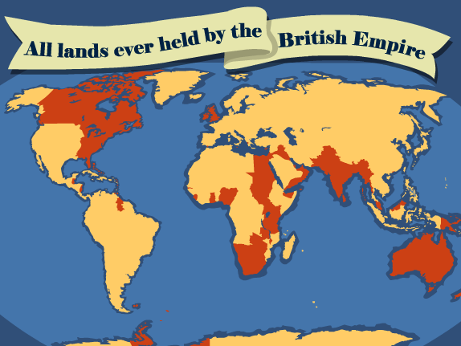

Slide 13
Was Europe lucky, evil, or smart?

Slide 14
THANK YOU FOR YOUR ATTENTION

