Slide 1

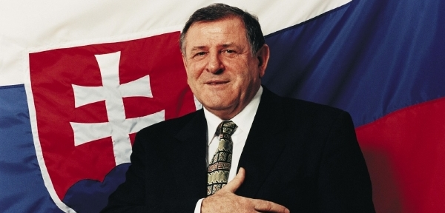
Era of Vladimír Mečiar and its end
Peter Spáč

Slide 2
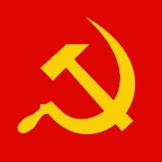
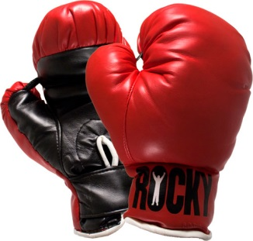
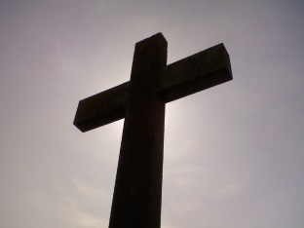
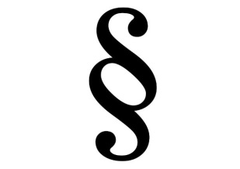
Beginning of the story
Born in 1942
Communist party:
  Active member of the Communist youth organization
  1962 – joined ranks of the party
  1970 – excluded from the party
1970s and 1980s:
  Graduated from Law faculty
  Company lawyer until the end of this period

Slide 3

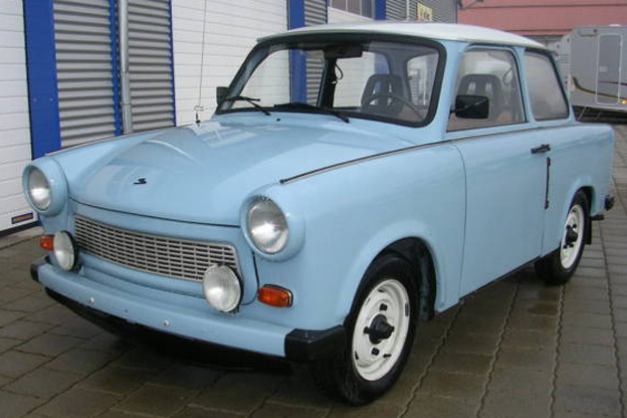
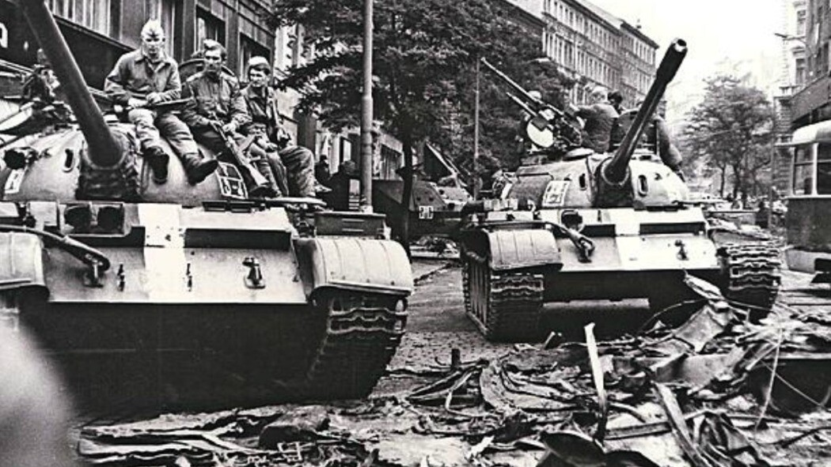
Tough times after 1968

Slide 4
The career leap
Reconstruction of Slovak government in 1989
Nearly a contest to find a proper person to lead the Ministry of Interior
Mečiar as one of the candidates:
  Alleged support of Alexander Dubček
  Excellent overview about the ministry and its structures
Mečiar selected and became member of the government

Slide 5
A new star in politics
Rising popularity of Mečiar
VPN`s demonstration `Let`s tell the truth`:
  Beginning of 1990
  Called against the communists who did not allow VPN`s leader to became chairman of Slovak parliament
  Mečiar warned those `who misused their positions that there is enough room in the prisons`

Slide 6
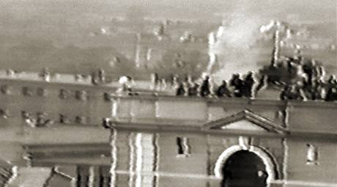
A new star in politics
Riot in Leopoldov prison in Spring 1990:
  Prisoners demanded amnesty and demolished the facility
  Lt. Sámel (from federal ministry) chosen to lead the intervention against the riot
  Expected casualties – 200-250 on both sides
  Mečiar refused to directly take part in the intervention

Slide 7
A new star in politics
March 28 – the intervention
  Prisoners asked to surrender (only 172 out of 1,006 did)
  Sámel demanded that Slovak government (in fact Mečiar) approves to conduct the charge
  In the following fight the riot was suppressed with only one dead prisoner
Later events:
  The intervention interpreted as a great success
  Lt. Sámel promoted to general
  1992 during the trial with prisoners Mečiar stated that `he personally had to take command in the intervention`

Slide 8
A new star in politics
Rising popularity of Mečiar in the society
An unknown member of the new government in 1989
Public surveys:
  April 1990 – No. 7 in highest popularity
  May 1990 – No. 4
After election 1990 one of three candidates of VPN for Prime Minister

Slide 9
Elections 1990
Party | Votes (in %) | Seats
VPN | 29,4 | 48
KDH | 19,2 | 31
SNS | 13,9 | 22
KSČ / KSS | 13,4 | 22
Hungarian parties | 8,7 | 14
DS | 4,4 | 7
Green party | 3,5 | 6
Others | 7,6 | 0
 |  | 150

Slide 10
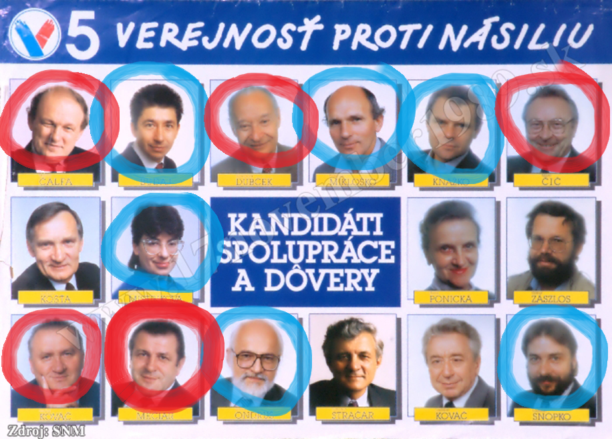

Slide 11
Government after elections
Prime Minister – Vladimír Mečiar
The strength of a bulldog: `All will go on vacation…after two years!`
Conflict between VPN’s liberal leadership and Mečiar:
  Office of Prime Minister given to Christian Democrats (KDH)
  VPN leader Fedor Gál ostracized and later decided to leave the country
1991 – Mečiar creates Movement for a Democratic Slovakia (HZDS)
  Slower economic reform
  Populism
  Nationalism

Slide 12
Elections 1992
Party | Votes (in %) | Seats (in %)
HZDS | 37,3 | 74
SDL | 14,7 | 29
KDH | 8,9 | 18
SNS | 7,9 | 15
Hungarian parties | 7,4 | 14
ODU | 4 | 0
Others | 19,8 | 0
 |  | 150

Slide 13
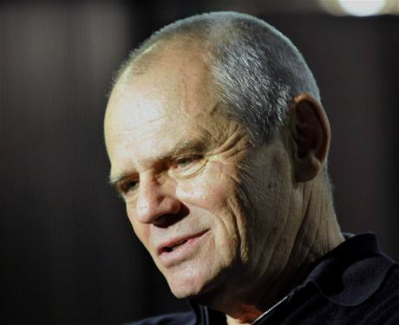
HZDS first rule (1992-1994)
Type of government?
  Officially HZDS ruled alone
  HZDS backed by 2 independents and also by nationalist SNS and leftist SDL
  One minister from SNS
Problematic features of the political style:
  University of Trnava
  Internal confrontations of Mečiar with other party officials → always ending with their departure from HZDS

Slide 14
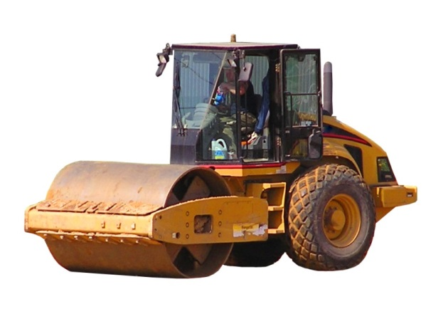
End of government in 1994
1993 – Michal Kováč elected for president:
  Candidate of HZDS
  Very soon became independent and later an arch-enemy of Mečiar
Publication of Mečiar’s private „steamroll“ speech about gaining total power in the state
Spring 1994:
  President’s criticism of HZDS in parliamentary report
  Government did not survive a vote of no confidence

Slide 15
Interim government
Prime Minister – Jozef Moravčík
In office only for several months
Very heterogeneous coalition:
  Christian democrats - KDH
  Ex-communists – SDL
  Former HZDS members → Democratic Union (DU)
  Supported by Hungarian parties
Mečiar: „This is not a Slovak government. This is a rule of foreigners in Slovakia.“

Slide 16
Support of HZDS

Slide 17
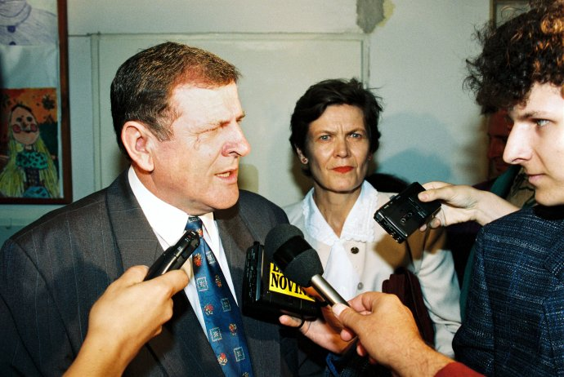
1994 Election

Slide 18
Early election 1994
Party | Votes (in %) | Seats (in %)
HZDS | 34,96 | 61
SDL (SV) | 10,41 | 18
Hungarian parties | 10,18 | 17
KDH | 10,08 | 17
DU | 8,57 | 15
ZRS | 7,34 | 13
SNS | 5,4 | 9
Others | 13,06 | 0
 |  | 150

Slide 19
Early election 1994
Party | Votes (in %) | Seats (in %)
HZDS | 34,96 | 61
SDL (SV) | 10,41 | 18
Hungarian parties | 10,18 | 17
KDH | 10,08 | 17
DU | 8,57 | 15
ZRS | 7,34 | 13
SNS | 5,4 | 9
Others | 13,06 | 0
 |  | 150

Slide 20
Early elections 1994

Slide 21
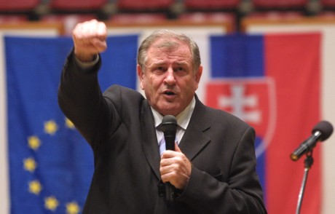
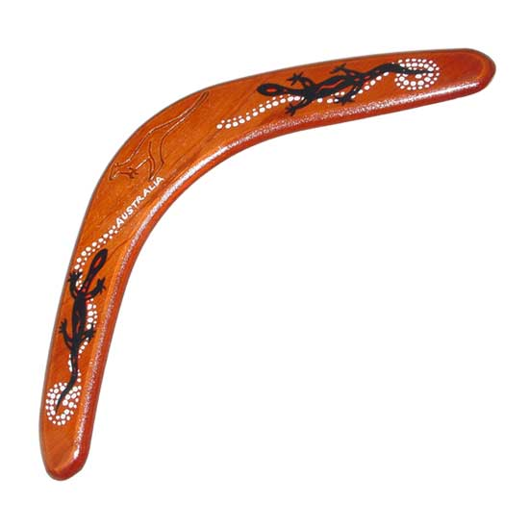
Government 1994 - 1998
Prime Minister – Vladimír Mečiar
Extremely heterogeneous coalition
Dominance of HZDS
Most problematic Slovak government since 1993 until now
„This is not a Prime Minister. This is a boomerang.“
(Milan Markovič, comedian)

Slide 22
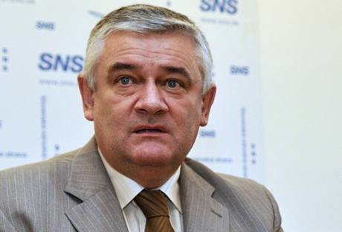
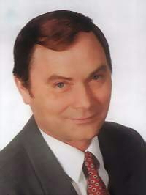
Coalition partners of HZDS
SNS:
  1993 – Ján Slota elected as leader
  Far right party
ZRS (Association of Slovak Workers):
  Created in 1994 by secession from SDL
  Radical left, populism
  Leader – Ján Ľupták

Slide 23
Government – problematic features
1. Mastery of state and its institutions
2. Economic policy
3. Power performance and clientelism
4. Mečiar as the leading factor
5. Public media
6. Search for enemies

Slide 24
1. Mastery of state
Traditions of power control:
  Independent audit institutions
  Independent media
  PR electoral system transformed into parliamentary committees
No respect to these traditions
In accordance with Mečiar’s „steamroll“ speech

Slide 25
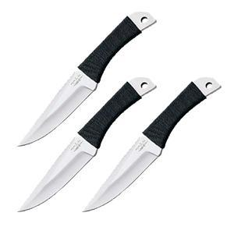
1. Mastery of state
November 1994:
  „The long parliamentary night“
  „Night of the long knives“
Demonstration of power in parliament:
  Opposition MPs granted only low rank positions
  Full power in parliamentary control committees
  Change of leadership in media, General Attorney, National Audit Office etc. (38 offices)
Violation of laws and constitution
Mečiar: „The elections are over. Get used to it“

Slide 26

2. Economic policy
Vast privatization of state property
Aim to create a Slovak „capital-generating“ class
The real story:
  Unprofitable sells to people connected to the governmental parties
  Direct sells without competition
 | 1995 | 1996 | 1997
Price as % of value | 74,67 | 28,17 | 18,02

Slide 27

East Slovakian Ironworks
March 1994 (the day of Mečiar`s fall):
  Sell of 10 % of shares to Mečiar’s friend Alexander Rezeš
  His company was created on the same day
Rezeš became member of Mečiar`s government after election 1994 and the state sold him further shares
1997 – Rezeš controlled about half of the shares (f.e. bought the football club Sparta Prague)
After 1998 – risk of bankrupt → company sold to U.S. Steel

Slide 28
3. Power performance
Forced stability of parliamentary groups:
  Contracts with MPs
  Exclusion of disloyal MPs from the parliament
Colonization of the state service:
  New territorial division of Slovakia
  Assignments only of fully loyal people or party members to this positions → rise of HZDS membership
Vast clientelism:
  Creation of alternative professional associations (journalists, towns, NGOs)

Slide 29
4. Mečiar as the leading factor
Most important person in the government and HZDS
A sole decision maker
Highest popularity of all during most of the 90s
Close to a personality cult among his supporters
Direct contact with voters on regular mass meetings
„The father of the nation“, „Only he“ (LenOn in Slovak)

Slide 30
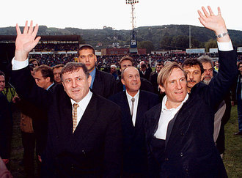
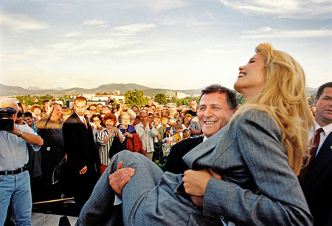
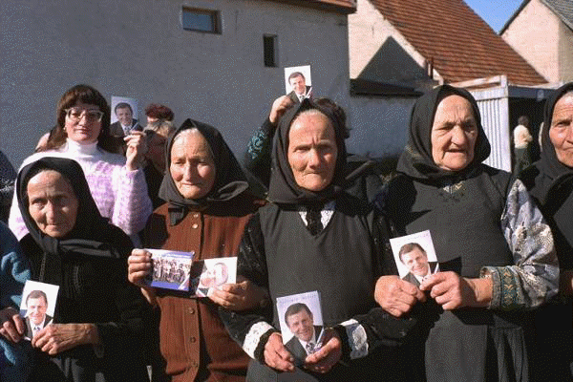
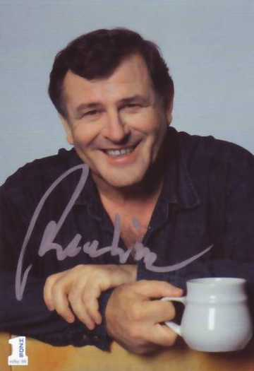

Slide 31
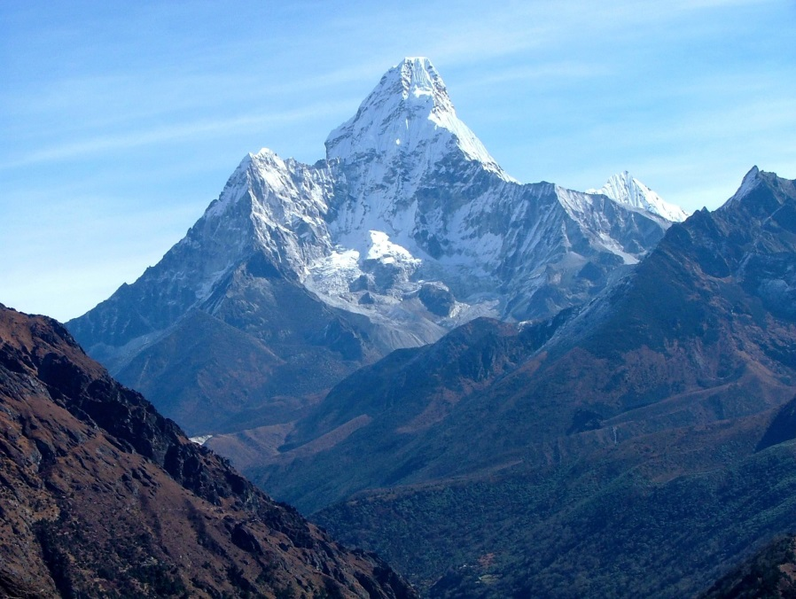
The peak of world
HZDS - `Where no political party has gone before`
1998 – successful expedition to climb Mt. Everest
After successful climb three flags have been installed on the top – Chinese, Slovak and HZDS

Slide 32
5. State owned media
Full control of these media acquired during the long parliamentary night in November 1994
The nationwide Slovak television:
  Absolute support during years 1994 – 1998
  Propagation during campaign 1998 – more than 4x more time devoted to government than the opposition
  Journalists moderated HZDS campaign meetings (!)
Minor newspapers (The Slovak Republic), party magazines

Slide 33
6. Search for enemies
Opposition:
  Not allowed to exercise real control of the politics
  Aim of HZDS to exclude DU from parliament
  Portrayed as the enemies of the country
President:
  No. 1 personal enemy of Mečiar
  Government had no power to force him to resign
  Graduation of confrontation

Slide 34
6. Search for enemies
A clear sign of Mečiar’s style of politics
Internal enemies:
  Hungarians, opposition, president
  Mečiar revealed 9 attempts of his assassination
External enemies:
  EU, NATO – application of double standard
Combination:
  Conspiracy theories about aims to end the government

Slide 35
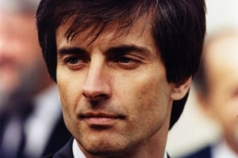
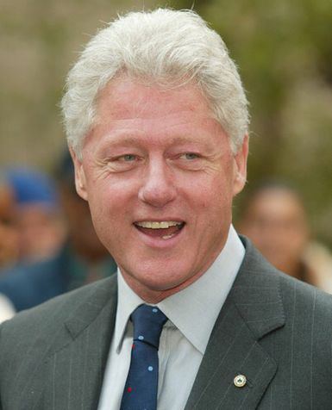
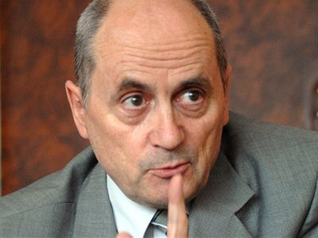
The masterplan

Slide 36
Impact of the government 1994 -98
Economic problems
Character of the regime:
  Definitely not a liberal democracy neither an authoritarian regime
  Possibly a hybrid regime
Devastated foreign image:
  Isolation, exclusion from integration to EU and NATO
  Madelaine Albright called Slovakia a „black hole on the map of Europe“

Slide 37
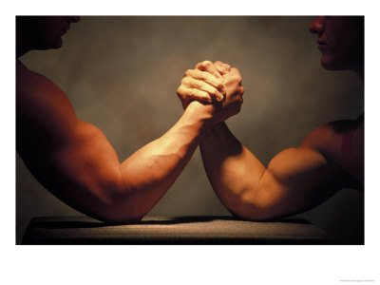
Party system
Extremely polarized
Division into two blocs – pro-Mečiar and anti-Mečiar
Party of the Civic Understanding (SOP):
  Leader – Rudolf Schuster (ex-communist, popular mayor of Košice)
  Vague ideology, populism
  Aim – to fill the position between the blocs
  Forced to choose → anti-Mečiar bloc

Slide 38
Party system
Integration and cooperation of opposition
Slovak Democratic Coalition (SDK):
  KDH, DU, DS, social democrats, greens
  Prevailing centre-right orientation
Opposition more popular than government → electoral reform only few months before elections aimed against coalitions (SDK, Hungarians)
Transformation of these coalitions into single parties

Slide 39
Public support

Slide 40



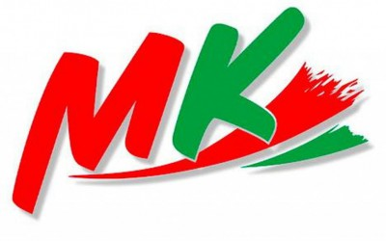

The „map“ of the party system in 1998
Pro-Mečiar bloc:
  HZDS
  SNS
  ZRS
Anti-Mečiar bloc:
  SDK
  SDL
  SOP
  SMK (Party of the Hungarian Coalition)

Slide 41
Elections 1998
Party | Votes (in %) | Seats (in %)
HZDS | 27 | 43
SDK | 26,33 | 42
SDL | 14,66 | 23
SMK | 9,12 | 15
SNS | 9,07 | 14
SOP | 8,01 | 13
ZRS | 1,3 | 0
Others | 5,81 | 0
 |  | 150

Slide 42
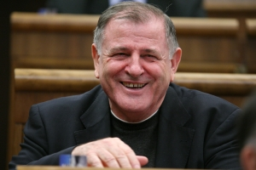
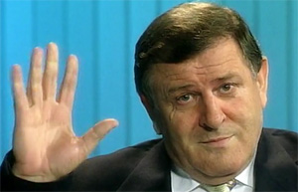
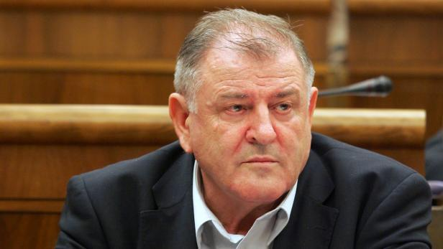
The fate of Mečiar

