Slide 1
Recent Development
Kuciak, 2020 Election, COVID-19
Peter Spáč

Slide 2
Support of SMER-SD (2012-2016)

Slide 3
2016 General Election

Slide 4
New Government
Decline of SMER-SD excluded the scenario of a one-party government
Two scenarios:
  SMER-SD + several partners
  Grand coalition without SMER-SD
Final outcome:
  SMER-SD, SNS, Most-Hid, Network
  Fico as the PM for the third time
  Network collapsed shortly after that and part of its MPs went to Most
“The barrier against extremism”

Slide 5
Acceptance of the government SMER-SD, SNS, Most-Hid, Network
 | Acceptable | Not acceptable | Do not know
SMER-SD | 85 | 11 | 3
SNS | 60 | 29 | 12
Most-Hid | 39 | 47 | 13
Network | 36 | 45 | 18
KDH | 31 | 53 | 16
We are Family | 23 | 62 | 15
LSNS | 19 | 71 | 10
SaS | 19 | 77 | 4
SMK | 16 | 84 | 0
OLaNO | 13 | 84 | 3
Non voters | 30 | 45 | 25
All | 39 | 47 | 14

Slide 6


Slide 7
The Breaking Point in February 2018
Murder of investigative journalist J. Kuciak and his fiancée M. Kušnírová at their home
Tremendous consequences:
  Public impact comparable to November 1989
  Mass demonstrations around the whole country
  Shifts in public opinions
  Personal earthquake in the government
  Negative effect primarily on SMER-SD

Slide 8
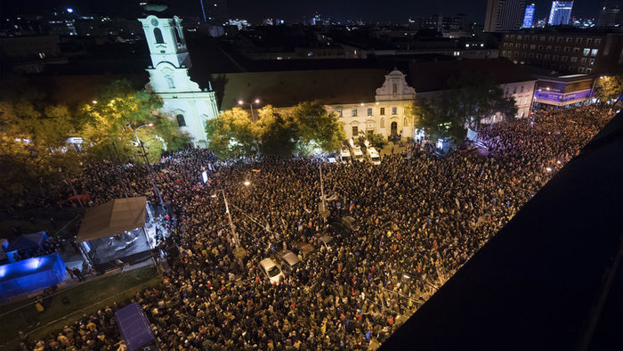
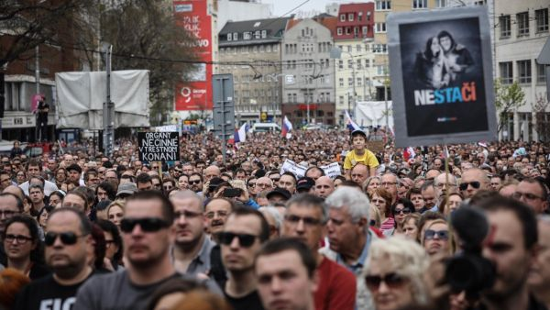
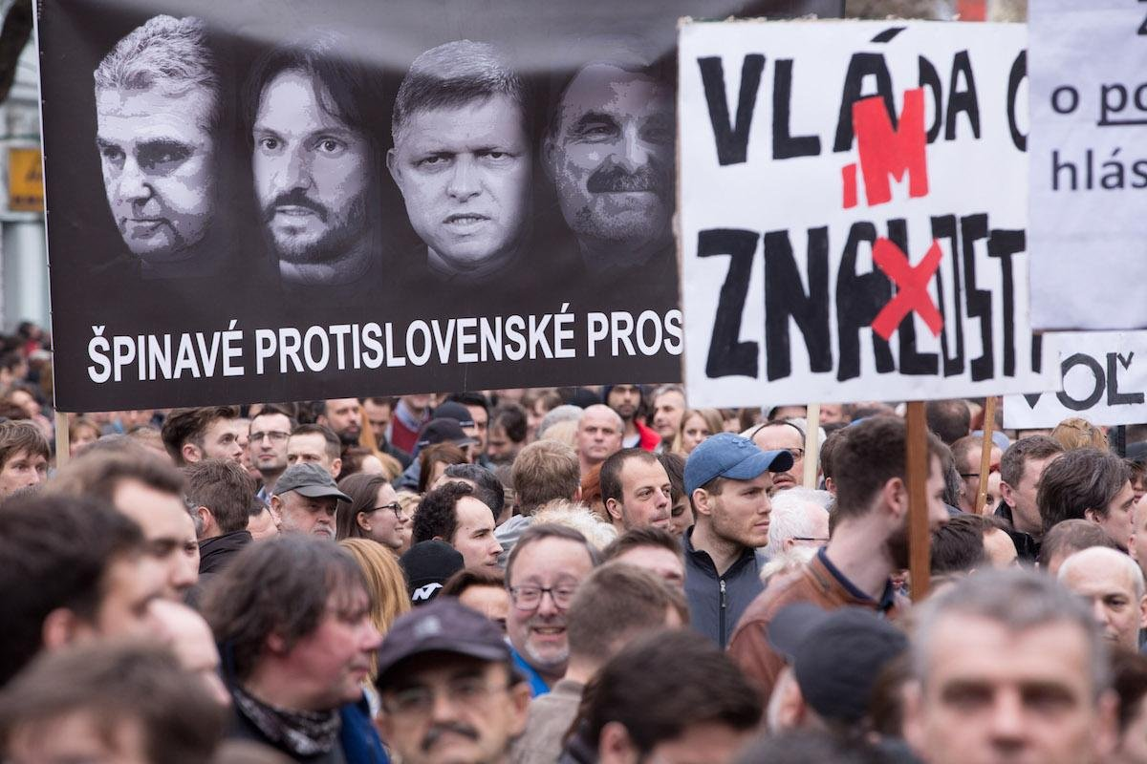
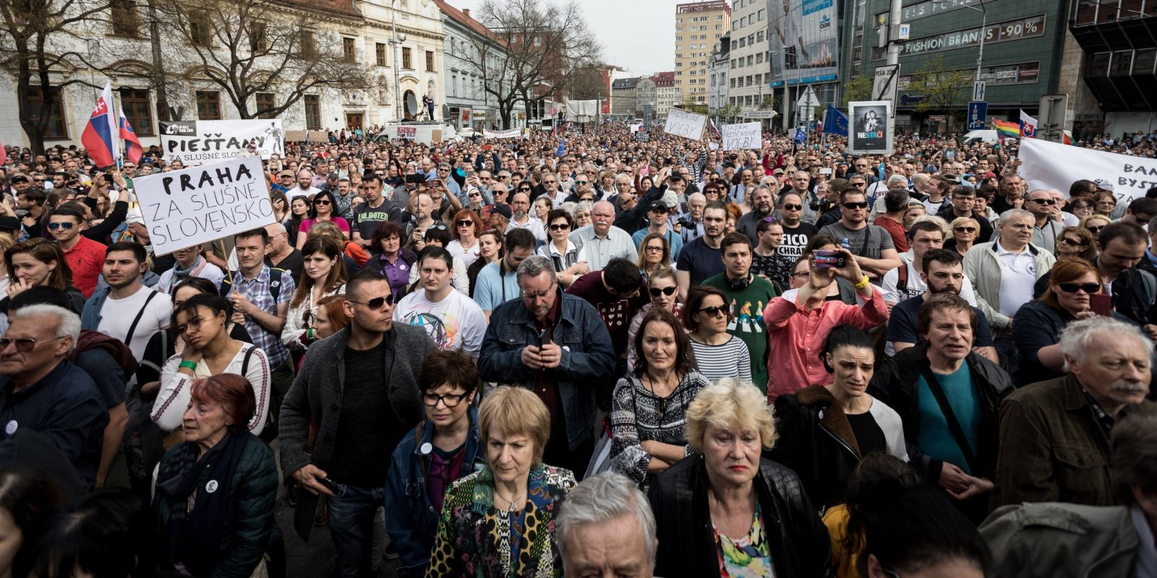

Slide 9
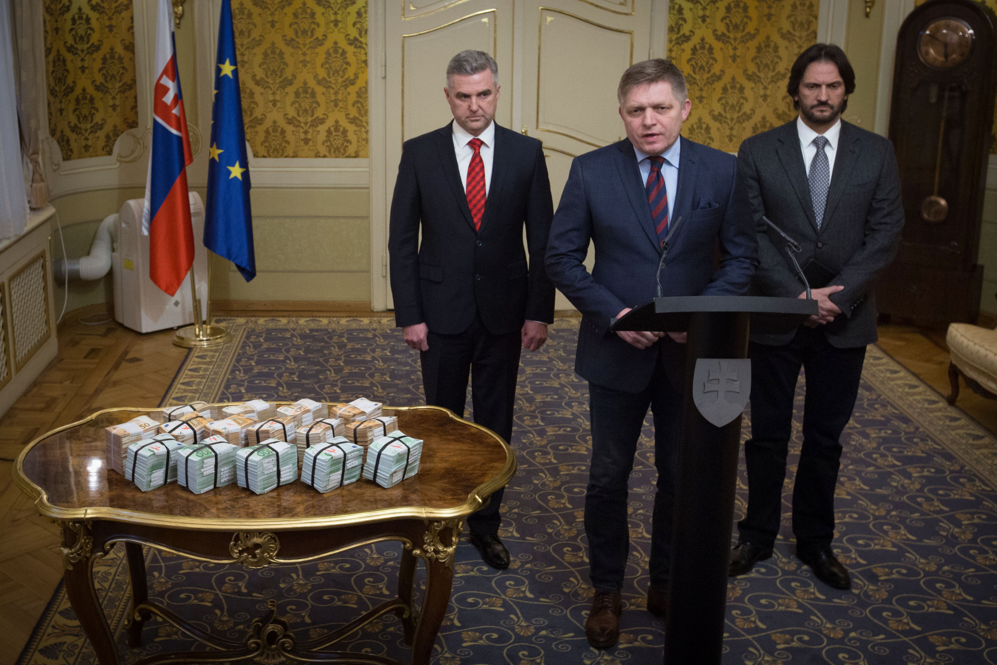

Slide 10
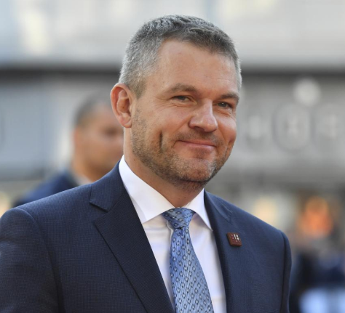
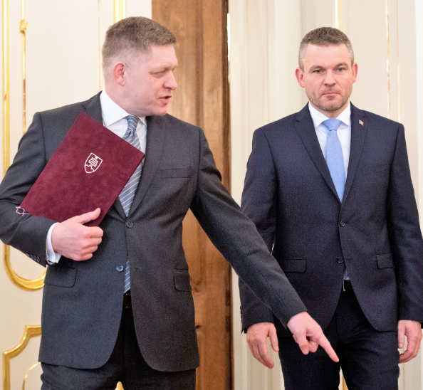
Personal Consequences
Various prominent officials forced to step down
  PM Fico
  Minister of Interior Kaliňák
  President of the Slovak Police Force Gašpar
Peter Pellegrini as the new PM (SMER-SD)
  Fico remained as SMER-SD leader
The General Attorney promised to unleash “hell”

Slide 11
Support of SMER-SD

Slide 12
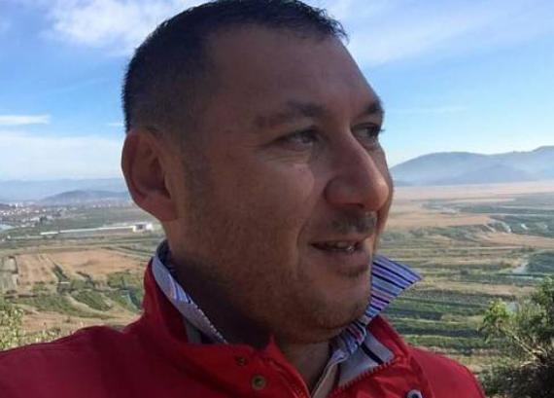
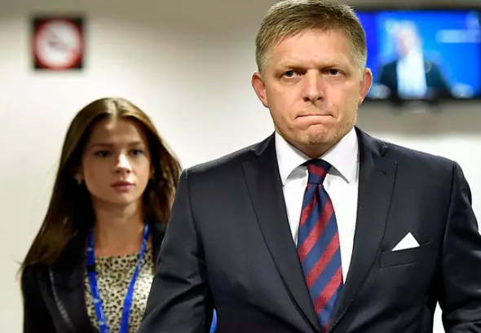
Investigation (1)
The Italian scenario

Slide 13
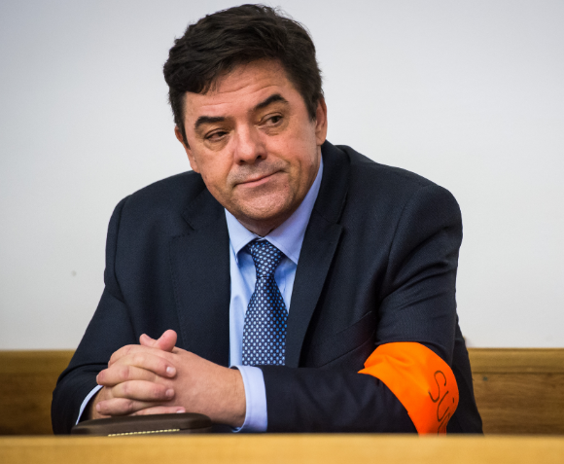
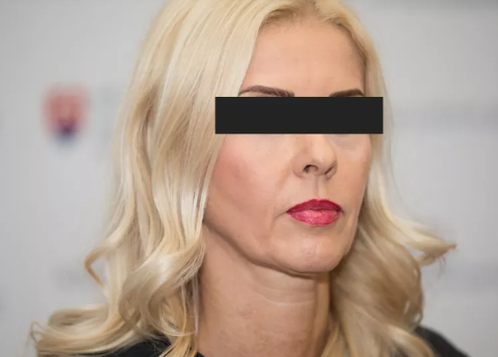
Investigation (2)
The Kočner network scenario
Murder as revenge
Network of judges granting him protection
Threema

Slide 14



New parties in the opposition
Progressive Slovakia (centre-left and liberal)
Together – Civic Democracy (centre-right)
Successful cooperation in 2018 local and 2019 EP and presidential election
For the People:
  Established by Andrej Kiska after finishing his mandate
  More conservative leaning

Slide 15
Four Months Before Election
Party | Votes in % | Votes - Threshold | Projected Seats
SMER-SD | 20.0 | 15.0 | 36
PS – Together | 11.7 | 4.7 | 21
For the People | 10.6 | 5.6 | 19
LSNS | 10.3 | 5.3 | 19
We are Family | 7.0 | 2.0 | 13
SNS | 6.8 | 1.8 | 13
KDH | 5.7 | 0.7 | 10
OLaNO | 5.7 | 0.7 | 10
SaS | 5.0 | 0.0 | 9
Most-Hid | 4.1 | -0.9 | 0
Survey by Focus Agency, October 30 – November 6, N = 1,020

Slide 16
Integration Attempts
“Democratic” opposition:
  PS-Together, For the People, OLaNO, SaS, KDH
  Separate line of KDH
  For the People only accepted a cooperation of all parties or nothing
  as a result, all parties continued alone (and PS-Together as a coalition)
„If there are too many parties just above the threshold, it is naive to expect that voters will coordinate their behavior to save all of them”

Slide 17
Further Integration Attempts
Hungarian parties:
  Both Most-Hid and SMK (now as MKO-MKS) below the threshold
  Too many Hungarian parties for a single Hungarian minority
  Initial hope ended without any result
Far right and protest parties:
  LSNS and the newly emerged Homeland
  Kotleba and Harabin scored 530,000 votes in 2019 presidential election (roughly ¼ of all votes)
  Discussions on integration failed

Slide 18
Main Topics in the Campaign
The 2018 murder
  Second anniversary only a few days before the election
Corruption, scandals of SMER-SD, linkages to Kočner
Rise of LSNS and extremism in general
Unsuccessful attempt to bring back “old” topics, e.g. immigrants

Slide 19


Slide 20
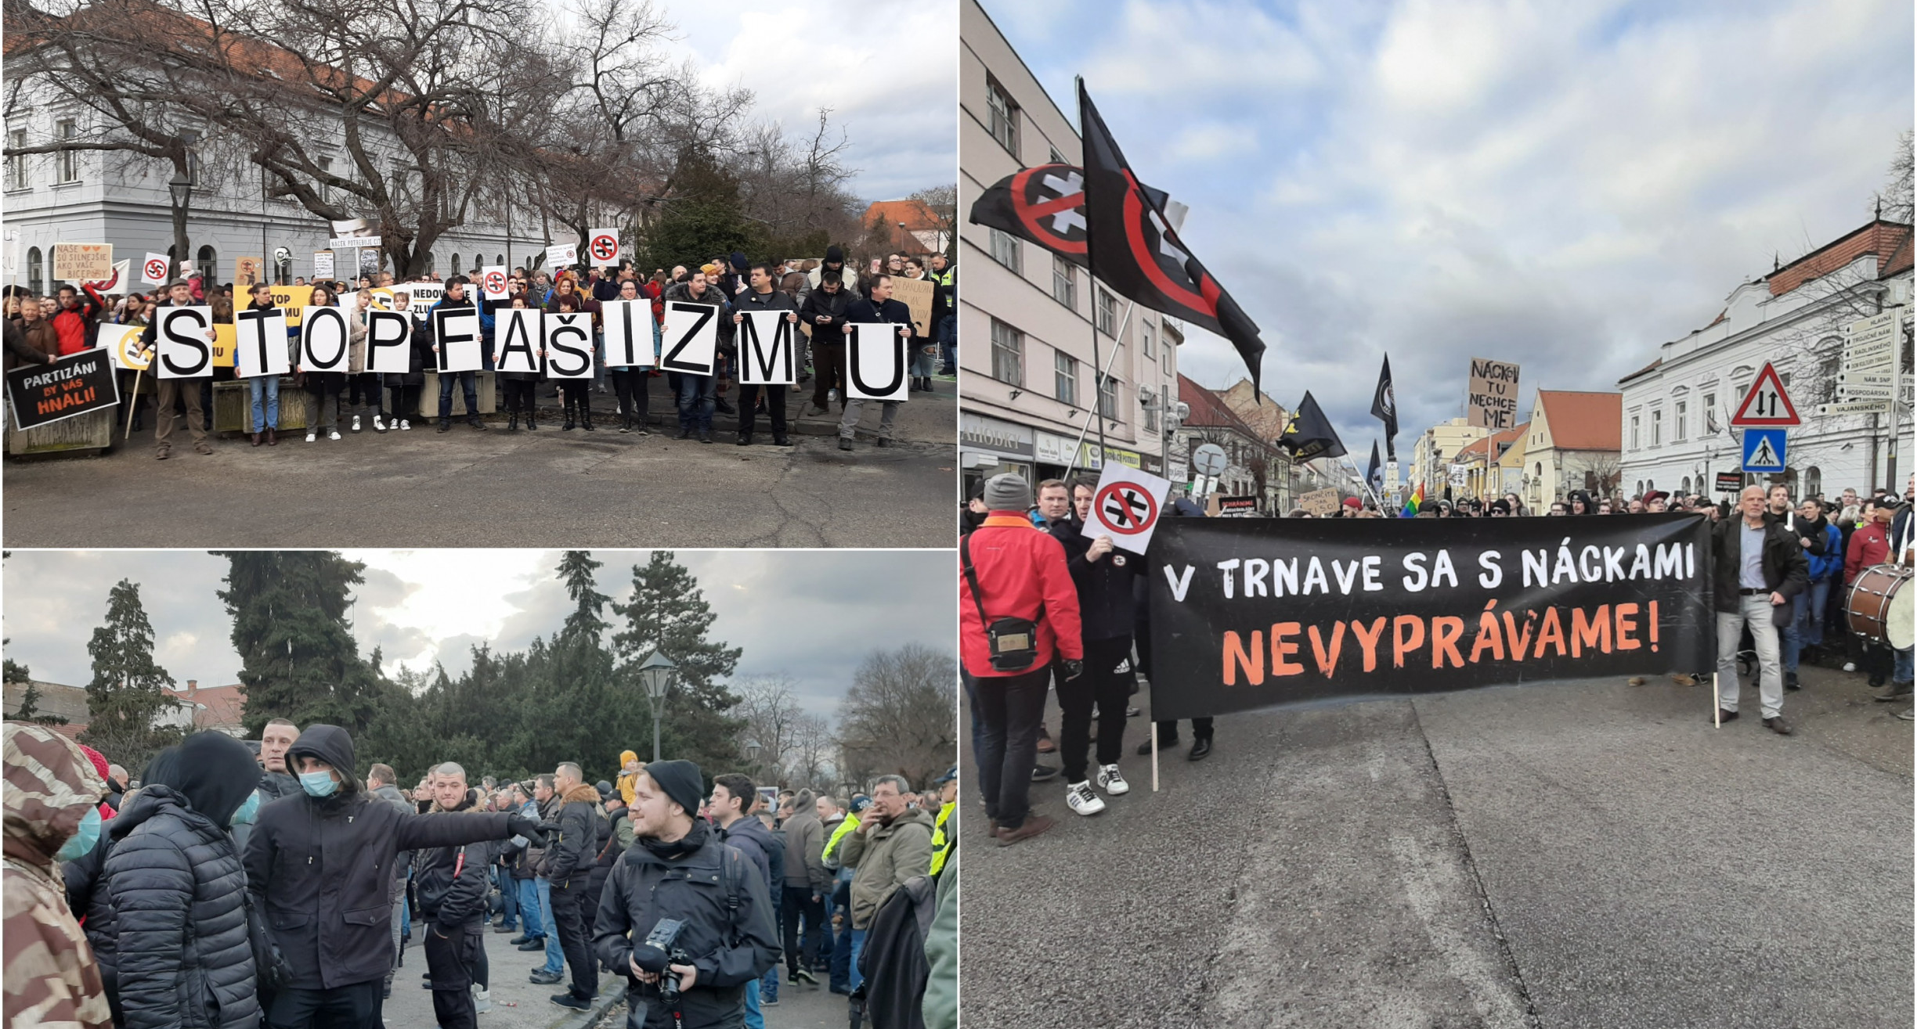

Slide 21
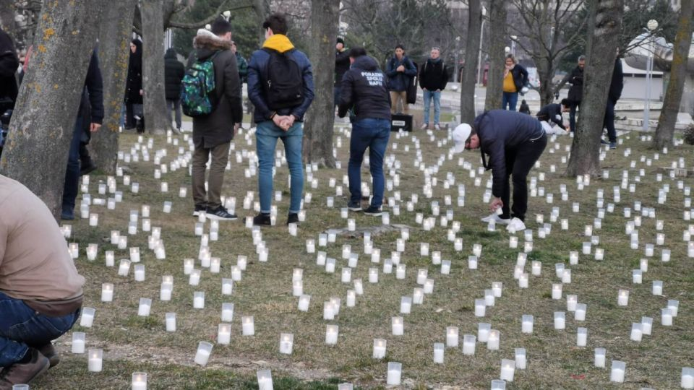
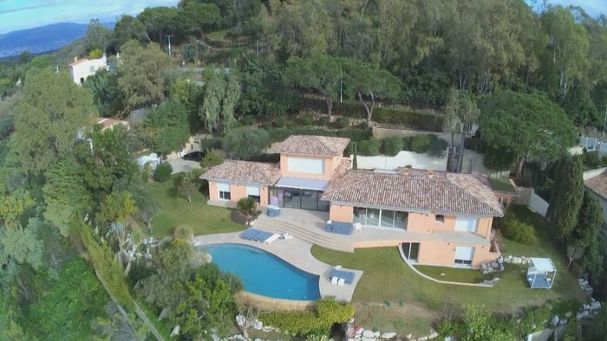
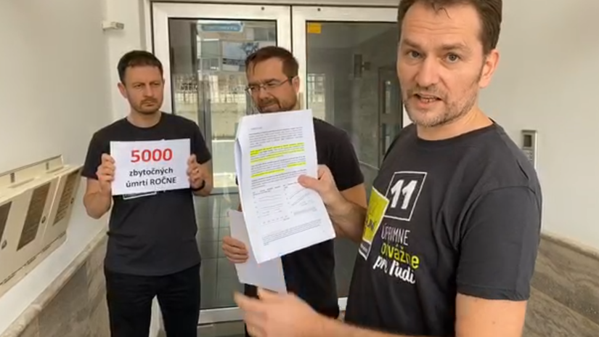
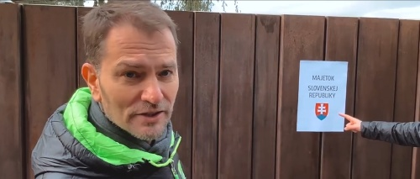

Slide 22









Expert Evaluation of the Campaign (N = 56)

Slide 23
Few Days Before the Election
SMER and SNS announced vast social benefits before the election
13th pension
Doubling of child allowances
Abolishment of highway tolls
The parliament passed only the pensions
  SMER-SD, SNS, LSNS, We are Family

Slide 24
2020 general election

Slide 25
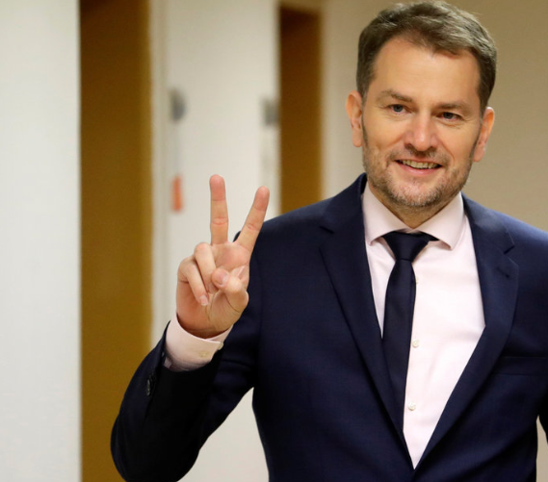
New Government
OLaNO, We are Family, SaS, For the People
PM Matovič
95 MPs (90 required to amend the Constitution)
Question of stability and survival

Slide 26
Potential clashes
OLaNO:
  Largest governing party, 53 MPs
  Previous record of low stability
Anti-corrupt voter’s attitudes vs. Christian activists among MPs
Conservatives vs. liberals in the government
Two minor parties (For the People and SaS) weakened
  Andrej Kiska retired from his party and politics

Slide 27
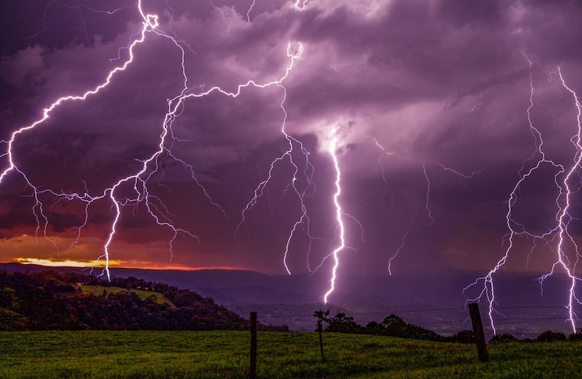
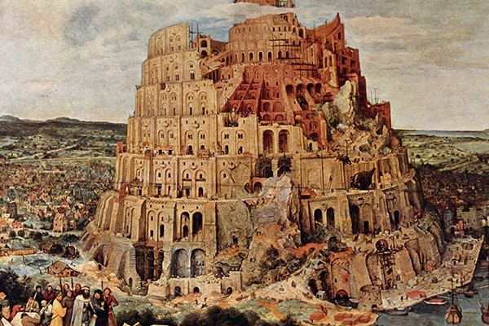
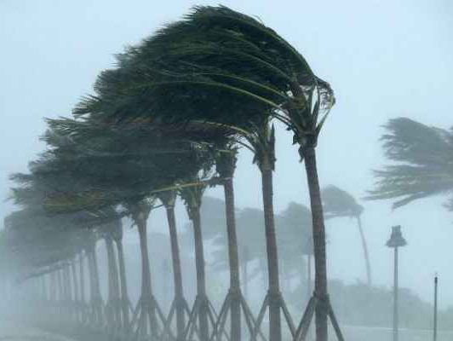
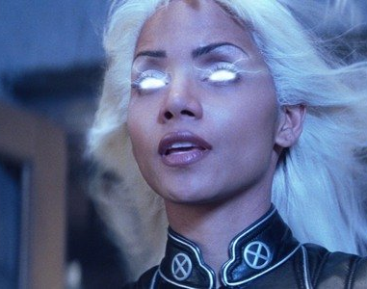
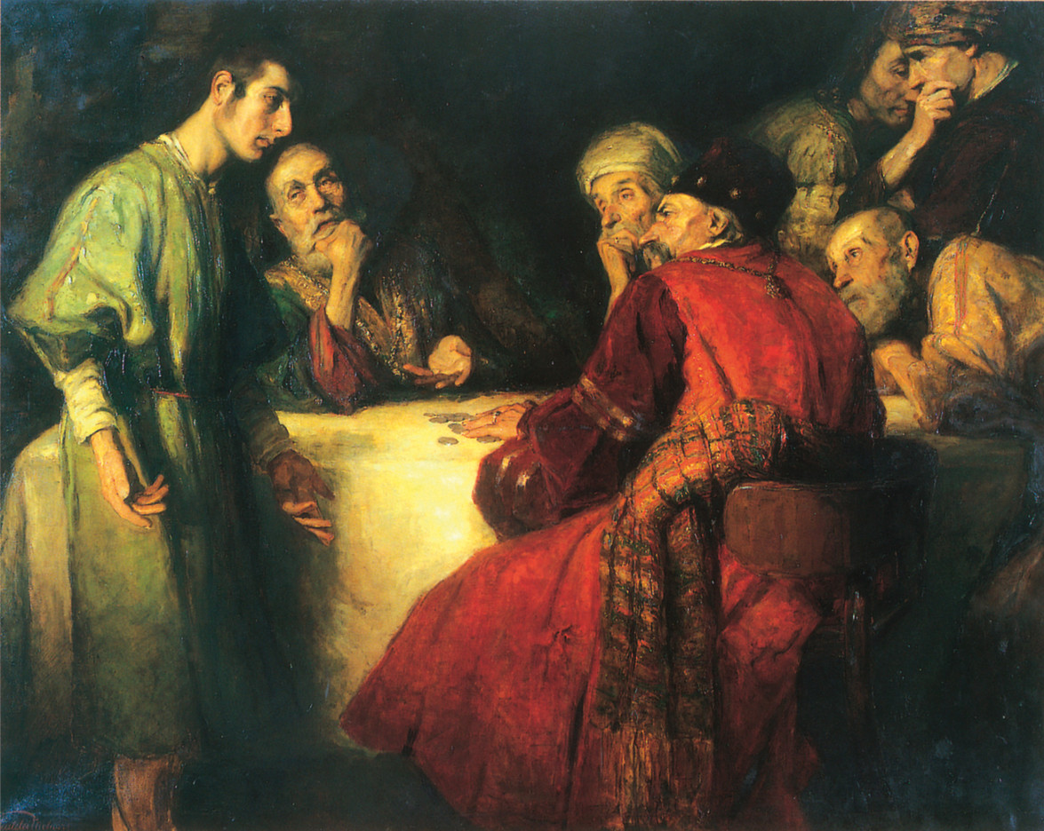

Slide 28
Anti-corrupt activities
“Mani pulite” in a Slovak way
Numerous arrests of prominent figures
  Judges, people in business, attorneys, police leadership
  Many already confessed they had committed crimes
Uncovering a huge corruption network allegedly linked to previous governing parties
Unleashed fantasy of police name generators:
  Storm, Tempest, Judas, Babylon, Purgatory, God Mills…

Slide 29
COVID-19
Spread of pandemic during the first days of the new government
  First positive test on March 6
Quick response similarly to other European countries
  Borders, lockdown, closure of schools, facemasks…
Spring to summer 2020:
  Great success in terms of numbers:
    Low number of cases
    Extremely low numbers of casualties
Before summer – weakening of adopted anti-pandemic restrictions

Slide 30
1st Wave of COVID-19

Slide 31
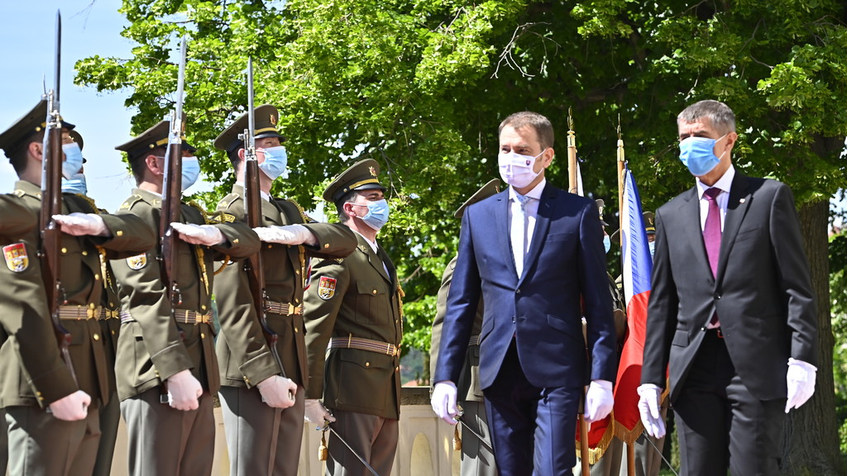
6 June 2020 – Borders re-opening

Slide 32
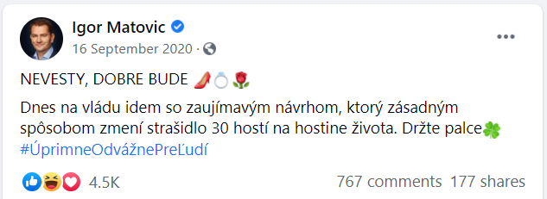
1st Wave of COVID-19 + Summer 2020

Slide 33
2nd Wave of COVID-19 – Cumulative Cases

Slide 34
2nd Wave of COVID-19 – Cumulative Deaths

Slide 35
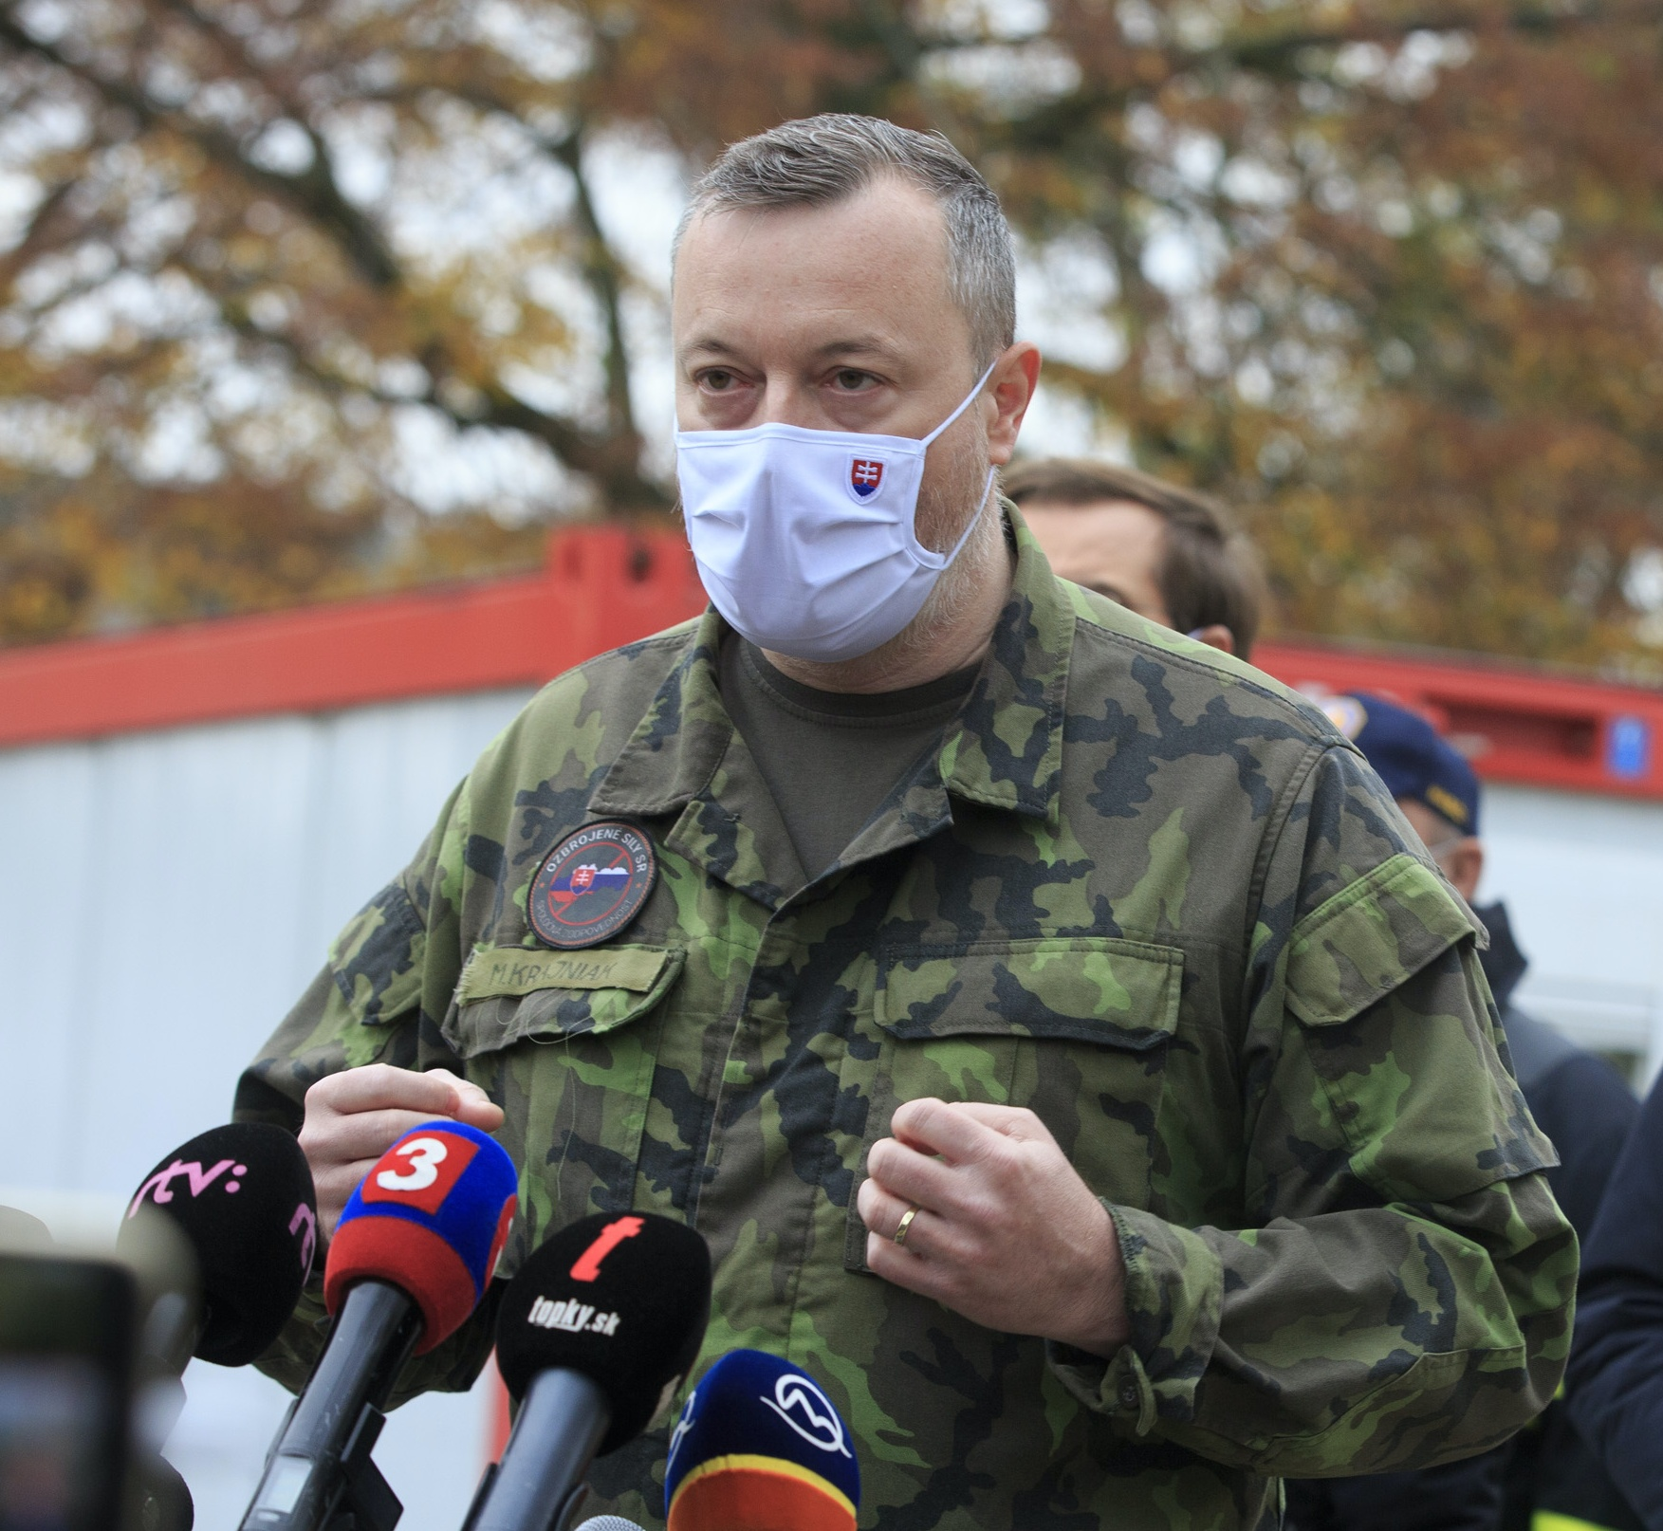
Atomic Weapon against COVID-19
Nationwide testing
Strongly supported by Prime Minister
‘The pass to freedom’
Held on October 31 – November 1
  More than 3.6 million people tested
  One per cent positives
Discrepancies over interpretation of its effects
Further rounds of testing in selected regions

Slide 36
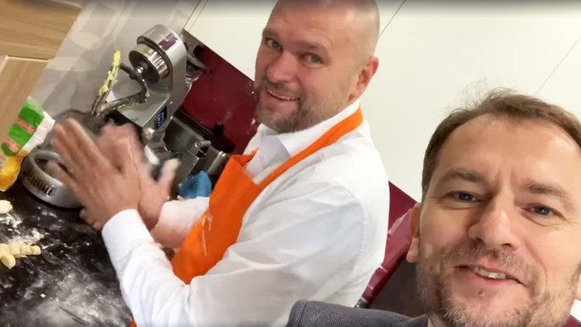
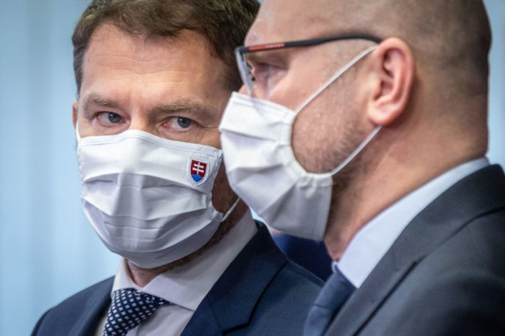
Rising conflicts in the government
Prime Minister Matovič v. SaS leader Sulík
Topics:
  Level of restrictions
  Nationwide testing
  Antigen tests purchase
Constant tensions between OLaNO and SaS
Enhanced by public opinion development

Slide 37
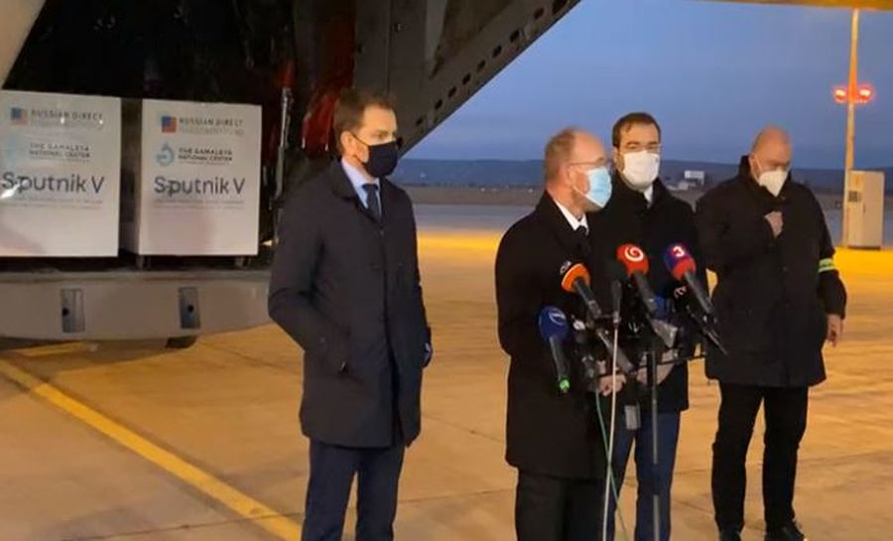
Government Crisis in March 2021
Escalation of previous development
Communication of PM – Facebook politics
Matovič v. Sulík
Atomic weapon v. reality
Purchase of unauthorized Sputnik V vaccine as the trigger

Slide 38
Government Crisis in March 2021
SaS and For the People demanded Matovič to resign
Various firmness of such demands – SaS v. For the People
A series of resignations of several members of the government
  All ministers of SaS (including Sulík), one minister of For the People
  One resignation from We are Family which remains a mystery
Matovič facing risk of losing majority in parliament
For the People facing risk of complete disintegration

Slide 39
Government Crisis in March 2021
Main scenarios:
  SaS leaves the government (80)
  SaS and For the People leave the government (70)
‘Reconstruction’ of the government:
  Matovič ends as PM and switches office with Ministry of Finance
  SaS and For the People ministers return back to their offices
  The resignation of the minister of We are Family still remains a mystery
Improving COVID-19 statistics as a factor?

Slide 40


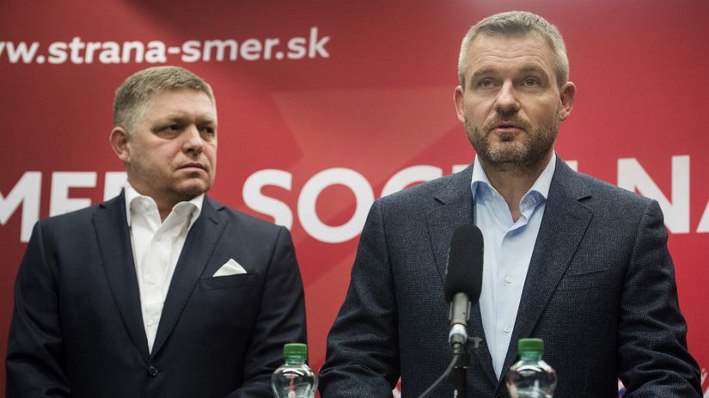
Dynamic Development in Opposition
Voice – Social Democracy:
  Splinter party from SMER-SD
  Leader Peter Pellegrini
  Support of 20-25 per cent of voters
  Hidden strategy?
SMER-SD:
  Fico’s unchallenged leadership
  Sharp decline of support
  New position of a small party

Slide 41
Referendum 2021?
Referendum for early election
Non-partisan initiative fully organized by political parties
  SMER-SD, Voice, SNS
Negative record of such referendums v. discontent in the society
  COVID-19 restrictions
  Economic impact of the pandemic
  Death of previous Police President
In April 2021 SMER-SD announced it gathered enough signatures

