Slide 1
Political system of Slovakia
Parliament, government, president
Peter Spáč

Slide 2
Freedom House Rating (1 – 7 scale)

Slide 3
Freedom House Rating 2021
Country | Political Rights (max 40 points) | Civil Liberties (max 60 points) | Result
Czech Rep | 36 | 55 | 91 (FREE)
Hungary | 26 | 43 | 69 (PARTLY FREE)
Poland | 34 | 48 | 82 (FREE)
Slovakia | 37 | 53 | 90 (FREE)

Slide 4
Division of power
Legislative:
  Parliament
Executive:
  Government
  President
Judicial

Slide 5
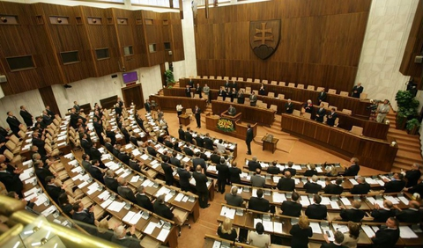
Parliament
Name:
  Until 1993 – Slovak National Council
  Since 1993 – National Council of Slovak Republic (NR SR)
Unicameral, 150 MPs
4 year electoral term

Slide 6
Parliament
Free (representative) mandate
MPs :
  Are not bound by any directives
  Act according to their „sense and conscience“
  Cannot be dismissed from NR SR except a few situations stated by law
  Cannot be revoked by voters

Slide 7
Parliament - powers
Adoption of law
Control of the government and the executive power in general
Main arena for government-opposition relations
Personal nominations:
  Chairman of the Supreme Audit Office
  General Attorney

Slide 8
Legislative process
Condition – at least 76 MPs have to be present
Issue | MPs needed
Common decisions and „regular“ laws | Majority of at least the needed 76 MPs
Overriding president’s veto | 76 MPs (majority of 150)
Constitution, war declaration | 90 MPs (three fifths of 150)

Slide 9
Electoral law
A crucial field with impact on the political system
Constitution:
  „Deputies are elected by secret ballot in general, equal, and direct elections. (..) Details concerning the election of deputies will be set out in a law.“
How many MPs (at minimum) are needed to change the electoral system?

Slide 10
Executive power
Traditional division into two main subjects:
  Government
  President
Government as the most powerful body in Slovak politics
Weak president with a question mark

Slide 11
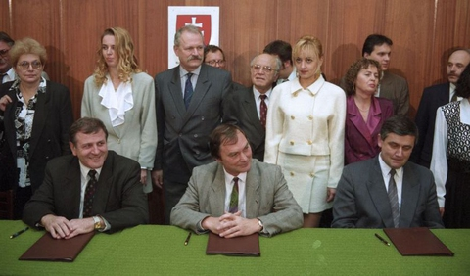
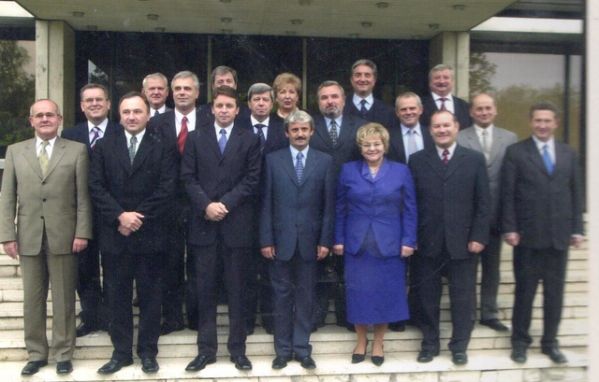
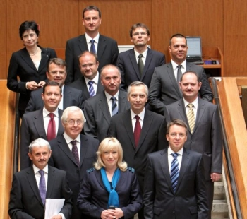
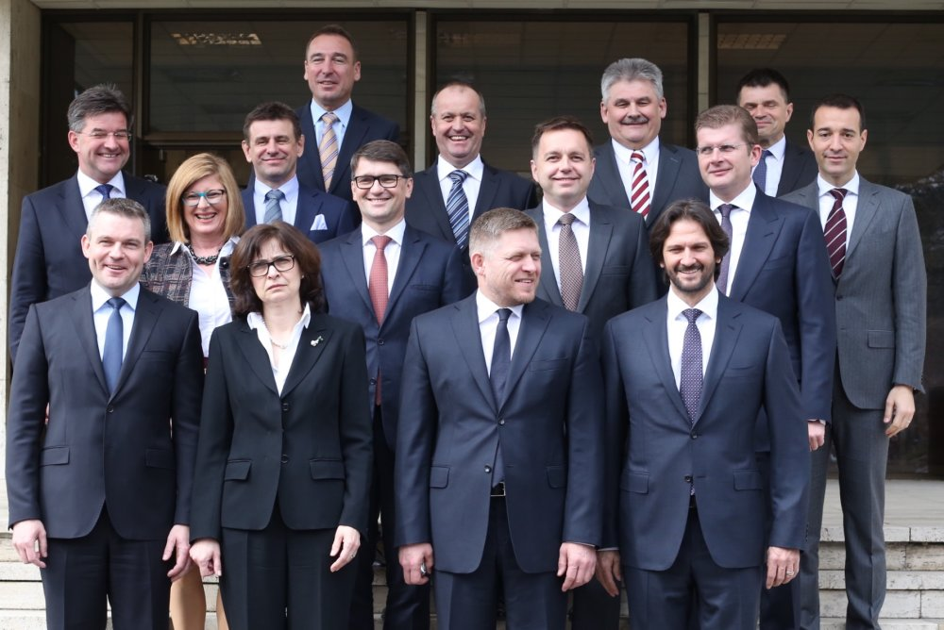

Slide 12
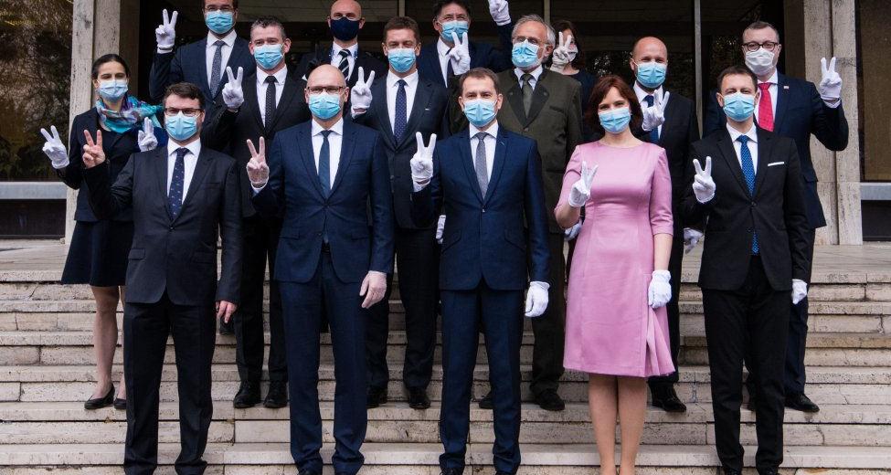
Government after 2020 election

Slide 13
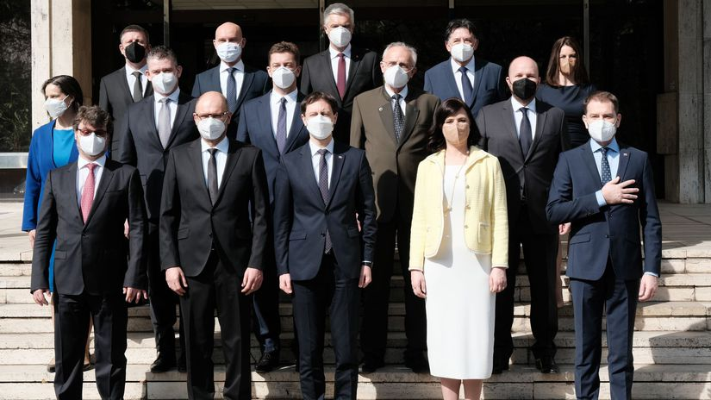
…and after 2021 reconstruction

Slide 14
Government
Responsible to NR SR
A vote of no-confidence may concern:
  The government as a whole
  Each individual minister
Votes of 76 MPs needed
Very often a symbolic gesture of opposition`s dissatisfaction with government’s results

Slide 15
Term | Government | Members | Months (app.)
1990 – 1991 | Mečiar | 3 | 11
1991 - 1992 | Čarnogurský | 3 | 14
1992 – 1994 | Mečiar II | 1 (?) | 22
1994 | Moravčík | 3 | 9
1994 – 1998 | Mečiar III | 3 | 47
1998 – 2002 | Dzurinda | 4 | 48
2002 – 2006 | Dzurinda II | 4 | 46
2006 – 2010 | Fico | 3 | 48
2010 – 2012 | Radičová | 4 | 21
2012 – 2016 | Fico II | 1 | 48
2016 - 2018 | Fico III | 4 → 3 | 24
2018 - 2020 | Pellegrini | 3 | 24
2020 - 2021 | Matovič | 4 | 12
2021 - ? | Heger | 4 | 1*

Slide 16
President
The head of the state
The highest state official
Elected for 5 years – vs. 4 years of parliament (and possibly the government)
De facto not responsible for performing the office

Slide 17
President - elections
Originally elected by the parliament
High polarization in 90s → inability to elect new president
Result - for more than one year Slovakia had no head of state (1998 – 1999)
Solution – direct elections since 1999 based on two-round system

Slide 18
President - elections
„Majority of valid votes of the eligible citizens“
What sort of majority is that?
Eligible citizens: 4 409 793
Voted: 1 914 021
How many votes does a candidate need for victory?
  Most constitutional lawyers say a majority of 4,4 mil. votes is needed but not all agree

Slide 19
President - powers
Belongs to weaker presidents
Numerous powers not only of symbolic meaning
Adoption of direct elections in 1999 was not accompanied by strengthening of his/her position
Some powers were even weakened (countersignature)

Slide 20
President - powers
President and government:
  Appoints and recalls the Prime Minister
  Appoints and recalls ministers based on the proposal of the Prime Minister
  Since 1999 the proposal of Prime Minister is imperative
President and parliament (NR SR):
  No right of legislative initiative
  Dissolution of NR SR (very limited)
  Veto
  NR SR may call for a plebiscite about president’s revocation

Slide 21
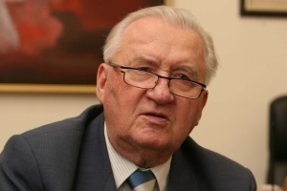
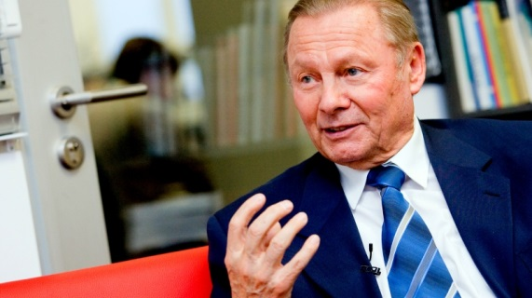
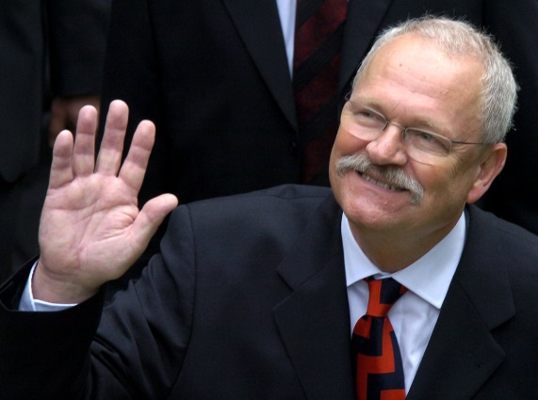
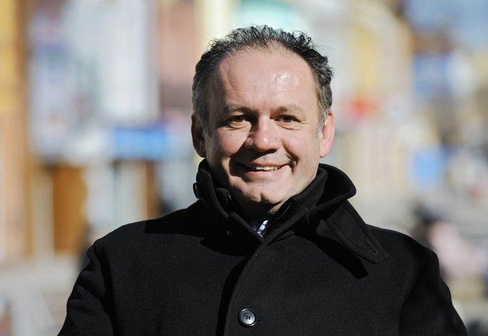
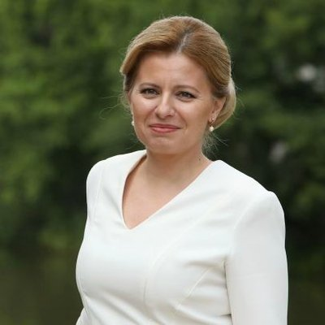
Slovak presidents
1993 – 1998 – Michal Kováč
1999 – 2004 – Rudolf Schuster
2004 - 2014 – Ivan Gašparovič
2014 – 2019 - Andrej Kiska
Since 2019 – Zuzana Čaputová

Slide 22
President in Slovak politics – decisive factor or a weak symbol?

Slide 23
Michal Kováč
  Economist, member of VPN and later HZDS
  Elected by parliament as nominee of HZDS
In office during two Mečiar’s governments
Expected loyalty to HZDS
Reality:
  Increasing independence from his party
  Raising conflicts with Mečiar
  Finally became the arch-enemy of HZDS and its chairman

Slide 24
Michal Kováč
1993 – 1994 – „the separation“:
  Presidential report in NR SR in spring 1994
  Impact → end of Mečiar’s government
1994 – 1998 – „the open war“:
  Mostly one-sided conflict
  Aim of Mečiar to weaken, delegitimize and humiliate the president

Slide 25
Michal Kováč
Revocation of president’s powers not backed by constitution
NR SR called a no-confidence vote even without any legal impact
Verbal accusation of high treason
Installment of digital clocks showing the remaining days of Kováč’s term

Slide 26
Michal Kováč
Kidnapping of Kováč’s son to Austria
Organized by Slovak secret service under leadership of HZDS nominee (never officially confirmed by court)
Later events:
  Violent death of direct witness
  Mečiar’s amnesty on the whole case
2012 – court ordered Kováč to apologize to that time director of the secret service

Slide 27
Rudolf Schuster
First directly elected president
Career:
  High communist official before 1989
  After 1989 – chairman of Slovak parliament, diplomat, mayor of Košice
Presidential election in 1999:
  Nominee of his party SOP with support of the majority of Dzurinda’s government
  Defeated Mečiar in 2nd round with 57,2 : 42,8 %

Slide 28
Rudolf Schuster
Aware of his own stronger legitimacy
Prepared to be a more active head of state
Aim to create an alternative power arena under his supervision
  Round tables for political parties
  Supplementary arena for dialogue between parties
  Political parties strictly refused such arrangement

Slide 29
Rudolf Schuster
Gradually rising discontent with Dzurinda’s government
2000 – Schuster’s serious illness
2002 – Dzurinda’s centre-right government and its liberal economic reforms
Veto:
  1999 – used three times
  Later years – higher intensity
  Together used for more than 100 times

Slide 30
Tactics failure
2004 – trade unions backed by party SMER announced the idea of referendum for early elections
Public opinion strictly opposed to governmental economic reforms
Trade unions asked the president for help
Schuster joined the referendum with presidential elections

Slide 31
Tactics failure
Logic of the plan:
  Higher chance for referendum to be valid (turnout)
  Easier situation for SMER as it could mobilize for both presidential elections and referendum
  Support of trade unions and SMER for Schuster
Result:
  No support from SMER
  Trade unions asked people only to take part on elections

Slide 32

Ivan Gašparovič
Career:
  Since 1989 – general attorney, MP, chairman of NR SR, vice-chairman of HZDS
  2002 – left HZDS and created his own marginal party
Presidential elections 2004 and 2009:
  Nominee of nationalist parties and later SMER
  Defeated V. Mečiar in 2004 and I. Radičová in 2009
First reelected president so far

Slide 33
President |  | Government
1993 – 1998 | Michal Kováč | – 1994 | V. Mečiar
 |  | 1994 | J. Moravčík (interim)
 |  | 1994 - 1998 | V. Mečiar
 |  | 1998 - 2002 | M. Dzurinda
1999 - 2004 | Rudolf Schuster
 |  | 2002 - 2006 | M. Dzurinda
2004 - 2009 | Ivan Gašparovič
 |  | 2006 - 2010 | R. Fico
2009 - 2014 | Ivan Gašparovič
 |  | 2010 - 2012 | I. Radičová
 |  | 2012 - | R. Fico

Slide 34
Ivan Gašparovič
Two models of behavior
1. Loyalty and passivity
  During governments of R. Fico
  Helped Gašparovič to gain reelection
2. Criticism and activity
  During government of I. Radičová
  Usage of formal powers to block or delay governmental decisions

Slide 35
Ivan Gašparovič
Main differing tool – veto
Government | Term | Appointed laws | Veto used | Veto used (in %)
Fico | 2006 - 2010 | 530 | 28 | 5,28
Radičová | 2010 - 2012 | 208 | 29 | 13,94
Fico | 2012 - 2014 | 228 | 12 | 5,26

Slide 36
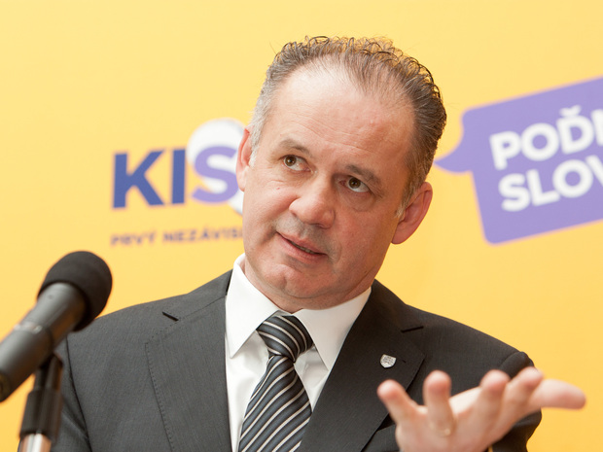
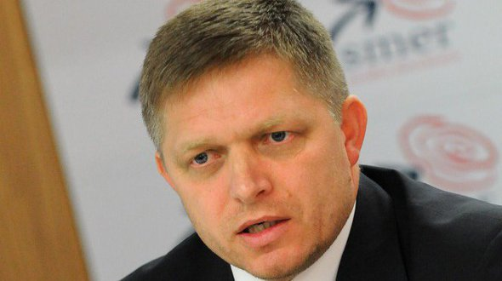
Elections 2014
40,6 % 59,4 %

Slide 37
Andrej Kiska
First non-partisan president
Businessman, chairman of charity organization
His `accompanying` Prime Minister was his main rival from presidential election
Found the party For the People (Za ľudí) after serving his office
The party scored 5.8 per cent in 2020 election and joined the government
Kiska seems to withdraw from (party) politics

Slide 38
Zuzana Čaputová
First female Slovak president
Lawyer and civic activist
Elected as a candidate of Progressive Slovakia party
Won in runoff against nominee of SMER-SD
After two years in office still highly popular among most segments of society

Slide 39
Real position of president
Not the leading factor of Slovak politics
Indicators:
  Weak party and political background
  Position „in between“ the parties and not „above“ them
  No alternative power arena
Will this status quo last for the future?
  Depends on whether some party leader obtains the office (unsuccessful attempt of R. Fico in 2014)

