Slide 1
Youth Development in Chinese Context: Family-Based Perspective
Yi Huang

Slide 2
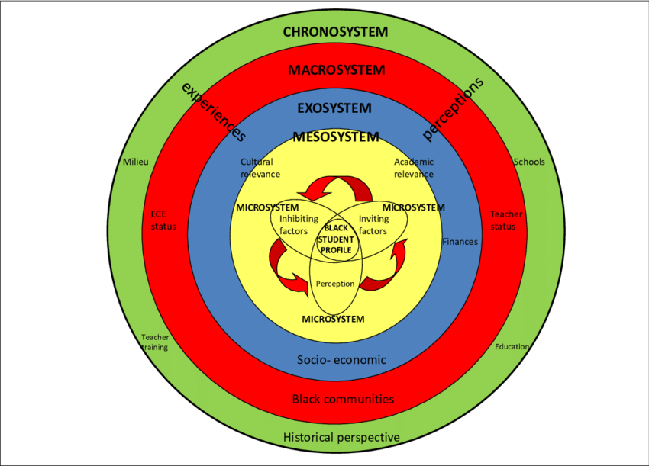
Ecological System Framework (Bronfenbrenner, 1979)
Micro-system:
Family
School
Peer relationships

Slide 3
Meso system: the interactions between elements in micro system.
Eg. The communications between parents and teachers in school regarding children’s academic achievement, problematic behaviors etc.
Eg. Parents’ monitoring of children’s social behaviors in peer relationships.
Exosystem: Mirco- and meso- systems are nested in exosystem.
Eg. A city where your family, school and friends settle.
Macrosystem: eg. Politics, religion belief, shared value and belief in a cultural context.
Chronosystem: history event. It is easy to image that the context of generation of World War II is different from the generation of internet.

Slide 4
Micro- : Parents/Family
Parenting Belief: China vs US
Family relationship
Chinese families emphasize the importance of family closeness and harmony because of Confucianism(Ho, 1986; Uba, 1994). In Confucian’s theory, the basic unit of society is the interpersonal relationship, instead of an individual.
Empirically, in the comparison of US families, perceived parental warmth, and conflict with parents were associated in the expected direction with depressive symptoms more strongly in China (Greenberger et. al., 2020).

Slide 5
Micro- : Parents/Family
Parenting Style: China vs US
Chinese Parental Belief: two-dimension structure (Chao, 1994)
A. Parent-child relationship
B. Ideologies on children’s development and learning
Chinese Parenting (Chao, 1994; Xu, et. al., 2005; Chan, Bowes, Wyver, 2009)
A. Authoritative
B. Authoritarian
C. Permissive
D. Neglectful

Slide 6
Micro- : Parents/Family
In the western context, there’re four typical types of parenting styles and usually, you can clarify which type describes a western parent. However, it is possible to find Chinese parents can get high scores in both authoritative and authoritarian parenting behaviors.
Explanation:
(1) underscoring family relationship ---> authoritative parenting
(2) having ideologies or plan for children’s future ---> authoritarian parenting

Slide 7
Meso- : Parents/Family + School + Peer relationships
A. High emphasis on academic achievement (The interaction between family setting and school setting) :
Thus, in China, grade in school has a stronger influence on adolescents’ mental health (Greenberger et. al., 2020).
B. The interaction between family setting and peer relationships:
Chinese parents are inclined to compare their children’s behaviors with those of adolescents in their native countries or with their own experiences growing up (Qin, 2006).

Slide 8
Macro- : How culture or policy influences Chinese parents
A. Gender equality
Decades of centralized political and ideological efforts directed toward
eliminating gender inequalities might be expressed in a smaller, or even nonexistent,
the gender gap in depressive symptoms in this Chinese cultural setting.
Empirically, compared to the USA, the gender difference in depression is smaller in China (Greenberger et. al., 2020)
B. One-child policy
In urban area of China, only-children experienced significantly lower love awareness from family, higher neurotic and social depression, trait anxiety, perceived stressors, and interpersonal dependency than did urban non-only children (Liu et.al., 2005).

Slide 9
References:
Greenberger, E., Chen, C., Tally, S. R., & Dong, Q. (2000). Family, peer, and individual correlates of depressive symptomatology among US and Chinese adolescents. Journal of consulting and clinical psychology, 68(2), 209.
Chao, R. K. (1994). Beyond parental control and authoritarian parenting style: Understanding Chinese parenting through the cultural notion of training. Child development, 65(4), 1111-1119.
Xu, Y., Farver, J. A., Zhang, Z., Zeng, Q., Yu, L., & Cai, B. (2005). Mainland Chinese parenting styles and parent-child interaction. International Journal of Behavioral Development, 29(6), 524-531.
Chan, S. M., Bowes, J., & Wyver, S. (2009). Chinese parenting in Hong Kong: Links among goals, beliefs and styles. Early Child Development and Care, 179(7), 849-862.
Qin DB. “Our child doesn’t talk to us anymore”: alienation in immigrant Chinese families. Anthropol Educ Q. 2006;37:162–79.
Liu, C., Munakata, T., & Onuoha, F. N. (2005). Mental health condition of the only-child: a study of urban and rural high school students in China. Adolescence, 40(160).

