Slide 1
Further sources
The European school survey project on alcohol and other drugs
http://www.espad.org
http://www.espad.org/sites/espad.org/files/TD0116475ENN.pdf
National institute on drug abuse
https://www.drugabuse.gov
https://www.drugabuse.gov/drugs-abuse/commonly-abused-drugs-charts
Erowid
erowid.org

Slide 2
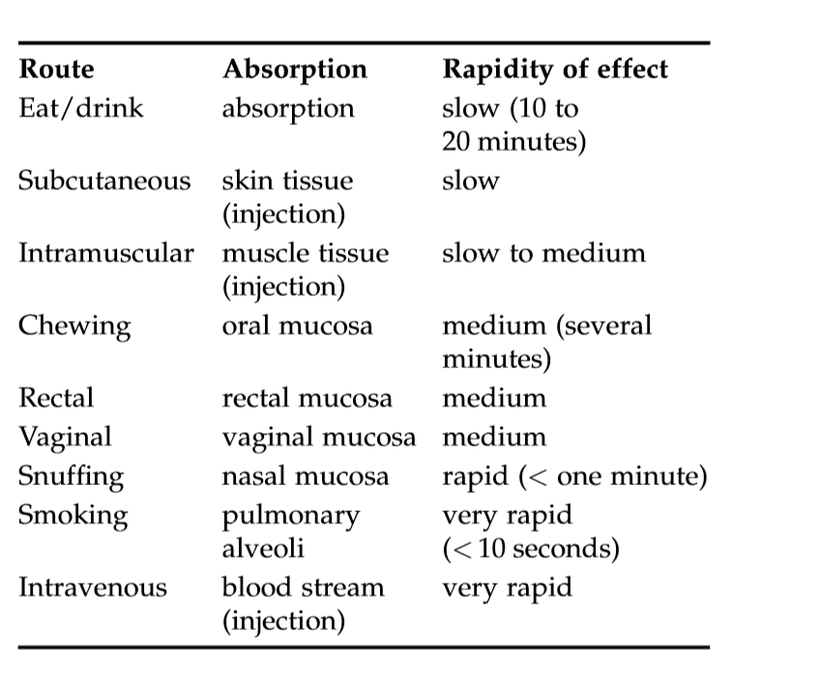
Routs of administration

Slide 3
CAFFEINE, NICOTINE, CANNABIS, ALCOHOL
ADDICTION

Slide 4
CAFFEINE
Alkaloid found in many plants (in coffee, tea, guarana), very similar to other alkaloids found also in tea (theobromine, theophylline)
Legal in all countries, but some have legal regulation e.g. in amount of caffeine per 100ml of drink or age limit for availability of energy drinks
Probably the most widely used psychoactive substance in the world

Slide 5
biological properties
Adenosine antagonist
Adenosine is inhibitor in CNS - promotes sleep and suppresses arousal
Caffeine binds to adenosine receptors. Secondary to decrease of adenosine in brain, increase of dopamine follows
Absorbed via stomach to blood stream and reaching brain within 5-30 minutes. Stimulating effect peaks in 15-45 minutes. Effect can last up to 2-4 hours.
Metabolised is via liver and excreted via urine. Half-life about 5 hours, but less in smokers and more in pregnant women (up to 18 hours; it can get to milk and to babies who metabolised it up to 30 hours).

Slide 6
dosage
Threshold usage - 10 mg
Lethal usage 3-20 grams (LD50 in rats 192 mg)
espresso has 60-100mg of caffeine, cup of filtered coffee 100-120 mg, cup of tea 40-80 mg, glass of coke 50 mg, high quality chocolate on average 35 mg, can of energy drink 80-300 mg
Daily recommended intake 200 mg (maximum 400mg) for healthy adults; 2.5 mg per 1kg of body weight for adolescents. Best results in high energy sports found in about 3 mg per kg of body weight
Although rare, overdose resulting to death have been reported

Slide 7
effects
Physical effects: increases heartbeat, respiration, basal metabolic rate, production of stomach acid, production of urine; it relaxes smooth muscles e.g. bronchial muscle.
Subjective effects: increased reactions, concentration, focus; decreased fatigue and sense of effort in physical activity
Beneficial health effects: Mild protective factor of dementia and Alzheimer‘s disease; protective factor from depression; removing effects of common cold and respiratory illnesses; helps to promote healthy life style by removing sense of effort in physical activities; helps in low-pressure problems
Confirmed positive effects in concentration, vigilance and increased safety in military, shift works etc. (e.g. regular caffeine consumption halves the risk of a car accident)
Best results in endurance sports and high-intensity sports (e.g. football, rowing), unclear results in short-term power sports (lifting, sprint) – pills are recommended over coffee

Slide 8
effects
Negatively effects quality and quantity of sleep
Heavy use or use by sensitive people increases anxiety, ulcer problems, heart problems and high pressure problems, osteoporosis. It may cause constipation
Avoid or at least decrease consumption in pregnancy and during breastfeeding period
Some doubts about positive effects in e.g. increased concentration – the effect may be related just to removal of caffeine withdrawal symptoms and because of taking a break for coffee

Slide 9
addiction
Some experts reject addiction to caffeine as substance addiction
Overdose produces restlessness, dizziness, nausea, headache, tense muscles, sleep disturbances, and irregular heartbeats, extreme overdose may include also anxiety attack, including delirium
Regular people develop emotional and mental dependency to their ‘everyday cup’, heavy user may develop withdrawal symptoms like headaches, lethargy, nervousness, inability to focus
No cross-sensitization with other substances and no comorbidity with other substances except nicotine. Concerns in case of use with alcohol – it may mask awareness of alcohol intoxication.
Overdose reported in few countries - energy drinks and children

Slide 10
emerging problem in youth?
Steep increase of caffeine drinks consumption in current adolescents – majority of them on daily basis (coke, ice tea, energy drinks)
Soft drinks include high amount of sugar – their consumption reinforce poor dietary habits and contribute to obesity
High caffeine consumption may prime brain reward circuits to other drugs e.g. nicotine
Children learn to use caffeine drinks to improve moods and thus may be more likely to repeat such coping with other substances
Caffeine often combined with alcohol makes binge drinking worse
Energy drinks are calibrated to healthy adult – adolescents’ physiology has bigger problems with metabolising it – more problems with anxiety, hyperactivity, insomnia that strongly impact developmental processes (e.g. learning, school results)
Energy drinks are preferred by children with hyperactivity and various externalising behaviours – and caffeine has the worst impact on them

Slide 11
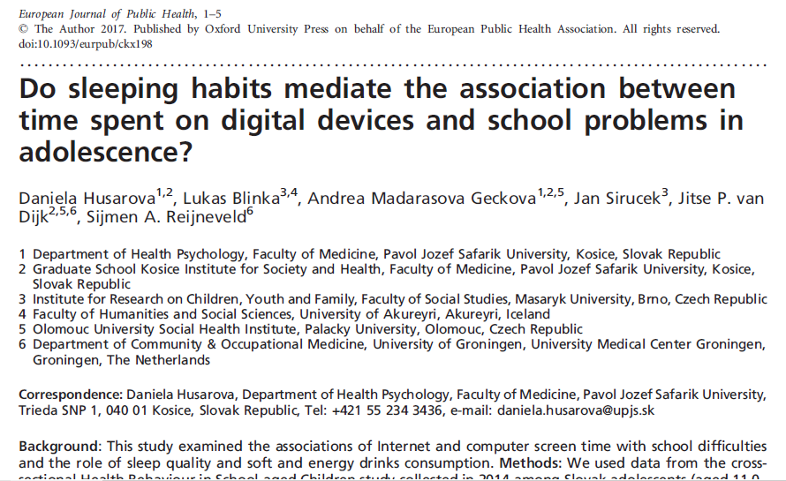

Slide 12
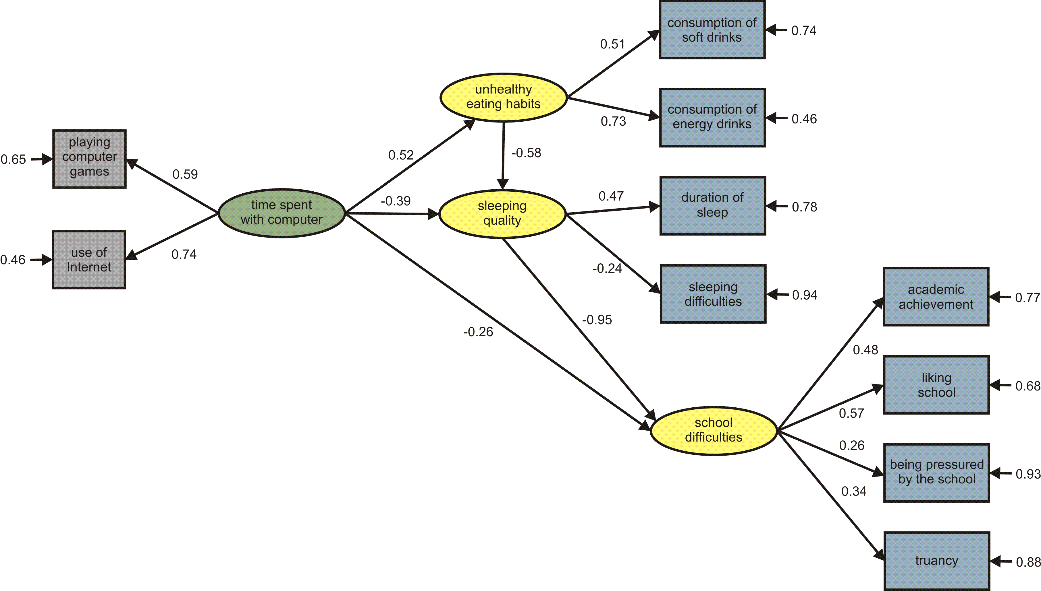
The association of time spent with a computer with school difficulties mediated by caffeine-rich drinks consumption and sleeping quality: a structural equation model. Goodness of Fit: Chi2=56.28; df=30; Chi2/df=1.87; p=0.0025, RMSEA=0.011

Slide 13

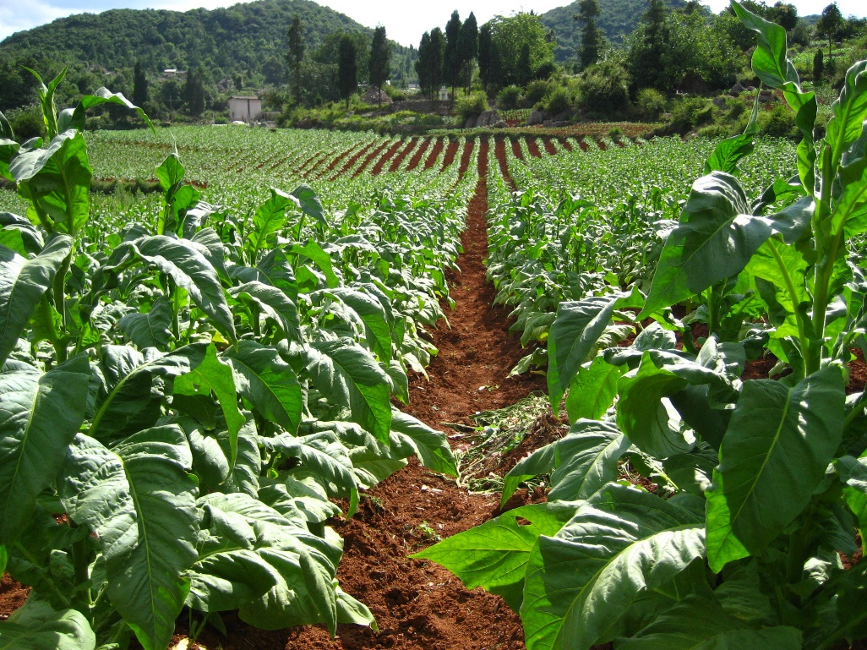
TOBACCO

Slide 14
NICOTINE
Alkaloid and the main psychoactive component of tobacco
Stimulant – agonist of nicotinic acetylcholine receptors. Acetylcholine plays a role in various parts of brain - connected to arousal, attention, memory and motivation. Nicotine increases amount of adrenaline (increases blood pressure, respiration, heart rate), dopamine (pleasure and motivation), glutamate, and noradrenaline. Decreases GABA (inhibitor neurotransmitter) – “nicotine volumes up the system”
https://www.youtube.com/watch?v=yd46Hs7pTow
About 4000 various chemicals are released when tobacco is burned
Effects are heavily influenced by the user – personal context, although it is more a stimulant than a sedative

Slide 15
dosage
Inhaled - effect starts in 10-20 sec and lasts about 10-30 minutes
Oral – effect starts in 2-5 min and lasts 1-2 hours
Depending on type of tobacco and the way of smoking, between 1 to 3 mg of nicotine one gets from a single cigarette. Nicotine gum usually has 2 to 4 mg. Nicotine patch usually has 7, 14, 21 mg (but released during within longer period – up to 24 hours).
LD50 for mice about 3mg. Unclear for humans – reports from 60mg (unlikely) to 500mg. Resistance to nicotine is massively influenced by tolerance
Overdose can happen in unexperienced smokers (e.g., in waterpipes) and via skin exposure in agriculture use (tobacco is used as insecticide). Media panic about drinking nicotine liquid used in e-cigarettes
Deaths have been caused by ingesting water that had cigarettes steeped in it or drinking insecticide brew. Death is often prevented because high nicotine intake causes vomiting.

Slide 16
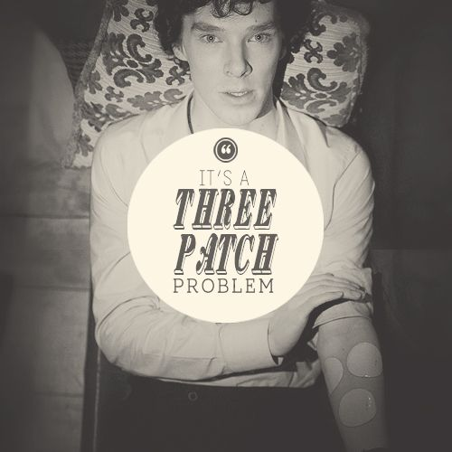


Slide 17
effects
Because it volumes-up several neurotransmitters, effects can be paradoxical
It can act as both stimulant and relaxant - it increases heart rate and blood pressure but also reduces anxiety and relaxes muscles (but smokers usually have elevated anxiety compared to non-smokers)
Improves cognitive functions, concentration, and (simple) task performance
Increases liking of other activities
Nicotine tends to reduce appetite (hence increased weight after terminated smoking can serves as a reason for relapse)

Slide 18
addiction
Nicotine is highly toxic and creates dependency quickly (compared to other substances) with high changes in tolerance
Smoking is very strong reinforcer – 10 puffs per cigarette = 300 puffs per packet if one smokes one packet per day = behaviour that is repeated 300 times per day and brain that is hit by reinforcing substance 300 times per day
Nicotine increases levels of dopamine in Nucleus accumbens that leads to more liking of activities we do while smoking - that leads to increased wanting of smoking in those situations.
As smoking helps to deal with stress, tendency to smoke increases in stressful situations
Effect on brain seems to be very long-lasting or even permanent
In treatment – crucial are positive coping skills (coping with stress), social support (quitting is taken seriously by close social circle), avoiding smoking environments. Nicotine replacement helps

Slide 19
epidemiology
Prevalence of smokers 20-30% in developed countries with about 10-15% dependent smokers in general public. Up to 70% of smokers become addicted (the highest in all drugs). Number of smokers, even addicted and even children, on the rise in developing countries.
85% of smokers would like to stop, 30% made at least three serous life attempts. 80% of smokers relapse within 6 months after quitting attempt
Men smoke more often – but almost no gender gap in developed countries
Those of lower social-economical status are more likely to start and continue smoking (not valid for many developing countries)

Slide 20
risk groups
Adolescents – most smokers start here, earlier start correlates with lifetime use
Lower social-economical status
Mental illness – 70% with psychiatric diagnosis are smokers; over 90% of schizophrenics are smoking
Prisoners – 85% relief from boredom, stress

Slide 21
Public health concerns
Smoking (not necessarily nicotine itself) is one the most important public health issues – causes number of diseases, smokers live 10 years less on average. 1 in 10 premature deaths (1 in 5 in developing countries)
Associated in both active and passive smokers with:
Lung diseases, chronic bronchitis, asthma
Cancer of lung, mouth, kidney, oesophagus, pharynx, larynx, stomach, pancreas, cervix, ureter, and bladder
heart disease including stroke, vascular disease, heart attack
Pregnant smokers: increased risk of stillborn, premature, or low-birth weight infants, sudden infant death syndrome. Pregnancy – 40% of infant deaths are attributed to mother smoking

Slide 22
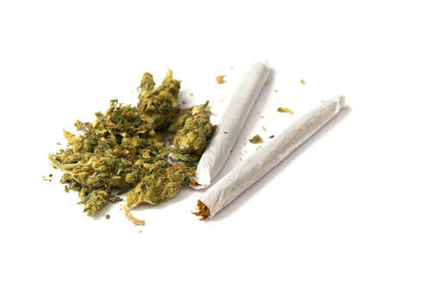
CANNABIS
https://www.youtube.com/watch?v=PRLYV0_6zY8 especially between 15:00 and 30:00

Slide 23
Cannabis
Flowers, stems, leaves, seeds of hemp plant (usually taken from the flower top). Also in concentrated resinous form (Hashish) or black oil (Hash oil)
Smoked or eaten – smoked has quicker but smaller effect. Eaten is slower but with much stronger effect
The main psychoactive substance is tetrahydrocannabinol (THC). It resembles endocannabinoids (e.g. anandamide – it decreases refractory period and neurons can fire immediately). THC last longer than endocannabinoids – prolonged effect
They also influence opioid system in nucleus accumbens – causing slightly higher release of dopamine (causing euphoria and enjoyment). It also increases levels of noradrenaline that can lead to higher anxiety. Receptors are also in peripheral system and immune system – cannabis have anti-inflammatory and analgesic effect
It has both relaxant/depressant and stimulating effects (e.g. some people feel sleepy while others feel aroused) - depending on person and context
https://www.youtube.com/watch?v=oeF6rFN9org

Slide 24
dosage
Amount of active substances in cannabis is fluctuating heavily. Amount of THC steeply increased after 2000.
In general in not very experienced person – one hit (mouth full of smoke) should be enough. With average potency, three hits are enough for experience person.
It is recommended to smoke about a quarter of hit and wait for 5 minutes. Then repeat in necessary.
Eating is not recommended for beginners – overdose may often happen with attack of panic
No direct deaths reported (only caused by injuries while driving under influence e.g.)

Slide 25
effects
Smoking - onset 20-90 seconds, duration 2-4 hours
Eating – onset 20-120 minutes, duration 12+ hours
Positive effects “high”
mood lift, euphoria, boring tasks or entertainment can become more interesting or funny
increased giggling and laughing
relaxation, stress reduction
creative, philosophical, abstract, or deep thinking : ideas flow more easily
increased appreciation or awareness of music; deeper connection to music; increased emotional impact of music
increased awareness of senses (taste, smell, touch, hearing, vision)
change in experience of muscle fatigue; pleasant body feel; increase in body/mind connection
medical use: pain relief (headaches, cramps), reduced nausea, increased appetite

Slide 26
effects
neutral to negative
general change in consciousness, time dilation and compression
slowness (slow driving, talking)
tiredness, sleepiness, lethargy
stimulation, inability to sleep (less common)
mouth dryness, sticky-mouth (varies with strain)
interruption of linear memory; difficulty following a train of thought
difficulty with short-term memory
panic attacks, anxiety, paranoia
coughing, asthma, upper respiratory problems
higher risk-taking (e.g. risky sexual behaviour in women, risky driving)

Slide 27
long-term health effects
Positive health effects – decreases eye pressure, effective in chronic pain treatment
Can influence existing or predisposition to psychosis (schizophrenia) and depression
Poor motivation (and thus e.g. lower school results)
Respiratory illnesses (asthma,…), poor lung functioning, lung cancer
Impaired reproduction capacity (in males)

Slide 28
addiction
All symptoms of cannabis addiction have been described
Cannabis is only slightly addictive (some experts claiming it is not addictive at all) – it secondary affects dopamine reward circuits. Problem may increase with increasing amount of THC in plants
Withdrawal is mild and not life threatening but may lasts up to several weeks. Symptoms include lethargy, loss of appetite, headaches, difficult sleeping, slowed thinking and talking
Hangover exists - irritated eyes, memory impairment, slow thinking, fatigue
Believe that endangered group are teenagers - cannabis may prepare their reward system for hijacking by another substance

Slide 29
gateway hypothesis
Stepping stone / escalation / progression hypothesis - Does marijuana open doors for other drugs?
Based on observation – illicit drug users used marijuana before. But correlation does not necessarily constitute causation. Longitudinal population studies show mixed results. Gateway hypothesis is often used within “moral model of addiction” and used to reason “war on certain drugs”
Animal studies – exposure to one substance (changes in reward system) increases of susceptibility to another substance. Regular exposure to THC increases preference to heroin or nicotine
Social and cultural context – when marijuana is not common, other substances serve as a gateway.
Other important factors play more important role – especially social-economical factors like unemployment are very strong
From substance use perspective, the strongest predictor is use of alcohol and tobacco in early-mid adolescence (and even soft and energy drinks)
Should be marijuana legal? When marijuana is pushed to black market, it is associated with other illicit substances. It is less addictive and with less negative effects than alcohol or tobacco. But we have more history and “social norms” with alcohol and tobacco. But marijuana has also great medical potential and this potential is underused because of illegal status.

Slide 30
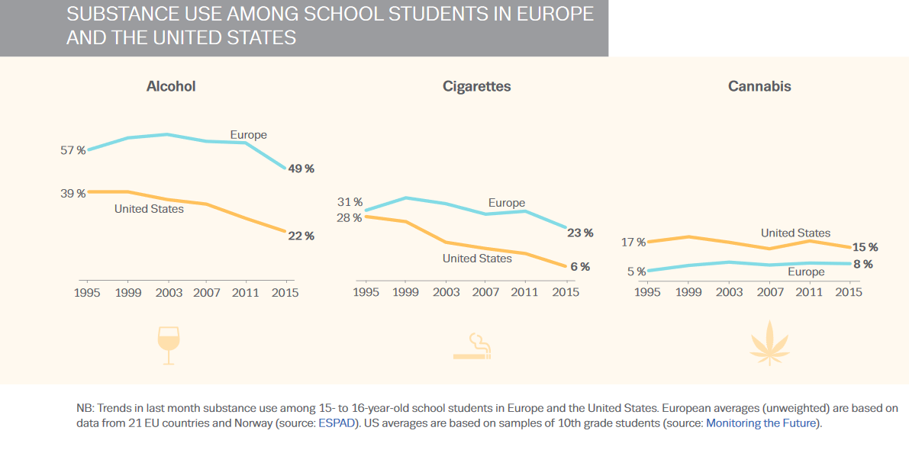

Slide 31
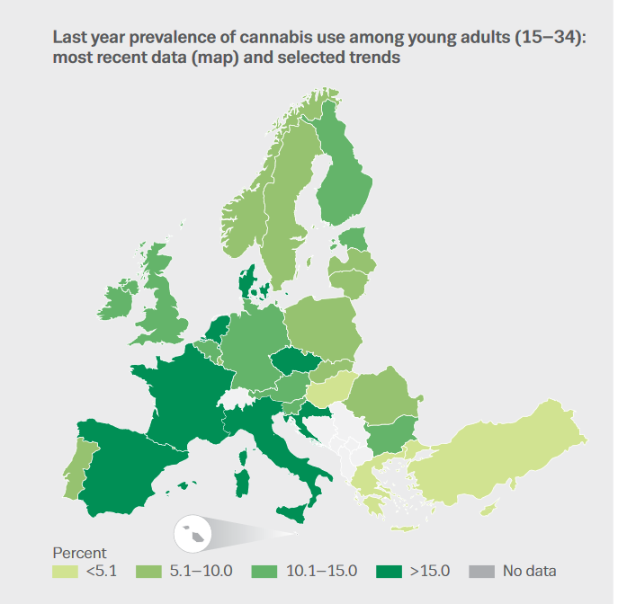
Last year prevalence rates among 15- to 34-year-olds range from 3.5 % in Hungary to 21.5 % in France.
Among young people using cannabis in the last year, the ratio of males to females is two to one.
The most recent survey results show most countries to be reporting either stability or only slight increases in last year cannabis use among young adults
Around 1 % of European adults are daily or almost daily cannabis users (in US estimated 4% of general population being dependent to Cannabis)
About 150000 of Europeans were in treatment in 2016 for cannabis use – increasing trend

Slide 32
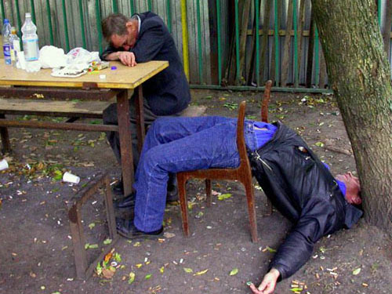

ALCOHOL

Slide 33
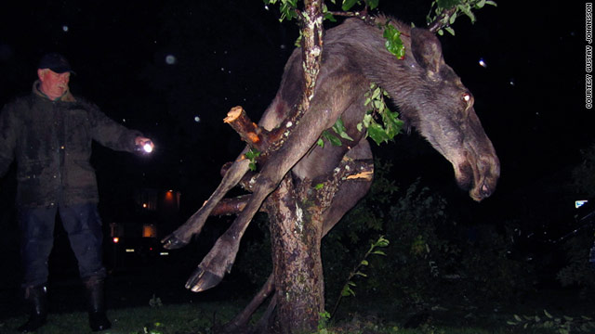

Slide 34
alcohol
Ethanol or ethyl alcohol
Made by fermentation of starch, sugar, and other carbohydrates
GABA agonist and Glutamate antagonist – it is a depressant. But also activates opioid receptors that release more of endorphins that leads to more release of dopamine and serotonin in nucleus accumbens
Effect in various parts of brain: nucleus accumbens and amygdala – pleasant and euphoria; cerebral cortex – slows down thinking; prefrontal cortex – shuts off inhibition in thinking and behaviour; cerebellum – loss of coordination; hypothalamus – mood regulation, increases sexual arousal but decreases sexual performance; medulla – increases sleepiness, decreases breathing, lowers body temperature
https://www.youtube.com/watch?v=B-EmeQg40wE

Slide 35
dosage
Coming up effect in 15 minutes after ingestion
Plateau effect in 30-60 minutes
Coming down effect in 45-60 minutes
Hangover can last up to 36 hours
Effects are influenced by blood alcohol content (BAC)
Effects is influenced by gender, genetic predisposition, speed of intake, combination with food (full stomach slows alcohol absorption), type of drink,…
Death may occur because of overdose itself (e.g. suppressed breath in BAC above 0.30%), by swallowing vomit in sleep, by accidents or even by bad withdrawal symptoms (delirium tremens). Deadly dosage about 0.50% BAC

Slide 36
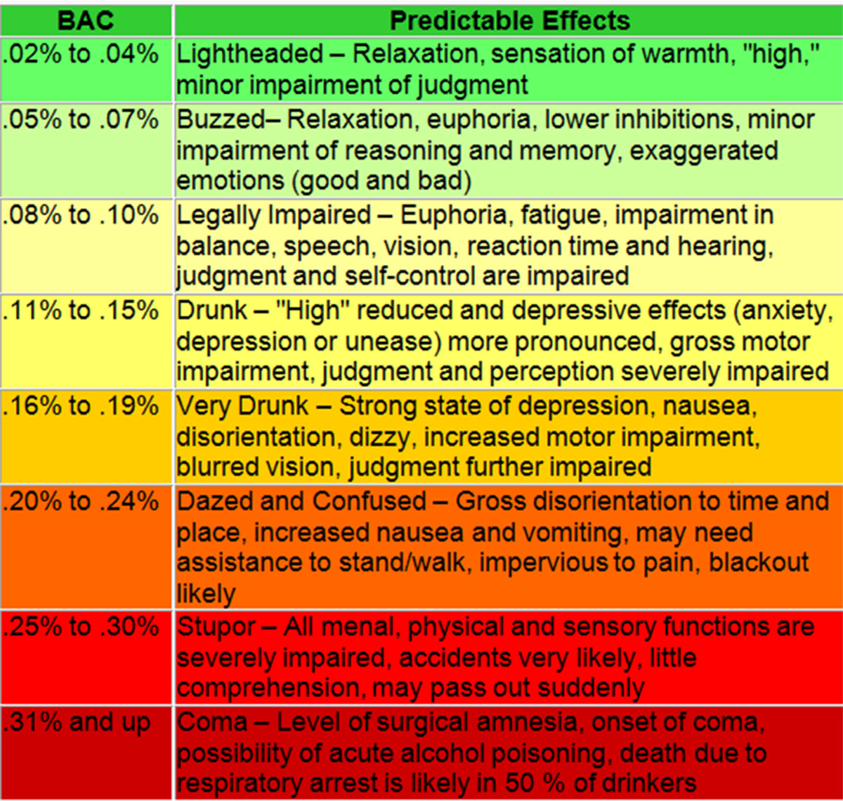

Slide 37
effects – short term
Positive
Relaxation & mood lift
increased sociability & reduced social anxiety
analgesia (kills pain)
Neutral
slurred speech
drowsiness, sleepiness
mild visual distortions
changed (often increased) response to sexual stimuli & changed aesthetic appreciation: normally beautiful things can seem ugly and vice versa
reduced impulse control

Slide 38
effects – short term
Negative
dizziness and confusion
emotional volatility (anger, violence, sadness)
nausea, vomiting
blackouts and memory loss
decreased ability to maintain erection in males and inability to reach orgasm in females
unwanted sexual encounters (date rape)
coma and death at extreme doses
frequent urination
Poor sleep quality and quantity – disrupted sleep patterns

Slide 39
Effects – health and harm
Reduced risk of heart diseases (strokes, arrhythmia,…)
Increased risks of cancer: oral, throat, liver, breast
Liver cirrhosis
Injuries from accidents and risky behaviour
Fetal alcohol syndrome
Suicides, suicide attempts, self-harm behaviour
Poor nutrition (e.g. Wernicke-Korsakoff Syndrome – memory impairment due to low levels of vitamin B Thiamine)
Criminality

Slide 40
addiction
Up to 5% of western population
Tolerance is created because brain removes some GABA, dopamine, glutamate and serotonin receptors – more alcohol is needed to achieve the effect (but poisoning happens normally. With increasing degeneration of body, even faster poisoning may happen)
Bad alcohol hangovers are considered to be worse than the day-after effects of nearly any other psychoactive
Cue reactivity & withdrawal – brain is learned to react by fastening itself (increased heart rate, increased blood pressure) when it expects some alcohol. If the alcohol is not coming, one is feeling miserable. The alcohol is then needed just to feel normal
Withdrawal – starts hours after last drink, persists for weeks. Delirium tremens – few days after last drink – visual and tactile hallucination, fewer, strong anxiety, death rate 5%

