Slide 1
DEFINITION, DIAGNOSTICS, COMPONENTS
ADDICTIONS

Slide 2
Why do we need definition?
Clinicians: who to treat?
Health insurances: whose treatment to pay?
Legal concern: to what extend are addicts responsible for their actions?
Philosophical: do we have free will? A man can do what he wants, but not want what he wants
Scientists: what concept can be tested/ used in research?
Public: how to think and feel about people involved in addictions?
Some models of addiction serve only some of these groups and may sometimes contradict each other

Slide 3
Problems with definitions
wide variety of those who are addicted, in what form of addiction, what are they addicted to, with what consequences, what were/are the motivations
Paradigmatic addictive substances: opioids, cocaine, amphetamines, alcohol, nicotine
Paradigmatic addictive behaviours: gambling, sex, eating disorders, computer gaming

Slide 4
Addiction is a primary, chronic disease of brain reward, motivation, memory and related circuitry. Dysfunction in these circuits leads to characteristic biological, psychological, social and spiritual manifestations. This is reflected in an individual pathologically pursuing reward and/or relief by substance use and other behaviours.
Addiction is characterized by inability to consistently abstain, impairment in behavioral
control, craving, diminished recognition of significant problems with one’s behaviors and interpersonal relationships, and a dysfunctional emotional response.
Addiction often involves cycles of relapse and remission.
Without treatment or engagement in recovery activities, addiction is progressive and can result in disability or premature death.

Slide 5
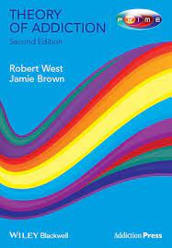
A repeated powerful motivation to engage in a purposeful behavior that has no survival value, acquired as a result of engaging in that behavior, with significant potential for unintended harm.
Addiction is a disorder of motivation

Slide 6
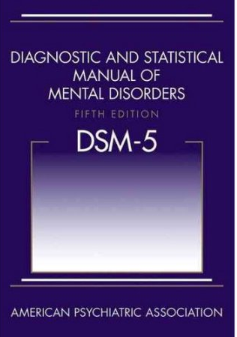
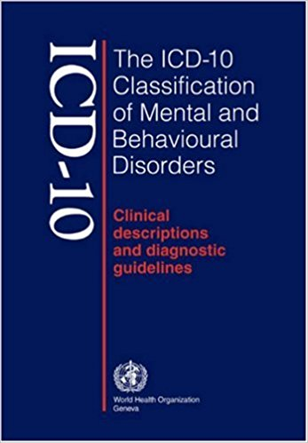
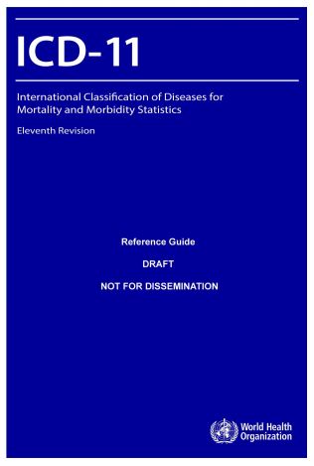

Slide 7
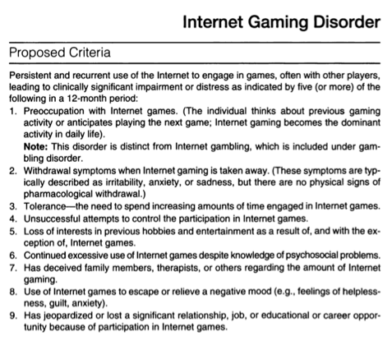
Five or more symptoms endorsed within 12-months period required for diagnosis

Slide 8
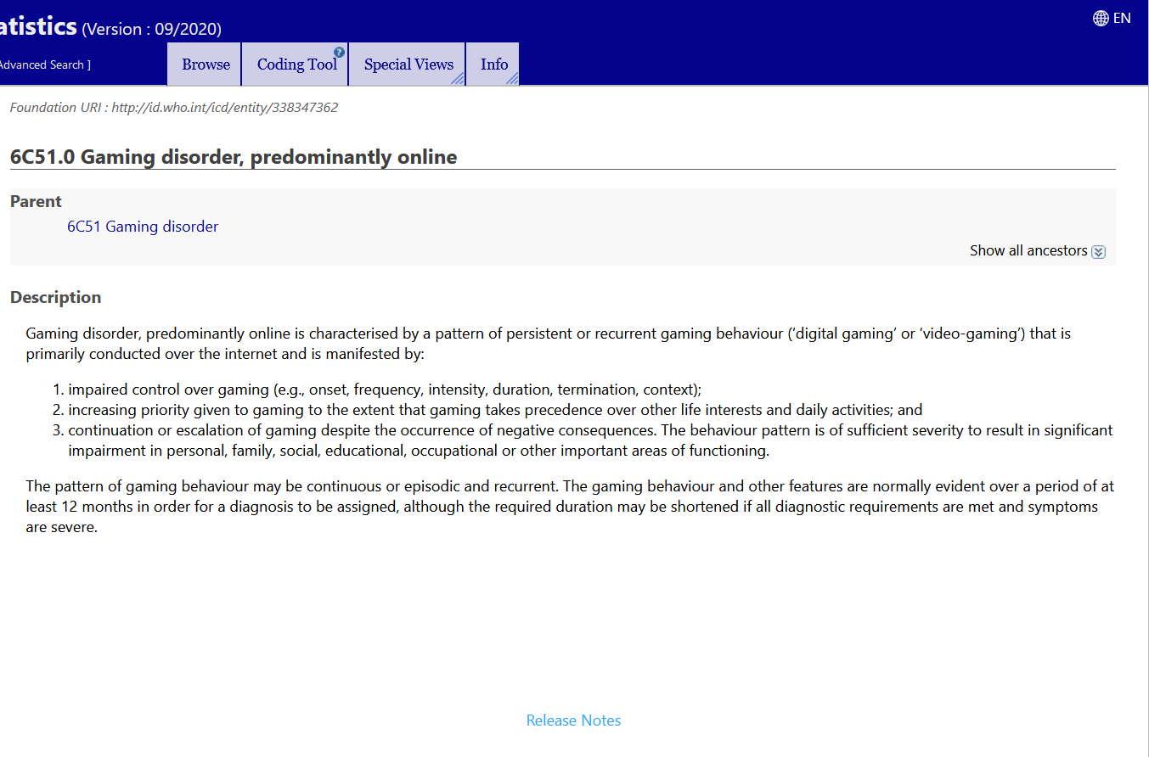

Slide 9
Components model of addiction
conceptualization of addiction based on shared commonalities – what do all addictions share? (e.g. Brown, 1993; Griffiths, 1996)
Salience
Mood modifications
Tolerance
Withdrawal symptoms
Conflicts
Relapse

Slide 10
SALIENCE – preoccupation, craving
it becomes the most important thing in the person‘s life
it dominates thinking (preoccupation, cognitive biases, tunnel visioning, incomplete memory), feelings (craving), behaviours.
Cognitive & behavioural salience
May be more apparent when it is not accessible

Slide 11
MOOD MODIFICATION - euphoria
To make oneself to feel better
High, buzz, escape stress, escape boredom, relax,…
It may have different effects in different situations – mood management
Coping strategy

Slide 12
TOLERANCE
More and more of the thing needed to achieve previously experienced positive feelings
Potentially more problematic in substance addictions – overdose
Not always apparent in behavioural addictions

Slide 13
WITHDRAWAL SYMPTOMS
Negative feelings when the substance or behaviour are out of reach, reduced or terminated
Strong physiological reaction only in substance addictions BUT substitute treatment can be used
Mild physiological reactions (somatization) connected to psychological reactions – headaches, sweating & chills, upset stomach,… but also psychological reactions like stress, anxiety, depression, burst of anger

Slide 14
RELAPS and reinstatement
Returning to problematic behaviour after period of some control and even after acknowledging negative consequences
Temporal satiation – temporal period of not being interested
Addictions can displace one another

Slide 15
CONFLICT – negative consequences
Quid pro quo
Physical consequences
Social conflicts - personal relationships, profession, school
Intrapsychic conflicts – feelings of self disgust, shame,…
Is conflict a necessary part of addictions?

Slide 16
addiction vs dependency
Addiction: repeated powerful motivation to engage in a rewarding but harmful behaviour
Dependency: physiological adaptation to a substance that needs to be taken to prevent adverse withdrawal symptoms
We often use these terms interchangeably and what term is the official one is often a political decision: e.g. APA used dependency till 1964 then started use addiction that was replaced by dependency again in 1980 to be replaced by addiction in 2013. One of the reasons for these changes was an attempt to remove stigmatizing label

Slide 17
Addiction vs intoxication
Substance poisoning (e.g. drunk in alcohol, high in cannabis) - condition that follows the administration of a psychoactive substance results in disturbances in the level of consciousness, cognition, perception, judgement, affect, or behaviour
If serious, a syndrome that can be diagnosed
Intoxication and addiction share the substance – but is intoxication a necessary part of addiction?
In 1990s tobacco companies tried influence the public and professionals to include intoxication as a necessary part of addiction – cigarettes would not fall into addiction category

Slide 18
Addiction vs compulsion
Compulsion – a strong urge to do something
Obsessive-compulsive disorder - anxiety disorder that includes recurring, unwanted thoughts, ideas or sensations (obsessions) that make them feel driven to do something repetitively (compulsions).
The repetitive behaviour, such as hand washing, checking on things or cleaning, can significantly interfere with a person’s daily activities and social interactions.
Compulsion usually does not include pleasure (addiction does) and people involved in compulsion often see that as problematic while addicts often deny problems
OCD was sometimes used (before 1050s) as a diagnose for addicts to overcome problems with non-existent addiction diagnosis

Slide 19
Impulse control disorders
Disorder characterized by failure to resist a temptation, an urge, an impulse
Unlike compulsion which is ego-dystonic it is often ego-syntonic – there is a pleasure on acting. While ICD often manifests as risk-seeking, OCD manifests as harm-avoidance
Over time ICD also become partially unpleasant and unwanted as they bring distress into life
Behavioural addiction are traditionally labelled as ICD - no or limited tolerance and withdrawal symptoms because there is no substance involved

Slide 20
An individual is addicted who
develops a powerful need to drink alcohol in an escalating pattern of consumption
continues to engage in a behaviour to an extent that he or she recognises as harmful despite having tried to stop
regularly experiences a powerful desire to engage in the behaviour
has not smoked cigarettes for 4 weeks but still experiences strong urges to smoke does not smoke every day but has tried to stop smoking completely and failed several times
drinks alcohol in the mornings to relieve feelings of anxiety
has his/her life dominated by using heroin and obtaining the money to buy heroin
has not drunk alcohol for 3 months but who still gets strong cravings for it
spends hours each day gambling online and stealing to cover the costs

Slide 21
An individual is not addicted who
feels a strong motivation to try alcohol but has not yet done so
does not feel a powerful desire to engage in the behaviour in situations when it would normally occur
takes medication every day purely to relieve chronic pain, depression or anxiety
feels a strong motivation to perform excessive hand-washing
has antisocial personality disorder, Tourette’s syndrome, bulimia or obsessive compulsive disorder without other behavioural problems
takes a psychoactive drug for the pleasurable experience but does not experience a powerful desire to take the drug when it is not available
gains satisfaction from an activity, and self-consciously decides that the beneﬁts outweigh the costs and this analysis is largely shared by society
drinks heavily but can easily go for several months without drinking
gambles heavily but not to a point where it is causing signiﬁcant harm is powerfully motivated to harm others

