Slide 1
Digitální intimita: dating, sexting a pornografie
Michaela Lebedíková

Slide 2


Digitální intimita
Intimita (Lomanowska & Guittman 2016)
Jak prožíváme intimitu v dnešní době?
  (De Ridder 2017, Scott et al. 2020)
Digitální intimita
  Klady
  Zápory
Výzkum intimity a regulace?
Notes:
In a world where young people increasingly live, experience, and augment their relationships (whether sexual or not) within digital spaces (Scott et al. 2020)
Digital media have become central to how friendships, family connections, and romantic and sexual relationships are cultivated, developed, and maintained. (Scott et al. 2020)
intimacies mediated through digital technologies are still considered relatively new, and research as well as policy and practice responses are constantly playing catch-up – particularly given rapid and continuing technological developments and the speed with which young people take up and abandon particular platforms (Scott et al. 2020)
= We use the term ‘digital intimacies’ to encompass a wide range of practices including sexually explicit image sharing; taking and sharing selfies; meeting sexual partners; communicating about sex and relationships; searching for information and advice; and creating, accessing, and circulating sexual content online, through social media and through apps. (Scott et al. 2020)
Intimita: It is commonly related to a number ofcomparable concepts, such as love, closeness, self-disclosure, support, bonding, attachment, and sexuality, with the boundaries between them often considered to be continuous rather than distinct (Prager, 1995; Sperry, 2010). (Lomanowska & Guittman 2016)
ways in which digital media have become integral to different forms of intimacy have significant implications for our understandings of what constitutes healthy sexuality, yet there is no agreement about how and at what age parents and professionals working with young people should address questions relating to digitally mediated sexual content and experiences. (Scott et al. 2020)
Messaging in particular plays a key role in maintaining everyday relationships, and mobile technologies are valued because their immediacy increases intimacy (Lasen 2004). For young people, technology enables relationships. For LGBT+ young people, in particular, online communications counter the potential isolation and stigma experienced in offline spaces (DeHaan et al. 2013; McGeeney and Hanson 2017). (Scott et al. 2020)
Shortcomings of digital intimacy (Lowmanovska a Guittman 2016): While accelerated intimacy in anonymous online commu-nication may facilitate relationship development, it may also lead to ex-cessive self-disclosure, sexual disinhibition, and unrealistic expectations about online partners (Genuis and Genuis, 2005; Padgett, 2007;Whitty, 2008). At the same time, there is a greater inherent risk ofencountering dishonesty, deceit, and exploitation in such anonymous interactions (Genuis and Genuis, 2005; Robson and Robson, 1998; Whitty and Joinson, 2009).
I argue that media, because of radical changes in technology and new media institutions, are now increasingly becoming infrastructures through which sexualities are lived (De Ridder, 2017)
are digital media either contributing to a more diverse and pluralistic sexual culture or, quite the opposite, are they limiting the sexual and diverse intimate life-worlds of people? (De Ridder 2017)

Slide 3

Jak se k digitální intimitě stavět u mladistvých?
Diskuze:
Regulace?
Vzdělávání?
Nějaké jiné nápady?

Slide 4
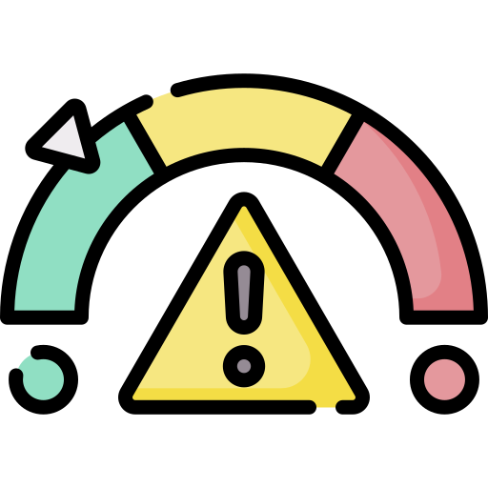
Odlišné pohledy na digitální intimitu
Perspektiva risku a abstinence
Sex-pozitivní přístup
Výchozí uvažování o (online) sexualitě adolescentů
V čem spočívá?
  Harden 2014, Fortenberry 2016
A proč je to špatně?
  Kritika metodologie
  Kritika praktických dopadů (příklad sextingu)
Nový typ uvažování
Adolescenti jako sexual beings
  Anderson 2013, Scott et al. 2020
Nespočívá v popírání rizik!
Notes:
the predominant “risk” perspective that presumes that abstinence from sexual activity is the ideal behavioral outcome for teenagers + Adolescent sex is commonly perceived— both by American society and in psychological research— as an inherently deviant behavior, whereas abstinence from sexual activity is often presumed to be the healthiest behavioral outcome for teenagers. (Harden 2014)
Since much current research and practice (although by no means all of either), focuses on the risks and harms of technology and sexual life (Flood 2009; Brown and L’Engle 2009), it is important that both also interrogate concepts of risks and harm, and recognise that these narratives can in themselves be harmful (Lerum and Dworkin 2009). For example, the approach of research and campaigns that frame sexually explicit image sharing (often referred to as ‘sexting’) as a risky activity that individuals must bear responsibility for constructs girls as both victims of image-sharing related bullying and as responsible for preventing it (by abstaining). Such framing can be harmful because by normalising theidea that there are different risks and responsibilities for boys and girls it reinforces stereotypical and heterosexualised gender norms and shifts responsibility from perpe- trators (Scott et al. 2020)
what would characterise ‘good’ sex and relationships might refocus the discussion on autonomy, consent, communication, diversity, pleasure, equality, and inclusion (Scott et al. 2020)
Perhaps the most harmful outcome of a lack of broad understanding of adolescent sexuality is the disjuncture created between young people’s lived experiences and our professional anxiety voiced solely in a language of danger, warning, and avoidance. (Fortenberry 2016)
Review literatury pozitivní sexuality: results indicate that sexu- al health, physical health, mental health, and overall well-being are all positively associated with sexual satisfaction, sexual self-esteem, and sexual pleasure (Anderson 2013)

Slide 5

Sexual well-being
Co je to well-being?
  Sexual well-being (Fortenberry 2016)
Proč je lepší sexual well-being než sexuální zdraví?
  (Harden 2014, Fortenberry 2016)
Notes:
A sexual well-being perspective could supplant an outmoded but still widely takendsexual risk perspective that does not countenance the possibility of healthy sex (other than abstinence) during adoles- cence [2]. A sexual well-being perspective is based in notions of well-being as a developmentally appropriate outcome of the multiple types of experiences of sexuality possible during adolescence. (Fortenberry 2016)
sexual well-being rather than the more widely used phrase “sexual health” to incorporate relevant dimensions of well-being in addition to health: personal se- curity; attachment to others; appropriate functioning; self- determination; and respect for self and others [3]. (Fortenberry 2016)
Definitions of adolescent sexual well-being vary but ofteninclude domains such as sexual self-esteem; sexual self-efficacy; sexual arousal; desire and pleasure; and absence of pain, anxiety, and negative affect (Harden 2014)
Sexual self-esteem addresses perceptions of worth and attractiveness as a sexual person. Sexual self-efficacy addresses perceived control in sexual situations, including the ability to consent to sex or refuse it. The topics of sexual arousal, desire, and pleasure intrinsic to adults’ sexual experiencesdare nearly absent in research about adolescent sex. (Fortenberry 2016)

Slide 6
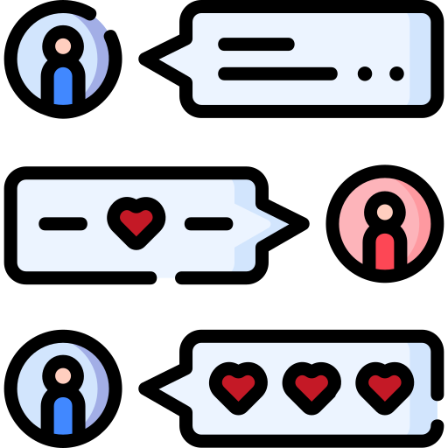
Dating
Jak spolu mladí lidé chodí v době digitální?
  Fáze randění (Manning et al. 2006)
  Jak to probíhá? (Baker & Carreno 2015)
  Seznamovací aplikace?
Notes:
Online dating: Tinder? 18+!
Většina studií na toto téma u adolescentů je zaměřena na online dating violence a abuse – sex positive research je velmi omezený ☹
dating, ‘‘hooking up,’’ ‘‘friends with benefits,’’ and relationship (Manning et al. 2006) + the use of technology, such as cell phone calls, instant messaging, and posts to social networking sites (Baker & Carreno 2015)
technology use was described in the context of initiating as well as dissolving relationships (Baker & Carreno 2015)
Their descriptions were similar in that they would begin communicating with someone through texts as well as on Facebook or other social networking sites. In some cases they had met the person at a party; in others, the person was a part of their extended group of friends (e.g., friend of a friend) (Baker & Carreno 2015)
Once it became ‘‘official’’, participants described how they would update their status on social networking sites, like Facebook (Baker & Carreno 2015)
Jealousy, monitoring (Baker & Carreno 2015)
At first, this would last a short time, maybe a day or two. After each fight, the time between receiving a text or online communication and responding to it would grow until after a few weeks the relationship would just end, often without any further face-to-face discussion of why it ended. This example illustrates how technology was used to, indirectly, end a relationship. (Baker & Carreno 2015)
Echoed in Van Ouytsel, J., Van Gool, E., Walrave, M., Ponnet, K., & Peeters, E. (2016). Exploring the role of social networking sites within adolescent romantic relationships and dating experiences. Computers in Human Behavior, 55, 76–86. doi:10.1016/j.chb.2015.08.042

Slide 7
Jaká vás napadají další specifika online datingu?
Online randění podle dospívajících
(Baker & Carreno 2015, Van Ouytsel et al. 2016)
  Iniciace vztahu
  „Zoficiálnění“
  Hádky
  Ghosting
  Negative?
Diskuze:
Negativa?
Covid-19 a vztahy?

Slide 8
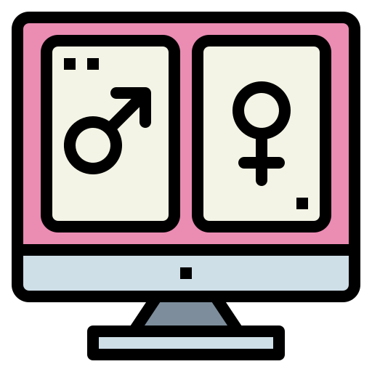
Sexting
Definice (není to jen „nudes“)
  Míra sexuální charakteristiky
  Typ média
  Typ akce
  Typ sdílení
Jak chápou sexting dospívající?
Proč je špatné nemít jednotnou definici? (Barrense-Dias et al. 2017)
  Proč je nutné dávat respondentům definici? (Lewis et al. 2018)
  In the PAST YEAR, have you EVER RECEIVED any sexual messages? This could be words, pictures or videos. (EU Kids Online 2020)
Notes:
Definice (není to jen „nudes“): review 18 studií o sextingu – není shoda (Barrense-Dias et al. 2017)
Míra sexuální charakteristiky, médium, typ akce, typ sdílení
Jak sextingu rozumí samotní dospívající? Most studies found that adolescents considered sexting as a possible activity during a relationship and could be defined as a normal way to flirt (Barrense-Dias et al. 2017)
Často souvisí s vyšším věkem a přítomností romantických vztahů
Prevalence
11.9-17 let, N = 110 380 (Madigan et al. 2018)
sending 14.8%; receiving 27.4%; forwarding 12.0%; being victim of fwd 8.4%
18-29 let, N = 18 122 (Mori et al. 2020)
sending 38.3%; receiving 41.5%; forwarding 15.0%; being victim of fwd 7.6%

Slide 9
Jak běžný je sexting?
Často souvisí s vyšším věkem a přítomností romantických vztahů
Prevalence
  12-17 let, N = 110 380 (Madigan et al. 2018)
    Posílání 14.8%; přijímání 27.4%; přeposílání 12.0%; oběť leaku 8.4%
  18-29 let, N = 18 122 (Mori et al. 2020)
    Posílání 38.3%; přijímání 41.5%; přeposílání 15.0%; oběť leaku 7.6%

Slide 10
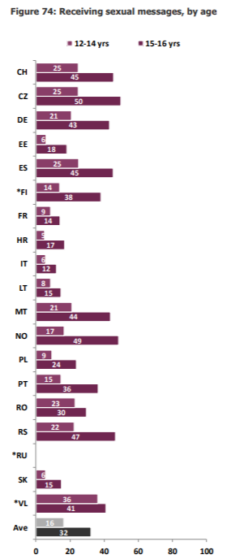
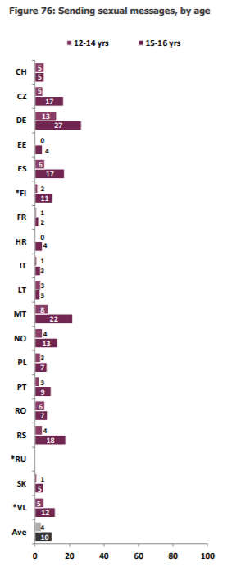
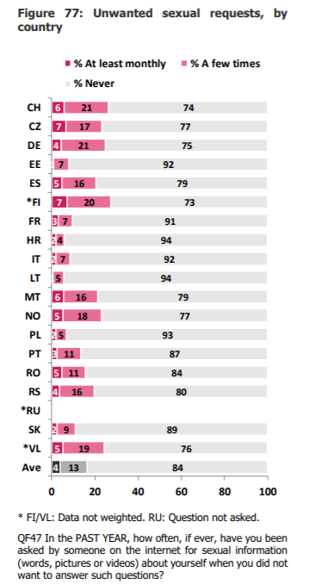
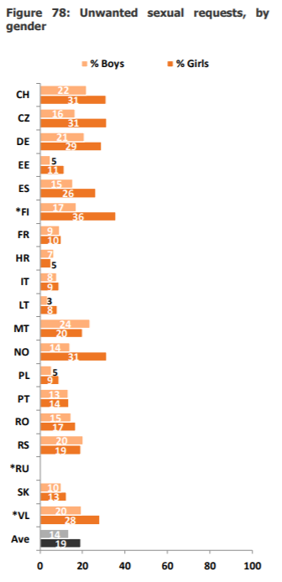
EU Kids Online 2020

Slide 11

Motivace k sextingu
Proč adolescenti sextují? (Kopecký 2011)
  A proč přeposílají?
Dívky a chlapci mají jiné motivace (Reed et al. 2019)
  Dívky: zábava a flirtování (56 %), sexy dárek pro partnera/partnerku (37 %), pod tlakem (39 %), ten druhý ve vztahu to chtěl tak dlouho, až poslala (33 %)
  Chlapci: zábava a flirtování (55 %), sexy dárek pro partnera/partnerku (53 %)
Notes:
Jiné pro holky a jiné pro kluky
Kopecký (2011) found the most frequently reported motives for sexting to be ‘out of boredom’, ‘to make intimate contact with the opposite sex’, ‘as a form of self- representation’, ‘under the context of peer pressure or influence’, ‘to arouse the recipient’,and ‘accidentally or unintentionally’.
Girls’ top motivations to sext included to be fun or flirtatious (56%), someone pressured you to send it (39.4%), as a sexy present for a boyfriend or girlfriend (36.7%), and a dating partner repeatedly asked for it until you gave in (33%). Among teen girls with sexting experience, 71.6% reported at least one non-coercive motivation for sexting, 52.3% reported at least one coercive motive for sexting, and 32.1% reported at least one non-coercive and at least one coercive motive for sexting (Reed et al 2019)
Boys’ top motivating reasons to sext included to be fun or flirtatious (55%) and as a sexy present for a boyfriend or girlfriend (53.3%). Among teen boys with sexting experience, 76.7% reported at least one non-coercive motive for sexting, 23.3% reported at least one coercive motive for sexting, and 16.7% reported at least one non-coercive motive and one coercive motive (reed et al 2019)

Slide 12


Genderovaná povaha sextingu
Genderové implikace
  (Cooper et al. 2016, Lippman & Campbell, 2014; Reed et al. 2019, Ringrose et al., 2013)
  Chlapci: sexting jako upevnění maskulinity (status, popularita, předvedení sex. zkušeností, uchovávání fotek v mobilu)
  Dívky: tlak, negativní emoce, dvojité břemeno (slut x prude), performance „bytí sexy“
Viktimizace obětí
Jak tohle reflektovat ve výzkumu?
  Etické issues (Linka bezpečí, atd.)
  Kvalitativní výzkum – understanding, motivace, praxe
Notes:
Although youth of all genders are engaging in sexting, sexting is a gendered experience that has more negative outcomes for girls (Cooper et al., 2016) (Reed et al. 2019)
Although both girls and boys reported sexting behaviors, girls were more likely to report receiving pressure to sext and negative emotional responses to sexting requests from a dating partner. Among girls, greater self-sexualization, lower religiosity, perceiving peer sexting as more common, and being older predicted more positive emotional reactions to sexting requests from a partner. Greater attachment anxiety, lower self-sexualization, greater religiosity, and being younger predicted more negative emotional reactions for girls. Among boys, lower attachment avoidance, greater self-sexualization, and lower religiosity predicted more positive emotional reactions to sexting requests. Only lower levels of self-sexualization predicted negative emotional reactions to sexting requests for boys (Reed et al. 2019)
girls are more likely than boys to experience both implicit and explicit pressure, harassment, and threats to sext (Reed et al. 2019)
s. Engaging in sexting has different social consequences for girls and boys; for boys, it is considered a way to express and reinforce masculinity in a way that gains status with peers (Lippman & Campbell, 2014; Ringrose et al., 2013). Boys are encouraged to take and share sexually explicit photos of girls as a way to bond with their male friends and appear sexually experienced (Burkett, 2015). Conversely, for girls, sexting is a “double bind” in which girls are encouraged to perform sexiness like the women they see in mainstream media, but are met with ‘slut-shaming’ and judgement when they engage in these behaviors (Ringrose et al., 2013). Lippman and Campbell (2014) added that even if girls decline to participate in sexting, they are often still met with name-calling and negative social consequences (e.g., ‘being a prude’). Even when pressure to sext is not explicit, girls may comply with sexting requests to please their partners or receive other relational benefits (Lippman & Campbell, 2014; Ringrose et al., 2012) (Reed et al. 2019)

Slide 13

Jak to teda s tím sextingem je?
Sexting je pozitivní zkušenost x asociace s příznaky deprese
a úzkosti (Raine et al. 2020)
  Potřeba longitudinálních studií
Ale když je sexting leaknutý …
  „Kyberznásilnění“, PTSD, deprese, úzkosti, sebevražedné myšlenky
  Větší téma: revenge pornografie
Notes:
Sexting je pozitivní experience (Raine et al 2020)
Three reviews identified positive aspects to sexting in rela- tion to the personal relationships of young people
sexting has been described by some young people as a safe medium for flirting and experimentation, as well as a safer alternative to having sex in real life. Sext- ing was also reported to help maintain long-distance relationships.
Other studies reported across the three reviews found no relationship between sexting and depression, or sexting and anxiety
One study included by Barrense-Dias et al. [28] identified an association between ‘psychological difficul- ties’ and an increased likelihood of receiving sexts and being ‘harmed’ by them. All three reviews reported evi- dence of a relationship between depression, or depres- sive symptoms and sexting. I
An association was also identified be- tween sexting and having contemplated or attempted suicide in the previous year.
Ale když je leaknutý …
„Kyberznásilnění“, PTSD, deprese, úzkosti, sebevražedné myšlenky
Větší téma: revenge pornografie

Slide 14
Vaše prezentace
Online pornografie: výhody a nevýhody její konzumace

Slide 15

Pornografie
Definice: 38 top výzkumníků pornografie (McKee et al. 2020)
  Shoda? Nebyla.
  Nejčastěji?: „Sexually explicit materials intended to arouse.“
„V POSLEDNÍM ROCE jsi asi viděl/a spoustu různých obrázků, fotek nebo videí. Některé obrázky, fotky nebo videa mohou být sexuálního charakteru, např. mohou zobrazovat nahé lidi nebo osoby, které mají sex. Možná jsi nikdy nic takového neviděl/a, ale možná jsi něco takového viděl/a na mobilu, v časopise, v televizi, na DVD nebo na internetu.
(výzkum EU Kids Online)
Pornografie nebo expozice sexuálně explicitním obsahům?
  18+?
  Záměrné x nezáměrné vystavení se sex. obsahům
  „Sexuální obsah“?
Notes:
Definice: 38 leading pornography researchers (McKee et al. 2020)
„Sexually explicit materials intended to arouse“
„In the PAST YEAR, you have seen lots of different images – pictures, photos, videos. Sometimes, these images might be obviously sexual, e.g., they may show people naked or people having sex. You might never have seen anything like this, or you may have seen something like this on a mobile phone, in a magazine, on the TV, on a DVD or on the internet.“ (EU Kids Online)
Pornografie nebo expozice sexuálně explicitním obsahům?
Z čeho vzešlo zkoumání pornografie
Co se zkoumá u adolescentů
Ze začátku prevalence, frekvence, méně už obsahy
Vliv na postoje a sexuální chování
Nyní: dopady na psychické zdraví

Slide 16

Sledování pornografie u adolescentů
Z čeho vzešlo zkoumání pornografie
Porno a 18+?
Co se zkoumá u adolescentů
  Ze začátku prevalence, frekvence, méně už obsahy
  Vliv na postoje a sexuální chování
  Nyní: dopady na psychické zdraví

Slide 17

Porn gap
Významný rozdíl mezi muži a ženami v přístupu k pornografii (Caroll et al. 2016)
  Nelze objasnit věkem, rokem publikace, ani mírou gender empowermentu v zemi studie (Peterson & Hyde 2010)
Tyto rozdíly byly taky v mnoha výzkumech o adolescentech po celé Evropě
  Důvody ke sledování
  Odlišný věk první konzumace
  Frekvence konzumace
  Odlišné reakce
Notes:
Perhaps the most notable finding of pornography research to date is the sizeable gender gap that exists between men and women when it comes to their personal use and acceptance of pornography (Caroll et al. 2016)
In their landmark review article, Peterson and Hyde (2011) examined major meta-analyses and large data set studies and found that many gender differences in sexuality are much smaller than is commonly believed. , Petersen and Hyde (2010) found a substantial gender difference in pornography use in which men were more likely than women to report using erotic materials such as magazines, videos, or the Internet. The authors also noted that neither age of the sample, year of publication, nor gender empowerment of the country moderated the gender difference in pornography use
This ‘porn gap’ may be even more pronounced among young adults (Caroll et al., 2008), and there are also consistent findings of gender differences regarding exposure to SEM among adolescents. Boys differ significantly from girls in their relationship to SEM: their reasons for SEM exposure are different, their SEM exposure is more intentional, and their consumption is higher. This relationship was consistently found across European countries (Ševčíková et al. 2014), and in several national samples, for example in Netherlands, Belgium, and Greece (Beyens et al. 2015; Doornward et al. 2015; Peter & Valkenburg 2006; Tsitsika et al. 2009; Vandenbosch 2015; Vandenbosch & Peter 2016).
These gender differences may be attributed to prevalent gender stereotypes (as girls may be less willing to disclose they consume SEM), and also to different biological development, as boys start to be sexually active more early than girls (Ševčíková & Daneback, 2014).

Slide 18
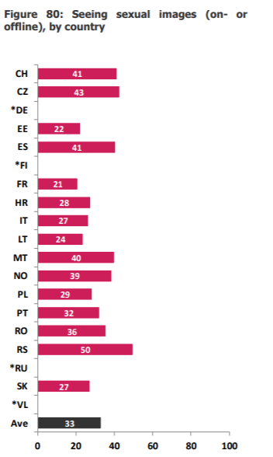
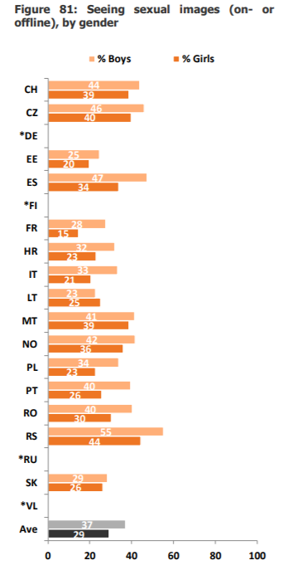
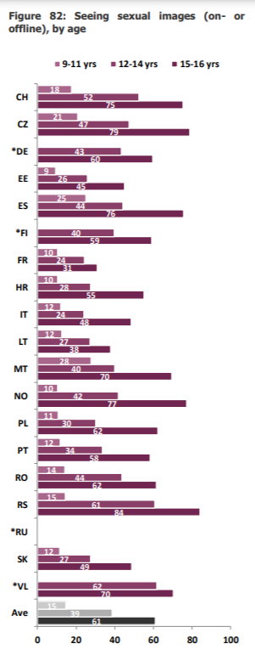

Slide 19
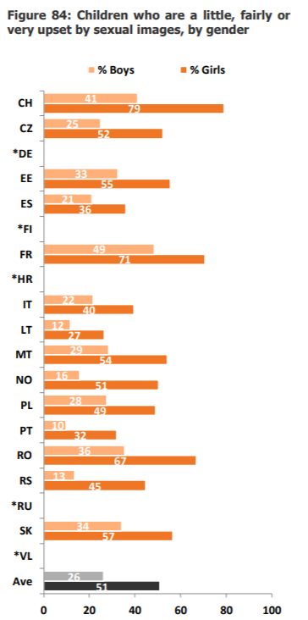
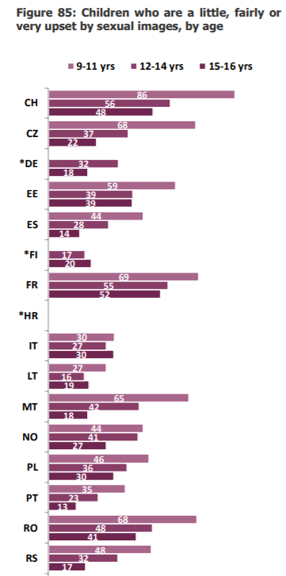
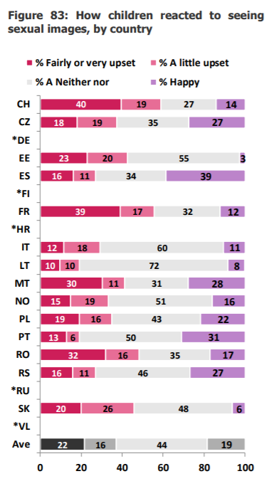

Slide 20
Porn literacy
Mediální gramotnost: fake news, posuzování informací, atd.
Co nás porno učí? (Albury 2014)
  1/3 českých adolescentů používá porno k učení se o sexu
  (Ševčíková & Daneback 2014)
„Výuka pornografické gramotnosti směřuje k tomu, aby mladiství kriticky uvažovali nad obsahem, který vidí.“ (Dawson et al. 2019)
Negativní perspektiva: jak je chápána porn literacy nyní? (Byron et al. 2020)
Notes:
Contemporary understandings of the core principles of media literacy include the “active inquiry and critical thinking about the messages we receive and create” (Alliance for Media Literate America [AMLA], 2007, p. 3) so that “people use their individual skills, beliefs and experiences to construct their own meanings from media messages” (Alliance for Media Literate America, 2007, p. 7) (Dawson et al. 2019)
While many commentators and scholars have acknowledged the educational qualities of pornography, there is no universal consensus as to what porn teaches its consumers and how it works as an educator (Albury 2014)
We found few articles that present empirical data to discuss porn literacies, and those we found commonly frame young people’s porn literacy as their ability to critically read porn as negative and comprising ‘unrealistic’ portrayals of sex. This model of porn literacy tends to be heteronormative, where only conservative ideals of ‘good’, coupled, and vanilla sex are deemed ‘realistic’. (Byron et al. 2020)
Findings suggest that the proposed learning outcomes should focus on reducing shame regarding pornography engagement and improving critical thinking skills regarding the following sexual health topics: body image comparisons and dissatisfaction; sexual and gender-based violence; fetishising of gay and transgender communities; and setting unrealistic standards for sex.+ LGBTQ+ consent + its an industry (Dawson et al. 2019) (18-29, focusky)

Slide 21
Co byste navrhli vy jako součást porn literacy?
Diskuze:

Slide 22
Co navrhují adolescenti? (Dawson et al. 2019)
Zmírnění studu, který obklopuje konzumaci pornografie
Body-image: srovnávání a nespokojenost
Sexuální a genderově zaměřené násilí a problematiku souhlasu (konsent)
Nerealistické standardy v sexu, které pornografie obsahuje
Vzdělávání o LGBTQ+
Že za pornografií je celý průmysl

Slide 23
Literatura
Kath Albury (2014) Porn and sex education, porn as sex education, Porn Studies, 1:1-2, 172-181, DOI: 10.1080/23268743.2013.863654
Anderson, R. M. (2013). Positive sexuality and its impact on overall well-being. Bundesgesundheitsblatt-GesundheitsforschungGesundheitsschutz, 56, 208–214.
Baker, C. K., & Carreño, P. K. (2016). Understanding the Role of Technology in Adolescent Dating and Dating Violence. Journal of Child and Family Studies, 25(1), 308–320. https://doi.org/10.1007/s10826-015-0196-5
Barrense-Dias, Y., Berchtold, A., Surís, J. C., & Akre, C. (2017). Sexting and the Definition Issue. Journal of Adolescent Health, 61(5), 544–554. https://doi.org/10.1016/j.jadohealth.2017.05.009
Byron, P., McKee, A., Watson, A., Litsou, K., & Ingham, R. (2020). Reading for Realness: Porn Literacies, Digital Media, and Young People. Sexuality & Culture. doi:10.1007/s12119-020-09794-6
Carroll, J. S., Busby, D. M., Willoughby, B. J., & Brown, C. C. (2016). The Porn Gap: Differences in Men’s and Women’s Pornography Patterns in Couple Relationships. Journal of Couple & Relationship Therapy, 16(2), 146–163. doi:10.1080/15332691.2016.1238796
Cooper, K., Quayle E., Jonsson L., Svedin, C. G. (2016) Adolescents and self-taken sexual images: a review of the literature. Computers in Human Behavior, 55, 706–716.
Dawson, K., Nic Gabhainn, S., & MacNeela, P. (2019). Toward a Model of Porn Literacy: Core Concepts, Rationales, and Approaches. The Journal of Sex Research, 1–15. doi:10.1080/00224499.2018.1556238
De Ridder, S. (2017). Mediatization and sexuality: An invitation to a deep conversation on values, communicative sexualities, politics and media.
Fortenberry, J. D. (2016). Adolescent Sexual Well-being in the 21st Century. Journal of Adolescent Health, 58(1), 1–2. https://doi.org/10.1016/j.jadohealth.2015.10.250
Harden, K. P. (2014). A Sex-Positive Framework for Research on Adolescent Sexuality. Perspectives on Psychological Science, 9(5), 455–469. https://doi.org/10.1177/1745691614535934
Kopecký, K. (2012). Sexting among Czech preadolescents and adolescents. The New Educational Review, 28(2), 39-48.
Lewis, L., Somers, J. M., Guy, R., Watchirs-Smith, L., & Skinner, S. R. (2018). “I see it everywhere”: Young Australians unintended exposure to sexual content online. Sexual Health, 15(4), 335–341. https://doi.org/10.1071/SH17132
Lippman, J. R., & Campbell, S. W. (2014). Damned if you do, damned if you don't… if you're a girl: Relational and normative contexts of adolescent sexting in the united states. Journal of Children and Media, 8, 371-386.
Madigan S, Ly A, Rash CL, Van Outsyel J, Temple JR. Prevalence of multiple forms of sexting behavior among youth: a systematic review and meta-analysis [published online February 26, 2018]. JAMA Pediatr. doi:10.1001/jamapediatrics .2017.5314
Manning, W. D., Giordano, P. C., & Longmore, M. A. (2006). Hooking up: The relationship contexts of ‘‘nonrelationship’’ sex. Journal of Adolescent Research, 21(5), 459–483
McKee, A., Byron, P., Litsou, K. et al. An Interdisciplinary Definition of Pornography: Results from a Global Delphi Panel. Arch Sex Behav 49, 1085–1091 (2020). https://doi.org/10.1007/s10508-019-01554-4
Mori, C., Cooke, J. E., Temple, J. R., Ly, A., Lu, Y., Anderson, N., Rash, C., & Madigan, S. (2020). The Prevalence of Sexting Behaviors Among Emerging Adults: A Meta-Analysis. Archives of Sexual Behavior, 49(4), 1103–1119. https://doi.org/10.1007/s10508-020-01656-4
Peterson, J. L., & Hyde, J. S. (2011). Gender differences in sexual attitudes and behaviors: A review of meta-analytic results and large data sets. Journal of Sex Research, 48, 149–165.
Petersen, J. L., & Hyde, J. S. (2010). A meta-analytic review of research on gender differences in sexuality: 1993 to 2007. Psychological Bulletin, 136, 21–38.
Raine, G., Khouja, C., Scott, R., Wright, K., & Sowden, A. J. (2020). Pornography use and sexting amongst children and young people: a systematic overview of reviews. Systematic Reviews, 9(1), 1–12. https://doi.org/10.1186/s13643-020-01541-0
Reed, L. A., Boyer, M. P., Meskunas, H., Tolman, R. M., & Ward, L. M. (2020). How do adolescents experience sexting in dating relationships? Motivations to sext and responses to sexting requests from dating partners. Children and Youth Services Review, 109, 104696. https://doi.org/10.1016/j.childyouth.2019.104696
Ringrose, J., Gill, R., Livingstone, S., & Harvey, L. (2012). A qualitative study of children, young people and 'sexting': a report prepared for the NSPCC. London: National Society for the Prevention of Cruelty to Children.
Ševčíková, A. & Daneback, K. (2014) Online pornography use in adolescence: Age and gender differences, European Journal of Developmental Psychology, 11:6, 674-686, DOI: 10.1080/17405629.2014.926808
Scott, R. H., Smith, C., Formby, E., Hadley, A., Hallgarten, L., Hoyle, A., Marston, C., McKee, A., & Tourountsis, D. (2020). What and how: doing good research with young people, digital intimacies, and relationships and sex education. Sex Education, 20(6), 675–691. https://doi.org/10.1080/14681811.2020.1732337
Van Ouytsel, J., Van Gool, E., Walrave, M., Ponnet, K., & Peeters, E. (2016). Exploring the role of social networking sites within adolescent romantic relationships and dating experiences. Computers in Human Behavior, 55, 76–86. doi:10.1016/j.chb.2015.08.042

