Slide 1
BSSb1194 Complex societies and their collapse
Jakub Drmola

Slide 2
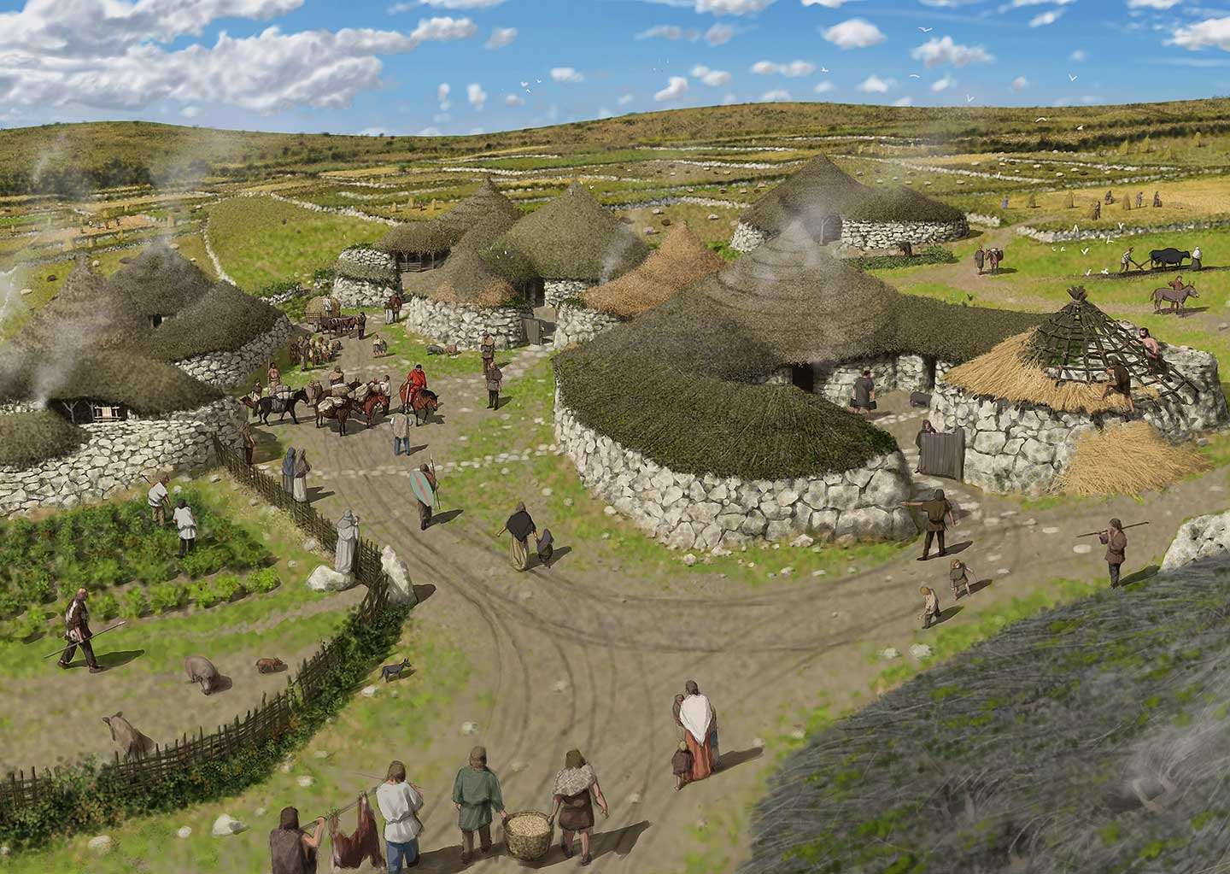
Early complex societies
what is their purpose?
why were early civilizations where they were and not somewhere else?
what do they need?
acceptable climate
water, food
natural resources

Slide 3
Agriculture
- ability to feed people is dependent on local crops
- it must be efficient to allow for specialization
- crops are not equal
wheat and rice are ideal
- it is difficult to spread crops to different latitude

Slide 4
Livestock
- domestication of animals is also crucial
for both meat and physical power
- animals are not equal either
some are much harder to domesticate than others
diet, growth and breeding, temperament, sociability, etc.
- can also have trouble migrating to different latitudes

Slide 5
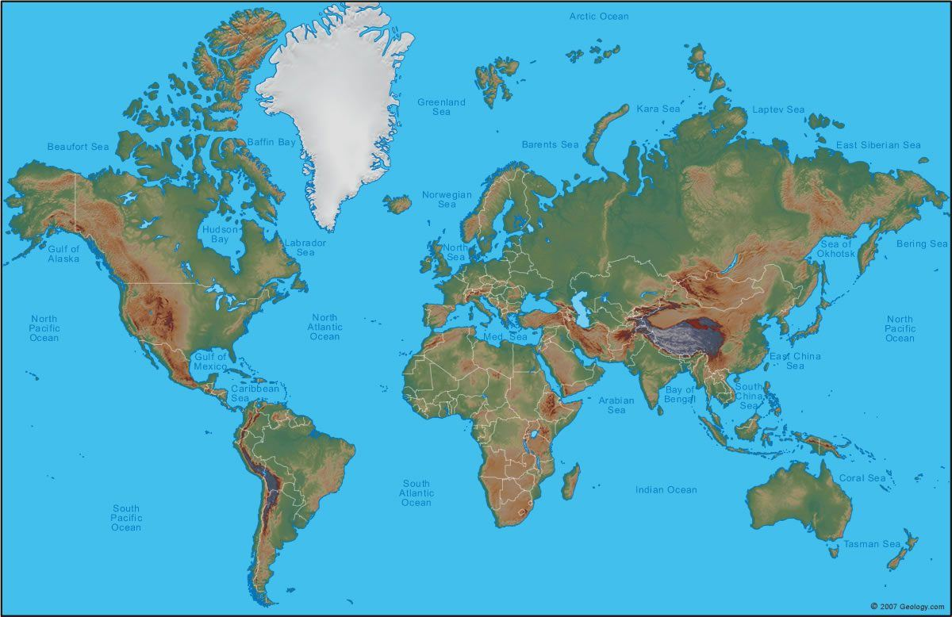

Slide 6
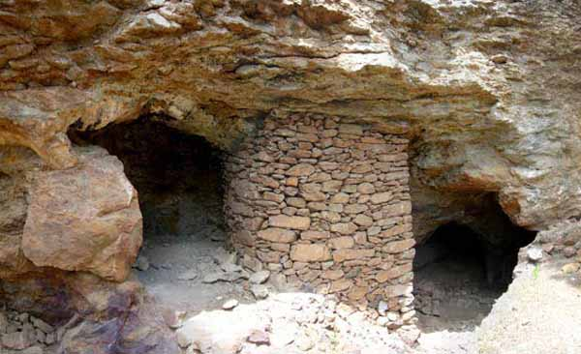
Natural resources
- societies need fuel
wood, coal, oil, …
- and structural materials
wood, metals, etc.

Slide 7
Causes of collapse
- societies grow more complex to solve problems
- complexity “costs energy”
- increasing complexity has diminishing returns
can be recovered by innovation and technology
- complexity tends to lead to specialization
- specialization tends to lower adaptability
- adaptability is needed to respond to shocks

Slide 8
Causes of collapse
- collapse = forced loss of complexity
when a society cannot “afford” itself anymore
can overshoot carrying capacity or diminish it
- dependent on neighboring societies
lack there of, trade, takeover – W vs. E Roman Empire
- most collapses from combination of causes, but not always, single shock can be enough

Slide 9
Resilience
- ability of a (social) system to maintain its function during some crisis or restore it afterwards
- specialization and optimizing for efficiency decrease resilience
for example on-time supply chains
or lacking redundancies

Slide 10
On shocks
- natural shocks are common triggers
famines, earthquakes, disease
- but “unnatural”, i.e. man-made, accidents
unintentional consequences of intentional actions
most commonly industrial disasters
like Chernobyl or Bhopal

Slide 11
Note on “self-propagating systems”
- any system that grows or multiplies with success (ie society/nation/empire …)
- competition among systems (for resources, etc.)
- winner grows and multiplies, loser withers
- basically a Darwinian perspective: natural selection among social systems
- prioritizes short-term gains over long-term risks

Slide 12
The Great Filter
- Drake equation
N = R * f_{p} * n_{e} * f_{l} * f_{i} * f_{c} * L
- Fermi paradox
“where are all the ETs?”
- Great Filter?
something stops intelligent life

Slide 13
Questions
- can we collapse?
- what would it take?
- what would it look like?
- are you prepared?

