Slide 1
Culture of the End
Jakub Drmola
BSSb1194

Slide 2
Causation
who’s fault is it?
humans have hard time dealing with chaos
great disasters must have great causes
conspiracies abound

Slide 3
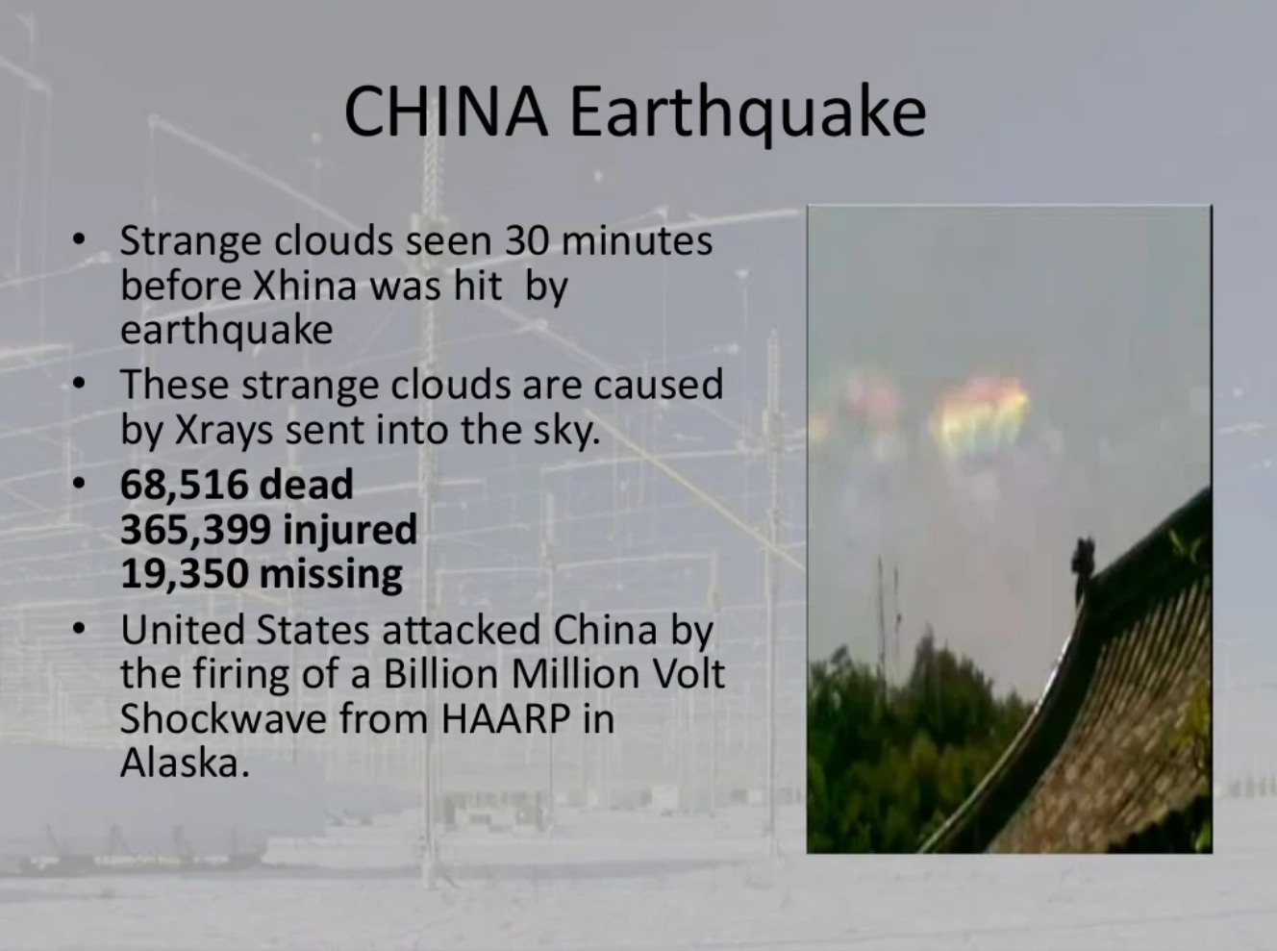

Slide 4
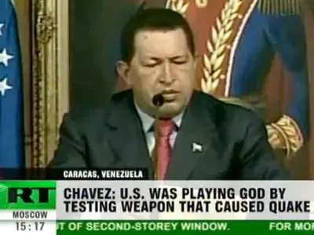

Slide 5
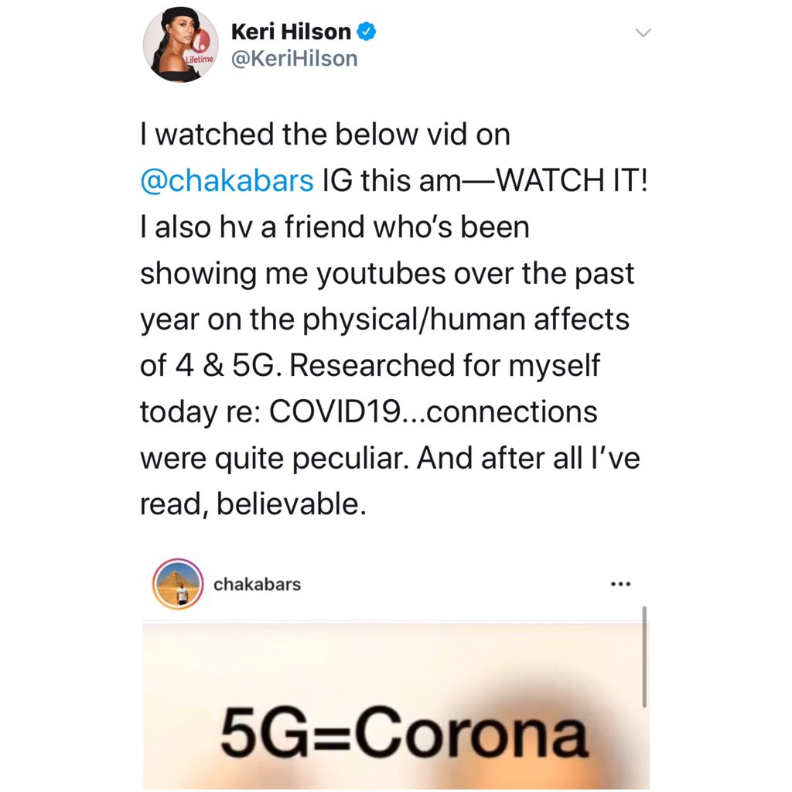
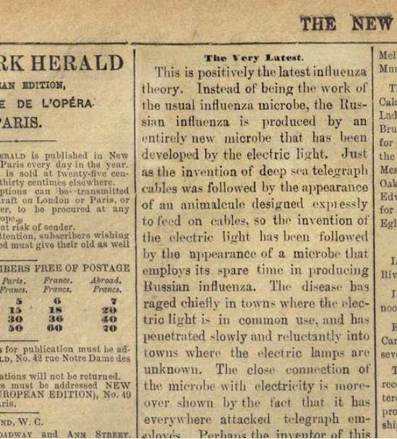

Slide 6
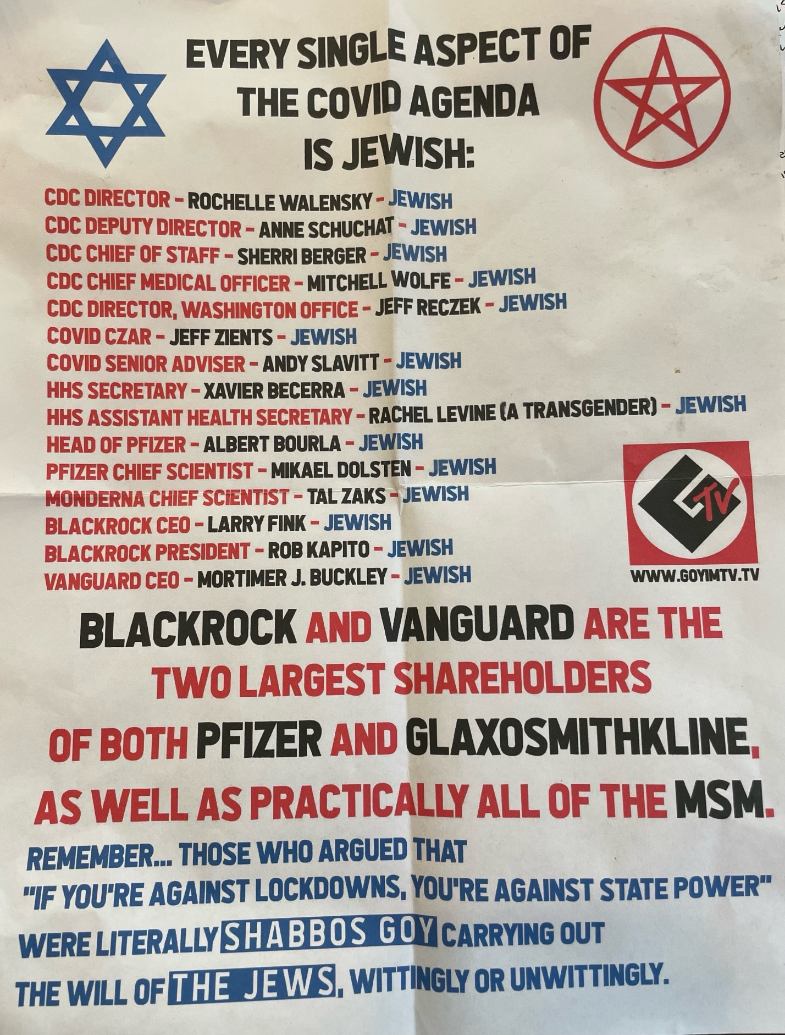
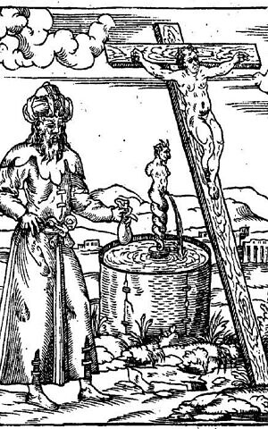

Slide 7
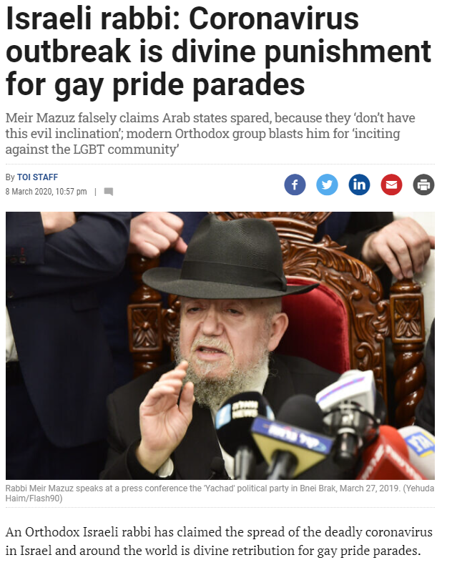

Slide 8
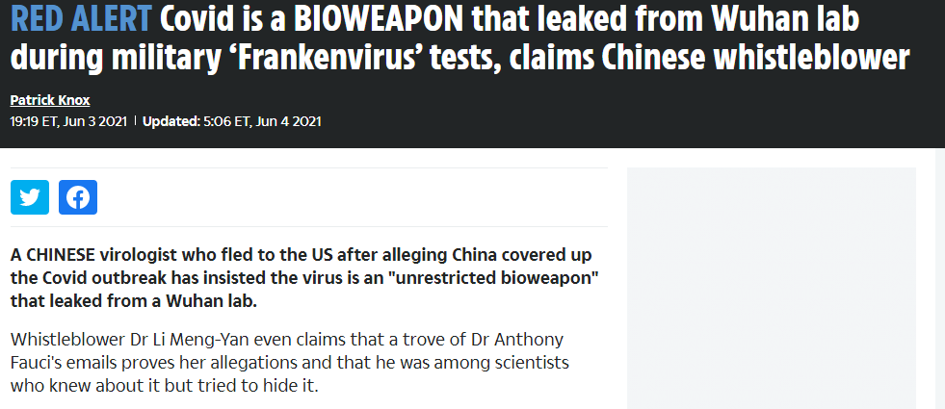
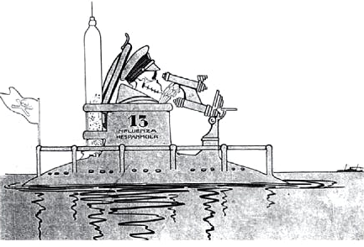

Slide 9
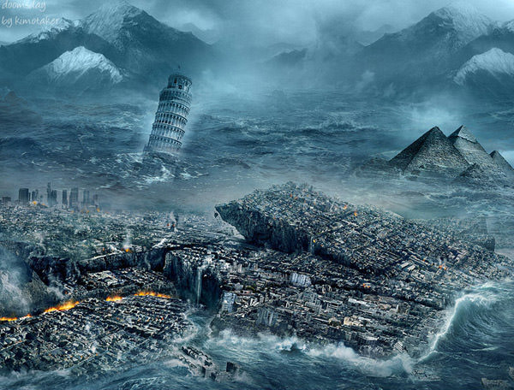
Predictions of the end of the world

Slide 10
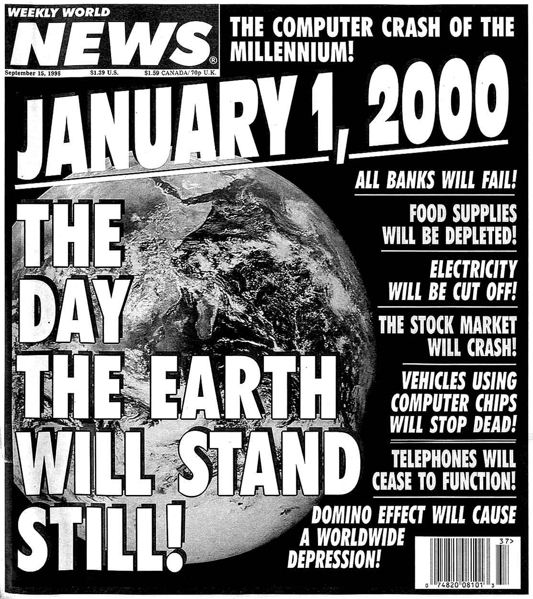
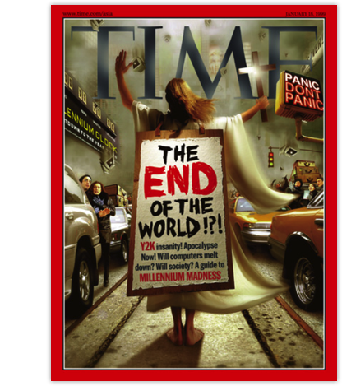

Slide 11
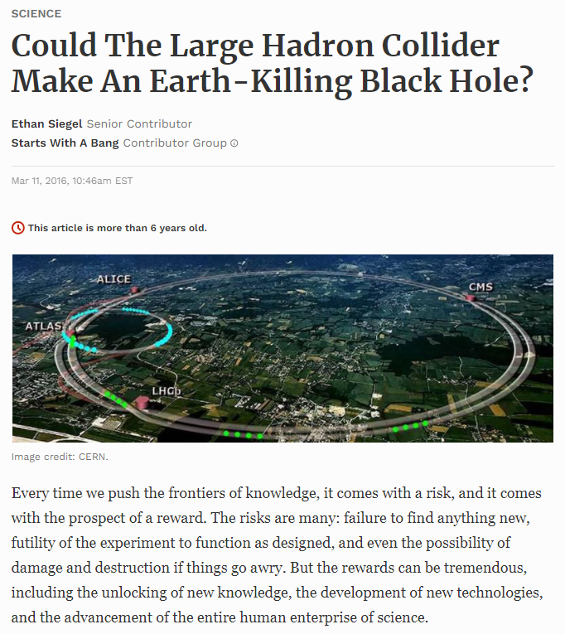

Slide 12
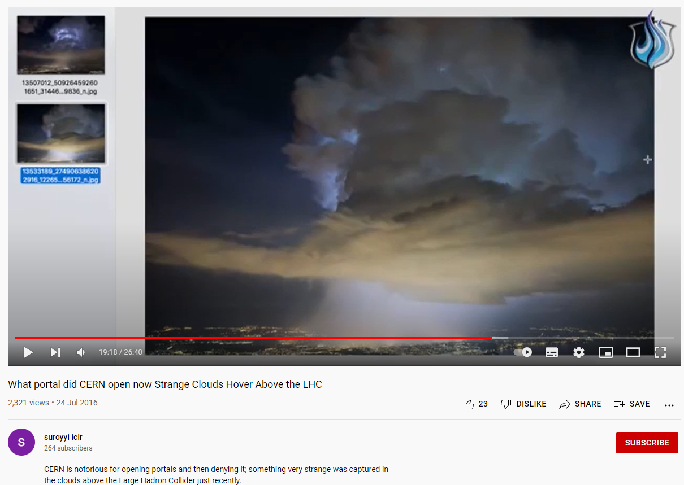

Slide 13
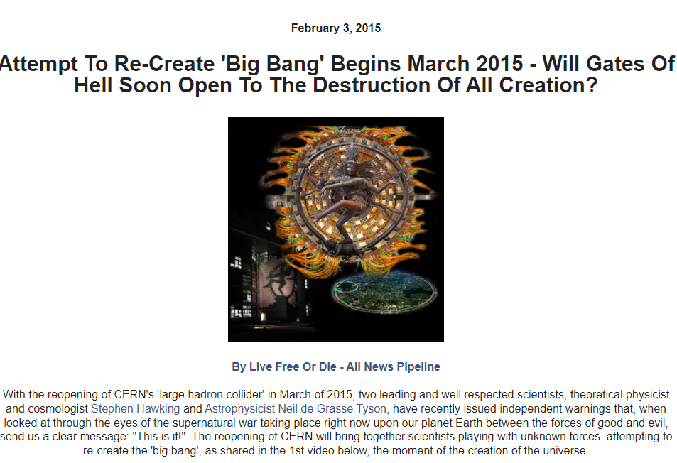

Slide 14
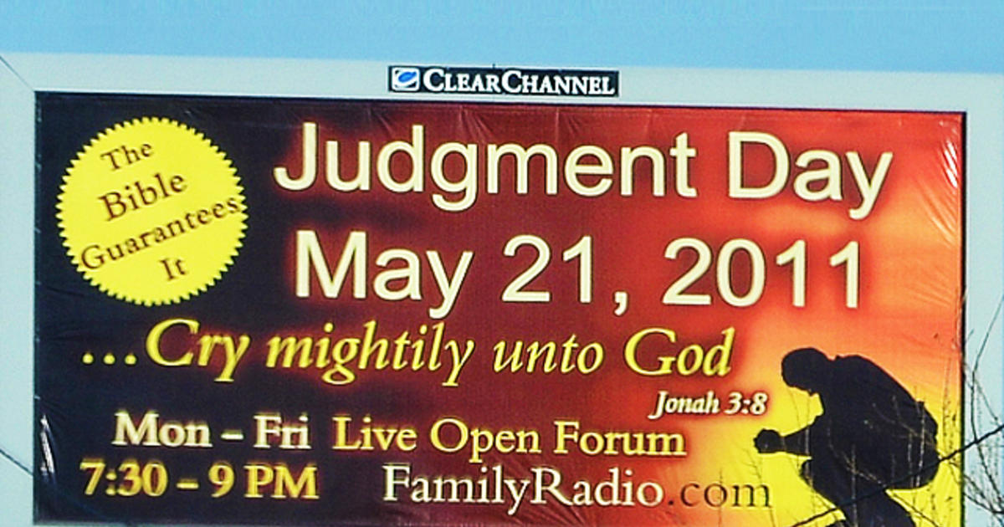

Slide 15
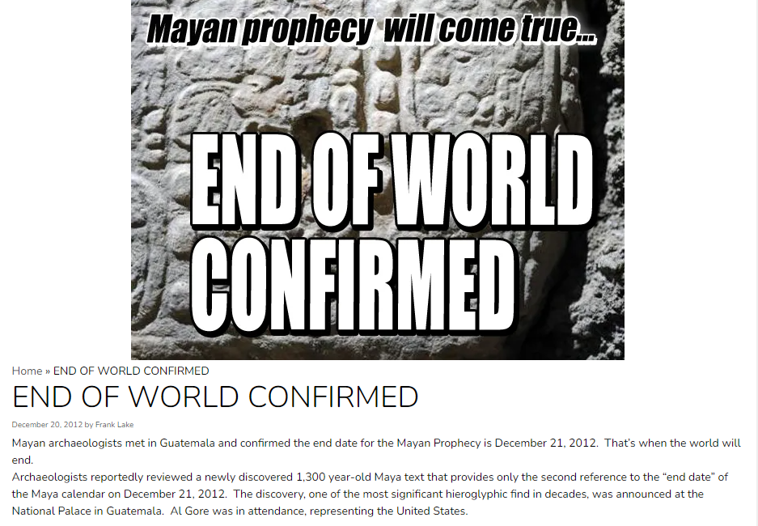
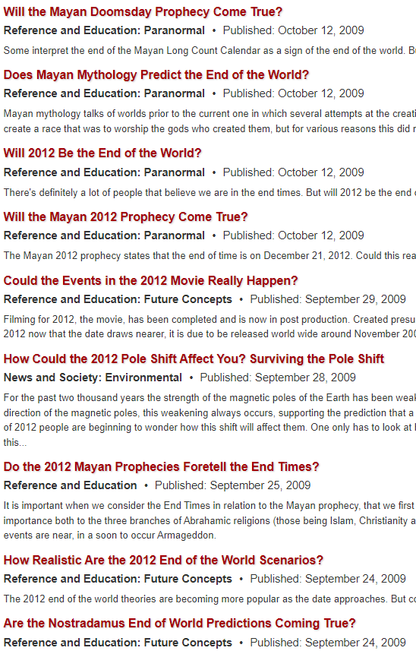

Slide 16
Eschatology
disasters as a sign of “End Times”
climax of history, battle of good vs. evil
will be replace by something better
nearly universally present in all religions

Slide 17
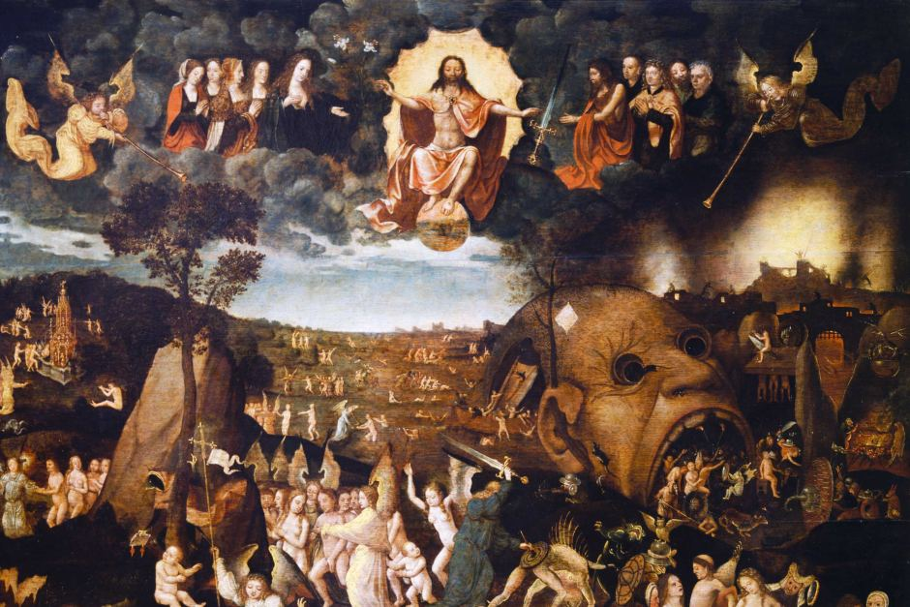

Slide 18
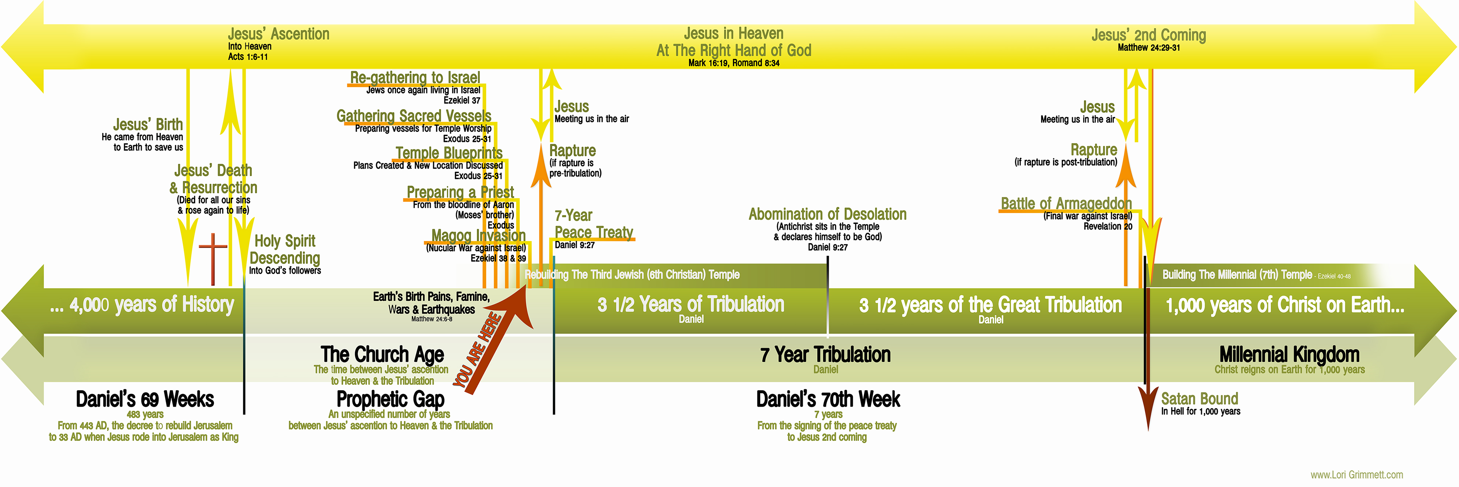
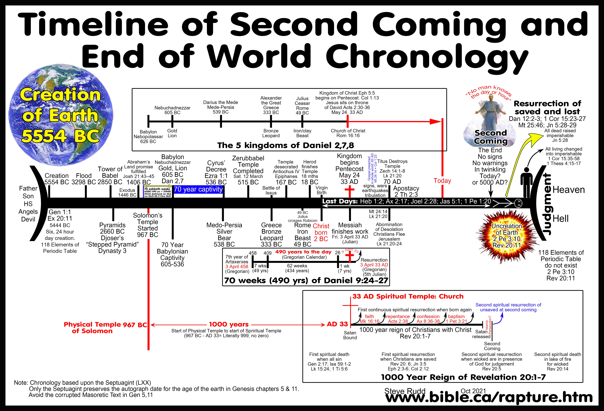
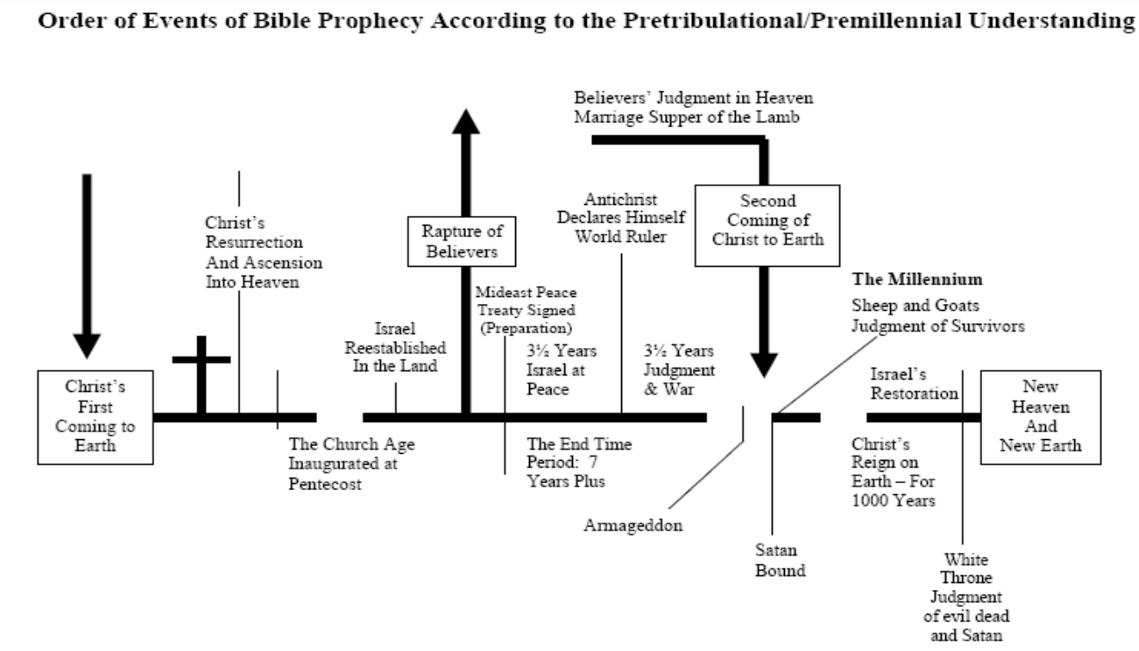

Slide 19
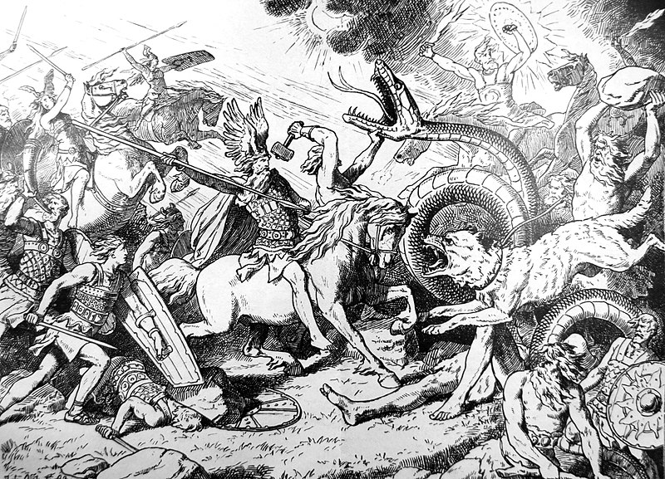

Slide 20
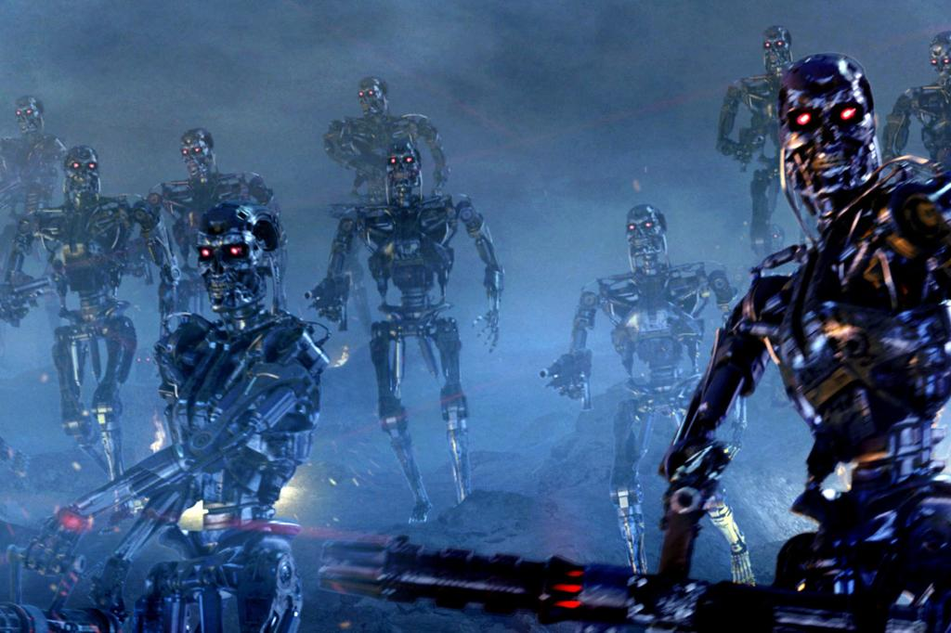
Technomilenialism

Slide 21
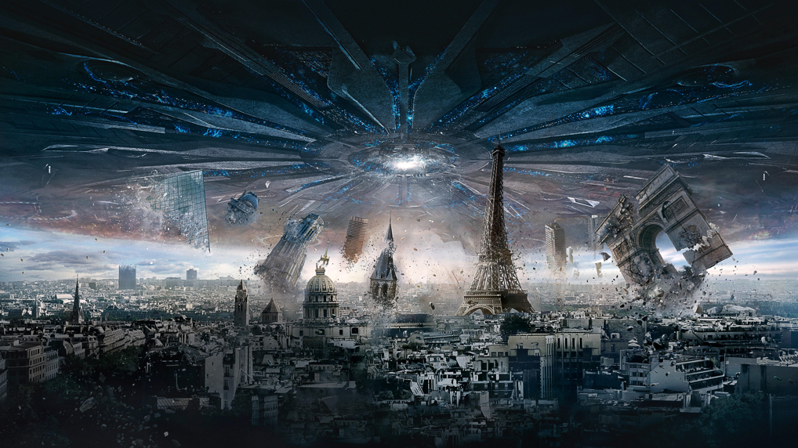

Slide 22


Slide 23
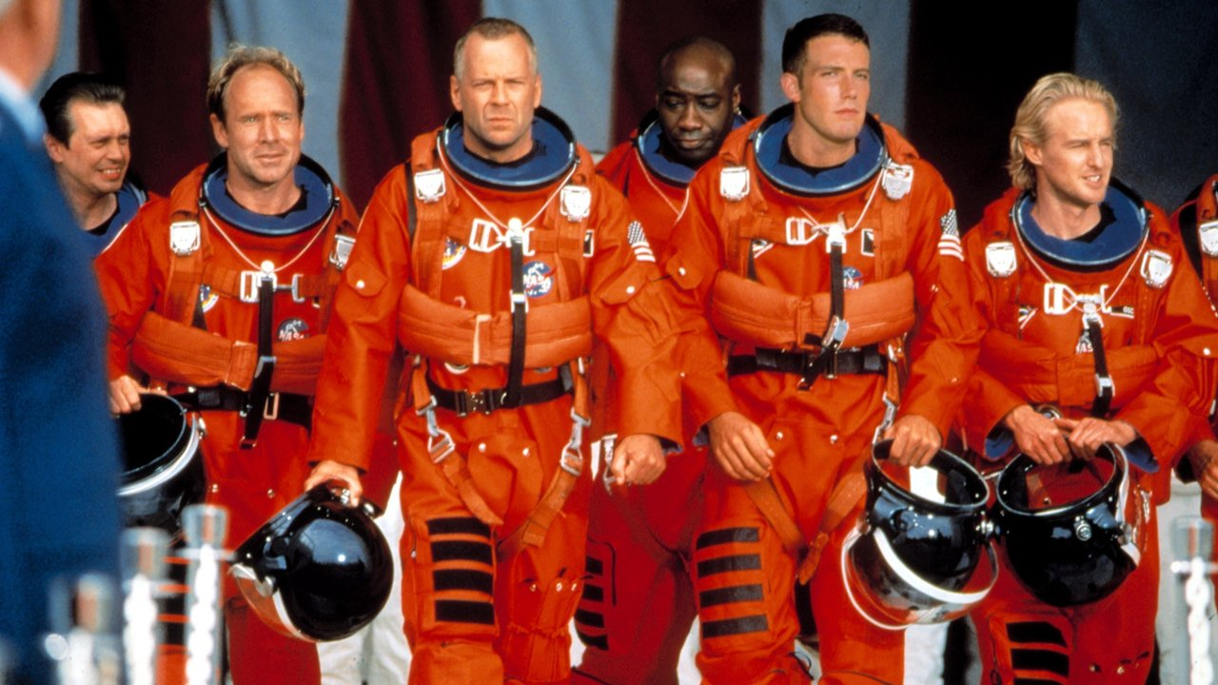

Slide 24


Slide 25
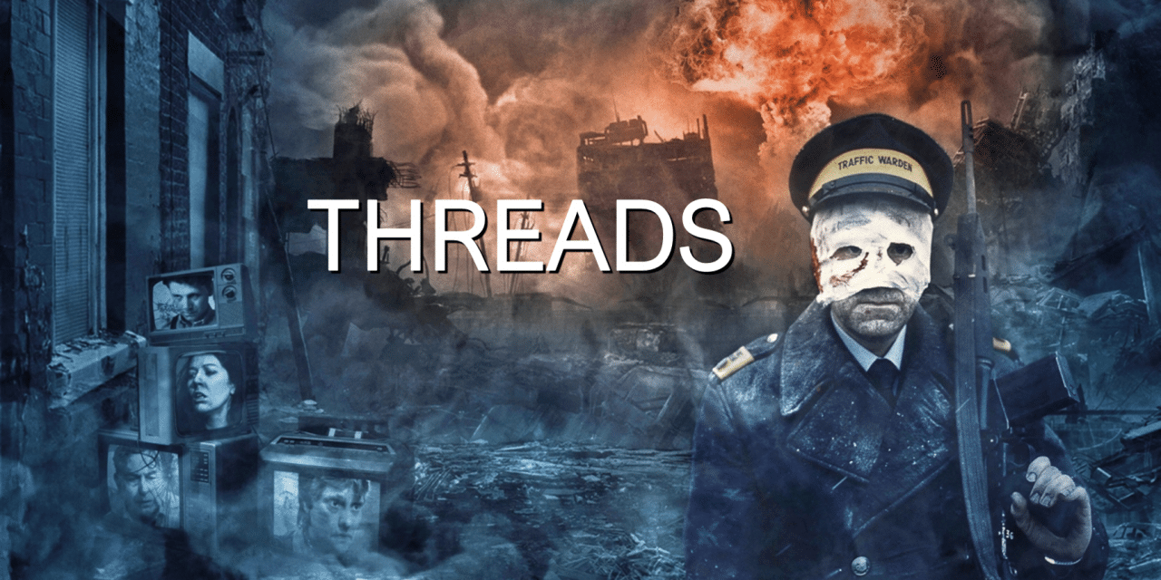

Slide 26
Popular Culture
entire genres of apocalyptic and post-apocalyptic media
very popular, reacting to current trends, fears and discoveries
frequent fantasies and escapism

Slide 27
Survivalism and preppers
roots in Cold War civil defense
wide spectrum of motivations and expected scenarios
many people actually looking forward to a global catastrophy
often infused with conspiracy theories or cults
can be practically useful during actual disasters and emergencies

Slide 28


Slide 29
