Slide 1
BSSb1194
Food, water and weather
Jakub Drmola

Slide 2
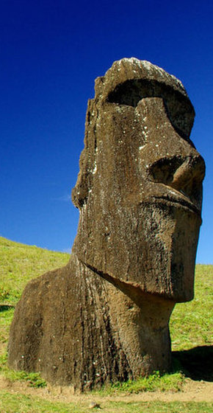
Easter Island
- relatively advanced, isolated society
- became unsustainable
- last tree cut down around 1650
- collapse from 12000 to <100 people
  food, building material, rats
  wars, disease, slavery, …

Slide 3
Famine
- often caused by combination of causes:
  droughts, diseases, pests, overpopulation
  almost always mismanagement
Irish Potato Famine (1845)
  primarily caused by blight + overspecialization
  1 million dead + emigration wave
Great Leap Forward (1960)
  primarily caused by policy + poor weather
  30-60 million dead

Slide 4
Natural (mostly) famines
- multiple famines with up to 10 million dead
  India 1770, 1783, 1790, 1877, 1943
  China 1860s, 1876, 1907, 1929, 1936
  France 1693
  Iran 1917
  Maya civilization in 11th century?
  deforestation and drought

Slide 5
Intentional famines?
Holodomor (1932)
  caused by collectivization policies a repression
  4-5 million dead, possibly genocide
Yemen (2016-)
  primarily caused by blockade and bombing
  combined with cholera + khat farming
  ongoing, death toll unknown

Slide 6
As conflict triggers
- adverse natural conditions can trigger conflicts
- Somalia
  escalating cycle of droughts and mismanagement
  failure of the state lead to collapse of fishing too
- Syria
  population explosion and urbanization
  droughts, poor harvest, unemployment, rising prices
  lots of angry, young men

Slide 7
Floods
- caused by abnormal weather
  too much snow melting or too much rain
  complicated by poor policies, infrastructure, deforestation, intensive farming, etc.
- secondary effects:
  crop failures, spread of disease, damaged buildings
- Huang He floods (1887, 1931, 1938) 5 mil. dead
- Czech floods (worst in 2002)

Slide 8
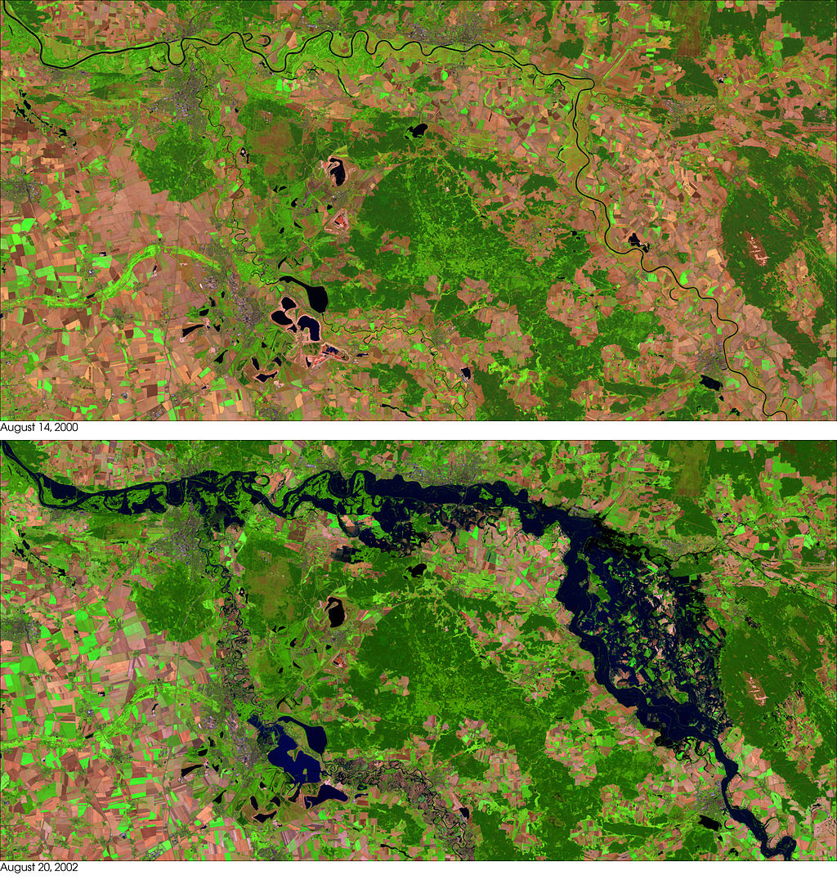

Slide 9
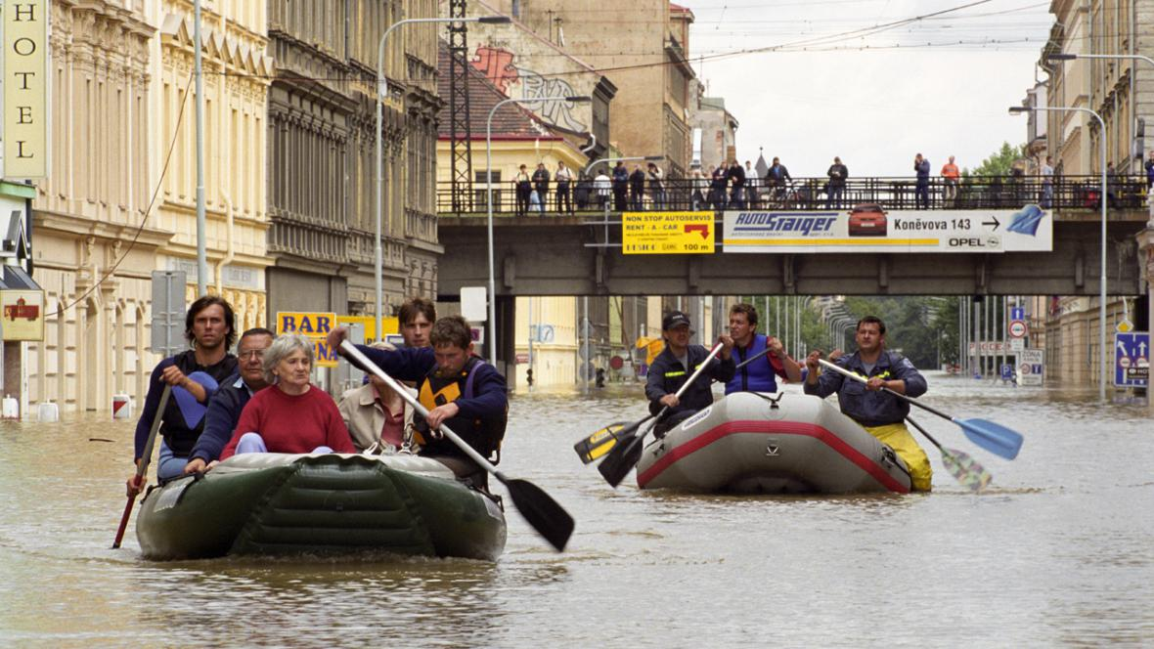

Slide 10
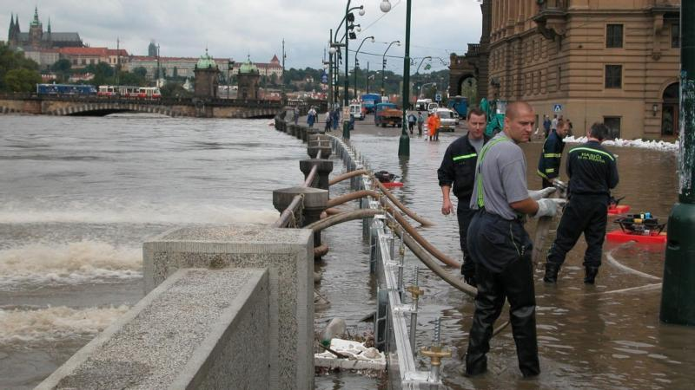

Slide 11
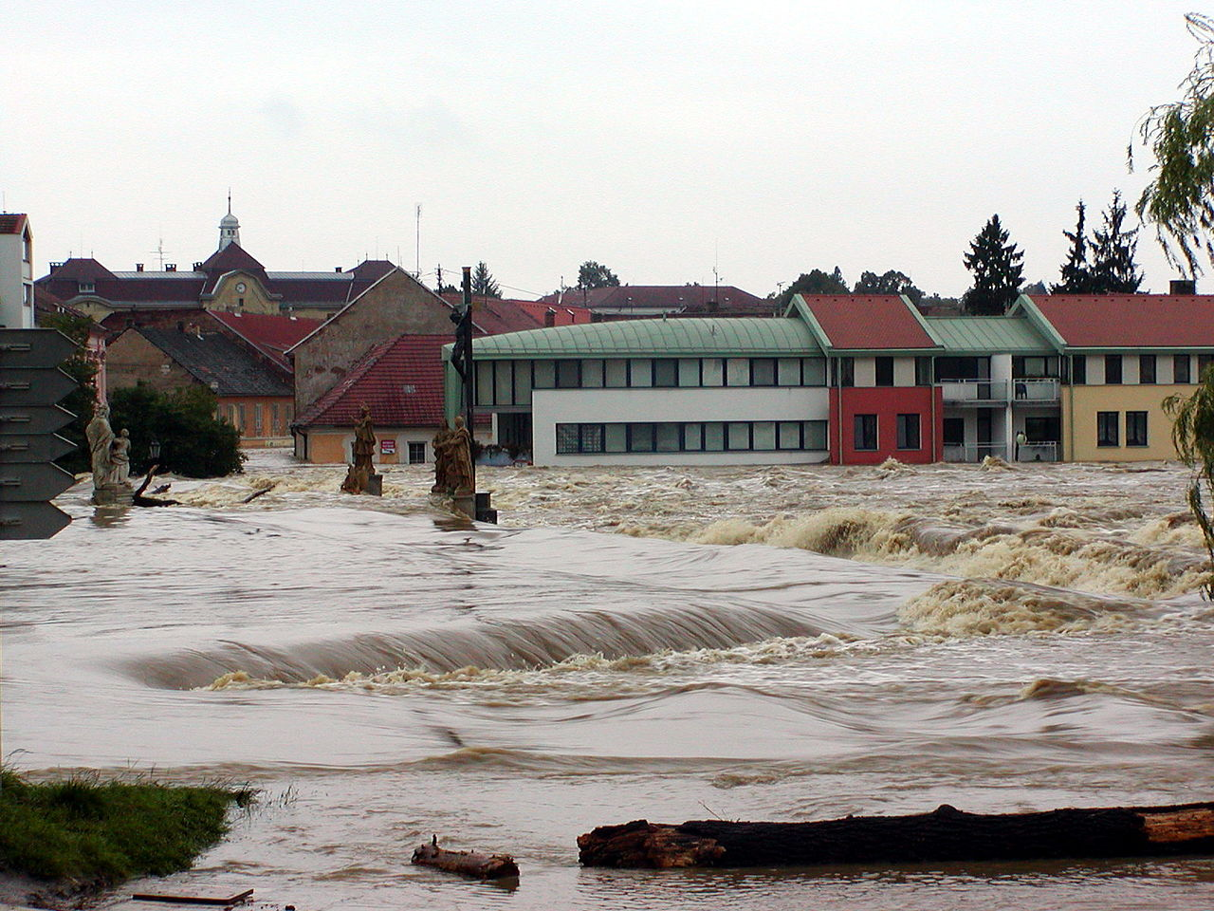

Slide 12
Non-natural floods?
- dams can fail
  Vajont, Italy (1963) – erosion and landslide, 2000 dead
  Ru, China (1975) – extreme rainfall, 2 dams, 200 000 dead
- or be destroyed intentionally
  Operation Chastise (1943), RAF bombing German dams

Slide 13
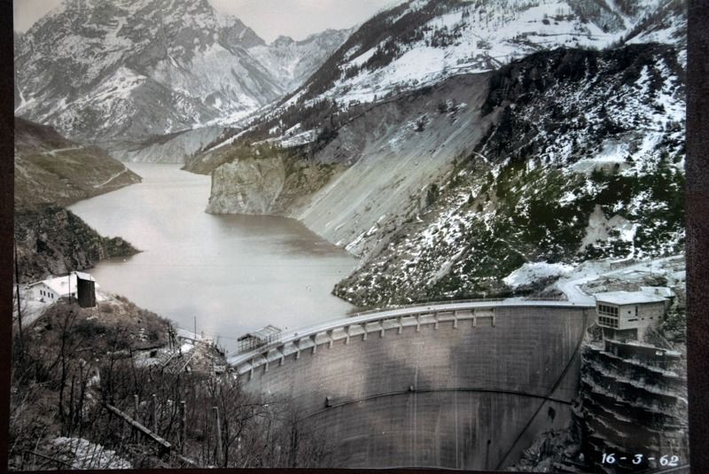

Slide 14
Weather…
- deadliest hurricanes are SE Asia
  1839, 1881, 1970, 1975, 2008 (hundreds of thousands)
- costliest hurricanes are in mid-Atlantic/Gulf coast
  1992, 2005, 2008, 2012, 2017 (up to over $100 billions)
- tornados are not so bad, comparatively
- lightning strikes – around 0.1 micromort
  depends where you live

Slide 15
Loss of species
- bees
  “colony collapse disorder”
  important pollinators, up to 10% of crops
- fisheries
  depletion by overfishing
- corals
  coastline protection and fish breeding
- loss of medical research opportunities
  any plants, fungi, animals

Slide 16
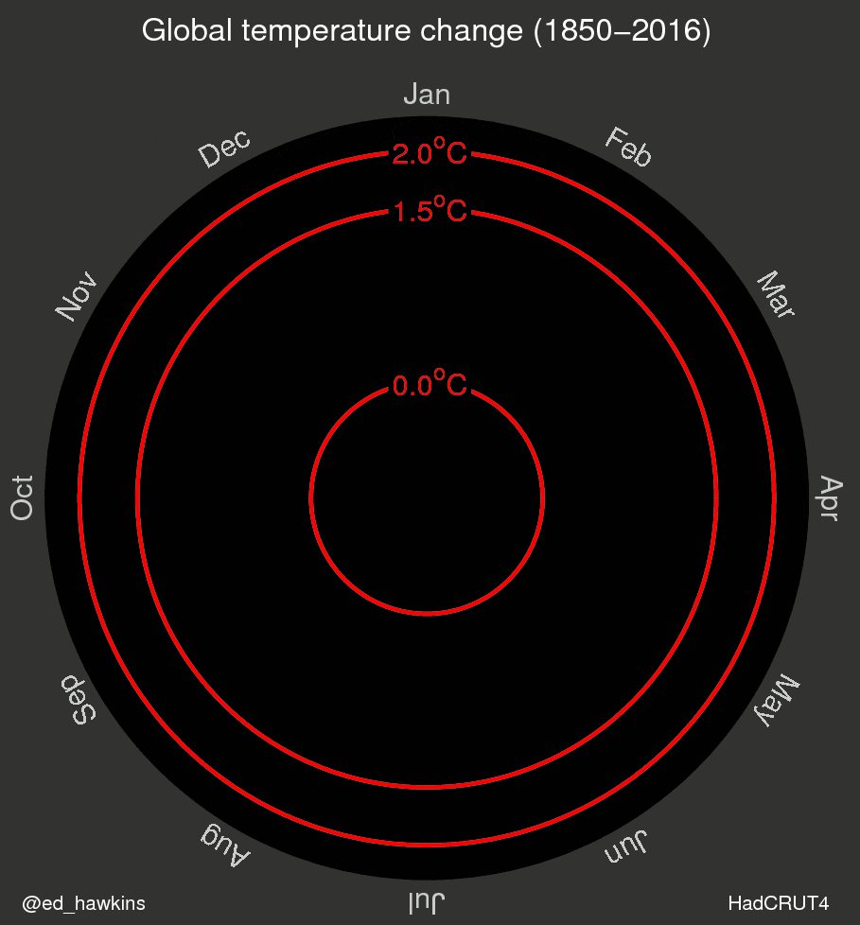
Climate change?
- makes everything above worse and more frequent
- instability and unpredictability of the environment increases
  which is bad for us
- some areas are more vulnerable than others

Slide 17
Lessons to be learned
- collapse or conflict often preceded by population boom, which then meets drop in productivity
  but also cuts the other way
- human societies fail at understanding and mitigating consequences distant in time and space from their causes
- dependent on speed and direction of feedback (positive/negative)
- tragedy of commons

