Slide 1
BSSb1194 Life kills life
Jakub Drmola

Slide 2
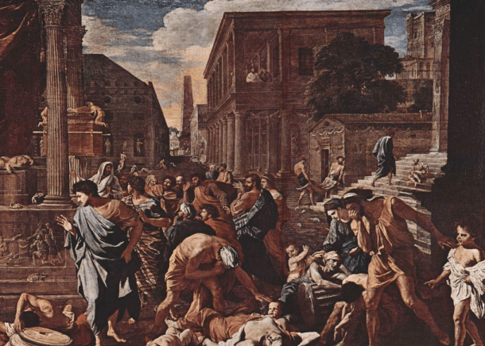

Slide 3
Historical cases
- mostly flu, smallpox, cholera and plague
- ancient pandemics
166 – smallpox, thousands of Romans dying daily
250 - flu, half the population dead in some places, Roman Empire nearly collapsed
541 – “Justinian plague” across Mediterranean, up to 100 million dead and 50% mortality
There were many more, but the ones in Mediterranean are best documented.

Slide 4
Plague
- bacteria Yersinia pestis
- often spread by fleas, sometimes through air
- 3 variants by progression:
1) bubonic plague (through lymphatic nodes, swelling)
2) septicemic plague (through blood, leads to surface necrosis)
3) pneumonic plague (lung infection, highest mortality)
- it still exists

Slide 5
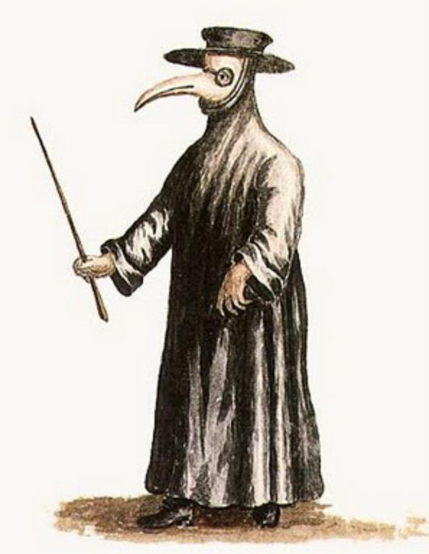
Black Death
- plague
- brought by Tartars through Crimea in 1346 (-1353)
- 100-300 million dead
- approx. half of Europe died out
- corpses piled up in streets with no one to bury them
- societal collapse, labor shortage

Slide 6
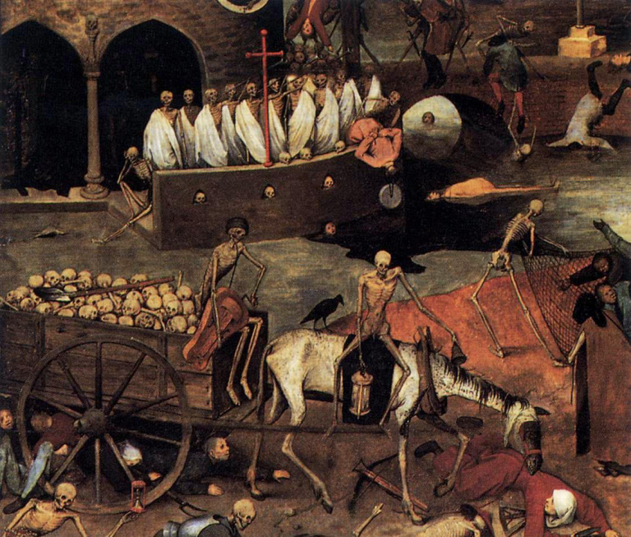

Slide 7
Americas
- Aztec empire (pop. of 25 million)
Spaniards arrived 1517
1520 – smallpox and drought, 8 million dead
1521 – conquest complete
1545 – cocoliztli (typhoid fever), 14 million dead
- Inca Empire (pop. of 17 million)
1520s – smallpox arrived (up to 50% died)
1526 – first contact with Spaniards
1532 – conquest mostly complete
50-90% of Native Americans killed by infections…

Slide 8
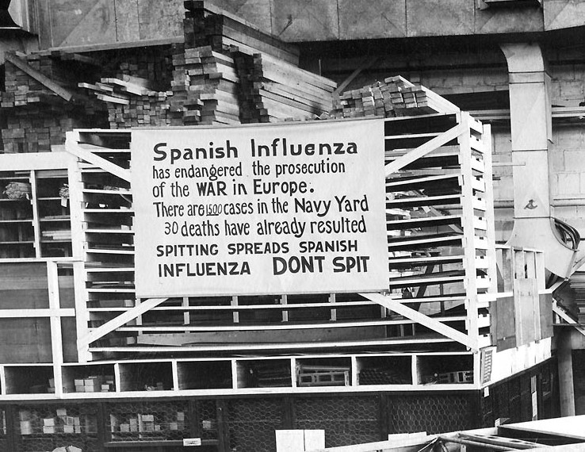

Slide 9
Spanish flu
1918-1919
global population 1.75 bil.
WW1: 15-20 mil. dead
WW2: 20-50 mil. dead
Spanish Flu: 50-100 mil. dead
up to 20% mortality of deadly second wave
(post)WW1 had perfect conditions

Slide 10
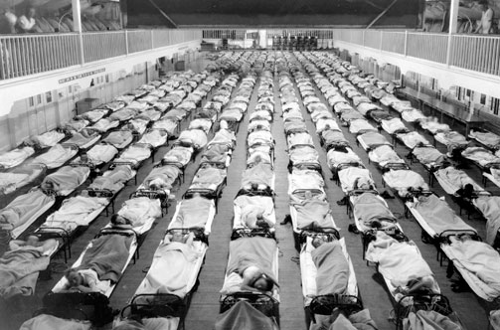

Slide 11
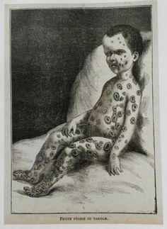
Smallpox
- vaccine in 1796
- campaigns since 19th cent.
- 2 million deaths per year in 20th century
- eradicated in 1977
- samples retained

Slide 12
Intentional use?
- during sieges
- Native Americans
the infamous blankets…
- 20th century
use against animals
use in China
- some terrorism attempts
- quite ineffective and hard to control

Slide 13
Ongoing pandemics
Malaria
0.5-1 million deaths per year
sickle red blood cells adaptation
HIV
1 million deaths per year (via AIDS)
zoonosis from SIV
covid-19
6+ million dead so far

Slide 14
Recently …
- SARS (2003) – 1000 dead, zoonosis from bats
- H1N1 “swine” flu (2009) – 100 000 dead
- zika (2015-2016) - microcephaly
- seasonal flus – 3-500 000 dead
- Ebola – avg. 50% mortality, 12 000 dead during the 2013-2016 outbreak

Slide 15
Causes and complications
- large concentrated populations
- fast travel between populations
- living in proximity with animals

Slide 16
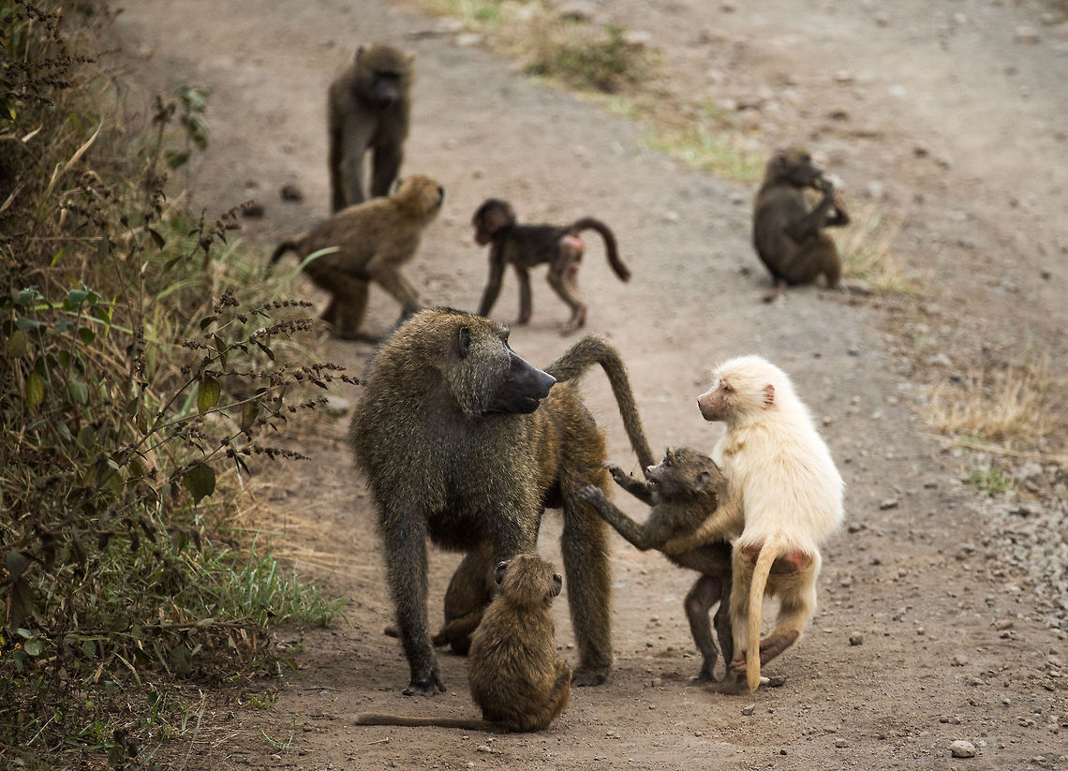
Adaptation
- Sewall Wright

Slide 17
Antibiotic resistance
https://www.youtube.com/watch?v=yybsSqcB7mE
- antibiotic misuse and overuse
- deaths probably already in millions, will get worse
- bacteriophages as solution?

Slide 18
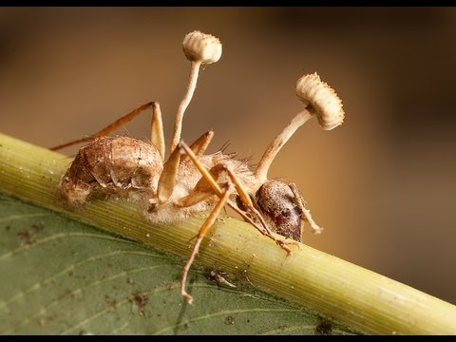
Zombies?
- cordyceps
fungi spores
arthropod parasites (insects, arachnids, etc.)
- horsehair worms
silent, thirsty crickets
- rabies
change in behavior
- toxoplasmosis
around 1/3 of humans
risky behavior?

Slide 19
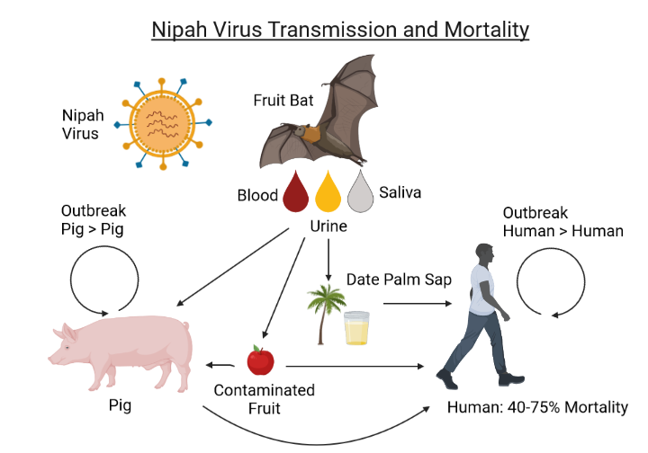
Theres more…
Ug99 - Puccinia graminis f. sp. Tritici
Nipah - Nipah henipavirus (NiV)

