Slide 1
BSSb1194
Introduction to security, threats, risk, and unintended consequences
Jakub Drmola

Slide 2
Studying “security”
- traditional Cold War era
- after the end of Cold War movement towards including other types of security
  economic, energy, political, etc.
- subjective/objective interpretations
- primarily concerned with organized violence, intentional threats and nation-states

Slide 3
Intentionality
- intentional threats
- threats lacking intention
- threats as unintentional consequences of intended actions

Slide 4
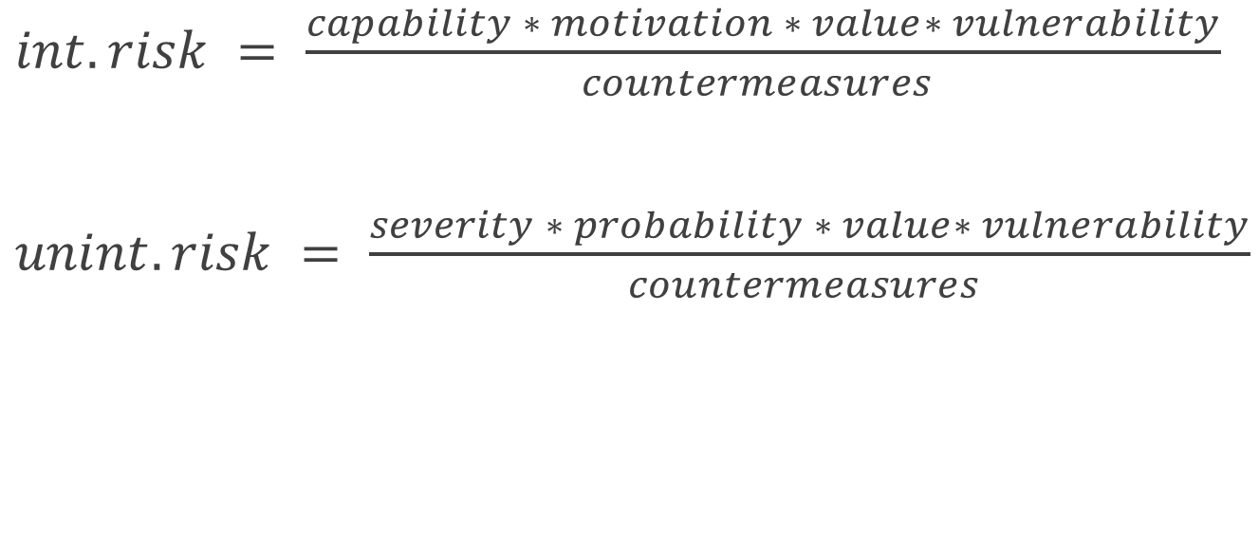
Equations?
$int. risk = \frac{capability ∗ motivation ∗ value∗ vulnerability}{countermeasures }$
$unint. risk = \frac{severity ∗ probability ∗ value∗ vulnerability}{countermeasures }$

Slide 5
Perceptions of “security”
Which type is most dangerous?
Which do/should we pay most attention to?
Which should we try to prevent?
Is perception more important than reality?
Do we know how dangerous some threats are?
How should we compare them?

Slide 6
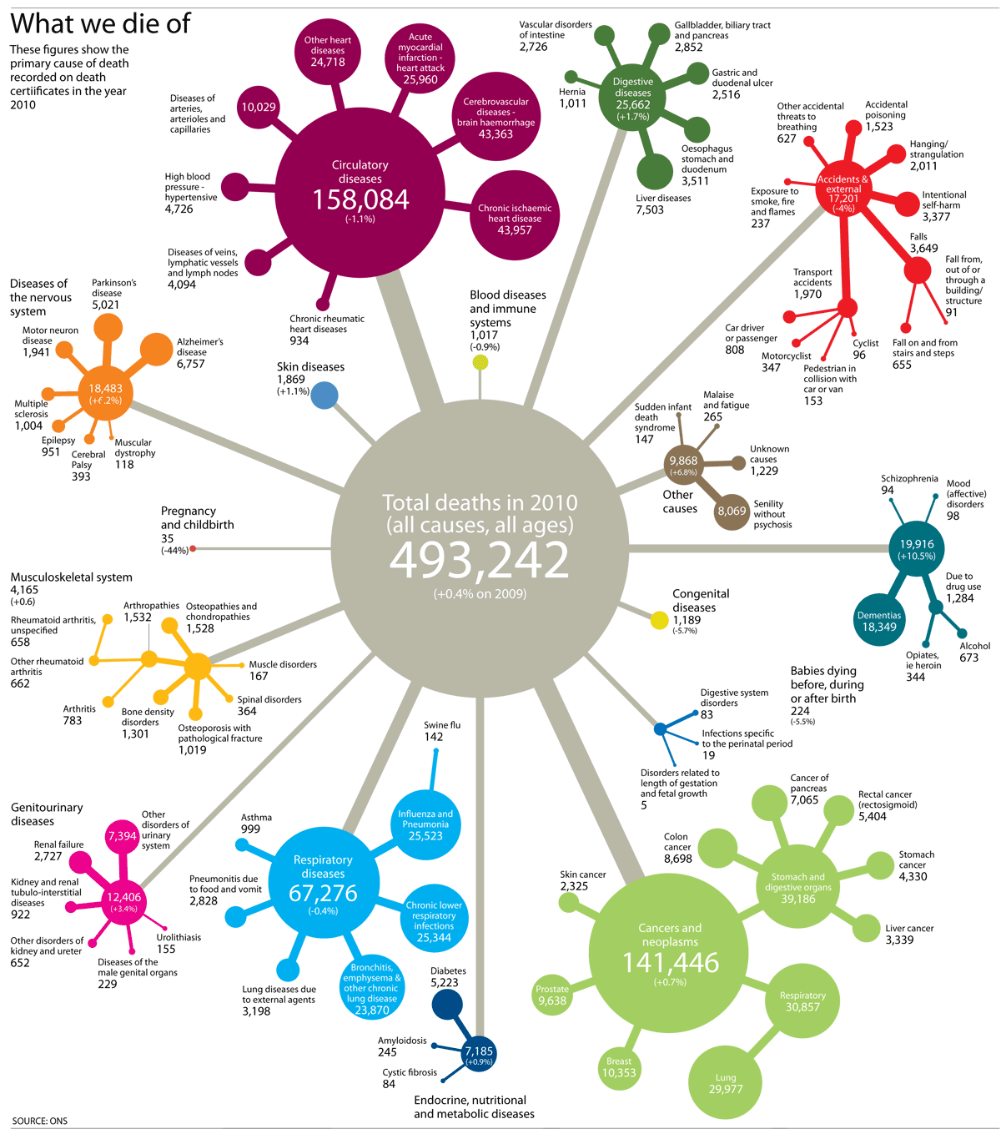

Slide 7
How to measure risk?
micromorts: one in million chance of sudden death
examples: 11km on a motorbike, walking 32km, biking 42km, driving 483km, 12070km on a plane or train
hobbies: scuba diving 5 micromorts, parachuting 10 micromorts, skiing or horseriding 0.5 micromort
one day as soldier in Afghanistan: 47 micromorts
bomber missions during WW2: 25 000 micromorts
terrorism in France: 0.1 micromorts/week

Slide 8
How to measure risk?
microlives: loss of one millionth of your lifespan
examples: 2 hours watching TV, smoking 2 cigarettes, 2 beers, a day of being 5kg overweight
we “use up” 48 microlives every day just by living
but we can recover some by diet, exercise etc.
activities can impact both microlives and micromorts

Slide 9
Perception of risk
- we are very bad at estimating and understanding risks
- we fear more what is: new, hard to understand, outside of our control, violent, intentional
- we fear less when we: get used to it, feel in control, understand how it works, consider it rare
- perceptions are easily distorted

Slide 10
Perception of risk
Do we care about micromorts? Should we?
What are impacts of wrong perceptions of risk?
If perceptions are wrong, how do we fix them?

