Slide 1
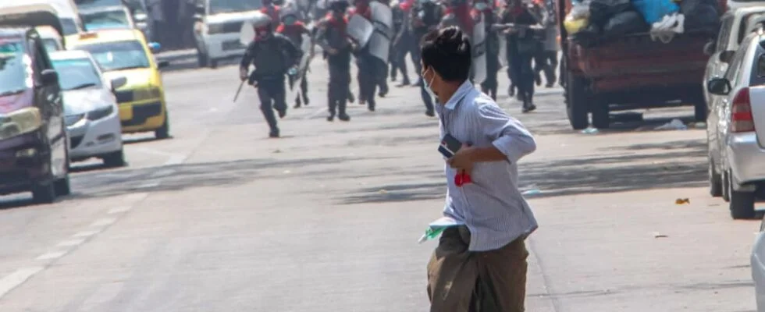
Violence against Civilians
Political Violence
Spring 2022
Doc. Marek Rybář, PhD.

Slide 2
Key questions
Why are some civil wars so much deadlier than others?
What accounts for severity of civil wars in terms of battle-related deaths?
Why do some warring factions engage in indiscriminate violence?
What is the logic (if any) of indiscriminate and targeted (strategic) violence against civilians?

Slide 3
Why are some civil wars so much deadlier than others?
one way to start is to investigate whether factors commonly associated with the outbreak of civil wars are also responsible for conflict severity
state strength: is conflict severity a result of weak state capacities? (since weak states provide a favorable context for civil war outbreak)
external military assistance, states with rougher terrain, and military quality (expenses per military personnel) may all serve as proxies for state strength
ethnicity and religion: ethnic and religious loyalties are often less flexible than other collective identities, i.e. ideologies (ethnic and religious fragmentation as a proxy)

Slide 4
Why are some civil wars so much deadlier than others?
regime type: type of political regime may matter; democracies tend to win wars (perhaps because they pick the fights, they are likely to win, and try to minimize casualties to avoid public backlash),
democracies may be less willing to use the harshest measures against rebels, or perhaps because democratic governments are in a better position to negotiate, and co-opt rebels than are other governments
Lacina (2006) analyzed civil wars between 1946 and 2002
what did she find?

Slide 5
Why are some civil wars so much deadlier than others?
1. state strength variables do not explain why some civil wars kill more people in combat than others
the availability of foreign assistance to the combatants is a strong predictor that a civil war will be severe (Cold War experience?!)
2. ethnic or religious heterogeneity does not explain the severity of internal war: no evidence that cultural diversity gives the elites an important tool to mobilize their followers and convince them to bear the costs of war
Instead, there is an unexpected link between ethnic homogeneity and large wars (!)
3. democracy is also associated with fewer battle deaths

Slide 6
Differences between warring groups?
why do some warring factions abuse noncombatants while others do not?
armed groups face a strategic challenge:
when they try to build, maintain, and deploy their fighting units, they inevitably rely on material resources and logistical support from civilians (noncombatants)
therefore, we can assume that coercive tactics are potentially costly because they undermine the civilian base of support for the warring parties

Slide 7
Why differences between warring groups?
Humpreys and Weinstein (2006) study unique data from a nationally representative survey of ex-combatants in Sierra Leone
the conflict was known for its unusually cruel treatment of the civilian population
five waring factions were involved in the civil war, committing all kinds of atrocities: sexual violence against women, the forcible recruitment of child soldiers, campaigns of killing and amputations perpetrated by the rebel groups
however, there was significant variation in how the militias treated civilians: rates of death and displacement varied dramatically in different parts of the country

Slide 8
Are there Incentives for Restraint?
the rebel groups are in repeated interactions with the population
one can assume that these very interactions facilitate more restraints on part of the rebels (it makes it worthwhile to refrain from total extraction, because the militias expect they will need their resources)
alternatively, if strong links exist between individual combatants and the population, the rebels may face higher costs if they employ abusive tactics in their own communities
in the regions where warring factions share their ethnic identity with the local population, one can expect lower levels of abusiveness

Slide 9
Contestation: between-group strategic considerations
the extent of civilian abuse may depend on who/how many rebel groups operate within a given territory:
if more than one rebel group can at least occasionally take hold over the territory, the incentives for restraint may decrease
(we do not want the other rebel group to benefit from civilian resources too)

Slide 10
Internal composition of the warring factions
a diversity of group characteristics and formal structures may affect their ability to coordinate and police the actions of its warriors
the rebel groups who recruit their new members by promising them private benefits may more abuse the civilian population
factions with loose disciplinary structures are likely to engage more in civilian abuse

Slide 11
Findings
patterns of abuse are largely explained by internal characteristics of the fighting units
the type of linkages that exist between combatants and communities or the degree of contestation between warring factions matter less:
abuse is more likely when groups lack the tools they need to prevent individual combatants from committing abuses
warring factions that recruit combatants with the promise of private benefits are more likely to exhibit high abuse of civilians
interestingly, there is no strong relationship between the extent of combatant-community ties and patterns of abuse (i.e. sharing ethnic/tribal bonds between militias and civilians has no effect on the level of abuse)

Slide 12
What is the logic driving indiscriminate violence?
violence is indiscriminate when selection criteria are rough
indiscriminate violence is generally (seen as) counterproductive in civil wars
yet, it is a phenomenon that takes place in most civil wars
Kalyvas argues that it is because indiscriminate violence is much cheaper than its selective counterpart for the combatants
it is most likely:
1. under an imbalance of power between warring groups or
2. when there is scarcity of resources and information are not availabe

Slide 13
What is the logic driving indiscriminate violence?
incumbent indiscriminate violence typically takes place in context of military campaigns that seek to search and destroy insurgents and to undercut civilian basis of the insurgency
the fact that insurgents do not shy away from this practice confirms that indiscriminate violence is related to lack of information (rather than ideology)
Insurgents also use it when they lack information: against villages that openly support the incumbents, or in the areas where their presence is limited (such as urban centers)

Slide 14
What is the logic driving indiscriminate violence?
indiscriminate does not mean meaningless:
it aims to deter people from collaborating with the rival actor; it collectively sanctions suspected collaborators and also those who are related to them
if the “guilty” cannot be identified and arrested, then violence targets innocent people that are somehow associated with them
the underlying assumption is that the “innocent” will either force the “guilty” to change their behavior OR the “guilty” will change their course of action when they realize its impact upon “innocent” people they care about

Slide 15
How effective is indiscriminate violence?
a general perception is that it fails to achieve its strategic goals
there is the tendency of insurgents to actually welcome incumbent indiscriminate violence because such reactions bring in new recruits
the most infamous example of the futility of indiscriminate violence is possibly the Nazi reprisal policy in occupied Europe
several reasons for its alleged failure are put forward

Slide 16
Emotional reactions
it targets people independently of what they did, and as such is perceived as deeply unfair
the desire for revenge produces armed reaction only if there is an organization that makes such action possible:
the absence or weakness of organizations leads to passivity or sloppy actions doomed to failure
no matter how outraged, civilians will have no choice but to collaborate with the indiscriminate actor

Slide 17
Ambiguity of structure of incentives for cooperation
compliance is almost as unsafe as noncompliance, because the “innocent” can do little to nothing to escape punishment and the “guilty” are no more threatened
consequently, there is little advantage in being a collaborator
indiscriminate violence lacks almost every feature generally considered to be necessary for the effectiveness of sanctions:
it is 1. late, 2. arbitrary, 3. inconsistent, and 4. disproportionate
furthermore, credible protection requires the establishment of incumbent control

Slide 18
Ambiguity of structure of incentives for cooperation
however, incumbents typically raid an area, kill civilians to take revenge for their lack of support, and then depart
There is a lesson for a counterinsurgency : try to “clear-and-hold” rather than “search-and-clear” the area
when there is no prospect of holding an area that may be cleared, no effort should be made to involve the inhabitants on the side of the government

Slide 19
Reverse discrimination and selective incentives for rivals
Incumbent indiscriminate violence often produces a reverse discrimination against “non-rebels” and “anti-rebels,” who wrongly believing that their “innocence” will protect them
civilians will be likely to collaborate with a political actor who credibly offers them protection, when its rival produces only indiscriminate violence

Slide 20
Why does indiscriminate violence occur anyway?
there is no systematic empirical evidence that indiscriminate violence is ineffective
most accounts of indiscriminate violence focus on the individual level, pointing to a combination of weak discipline and strong emotions that generates frustration and stress, eventually leading to indiscriminate violence
they remain unsatisfactory, because they do not consider whether emotions and attitudes, such as fear, anger, or racism, are the causes, the correlates, or the results of using indiscriminate violence

Slide 21
A general theory of indiscriminate violence
there is ample evidence in many civil wars documenting such a shift to higher levels of discrimination in violence over time
it can be explained by their better access to local information
the persistent use of indiscriminate violence indicates that political actors are fundamentally weak: this is the case with civil wars in failed states
high levels of indiscriminate violence emerge because no actor has the capacity to set up the sort of administrative infrastructure required by selective violence (state collapse)

Slide 22
When does selective violence occur?
selective (discriminate) violence is process, jointly created by the actions of both warring actors and civilians
information and violence are the key resources around which the process is ordered
political actors need information in order to be able to target selectively, to distinguish from among civilians those who are helping the enemy
civilians have information, which they provide through denunciation

Slide 23
When does selective violence occur?
there is a great potential for abuse in such a system, but violence need only be perceived as selective in order to avoid the pitfalls of indiscriminate violence
denunciation will only occur when potential denouncers perceive the political actor as able to protect them from retaliation
in civil wars, selective violence can only take place in those areas where control is complete enough for denouncers to denounce
(but not so complete that defectors have either fled or simply ceased to be of concern to the political actor)

