Slide 1
The Weimar Republic, Austria and inter-war Czechoslovakia
Věra Stojarová
Democratisation and De-democratisation

Slide 2
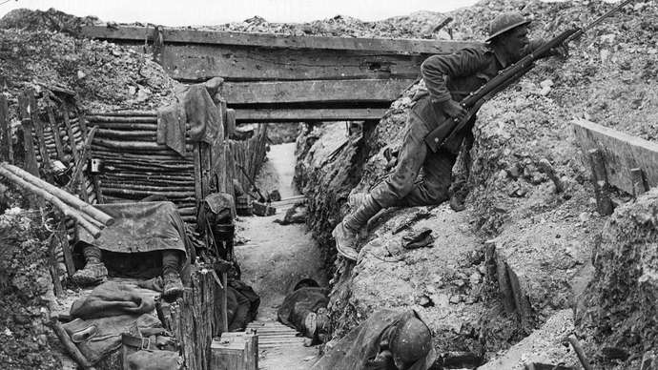
The prelude
WWI – 1014-1918 The great war
over 20 million deaths as direct result of the war plus Spanish flu, resulted in revolutions, uprisings
Austro-Hungarian, Russian, Ottoman and German empires ceased to exist
Numerous states created
Paris Peace Conference
League of Nations created

Slide 3
Warming- up
It´s 1918 – you are about to create Czechoslovakia/Austria/Weimar republic – what do you have to do? What do you have to deal with? What are the challenges for the new states?

Slide 4
The Weimar republic

Slide 5
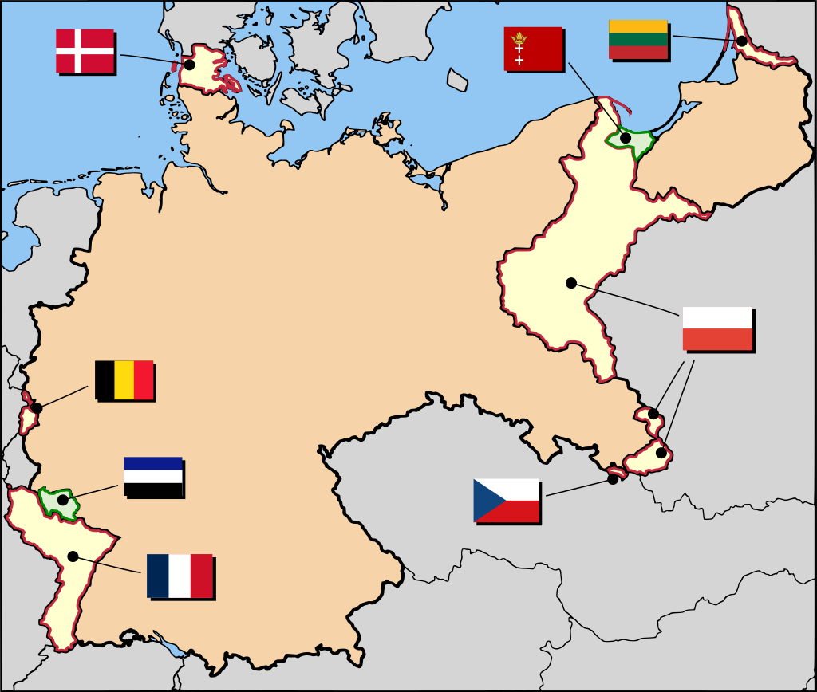
Treaty of Versailles
required Germany to disarm (army of no more than 100,000 men in a maximum of seven infantry and three cavalry divisions.
make ample territorial concessions
Colonies transfer
and pay reparations
In 1921 the total cost of these reparations was assessed at 132 billion gold marks (then $31.4 billion or £6.6 billion, roughly equivalent to US$442 billion in 2021).
Renegotiations, postponement
Cause of WWII?? https://www.bbc.co.uk/bitesize/guides/z9y64j6/revision/3 (Treaty of Versailles 30 sec, excerpt)

Slide 6
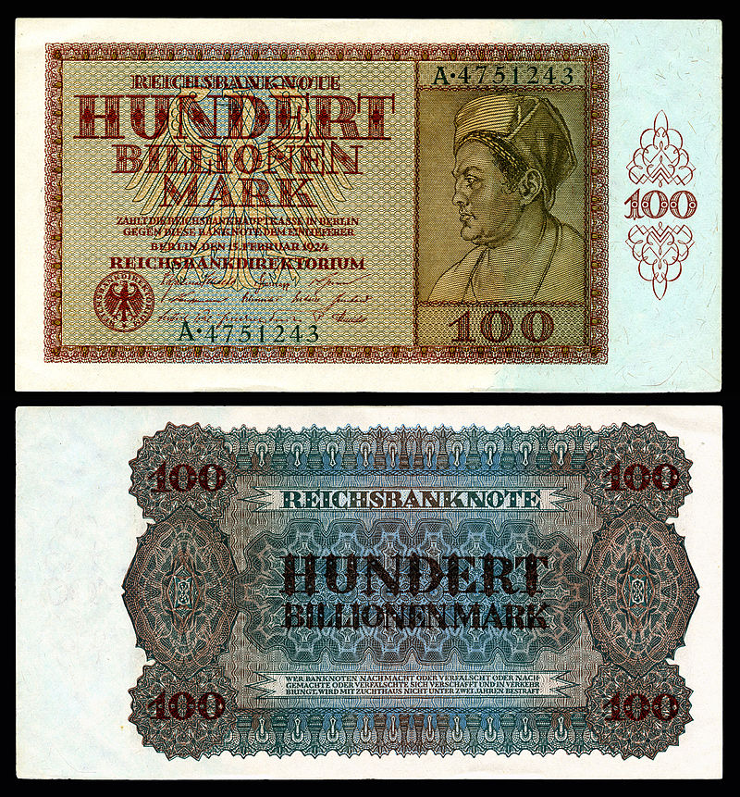
Weimar Republic 1918-1933
German exhausted
Proclamation of republic and abdication of the monarch
Hyperinflation
Political extremism
Paramilitaries to fill in the gap after the army
Issues with neighbours
Golden 1920´s and then decline
Economic crisis 1929
Notes:
In October 1923, Germany experienced a 29,500% hyperinflation (roughly 21% interest per day). Historically, this one-month inflation rate has only been exceeded three times: Yugoslavia, 313,000,000% (64.6% per day, January 1994); Zimbabwe, 79.6 billion% (98% per day, November 2008); and Hungary, 41.9 quadrillion% (207% per day, July 1946).

Slide 7
Weimar Constitution
Notes:
Strengths
A genuine democracy - Elections for parliament and president took place every four years and all Germans over 20 could vote.
The power of theReichstag - The Reichstag appointed the government and made all laws. This was very different from its powers before the war under the Kaiser.
A Bill of Rights - This guaranteed every German citizen freedom of speech and religion, and equality under the law.
Weaknesses
Proportional representation - Each party got the same percentage of seats in parliament as the percentage of votes it received in an election. This meant there were lots of small parties in Parliament making it difficult to pass laws and led to weak and often short-lived governments.
Article 48 - This gave the president the power to act without parliament’s approval in an emergency. However, it did not clearly define what an 'emergency' was, so the power was overused, which weakened Germans’ confidence in democracy.

Slide 8
Progressive Social policies under Weimar
maximum working 48-hour workweek
restrictions on night work
a half-holiday on Saturday, and a break of thirty-six hours of continuous rest during the week.
health insurance was extended to wives and daughters without their own income, people only partially capable of gainful employment, people employed in private cooperatives, and people employed in public cooperatives.
progressive tax reforms
all aid for the disabled and their dependents be taken over by the central
Unnemployment benefits
Health insurance
State responsibility, welfare system

Slide 9
Under attack of left and right-wing
Freikorps
Spartacist uprising 1919 between moderate and radical left (Fridrich Ebert social democrats vs. Karl Liebknecht and Rosa Luxembourg communists)
1920 Bavarian Soviet Republic
1923 Munich poutsch (Beer Hall Putsch) – Hitler in jail writing Mein Kampf, re-thinking means how to gain power (https://www.youtube.com/watch?v=pJVQZWLqSPE&list=PLu2xst_eS6dqU4NGf92ipWZ2jnvPmXnV8&index=11 10 min)
Notes:
he Freikorps was an army outside the control of the government, but they were in close contact with their allies in the Reichswehr.

Slide 10
The 1930´s
Hyperinflation
Unemployment
NSDAP entered parliament 1930
Chancellors ruling by decrees without the parliament
https://www.youtube.com/watch?v=vO-_HXO7HwY (10 minutes Weimar republic)
1932 July elections (NSDAP 37%, SDP 21%, Communists 14%) no coalition government with a majority could be formed
1932 November elections (33% NSDAP, 20% SDP, communists 16%) last free elections, Hitler forms government
1933 elections – suppression of communists and SD

Slide 11
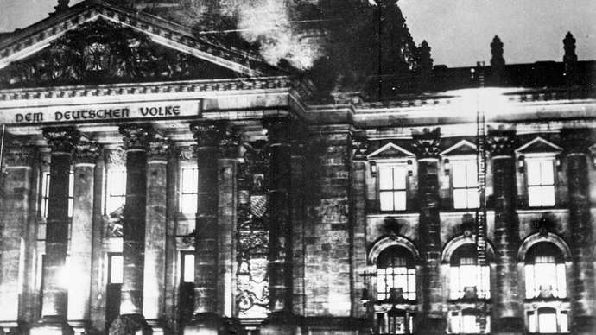
Seizure of control 1930-33)
Nazi Propaganda and the power of radio (https://www.youtube.com/watch?v=aD6zpu0H6d4 6 min)

Slide 12
1933 – end of Weimar Republic
Meetings of the left-wing parties were banned and even some of the moderate parties found their members threatened opposition.
suppressed the Communist Party
arrests of Reichstag deputies.
The Reichstag fire on 27 February was blamed by Hitler's government on the Communists.
state of emergency
Reichstag Fire Decree - The decree invoked Article 48 of the Weimar Constitution and "indefinitely suspended" a number of constitutional protections of civil liberties, allowing the Nazi government to take swift action against political meetings, arresting and killing the Communists.
State broadcasting exploited by NSDAP
1933 elections (NSDAP 43%, SD 18%, Communists 12, Center 11%) – NSDAP „monitoring the voting proces“

Slide 13
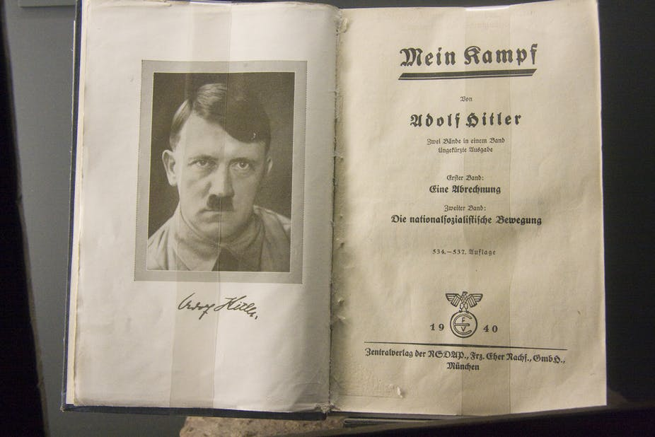
Mein Kampf
process by which Hitler became antisemitic and outlines his political ideology and future plans for Germany
the Jewish peril", which posits a Jewish conspiracy to gain world leadership
he world's two evils: Communism and Judaism.
his ambitions for creating a New Order.
Hitler saw a purpose in destroying "the weak" in order to provide the proper space and purity for the "strong“
Lebensraum
the Jews and "Bolsheviks" as racially and ideologically inferior and
unification of German peoples into one Greater Germany.

Slide 14
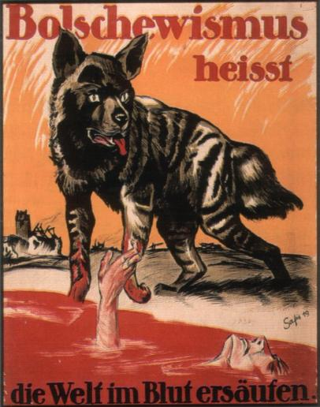
Power of propaganda
Voelkischer Beobachter, Angriff
Public meetings speeches by Hitler
Ministry for propaganda
The KdFwas created to monitor what workers were doing in their non-working time.
The KdF also monitored holidays and all leisure time by scheduling activities for workers
This produced support for the state from the working class which led to Nazi Germany's further rise in power.
The KdF required members to participate in the activities offered to them, otherwise, any members who didn't participate were classified as anti-government. being sent to a concentration camp as punishment.
Textbooks for schools, jewish authors banned, textbooks for occupied territories
Newspapers, film posters

Slide 15
Austria between WWI and WWII

Slide 16
Austria between WWI and WWII
Republic of German Austria/First Austrian Republic 1919
Left/right violent politics
Paramilitary clashes (Republikanischer Schutzbund of SD and nationalist Heimwehr
Conservative countryside vs. social democrats in „Red Vienna“

Slide 17
Constitution
Parliamentary democracy – strong parliament , 2 chambers
Executive power in the hands of chancellor nominated by the parliament
Relatively weak president elected by both houses as a head of state

Slide 18
The July revolt of 1927
Vienna Palace of Justice fire
major riot
It culminated with police forces firing into the outraged crowd, killing 89 protesters, more than 600 protestors and around 600 policemen were injured.
Clash as a result of left/right clashes

Slide 19
Towards authoritarianism
In 1929 constitutional revision – more powers for the president
President elected by the people
The president was also to be vested with the authority to dissolve the parliament, a power typically not held by heads of executive branches of parliamentary republics. He also had the authority to formally appoint the chancellor and the cabinet.
towards a system concentrating power in the hands of president was made in an attempt to appease the para-fascist movements
In 1934, authoritarian corporate state
1938 Austria was annexed by Nazi Germany

Slide 20
Economy
Barely able to provide food for its citizens
The great depression

Slide 21
Austrian civil war - 1934
Austrian Nazi party wanted Austria to join Germany.
Competition to Roman Catholicism as a means to show the reason why Austria should not join a predominantly Protestant Germany.
War between Nazis, Social Democrats and government forces.
On 1 May 1934, Dollfuss created a one-party state, to be led by the Fatherland Front
Federalism and the controlling powers of the Federal Council was curtailed
elections for the National Council was abolished
its members nominated by four non-elective, corporatist-styled councils
all legislation and appointments were exercised from above by the Federal Chancellor's and President's decree.

Slide 22
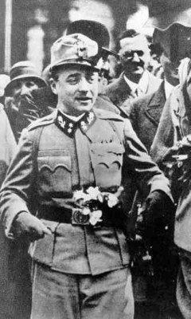
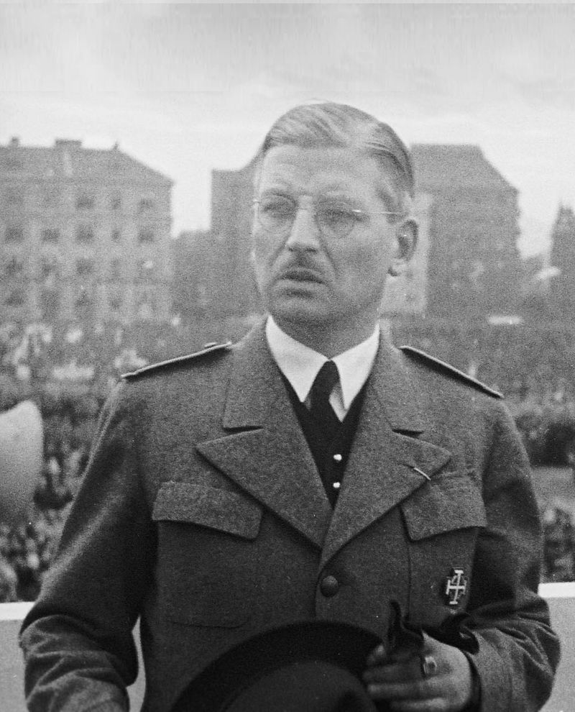
1934-38 Dictatorship
The Nazis assassinating Engelbert Dollfuss during the July Putsch of 25 July 1934
The successor to Dollfuss, Kurt Schuschnigg, maintained the ban on Nazi activities, banned the Heimwehr in 1936.
Anschluss

Slide 23
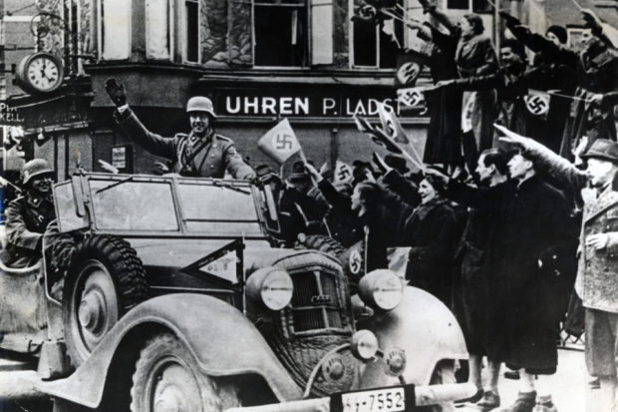
Anschluss
Paris Treaties had explicitly forbidden the unification of Austria and Germany
On 12 March, German troops entered Austria, who met celebrating crowds, in order to install Nazi puppet Arthur Seyss-Inquart as Chancellor.
With a Nazi administration
integrated into the Third Reich and renamed as "Ostmark" until 1942, when it was renamed
A rigged referendum on 10 April was used to demonstrate the alleged approval of the annexation with a majority of 99.73% for the annexation.
The Jews, Communists, Socialist and hostile politicians were sent to concentration camps

Slide 24
Czechoslovakia between WWI and WWII

Slide 26
Inter war Czechoslovakia
First republic 1918-1938
Second Republic 1938-39
After 1933 Czechoslovakia was left the only democracy in central and Eastern europe

Slide 27
Constitution
parliamentary democracy
2 chambers
universal suffrage
The National Assembly was responsible for legislative initiative and was given supervisory control over the executive and judiciary as well.
Every seven years it elected the president and confirmed the cabinet appointed by him.
Executive power was to be shared by the president and the cabinet; the latter, responsible to the National Assembly
The reality differed somewhat from this ideal - strong presidencies of Masaryk and his successor, Beneš

Slide 28
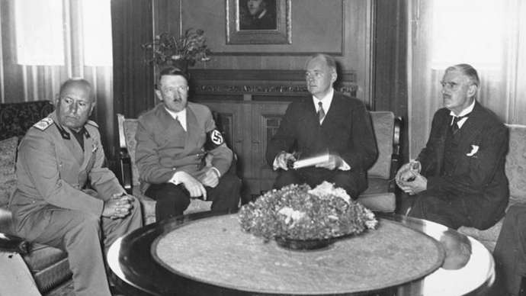
2nd Republic
Munich Agreement 30.3.1938 UK, Fr, It, Ger, Sudetenland
major natural obstacle to any possible German attack.
Sudetenland was of absolute strategic importance to Czechoslovakia.
Hungarian attempts to revise borders
Slovak strive for independency, Subcarpathian Ruthenia for autonomy
Secrets meetings with Slovak politicians with Hitler
Political system in chaos, Communist party dissolved

Slide 29
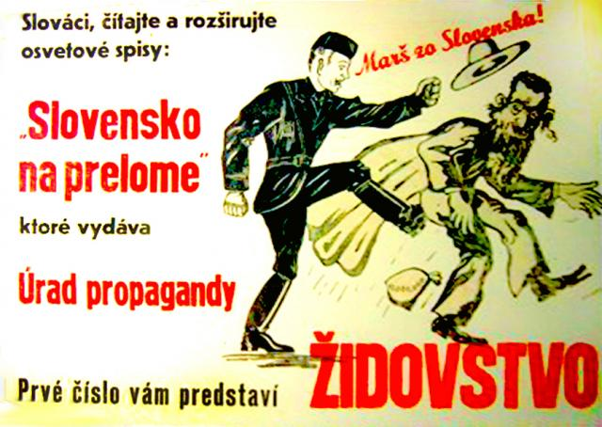
This is the end…
14th March independent Slovakia (if you do not declare independency we will leave you to the Hungarian and Polish hords)
15th March 1939 occupation, protectorate of Bohemia and Moravia
Hungarian occupation of carpatho-ruthenia
Foreign agression, ethnic tensions, internal political tensions
WWII

Slide 30
Seminar
Its 1918 – you are about to create Czechoslovakia/Austria/Weimar republic – what do you have to do?

Slide 31
Weimar Republic, Austria, Czechoslovakia
Political transformation – from monarchy to republic, design of the political system, what shall we do with monarchs? Foreign policy? Do we have enough of capable cadres? Design of the electoral system (from majority to proportional?), who shall have the right to vote, to be elected (those who can read and write?, who have property, soldiers, mentally disabled???) accomodation of nations (centralisation/decentralisation), debts of Austria/Hungary and successor states, state borders, currency, flag, coat of arms, war reparations paid by Czechoslovakia though being victorious state,
Social transformation – what shall we do with the feudals? Women and the suffrage? Women and work? Accomodation of women, minorities, cleavage city/village, abolition of censorship and flourishing of media, radio, cinema, war reconciliation, collaboration, land reform, division of the church from the state, emergence of new churches
Economy – capitalism? Socialism? Welfare state? Health system? Unemployment benefits? New borders within austria/hungary leading to protectionism of the agricultural products

Slide 32
Factors influencing the prosperity and stability of the state?

Slide 33
Factors of prosperity and stability
The geographical position
The region and the history
The political system
The population and ethnic structure
The language, religion and culture
The symbols of the state
The size and density of population
The urban versus rural percentage
The wealth of the state
The interaction and intermarriages

Slide 34
Seminar
Construct totalitarian state (in terms of geography, politics, economic, symbols, religion, language, culture, etc. Elect leader and write his inauguration speech

Slide 35
Seminar
Transitional justice
International tribunals (nurnberg, tokio)
Reparations (concept, case studies)

