Slide 1

Intro to theme
Video: Inequality: A persisting challenge and its implications
https://youtu.be/PQIrwVTrBWc

Slide 2
Inequality and social stratification
Connection between social stratification and inequality
Systematic inequality between groups of people = social stratification
Why social?
  SS concerns the groups of people
  Inequality is organized around groups with similar characteristic
Criteria delimit the inequality
  wealth, income, prestige, power, gender, education, age
Rankings of groups change only very slowly
All societies are stratified societies

Slide 3
Three basic historical models of inequalities
Slavery—ownership of certain people
Caste—status for life
Class—positions based on:
  economics
  employment (paid jobs)
  labor markets
Modern and postmodern societies
3
Notes:
Historically speaking, there are three major types of systems of social stratification: slavery, caste, and class. Let me briefly describe each type.
1. In slave systems, some peoples are considered less than human and are owned as property. Their legal rights are limited, certain relationships are prohibited, and as you might imagine, and social power is essentially nonexistent.
2. In caste systems, societal groupings are based on deeply held cultural ideals and boundaries. The Indian caste system exemplifies this societal form of stratification, having both cultural and economic impacts. Caste systems are rigidly based. They are characterized by hereditary status, endogamy, and social barriers and are sanctioned by custom, law, and religion.
3. Class systems are the stratification system we are familiar with. People are divided according to economic markers such as income, wealth, ownership, and so on. There are many different characterizations of what constitutes class, and we will be talking about these characterizations today.

Slide 4
Inequality dimensions
Economic inequality: wealth, money (rich vs. poor people)
Social class inequality: occupations (labour market positions)
Social status inequality: prestige, respect
Power inequality: influence, authority
The debate is over which type if inequality is the most important?
Three main dimensions of inequality:
  economic
  educational
  power

Slide 5
Social stratification cube
Three main dimensions
  economic capital (income, salary)
  education (prestige, respect)
  power (authority)
Fourth dimension
  time
Social mobility vs. social reproduction

Slide 6
Reproduction of inequality
Reproduction of social strata
  In European countries children from the highest social classes have about 80% higher probability to attend university compare to children from the working class
    IEO
  Children from highest social class have 70% probability to get married with the same social class partner
    Homogamy
  Inequality is reinforced by:
    socials mechanisms (system)
    individual based actions (actor)

Slide 7
Two reasons of reproduction of inequalities
System: social reproduction
  glass ceiling
  social barriers
  everyone wants the same
Actor: cultural reproduction
  sticky floor
  cultural values, attitudes
  behavior
  people want different things

Slide 8
Two basic inequality concepts
Inequality of conditions
  unequal distribution of income to people
  differences in wealth and material conditions
  different incomes means different chances to get different goods
Inequality of opportunity
  unequal start positions
  different start positions means different chances to get different levels of education, jobs and incomes
8
Notes:
Historically speaking, there are three major types of systems of social stratification: slavery, caste, and class. Let me briefly describe each type.
1. In slave systems, some peoples are considered less than human and are owned as property. Their legal rights are limited, certain relationships are prohibited, and as you might imagine, and social power is essentially nonexistent.
2. In caste systems, societal groupings are based on deeply held cultural ideals and boundaries. The Indian caste system exemplifies this societal form of stratification, having both cultural and economic impacts. Caste systems are rigidly based. They are characterized by hereditary status, endogamy, and social barriers and are sanctioned by custom, law, and religion.
3. Class systems are the stratification system we are familiar with. People are divided according to economic markers such as income, wealth, ownership, and so on. There are many different characterizations of what constitutes class, and we will be talking about these characterizations today.

Slide 9
Basic principles inequality reproduction
Cumulative advantage
  Matthew effect
  Advantages have tendency to strengthen itself
  The same can be applied to disadvantages.
Compensatory advantage
  Economic, cultural, social, family resources to face risks along the life course

Slide 10
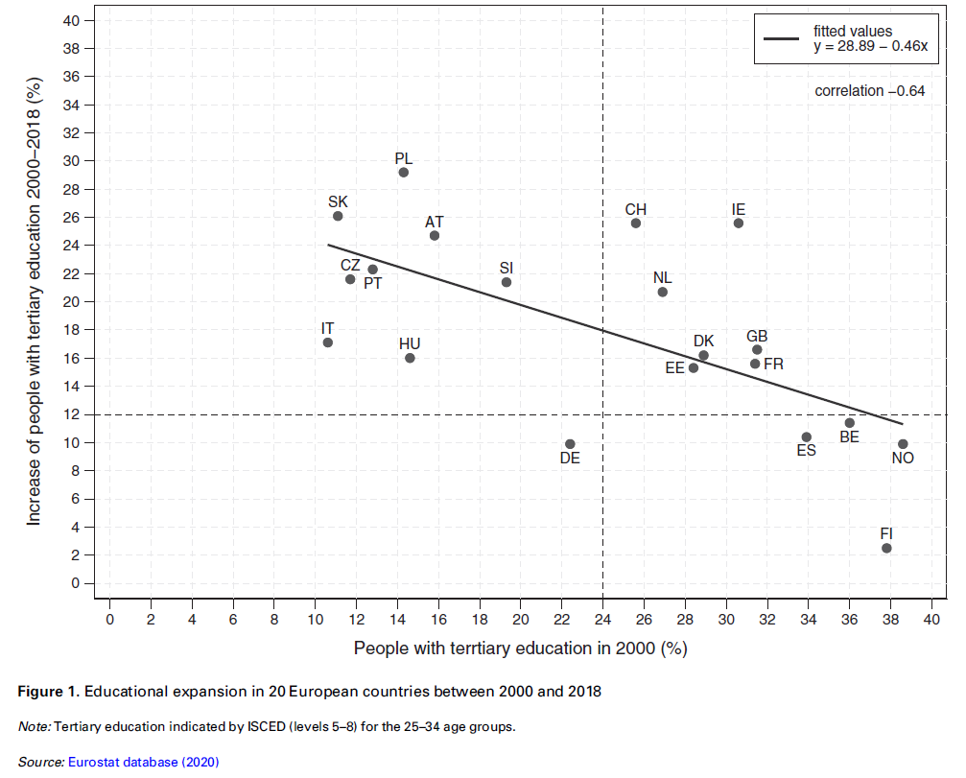
IEO and educational expansion
IEO: chances to attain certain level of education by social origin (SO) - family background
Educational expansion (EE) is seen as a social-political provision for change of IEO (inequality of educational opportunity)
EE via IEO helps to increase social justice, equality and meritocracy
The relationship between IEO and EE has higher relevance for academic research as well as for social policy and it is the source of legitimization of social systems.

Slide 11
Legitimization of inequality
Inequality is needed (for instance in salaries) in order the talented people would be motivated for education that is necessary for different jobs (doctors, layers, other professionals)
Is it true or we just believe in it?
How large these differences in salaries should be?

Slide 12
Ascription versus Achivement
What is ascription?
  How does acriptive society work?
What is achivement?
  How does meritocratic society work?
Why we should strive for meritocratic societies?
  Discussion

Slide 13
Standards of Equality – what should be the goal?
Ontological equality - everyone is created equal. Goal is equal respect and status within the culture.
Equality of Condition – “level playing field,” same starting point for everyone. Goals may include increasing diversity & using affirmative action.
Equality of Opportunity - inequality of condition is acceptable as long as everyone has the same opportunities for advancement and is judged by the same standards
  Fits most closely with modern capitalist society
Notes:
Photo Courtesy of AP Photo.

Slide 14
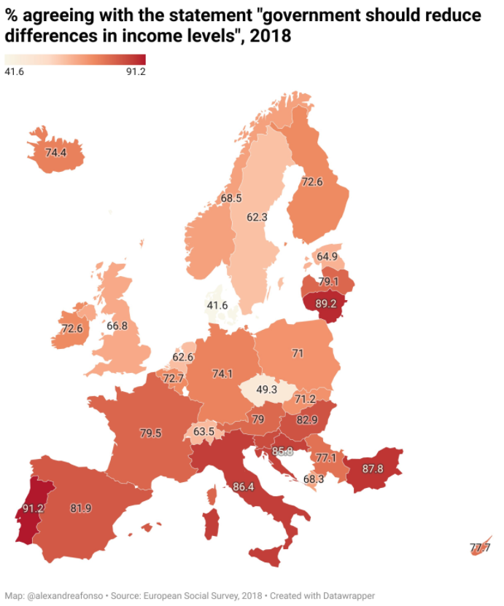
Proportion of respondents agreeing with the statement "government should reduce differences in income levels", %, 2018 (European Social Survey)

Slide 15
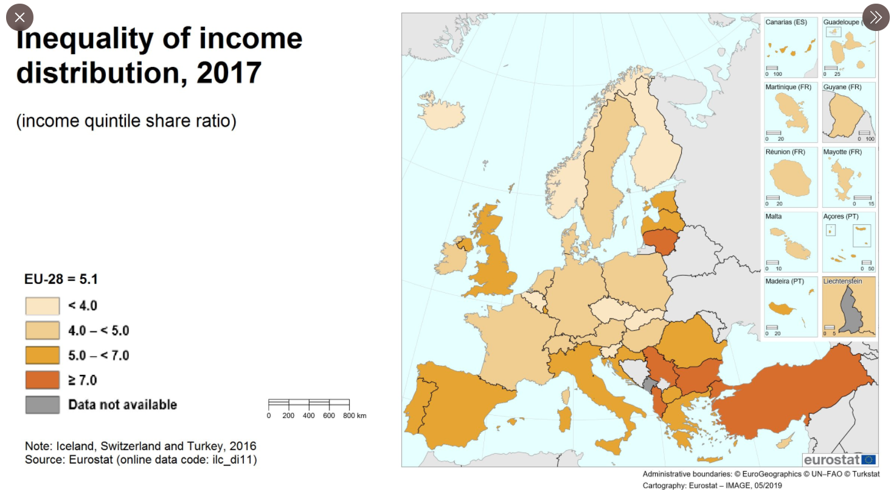
Would you say the inequality of income distribution has some relation with that map?

Slide 16
