Slide 1
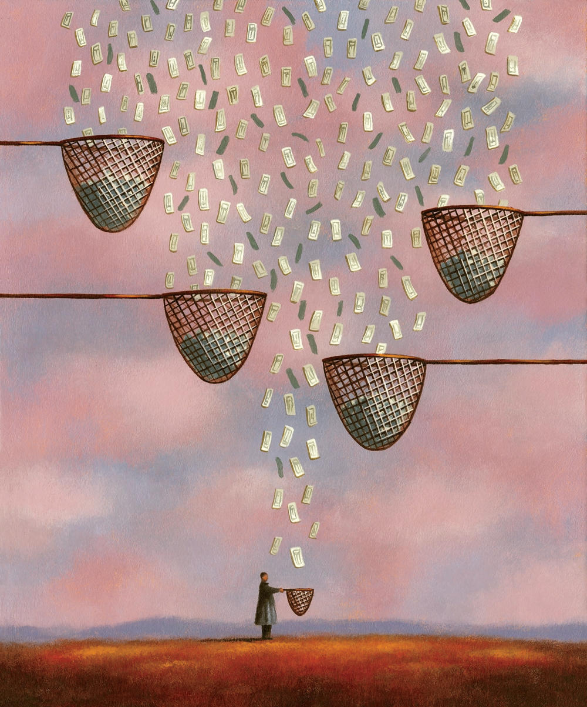
11. Inequality and capital
ESOn4022: Inequality and Society

Slide 2


Slide 3
Inequality of income
Individual level (organizations, states)
Artificial phenomenon, not „natural“, not moral
Consists of income from labour + income from capital (+ their interaction)
Legitimization – personal effort vs. Inheritance, meritocracy vs. Plutocracy
What is the relative importance of inequality of income from labour vs. of income from capital? How has it changed?

Slide 4
Evolution of inequality
Inequality of income from capital always bigger
May be reduced via public policies (two world wars)
Rise since 1970´s and 1980´s
What mechanisms are in play? Inherited wealth – cumulative effects / different effects on wage in different settings
Which social class is dominant? Which one is lower, middle, upper?
Top centile – large groups with power

Slide 5
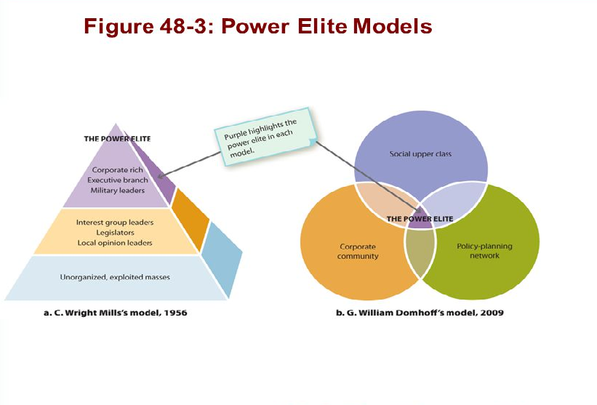

Slide 6
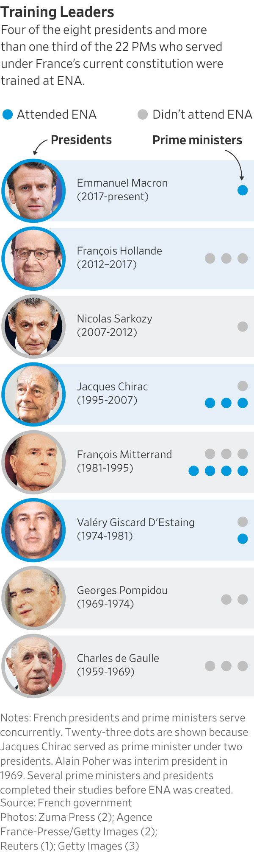
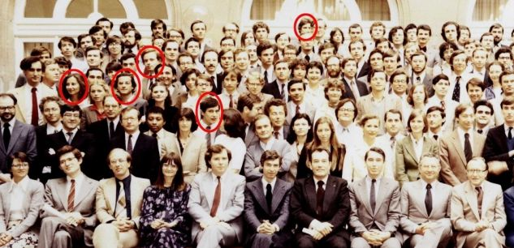
Which type of inequality?

Slide 7
Income inequalities

Slide 8
Logic of inequality
Traditional societies – negative correlation bwetween income from capital and income from labour
Modern societies - positive correlation bwetween income from capital and income from labour
Income from labour more important (2/3 – ¾ of national income)
Rise of patrimonial middle class/fell of the share of top class – transformation of the distribution conflict (decline of the society based on inheritance of capital)

Slide 9
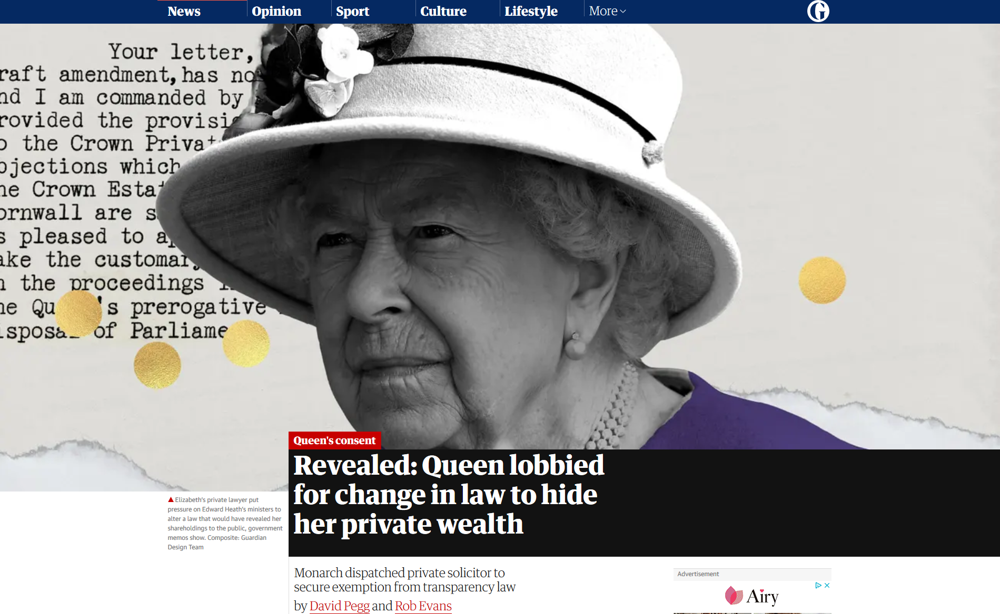

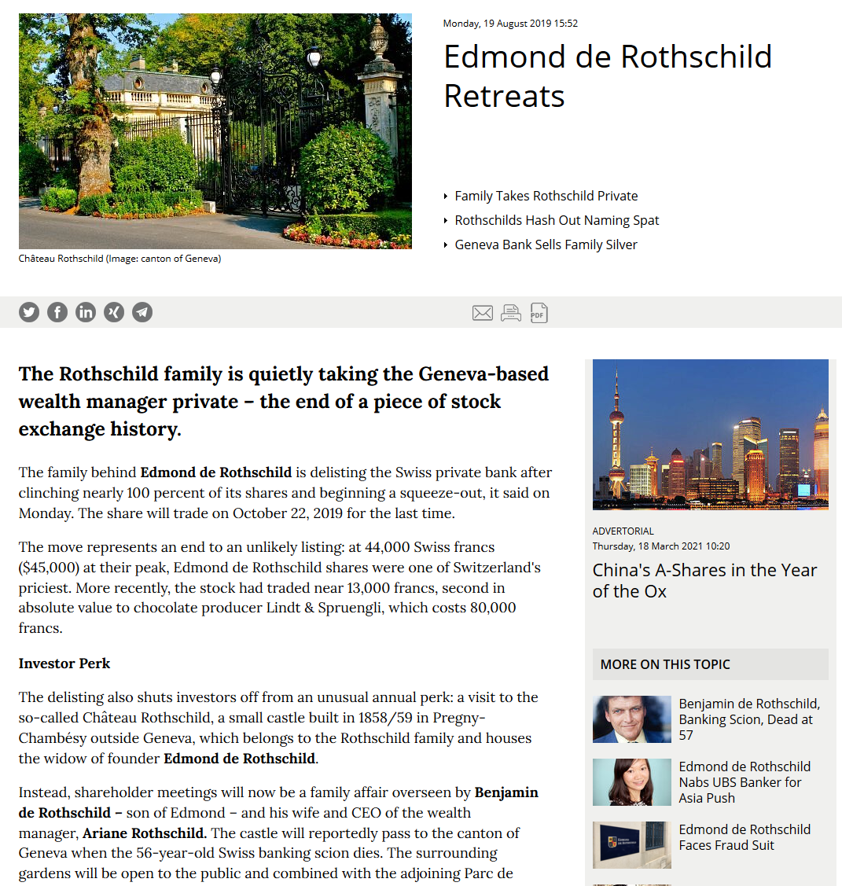

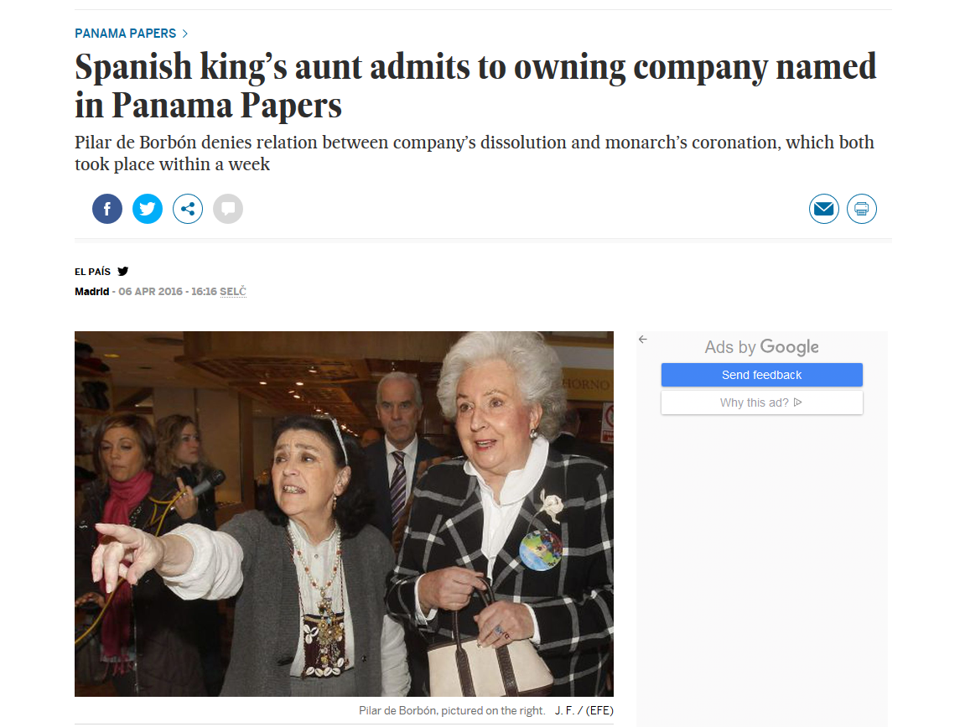
Aristocracy vs. capital

Slide 10

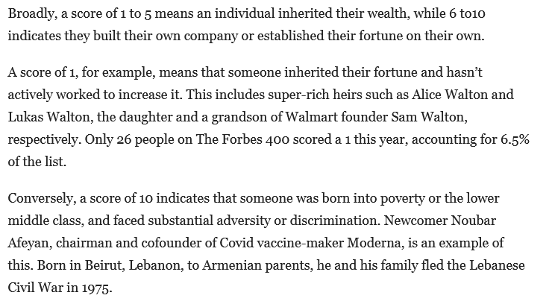
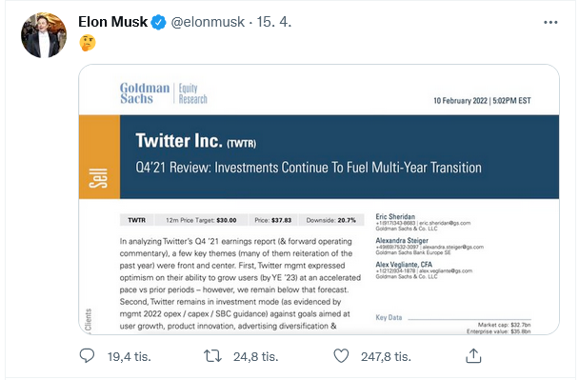
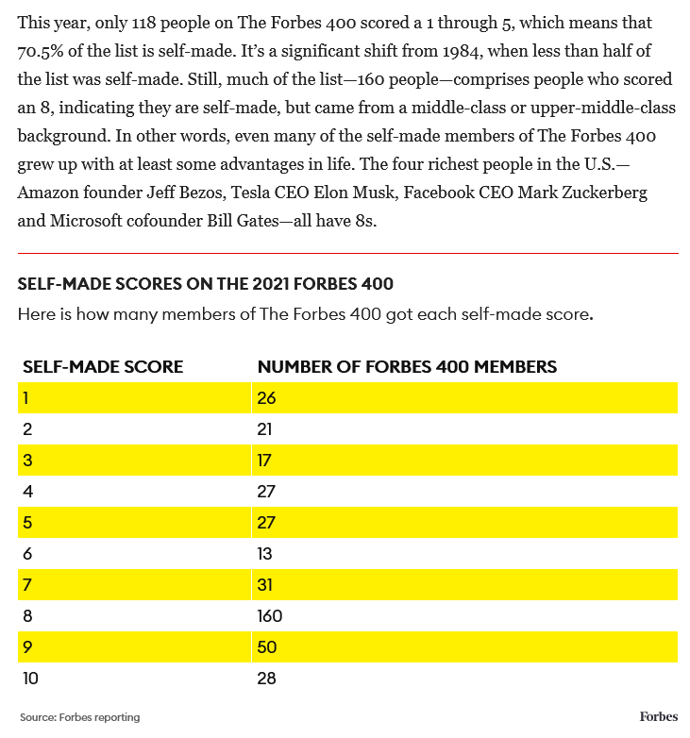
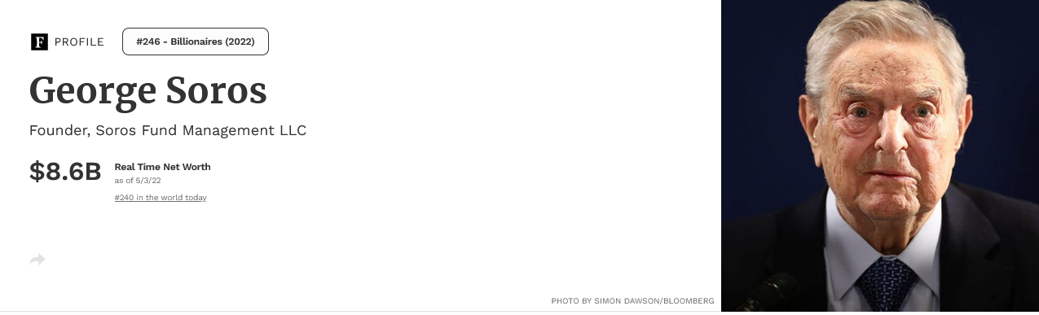
Income-based billionaires?

Slide 11
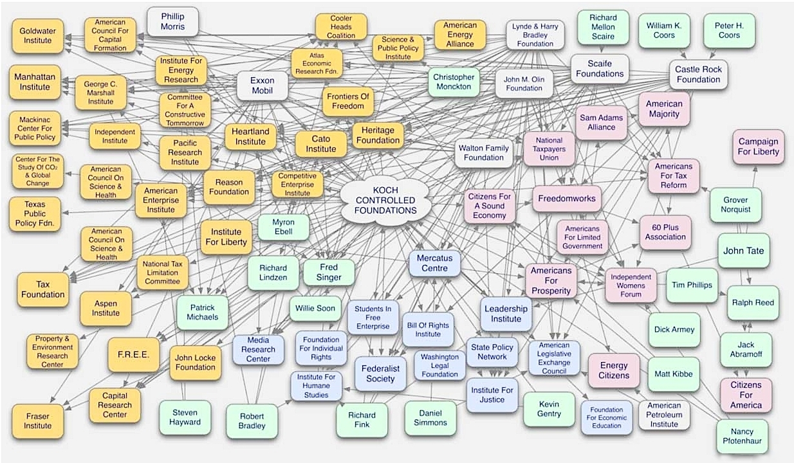
Capital and politics

Slide 12
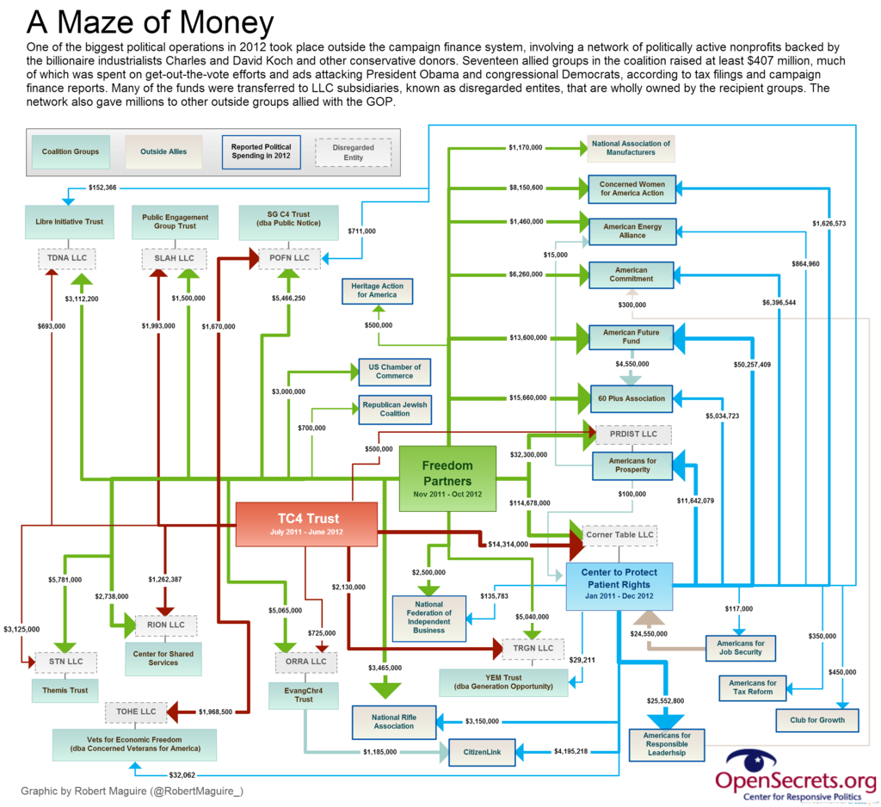
U.S. presidential elections 2012

Slide 13

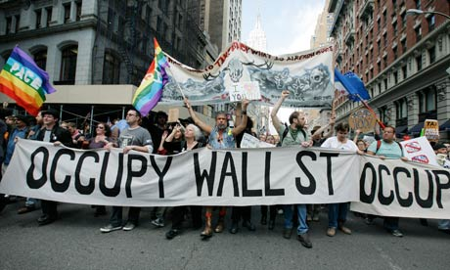
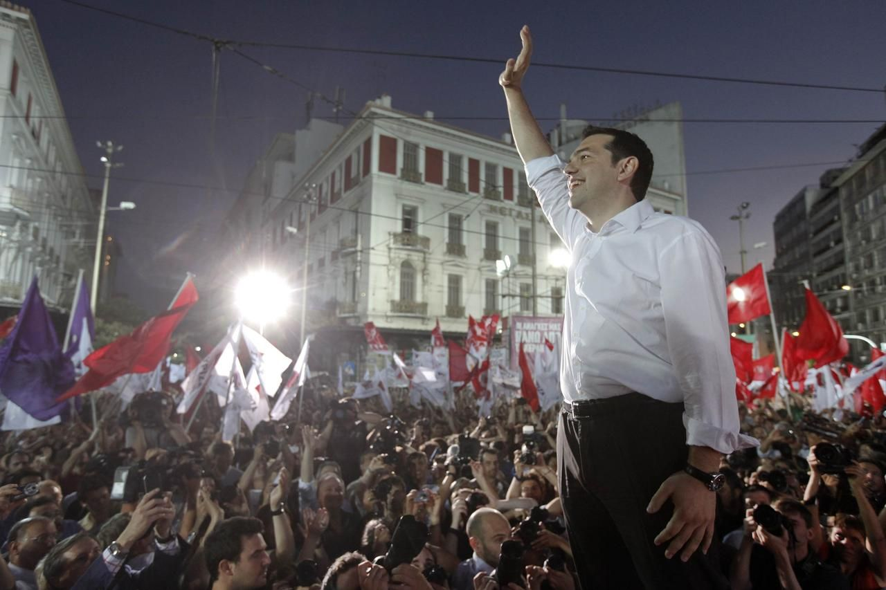
Inequality and its discontents
Very high inequality closer to that of labour income inequality
Too high wealth concentration – revolution
Depends on the legitimation of the system + repression
Two ways to inequal society (may coexist): Society of rentiers vs. Society of superheroes
Globalization cleavage (winners x losers of globalization), Great Recession protests, OWS...

