Slide 1
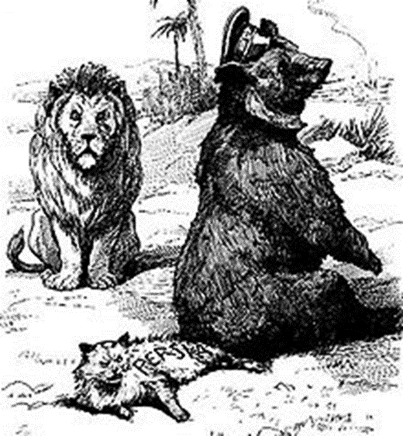
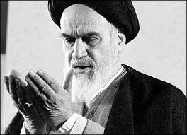
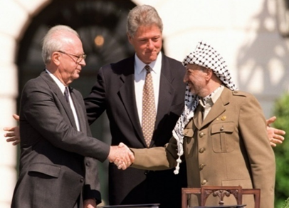
MIDDLE EAST CROSSROADS
Mgr. Eva Taterova, M.A., Ph.D.
Faculty of Social Studies
Masaryk University

Slide 2
COURSE OVERVIEW
Credits: 4 ECTS
Lecturer: Mgr. Eva Taterova, M.A., Ph.D. (evataterova@gmail.com)

Slide 3
COURSE SCHEDULE
February 17: Introduction: scope of the course, organization of the course, and course requirements
February 24: Looking Back: Middle East in last 100 years.
March 3: Carving up the Middle East in and after WWI: Was Europe lucky, evil, or smart?
March 10: The Pragmatic Superpowers: Winning the Cold War in the Middle East.
March 17: The Suez Crisis: New Saladin of the Arab World and a final confirmation of European decline.
March 24: Iranian Revolution 1978: Great Satan, Little Satan demonizing epithets and the spread of anti-western propaganda in the Middle East.

Slide 4
COURSE SCHEDULE
March 31: 1990s as the Decade of Hope: Does peace even have a chance in the Middle East?
April 7: Kurdish Issue and Palestinian Issue: Do all nations deserve their own state?
April 14: Online essay
April 21: Interpreting the Arab Spring: Can democracy work in the Middle East?
April 28: Global Jihadism: Clash of civilization confirmed?
May 5: Current events in the Middle East
May 12: Final exam

Slide 5
COURSE ACTIVITIES
Presentation: The topics will be chosen by the students from the list available in IS. (30 points)
Online essay: April 14, 2022 (20 points)
Final Exam: May-June, 5 open questions (60 points)

Slide 6
PRESENTATION
Each presentation is about 20 minutes long.
Consists of a short summary/background to the given topic, critical analysis of the problem, questions for in-class discussion, and literature and sources.

Slide 7
PRESENTATION TOPICS
March 17 Anwar Saddat
March 24 ayatollah Ali Khamenei
March 31 Yasser Arafat
April 7 Binyamin Netanyahu
April 21 Bashar Assad
April 28 Abu Bakr al-Baghdadi
May 5 Mohammed bin Salman

Slide 8
ONLINE ESSAY
The students shall provide critical assessment of the perspectives to the given topic based on classes and readings. The students are expected to integrate the readings in a thoughtful way, not just summarize them.
Sample question: Discuss the consequences of Arab Spring for the Middle East.

Slide 9
GRADES
A 92 - 100
B 84 - 91
C 76 - 83
D 68 - 75
E 60 - 67
F less than 60 points

Slide 10
LEBANON

Slide 12
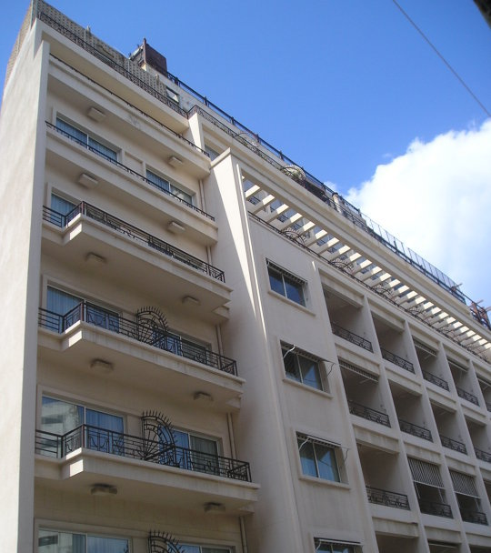
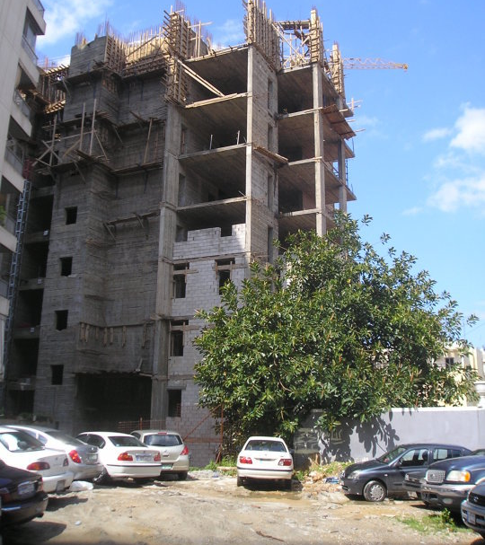

Slide 13
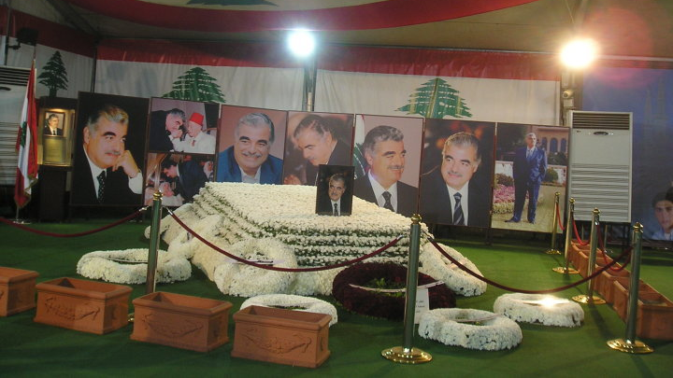

Slide 14
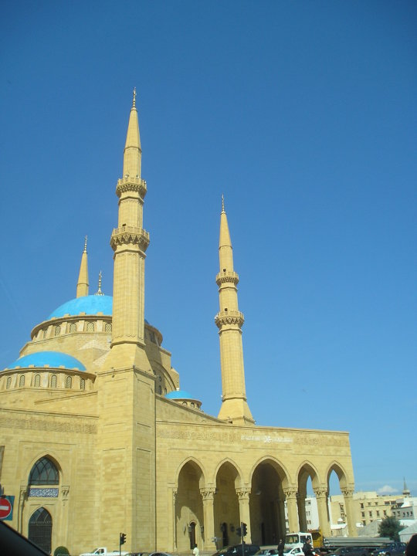
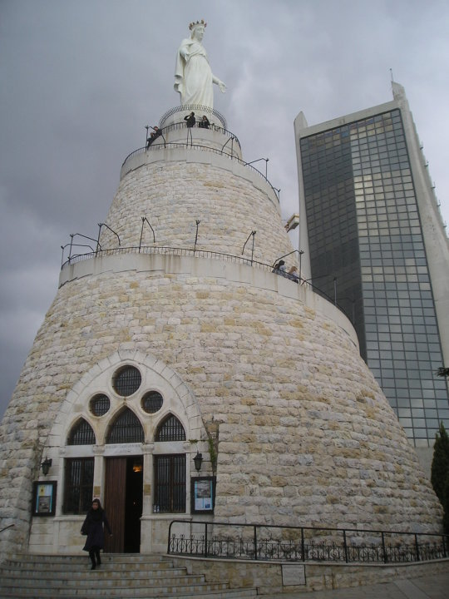

Slide 15
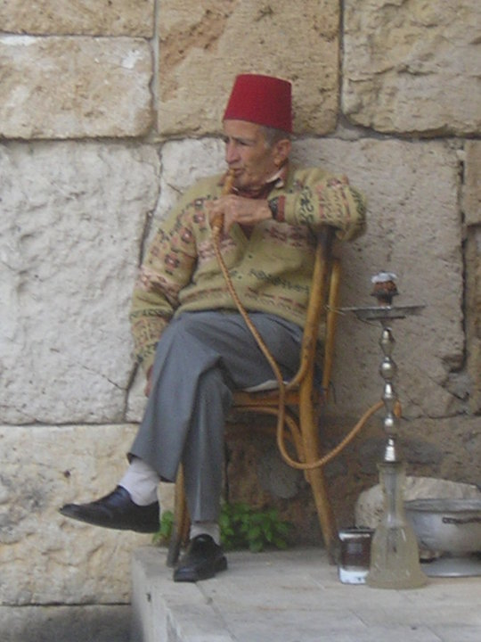
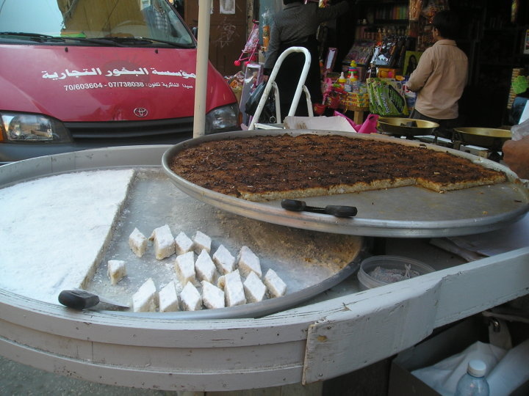

Slide 16
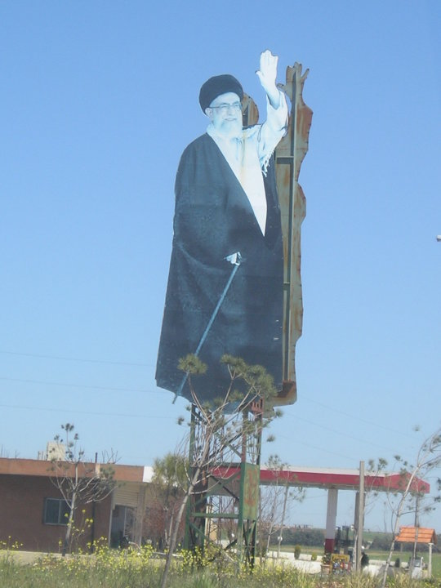
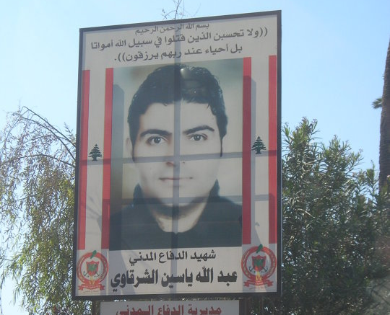

Slide 17
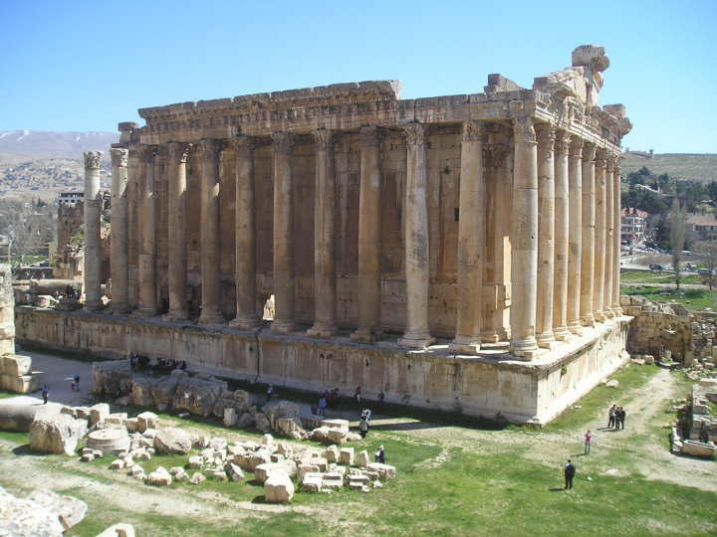

Slide 18
SYRIA

Slide 20
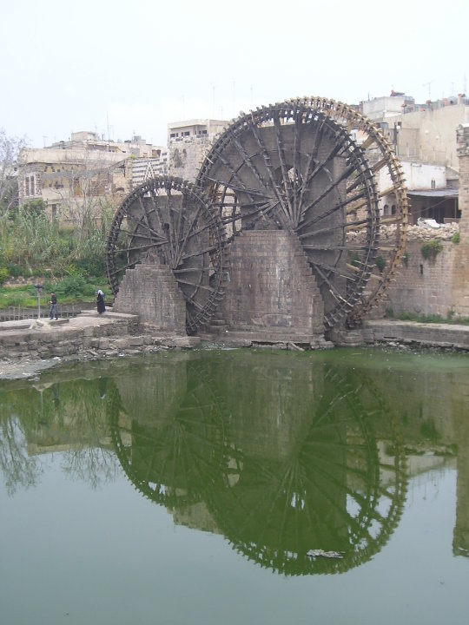
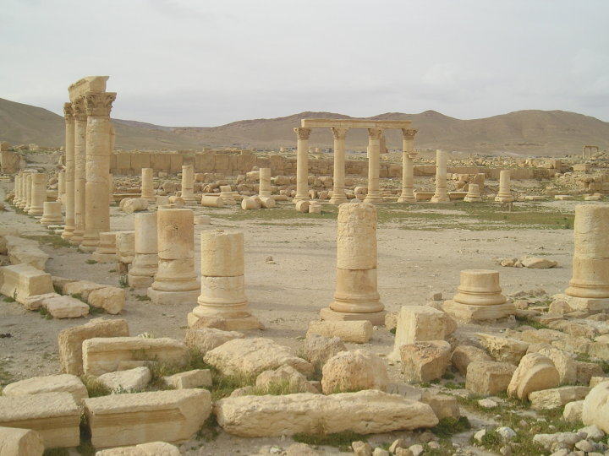

Slide 21
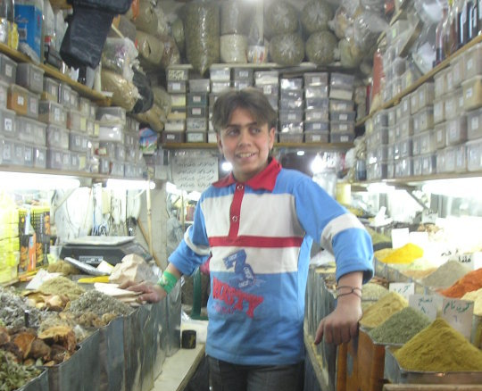
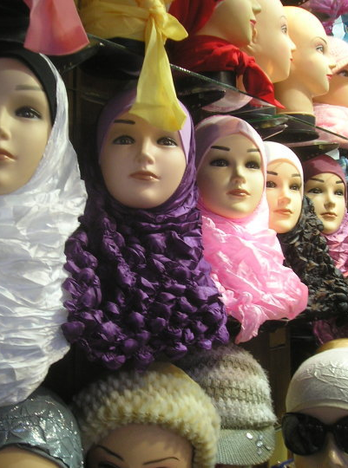

Slide 22
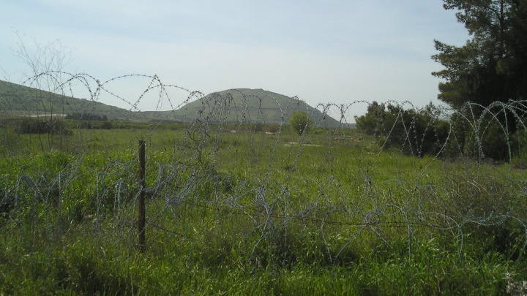

Slide 23
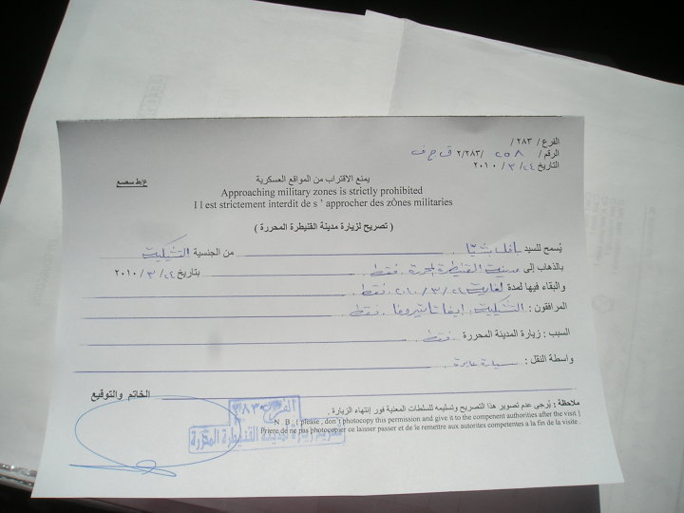
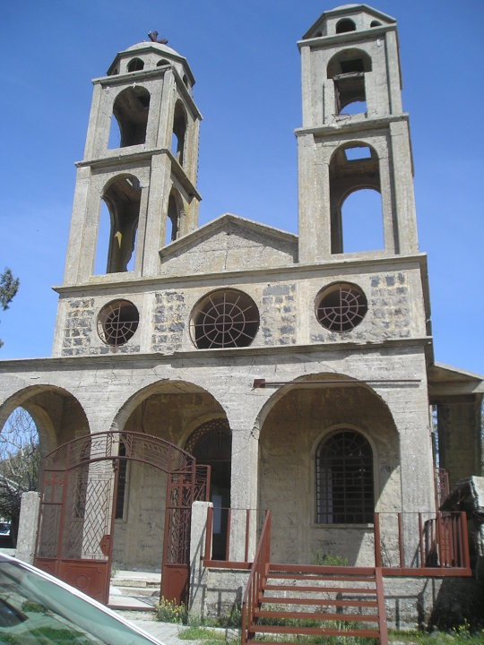

Slide 24
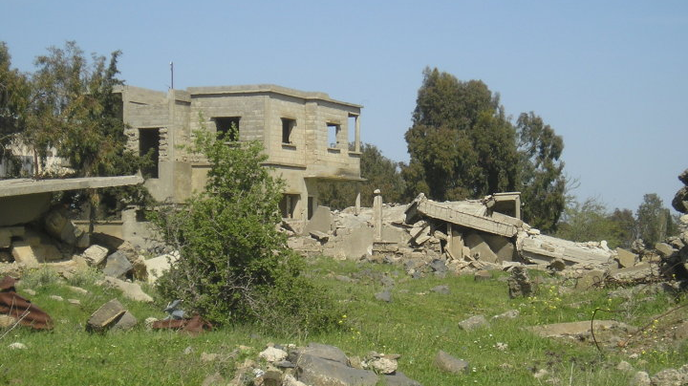

Slide 25
JORDAN

Slide 28
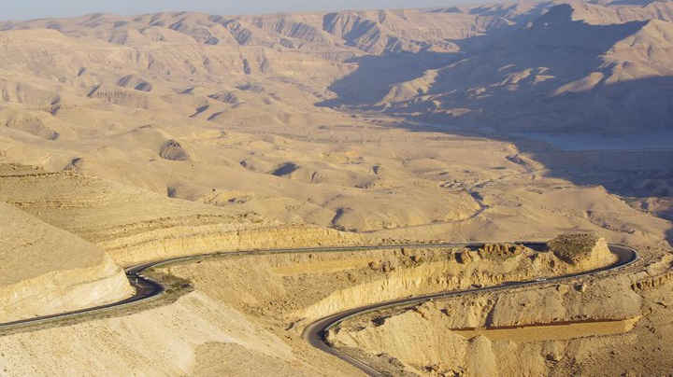

Slide 29
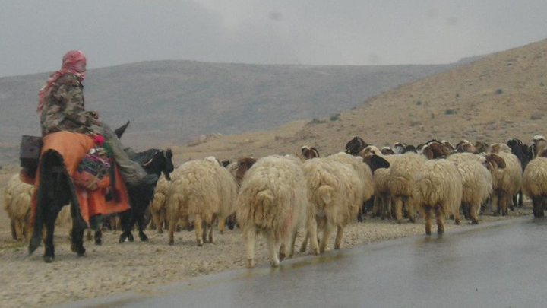

Slide 30
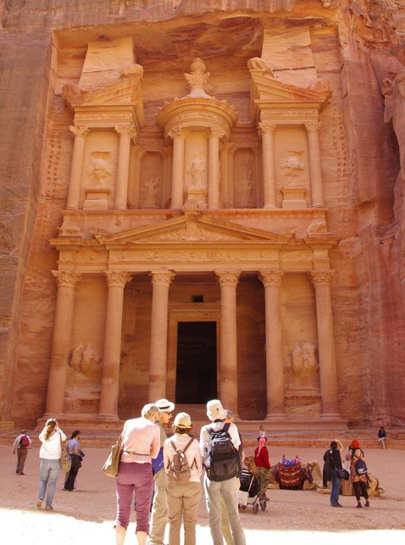
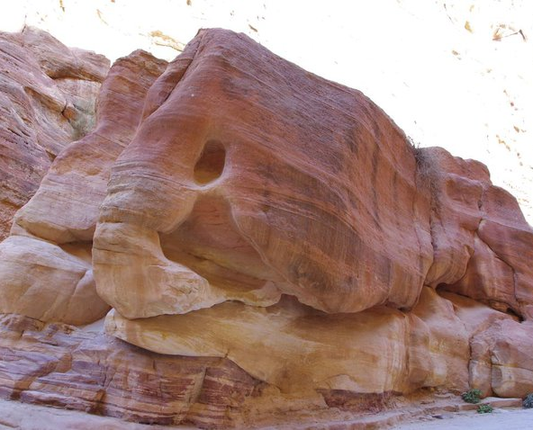

Slide 31
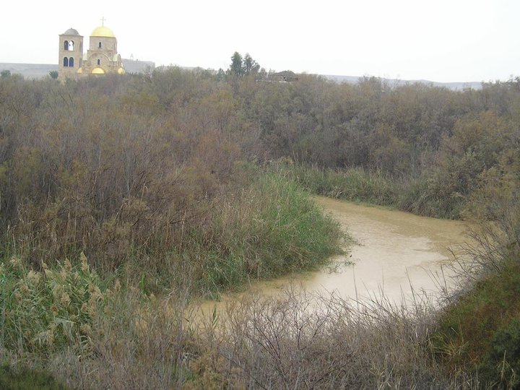

Slide 32
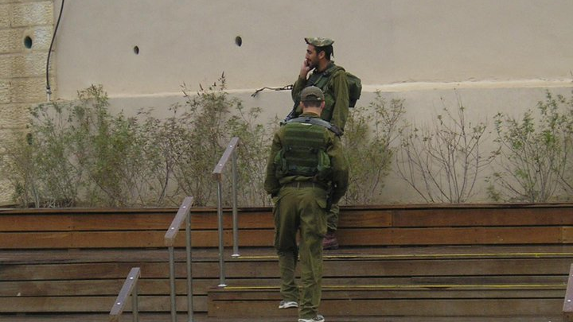

Slide 33
ISRAEL/PALESTINIAN TERRITORIES

Slide 34
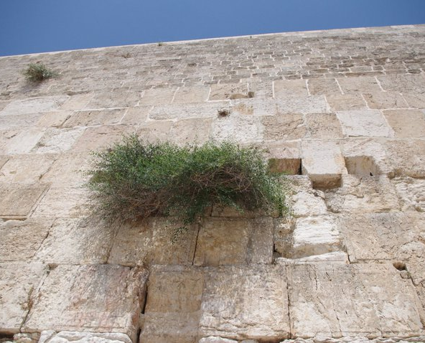

Slide 35
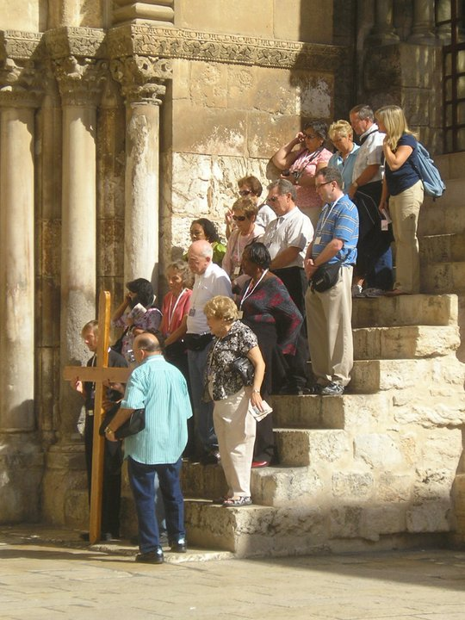
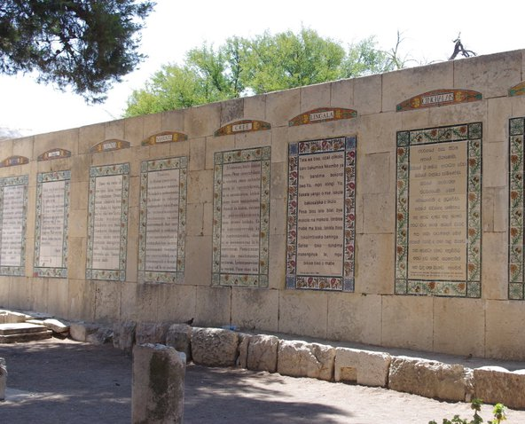

Slide 36
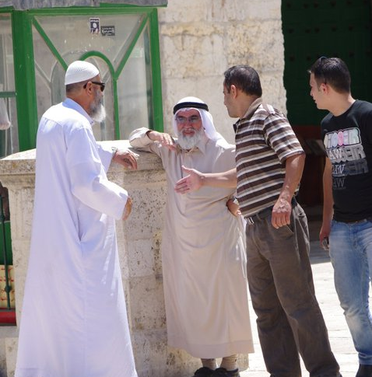
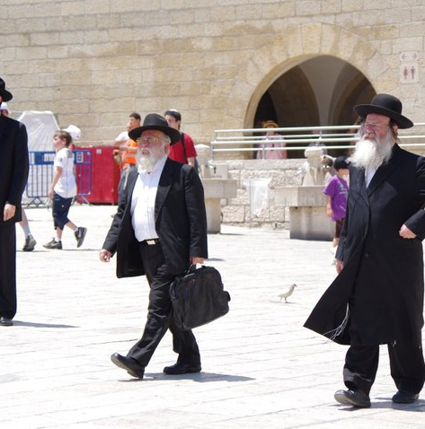

Slide 37
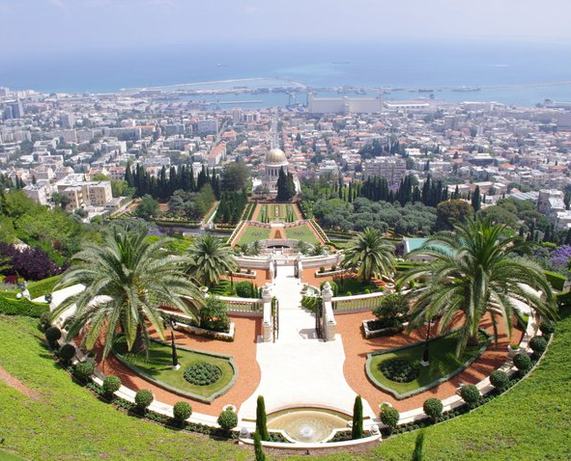
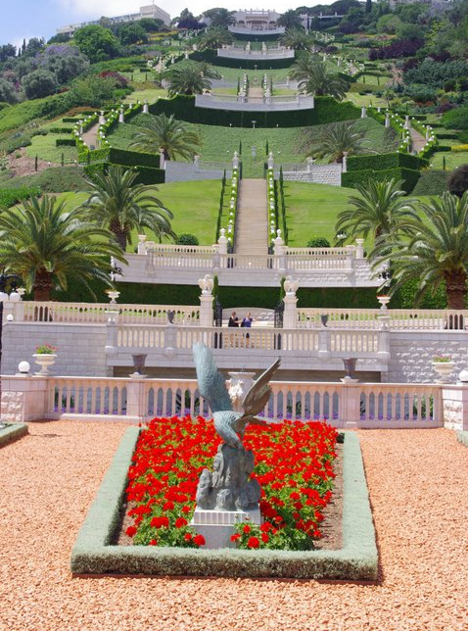

Slide 38
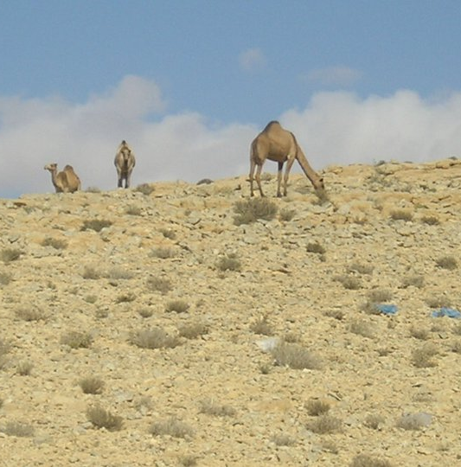
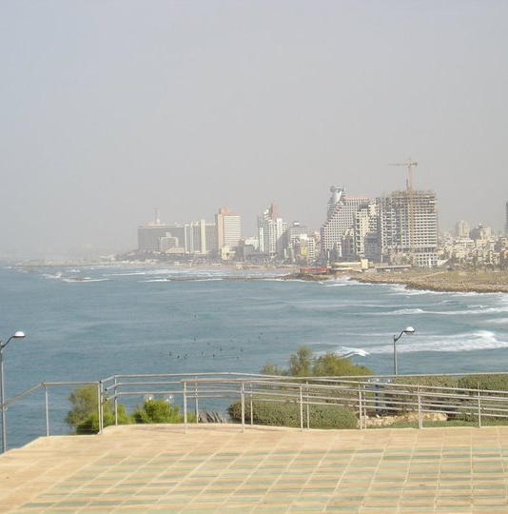

Slide 39
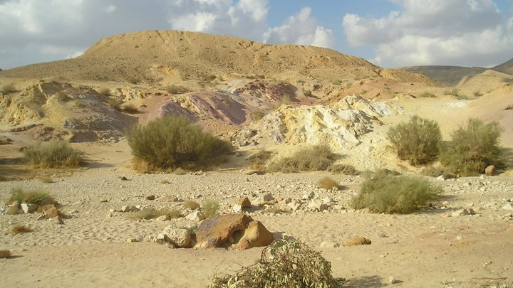

Slide 40
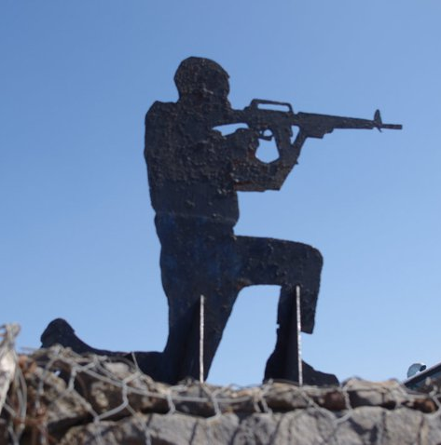

Slide 41
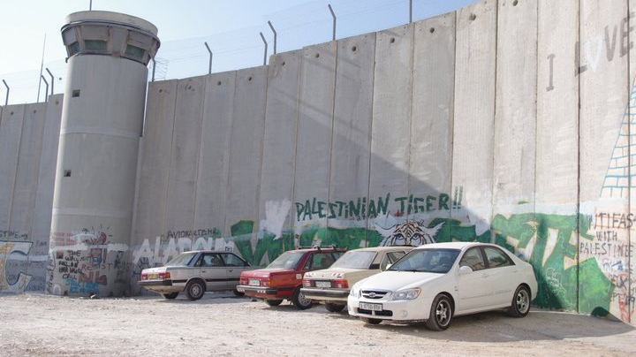

Slide 42
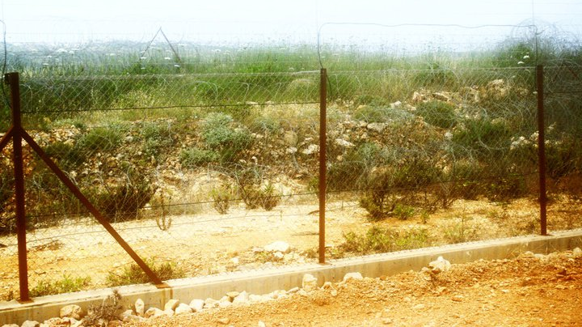

Slide 43
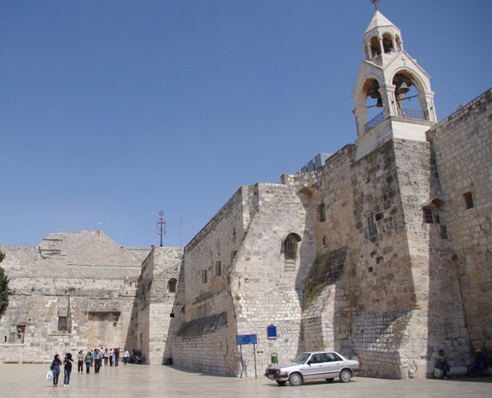

Slide 44
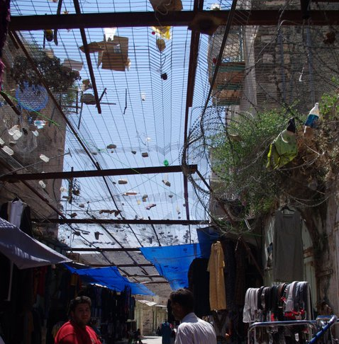
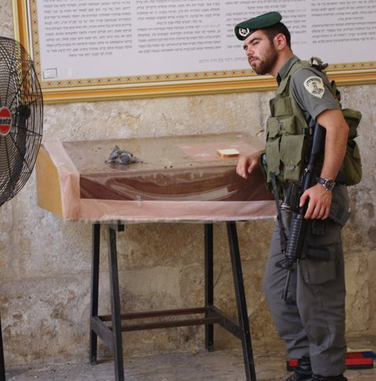

Slide 45
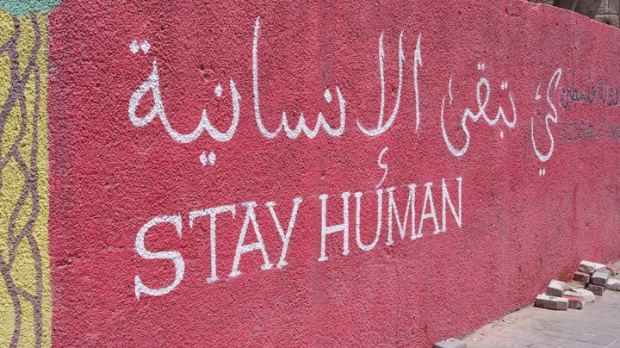

Slide 46
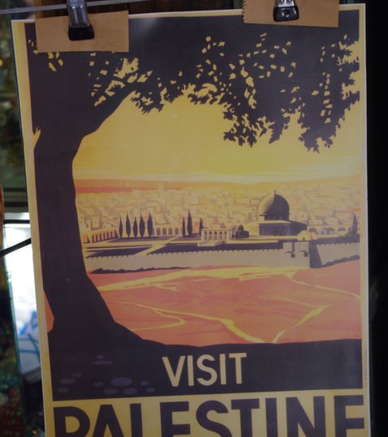
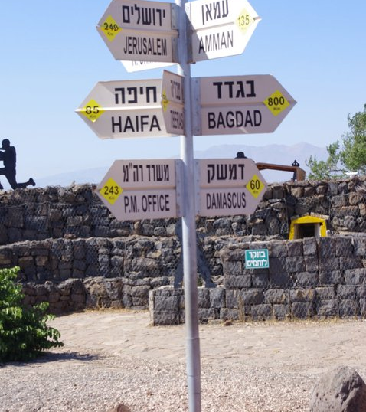

Slide 47
THANK YOU FOR YOUR ATTENTION

