Slide 1
Evropská ekonomika ve 21. století
Evropa ve světové ekonomice
2022

Slide 2
Komunistická Čína
Radikální rozchod s hodnotami a institucemi;
Malý skok kupředu (1949-1957): kolektivizace, obilní monopol a omezení pohybu;
Velký skok kupředu (1958-1962): komuny (produkce železa), hladomor;
Oslabení Mao Ce-tunga (1959) - ultralevicová klika a Kulturní revoluce 1966-69, 1976 (vyčištění od kontrarevoluce – rozklad);
Reformy Teng Siao-pching 1978:
  decentralizovaná ekonomika; rodinné farmy, lokální management průmyslu, soukromé SME podniky;
  socialistický princip – kolektivní vlastnictví velkých podniků (zisk); cíl socialismu – eliminace chudoby; investice z státních bank do průmyslu a ELG;
Od 2000 zvláštní ekonomické zóny (tržní ekonomika);
V 80.letech růst HDP 10%, v 90. letech 7,5%, po roce 2000 v průměru 9,5% (do 2015 růst 10%).

Slide 3
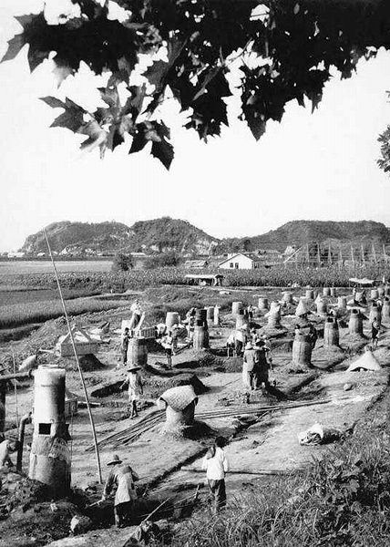

Slide 4
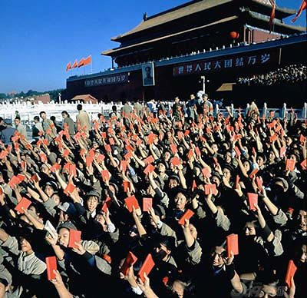

Slide 5
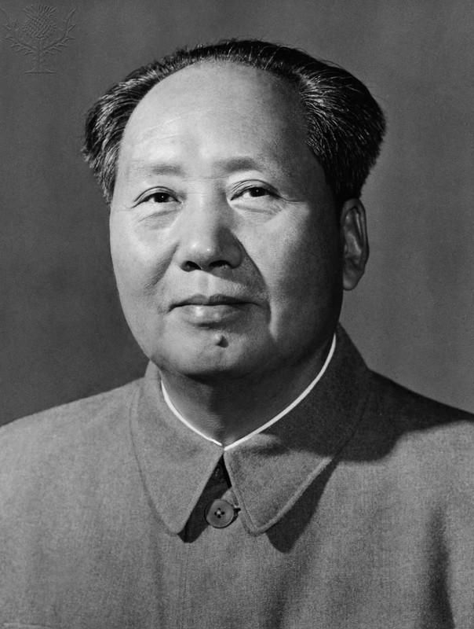
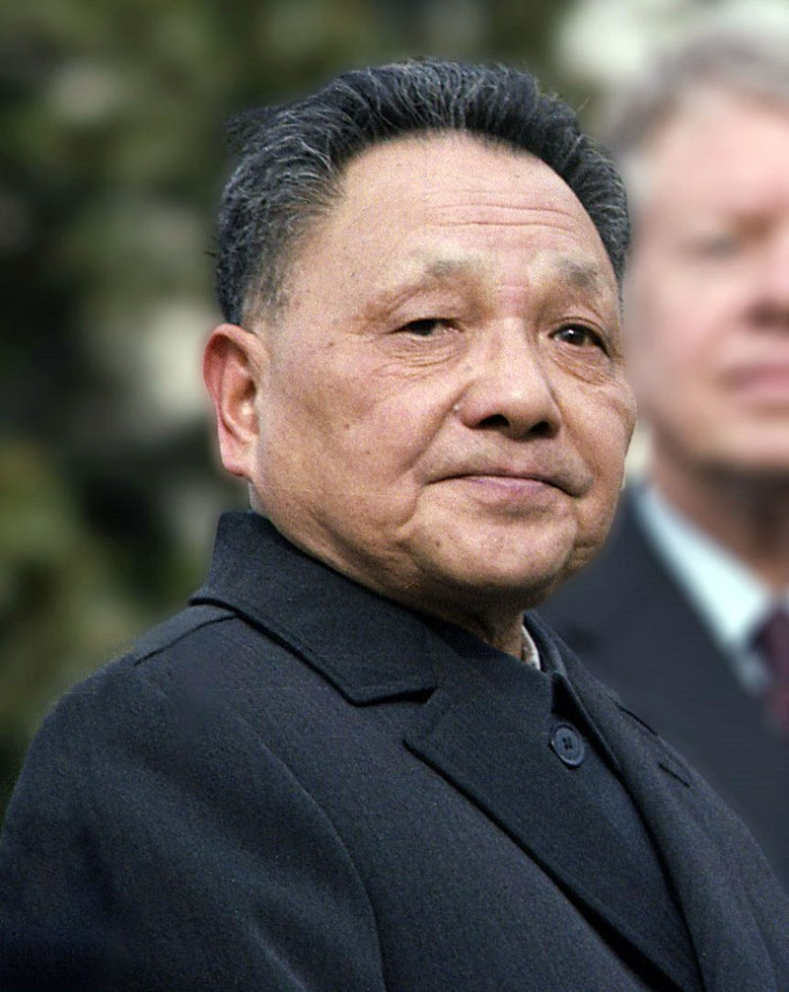

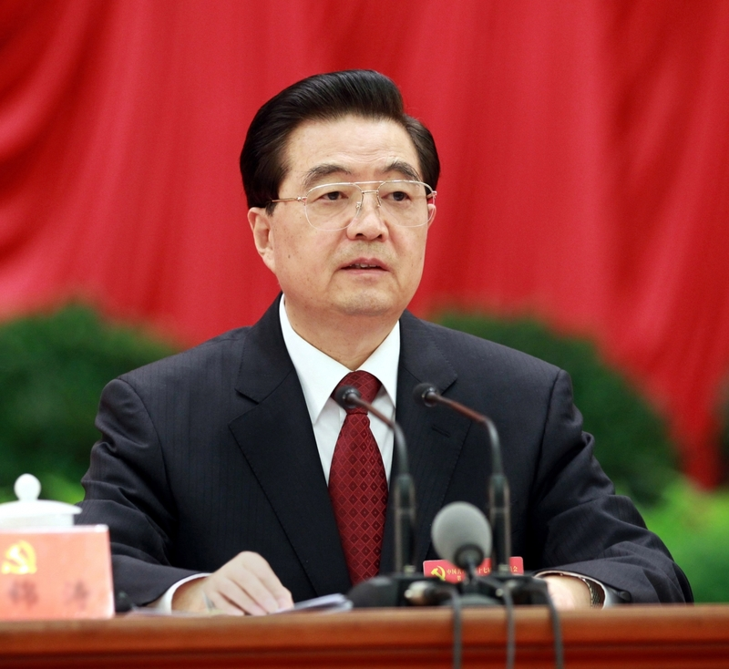
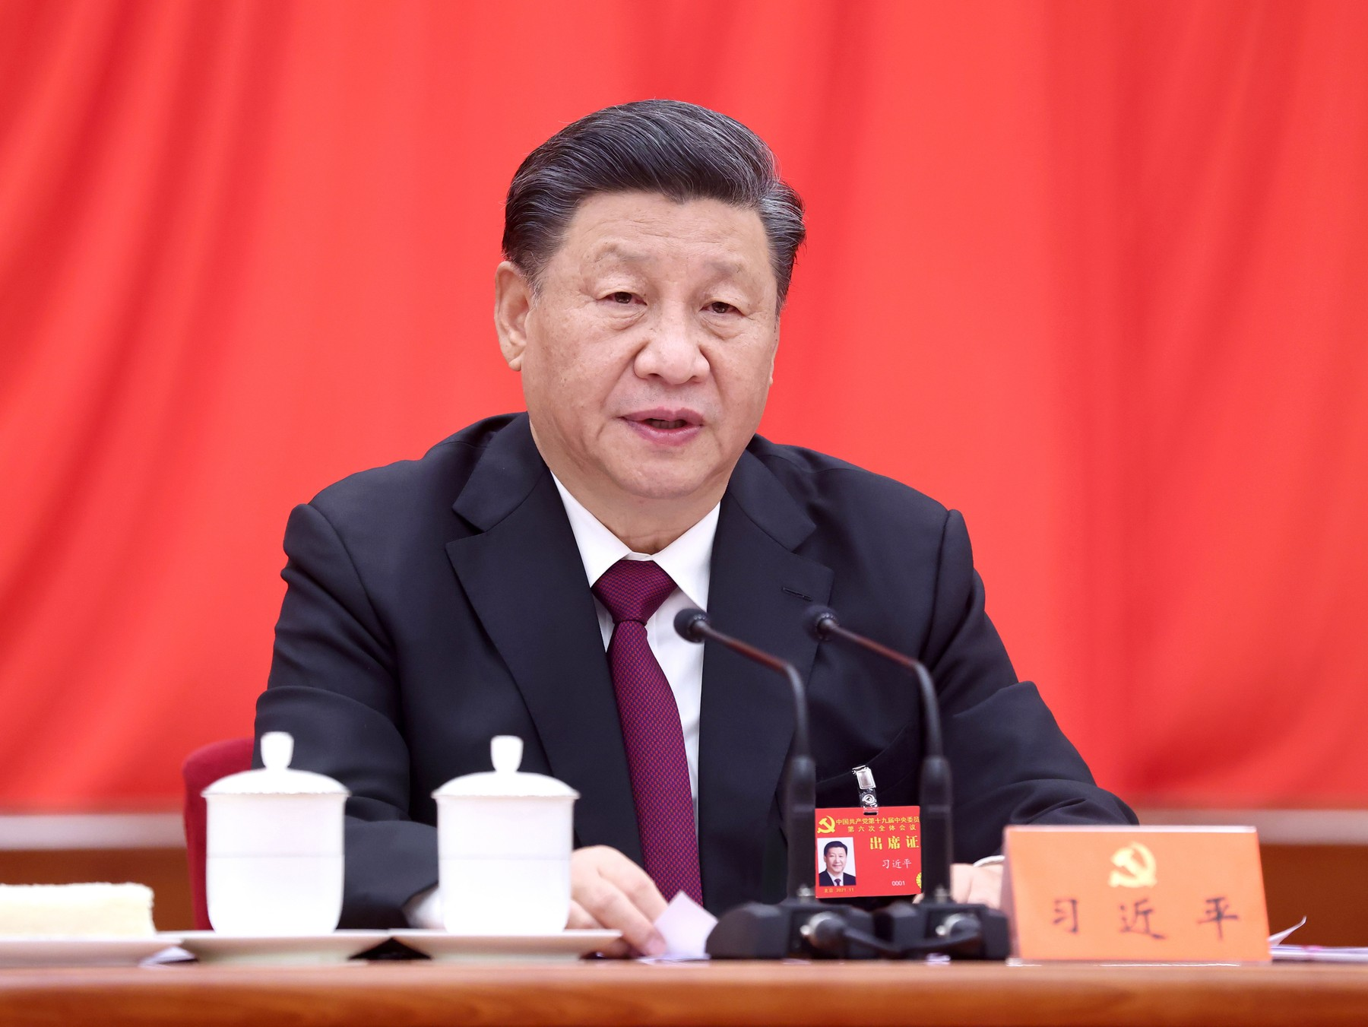
Mao Ce-tung (1943-1976)
Teng Siao-pching (1978-1990)
Ťiang Ce-min (1993-2003)
Chu Ťin-tchao (2003-2013)
Si Ťin-pching (2013-)

Slide 6
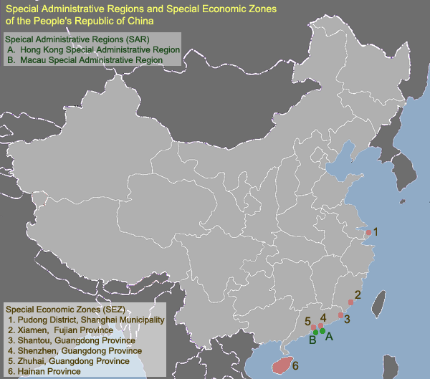

Slide 7
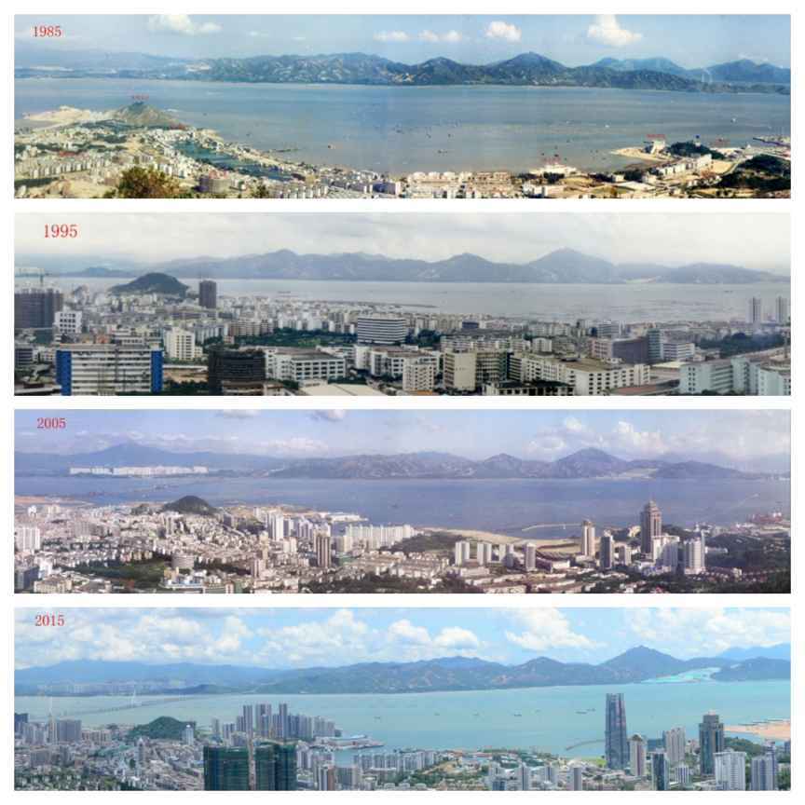

Slide 8
Od reforem k exportu socializmu s čínskými charakteristikami
Teng Teng Siao-pching (1978-1989): „hide your strength, bide your time, never take the lead“;
Ťiang Ce-min (1993-2003): „…moderately prosperous country“;
Chu Ťin-tchao (2003-2013): „harmonická společnost“ – reindustrializace a modernizace;
Si Ťin-pching (2013-): prosperující společnost v 2021 (KSČ) a plně rozvinutá země v 2049 (ČLR); 13tý 5letý plán (2016-2020);
  vyčerpání catch-up growth – státní podniky a banky, masivní investice do infrastruktury; exportem tažený růst;
  pozitivní zkušenost: mobilizace kapitálu pro hospodářský rozvoj, investice do infrastruktury, operace státních podniků;
Problémy: nerovnoměrný rozvoj; závislost na produkci pro světový trh; nízká přidaná hodnota; rostoucí mzdy; nadprodukce ve státem podporovaných sektorech (těžký průmysl a stavebnictví); rezervy zahraničních měn;
Go Global!; Belt and Road Initiative; Made in China 2025;
Připouští rivalitu se západem (USA bude blokovat Čínu) – vývoz čínského modelu „No strings attached“…

Slide 9
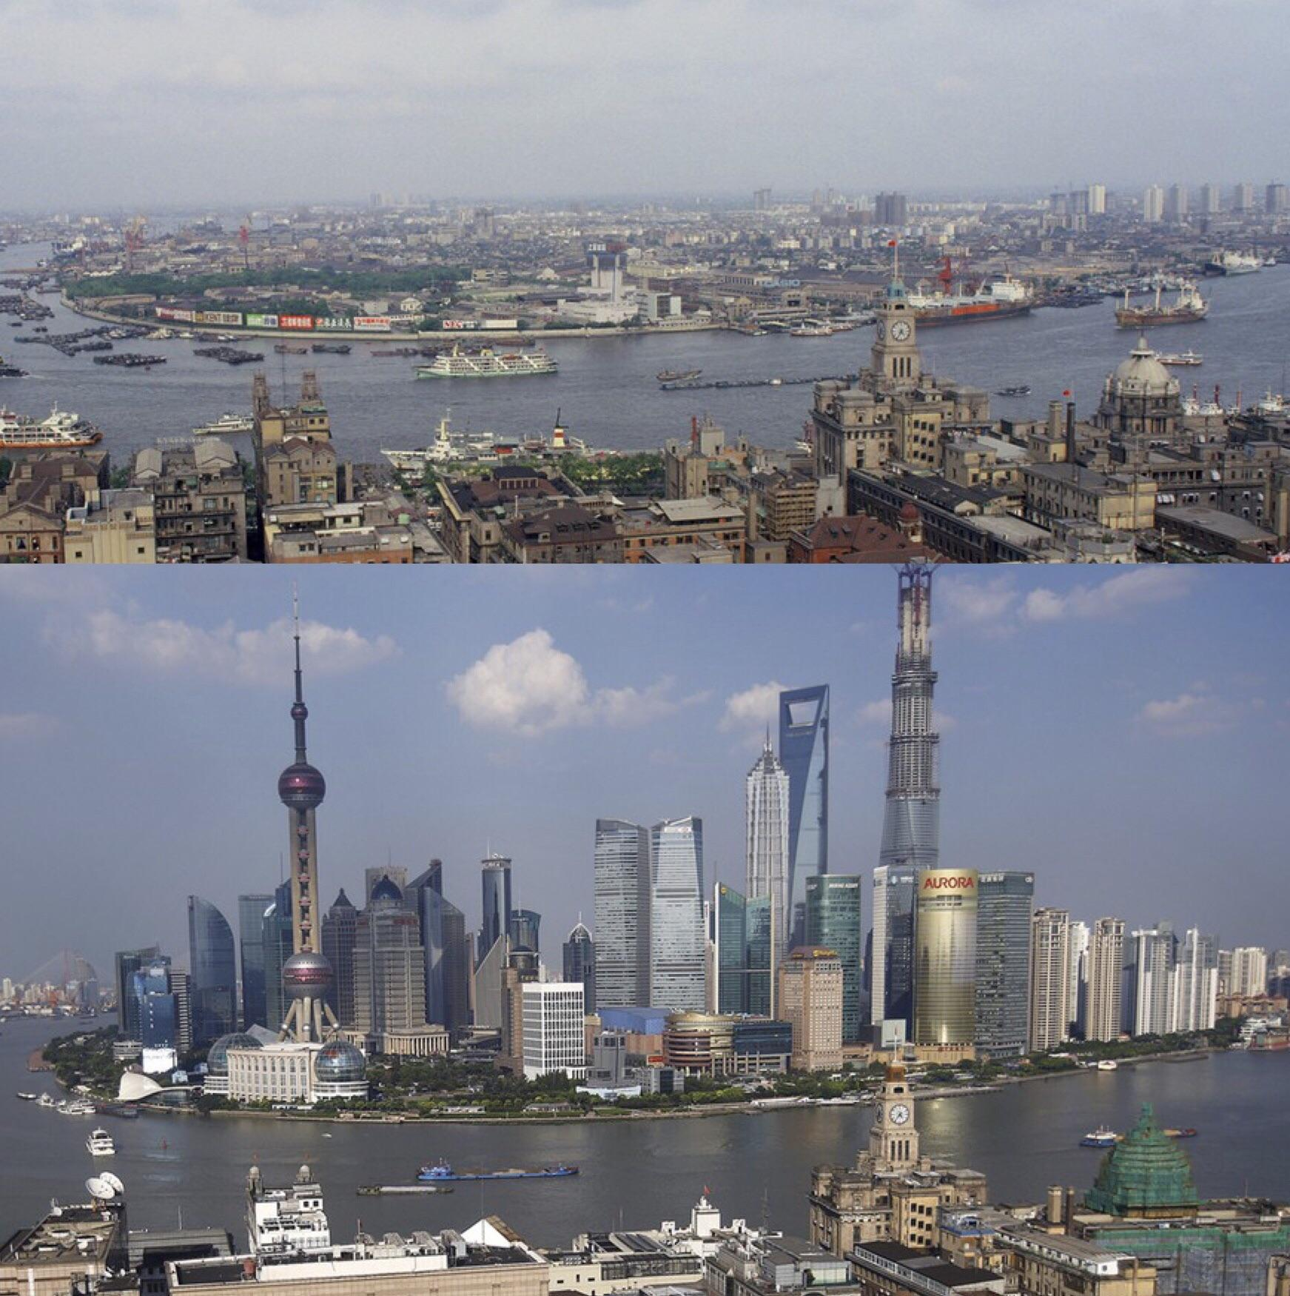

Slide 10
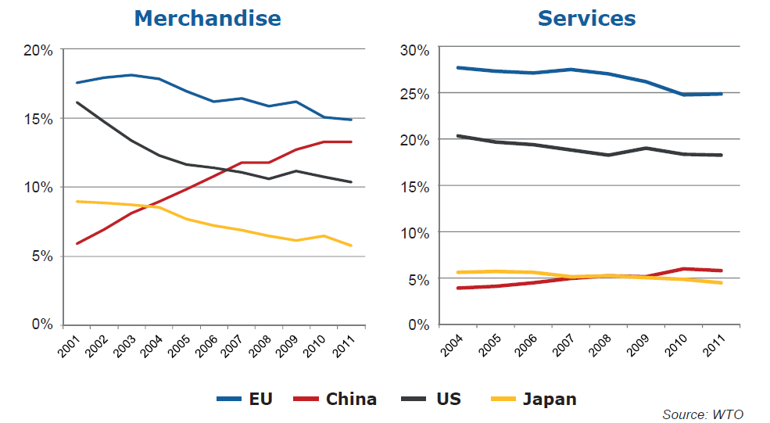
Podíl na světových exportech

Slide 11
Export - market share (2005) and its change (1995-2005) (%)
 | Market share | Change
EU15 | 18,4 | -1,77
EU25 | 19,5 | -1,33
USA | 13,0 | -4,41
Canada | 4,2 | -0,83
Mexico | 2,7 | 0,62
Japan | 9,5 | -4,12
China | 14,1 | 8,37
Korea | 4,3 | 0,68
India | 1,5 | 0,44
ASEAN | 8,7 | 0,13
Russia | 1,4 | 0,31
Brazil | 1,7 | 0,31
Export by value; share of World exports.

Slide 12
Share of total export on the main markets (2005); change in 1995–2005
 | MARKETS
 |  | USA |  | Japan |  | China
 |  | share | change | share | change | share | change
A C T O R S | EU15 | 20,1 | 1,17 | 15,6 | -2,32 | 13,5 | -2,02
 | EU25 | 20,8 | 1,53 | 16,1 | -2,06 | 14,0 | -1,82
 | USA | / | / | 16,3 | -9,76 | 9,0 | -1,28
 | Canada | 16,2 | -2,74 | 1,9 | -1,12 | 1,2 | -1,31
 | Mexico | 10,6 | 2,29 | 0,6 | 0,22 | 0,3 | 0,17
 | Japan | 10,1 | -8,06 | / | / | 16,6 | -1,41
 | China | 16,1 | 10,46 | 28,8 | 16,70 | / | /
 | Korea | 3,2 | -0,43 | 6,0 | -0,32 | 12,0 | 5,05
 | India | 1,4 | 0,52 | 0,6 | -0,28 | 0,8 | 0,53
 | ASEAN | 7,3 | -1,98 | 14,2 | 1,04 | 11,1 | 4,68
 | Russia | 0,5 | -0,08 | 0,9 | -0,72 | 1,5 | -0,85
 | Brazil | 1,6 | 0,33 | 0,8 | -0,30 | 1,0 | 0,06

Slide 13
World export shares by technological level (2005) and its change (1995–2005)
 | Total | H-T | M-T | L-T | R-B | P-P
EU25 change | 19,62 | 17,27 | 24,03 | 15,75 | 22,32 | 9,57
 | -1,39 | -0,57 | -1,32 | -3,29 | -1,49 | -0,84
USA change | 13,03 | 14,32 | 14,65 | 8,08 | 11,31 | 16,17
 | -4,35 | -7,63 | -3,07 | -2,29 | -3,65 | -5,87
Japan change | 9,50 | 9,51 | 15,42 | 4,75 | 4,93 | 0,68
 | -4,08 | -9,26 | -5,16 | -2,01 | -0,58 | 0,13
China change | 13,96 | 17,79 | 8,75 | 28,16 | 6,65 | 5,16
 | 8,20 | 13,94 | 5,53 | 11,55 | 3,40 | 1,03
India change | 1,46 | 0,39 | 0,83 | 3,05 | 2,65 | 2,84
 | 0,43 | 0,18 | 0,42 | 0,68 | 1,11 | 0,44
Russia change | 1,39 | 0,36 | 1,28 | 0,92 | 4,21 | 1,13
 | 0,36 | 0,18 | 0,60 | 0,35 | 0,92 | -0,35
Brazil change | 1,69 | 0,59 | 1,57 | 1,11 | 2,70 | 7,12
 | 0,32 | 0,36 | 0,42 | -0,08 | -0,05 | 3,69

Slide 14
Export structure by technological level
(2005) and its change (1995- 2005, %)
 | H-T | M-T | L-T | R-B | P-P
EU25 change | 23,7 3,4 | 42,3 1,5 | 13,8 -2,1 | 16,8 -1,5 | 2,6 -1,0
USA change | 29,6 -0,5 | 38,8 4,4 | 10,7 0,2 | 12,8 -1,1 | 6,7 -2,6
Japan change | 27,0 -0,6 | 56,1 4,8 | 8,6 -0,1 | 7,7 1,1 | 0,4 0,1
Brazil change | 9,4 5,4 | 32,1 3,6 | 11,3 -4,0 | 23,7 -8,8 | 22,7 4,4
Russia change | 6,9 2,7 | 31,8 9,4 | 11,3 1,6 | 44,7 -6,9 | 4,4 -6,1
India change | 7,1 2,3 | 19,5 6,1 | 35,9 -4,6 | 26,7 2,6 | 10,5 -6,6
China change | 34,3 18,4 | 21,7 2,7 | 34,7 -15,9 | 7,0 -2,1 | 2,0 -3,2
World change | 26,9 3,1 | 34,5 0,7 | 17,2 -0,3 | 14,8 -1,4 | 5,4 -1,9

Slide 15
World export shares by market segments (2004) and its change 1995–2004 (%)
 | Low segment |  | Mid segment |  | Up-market segment
 | 2004 | change | 2004 | change | 2004 | change
EU25 | 15,3 | -2,27 | 17,5 | -1,95 | 30,0 | 0,40
Japan | 7,2 | -2,55 | 10,9 | -5,74 | 14,1 | -4,45
Korea | 4,8 | 0,20 | 5,0 | 1,38 | 4,4 | 0,47
India | 2,2 | 0,82 | 1,4 | 0,42 | 0,8 | 0,36
Russia | 1,5 | 0,45 | 2,1 | 0,58 | 0,8 | 0,47
USA | 12,1 | -4,42 | 12,7 | -4,11 | 14,4 | -3,47
Canada | 4,2 | -1,08 | 5,0 | -0,68 | 3,1 | 0,16
Mexico | 3,8 | -0,37 | 3,5 | 1,41 | 1,6 | 0,91
China | 19,5 | 10,56 | 9,1 | 4,84 | 4,1 | 2,42
Brazil | 2,0 | 0,32 | 2,2 | 0,21 | 0,8 | 0,01
ASEAN | 8,7 | -1,16 | 10,3 | 2,41 | 8,7 | 1,43

Slide 16
Structure of exports by market segments (2004) and its change
1995–2004 (%)
 | Low segment | Mid segment | Up-mark. Seg.
EU25 change | 20,6 -3,4 | 33,3 -1,0 | 46,1 4,4
US change | 26,61 -1,52 | 38,46 -1,59 | 34,93 3,12
Japan change | 19,64 3,32 | 42,66 -7,11 | 37,7 3,79
Brazil change | 44,99 5,23 | 36,15 -2,38 | 18,86 -2,85
Russia change | 45,12 -5,96 | 32,34 -1,53 | 22,54 7,49
India change | 39,18 -7,8 | 38,39 2,76 | 22,43 5,04
China change | 54,01 0,07 | 37,09 -0,96 | 8,9 0,89
World cahnge | 30,46 0,49 | 38,29 -0,82 | 31,25 0,33

Slide 17
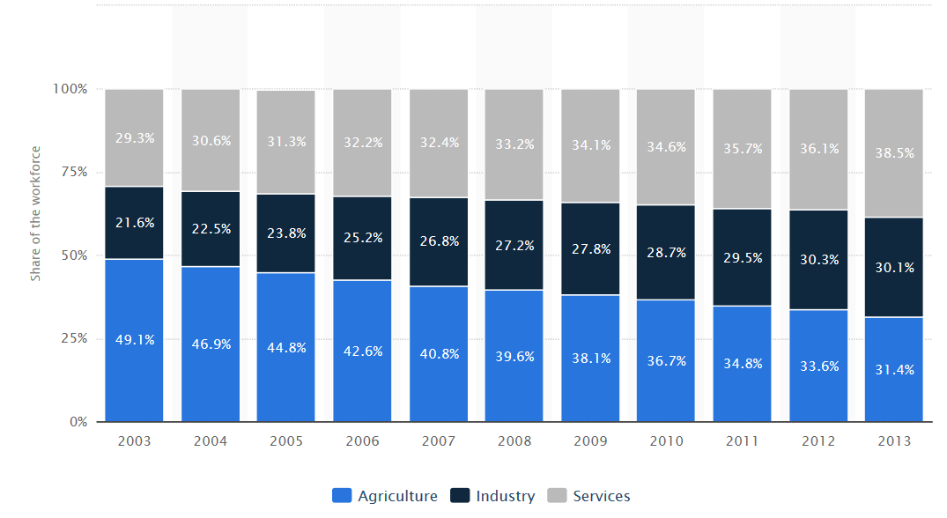
China – distribution of workforce

Slide 18
Pozice EU ve světové ekonomice
– produkt, obchod se zbožím a službami

Slide 19
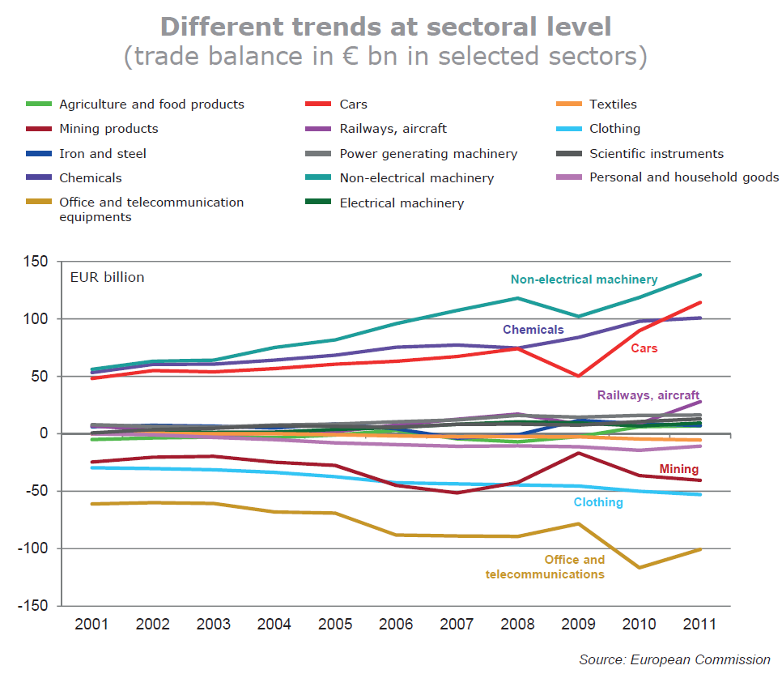

Slide 20
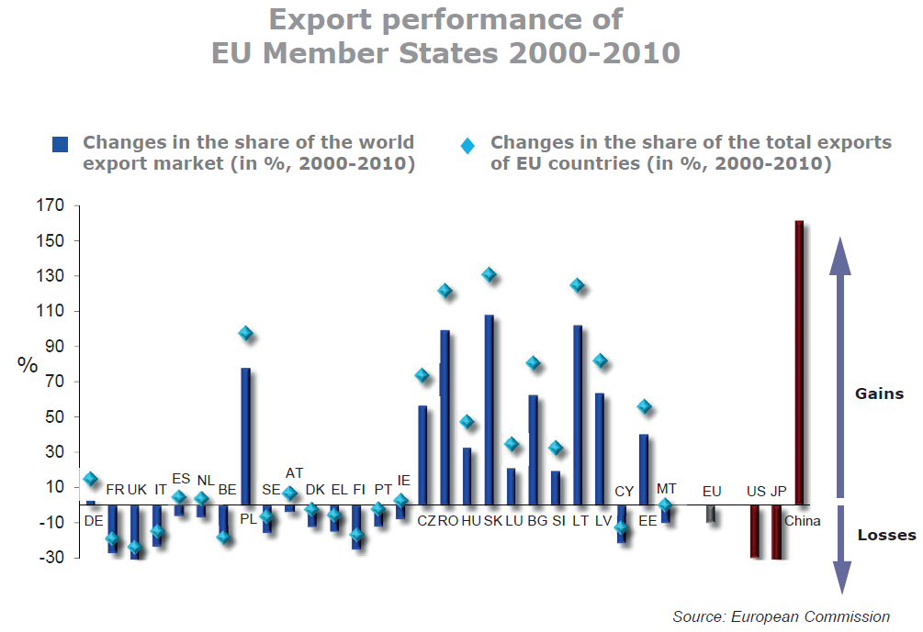

Slide 21
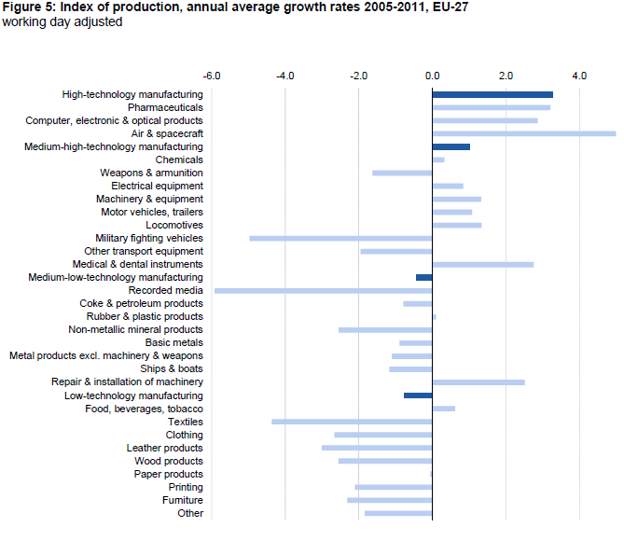

Slide 22
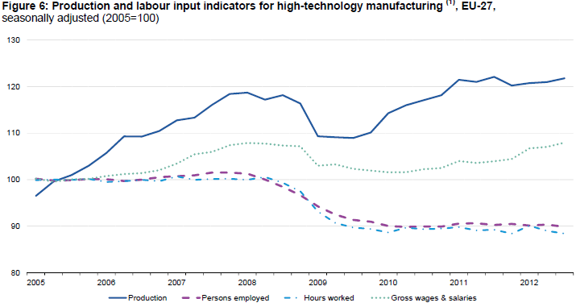

Slide 27
EU trade (goods, bill. EUR)
 |  | 2006 | 2008 | 2010 | 2012 | 2014 | 2016 | 2018 | 2020 | 2021
World | IMP | 1,368 | 1,585 | 1,471 | 1,703 | 1,625 | 1,603 | 1,912 | 1,717 | 2,113
 | EXP | 1,153 | 1,309 | 1,436 | 1,771 | 1,797 | 1,867 | 2,060 | 1,933 | 2,180
 | BAL | -216 | -276 | -36 | 68 | 171 | 264 | 148 | 216 | 68
US | IMP | 171 | 183 | 175 | 209 | 209 | 249 | 267 | 203 | 233
 | EXP | 267 | 248 | 243 | 294 | 312 | 364 | 406 | 353 | 399
 | BAL | 96 | 65 | 69 | 84 | 102 | 115 | 139 | 150 | 167
China | IMP | 196 | 249 | 284 | 292 | 303 | 352 | 395 | 385 | 472
 | EXP | 64 | 78 | 114 | 144 | 165 | 170 | 210 | 203 | 223
 | BAL | -132 | -171 | -171 | -148 | -138 | -183 | -185 | -182 | -248

Slide 28
EU trade partners – goods
2018
2021
 | Imports |  |  | Exports |  |  | Total trade
 | value | share |  | value | share |  | value | share
CH | 395 | 19.9 | US | 406 | 20.8 | US | 674 | 17.1
US | 267 | 13.5 | CH | 210 | 10.7 | CH | 605 | 15.4
RUS | 168 | 8.5 | SWI | 157 | 8.0 | SWI | 266 | 6.7
SWI | 109 | 5.5 | RUS | 85 | 4.4 | RUS | 254 | 6.4
NOR | 84 | 4.2 | TUR | 77 | 4.0 | TUR | 153 | 3.9
TUR | 76 | 3.8 | JAP | 65 | 3.3 | NOR | 138 | 3.5
JAP | 71 | 3.6 | NOR | 54 | 2.8 | JAP | 135 | 3.4
KOR | 51 | 2.6 | KOR | 49 | 2.5 | KOR | 100 | 2.5
IND | 46 | 2.3 | IND | 46 | 2.3 | IND | 92 | 2.3
VIE | 38 | 1.9 | CAN | 41 | 2.1 | CAN | 72 | 1.8
 | Imports |  |  | Exports |  |  | Total trade
 | value | share |  | value | share |  | value | share
CH | 472 | 22.4 | US | 399 | 18.3 | CH | 696 | 16.2
US | 233 | 11.0 | UK | 284 | 13.0 | US | 632 | 17.7
RUS | 159 | 7.5 | CH | 223 | 10.2 | UK | 430 | 10.0
UK | 147 | 7.0 | SWI | 157 | 7.2 | SWI | 280 | 6.5
SWI | 124 | 5.9 | RUS | 89 | 4.1 | RUS | 248 | 5.8
TUR | 78 | 3.7 | TUR | 79 | 3.6 | TUR | 157 | 3.7
NOR | 75 | 3.5 | JAP | 62 | 2.9 | NOR | 131 | 3.1
JAP | 62 | 3.0 | NOR | 57 | 2.6 | JAP | 125 | 2.9
KOR | 55 | 2.6 | KOR | 52 | 2.4 | KOR | 107 | 2.5
IND | 46 | 2.2 | IND | 42 | 1.9 | IND | 88 | 2.1

Slide 29
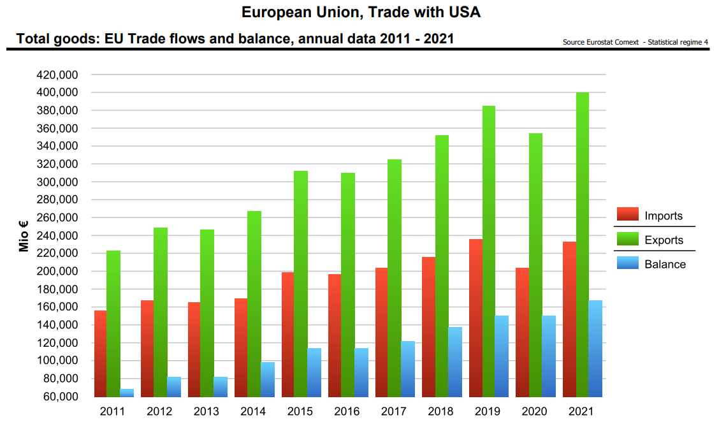

Slide 30
EU – US trade 2018 | Imports |  | Exports
 | bil EUR | % total | bil EUR | % total
food | 12 | 4.4 | 21 | 5.2
steel | 1 | 0.5 | 7 | 1.7
chemicals | 55 | 20.7 | 99 | 24.4
- pharmaceuticals | 29 | 10.9 | 58 | 14.3
mach. and trasport eq. | 111 | 41.6 | 173 | 42.6
- transport eq. | 35 | 13.0 | 74 | 18.3
-- automotive | 9 | 3.4 | 47 | 11.6
- power gen. mach. | 33 | 12.5 | 19 | 4.6
- non elect. mach. | 19 | 7.0 | 48 | 11.7
- elect. mach. | 11 | 4.0 | 18 | 4.5
other manufactures | 29 | 11.0 | 47 | 11.4
EU – US trade 2021 | Imports |  | Exports
 | bil EUR | % total | bil EUR | % total
Food | 8.8 | 3.8 | 23 | 5.7
steel | 0.8 | 0.4 | 5.2 | 1.3
Chemicals | 58 | 24.8 | 115 | 28.9
Pharmaceuticals | 30 | 12.9 | 76 | 19.0
mach. and trasport eq. | 80 | 34.6 | 146 | 36.6
- transport eq. | 27 | 11.5 | 54 | 13.4
-- automotive | 10 | 4.3 | 35 | 8.7
- power gen. mach. | 18 | 7.5 | 12 | 2.9
- non elect. mach. | 15.3 | 6.6 | 47 | 11.8
- elect. mach. | 9.2 | 3.9 | 19.3 | 4.8
other manufactures | 26 | 11.0 | 43 | 10.8

Slide 31
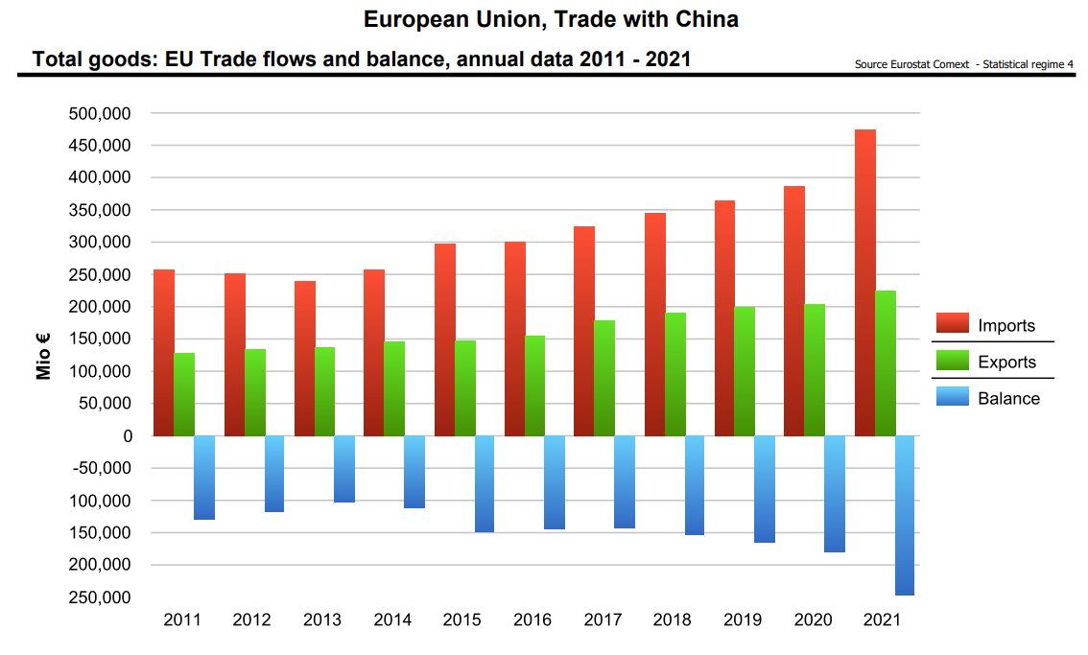

Slide 32
EU – China trade 2018 | imports |  | exports
 | bil EUR | % total | bil EUR | % total
agri. products | 8 | 2.0 | 16 | 7.5
fuel and mining | 5 | 1.2 | 14 | 6.5
chemicals | 21 | 5.4 | 27 | 12.8
other semi. manu. | 32 | 8.0 | 10 | 4.5
mach. and trasport eq. | 209 | 53.1 | 112 | 53.4
- office and telecom. | 123 | 31.1 | 10 | 4.5
-- elect.data processing. | 50 | 12.6 | 1 | 0.6
-- telecom. eq. | 67 | 17.1 | 3 | 1.3
- transport. eq | 13 | 3.2 | 50 | 23.8
- non elect. mach. | 26 | 6.6 | 32 | 15.0
- elect. mach. | 42 | 10.7 | 16 | 7.5
clothing | 29 | 7.4 | 2 | 0.9
other manufactures | 75 | 19.0 | 19 | 8.9
EU – China trade 2021 | imports |  | exports
 | bil EUR | % total | bil EUR | % total
agri. products | 7.8 | 1.6 | 22.4 | 10.0
fuel and mining | 4.6 | 1.0 | 8.6 | 3.9
Chemicals | 34 | 7.3 | 33 | 14.7
other semi. manu. | 36 | 7.7 | 10 | 4.5
mach. and trasport eq. | 263 | 55.8 | 116 | 51.9
- office and telecom. | 138 | 29.3 | 15 | 6.9
-- elect.data processing. | 55 | 11.6 | 1.6 | 0.7
-- telecom. eq. | 67 | 14.3 | 3.6 | 1.6
- transport. eq | 22 | 4.7 | 44 | 19.8
- non elect. mach. | 36 | 7.6 | 34 | 15.1
- elect. mach. | 59 | 12.5 | 18 | 8.0
clothing | 26 | 5.4 | 3 | 1.4
other manufactures | 83 | 17.6 | 23 | 10.4

Slide 33
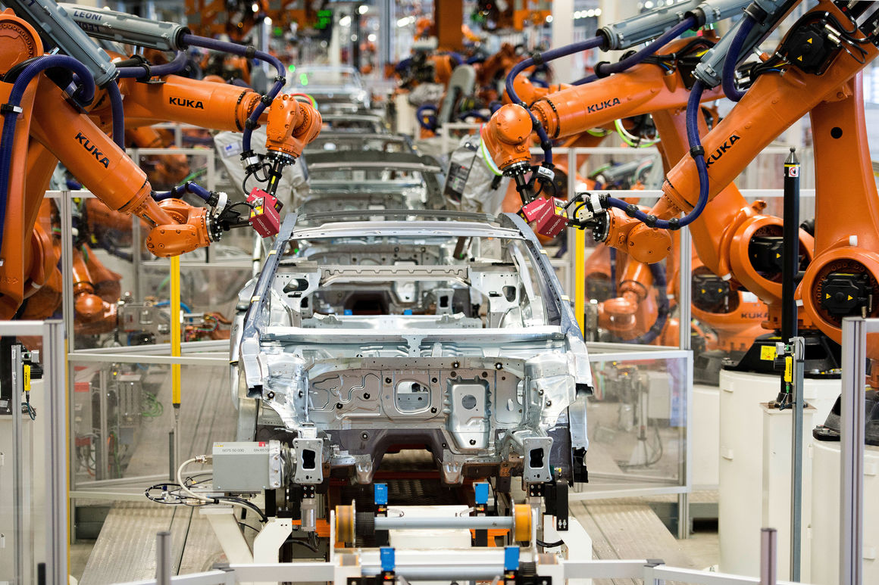
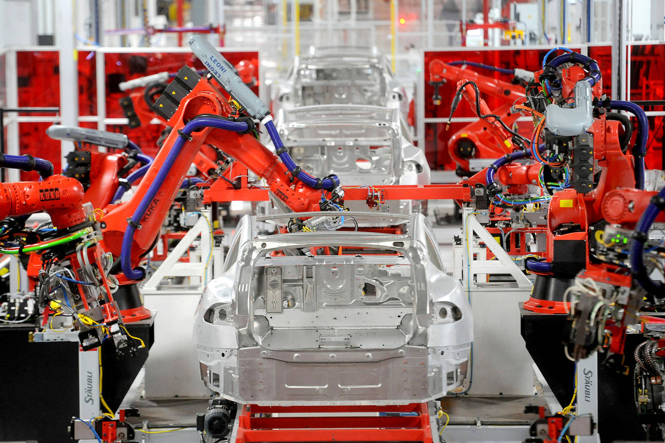
KUKA - Keller und Knappich Augsburg (1898)
KUKA Systems’ plants/equipments are being used by various automotive manufacturers such as BMW, GM, Chrysler, Ford, Volvo, Volkswagen, Daimler AG, Valmet Automotive as well as manufacturers from other industrial sectors such as Airbus, Siemens and others.
In 1973, KUKA created its own industrial robot FAMULUS.
In June 2016, Midea Group offered to buy Kuka for about €4.5 billion ($5 billion). Midea completed the takeover bid in January 2017 by taking 74.55% voting stake in the company.
Midea Group - produces lighting, water appliances, floor care, small kitchen appliances, laundry, large cooking appliances, and refrigeration appliances (135 thousand employees, 60 affiliates)…

Slide 34
EU – JAP trade 2018 | Imports |  | Exports
 | bil EUR | % total | bil EUR | % total
food | 0.4 | 0.5 | 7 | 10.0
chemicals | 7 | 10.3 | 15 | 22.6
- pharmaceuticals | 1 | 1.8 | 9 | 13.5
mach. and trasport eq. | 47 | 66.9 | 25 | 39.1
- transport eq. | 20 | 27.7 | 13 | 20.7
-- automotive | 14 | 20.3 | 10 | 15.9
- other machinery | 21 | 29.6 | 10 | 15.7
- non elect. mach. | 12 | 17.4 | 6 | 8.6
- elect. mach. | 10 | 4,2 | 17 | 4,6
Other manu – scientific | 4 | 6.0 | 4 | 5.4
EU – JAP trade 2020 | Imports |  | Exports
 | bil EUR | % total | bil EUR | % total
food | 0.3 | 0.6 | 7.8 | 14.3
chemicals | 7.8 | 14.2 | 13 | 24.2
- pharmaceuticals | 1.5 | 2.8 | 7.9 | 14.5
mach. and trasport eq. | 35 | 63.5 | 19 | 34.5
- transport eq. | 14 | 26.2 | 8.6 | 15.9
-- automotive | 11 | 20.0 | 6.8 | 12.5
- other machinery | 15 | 27.5 | 8 | 14.7
- non elect. mach. | 8.9 | 16.1 | 5 | 9.2
- elect. mach. | 5.2 | 9.4 | 2.1 | 3.9
Other manu – scientific | 7 | 12.8 | 6.9 | 12.6

Slide 35
EU – RUS trade 2018 | Imports |  | Exports
 | bil EUR | % total | bil EUR | % total
food | 2 | 1.3 | 6 | 6.7
fuels and mining | 125 | 74.2 | 1 | 1.6
chemicals | 6 | 3.4 | 18 | 20.8
mach. and trasport eq. | 2 | 1.3 | 39 | 45.4
- transport eq. | 0,7 | 0.4 | 13 | 15.1
- non elect. mach. | 0.4 | 0.2 | 15 | 17.3
- elect. mach. | 0.4 | 0.3 | 5 | 5.8
clothing | 0.03 | 0,0 | 3 | 3.0
EU – RUS trade 2021 | Imports |  | Exports
 | bil EUR | % total | bil EUR | % total
food | 2.6 | 1.6 | 6.2 | 7.0
fuels and mining | 111 | 69.9 | 2.1 | 2.4
chemicals | 6.7 | 4.3 | 20 | 22.5
mach. and trasport eq. | 1.9 | 1.2 | 39 | 43.8
- transport eq. | 0,6 | 0.4 | 12.8 | 14.4
- non elect. mach. | 0.4 | 0.3 | 15 | 16.7
- elect. mach. | 0.4 | 0.3 | 5.2 | 5.9
clothing | 0.04 | 0,0 | 2.4 | 2.7

Slide 36
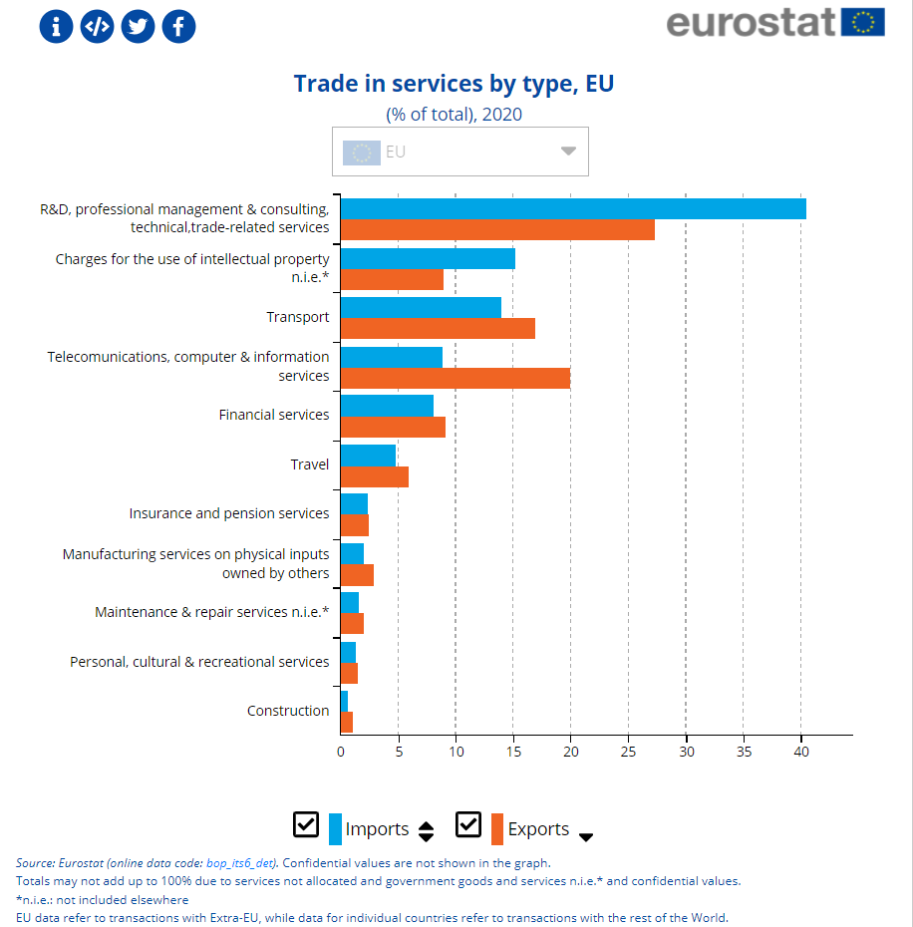

Slide 37
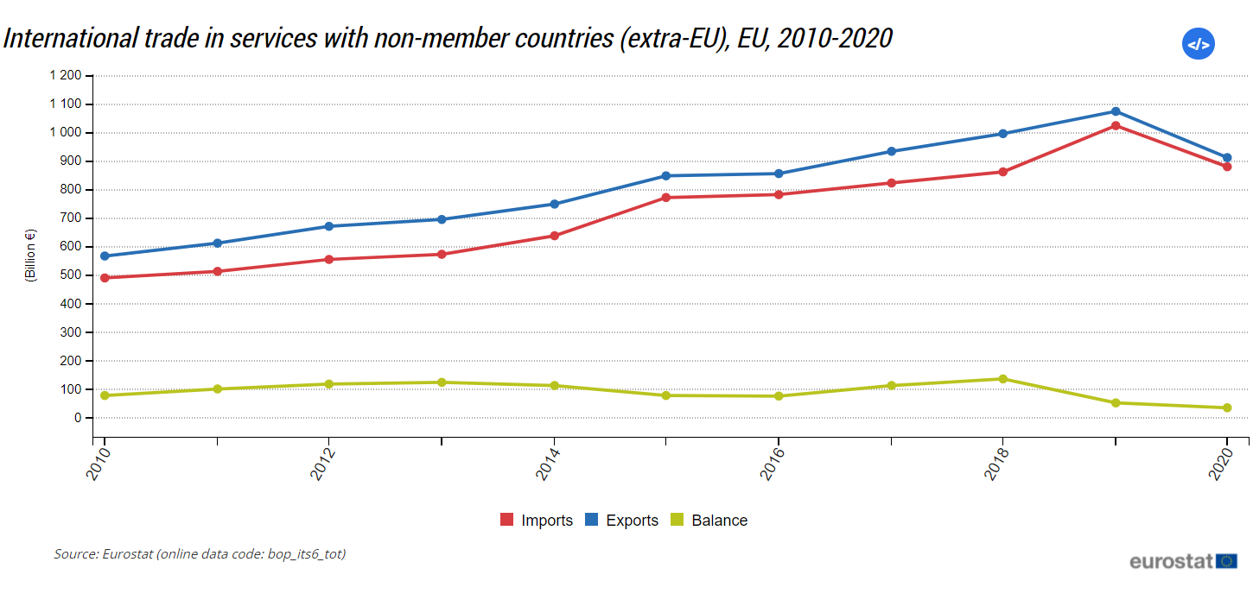

Slide 38
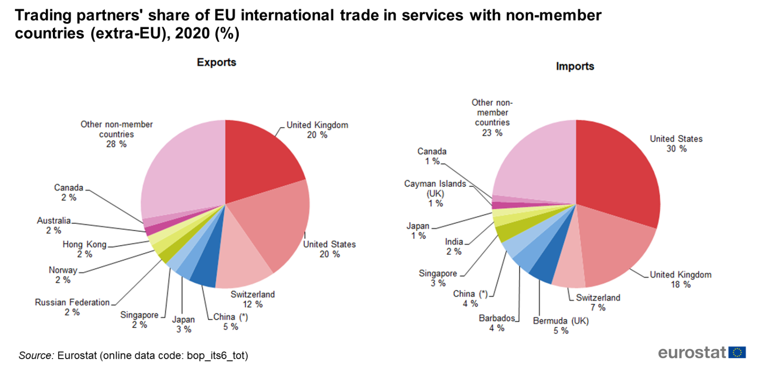

Slide 40
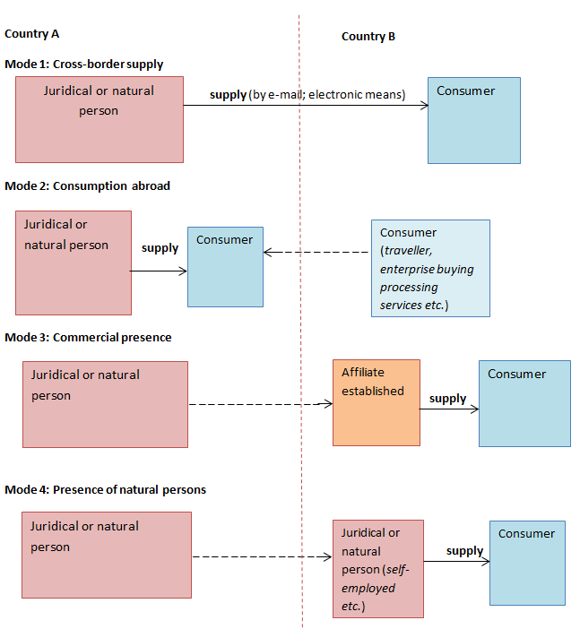

Slide 41
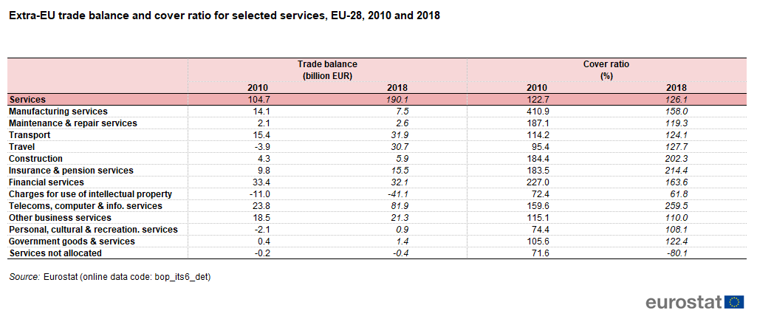
Cover ratios — the value of exports divided by the value of imports, expressed as a percentage.

Slide 43
International trade in services, selected countries, 2010 and 2018
 | Exports |  | Imports |  | Share of world total, 2017
 | (billion EUR) |  |  |  | (%)
 | 2010 | 2018 | 2010 | 2018 | Exports | Imports
World (¹) | 2 164,1 | 3 575,4 | 2 145,6 | 3 462,1 | 100,0 | 96,8
EU-28 (²) | 566,7 | 918,5 | 462,0 | 728,4 | 25,5 | 20,2
Australia | 35,0 | 58,8 | 38,9 | 61,7 | 1,6 | 1,7
Brazil | 23,1 | 28,8 | 45,9 | 57,6 | 0,9 | 1,7
Canada | 58,0 | 78,9 | 74,3 | 95,3 | 2,2 | 2,7
China | 88,7 | 197,8 | 106,3 | 445,2 | 5,3 | 11,7
Hong Kong | 60,8 | 96,3 | 53,1 | 68,6 | 2,6 | 1,9
India | 88,3 | 173,7 | 59,5 | 105,6 | 4,6 | 2,7
Japan | 101,5 | 164,0 | 124,4 | 170,1 | 4,6 | 4,8
Mexico | 11,7 | 24,4 | 20,3 | 32,0 | 0,7 | 0,9
Russia | 37,1 | 54,7 | 56,8 | 80,1 | 1,4 | 2,2
Singapore | 75,7 | 154,6 | 75,8 | 156,0 | 4,2 | 4,4
South Africa | 12,1 | 13,5 | 14,8 | 14,0 | 0,4 | 0,4
South Korea | 62,6 | 83,9 | 73,1 | 109,1 | 2,2 | 3,1
Turkey | 27,5 | 41,4 | 14,9 | 19,7 | 1,1 | 0,6
United States | 424,5 | 700,2 | 308,8 | 480,4 | 19,8 | 13,5
Note: United Arab Emirates: not available.
(¹) Excludes intra-EU trade. 2017 instead of 2018.
(²) Extra-EU trade.

Slide 44
SERVICES | Trade balance (billion EUR) |  | Cover ratio (%)
 | 2010 | 2018 | 2010 | 2018
EU-28 (¹) | 104,7 | 190,1 | 122,7 | 126,1
Australia | -3,9 | -2,8 | 90,0 | 95,4
Brazil | -22,7 | -28,7 | 50,4 | 50,1
Canada | -16,2 | -16,4 | 78,2 | 82,8
China | -17,7 | -247,5 | 83,4 | 44,4
Hong Kong | 7,7 | 27,7 | 114,4 | 140,3
India | 28,8 | 68,1 | 148,4 | 164,5
Japan | -22,9 | -6,1 | 81,6 | 96,4
Mexico | -8,6 | -7,6 | 57,6 | 76,2
Russia | -19,7 | -25,4 | 65,3 | 68,3
Singapore | -0,1 | -1,4 | 99,9 | 99,1
South Africa | -2,7 | -0,5 | 82,0 | 96,8
South Korea | -10,5 | -25,2 | 85,6 | 76,9
Turkey | 12,6 | 21,6 | 185,0 | 209,8
United States | 115,7 | 219,9 | 137,5 | 145,8
Cover ratios — the value of exports divided by the value of imports, expressed as a percentage.

Slide 47
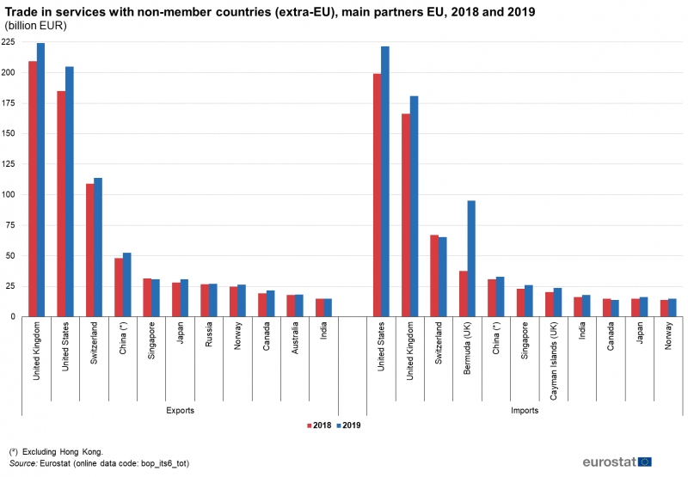

Slide 48
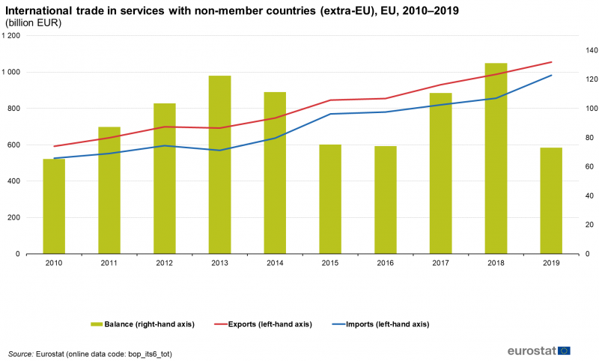

Slide 49
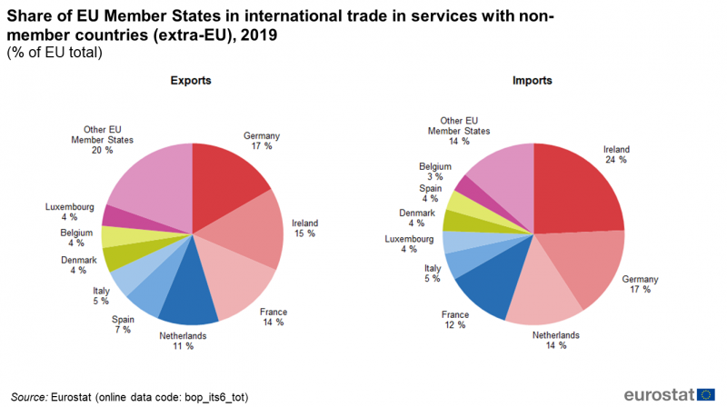

Slide 50
