Slide 1
In this course, we talk a lot about the REPLICATION CRISIS
What is replication crisis?
Can you describe it in your own words?
I want to be a psychotherapist – is this relevant for me?
How about other disciplines?

Slide 2
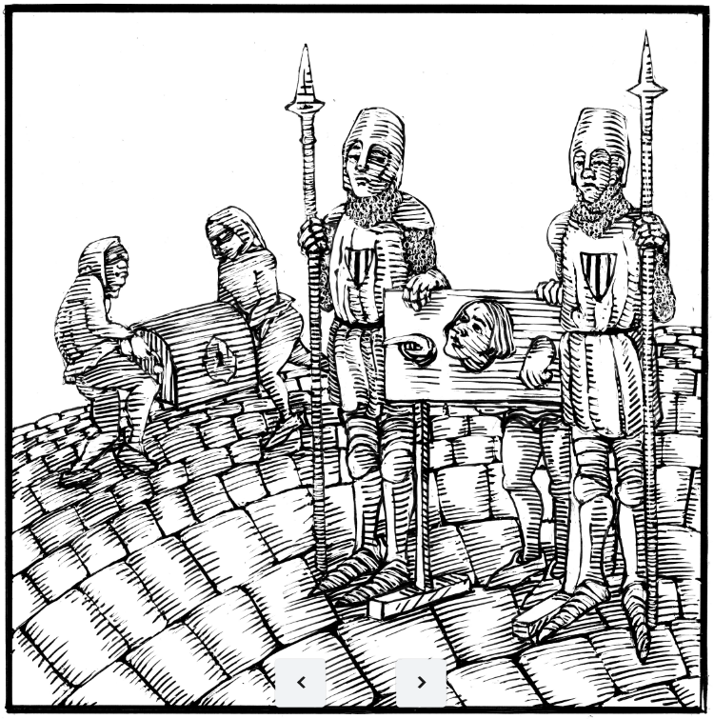
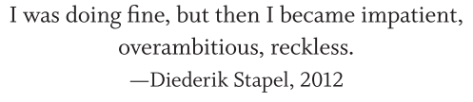
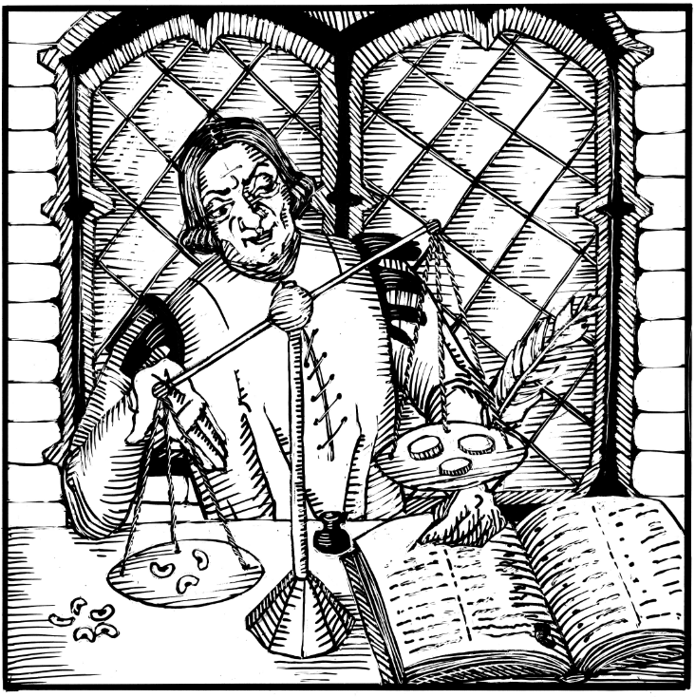
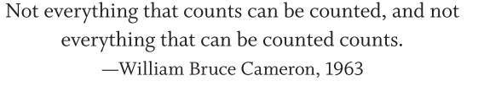
The Sin of Bean Counting
The Sin of Corruptibility

Slide 3
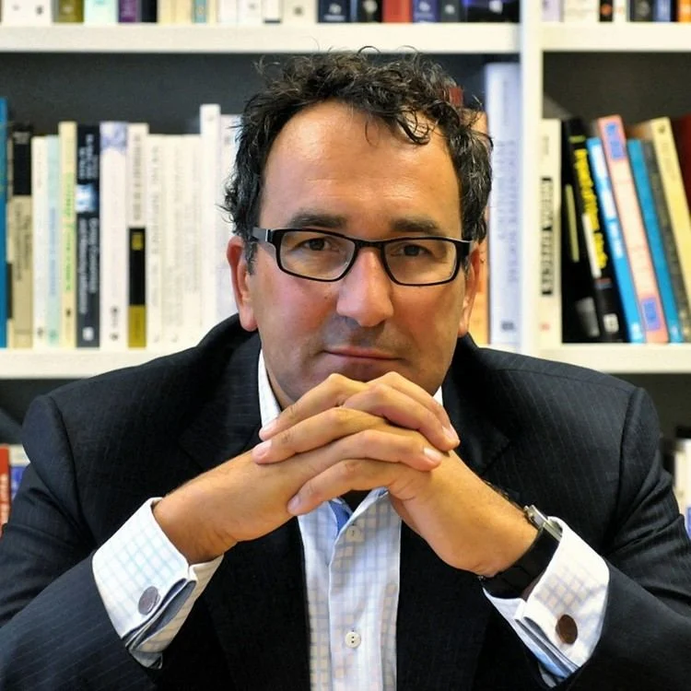
Who is this guy?

Slide 4

Who is this guy?

Slide 5
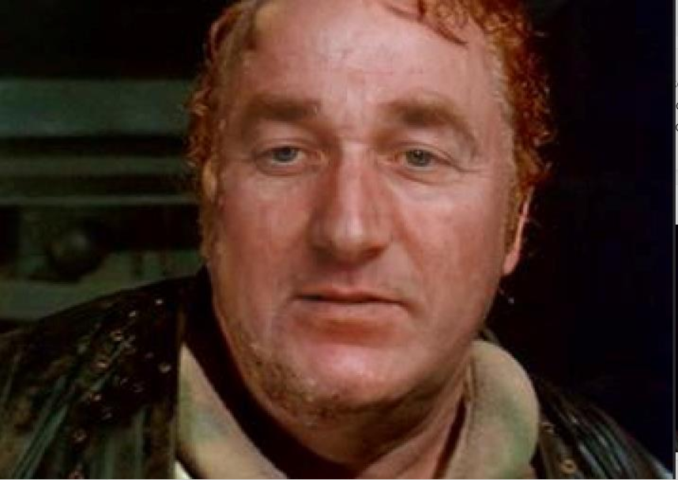
Who is this guy?

Slide 6
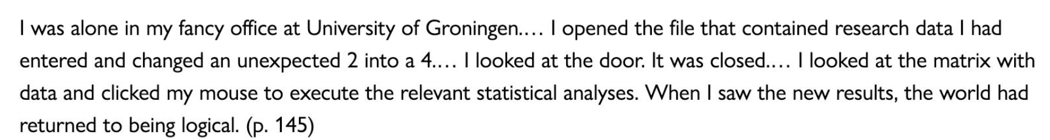
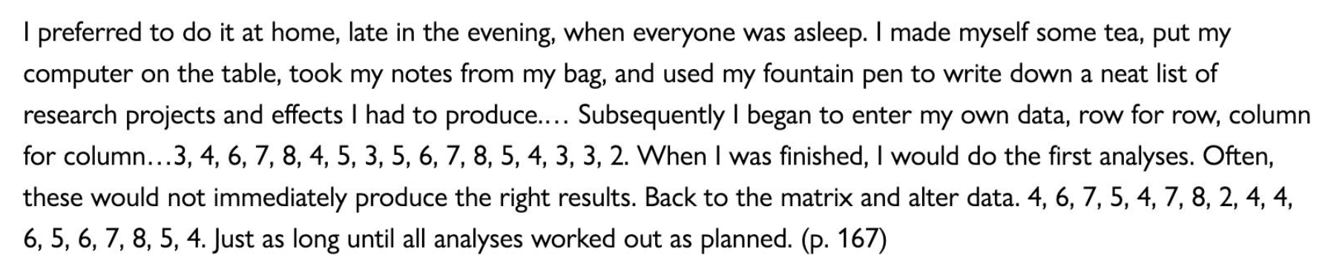

Slide 7
Psychology must learn a lesson from fraud case (Wicherts, 2011)
“The interim report of the investigating committee revealed that Stapel often refused to share his research data with colleagues, even co-authors on papers. To scientists in other fields, this may seem extraordinary; to psychologists it is sadly common practice.”
almost 3/4 of researchers who had published a paper in a high-impact psychology journal had not shared their data (more with the Sin of Data Hoarding)
it is not unusual for data that are shared to list variables only as VAR00001 through VAR00019, with no further explanation.
co-authors rarely verify a study's analysis

Slide 8
Psychology must learn a lesson from fraud case (Wicherts, 2011)
readers of published papers are shown dense summaries of results
sharing data: there are practical problems, including the need to keep data or participants confidential
  these can be solved by embargoes on releasing data for longitudinal studies, guidelines for pre-processing raw data, proper anonymity and exemptions where necessary
a 'co-pilot' model, in which we share data between us for double-checking and preventing embarrassing errors

Slide 9
But why would they do it?

Slide 10
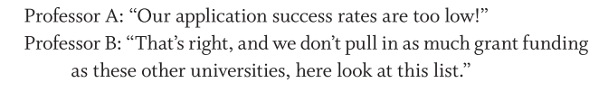


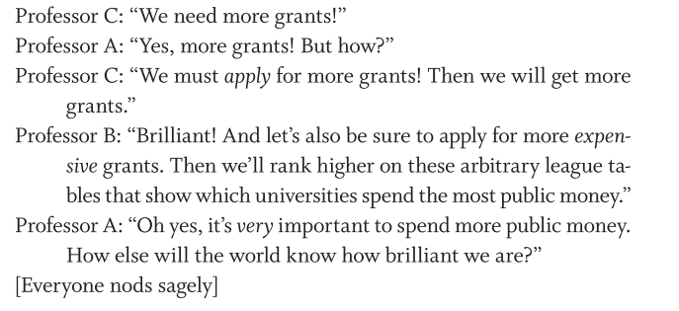
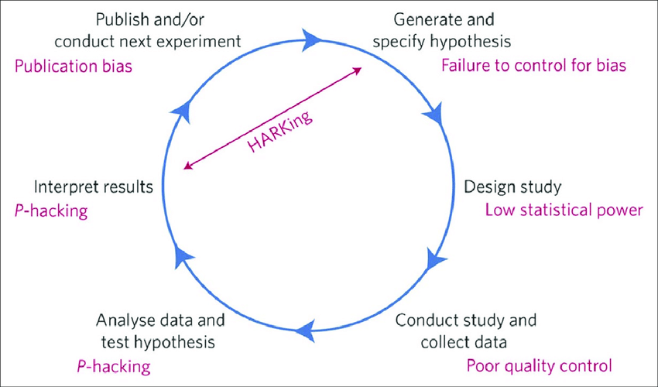
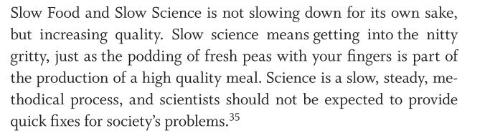

Slide 11
Impact factor
A well-intentioned measure of journal quality
Started in 1979, now calculated by a private company Clarivate
IF = number of citations / number of publications in two preceding years

Slide 12
Impact factor – examples
Nature: 50
Science: 47
European Journal of Psychological Assessment: 3
Czechoslovak Psychology: 0.5
Testforum: NA

Slide 13
Article Influence Score
An alternative to IF that measures influence of a journal
Recently implemented as the metric that decides funding in Czech Republic
Mean AIS = 1
Omits journal-level self-citations
AIS = journal’s citation influence / number of articles over five years

Slide 14
AIS – examples
Nature: 24
Science: 22
European Journal of Psychological Assessment: .96
Czechoslovak Psychology: .06
Testforum: NA

Slide 15
h-index
Measure of author quality, comparable within fields
Started in 2005
Intedned to be better than raw number of papers or raw number of citations... but correlates r = .90 with the raw number of papers, oops.
Among all publications of an author, at least h of them received at least h citations.

Slide 16
h-index – examples
Albert Einstein: 117
Albert Bandura: 208
Eric-Jan Wagenmakers: 101
Jordan Peterson: 55
David Šmahel: 28
Stanislav Ježek: 19

Slide 17
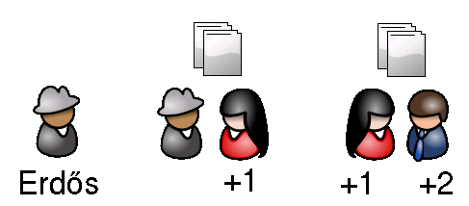
Erdös number
The only measure of author quality that makes sense
The only measure of author quality that measures something real
E_N = How many co-authors separate you from the mathematician Pál Erdös

Slide 18
On 20 September 1996, at the age of 83, he had a heart attack and died while attending a conference in Warsaw.^{[17]} These circumstances were close to the way he wanted to die. He once said,
  I want to be giving a lecture, finishing up an important proof on the blackboard, when someone in the audience shouts out, 'What about the general case?'. I'll turn to the audience and smile, 'I'll leave that to the next generation,' and then I'll keel over.^{[17]}
Other idiosyncratic elements of Erdős's vocabulary include:^{[32]}
Children were referred to as "epsilons" (because in mathematics, particularly calculus, an arbitrarily small positive quantity is commonly denoted by the Greek letter (ε)).
Women were "bosses" who "captured" men as "slaves" by marrying them. Divorced men were "liberated".
People who stopped doing mathematics had "died", while people who died had "left".
Alcoholic drinks were "poison".
Music (except classical music) was "noise".
To be considered a hack was to be a "Newton".
To give a mathematical lecture was "to preach".
Mathematical lectures themselves were "sermons".^{[33]}
To give an oral exam to students was "to torture" them.

Slide 19
Erdös number – examples
Albert Einstein: 2
Albert Bandura: NA
Eric-Jan Wagenmakers: 3
Jordan Peterson: NA
David Šmahel: NA
Stanislav Ježek: NA

Slide 20
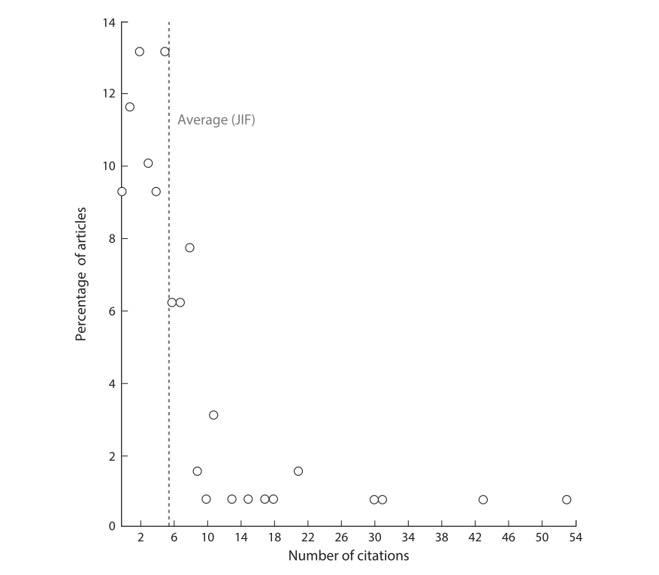
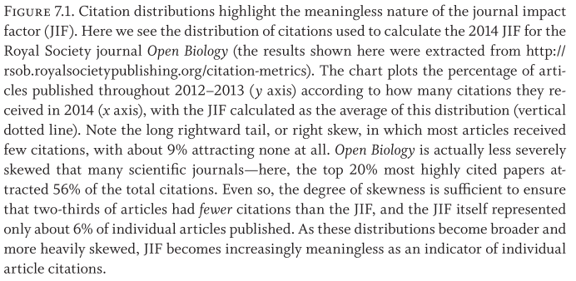

Slide 21
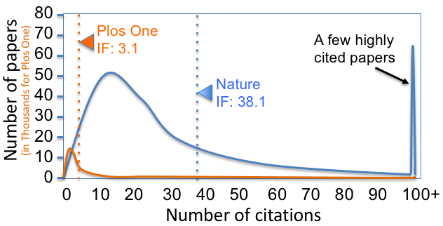

Slide 22
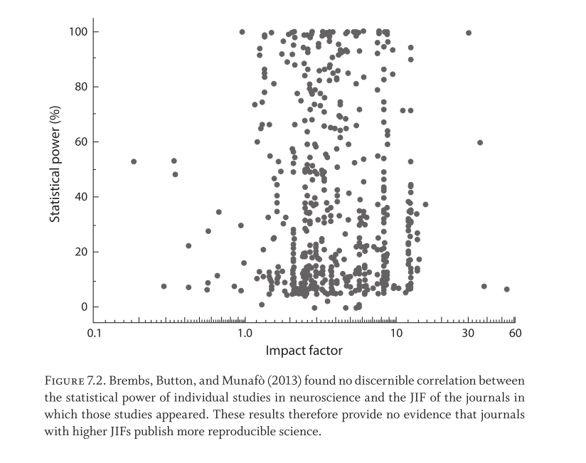

Slide 23
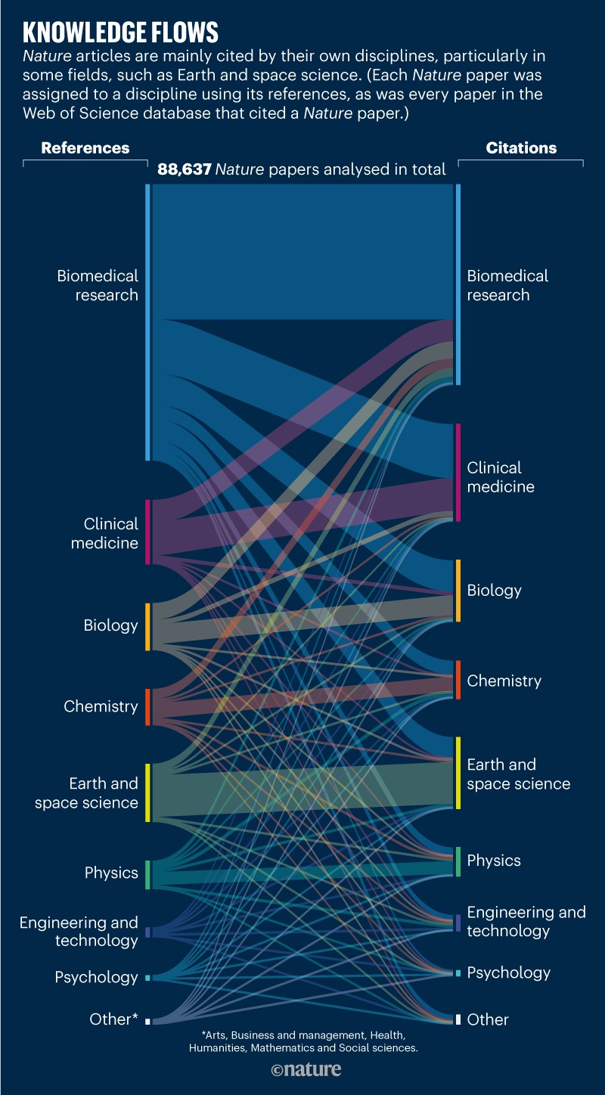
A "popular" article has been published in nature. The graph maps articles in the domains covered by nature and its "daughter" journals:
- articles are mapped to citations
- the likelihood is high that papers from a certain discipline are cited by their own disciplines
- the lower we go, the less cross-disciplinary citation
QUESTION 1: Are measures that are heavily based on citations (without a correction) comparable across disciplines?
QUESTION 2: Having a look at the picture, how is psychology faring in the business?
https://www.nature.com/articles/d41586-019-03308-7?proof=t%3B

Slide 24
Reason distinguishes a “person approach” to error from a “system approach” (Reason, 2000):
He notes that “high reliability” organizations (including air traffic control centers, nuclear power plants, and nuclear aircraft carriers) are characterized by a focus on error management at the systems level more than the individual level.
Reason's logic has also been adopted in widespread attempts to reduce medical errors and a focus on moving medicine from a “blame and shame” cultural perspective to one of a “reporting and feedback” cultural perspective, with public reporting of individual and organizational performance being crucial (Leape, 2010).

Slide 25

6 core reasons for DRP
(1) career and funding pressures
(2) institutional failures of oversight,
(3) commercial conflicts of interest,
(4) inadequate training,
(5) erosion of standards of mentoring, and
(6) part of a larger pattern of social deviance.

Slide 26
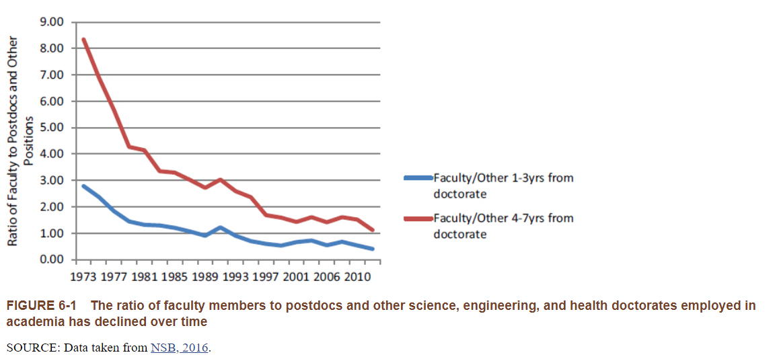

Slide 27

Take home message
Scientists are incentivized to engage in fraud
Metrics that incentivize them are fatally flawed
Fraud is not merely an issue of individual bad apples, but rather a larger flaw of the whole academic culture
Resisting all bad research practices is hard due to institutional (and personal ) pressures

Slide 28
Thank you for your attention!
Don’t forget that you will be quizzed on the sins of Corruptibility & Bean counting next week.
And please fill in the feedback form. ☺
https://forms.gle/jL8D3pVxKddxWEGu8

