Slide 1
BULLYING IN ADOLESCENTS

Slide 2
The Definition of Bullying
Several aspects…
Intentional harm
Repeated over time
Power imbalance

Slide 3
Depressive Symptoms, Friend Distress, and Self-blame: Risk Factors for Adolescent Peer Victimization
Hannah L. Schacter, Jaana Juvonen
Journal of Applied Developmental Psychology (2017)

Slide 4
Research Question
How social cognitions and peer relationships of adolescents with depressive symptoms affect the risk of future victimization?
The Aim of the Study
Depressive symptoms as a risk factor for peer victimization in early adolescence by focusing on self blaming

Slide 5
Hypothesis
Self-blame can help account for increased victimization risk and that friends’ depressive symptoms further strengthen this association.
Participants
The ethnically diverse sample which includes middle school adolescents (N = 5374) from 26 urban public schools in California

Slide 6
Design and Procedure
Students completed questionnaires in the Fall of the 6th grade, Spring of the 6th grade, and Spring of the 7th grade in a classroom setting.
Measures
1. Perceived peer victimization
Two statements separated by the word “but” (e.g., some kids are often picked on but other kids are not picked on)

Slide 7
Rating part (if the statement was "really true" or "sort of true" on a 4-point scale).
Other three items were about being called names, being the target of gossip, and being pushed around by others.

Slide 8
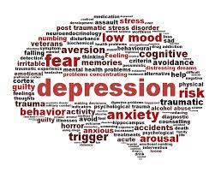
2. Depressive symptoms
Adapted version of the Center for Epidemiologic Studies Depression Scale (CES-D; Radloff, 1977)
(e.g., "I felt depressed," " I felt sad," " My sleep was restless".)
How often they had experienced each item in the past week

Slide 9
3. Friends' depressive symptoms
They were asked to list the names of their good friends in their grade at school.
4. Characterological self-blame
Vignette 1 (in the Fall of 6th grade)
Vignette 2 (in the Spring of 6th grade)
Self-blame (e.g., more likely to happen to me than to other kids)

Slide 10
Results
Students who reported higher levels of depressive symptoms at the beginning of middle school were more likely to endorse self-blaming attributions at the beginning and end of the 6th grade.
Students who reported higher levels of depressive symptoms at the beginning of middle school were more likely to experience peer victimization both concurrently and during 7th grade.

Slide 11
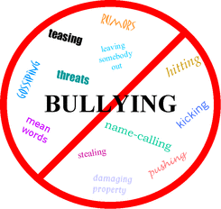
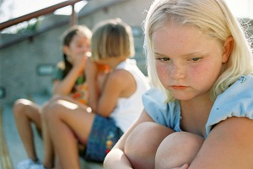
Higher depressive symptoms were related to having friends with depressive symptoms and higher levels of self-blame and victimization.

Slide 12
Bullying Among Turkish High School Students
Yasemin Karaman Kepenekci, Şakir Çınkır
Child Abuse & Neglect (2006)

Slide 13
Research Questions
What types of bullying are taking place in high school in Turkey?
What is the gender of the victims?
Where does bullying take place?
What do the victims do in order to protect themselves from bullying?
Who are the bullies?
Why do the children bully each other?
The Aim of the Study
Investigate school bullying among public high school students in Turkey.

Slide 14
Participants
Students chosen from five state high schools in Ankara (N = 692)
14-17 years of age
385 of them were girls and 307 of them were boys
Questionnaire Design
To determine the students’ perceptions of bullying in schools

Slide 15
Questions were derived from the studies by Olweus (1993) and Elliot (1997)
Four types of bullying : physical, verbal, emotional, and sexual
28 binary or multiple-choice questions
Two open-ended questions (consequences of bullying & prevention methods)

Slide 16
Procedure
During normal class time
Anonymous
Results
All students reported that they experienced at least one type of bullying.
35.3% verbally (pushing)
35.5% physically (name calling)
28% emotionally (humiliating)
15.6% sexually

Slide 17
Gender and types of bullying
Physical and verbal bullying were the most common type.
Boys experienced more physical (kicking) and verbal (name calling, swearing) bullying than girls.
”Where does bullying usually take place?”
Classroom, school corridors, on the way to school, school canteen etc.

Slide 18
“Who was likely to do the bullying in schools?”
33.5% said boys,
9.8% said girls,
18.7% said chubby students,
18.4% said older students,
16.7% said less successful student
2.9% said other

Slide 19
“Why do you think students bully each other?”
“pretending to be strong” (43.1%),
“who do not know how to handle their problems” (24.1%),
those who “have personal problems” (22.1%),
no clue (10.7%)

Slide 20
Open-ended questions: consequences of bullying and prevention methods
“A friend insulted and sweared at me. I never told anyone including my family. I feel like crying. I feel helpless and sometimes lose concentration. I am losing trust in myself.” (Low psychological well-being)

Slide 21
“Whenever I am faced with discrimination I feel alone and put a distance between my friends and myself.” (Poor social adjustment)
“My friends gave me a nickname. I went into depression. Became antisocial. I feel like punching them.” (Psychological distress)

Slide 22
What about prevention?
High school students in Turkey were more likely to protect themselves rather than telling someone else.

