Slide 1
How mate selection in Japan evolved?
PSYb2730 Youth Development
530306 Hinako Sato

Slide 2
Summary
・Romantic relationships can be a new type of comfort zone and opportunities to enhance their personality and identity creation for young Japanese adults
・Currently male selection is in the process of transition from arranged marriage to love marriage
・In Semi-arranged marriage process, people still have some limitations about decision-making, method of finding mate, etc.
・Criteria for male selection reflect cultural/economic background of the countries
・Dating app market is expanding rapidly, which also provide opportunity to find mate.

Slide 3
Feeling and engagement of romantic relationship
Sternberg’s triangular theory of love
Intimacy: closeness, connectedness, bondedness
Commitment: feelings that lead a person to remain with someone and move toward shared goals
Passion: feelings and desires that lead to physical attraction, romance, and sexual consummation
All three components of intimacy, commitment, and passion are emphasized in romantic relationships(Feuerman, 2022).

Slide 4
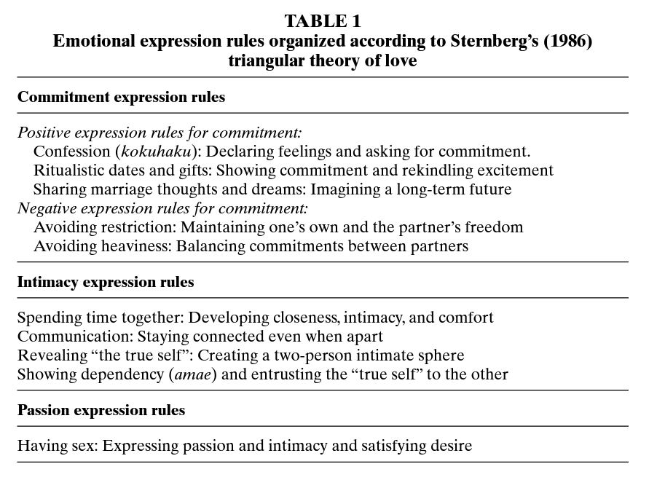

Slide 5
Feeling and engagement of romantic relationship
Average of first marriage in Japan
1975: 27 for men and 24.7 for women
2006: 30 for men and 28.2 for women (Ministry of Health, Labor and Welfare (MHLW), 2006).
29.9% met at their workplaces or through work-related areas;
30.9% met through friends or siblings; and
11.1% met at school (NIPSSR, 2002).

Slide 6
Feeling and engagement of romantic relationship
Romantic relationships can be a new type of comfort zone for young Japanese adults redefining the boundaries of the “inner” and “outer” self, often replacing or displacing family ties as the context for displaying a backstage “true self.”
The romantic relationship thus represents a transitional life stage for heterosexual Japanese young people(Farrer, Tsuchiya, & Bagrowicz, 2008)

Slide 7
69%
Arranged marriage In 1940

Slide 8
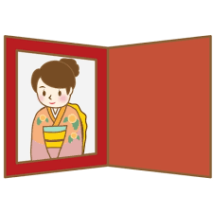
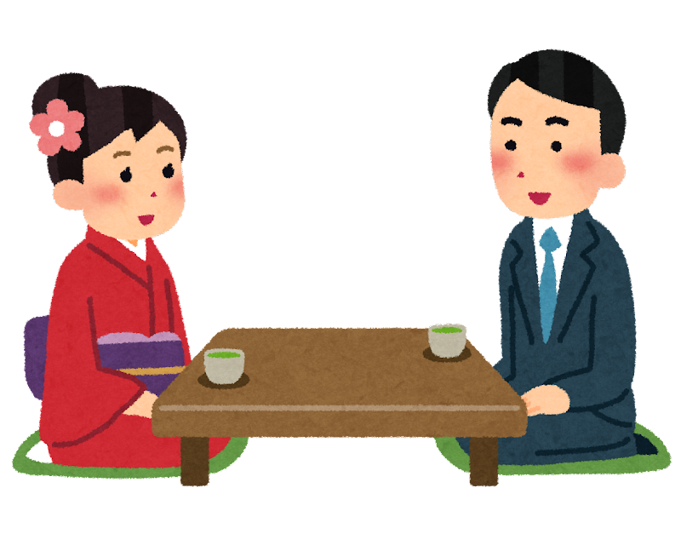

Arranged marriage ”Omiai”

Slide 9
Arranged marriage to Love marriage
・a man or woman conducts the search by his or her free will, but parental approval is eventually needed.
・where parental influence is weak but a pretense of traditional rituals of engagement is presented
・the search process is initiated by parents, kin, or matchmakers, but the decision to marry is autonomous(Tsutsui, 2013).
Arranged marriage
Semi-arranged marriage
Love marriage

Slide 10
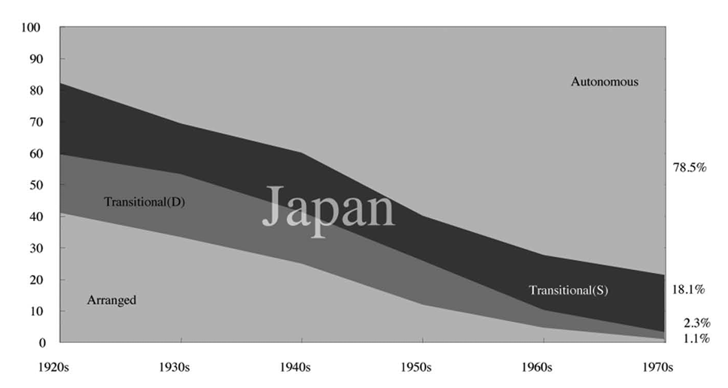
Arranged marriage to Love marriage
Tsutsui, J. (2013). The transitional phase of mate selection in East Asian countries. International Sociology, 28(3), 257–276. https://doi.org/10.1177/0268580913484775

Slide 11
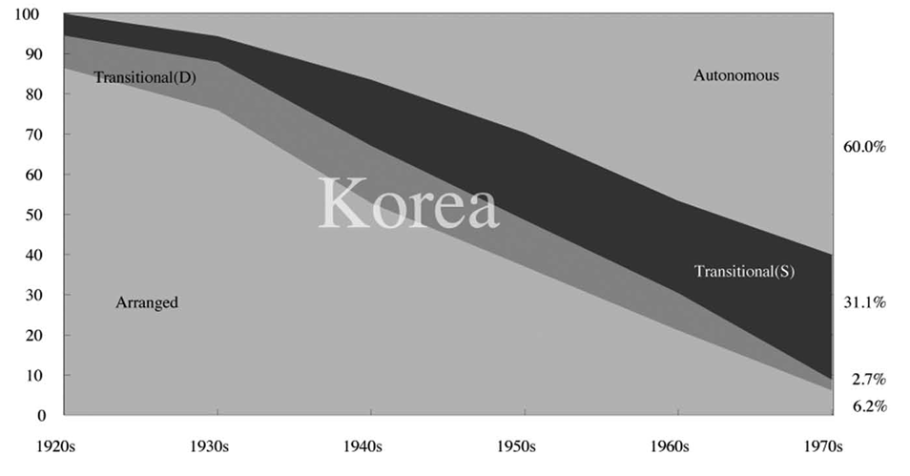
Arranged marriage to Love marriage
Tsutsui, J. (2013). The transitional phase of mate selection in East Asian countries. International Sociology, 28(3), 257–276. https://doi.org/10.1177/0268580913484775

Slide 12

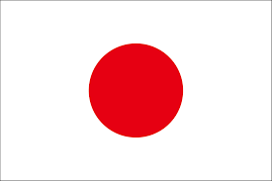
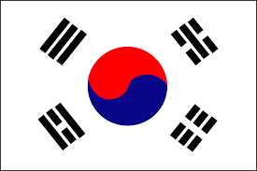
Three most important criteria for mate selection
1 | High moral standards | Love | Work ability
2 | Emotional compatibility | Financial stability | Love
3 | Common interests | Personal traits | Financial stability
 | (7: Love)

Slide 13
Criteria for mate selection
Mate selection criteria changes over time based on changes in the cultural environment.
Male selection is not only individual process, but it reflects some cultural process(Yu, 1993).

Slide 14
Potentials of dating app
11.1% of couple got married in 2021 met from dating app(Recruit Bridal, 2022).
＝4 times as matchmaking party/event
Photographer, consultant of the text of introduction of dating app
Secondary business of dating app

Slide 15
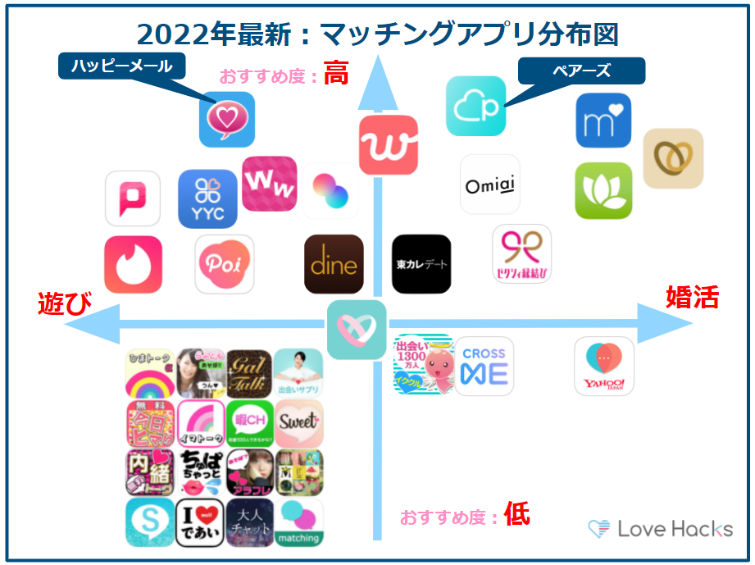

Potentials of dating app
Distribution of dating app in Japan
Serious to
marriage
Just for fun

Slide 16
References
Applbaum, K. D. (1995). Marriage with the proper stranger: Arranged marriage in metropolitan Japan. Ethnology, 34(1), 37-51.
Arakawa, K. (2018). The reason why all Japanese 100 years ago could got married. Toyo keizai online. https://toyokeizai.net/articles/-/202863?page=3
Farrer, J., Tsuchiya, H., & Bagrowicz, B. (2008). Emotional expression in tsukiau dating relationships in Japan. Journal of Social and Personal Relationships, 25(1), 169-188.
Ju, Y. (1993). Mate selection as cultural choice: Reflections on findings in China, Japan, and Korea. Interpersonal communication in friend and mate relationships, 201-218.
Love Hacks. (2022). 3 minute read “features and all precautions of Dine”.https://love-hacks.jp/dating-apps-dine/
Tsutsui, J. (2013). The transitional phase of mate selection in East Asian countries. International Sociology, 28(3), 257–276. https://doi.org/10.1177/0268580913484775

