Slide 1
History of Social Anthropology (Course Code: SANb 2032)
FSS, Masaryk Univ. Brno
When: Winter/Spring 2022, Thurs from 16:00 to 17:40 (CET). Where: U43
Course convenor: Dr Patirck LAVIOLETTE
246133@mail.muni.cz / patrick.laviolette@fss.muni.cz
Office Hours: Tuesdays 14:00 16:00 (or Zoom appointment)
Office: Room 3.48, Joštova 218/10. 602 00 Brno
Phone: +420 549 49 49 04
Or by Zoom appointment:
Notes:
1

Slide 2
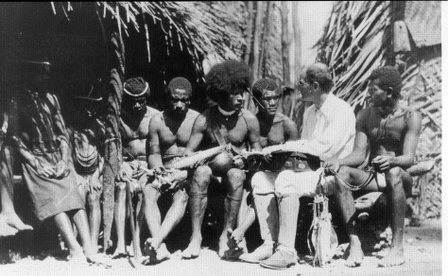
Bronislaw Malinowski [1884-1942] Trobriand Islands

Slide 3
Some Readings
History and Anthropology journal, Taylor & Francis
Haddon, A.C.1934. History of Anthropology. London: Watts & Co. (free download)
http://archive.org/details/historyofanthrop020141mbp
History of anthro series UW Press
Stocking, G.W.Jr. 2010. Glimpses into My Own Black Box: An Exercise in
Self-Deconstruction. Madison: Univ of Winconsin Press. (Vol 12)
Handler, R. (ed) 2006. Central Sites, Peripheral Visions Cultural and Institutional
Crossings in the History of Anthropology. Madison: Univ of Winconsin Press. (Vol 11)
Handler, R. 2003. Significant Others Interpersonal and Professional Commitments in
Anthropology. Madison: Univ of Winconsin Press. (Vol.10)
Handler, R. (ed) 1999. Excluded Ancestors, Inventible Traditions: Essays Toward a
More Inclusive History of Anthropology. Madison: Univ of Winconsin Press. (Vol 9)
Stocking, G.W. Jr. 1996. Volksgeist as Method and Ethic: Essays on Boasian
Ethnography and the German Anthropological Tradition. Madison: Univ of Winconsin
Press. (Vol. 8)

Slide 4
British social anthropology, genealogy
Edward B. Tylor [1832-1917] (Oxon) Augustus Henry Lane-Fox Pitt-Rivers [1827-1900] (Oxon)
James George Frazer Alfred Cort Haddon WHR Rivers Charles Seligman Edvard Westermarck
[1854-1941](Cantab) [1855-1940](Cantab) [1864-1922](Cantab) [1873-1940] (LSE) [1862-1939] (LSE)
Robert R. Marett Alfred Reginald Radcliffe-Brown Bronislaw Malinowski]
[1866-943] (Oxon) [1881-1955] (Cantab, misc. Oxon) [1884-1942] (LSE)
C. Daryll Forde E.E. Evans-Pritchard Meyer Fortes Raymond Firth Camilla Wedgwood Audrey Richards
[1902-73] (UCL) [1902-73] (Oxon) [1906-83](Cantab) [1901-2002](LSE) [1901-55](Cantab,LSE) [1899-1984](LSE)

Slide 5
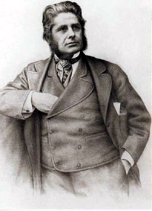
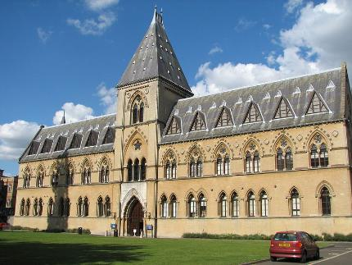
Lieutenant General Augustus Henry
Lane-Fox Pitt-Rivers [1827-1900]

Slide 6
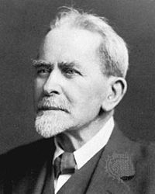
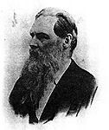
James George Frazer [1854-1951]
Edward B. Tylor [1832-1917]

Slide 7
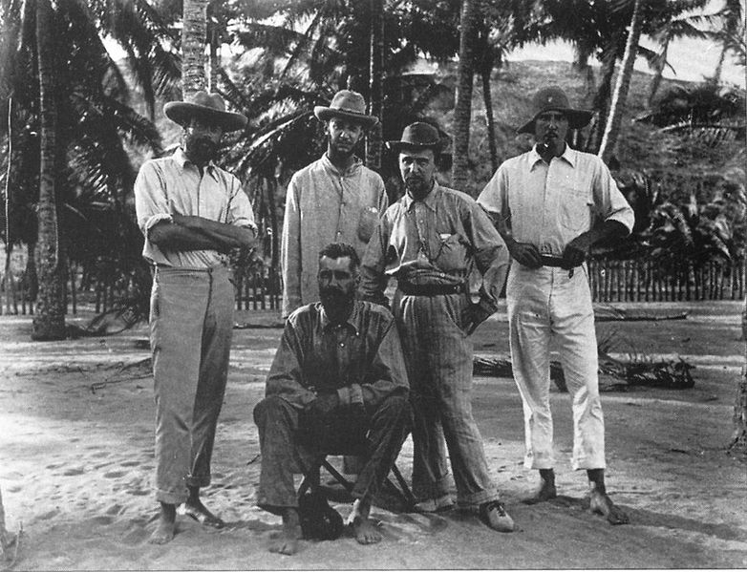
1898 Torres Straits Expedition. Standing (from left to right): W.H.R. Rivers, Charles Gabriel Seligman, Sidney Herbert Ray, Anthony Wilkin. Seated: Alfred Cort Haddon

Slide 8
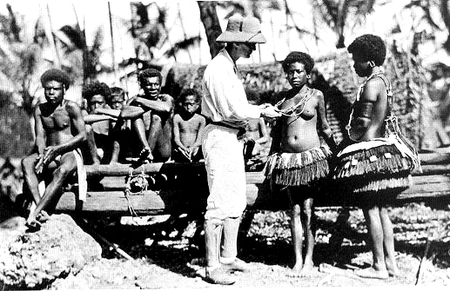
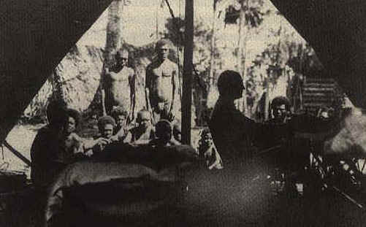

Slide 9
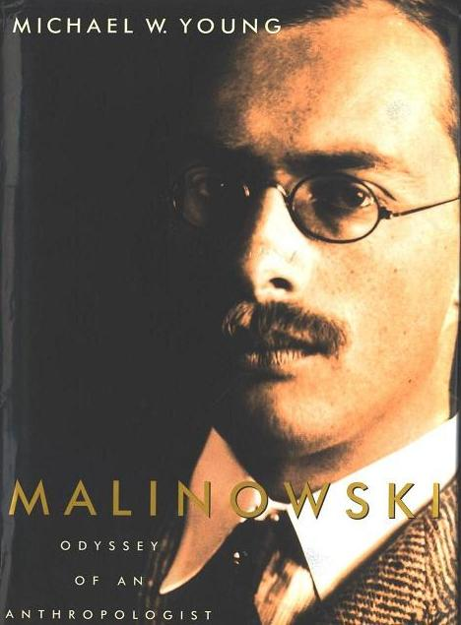
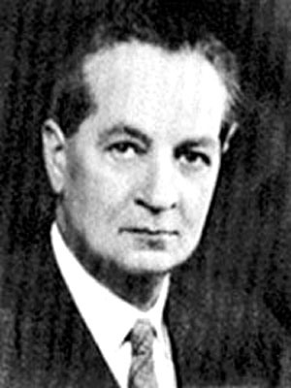
Alfred Reginald Radcliffe-Brown
(1881 - 1955)
Malinowski (1884 - 1942)

Slide 10
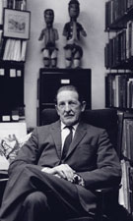
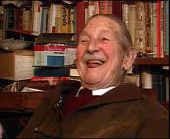
Fourth of Firth:
B aphical Festschrift of Sir Raymond
Raymond Firth, (1901 - 2002)

