Slide 1
SPRn4485
Social Enterprises and Poverty Alleviation
Lecture 01-Introduction to Course
Susantha Kumara Rasnayake
PhD. Student (MU)

Slide 2
Objectives of today’s lecture
To introduce
  the course, it’s scope, aims and objectives
  Method of teaching/lecturing
  Knowing your role
  Evaluation etc.

Slide 3
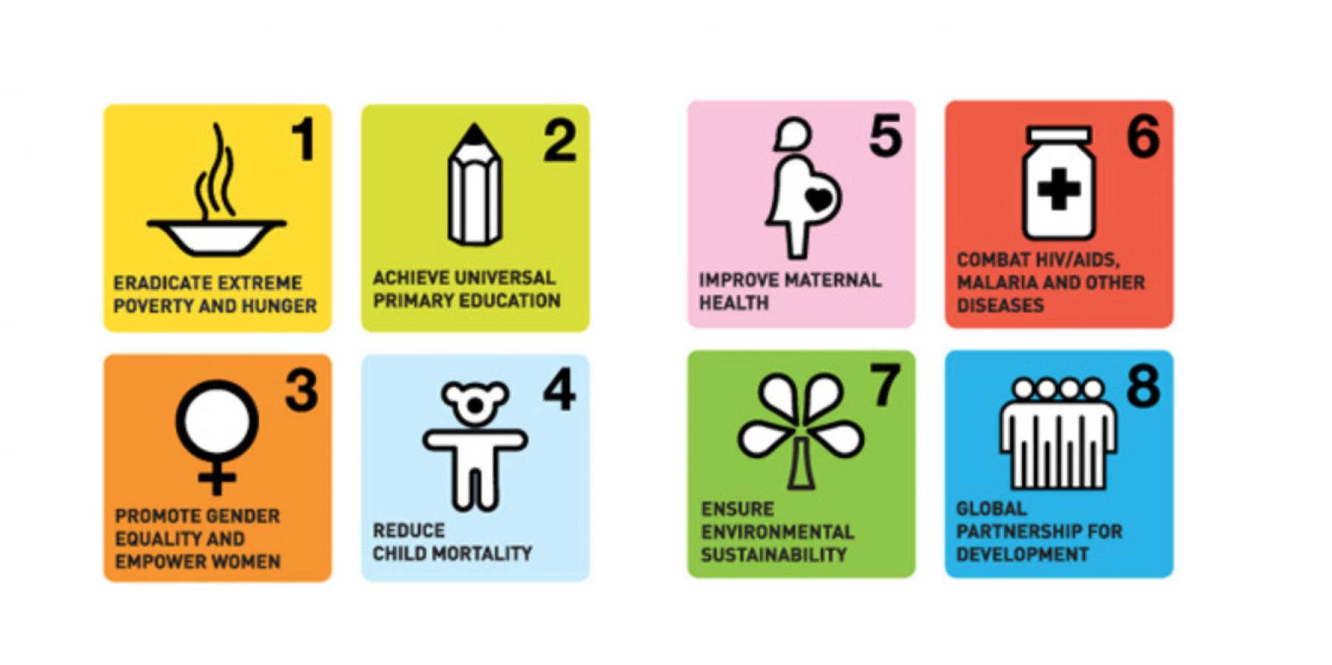

Introduction
Poverty is a universal cause of social exclusion
Poverty eradication as a key field in social policy and social work
Special emphasis is given to developing and least developed world
First priority in the global development agenda MDGs (1990-2015)and SDGs (2015-2030)

Slide 4
10% of the world's population still live on less than $2 a day.
Situation will be further bad due to the COVID-19 pandemic
EAPN-CR (2020) (European Anti-Poverty Network) says
16% of the inhabitants in the European Union live in poverty, which is about 78 million people. In the Czech Republic lives more than 10% people in poverty, which is about 1 million inhabitants. Percentage of children with risk of poverty under 17 is 19%. It is little higher percentage than for people over 65. About 33% of households with one parent and underage children are at risk of poverty

Slide 5
Conventional efforts for eradicating poverty
This situation challenges the conventional efforts to poverty eradication actions
  Providing subsidies
  Financial supports
  Welfare programmes
  Tax reliefs
Social enterprise model gains recognition as an innovative method of poverty alleviation and socio-economic value creator in both developed and developing economies.

Slide 6
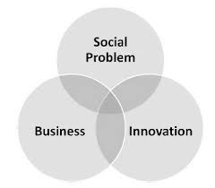
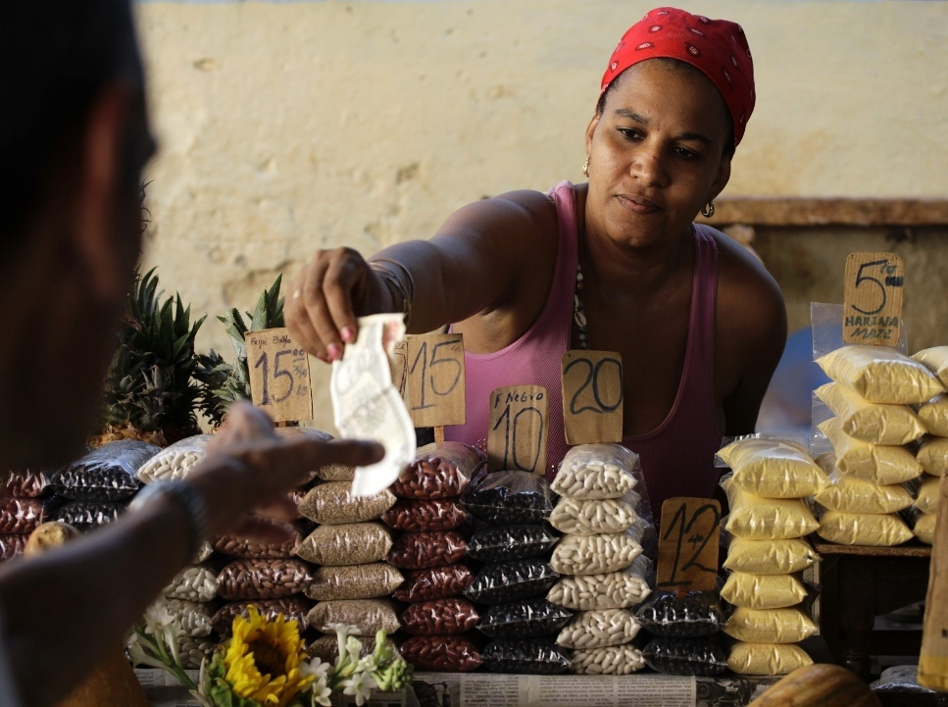
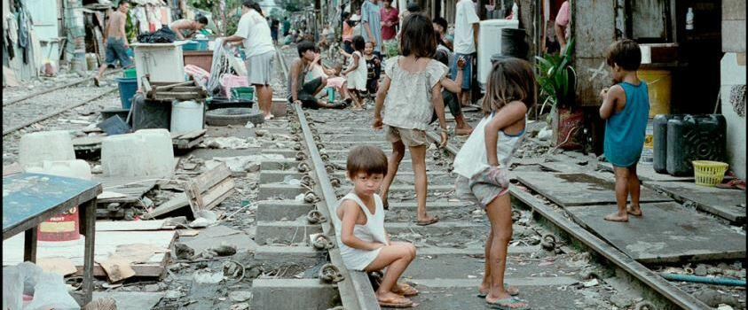
Social enterprise model as an innovative solution
Joseph Schumpeter’s concept -‘Creative Destruction’

Slide 7
The Social Enterprise Coalition defines
"using commercial means to achieve social goals".
Social enterprises, through their innovative business plans, aim to solve social problems and improve public welfare.
Social enterprises exist in many economic sectors.
In Europe they are active in a wide spectrum of activities and in many different fields ranging from social and welfare services, poverty alleviation, education, housing, health, renewable energies, utilities, environment, culture and tourism.
Thus, social enterprises do not pursue purely for their own profit maximization purposes. So, unlike traditional business enterprises, social enterprises are proven to play an important role in addressing social, economic and environmental challenges, fostering inclusive growth, increasing social cohesion, nurturing local social capital, supporting democratic participation and delivering good quality services.

Slide 8
In this background,
this course is designed with the purpose that students will use social entrepreneurship model to address society’s most pressing social problems including poverty and unemployment.

Slide 9
Intended Learning Outcomes (ILOs):
The students should be able to:
Demonstrate a clear understanding of the concept of poverty and the conventional strategies that aim at poverty alleviation
Describe the change agent role of social enterprises in creating innovative responses to poverty alleviation
Learn business and entrepreneurship skills that will help build a sustainable business model that addresses a societal problem.
Explain the existing challenges, constrains and sustaining a social enterprise
Conceptualize and develop a social enterprise model to alleviate poverty in a given context.

Slide 10
Course content/Course description:
Concept of poverty,
conventional strategies of poverty alleviation,
Introduction to social innovation/entrepreneurship and change making,
identification and developing a social enterprise,
mainstream capital funding and poor,
role of micro credits and managing credits,
empowering women and youth social entrepreneurship,
networking poor for creation of social enterprises,
managing social enterprises,
cross-sector partnerships (public, private, and/or non-profit institutions) and value creation for socio-economic change,
Case studies of success stories; Grameen Bank and BRAC

Slide 11
Course assessment method
In-course 60% (active participation in class-10%,
social change group project-30%
Case study analysis- 20% )
End Semester examination- 40%

