Slide 1
Grameen Bank: a Successful Story
Lecture 8
My whatsapp +94713888753

Slide 2
Background
1970s, over 70 percent of Bangladesh population were living below poverty line
In 2021, 14 percent live below poverty line and ranked as the world’s 8th population
Dr. Muhammad Yunus
In 1976, he founded Grameen Bank, a so-called “bank for the poor,” with just 27 USD.
The bank provides people access to small loans without the need for collateral. Since its creation, Grameen Bank has given loans totaling over 3B USD to 7 million people.
According to the bank, among those who received a loan, over 50% escaped from poverty. Their community-based monitoring system helped the bank reduce the costs and achieve a high repayment rate of over 90%.

Slide 3
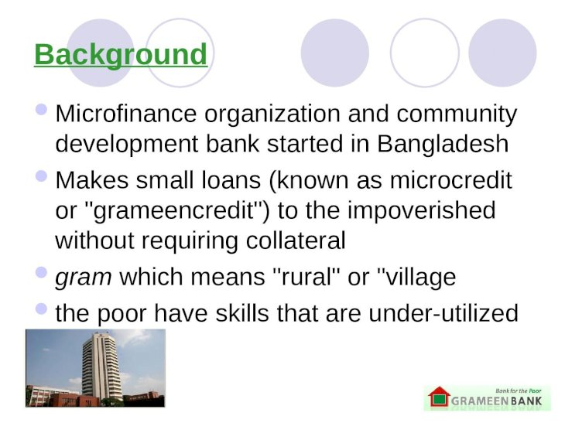

Slide 4
Grameen Bank as a value creator
Grameen Bank is founded on the principle that loans are better than charity to interrupt poverty
It maintains the belief that people have endless potential, and unleashing their creativity and initiative that helps them end poverty
Grameen has offered credit to classes of people formerly underserved: the poor, women, illiterate, and unemployed people
Grameen's objective has been to promote financial independence among the poor.
GB encourages all borrowers to become savers so that their local capital can be converted into new loans to others

Slide 5
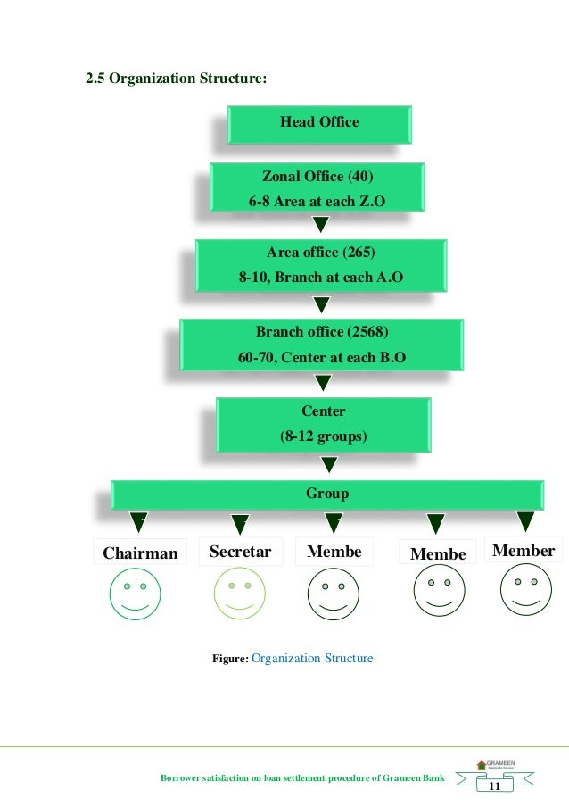

Slide 6
It targets the poorest of the poor, with a particular emphasis on women, who receive 95 percent of the bank’s loans.
Women traditionally had less access to financial alternatives of ordinary credit lines and incomes.
They were seen to have an inequitable share of power in household decision making.
Grameen Bank is best known for its system of solidarity lending.
The Bank also incorporates a set of values embodied in Bangladesh by the Sixteen Decisions

Slide 7
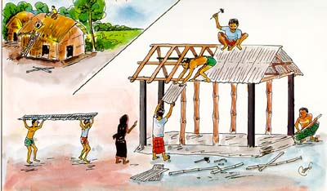
We shall follow and advance the four principles of Grameen Bank
1. Discipline, Unity, Courage and Hard work – in all walks of our lives

Slide 8
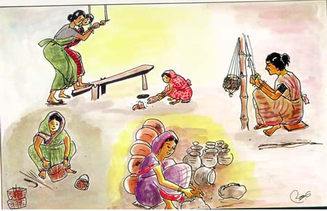
2. Prosperity we shall bring to our families

Slide 9
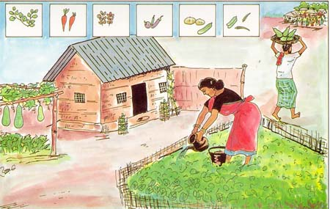
3. We shall grow vegetables all the year round. We shall eat plenty of them and sell the surplus.

Slide 10
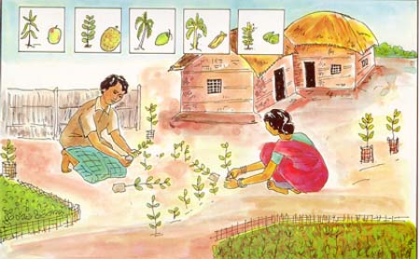
4. During the plantation seasons, we shall plant as many seedlings as possible

Slide 11
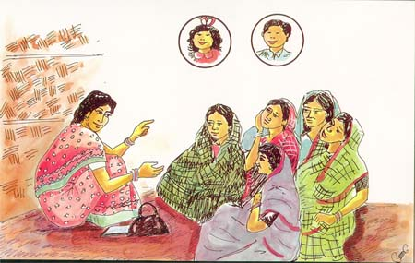
5.We shall plan to keep our families small. We shall minimize our expenditures. We shall look after our health

Slide 12
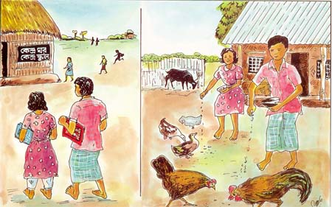
6. We shall educate our children and ensure that they can earn to pay for their education

Slide 13
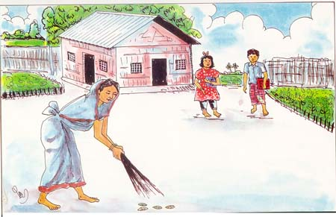
7. We shall always keep our children and the environment clean

Slide 14
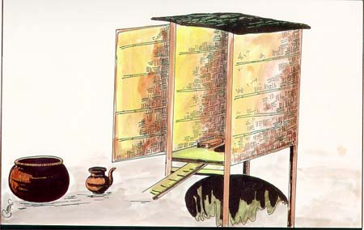
8.We shall build and use pit-latrines

Slide 15
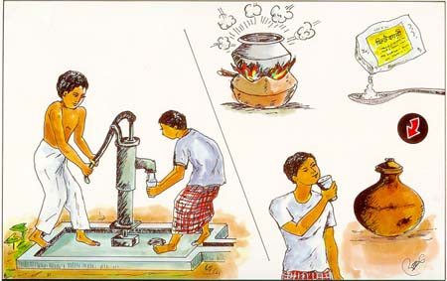
9. We shall drink water from tubewells. If it is not available, we shall boil water or use alum

Slide 16
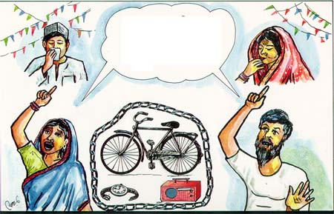
10. We shall not take any dowry at our sons’ weddings, neither shall we give any dowry at our daughters wedding. We shall keep our centre free from the curse of dowry. We shall not practice child marriage

Slide 17
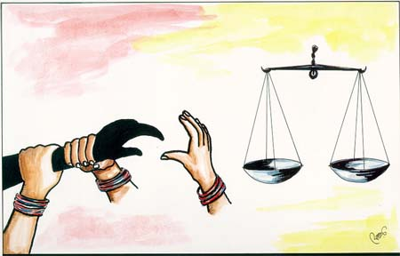
11. We shall not inflict any injustice on anyone, neither shall we allow anyone to do so

Slide 18
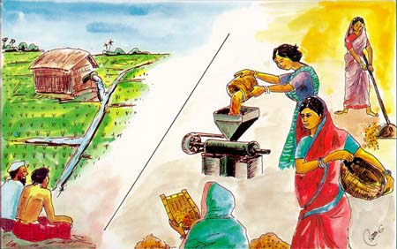
12. We shall collectively undertake bigger investments for higher incomes.

Slide 19
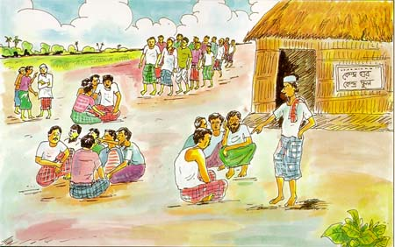
13. We shall always be ready to help each other. If anyone is in difficulty, we shall all help him or her

Slide 20
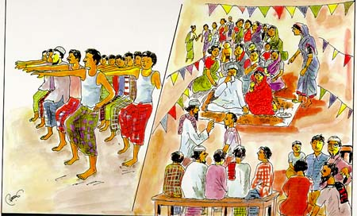
14. If we come to know of any breach of discipline in any centre, we shall all go there and help restore discipline

Slide 21
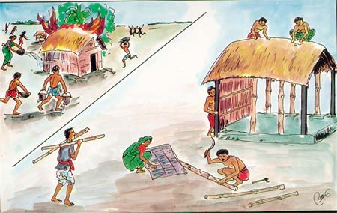
15. We shall take part in all social activities collectively.

Slide 22
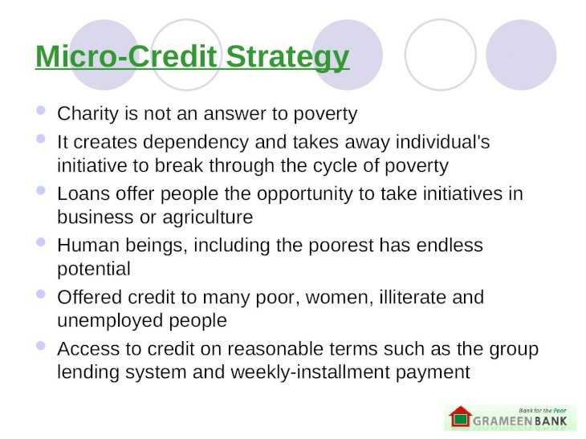

Slide 23
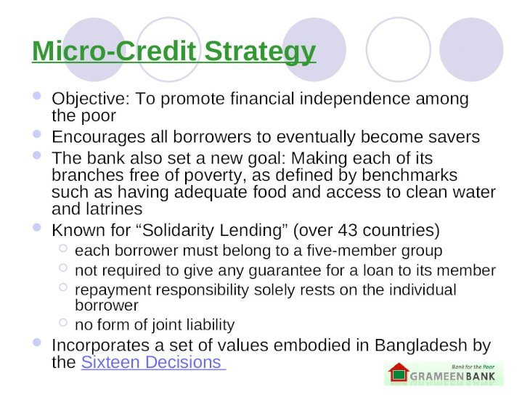

Slide 24
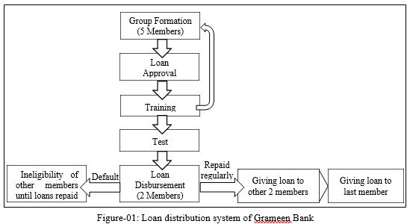
Loan process

Slide 25
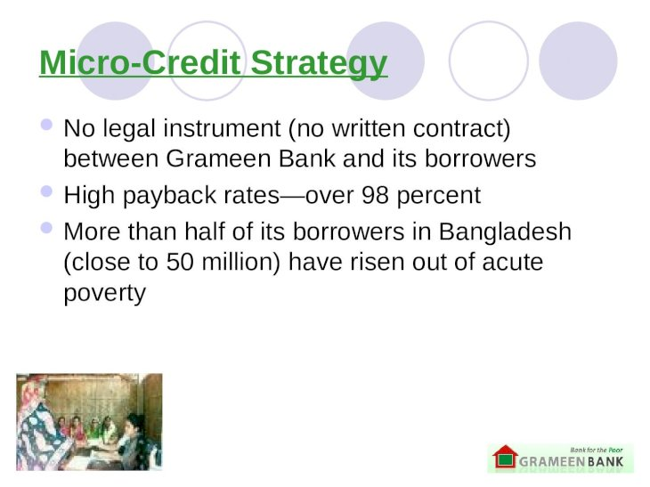

Slide 26
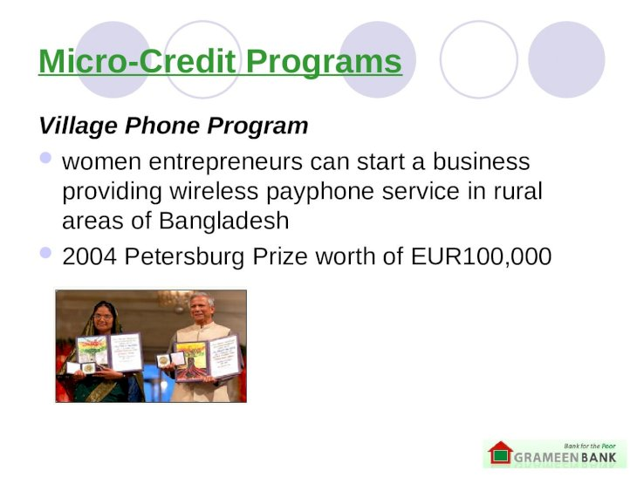

Slide 27
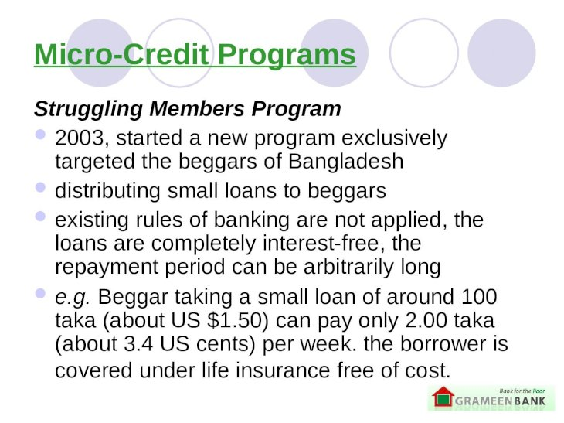

Slide 28
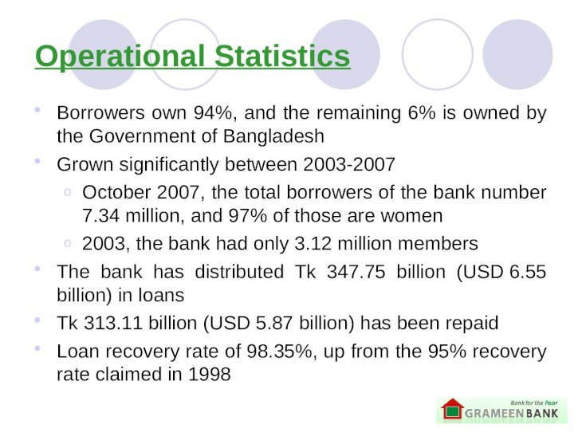

Slide 29
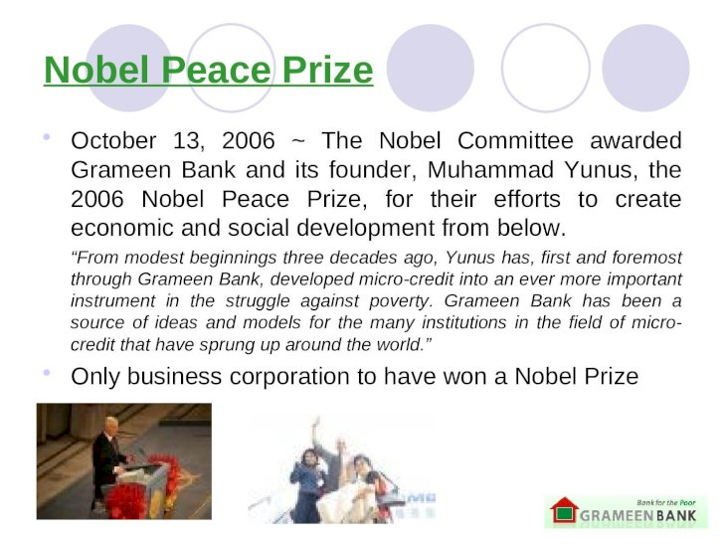

Slide 30
