Slide 1

Personality Profiles
Department of Media Production
Henry Loeser PhD

Slide 2
Department of Media Production
Fusion
Education, Research, Professional practice
Inspire learning, advance knowledge and enrich society.

Slide 3
Department of Media Production
Description
The value of rapport in successful collaboration
The role of personality profiles in the professional experiences of media industry workers.

Slide 4
Department of Media Production
Aim
Equip graduates with the business knowledge and skills necessary to become a media professional in a challenging and ever-changing industry

Slide 5
Department of Media Production
Disclaimer:
“The concepts and techniques you are about to see are not considered academically rigorous.”

Slide 6
Department of Media Production
Rapport
“A close and harmonious relationship in which the people or groups concerned understand each other's feelings or ideas and communicate well.”

Slide 7
Department of Media Production
Communication
Active listening
Adapting your style to your audience. ...
Volume and clarity
Friendliness, Confidence
Giving and receiving feedback
Empathy, Respect

Slide 8
Department of Media Production
Personality Profile Systems
Meyers - Briggs
Neuro-Linguistic Programming (NLP)
Merrill - Wilson

Slide 9
Department of Media Production
Meyers-Briggs
Introversion/Extraversion
Sensing/Intuition
Thinking/Feeling
Judging/Perception

Slide 10
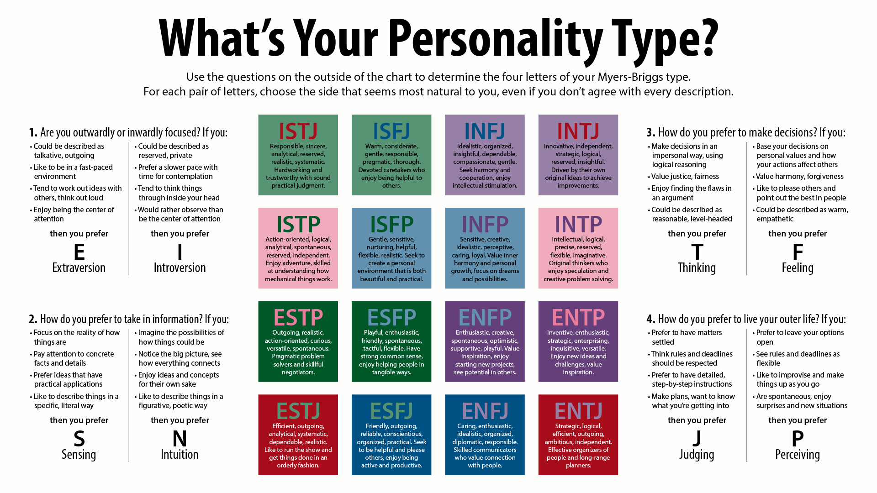
Department of Media Production

Slide 11
Department of Media Production
Neuro-linguistic Programming
a psychological approach that involves analyzing strategies used by successful individuals and applying them to reach a personal goal.
It relates thoughts, language, and patterns of behavior learned through experience to specific outcomes

Slide 12
Department of Media Production
NLP categories
Visual
Auditory
Kinestetic

Slide 13
Department of Media Production
Merrill-Wilson 4 Quadrants
Simple to understand
Easy and quick to identify

Slide 14
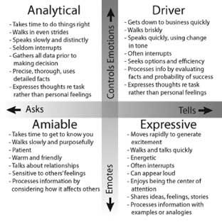
Department of Media Production

Slide 15
Department of Media Production
Building rapport:
-identify
-mirror
-pace

Slide 16
Department of Media Production
Aim
Equip graduates with the business knowledge and skills necessary to become a media professional in a challenging and ever-changing industry

Slide 17
Personality Profiles
Department of Media Production
Henry Loeser PhD

