Slide 1
Elements of Creative Collaboration
Henry Loeser PhD
1

Slide 2
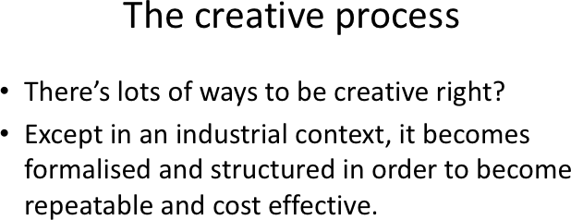

Slide 3
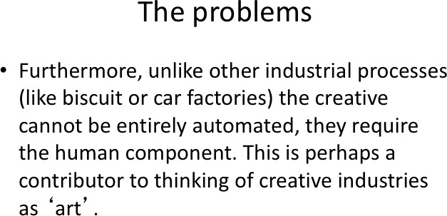

Slide 4

Elements of
“______________”
is important for creative collaboration
1

Slide 5
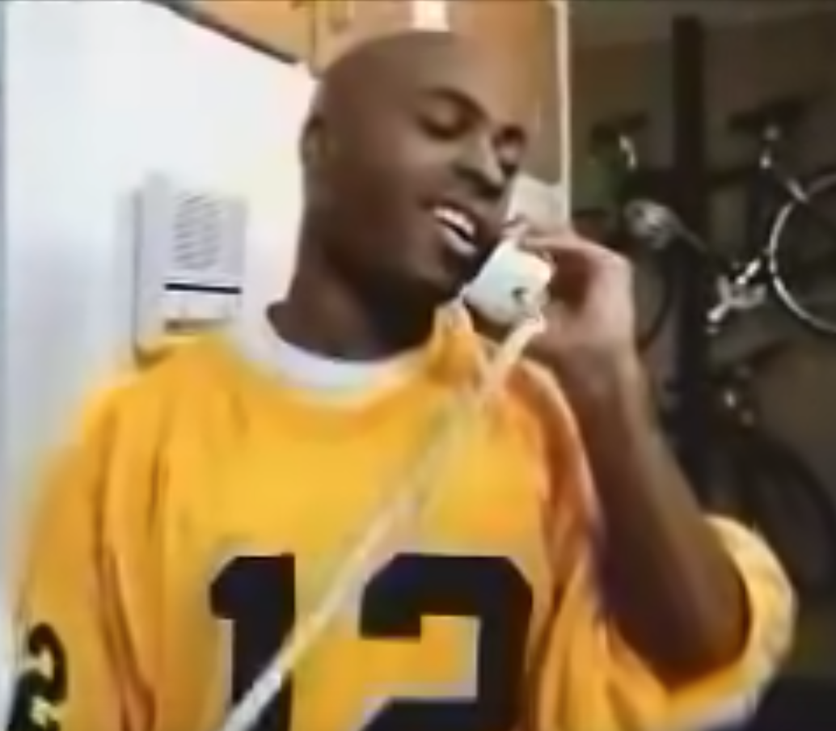
Elements of
Communication
1

Slide 6
Elements of
Participation
1

Slide 7
Elements of
Environment
1

Slide 8
Elements of
Rules
1

Slide 9
Elements of
Planning
1

Slide 10
Elements of
Roles
1

Slide 11
Elements of
Leadership
1

Slide 12
Elements of
Debate
1

Slide 13
Elements of
Empathy
1

Slide 14


Slide 15
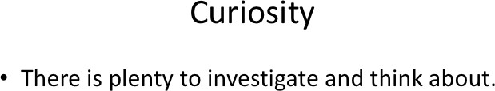

Slide 16
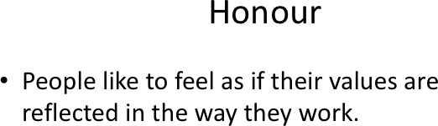

Slide 17
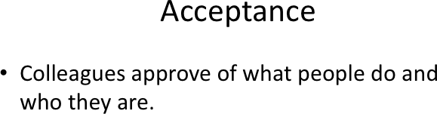

Slide 18
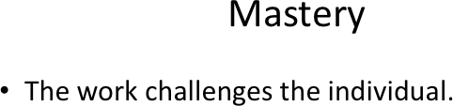

Slide 19
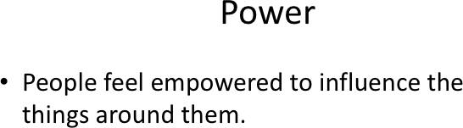

Slide 20
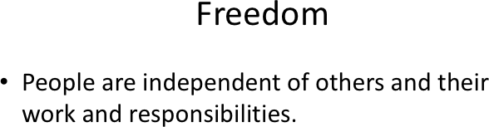

Slide 21
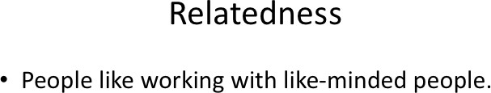

Slide 22
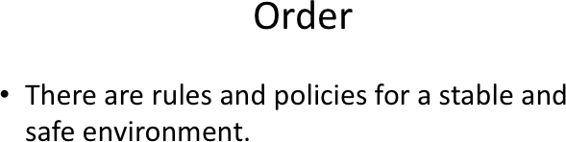

Slide 23
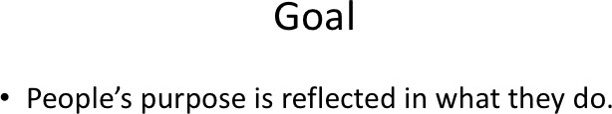

Slide 24
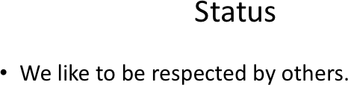

Slide 25

Who are you?

Slide 26
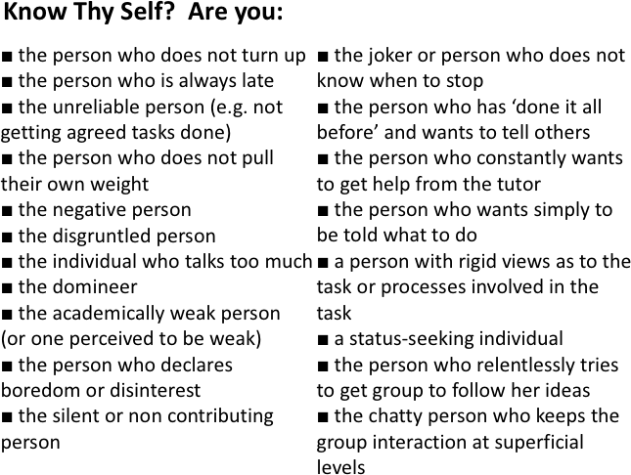

Slide 27
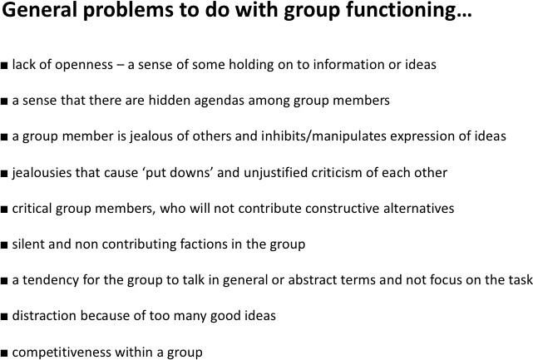

Slide 28
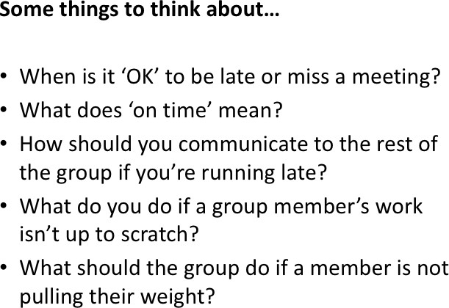

Slide 29


Slide 31
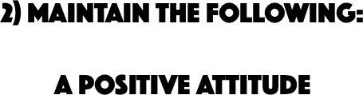

Slide 32
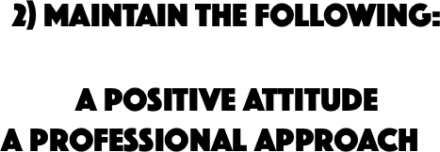

Slide 33
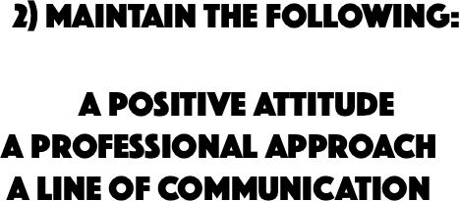

Slide 35
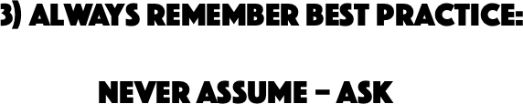

Slide 36
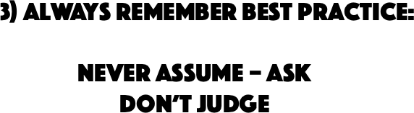

Slide 37
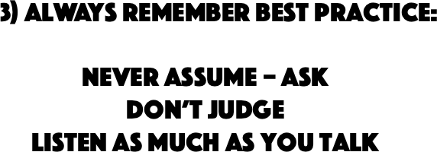

Slide 38
Elements of
Henry Loeser PhD
1

Slide 39


