Slide 1

Defining homelessness
Absolute - the condition of people without physical shelter who sleep outdoors, in vehicles, abandoned buildings or other places not intended for human habitation
Relative - the condition of those who have a physical shelter, but one that does not meet basic standards of health and safety; these include protection from the elements, access to safe water and sanitation, security of tenure, personal safety and affordability (Hwang, 2001)
Apparent, hidden, potential (Hradecký & Hradecká, 1996)
Alienation for the rest of the society (Ravenhill, 2016)
Broad consensus that the term ‘homelessness’ covers more living situations than being without a roof over one’s head

Slide 2
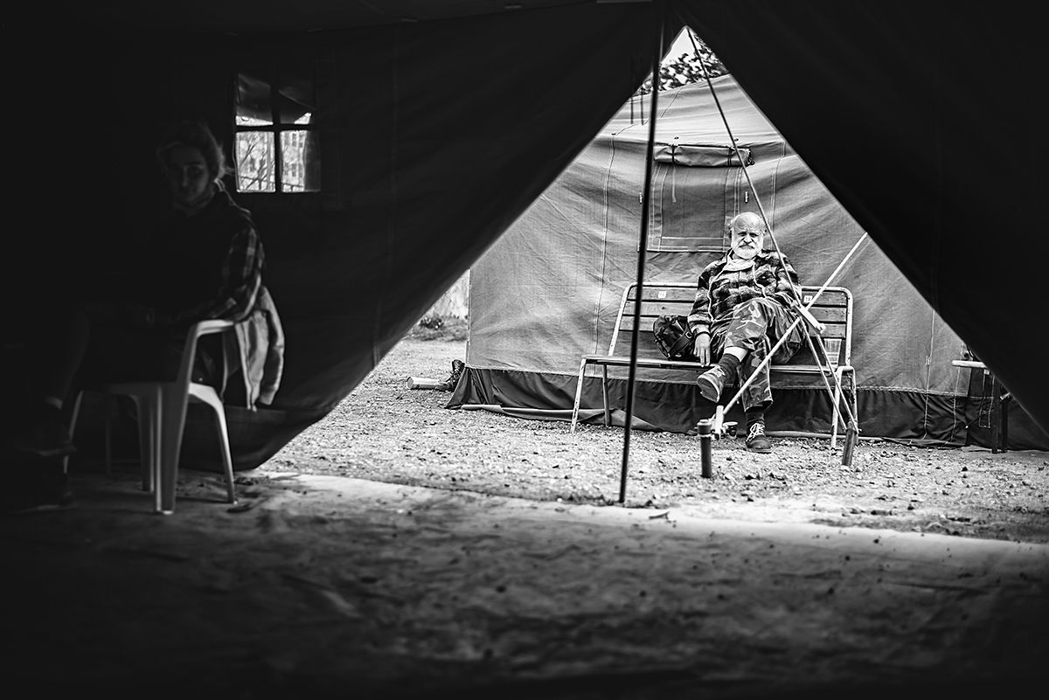
Home
“having a decent dwelling (or space) adequate to meet the needs of the person and his/her family (physical domain); being able to maintain privacy and enjoy social relations (social domain) and having exclusive possession, security of occupation and legal title (legal domain)“ (Edgar, 2009, p. 15)
Three domains of home (Edgar, 2009)
  Physical
  Legal
  Social
Homelessness is absence of home
  Absence of two and more domains – homelessness
  Absence of 1 domain – housing exlusion

Slide 3
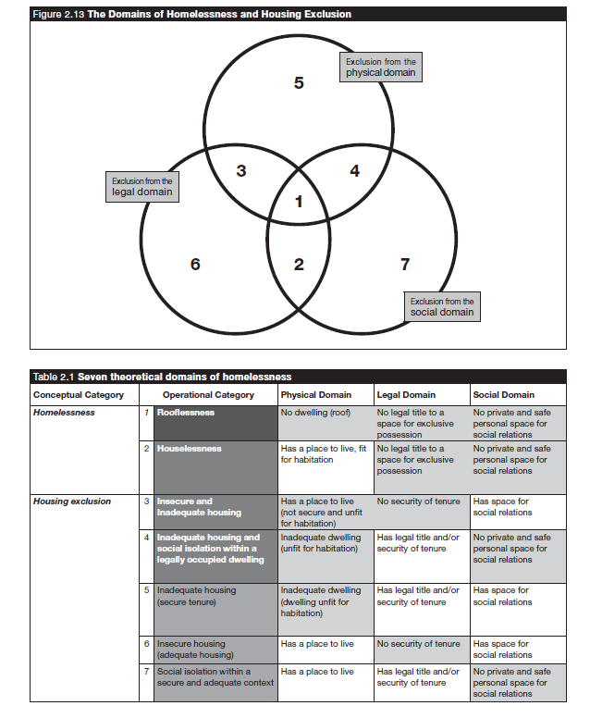

Slide 4
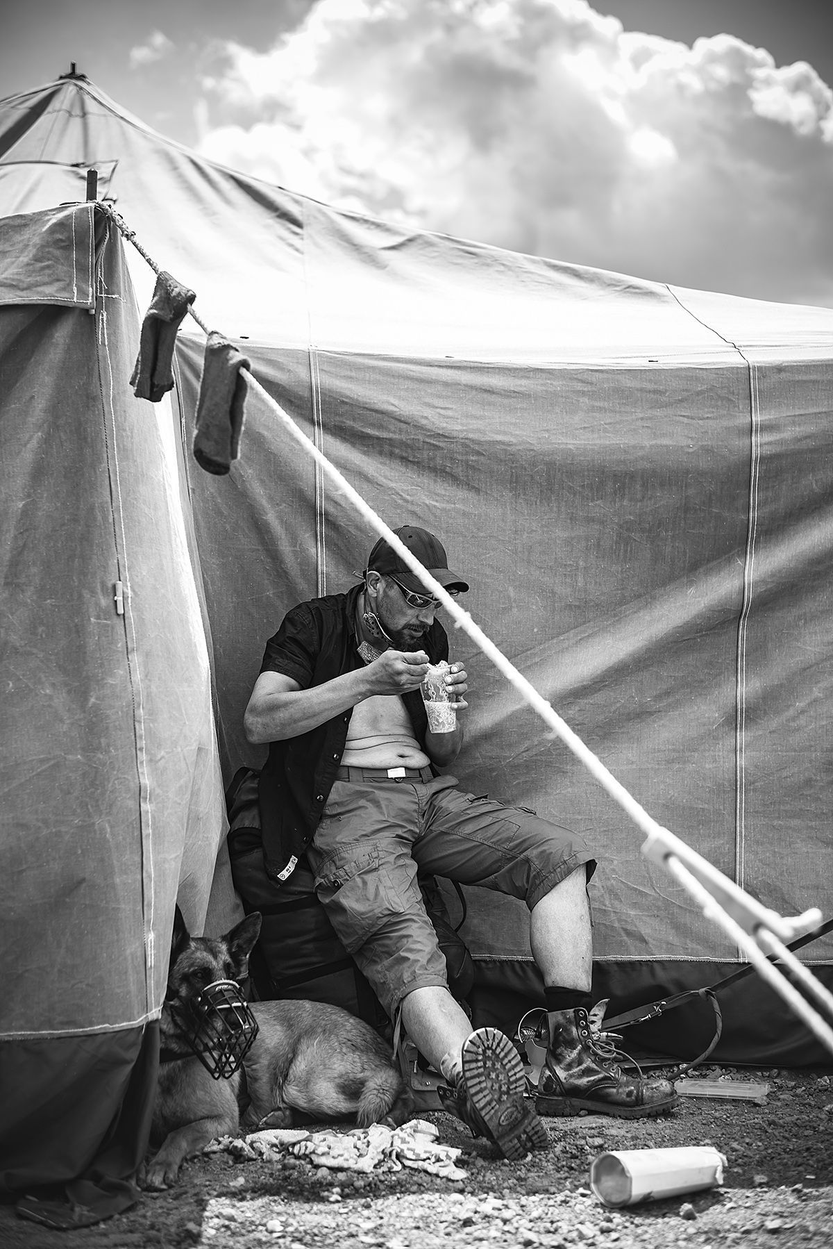
ETHOS – The European Typology on Homelessness and Housing Exclusion
Roofless
  Living rough
  Emergency accommodation
Houseless
  Accommodation for homeless
  Women‘s shelters
  Accommodation for immigrants
  People due to be released from institutions
Insecure housing
  Insecure accommodation
  Under threat of eviction
  Under threat of violence
Inadequate housing
  Temporary or non-conventional structures
  Unfit housing
  Extreme overcrowding

Slide 5
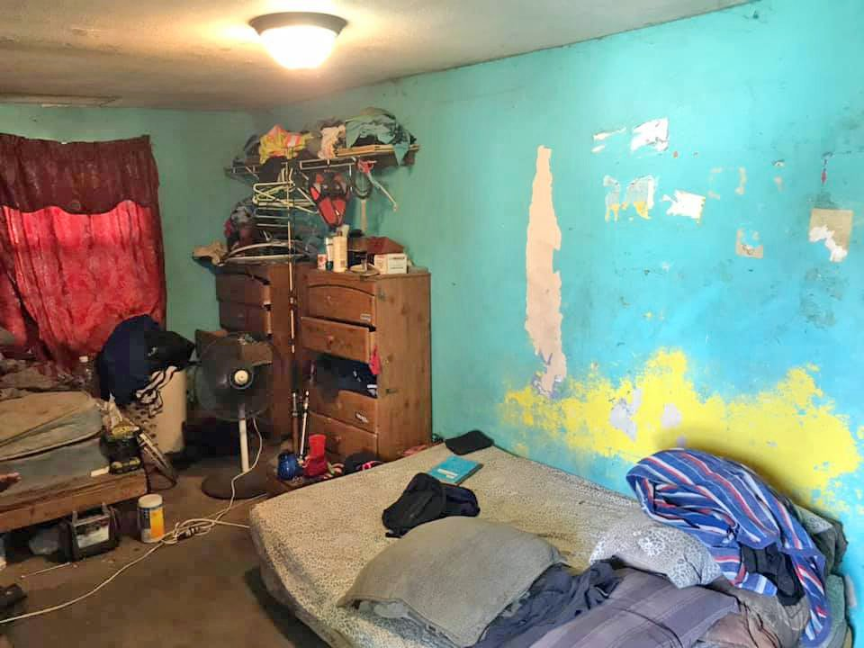

Slide 6
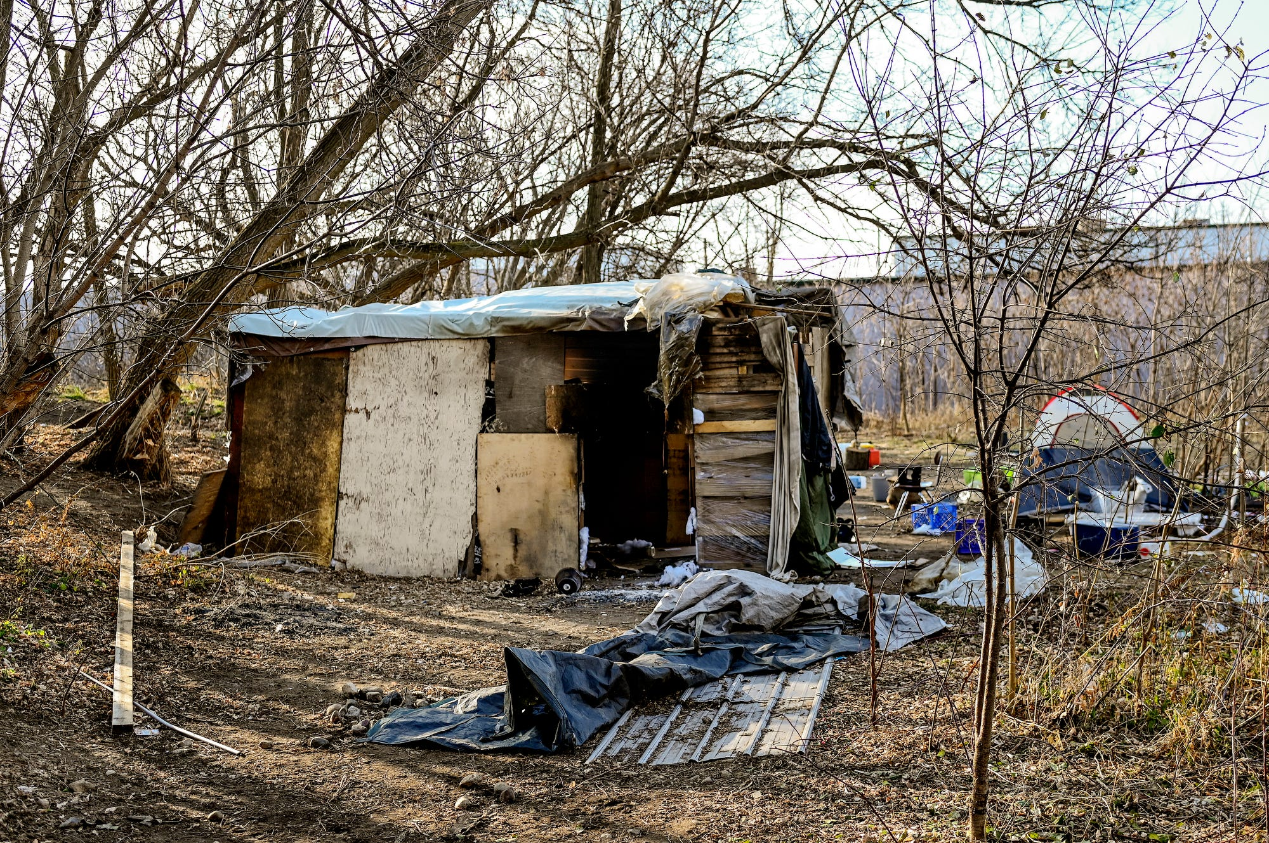
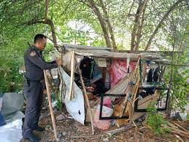

Slide 7
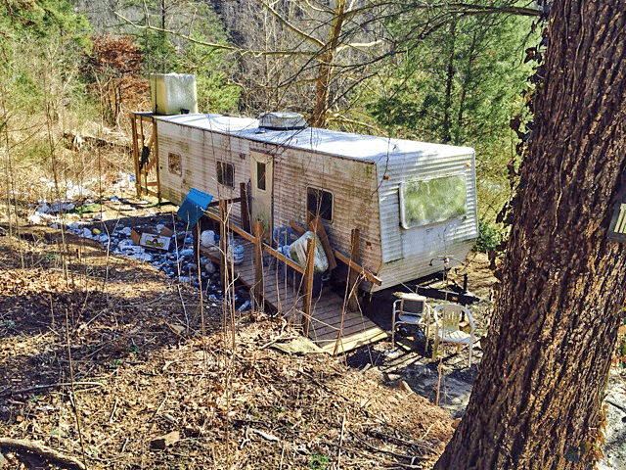

Slide 8
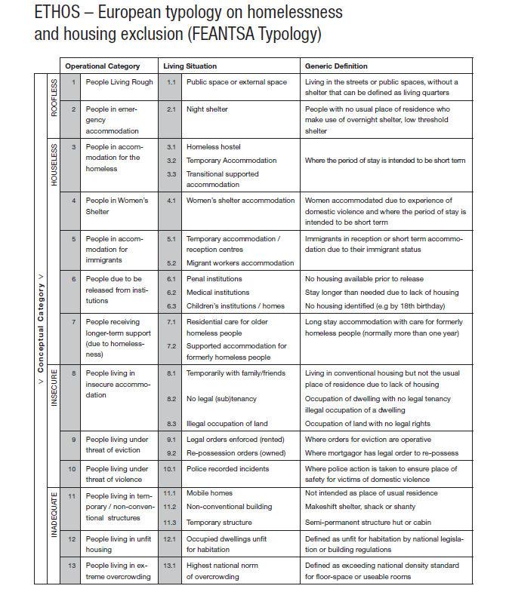

Slide 9
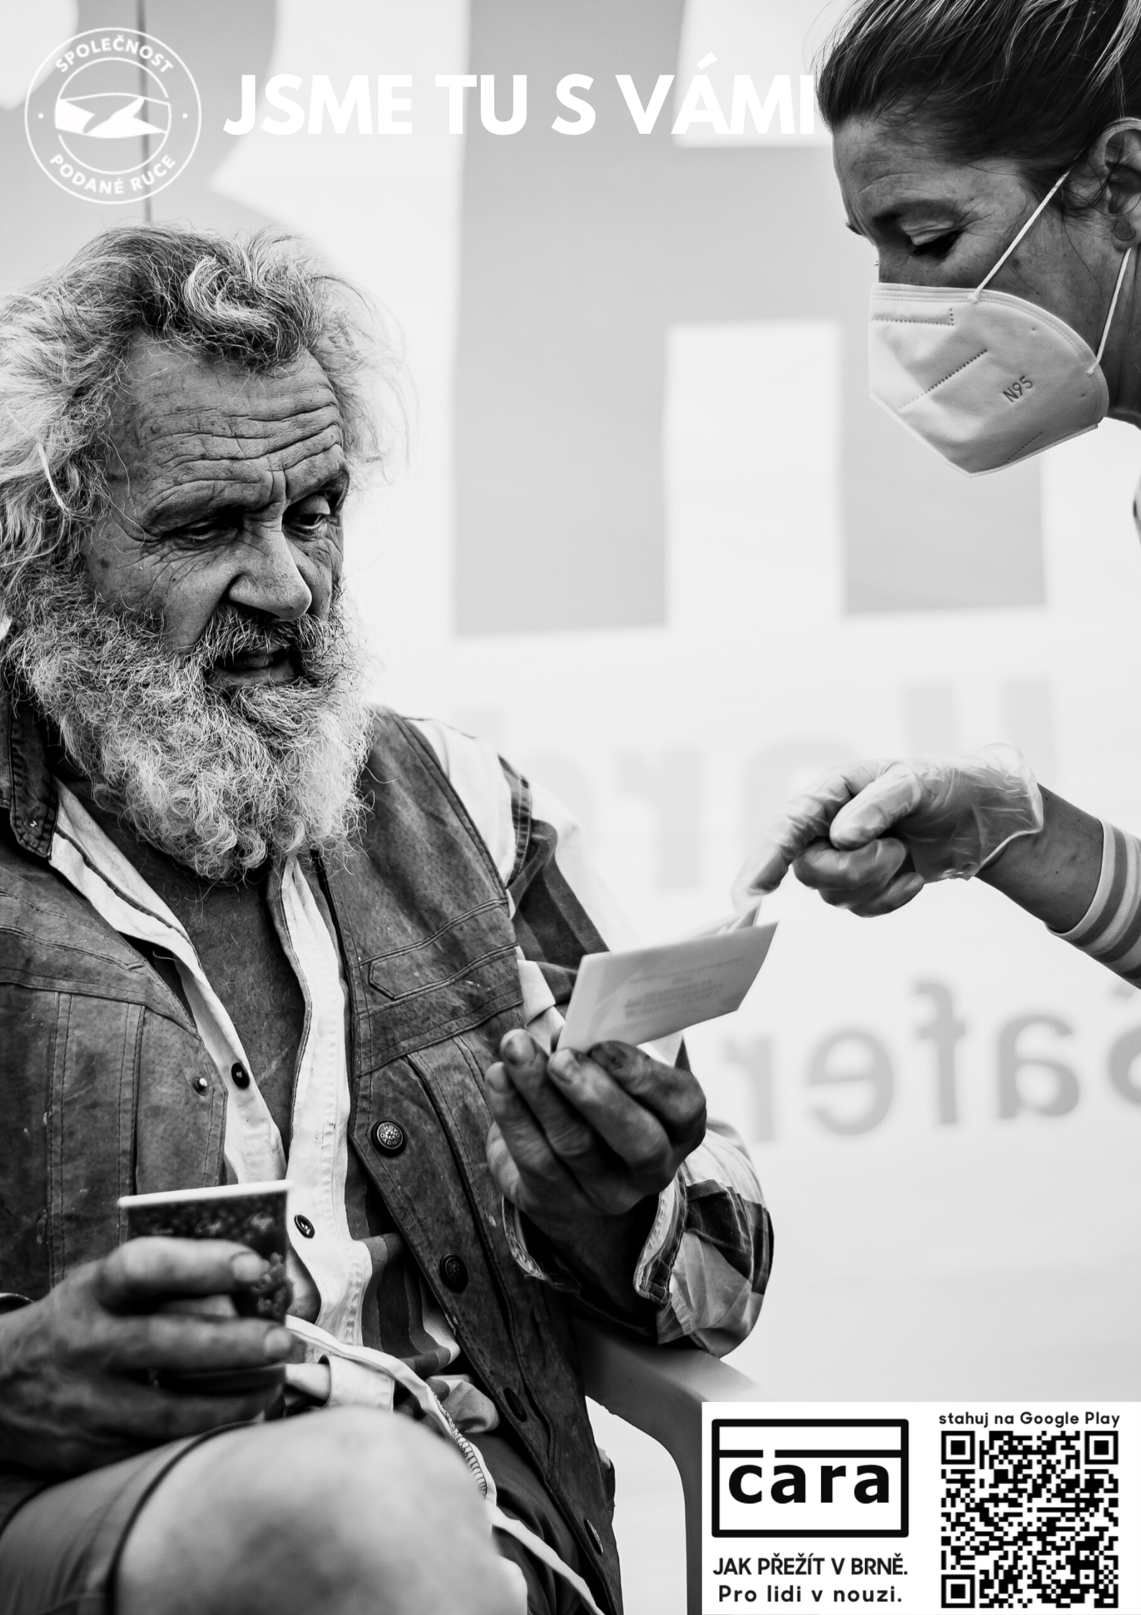
Causes of homelessness
Structural
  Economic processes that affect income or employment stability
  Citizenship and lack of access to social protection
  Housing market (affordability, social housing)
Institutional
  Shortage of services
  Lack of coordination between existing services
  Allocation mechanisms
Relationship
  Family status – e.g. single parents more vulnerable
  Relationship situation – abusive partners, step-parents
  Relationship breakdown – death, divorce, separation
Personal
  Disability, long-term illness
  Low education attainment
  Addiction - drugs, alcohol, gambling (bitcoin?)
  Age and gender
  Immigration situation – refugee status / recent arrival

Slide 10
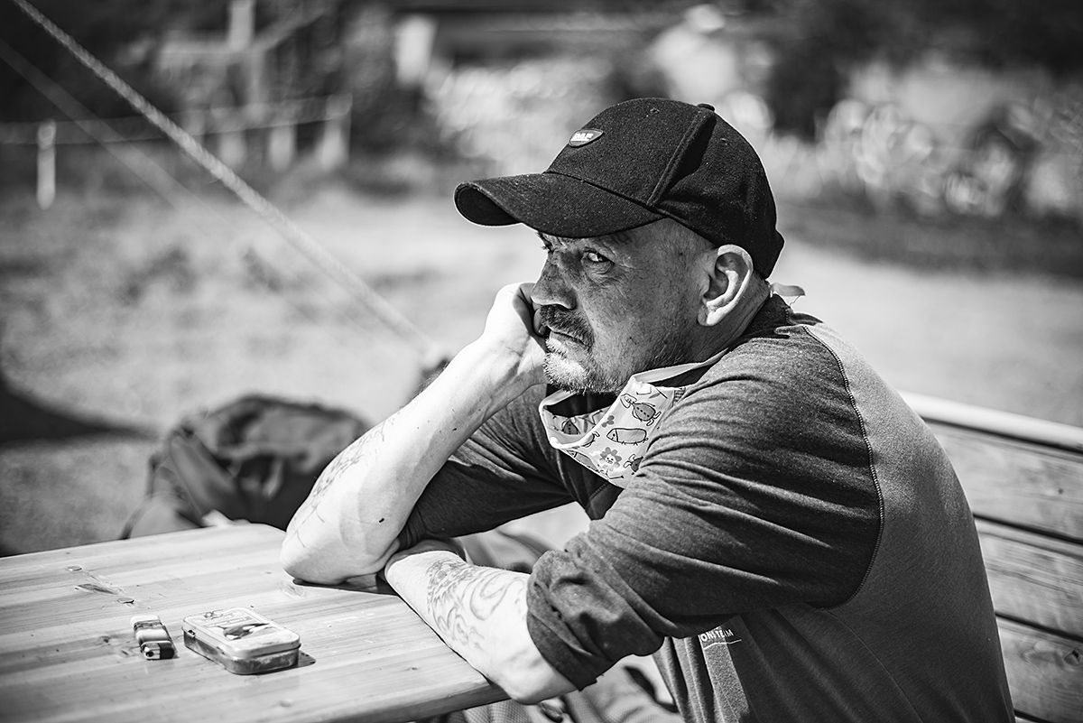
Transitions and trajectories
Transition – a single life change or event
  Married to single
  Employed – unemployed
  Healthy – injured
Trajectory – long-term process, set of transitions
  Education
  Career
  Mental illnesses

Slide 11
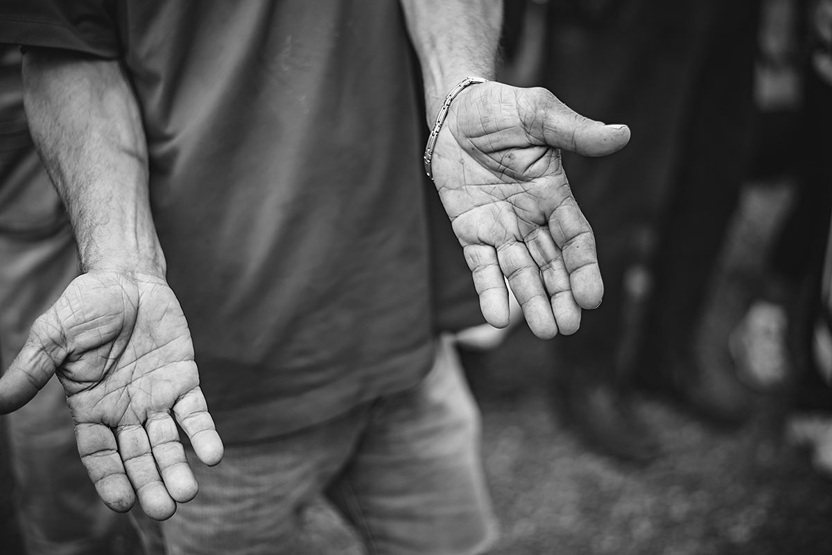
Some numbers (2019)
23 825 in total
2 595 children
11 608 – sleeping rough or at night shelters
Due to be released from:
  Prisons – 1500
  Hospitals – 2 668
Prague – 3 056
Brno – 1 762
700 000 – Europe estimation (FEANTSA, 2020) – 70 % increase in 10 years
COVID?
Reality?

Slide 12
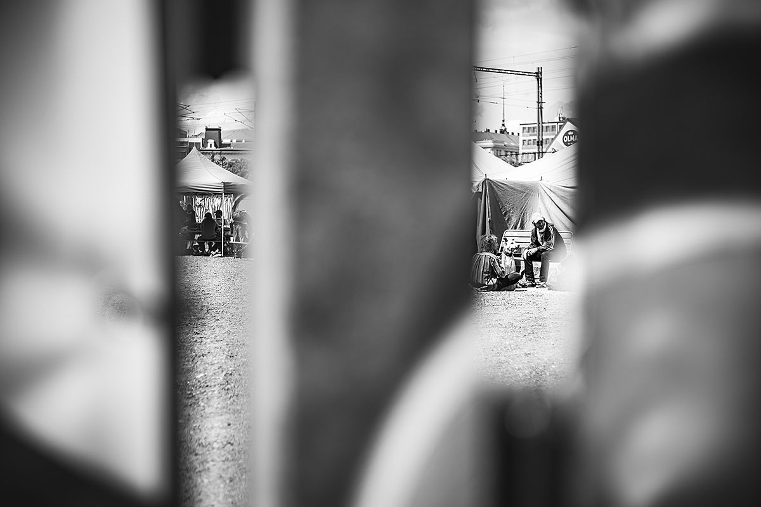
More numbers
In Ireland 1 in 3 homeless people in temporary accommodation was a child
In England 90% of single parent families applying for public support for homeless people were women
In Finland 25% of homeless families are immigrants
In Austria homeless people had a mortality risk 4 times higher than the rest of the population
In London the coronavirus mortality rate of homeless people living in emergency accommodation has been 25 times higher than that of the general adult population
In France 495 homeless people died in the streets in 2019

Slide 13
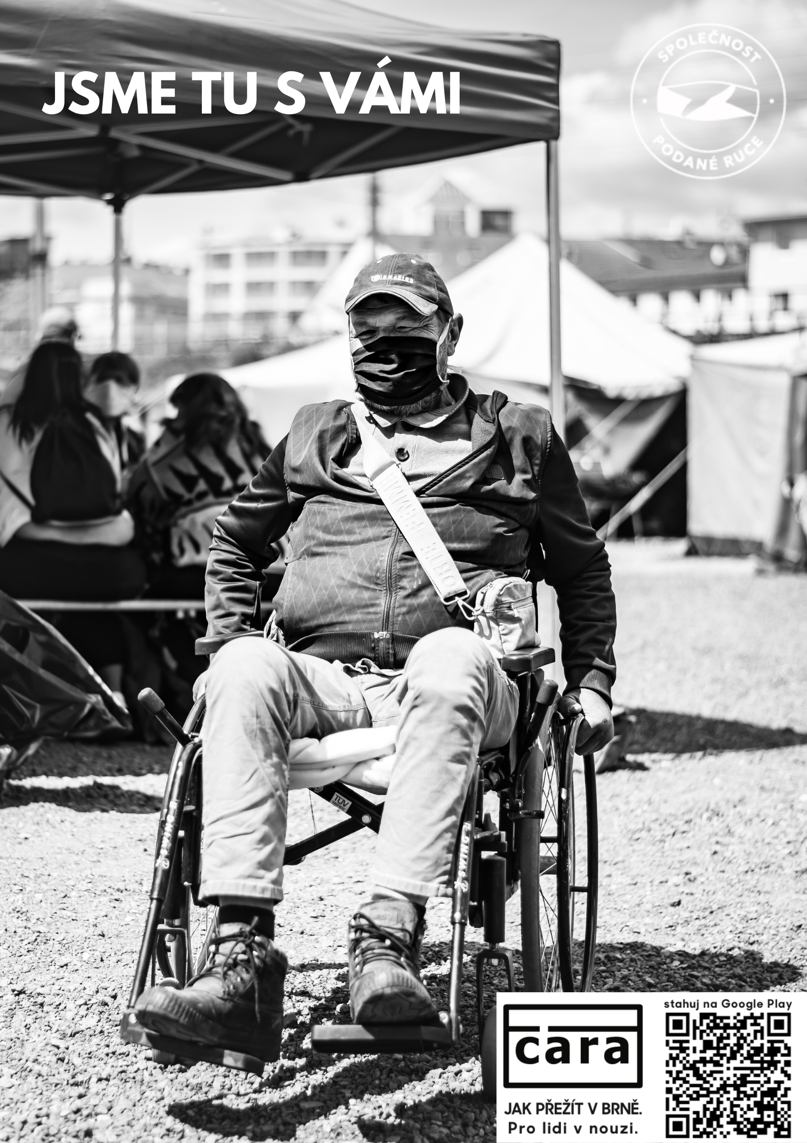
Why understanding homelessness matter?
The public perception
  Based on the roofless
    Just the tip of the iceberg
    Most controversial, problematic
Financing
Prevention
Social exclusion
More societal groups in one bag
  Young, elderly, physical/mental health, addictions, immigrants, criminals
Fear

Slide 14
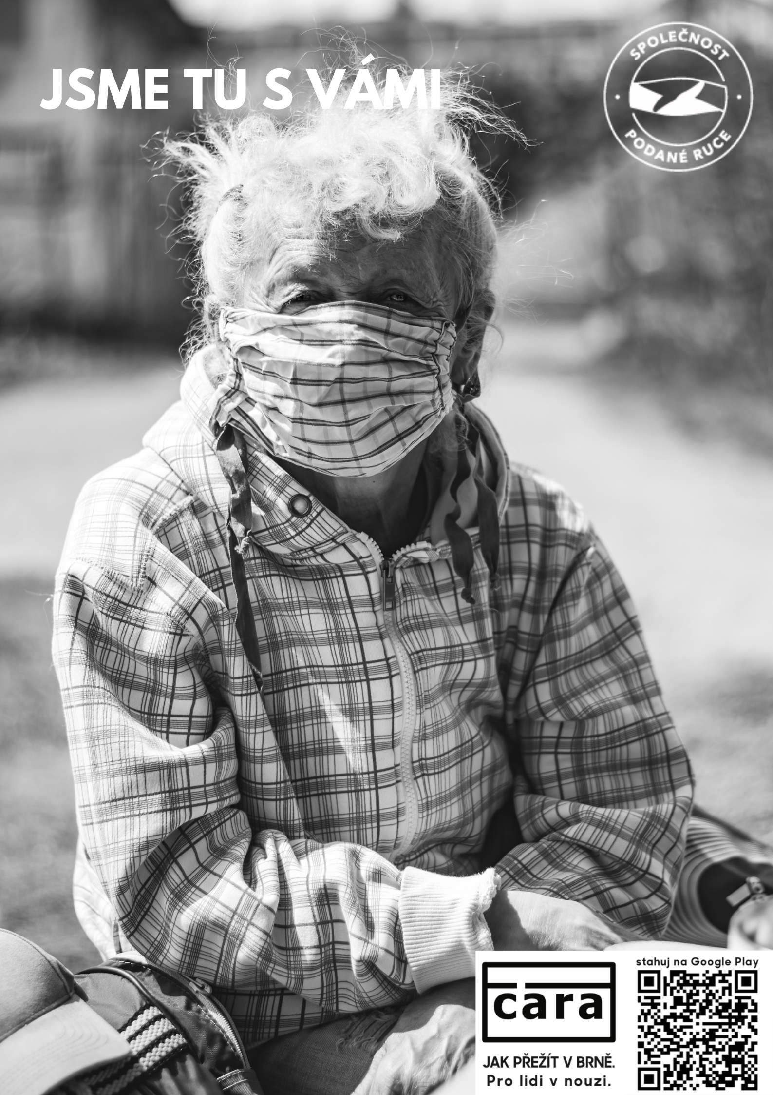
Who are homeless people?

Slide 15

1st assignment
Essay (750 words) covering:
  Your perception and understanding of homelessness
  Identify potential stereotypes/prejudice you may have
  Reflect it using ETHOS
  Suggest ways how to overcome stereotypical/prejudicial understanding of homeless people

