Slide 1

What is ethnography?
A method where the researcher observes and often participates in naturally groups to document their culture (symbols, norms, values, beliefs,…)
Not a single method, rather a family of approaches
Uncovering meanings, describing a culture” and life from the “the native point of view”
People’s identities evolve and are locally intertwined within the context in which they act
Ethnographers must be able to immerse themselves in the given context
  The issue of access becomes important
Carried out in naturally occurring settings
Relatively long-term data collection process (days, weeks, months, years)
Relies on participant observation, or personal engagement
Employs other types of data as well as that from observation: experiential data from participation; interviews (informal and perhaps also formal); documents (elicited and/or already available)
Data are recorded in the form of ‘unstructured’ fieldnotes and/or through electronic recording (audio or audio-visual)

Slide 2
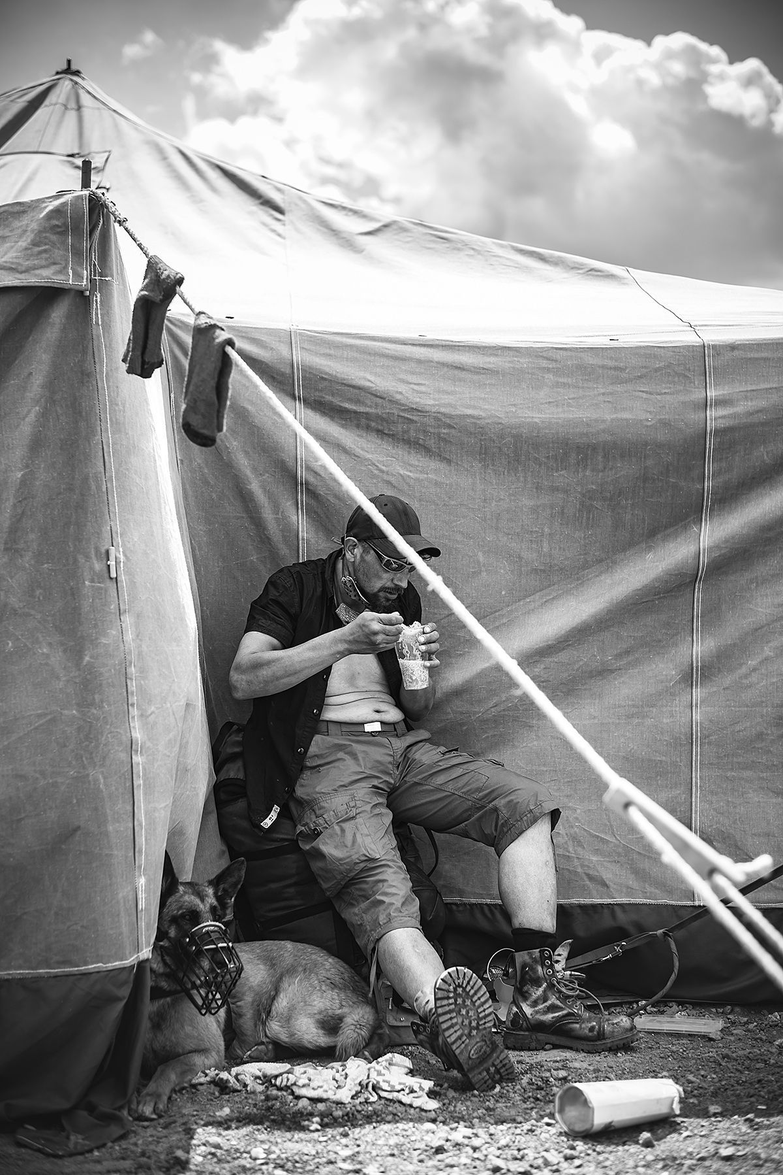
Ethnographic methods
https://www.youtube.com/watch?v=MNj5y-GsJFk
Observation
  Participant
    Fully participating
    Partially participating
  Non-participant
  Ouvert or covert
Interviews
  Semi-Structured
  In-depth
  How not to: https://www.youtube.com/watch?v=E2Q3-OHyeUA
Fieldnotes
Behavioral recordings
Artifact Analysis
Triangulation
Lamination

Slide 3
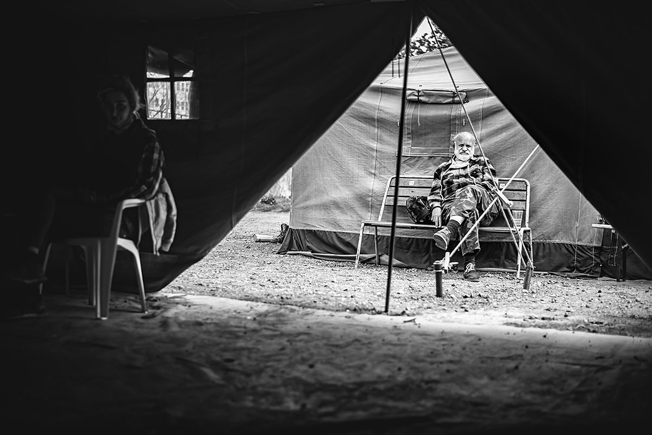
Fieldnotes
Written, audio-recorded, video-recorded…
Who – are the key actors in the given context?
What – happens in the given time and place? What catches your attention? What is different or unusual? Any repeated keywords?
Where – do you find the subjects of your study? What does the place look, smell, sound like? How do you feel about it? How do the people feel about it?
When – do things happen? Are there any patterns?
How – do things appear to work? Any written rules? Tacit understandings? How do they know how to behave? Is it always the same? Do different categories of people (young, old, male, female, newcomer, old-hand) behave differently?
Why – do all these things happen?

Slide 4

After taking fieldnotes
Ethnography, in large part, may be said to take place in and through the fieldnotes
Impressions or responses to the notes that you’ve previously taken. Do they seem “partial” or “incomplete?” Has your understanding changed since you took them? If so, how?
Do your notes raise any questions? Are these questions about the subjects of your study? Might they also be about how you’re conducting your study? Think also about how you’re going about your work.
Do you need to make any adjustments to your approach? If so, what? How will you go about making those changes and why? What have you learned about the process?
What do you need to ask people in order to answer questions raised that you cannot answer on your own based on your observations?
Do you find that there are things that you would like to know more about that would require further study? What are these things?
Much of fieldwork involves serendipity. We unexpectedly find things. We discover. So, there are many “surprises.” What surprised you? Why? Listen to your reactions.
Are there noticeable differences between what you think or believe to be “true” regarding the people and places you are studying and what you are finding that the “locals” or “natives” think or believe about themselves?
How do you think you are perceived/received by the group or in the place where you are working? What is the nature of this relationship? What sort of things do people say and do because of your presence?
Coding

Slide 5

Observations to consider
Amount of free time and will to spend it meaningfully
Will to participate and talk, discuss, share, speak out, being a partner
Have chance to decide for them
Partial self-victimization in sharing their story
Being proud of battling their brokeness, not giving up
Need for being seen as a human being
  https://www.youtube.com/watch?v=sF19L00KbAI
Feeling unworthy of having own voice, self-pity, low self-esteem, shame, self-hatred
Other minorities?
How do they see current migration crisis?

Slide 6
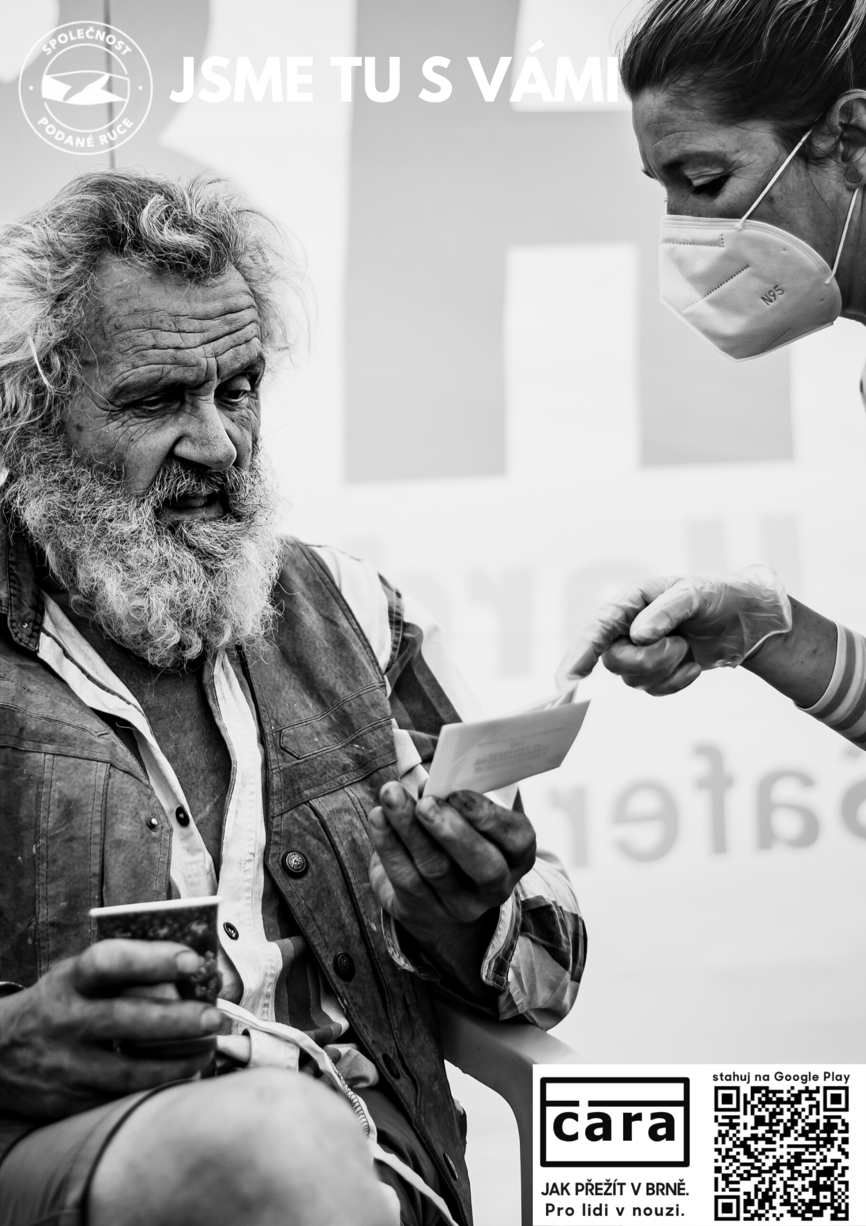
Advantages and disadvantages
Deeper understanding of the phenomenom and its context
Exploratory nature, flexibility – especially related to social change and human behavior
Observation in its natural setting
Triangulation of methods
Close insight
Time
X
Time
Access
Requires deep knowledge of the studied phenomenom
Risk of losing objectivity after long-term immersion in the field
Reactive effects
Not generalizable
Ethics

Slide 7
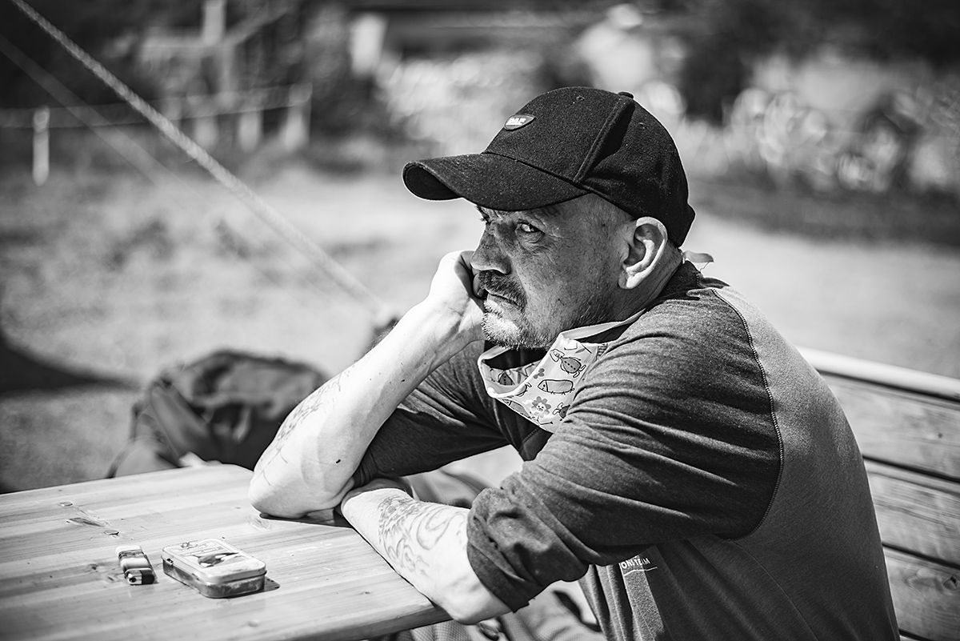
What is autoethnography?
An approach to research and writing that seeks to describe and analyze personal experience in order to understand cultural experience
Using tenets of autobiography and ethnography
Both process and product
Use when asking questions with deeper personal, experiential, ethical and emotial dimensions
Reflexivity and introspection
Writing process as a primary method of inquiry – write to know the subject better
Memories, emotions, intuitions, intentions, expectations, prejudice
Write every day, rewrite, polish, write about your own experience

Slide 8

Should we do ethnography?
A desire to know what people do in practice, and what they really believe (rather than what they say they do, or say they believe, on questionnaires, in formal interviews, or in public or even private documents)
A concern to understand the contextual meanings that inform people’s conduct, since only with such understanding can we explain this conduct, or even describe it accurately
A commitment to discover how people’s lives are affected by the situations they face
A focus on how attitudes and actions unfold over time
Any outcomes we wish to explain are likely to be a product of complex processes
It involves a distinctive attitude or sensibility, and being prepared to ‘learn other cultures’: this involves suspending one’s assumptions and evaluations

Slide 9
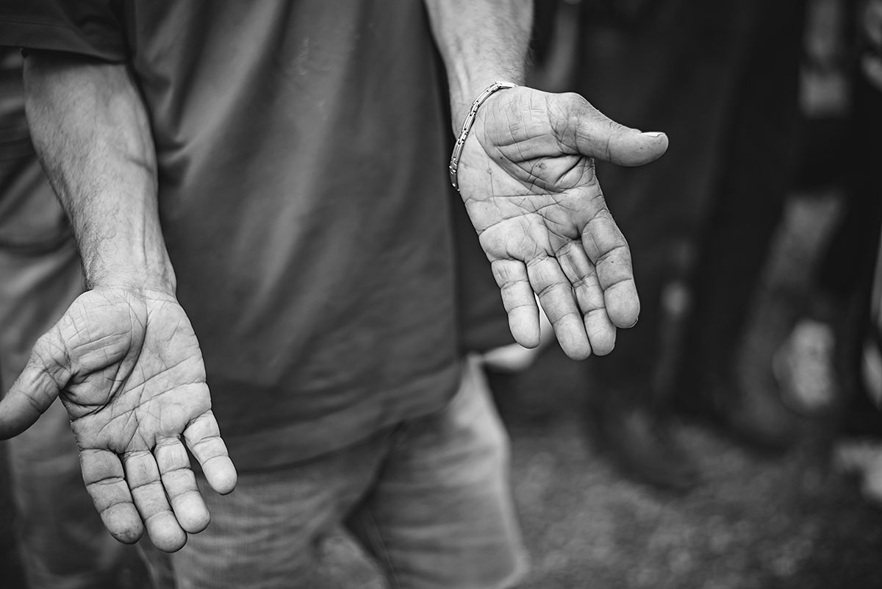
What is ethnographic journalism?
Employment of immersion strategies adopted from social science for distinct storytelling purposes
Used to portray human environments from within
A highly interpretive practice in which you search for meanings rather than facts per se
Examining the ‘inner truths’ of group through immersion by which the members of the group in question are the ultimate authorities regarding the significance of events
Using ethnographic methods to report on the subject with high accuracy, rich description, insider point of view

Slide 10

Where to in the field?
Joining outreach, cameras, audio-recorders, diary, fieldnotes
Illegally inhabited buildings
Streets and the parks
Homeless shelters
Homeless hostels
Overcrowded housing
Tent villages

