Slide 1
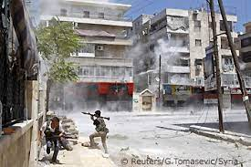
Long-term trends in violence and armed conflicts
Dr. Marek Rybář
Political Violence
Spring 2023

Slide 2
Leviathan
Thomas Hobbes (1651)
“[All men have the equality of ability such that the weak may be able to kill the strong] . . . this equality of ability ariseth equality of hope in the attaining of our ends. And therefore if any two men desire the same thing, which nevertheless they cannot both enjoy, they become enemies”
Notes:
questions that have been at the core of major world religions and addressed by many philosophers
Trends in political violence in the last 100/150 years?
If so, how can we explain it?

Slide 3
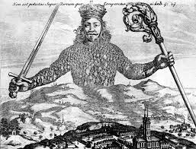
Leviathan (cont.)
“In the nature of man, we find three principal causes of quarrel: first, competition; secondly, diffidence (fear), thirdly, glory. The first maketh man invade for gain; the second, for safety; and the third, for reputation.”
Notes:
Hobbes explain why people fight each other: 3 human "instincts"
The conflict is not necessary, can be avoided. Under what conditions?

Slide 4
Leviathan (cont.)
“During the time men live without a common power to keep them all in awe, they are in a condition which is called war. . . . every man against every man. . . . and the life of man [is] solitary, poor, nasty, brutish, and short.”
Notes:
To avoid violence, people need a central authority with oversight powers

Slide 5
Hobbes
Hobbes’ work is sometimes confused for an apology for absolutism
however, it is more appropriate to understand it as a warning: situations in which there is no central authority (the state), i.e. no monopoly for legitimate use of violence, recede to chaos
William Golding – Lord of the Flies
a good illustration is the anarchical nature of international relations: there is no central authority able to control the states‘ behavior
Notes:
Hobbes works is best seen as a warning against situations without central authority (the state)
the anarchical nature of international relations

Slide 6
Is violence ubiquitous?
a suicide bombing attack in Peshawar (Pakistan) in January 2023
a Russian invasion of Ukraine (Feb 2022-)
civil wars in Ethiopia and Yemen
ongoing conflicts in Somalia, Libya, Venezuela and elsewhere
the war of Mexican drug cartels
Notes:
TV news report violence as omnipresent and ubiquitious

Slide 7
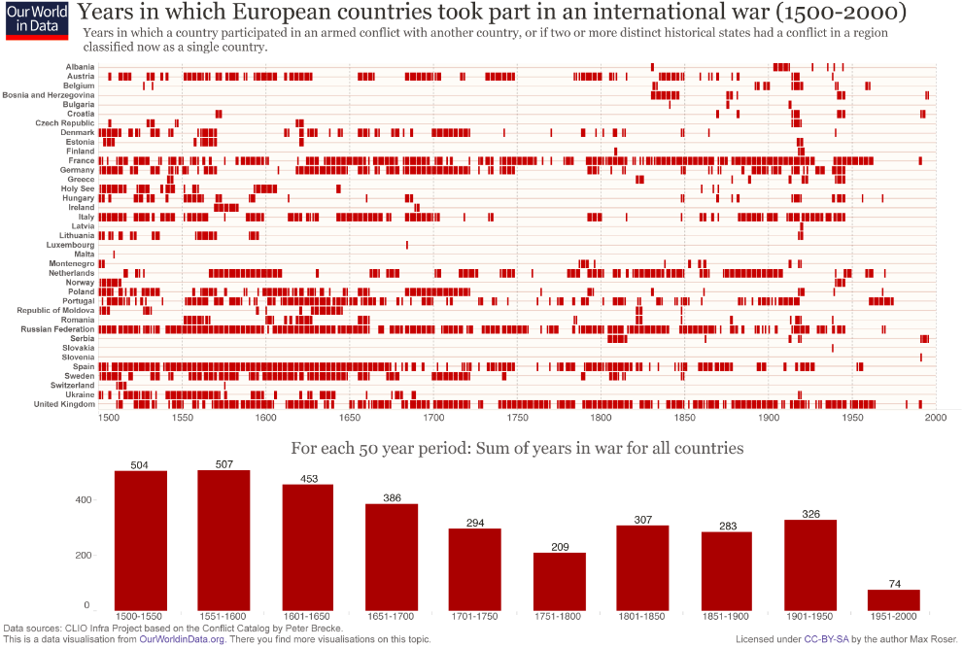
Unusually peaceful times
Notes:
Explore the question from European perspective first:
the last 500 years - unusually peaceful times

Slide 8
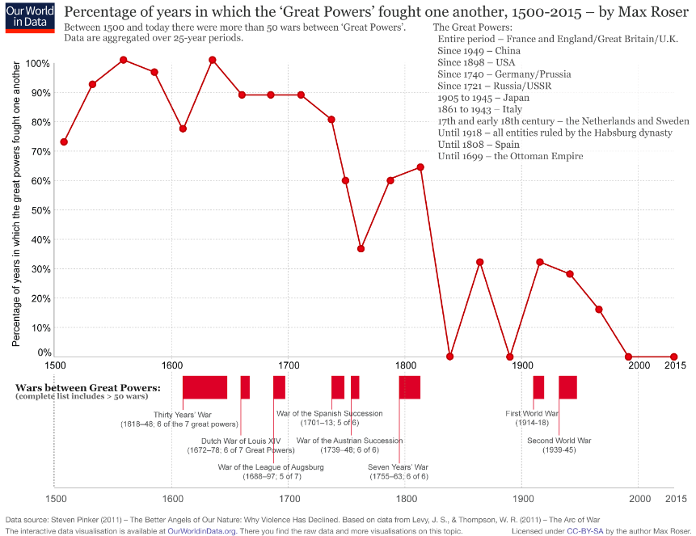
Unusually peaceful times
Notes:
Consider global incidence of violence
an overall decline to zero of great powers fight each others
(Korean war, effectively ended 70 years ago)
the last sustained regular war with regular armies - Ethiopia-Eritrea war
(Armenia-Azerbaijan 2020)

Slide 9
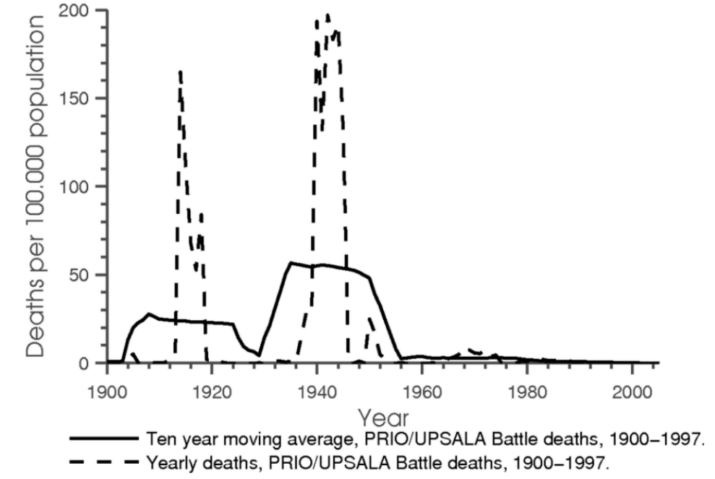
Battle deaths in international conflicts per 100.000 inhabitants (Acemoglu 2012)
Notes:
battlefield deaths - the last three decades very peaceful

Slide 10
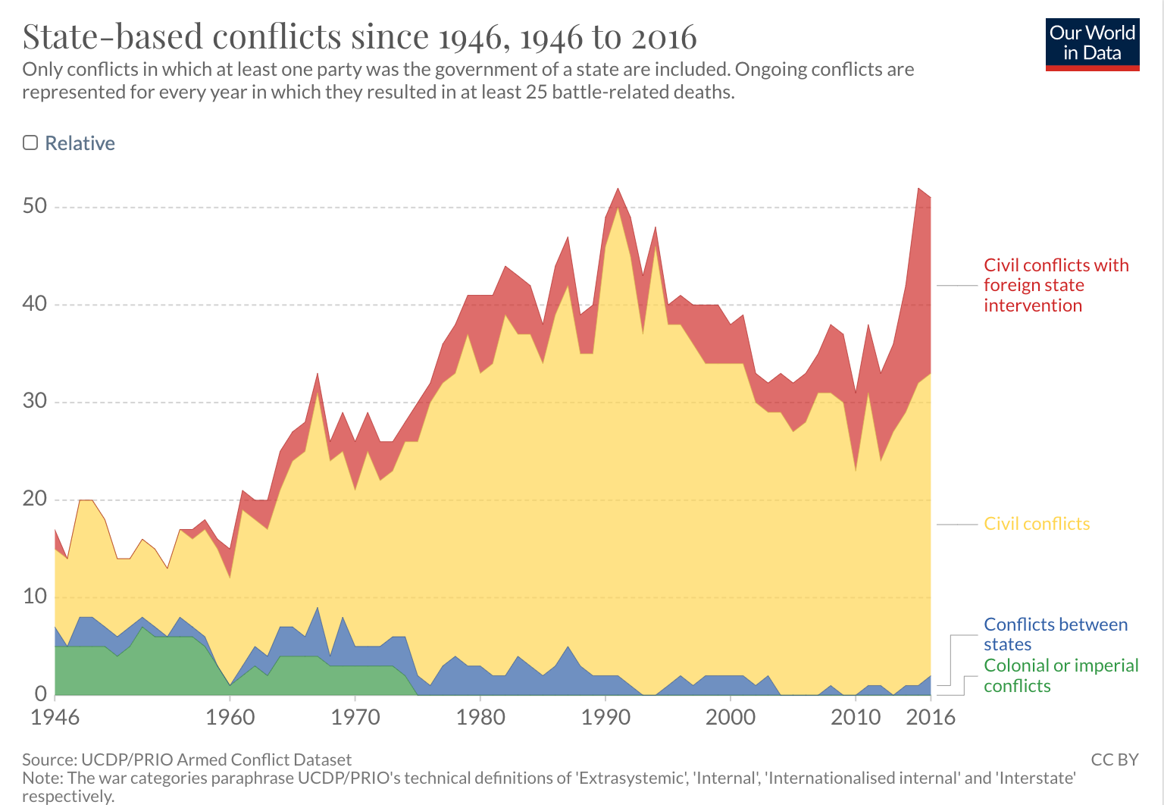
Notes:
armed conflicts declined because they have fundamentally changed: asymmetrical wars do not produce extremely high costs of lives
technological change make wars less brutal (arm drones)
improvement in battlefield medicine

Slide 11
Is it a statistical fluke?
skeptics: human nature has not changed, we all share innate inclination to violence
similar innate aggressive tendencies exist among all primates
the universality of violence in human societies: homicide, rape, domestic violence, rioting, raiding and feuding

Slide 12
Is it a statistical fluke?
furthermore, evolutionary psychology concludes that, as our species evolved, certain genes, hormones, brain circuits, and selective pressures militated toward violence
those pressures could not have gone into reverse within two-three generations since the end of WWII

Slide 13
If it is not a trend, how can we explain that
human sacrifice was a regular practice in every early civilization and now has vanished?
Between the Middle Ages and the 20th century, rates of homicide in Europe fell at least 35fold?
since the second half of the 18th century, every major Western country abolished the use of torture as a form of criminal punishment?
European countries used to have hundreds of capital crimes, including trivial offenses, and by mid-20th century the death penalty was abolished by every western democracy (except the US)?

Slide 14
If it is not a trend, how can we explain that
slavery was once legal everywhere on earth, the last country to outlaw it was Mauritania (1980)?
witch hunts, religious persecutions, dueling, blood sports, and debtors’ prisons were abolished?
corporal punishment of children (both paddling and whipping in schools AND smacking in households) in sharp decline in most Western countries and made illegal in several European countries?

Slide 15
Human nature has multiple components 1/4
human violence springs from several motives, each involving different neurobiological system:
1. exploitation: violence used as the means to an end, damaging a human who is an obstacle to something one wants
2. dominance: the urge to dominate, to become the alpha male; the urge among groups for tribal, ethnic, racial, national or religious supremacy

Slide 16
Human nature has multiple components 2/4
3. revenge: the conviction that someone who has committed a moral infraction deserves to be punished
4. ideology: shared belief systems, spread virally or by indoctrination or force, hold out the prospect for a utopia: since utopia is a world that will be infinitely good, one is permitted to use unlimited amount of force against those who stand in its way

Slide 17
Human nature has multiple components 3/4
some of our kinder gentler faculties are pushing against these impulses:
1. self-control: circuitry in the frontal lobes of the brain that can anticipate the long-term consequences of our actions and inhibit them accordingly
2. empathy: the ability to feel someone else’s pain
Notes:
Pinker: factors that mitigate human violence: kinder gentler faculties

Slide 18
Human nature has multiple components 4/4
3. the moral sense: a system of norms and taboos centered on intuitions of fairness, loyalty to a community, deference to legitimate authority etc., can motivate the imposition of standards of fairness
4. reason: cognitive processes that allow us to engage in objective detached analysis

Slide 19
Contextual nature of the use of violence
any combination of the violence-inducing motives may trigger the decision to wage war
many human responses are opportunistic, reactive or facultative, elicited by various combinations of environmental triggers and cognitive and emotional states
predation and exploitation may occur when an opportunity to exploit a victim at low risk presents itself
if one lives an orderly bourgeois life free from grave threats or insults, any violent tendencies could lie as dormant
Notes:
Complexity of human nature: the use of violence is highly dependent on context

Slide 20
Human Cognition
the cognitive apparatus which makes it possible for humans to reason is special in inhibiting humans from the use of violence
human cognition can produce social constructs that are capable of preventing violence if the right social infrastructure is there: literacy, open debate, the mobility of people
they work by disincentivizing leaders and populations from plunging into war

Slide 21
Social Constructs capable of Preventing Violence
limits on government, including in democracy, so that governments do not perpetrate more violence on their people than they prevent
an infrastructure of commerce, which makes it cheaper to buy things than to plunder them and which makes other people more valuable alive than dead
an international community which can propagate the norms of nonviolent cooperation
intergovernmental organizations which can encourage commerce, resolve disputes, police infractions and penalize aggression

Slide 22
Social Constructs capable of Preventing Violence
measured responses to aggression, including economic sanctions, symbolic declarations, tactics of nonviolent resistance, and proportional counterstrikes
reconciliation measures such as ceremonies, monuments, truth commissions and formal apologies
humanistic counter-ideologies such as human rights which can compete with nationalism, militarism, revanchism and utopian ideologies

Slide 23
Criticism
there is wide agreement on the decline of war and other forms of violence
however, we are unable to choose between alternative plausible theories explaining that decline
furthermore, even if the trend is accepted, it cannot be extrapolated into the future
Notes:
decline of war and violence, we do not know why that is the case
cannot be extrapolated to future unless we understand the reasons behind the decline of war

Slide 24
Criticism
there may be lack of “better angels” outside the West, and even the West may be backsliding
Pinker may underestimate the importance of the international system and the distribution of power
the rise of China is of particular concern
a panel of scientist in 1912 could have extrapolated from the current trends toward a decline of war too
environmental change, esp. climate change (future scarcity conflicts, population migration etc.)
Notes:
decline of violence on the personal level cannot be easily transferred to the level of international system (inter-state relations)
peace caused by economically liberal worldwide networks? (not human nature)

Slide 25
Criticism
democracy may lead to peace but democratization process has often been associated with violence
our evolutionary legacy ensures that the inner demons never go away, they may be triggered in response to threats and actions outside West
leaders play a key role: they may be more likely than the average person motivated by inner demons (competition, corruption etc.)

Slide 26
The Importance of International System
Pinker misses the influence of the system in promoting and (after WWII) suppressing violence
US primacy: during the Cold War, US leadership reduced frictions among many states that were historical antagonists
ability to spread democracy and many of the other positive forces identified by Pinker
economically liberal worldwide network – the growth of the global economy

Slide 27
What if War is (sometimes) Rational?
Once a power shift has occurred, the states will reach a negotiated settlement. (War is costly.)
But if states are experiencing a great power shift, that peaceful settlement may be highly disadvantageous for the declining state.
Declining states therefore launch preventive wars if they prefer a costly but advantageous war today to an efficient but disadvantageous peace tomorrow.
Notes:
even more unsettling - war may be at times rational (cost-benefit calculations)

