Slide 1
WEEK 2
Commodification & Alienation
Key thinkers: Karl Marx & Antonio Gramsci
Lecturer: Olivera Tesnohlidkova
o.tesnohlidkova@mail.muni.cz
Office hours: contact via e-mail beforehand

Slide 2
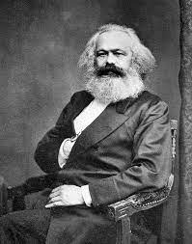
Karl Marx (1818 –1 883)
Major work:
  Economic and Philosophic Manuscripts of 1844
  The German Ideology (1845–1846) - with Friedrich Engels
  The Communist Manifesto (1848) - with Friedrich Engels
  Capital (1867)

Slide 3
Theoretical system: historical materialism
(influenced by and breaking from Hegel’s dialectic idealism)
  History as a dialectical process, a progress culminating in freedom and self-realization, a utopia free of conflict and exploitation
  Historical change is sparked by material existence
  Social change is driven by class struggle
  The dominant economic class controls the means of material production as well as the production of ideas
  Forces and relations of production are predetermined

Slide 4
Class and capitalism
Class is determined in relation to forces of production
Proletariat vs bourgeoisie; working class (propertyless wage earners) vs capitalist class (private property owners)
Goal is to achieve class consciousness
Capitalism carries a potential for self-destruction, ultimately leading to communism

Slide 5
Alienation
Basic premises:
  Humans are creative beings in nature
  Work is essential expression of human nature
Capitalism, based on the principles of private ownership, leads to alienation
4 types of alienation:
  Alienation in the object of production
  Alienation in the process of production
  Alienation from species-being
  Alienation between humans

Slide 6
Commodification
Commodity as something that fulfills human needs
Use-value and exchange-value of commodities
Labor power as commodity
Surplus value – the source of profit for the capitalist, and of exploitation for the worker
Commodification of social relations – social relations are defined by commodities in capitalism
  Fetishism of commodities – commodities appear to contain magical powers; conceals social reality of the object (the process and conditions of its creation)

Slide 7
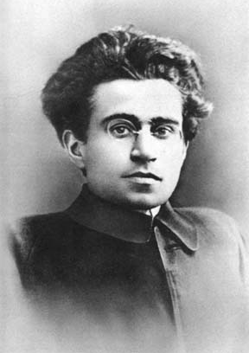
Antonio Gramsci (1891–1937)
Member and general secretary of the Italian Communist Party
Political activist – imprisoned in 1926
Co-founder of The New Order: A Weekly Review of Socialist Culture
Prison Notebooks – 29 notebooks of political and philosophical analysis (almost 3000 hand-written pages); published posthumously

Slide 8
Cultural hegemony and intellectuals
Gramsci highlighted the role of ideas in establishing “hegemony”
Cultural norms and ideas as a way of controlling and subordinating people
  Hegemony established through “consent” rather than coercion
Cultural norms are dictated by dominant social classes, and they are being reinforced as people are born into those cultural norms
Traditional (i.e., professional) intellectuals vs organic intellectuals
Organic intellectuals should question the ‘status quo’ and the existing social order for change to happen

