Slide 1
WEEK 3
Social performance and presentation of self
Key thinkers: Erving Goffman & Jeffrey C. Alexander
Lecturer: Olivera Tesnohlidkova
o.tesnohlidkova@mail.muni.cz
Office hours: contact via e-mail beforehand

Slide 2
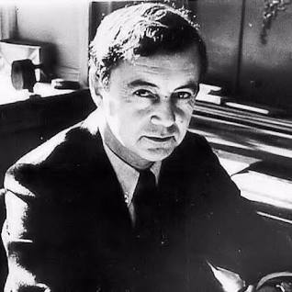
Erving Goffman (1922-1982)
The Presentation of Self in Everyday Life (1956)
Examines how individuals present themselves and their activity in everyday life to others
  Goal is “impression management” – controlling the impression others have of us as well as the conduct/response of others
Stage – Actors – Audience
Effective performances are those in which the audience acts as if the individual has conveyed the desired impression
Both ‘actors’ and the audience project a definition of the situation that appears before them; actors through their performance, audience through their response

Slide 3
Performance – “all the activity of a given participant on a given occasion which serves to influence in any way any of the other participants” (p. 8)
Front – part of individual’s performance which functions to define the situation for the observers (intentional or unwitting)
  Setting (i.e., scenery, props)
  Personal front – elements of expressive equipment attributed to the performer himself (clothing, sex, age, rank, facial expressions, speech patterns)
  ‘Appearance’ – stimuli which define the performers social status or the social activity he is engaging in
  ‘Manner’ – stimuli signifying the interaction role the performer expects to play (e.g., arrogant, apologetic, angry…)
Audience expect coherence between different elements of performance
When different routines (performances) employ the same front, the social front becomes institutionalized, creating a set of stereotyped expectations and meaning – the front becomes a ‘collective representation’

Slide 4
Regions & region behavior
Region – “any place that is bounded to some degree by barriers to perception” (p. 66) (e.g., classroom, hallway); ‘perception’ not only in visual terms
  Front region – place where a performance is given
    Politeness vs. decorum – how one engages with audience vs. how the performer behaves himself in front of audience
    Decorum is dictated by moral and instrumental requirements
  Back region (a.k.a. backstage) – space where impression made in the front region (i.e., during the performance) is “knowingly contradicted” and where the impressions are “openly constructed” (p. 69)
  Regions are not universal; they are defined based on the purpose they serve during an individual performance
    Spaces that serve no purpose during a performance – ‘the outside’
    Outsiders
“impression management” requires maintaining control over regions

Slide 5
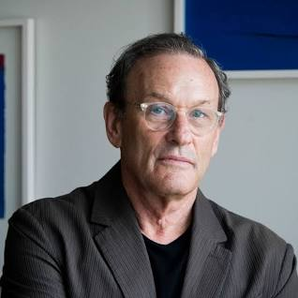
Jeffrey C. Alexander (1947- )
Founding figure of cultural sociology, a.k.a. the “strong program”
To believe in the possibility of a “cultural sociology” is to subscribe to the idea that every action, no matter how instrumental, reflexive or coerced vis-a-vis its external environments, is embedded to some extent in a horizon of affect and meaning (Alexander 1998).
Characteristics of the Strong Program
  Culture as an “independent variable” capable of “shaping actions and institutions, providing inputs every bit as vital as more material or instrumental forces” (Alexander & Smith, 2003, p. 12) – autonomy of culture
    Culture is not defined by social life, rather it takes part in defining it
  Thick description of texts (Geertz) and structural hermeneutics
  Causal specificity – specifying mechanisms through which culture does its work

Slide 6
Performance and Power (2011)
Cultural pragmatics
  “Individuals and collectivities strategically direct their actions and mobilize all their available resources, but their instrumental power usually depends on success of a cultural kind. This does not mean that the explanation of their success should be purely symbolic. It means that pragmatic and symbolic dimensions are intertwined” (p. 78)
Macro-sociological model of social action as cultural performance
Cultural performance is “the social process by which actors, individually or in concert, display for others the meaning of their social situation.” (p. 28)
Goal: psychological identification and cultural extension (similarly to sacred rituals)
  Creating an emotional connection between audience, actor, and text, is required if the cultural meanings are to be projected to an audience

Slide 7
Fusion, de-fusion, re-fusion
Depending on the complexity of the collective organization, social and cultural parts are more or less segmented and differentiated, and the elements of a social performance are more or less fused
  Simple collectivity = less segmentation and greater fusion of elements
  Complex collectivity = greater segmentation and weaker fusion (i.e., elements of a performance are de-fused)
To be effective in complex societies, social performances must go through a process of re-fusion (i.e., must become more ritual-like)
If identification and cultural transmission have been established, the elements of a performance have been fused

Slide 8
Elements of Social Performance
Systems of collective representation – background symbols and foreground scripts
  Systems of collective representation – actors’ symbol-bearing world(s) from which they draw upon for symbolic referents that inform their performance
    Made up of deep background of collective representations and foreground scripts (i.e., referential texts)
Actors – the one(s) performing and putting collective representations into practice
  Literature vs. theatre (walking and talking)
Audience/observers – evaluating performances; have the agency to reject it
  Actors attempt to achieve identification by conveying authenticity

Slide 9
Means of symbolic production – venue of the performance, expressive equipment, material resources
Mise-en-scène – “putting into the scene”; performances must be directed, to walk and talk a text must be “sequenced temporally and choregraphed spatially” (p. 32)
Social power – social performances are dependent on the distribution of power within a society which determine the access to means of symbolic production (who gets to act, what can be acted, who can observe)

Slide 10
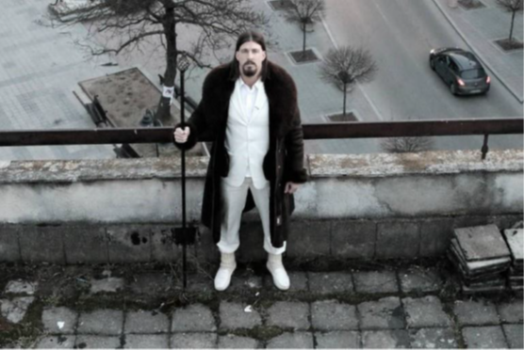
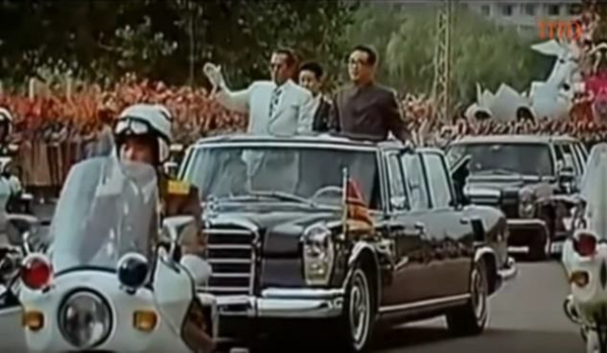
Case study – Ljubiša Preletačević Beli
https://www.youtube.com/watch?v=zEhWOa-D3Wo&t=12s

