Slide 1
Experiments
GLCb1008 Introduction to Methodology of Social Sciences

Slide 2
Aim of this lecture
Logic of experiments
Experimental designs
Strengths and weaknesses of experiments
Practical issues

Slide 4
Testing theories
Limits of observational studies
We cannot save and load reality
Ask a political party to go back in time and do a different campaign
Experiments help us to overcome this impossible scenario

Slide 5
Experiment - basics
Main role:
To estimate effect of independent variable on dependent variable
Almost perfect control for effects of all other variables
The researcher manipulates with the independent variable
Participants are split into at least two groups:
Each group obtains a different treatment (or no treatment at all)
The analysis compares results for each group to estimate the effect of IV
Many modifications

Slide 6
A simple two group design
Experimental group
(Group 1)
Control group
(Group 2)
Article about corruption
(treatment)
Waiting in a room
(no treatment)
Questionnaire:
Trust in politics (0-10)

Slide 8
A three group design
Experimental group 1
(Group 1)
Experimental group 2
(Group 2)
Control group
(Group 3)
Article about tiny corruption
(treatment)
Article about large corruption
(treatment)
Waiting in a room
(no treatment)
Questionnaire:
Trust in politics (0-10)

Slide 10
Groups
Theoretically unlimited number of groups
Beware of too complicated designs (especially if you have less experience)
Costs of more groups (each groups needs participants)
Control group is not a necessary feature
Control group may receive a meaningless treatment (article about weather)

Slide 11
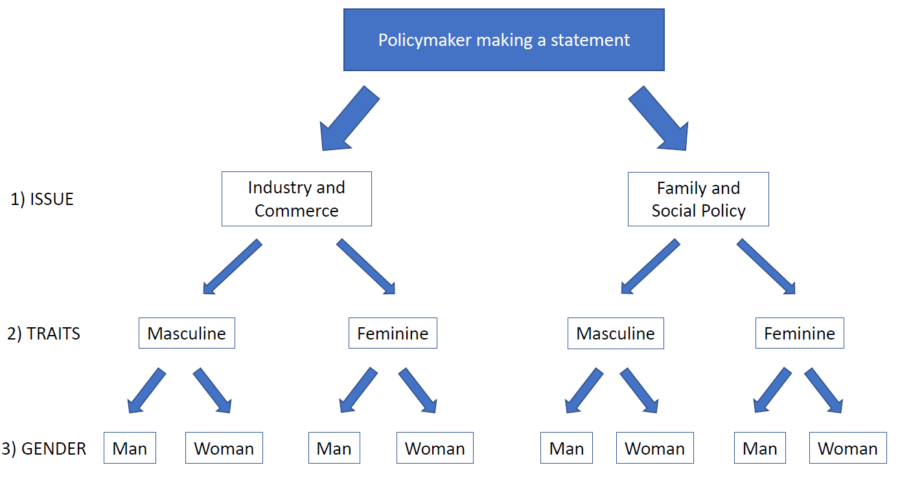

Slide 12
How to divide participants into groups?
Does corruption decrease trust in elected representatives?
Laboratory experiment, 2 groups
Group 1: Article with corruption of a political official
Group 2: Article with daily duties of a political official
Sample of 100 people
How to divide the sample into groups?

Slide 13
100 people

Slide 14
50 men (blue dots), 50 women (white dots)

Slide 15
Wrong Solution
Experimental group: Control group:
50 M, 0 W 0 M, 50 W

Slide 16
Post experimental questionnaire
On a scale from 0 to 10 how do you trust the political official?
Experimental group (50 M, 0 W):
Result: 4.2
Control group (0 M, 50 W):
Result 6.7
The result – reading an article on corruption lowers trust to political officials by 2.5 points

Slide 17
Post experimental questionnaire
On a scale from 0 to 10 how do you trust the political official?
Experimental group (50 M, 0 W):
Result: 4.2
Control group (0 M, 50 W):
Result 6.7
The result – reading an article on corruption lowers trust to political officials by 2.5 points
What if the article has no effect but
men simply have lower trust in politicians?

Slide 18
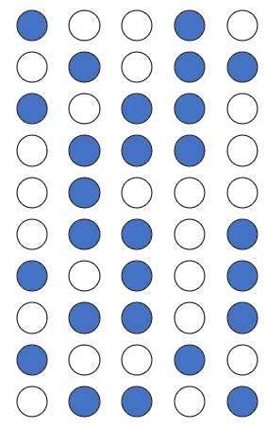
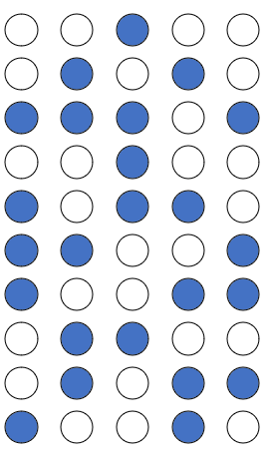
Correct Solution
Experimental group: Control group:
26 M, 24 W 24 M, 26 W

Slide 19
Correct Solution
All differences (that can affect the results, e.g., age, income, education) are eliminated.
The only difference between the groups is our treatment (the article).
If the article has an effect, we will see it in different scores of groups and vice versa.
Experimental group: Control group:
26 M, 24 W 24 M, 26 W

Slide 20
Random assignment vs. random sampling
Never confuse these two concepts
Random sampling:
Procedure of selection of participants
Typically a random choice (not always from the whole population, but only from students, locals etc.)
Random assignment:
Procedure of assignment of participants into groups
Random assignment is a critical feature that defines experiments

Slide 21
Types of experiments
Based on conditions:
Lab (laboratory)
Field
Survey
Do not take the names literally:
Lab does not mean you need a laboratory, but controlled conditions
Field experiments do not (usually) take place at fields
Survey experiments can be held in laboratories
Conditions (and not the place) decide

Slide 22
Lab Experiment

Slide 23
Field experiment
Institution 1 (short email)
Institution 2 (short email)
Institution 3 (long email)
Institution 4 (long email)

Slide 24
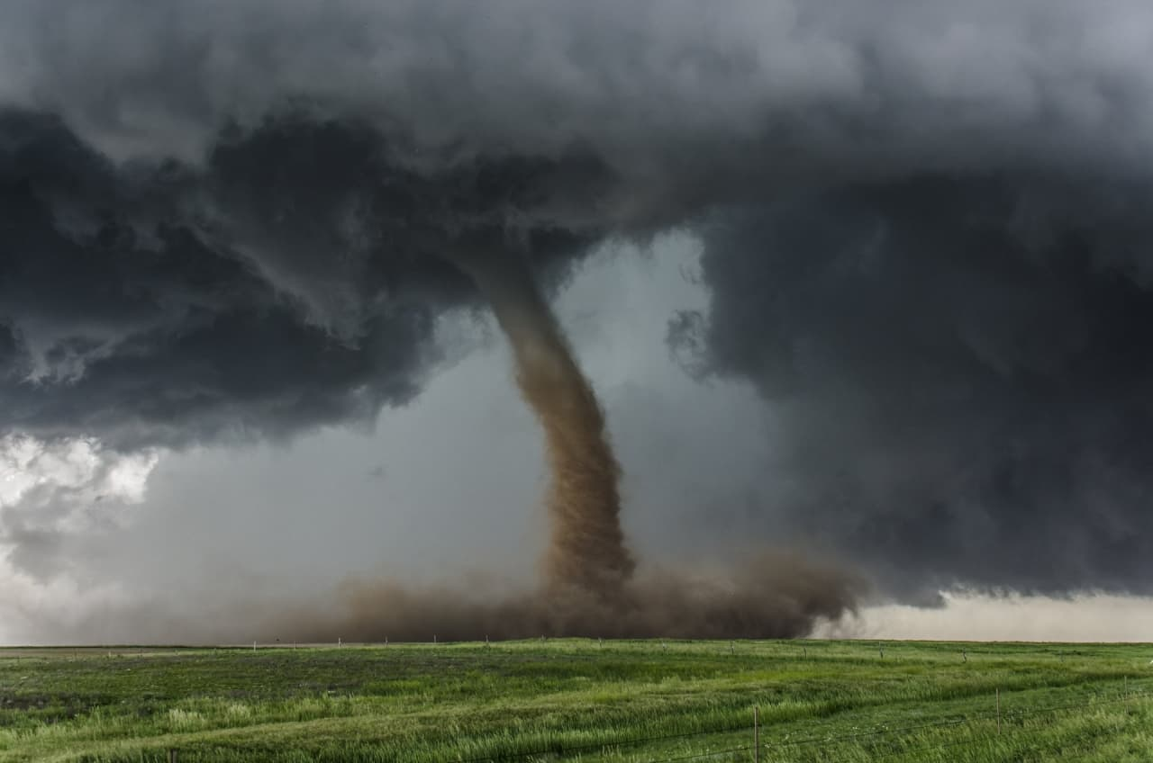
Natural experiments
Experiments occur naturally:
Randomly assigned people who get basic income
Towns selected for high-speed Internet
Natural disaster that affects a part of a country
Researchers do not provide a treatment, they “only” collect the data
Assignment to groups is either random or it should be close to random

Slide 25
Transparency at the Local Level
Topic: Reactive provision of information by local governments
Effect of Freedom of Information (FOI) requests on responsiveness of local governments compared to less formal requests
Experimental study on 2,926 municipalities in Slovakia
Requests on information about local elections

Slide 26
Preparation of Experiment
Random assignment of municipalities into three groups
All municipalities obtained an information request
Control group – baseline version
Exp group 1 – baseline + moral paragraph
Exp group 2 – baseline + FOI paragraph
All requests sent via e-mail on Monday

Slide 27
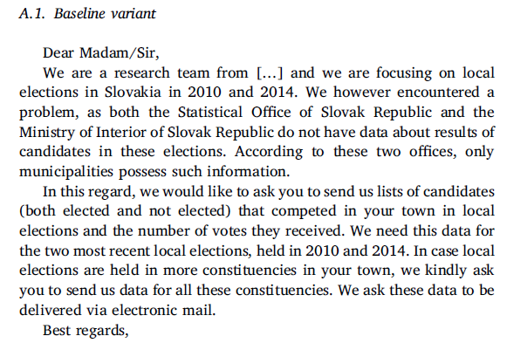
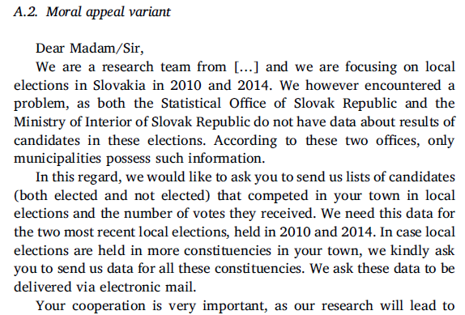
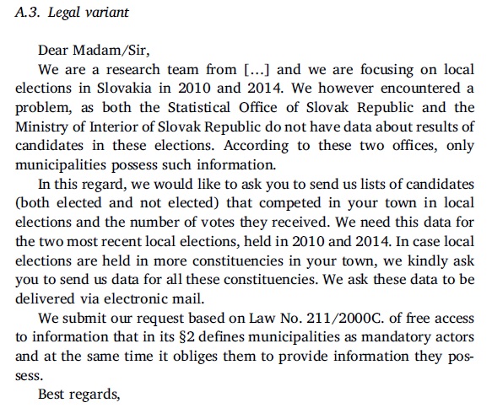

Slide 28
Results
Group | N | No response (%) | Response (%)
Control | 961 | 78.0 | 22.0
Moral Appeal | 922 | 77.3 | 22.7
Legal FOI | 943 | 56.1 | 43.9

Slide 29
Validity
Internal:
Conviction that the findings are the result of experimental treatment
Main threats – noncompliance and attrition
How to support
External:
Ability to generalize the results beyond the group of participants
Experiments often conducted on student samples
Hawthorne effect – reaction to being observed
What to do – replications, different ways of measurement, better samples (population experiments)

Slide 30
Ethics
Experiments are often confronted with ethical challenges
Risk to current and later experiments
Solution:
Good organization, ethical boards
Natural experiments

Slide 31
Experiment
Strengths:
Effective isolation of other variables
Reliability, internal validity
Weaknesses:
External validity (vs. experiments based on population sample)
Not always applicable in social sciences
Not all independent variables are subject of manipulation (age, values)
Need of replication

