Slide 1
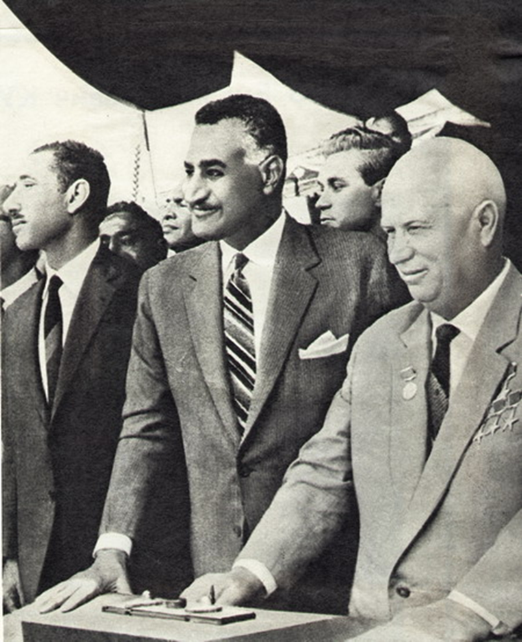
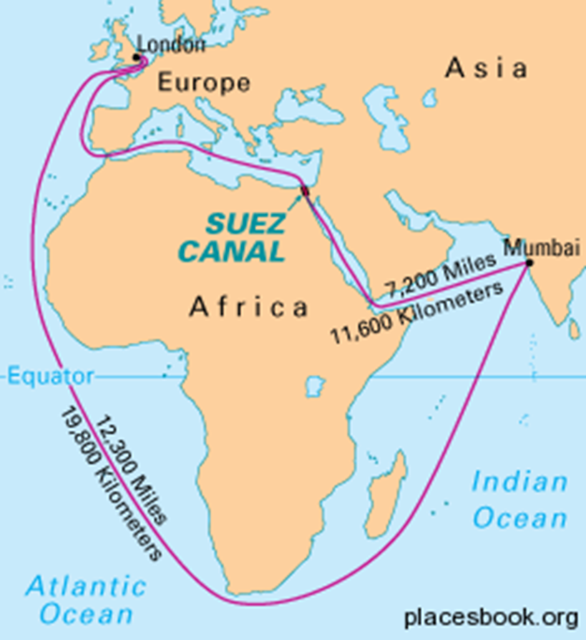
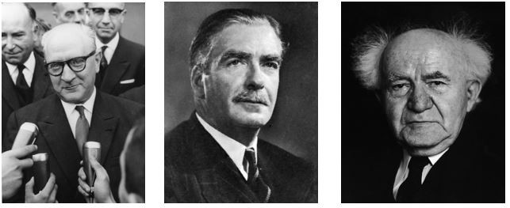
The Suez Crisis:
New Saladin of the Arab World and a final confirmation of European decline.
Mgr. Eva Taterova, M.A., Ph.D.
Middle East Crossroads

Slide 2
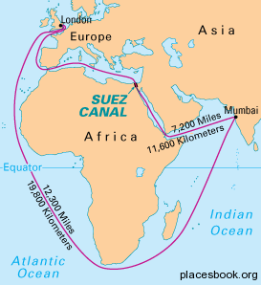
GEOSTRATEGIC IMPORTANCE OF THE SUEZ CANAL
1858: Ferdinand de Lesseps formed the Suez Canal Company (concessionary company)
for the purpose of building the canal → officially opened in 1969.
Its length is 193.30 km connecting the Red Sea
to the Mediterranean Sea.
Crucial role of the Suez Canal for the international trade.

Slide 3
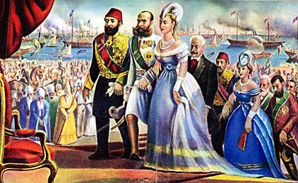
OPENING THE SUEZ CANAL IN 1869

Slide 4
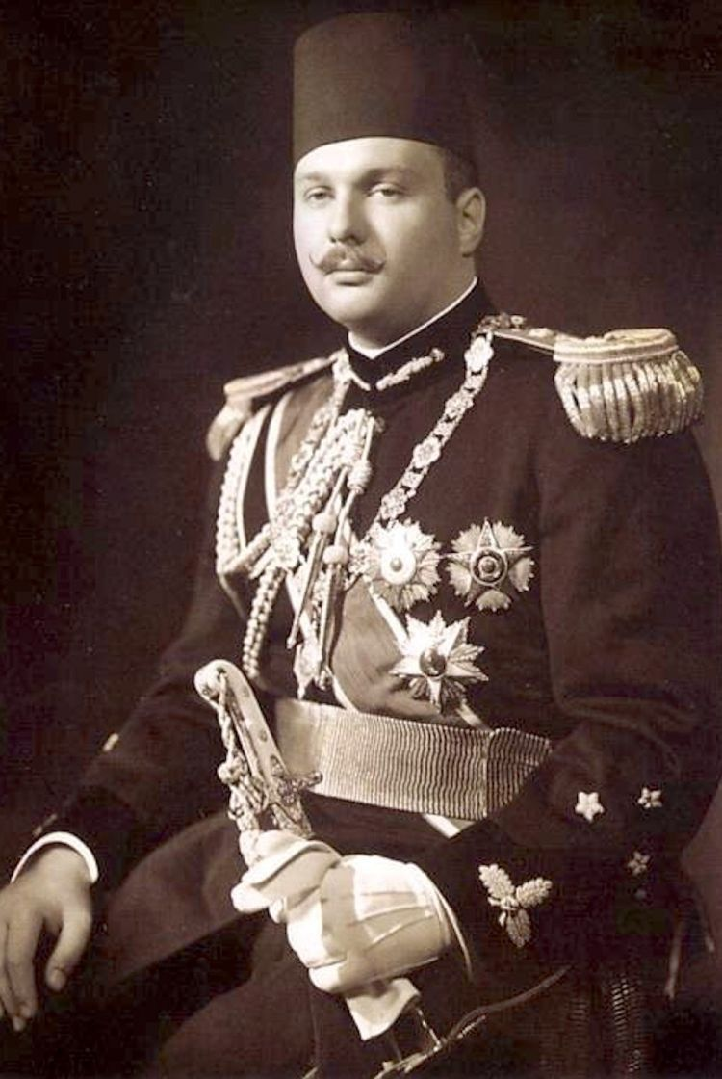
SITUATION IN EGYPT BEFORE THE CRISIS
After WW2 still a significant political influence of GB in Egypt.
Economic troubles of the country, disillusion from the loss in war with Israel in 1948.
1952 the Egyptian revolution (coup of the Free Officers) → fall of the royal dynasty (king Faruk I).
Short rule by general Naguib who was then replaced by colonel Nasser (pan-Arabism + Egypt interventions in various countries of the Middle East).

Slide 5
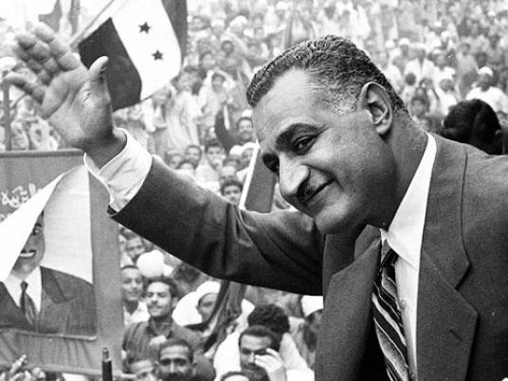
GAMAL NASSER (1918-1970)
Symbol of resistance in the age of decolonization in the Middle East.
“New Saladin of the Middle East“ – charismatic leader, the spiritual father of modern Arab nationalism.
In 1955, Nasser signed a huge arms contract with Czechoslovakia – disapproved by USA and GB who then stopped their intended financial support for the project of Aswan Dam.
Since January 1956, Egyptian blockade of Eilat
in Straits of Tiran.

Slide 6
07/26/1956: SUEZ CRISIS
NASSER ANNOUNCES NATIONALISATION
https://www.youtube.com/watch?v=Qt1Xah1qR14

Slide 7
HUGH GAITSKELL‘S SPEECH IN THE PARLIAMENT
"It is all very familiar. It is exactly the same that we encountered from Mussolini and Hitler in those years before the war.“

Slide 8

INTERNATIONAL RESPONSE
USA offered a diplomatic solution
of the crisis – unsuccessful.
Soviet Union was already supporting Nasser with the intention to undermine the British imperialism in the Middle however at the time of the Suez Crisis, Soviet Union was rather focused on the situation in Hungary.
Negotiations by anti-Nasser coalition (France, GB, and Israel) – important secret meeting in Sèvres in October 22, 1956 → plan of the military intervention.

Slide 9
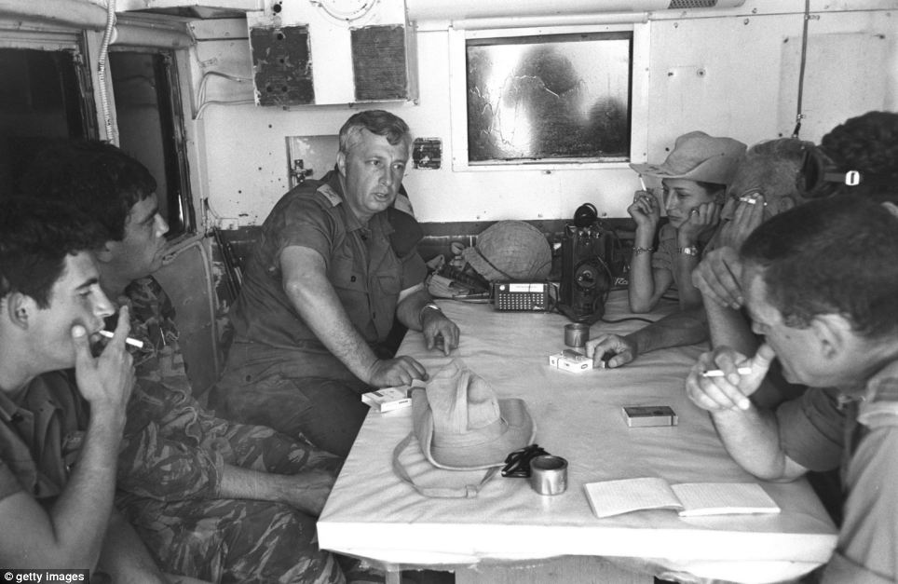
MILITARY INTERVENTION IN EGYPT
(October 29 – November 7, 1956)
Sinai War, 2nd Arab-Israeli War, Tripartite Aggression.
October 29, Israeli army started operating in Sinai.
October 31, beginning of the military operation of GB and France in the area (Port Said, Port Fuad).
Pressure by both USA and Soviet Union to end the military operation
at the earliest convenience.

Slide 10
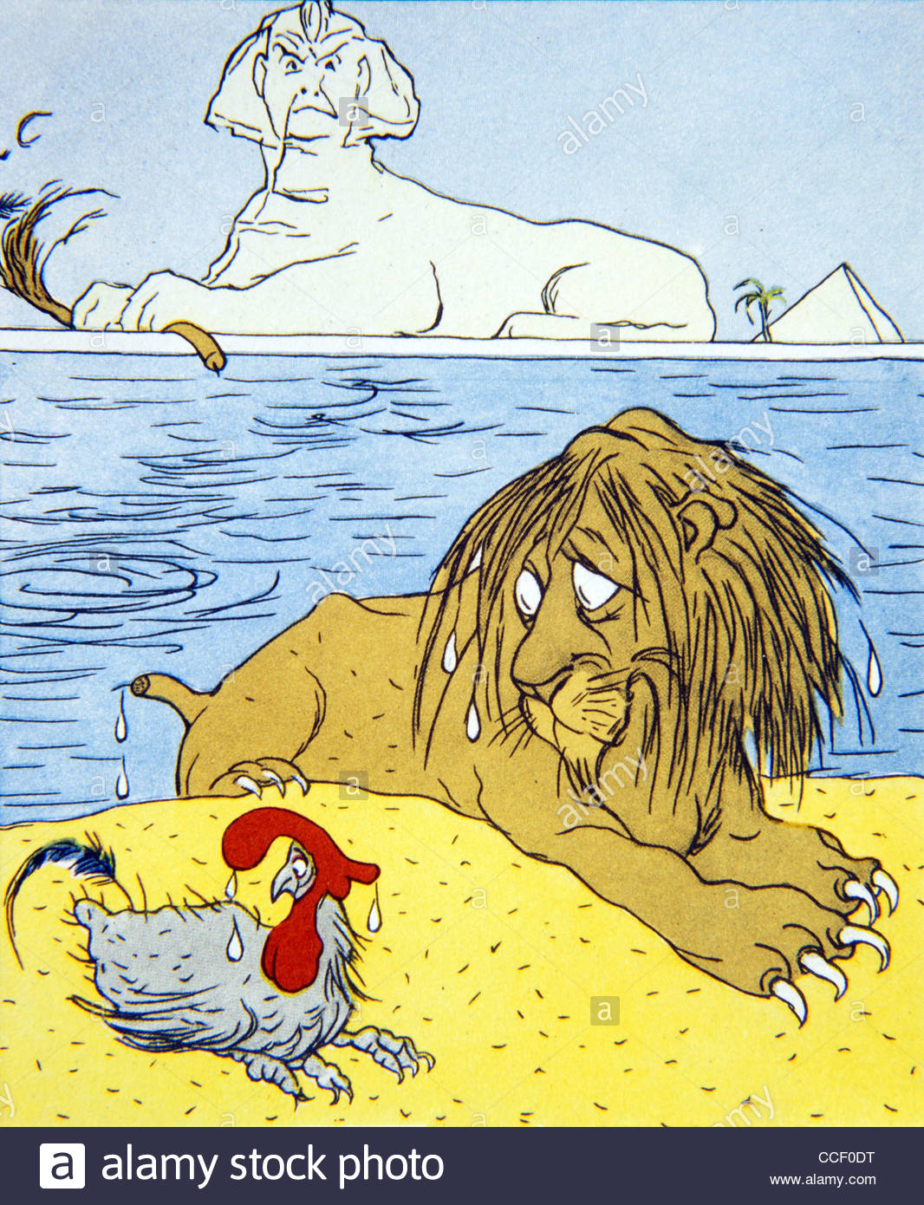
CONSEQUENCES
Final confirmation of the decline of traditional European great powers → accelerating process of decolonization.
Nasser portraited as a hero in Arab world.
Increasing influence of the Soviet Union
in the Middle East.
Increasing military prestige of Israel + security guarantees provided by UNEF.

Slide 11
wHAT makes the military victory
a political victory?

Slide 12
THANK YOU FOR YOUR ATTENTION

