Slide 1
MEMORY WARS IN EASTERN AND CENTRAL EUROPE

Slide 2
What are the goals?
Memory Wars: What are they? (The relation between memory and identity)
Why are they important?
  Political Significance, both nationally and internationally
  Insight into different societies of the region and why they clash
What do they say about the theory and practice of international politics?
  Start with constructivist theory of international politics
  Examine also the idea of ontological security
  Discussions about the politics of memory

Slide 3
Introductions
James Richter
  Education
  2. Employment
  3. Research Interests
  Memory is new, and I am interested in your ideas
  4. Other Interests
Who are you?

Slide 4
Course Information
Four Answers to Daily Question: Due at noon the next day
Choose Topic for Paper by Thursday, March 23.
Rough Draft by April 14, Final Draft by May 1.

Slide 5
General Introductions
Questions for me?
  Perhaps about US politics?
Questions for you

Slide 6
Part I and II: The Theoretical background
Theories of International Politics: Realism vrs. Constructivism
Theories of Identity, Memory and Narrative

Slide 7
Realism VRS. Constructivism
Key Actors: Sovereign States
Structure of System: Anarchic
Security is Scarce: Zero-sum
Key Motivation of States: Self-Help
States are Rational Actors
Distribution of power is key variable

Slide 8
ISSUES WITH REALISM?
How do you decide what the national interest is?
How can you tell between competing notions of national interest?
What makes the EU possible?
Why does Putin make a mistake?

Slide 9
First Step:
Constructivist Notions of Identity and Interests
The social world is constructed: Many things we take for granted have no physical reality, but are “real” because of persistent patterns of social relations
Individuals confront, understand constructions as “real”, identity shaped by interaction with that structure
  Nationality
  If individual challenges that social reality, often considered weird, insane, criminal—Soviet dissidents
The structure and agent are mutually constitutive
  The social structure reproduced by the actions of agents
  The social structure appears as fact as individual that shapes identity

Slide 10
IDENTITY: What is it?
Personal Identity: (from Wikipedia). This refers to your individual perception of the qualities, personality, values, aspirations and codes of conduct that define who you are in relation to the outside world.
Social Identity: This refers to the social categories you belong to—including memberships in groups and social roles you perform—along with the social expectations generally assigned to this identity. This includes things like nationality, race, ethnicity, gender, class, occupation, and others. Such identities can be chosen, such as occupation, or imposed, such as often occurs with ethnic identity. Individuals can feel different ways about what each category means, and respond to expectations in different ways. The latter can be tricky, however.

Slide 11
IDENTITY: WHAT DOES IT DO?
(Henry Hale)
REDUCES UNCERTAINTY:
Helps sift through barrage of incoming perceptions
Gives you a range of possible behaviors
Gives you range of expectations of how others will
respond
    Allows coordination
PROVIDES SECURITY
WHAT ARE IDENTITY CRISES? When old rules don’t work. Some students feel an identity crisis when you they first arrive, because no one knows you, you don’t know how to act, etc.
  Could also occur if your earlier ideas disproved.

Slide 12
IDENTITY: WHERE DOES IT COME FROM?
One’s identity emerges from accumulated interpretations of one’s interactions with others.
Human beings are social animals and depend on others to survive, beginning in infancy with parents and other caregivers.
You take up cues from others’ responses, esp. others who are important to you.
But the definition emphasizes interpretation. Identity is not merely passive, but also active.
EX. If you say thank you as a young child and your parents praise you for being polite, you will probably want to do that more, and you may expect others to be pleased when you do so as well.
Over time, get an instinct about how to respond in different situations and different people. You don’t act around me as you would each other or your parents, because you understand it’s not the same sort of relation

Slide 13
IDENTITY: More ABOUT What IT IS?
Identity is Multifaceted, Situational and Dynamic
Multifaceted: People have many sides, and play many different roles in life. You may be an American, a woman, a college student, an activist and a rugby player all at the same time.
Situational: Different identities become more salient in different contexts. If you go to a foreign country, your nationality often becomes more salient. Similarly, you focus more on different aspects of others’ identity In different circumstances.
Dynamic: Identity never complete, never static. The roles you play and your conception of these roles change over time. And there is more or less room for choice.

Slide 14
Collective Identity
DEFINITION: A collective identity occurs when a group—a nation, an ethnic group, a religious group—self-consciously defines itself as a community with a common past and a common future.
COLLECTIVE IDENTITIES ARE SOCIAL CONSTRUCTIONS:
They exist and have meaning only insofar as society grants them that meaning.
  The “nation” as an imagined community

Slide 15
Can a State Have an “Identity”?
What is the state? How does it gain sense of reality sufficient for people to risk their lives to defend it? Why is not amorphous collection of offices, bureaus, building, etc. What makes it cohere? What makes it legitimate?
Is it simply the source of military protection? Is it simply collection of interests? Is it locus of identity?
Identity helps to coordinate to actions
Creates basis to decide what is appropriate policy
In modern world, state legitimated as representative of people
    Sovereignty resides in the people
If persuade others to accept national identity, national interest
Key aspect of legitimacy
  But many identities in any individual, many individuals in any state

Slide 16
Why is Constructivism important? Realism Plus
1. Realism does not problematize sovereign state system
Constructivism argues sovereign state system a construction,
which can be deconstructed
2. Realism believes competition and conflict a natural result of anarchic s structure
Constructivism believes that competition aspect is constructed, can
be changed
Realism argues ”national interest” logical result of state’s power capability and its geography relative to other states
  Constructivism believe ”national interest” product of norms, national identity and history, as well as power relations within countries

Slide 17
How does state identity get embedded in institutions?
State as an organization
  Identity as domestic legitimation
Organizations created to perform particular tasks
  These organizations, tasks, must be justified in terms of identity and interests
  These institutions have staying power
  Individual actors invested in the tasks of these institutions
  New recruits, those who are promoted should accept tasks of those institutions
  Those who populate institutions will defend ideas that justify them
  But may define identity in different ways:
    Educators may define US identity different from military

Slide 18
Ontological Security
”Ontological security first and foremost entails having a consistent sense of self and having that sense affirmed by others.” (Zarakol)
  Individuals, states and other groups act not only in interests of physical and economic interests, but also willing to accept significant harm to these interests in order to protect that sense of self (Mitzen. ,Steele, Kinnvall)
Mnemonic Security: “the idea that distinct understandings of the past should be fixed in public remembrance and consciousness in order to buttress an actor’s stable sense of self “(Malksoo)
Challenge to fixed narrative represents a challenge to sense of self that requires a remedy
The question: does identity come primarily from within or from without?

Slide 19
Back To realism:
How Does Power Fit into this?

Slide 20
BREAK

Slide 21
The Role of Memory
MEMORY FORMS IDENTITY, AND VICE-VERSA
Recollection, reflection and integration
Constructing the narrative, self-biography
Select what is important, what is not
Influenced by identity (can make up things)
May try to justify, explain things that were uncomfortable, or contradictory
Narrative helps explain the present
Provides framework for decision-making

Slide 22
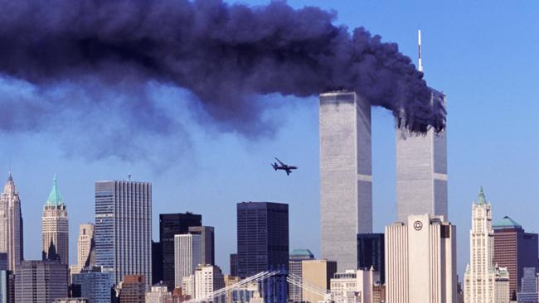
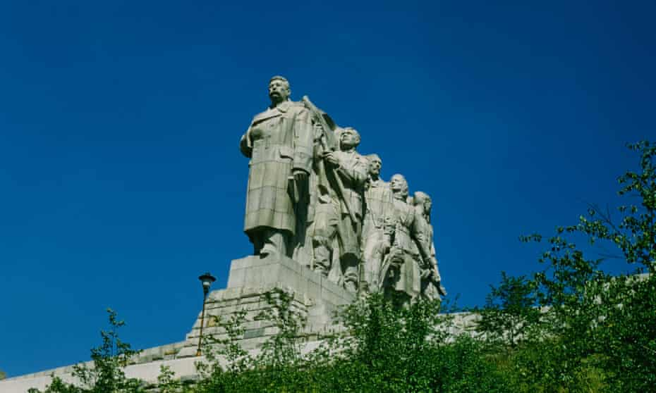
COLLECTIVE MEMORY:
Assman
COLLECTIVE MEMORIES
They are a shared sense of a past event with a group
Memories are shared even though not everyone actually experienced that event, such as 9/11.
These memories then are shaped into a collective narrative.
Creates the boundaries of the group
They offer also an explanation of where the group comes from, why it is where it is, and it’s future may be.

Slide 23
Examples from the class

Slide 24
Different Forms of Memory: Assman
COMMUNICATIVE MEMORY: Passed down through stories. How long does it last?
PUBLIC MEMORY: “the official memory strategies propagated by holders and competitors of state power, as well as the cultural memory propagated within the public sphere, such as media, movies, memorials.” (Bernhard and Kubik). Institutionalized. Exists independent of stories
OFFICIAL MEMORY: Narrative propagated by state agents.
How different can it be?
MEMORY CULTURE : “frames of historical reference” within communities “who share a critical mass of content, patterns of interpretation and rituals of collective memory.”
THE DIFFERENCE BETWEEN MEMORY AND HISTORY

Slide 25
Examples:
A movie
A facebook page
A speech by the foreign minister
Your great-grandfather’s birth certificate
A newspaper in Germany
A letter written by your father’s grandfather
A “memory law”
A monument
The disjunction between communicative memory and public memory culture

Slide 26
Collective Narratives and the Nation: The Nation as an ”Imagined Community”
The nation as the principle legitimate political unit in world politics
But it also has no physical existence.
We cannot see the nation.
The boundaries of nations are fuzzy (and your definition of who is an “American” and mine may differ, and may not differ).
It is ”imagined” in that it exists only in the collective imagination of its members and people who are not its members, and therefore act as if it exists in reality.
We help to make it seem real with symbols like the flag, like the national anthem, like the Jan Hus momument, etc.
The nation is “imagined” but not “imaginary.” It has huge consequences in world politics. It can mobilize enormous human and material resources, sometimes to improve life, sometime to destroy it.
”Banal” or “Everyday Nationalism”

Slide 27
Official Narratives-Malinova
Official narratives try to create “Memory community” by forming common story but also by differentiating them from others
Usually focus on glorious past or common traumas

Slide 28
THE ELEMENTS OF A ”NATIONAL” COLLECTIVE NARRATIVE
    A sense of common past: founding myth
    A sense of boundaries: who belongs to the state identity: who does the state serve?
    What are primary values does state claim to represent, to further in the world?
      What is sense of purpose?
    How does it define, relate to others, both internally and externally?
    What future is looking for?
    Recent restoration of Habsburg monuments in Prague

Slide 29
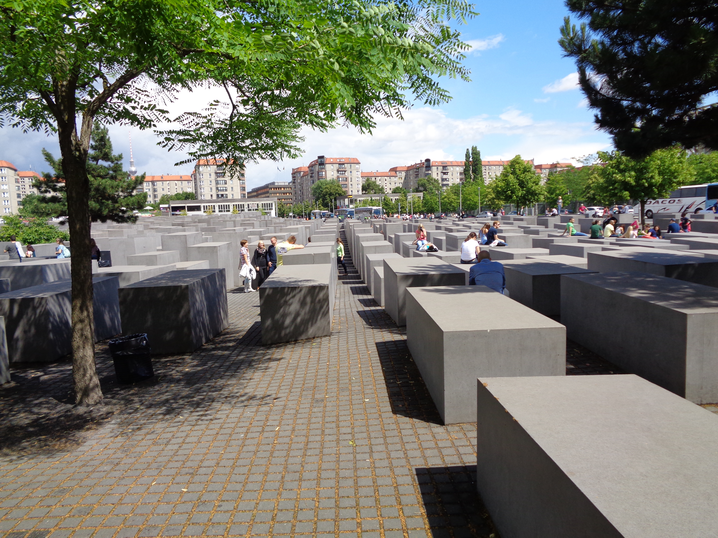
What about ”dark pasts”?
Denial—but perhaps not forever
Foot-dragging—but perhaps not forever
Victim and Perpetrator?
Reconciliation
Reparations

Slide 30
The Politics of Memory
National Identity Informs National interest
Collective memory informs national identity
Collective consists of many different identities, memory
The Memory that gains prominence has power
Which memory is prominent? Depends in part on power and politics
Politics of memory comprises public activity of various social institutions and actors aimed at the promotion of specific interpretations of a collective past and establishment of an appropriate sociocultural infrastructure of remembrance, school curricula, and, sometimes, special legislation.

Slide 31
Memory Wars
Malinova
  Nation-Building Imperative
  Ontological Security
  Mnenomic Security Dilemma

Slide 33
Bernhard and Kubik

Slide 34
Questions?
Does instrumentalism work as an assumption?
What role does culture, history play?
How do you gain followers?
Recent restoration of Habsburg monuments in Prague?

