Slide 1
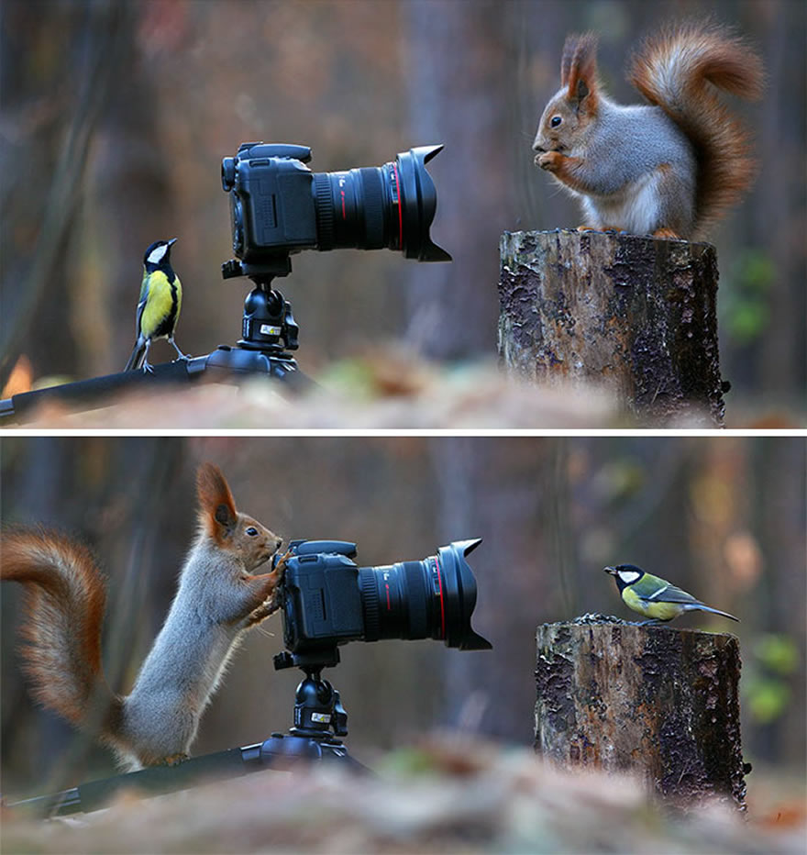
Visual Anthropology and Visual Culture
Patrick Laviolette
Paride Bollettin
23/02/2022
Picture by: Vadim Trunov (Russia)

Slide 2
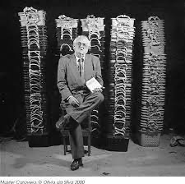
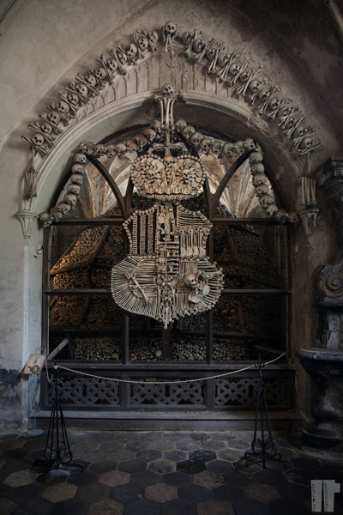
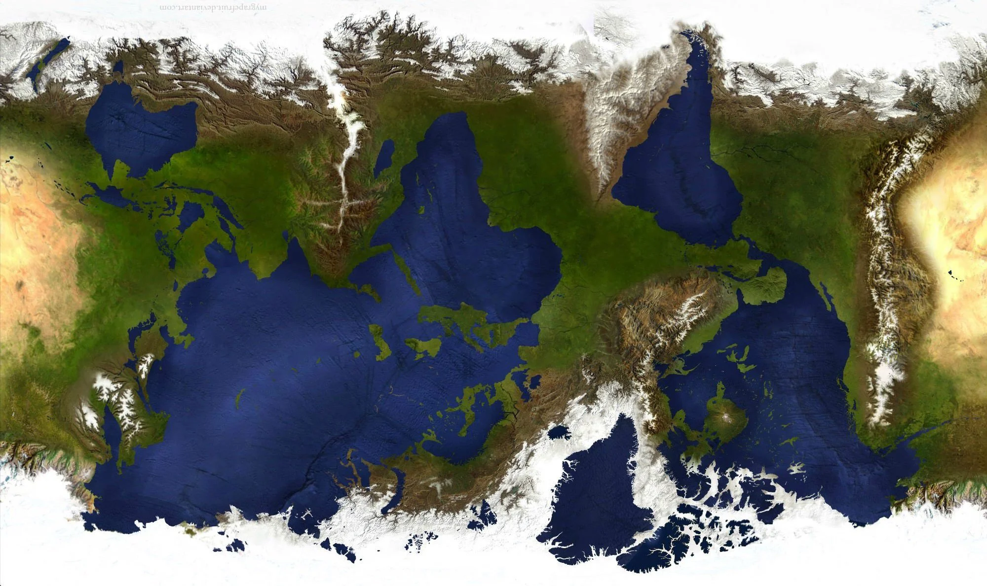
For today…
Reading Sarah Pink: Introduction and Chapter 1 from Doing Visual Ethnography (2013)
From Pink 2013:6.
Main points?
Source: Lorenzo Taccioli (Kutna Hora)
Source: https://i.imgur.com/FurLBLm.jpg

Slide 3
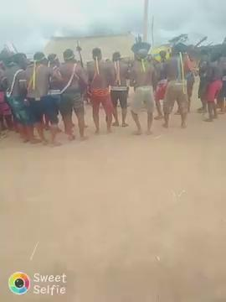
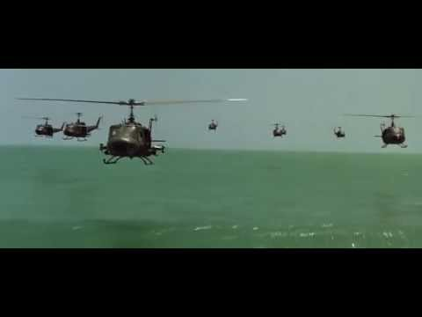
“Images are everywhere”
Source: Fancis Ford Coppola, Apocalypse now (US, 1979, in: https://youtu.be/fc3G_f34Wrc
Source: Bekwy Xikrin, Metoro (2021, Brazil - shared via WhatsApp)

Slide 4
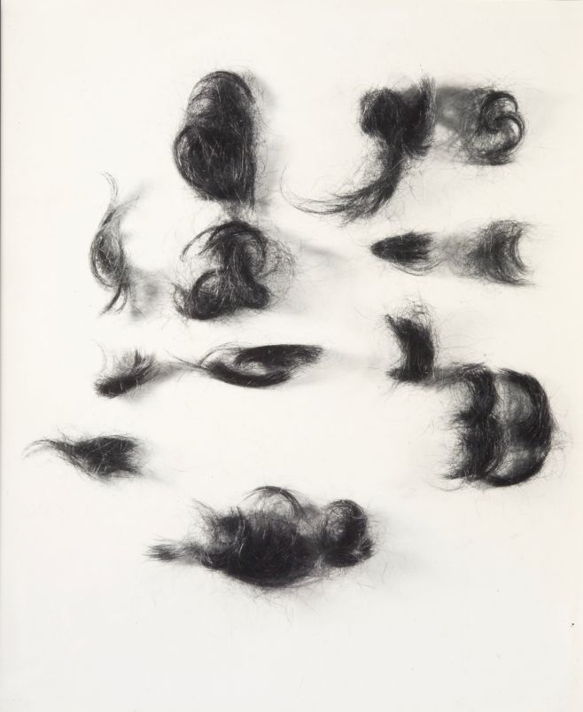
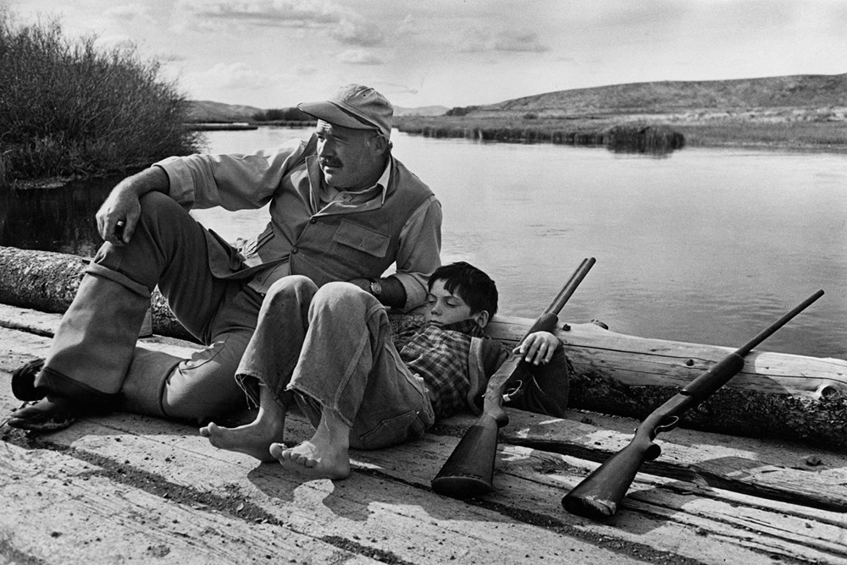
Subjectivity
Source: Robert Capa, Ernest Hemingway and son (US, Sun Valley, Idaho, October 1941).
Source: Běla Kolářová, Znaky (Czech Republic, 1964)
Small things, indispensable for our life yet taken for granted so that we can hardly notice them in spite of their great number...
If your pictures aren't good enough, you aren't close enough

Slide 5
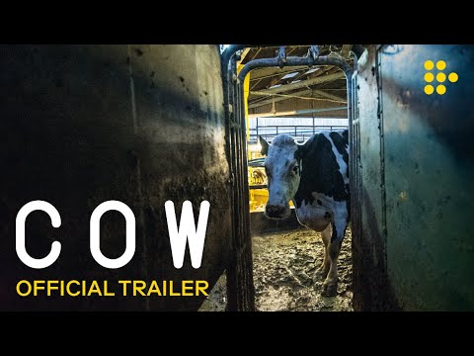
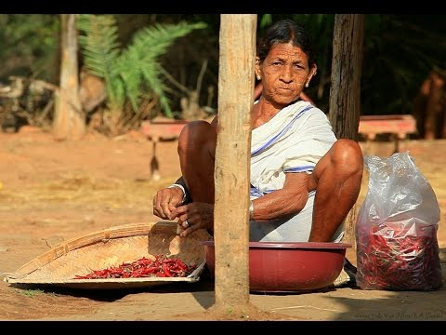
Methodologies and the field
Source: Saumya Sharma, Yaya (India, 2017) - Official trailer: https://www.youtube.com/watch?v=GY1jmYSsupY
Source: Andrea Arnold, COW (UK, 2021) - Official Trailer: https://www.youtube.com/watch?v=tA23-RzhkzY

Slide 6
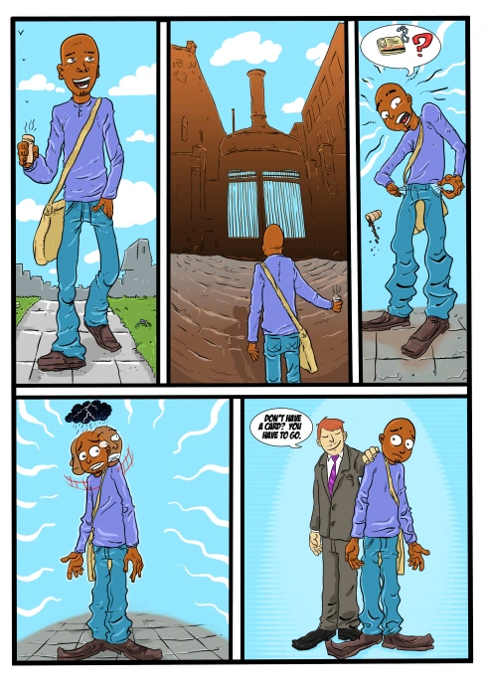
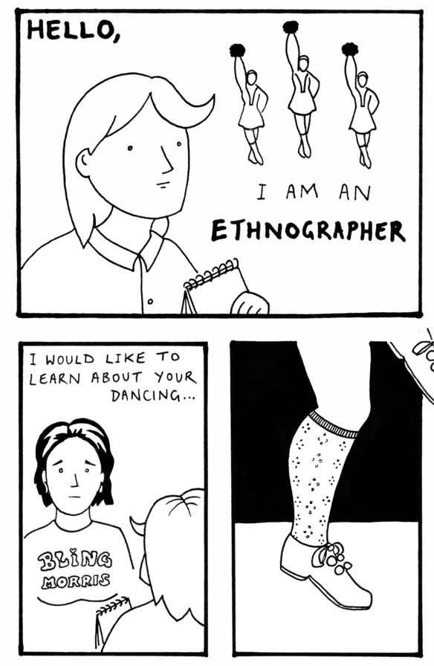
Ethnography as methodology
Source: Aleksandra Bartoszko, Integration (Norway 2011) - in: https://anthrocomics.wordpress.com/author/anthrocomics/
Source: Lucy Wright, Ethnographics (US-Vermont, 2018) - in: https://www.vermontfolklifecenter.org/fieldnotes/culture-through-comics-wright

Slide 7

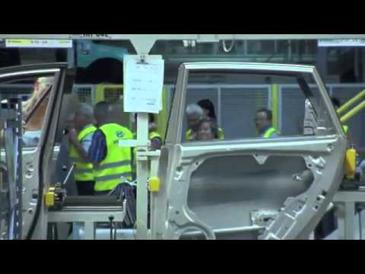
Ethnography as methodology
Source: Vít Klusák, Vse pro dobro sveta a Nosovic (Czech Republic 2010) - Official Trailer in: https://www.youtube.com/watch?v=QPkqUWS_uvg)
Source: Pavel Borecký, Living Water (Czech Republic 2020) - Official trailer in: https://vimeo.com/472845438?embedded=true&source=vimeo_logo&owner=17480916

Slide 8
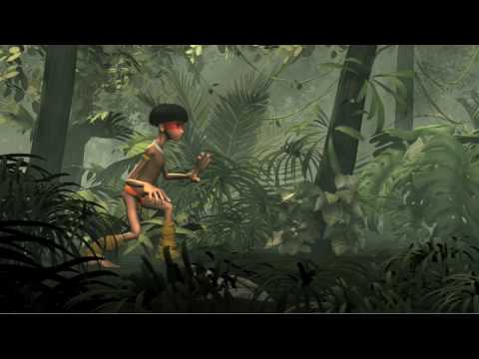
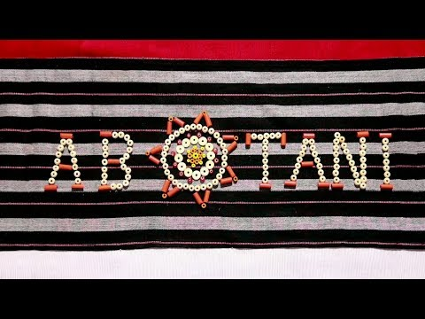
Ethnography as methodology
Source: Tara Douglas and Adivasi Art Trust, Abotani (2015, India) - in: https://www.youtube.com/watch?v=6Yo00F9Eb4A&t=1s)
Source: Leonardo Cadaval, Pajerama (2008, Brazil) - in https://www.youtube.com/watch?v=BFzv0UhHcS0)

Slide 9
Task for next week
See the movies:
Takumã Kuikuro, 2015, Ete London. Color, 19:59, UK-Brazil.
https://www.youtube.com/watch?v=FciwjZ_1B1w&t=170s
Jean Rouch, 1961, Chronicles of a Summer (Eng. subtitles)
https://www.youtube.com/watch?v=ct-49TYmzMg
Than think about possible connections, comparisons, contrasts, and bring your ideas to the collective…

